Slide 1

Searching for Related Objects in Relational Databases
Xiaoxin Yin, Jiawei Han
Univ. of Illinois at Urbana-Champaign
Jiong Yang
Case Western Reserve Univ.

Slide 2
Roadmap
Overview
Selectivity Estimation
Finding Best Join Paths
Answering Queries
Experimental Results

Slide 3


Gap between End Users and Databases
An end user wants to retrieve information from a database
Database of UIUC
What professors in UIUC work on data mining
?
  End users cannot query a relational database, if he does not know SQL and relational schema
  Can we enable convenient knowledge retrieval from databases?

Slide 4
Keyword Search in Databases
Several systems developed
  DBXplorer [1], BANKS [2], DISCOVER [3]
    Return trees of objects that contain all query words
    Smaller trees (with less joins) are ranked higher
  IR-Style keyword search [4]
    Integrated with IR-models (e.g., TF/IDF)
  ObjectRank [5]
    Use the PageRank idea to rank objects

Slide 5
Relationship between Query and Objects
Key of keyword search: relationship between the query and objects
Query: find students related to ‘data mining’
Students
Data mining group
Publications
… data mining …
Data mining ……
Data mining course
What factors indicate relationship between objects and query?

Slide 6
Relationship between Query and Objects
Length of join path
  Shorter join path indicates stronger relationship
    Student – Group: strong
    Student – Group – Professor – Publication: weak
  Used in BANKS, DBXplorer, and DISCOVER
Selectivity of join path
  A more selective join path indicates stronger relationship
    Student – Group: strong
    Student – Course: weak
    Student – Advisor – Teach – Course: fairly strong
Notes:
There are many other examples. For example, in the database of Amazon.com, a customer that viewed a SONY product may not be related with SONY, but a customer that bought a SONY product is related with SONY. For example, an actor who is in the same movie studio with a director may not be related with him, but an actor who participates in the move with a director

Slide 7
Relationship between Query and Objects
 | length | selectivity | relationship
Student – Group | + | + | +
Student – Advise | + | + | +
Student – Course | + | − | −
Student – Advisor – Teach – Course | − | + | +
Student – Group – Professor – Publication | − | − | −
Student – Course - Professor | + | − | −
Student – Publication - Professor | + | + | +
Student – Advise – Professor – Advise –Student | − | + | +
Student – Register – Course – Register – Student | − | − | −

Slide 8
Measuring Strength of Relationship
Strength of relationship – a property of a certain join path
  E.g., what is the strength of relationship carried by “Student – Publication – Professor”?
We combine the two factors
  Selectivity & Length of join path
  Weight of a join path p:
  W(p) = log[S(p)] + β∙|p|
  Smaller weight indicates stronger relationship

Slide 9
How to find selective join paths?
There are many join paths between two relations (link to DB schema)
  Infinitely many if we allow loops
How to find join paths with smallest weights?
  Shortest path: often not selective
  Estimate selectivity of every path: too expensive
  We propose an efficient approach that can find join paths with smallest weights from the graph of schema, with reasonably accurate estimation of selectivity

Slide 10
Roadmap
Overview
Selectivity Estimation
Finding Best Join Paths
Answering Queries
Experimental Results

Slide 11
Selectivity Estimation
We need a simple approach that can be used to find most selective join paths
Naïve approach
  Join path p = R₁→R₂→R₃→R₄
  S*(p) = S(R₁→R₂)∙S(R₂→R₃)∙S(R₃→R₄)
  Not considering
  overlapping of
  different paths
R₁
R₂
R₃
R₄
Notes:
There are many existing approaches for estimating selectivity of a certain join path. But they cannot be used to find most selective join paths.

Slide 12
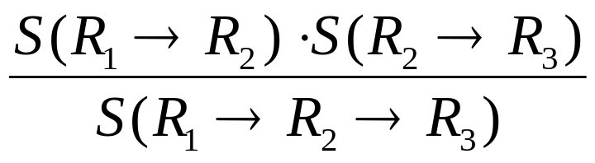
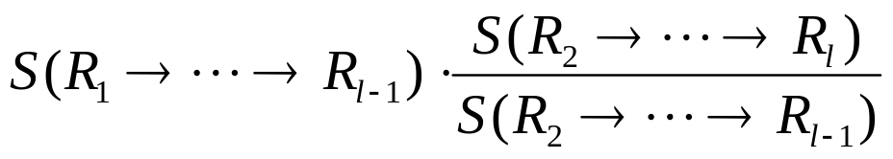
Overlapping Factor
For example, p = R₁→R₂→R₃
R₁
R₂
R₃
O(R₁→R₂→R₃) =
S(R₁→R₂→R₃)=2.5
O(R₁→R₂→R₃)
= 4.2/2.5 = 1.68
S(R₁→R₂)=3
S(R₂→R₃)=1.4
Definition: Overlapping factor of a join path R₁→R₂→ ∙∙∙ →R_{l} is the ratio between
and S(R₁→ ∙∙∙ →R_{l})
It indicates the average number of different non-overlapping paths from a tuple in R₁ to a tuple in R_{l}

Slide 13
Consider Overlapping in Estimating Selectivity
Suppose we have computed
  S(R₁→R₂), S(R₂→R₃), S(R₃→R₄)
  O(R₁→R₂→R₃), O(R₂→R₃→R₄)
R₁
R₂
R₃
R₄
S(R₁→R₂)
∙S(R₂→R₃)
∙S(R₃→R₄)
S*(p)=
O(R₁→R₂→R₃)
∙O(R₁→R₂→R₃)

Slide 14
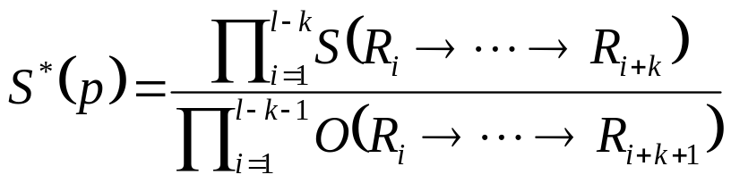
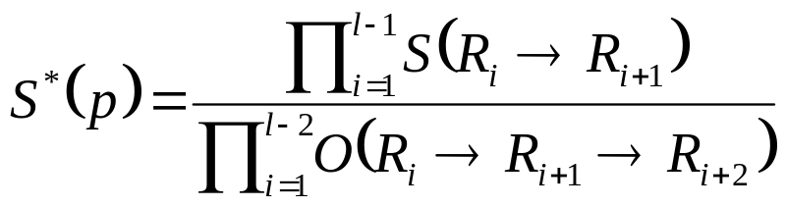
Consider Overlapping in Estimating Selectivity
Considering overlapping factors lead to more accurate selectivity estimation
p = R₁→R₂→ ∙∙∙ →R_{l}
Pre-compute selectivity of all join paths of length k, and overlapping factors of all join paths of length k+1
Estimating S(p) using
E.g. k=2,

Slide 15
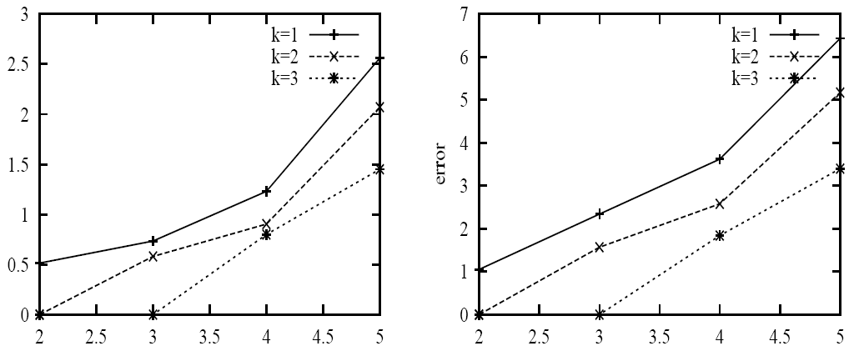
Consider Overlapping in Estimating Selectivity
We test different k in selectivity estimation
We use k=2 for a tradeoff of efficiency and accuracy
CS Dept Database
Northwind Database
log error
log error
join path length (# joins)
join path length (# joins)

Slide 16
Roadmap
Overview
Selectivity Estimation
Finding Best Join Paths
Answering Queries
Experimental Results

Slide 17
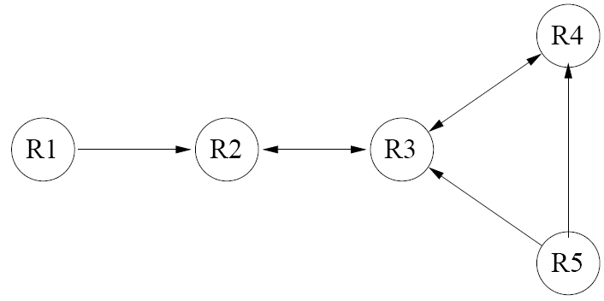
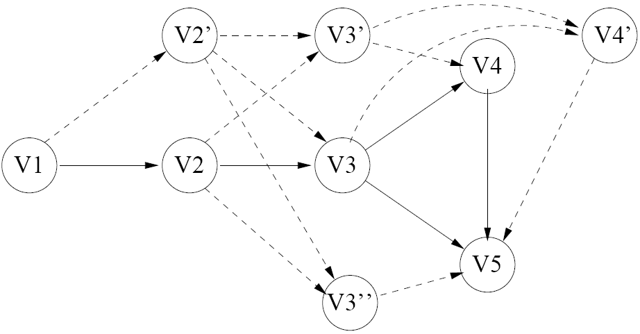
Finding Best Join Paths
Convert the relational schema into a graph
The shortest paths in the graph correspond to best join paths
Database schema
The graph for above schema

Slide 18
Building Graphs from Schemas
A simple database schema
A simple graph
  For simplicity we only consider selectivity in weights of join paths
  (W(p) = log[S*(p)])
  Can not use S(R₁→R₂→R₃) and O(R₁→R₂→R₃)
R₁
R₂
R₃
R₄
V₁
V₂
V₃
V₄
log S(R₁→R₂)
log S(R₂→R₃)
log S(R₃→R₄)

Slide 19
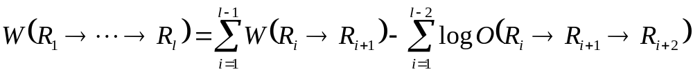
Building Graphs from Schemas
Method for building graphs
  Theorem 1:
w_{2’3’}=w_{2’3}
V₂’
V₃’
w_{3’4}=w₃₄− logO(R₂→R₃→R₄)
w_{12’}=w₁₂
w_{2’3}=w₂₃− logO(R₁→R₂→R₃)
w_{23’}=w₂₃
V₁
V₂
V₃
V₄
w₁₂=
log S(R₁→R₂)
w₂₃=
log S(R₂→R₃)
w₃₄=
log S(R₃→R₄)

Slide 20
Properties
Suppose graph G is constructed for database D.
Theorem 2: If there is a join path p in D from R₁ to R_{l}, there is a path q in G from V₁ to V_{l}, so that w(q)=W(p), and q is the shortest path in G that correspond to p.
Theorem 3: The k shortest distinct paths in G between V₁ to V_{l} correspond to the k join paths between R₁ to R_{l} with smallest weights.

Slide 21
Finding k Shortest Paths
We use a highly efficient algorithm to find k shortest paths between two nodes in a graph
  E.Q.V. Martins, J.L.E. dos Santos. A New Shortest Paths Ranking Algorithm. Investigacao Operacional, 2000.
Complexity of finding k shortest paths in a graph with n nodes and m edges:
  O(k∙n+k∙m) time and O(k∙n+m) space

Slide 22
Roadmap
Overview
Selectivity Estimation
Finding Best Join Paths
Answering Queries
Experimental Results

Slide 23
System Overview
Keyword Query
Inverted Index
Object Query
Results
Execution Engine

Slide 24
Query Semantics
FIND Student RELATED-TO (Professor ‘John Doe’)
  Rank students according to their relationship with Professor ‘John Doe’
    E.g., (1) students advised by ‘John Doe’,
    (2) those coauthoring papers with ‘John Doe’
    (3) those working in same group with ‘John Doe’ (4) those taking classes of ‘John Doe’

Slide 25
Query Semantics
FIND Student RELATED-TO ((‘John Doe’) OR (Course ‘Data mining’))
  Rank students according to their relationship with either ‘John Doe’ or Course ‘Data mining’
  Two sub queries: Q = Q₁ OR Q₂
  Q₁ = FIND Student RELATED-TO (‘John Doe’)
  Q₂ = FIND Student RELATED-TO (Course ‘Data mining’)
  Score of tuple t w.r.t. query Q:
  s(t,Q) = max[s(t,Q₁),s(t,Q₂)]
Notes:
When we compare two tuples, we prefer the tuple with smaller score with either Q1 or Q2

Slide 26
Query Semantics
FIND Student RELATED-TO ((‘John Doe’) AND (Course ‘Data mining’))
  Two sub queries: Q = Q₁ AND Q₂
  Q₁ = FIND Student RELATED-TO (‘John Doe’)
  Q₂ = FIND Student RELATED-TO (Course ‘Data mining’)
  Score of tuple t w.r.t. query Q:
  s(t,Q) = min[s(t,Q₁),s(t,Q₂)]
Other types (e.g., average) of queries can be easily implemented

Slide 27
Object Query
FIND Student RELATED-TO ((‘John Doe’) AND (Course ‘Data mining’ VIA Register))
Results
Student
AND
Course.name
Data mining
VIA
Register
OR
Professor.name
John Doe
TeachCourse.instructor
John Doe

Slide 28
Pipelined Query Processing
Results
Student
[Tom, 3.0]
AND
[Cathy, 2.0]
[Tom, 3.0]
[Tom, 2.0]
Course.name
Data mining
VIA
Register
OR
[Cathy, 2.0]
[Tom, 4.0]
[Tom, 3.0]
Professor.name
John Doe
TeachCourse.instructor
John Doe

Slide 29
Roadmap
Overview
Selectivity Estimation
Finding Best Join Paths
Answering Queries
Experimental Results

Slide 30
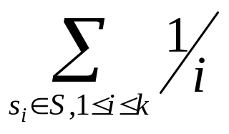
Relationship Prediction
ROSS: our approach
KOSS: using join path length to measure relationships
Prediction accuracy of a ranked list
  E.g., predict which students are advised by professor p
  S* is the real set of students advised by p
  Suppose an approach gives a ranked list L of students, L = s₁, …, s_{k}
  Score(L) =

Slide 31
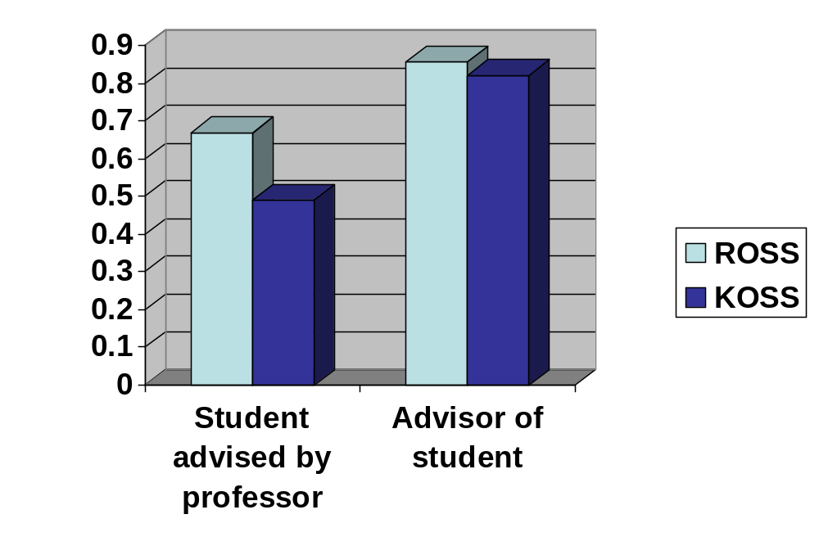
Relationship Prediction
Remove Advise relation from database
For each professor p, predict all his students using
  “FIND Student RELATED-TO Professor p”
For each student s, predict her advisor using
  “FIND Professor RELATED-TO Student s”

Slide 32
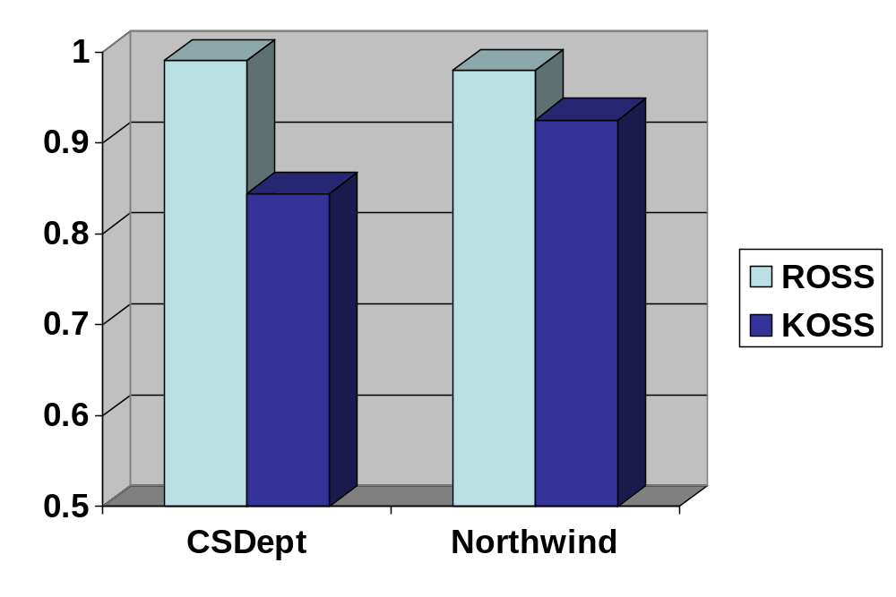
Answering Keyword Queries
CS Dept dataset and Northwind dataset
20 representative queries for each dataset
  (as shown in paper)
Standard answers are provided according to a set of rules for ranking relationships

Slide 33
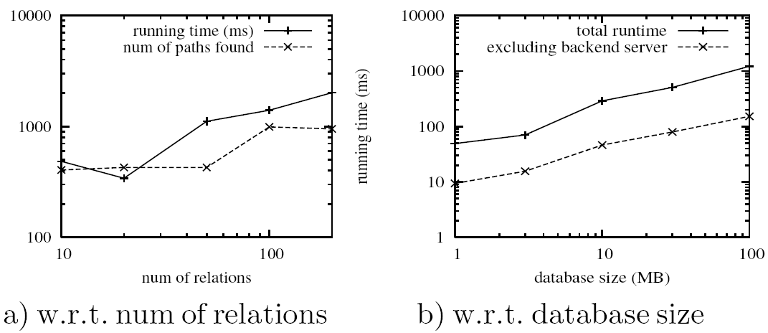
Scalability

Slide 34

Thank you!

Slide 35
References
S. Agrawal, S. Chaudhuri, G. Das. DBXplorer: A System for Keyword-Based Search over Relational Databases. ICDE, 2002.
A. Balmin, V. Hristidis, Y. Papakonstantinou. ObjectRank: Authority-Based Keyword Search in Databases. VLDB, 2004.
G. Bhalotia, C. Nakhey, A. Hulgeri, S. Chakrabarti, S. Sudarshanz. Keyword Searching and Browsing in Databases using BANKS. ICDE, 2002.
V. Hristidis, Y. Papakonstantinou. DISCOVER: Keyword Search in Relational Databases. VLDB, 2002.
V. Hristidis, L. Gravano, Y. Papakonstantinou. Efficient IR-Style Keyword Search over Relational Databases. VLDB, 2003.
E.Q.V. Martins, J.L.E. dos Santos. A New Shortest Paths Ranking Algorithm. Investigacao Operacional, 2000.

Slide 36
CS Dept Database
Work-In
Professor
Open-course
Course
person
name
course
course-id
Back 1
group
office
semester
name
position
instructor
area
Publish
Publication
Group
Advise
author
title
name
professor
title
year
area
student
conf
degree
Registration
Student
student
name
course
office
semester
position
unit
CS Dept Database
grade

