Slide 1




A Scientific Workflow Approach to Distributed Geospatial Data Processing using Web Services
Efrat Frank¹, Ilkay Altintas¹, Jianting Zhang²,
Deana Pennington², Bertram Ludascher¹,³, William Michener²
1 San Diego Supercomputer Center, University of California, San Diego
2 LTER Network Office, University of New Mexico
3 Department of Computer Science, University of California, Davis
Notes:
The title of my presentation is. In this presentation, I will discuss the proposed scientific workflow approach and report some of our preliminary results.
This is the joint work between several information technology research projects Under Kepler scientific workflow system framework.
Ilkay is also here. We will be happy to answer your questions either after this presentation or during the poster session.

Slide 2
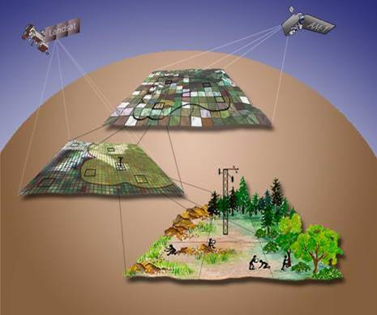
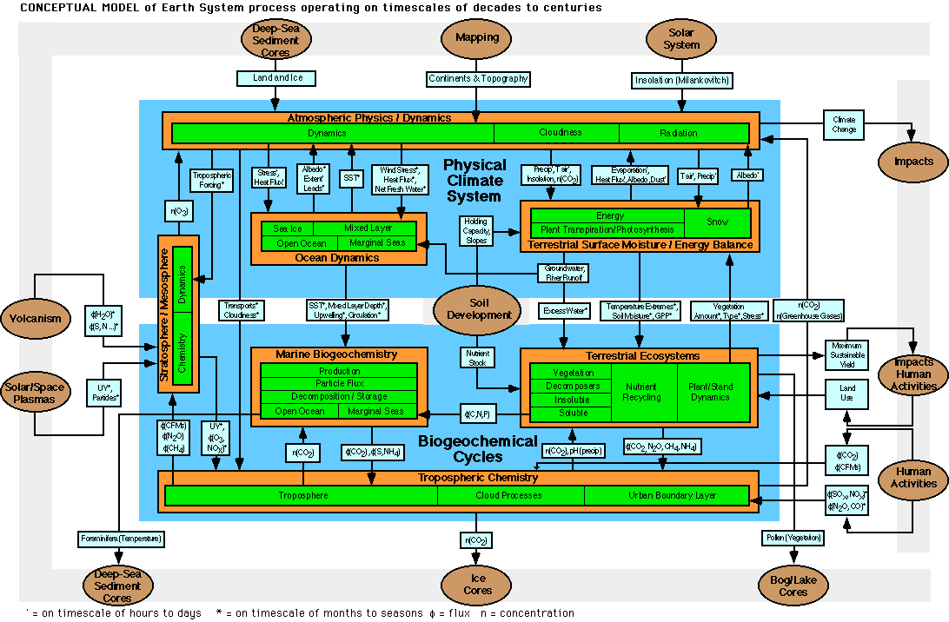
Geospatial data processing is essential to multiple sciences: geology, ecology, hydrology, biology, meteorology……
Geospatial data is distributed in nature and often requires distributed processing
Geospatial modeling is getting increasingly complex:
  Increasing number of components
  Increasing number of interfaces
  Increasing needs for integration
Information Technology is getting increasing complex for scientists
  Available software tools
  Heterogeneous environments
  Distributed computing schemas
Source: http://www.usra.edu/esse/BrethColor.GIF
Notes:
This figure shows the conceptual model of earth system process operating on timescales of decades to centuries. There are many components in the model and each component can have sub-models.
While more and more scientific models are being developed, how to integrate these models in an effective and efficient way for multi-disciplinary studies remains a challenging problem.
Some multi-disciplinary research areas that involves geospatial data processing are: global climate change, environmental impact assessment and biodiversity conservation.

Slide 3
Existing Approaches to DGDP
Distributed Geographical Data Processing (DGDP)
  Pure GIS approach
    Major commercial GIS software (such as ArcGIS, MapInfo, GeoMedia) supports DGDP to a certain degree
    Adopts one or more existing distributed computing schemes (DCOM/DotNet, J2EE, CORBA)
    Proprietary, difficult to integrate
  Pure Database approach
    Commercial (Oracle/DB2) and open source DBMS support spatial queries and limited analytical functions
    Large DBMS supports DGDP through its infrastructure
    DBMS is good at query (filtering) but poor at analysis (transformation)
    Applications require hosting DBMS environments; technically complex
Notes:
By saying transformation, we mean either spatial data types or spatial data values are changed by an operation.
COBRA: Common Object Request Broker Architecture

Slide 4
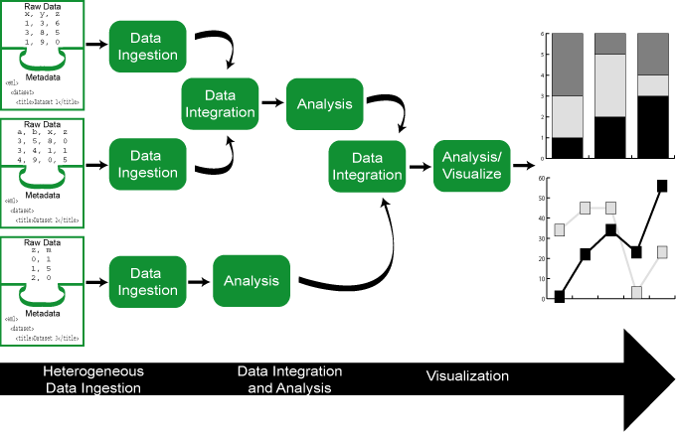
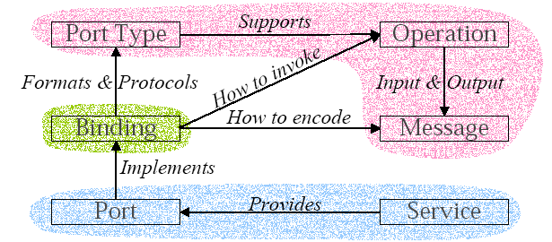
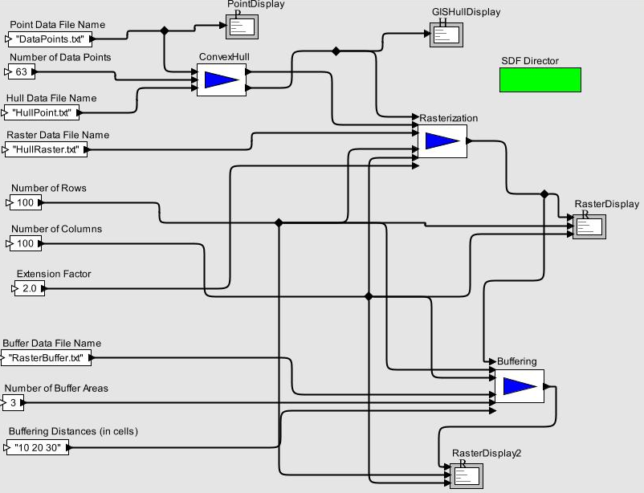
The Scientific Workflow Approach
Using Web Service
WSDL provides a framework for defining
– Interface: operations and input/output
– Access specification: SOAP bindings
– Endpoint: the location of service
Scientific WF System
Source: Leymann BTW 2003 talk
Building Block
A
B
WS
SOAP/XML
WS
Notes:
We propose a scientific workflow approach to DGDP using Web Services.
Scientific workflows can be seen as scientific data analysis pipelines that connect a serial analytical steps.
Compared to business workflows, scientific workflows can be data-intensive, compute-intensive, analysis intensive, visualization-intensive, etc.
There are two issues in using a scientific workflow approach to DGP, one is needing a workflow composition and execution environment. The second is how to represent a single analytical step in a pipeline.
For the first issue, we use Kepler scientific workflow system and I will introduce it shortly; for the second issue, We propose to use Web Services. In our approach, each analytical step is implemented as a Web service. Web Services are chained together to form a modeling task.
In the core of Web Service technology is WSDL. WSDL is written in XML and can be understood by both machine and human and can achieve greater interoperability.
WSDL clearly separate abstract definition and concrete implementation which provides flexibility in mapping conceptual scientific models to existing computation resources. Furthermore, the communication protocol between Web services typically is SOAP which is also in XML format.

Slide 5
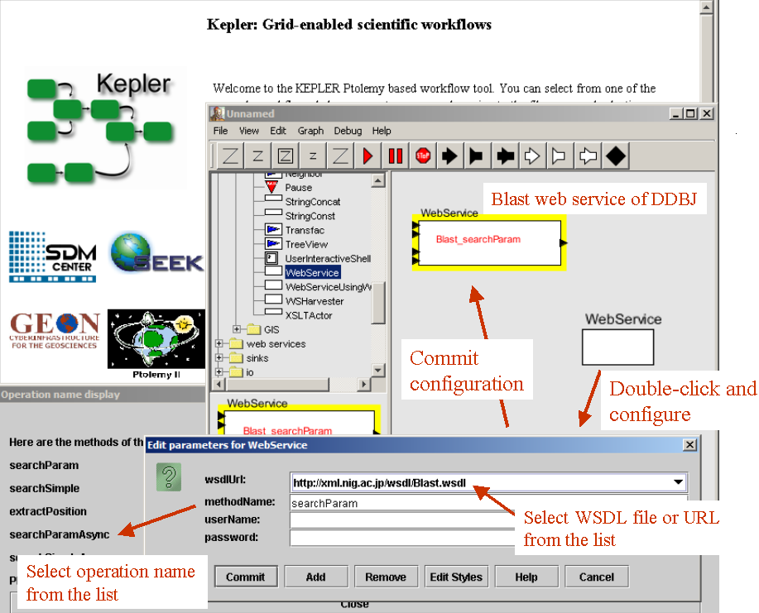
Kepler Scientific Workflow System
And Its Web Service Actor
Notes:
In this slide, we briefly introduce Kepler workflow system and its Web Service Actor.
Kepler is built on top of Ptolemy II system which is used for modeling, simulation and design of concurrent, real-time, embedded systems.
Kepler/Ptolemy provides a drag-and-drop environment for scientific workflow composition; interactive or batch execution of scientific workflows. In Kepler, workflow steps are called actors. An actor can have multiple input and output ports, through which streams of data tokens flow. Additionally, actors may have parameters to define specific behavior.
The Web Service actor in Kepler serves as a proxy between the workflow system and the Web Service endpoints. There are two steps to use a Web Service actor in Kepler. The first step is to specify the URL of the WSDL of a Web Service. The WS actor will parse the WSDL URL and retrieve available methods and their input/output types declared in the WSDL document. In the second step, users are required to select a method from a dropdown list. After the selection, the actor will add the corresponding ports to itself and is ready to connect its ports to ports in the other actors.

Slide 6
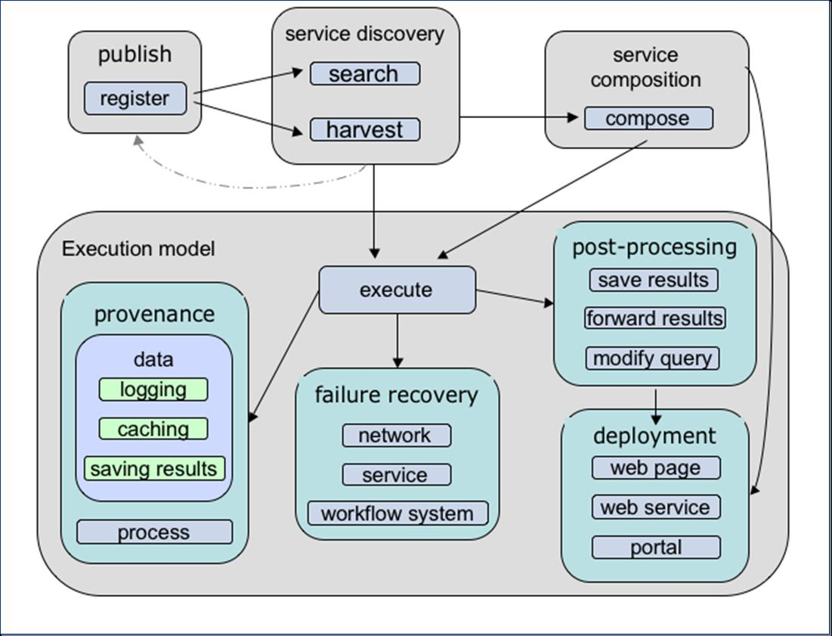
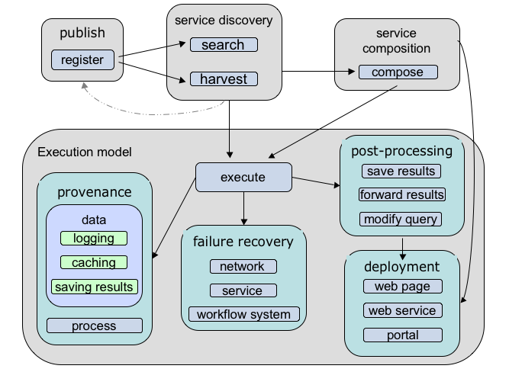
Service Oriented Science for Scientific Workflow
Notes:
This slide shows the architecture of using Web Service in scientific workflows. There are several components in the architecture: publish, discovery, composition and execution. The framework also handles several technical issues like provenance, failure recovery, post-processing and deployment. Ilkay can provide you more details regarding to this framework if you come to our poster during the poster session.

Slide 7
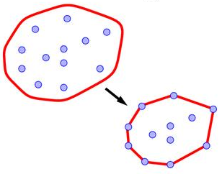
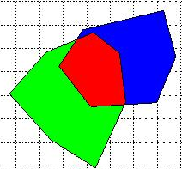
Example – Computing Components
Find all the occurrences of species A that are within the intersection of the convex hulls of the occurrences of species B and species C.
Distributed Computing Resources:
  Species A Occurrence: flat data file (Linux)
  Species B Occurrence: SQL Server 2000 database (Windows)
  Species C Occurrence :Oracle 10g database (Windows)
  Convex Hull Service: GRASS GIS through JNI-DLL (windows)
  Polygon Intersection Service: Oracle 10g Spatial (windows)
  Points in Polygon test Service: Java program (Linux)
Geospatial Processing
Convex Hull
Polygon Intersection
Points in Polygon

Slide 8
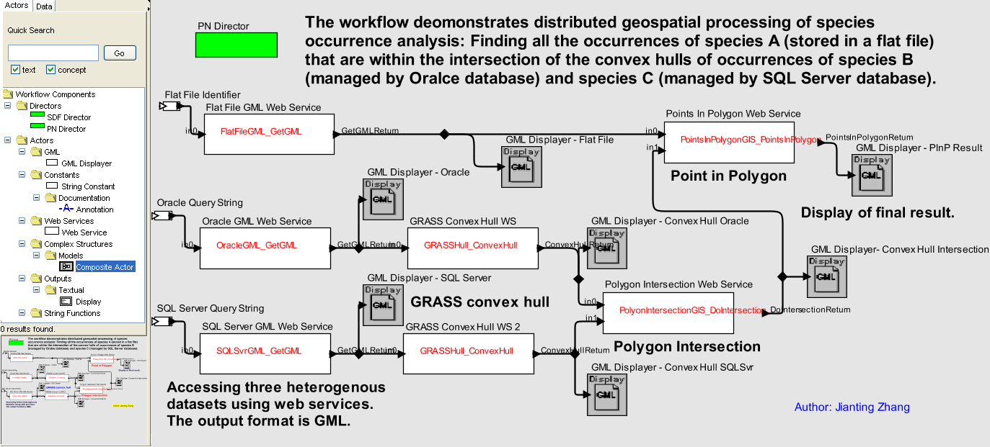
Example – Scientific Workflow
Notes:
Drag and drop
Three data sources.
The same convex hull Web service are deployed in two machines and executed in parallel.
You can add more display actors to the workflow and view final or intermediate results in different formats.

Slide 9
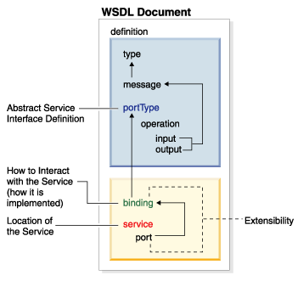
GML and its Tunneling in WS
Geographical Mark-up Language (GML): “Foundation for the Geo-Web”
Currently OpenGeospatial specification and ISO-19136 standard to-be
Versions 1.0,2.0, 3.0, 3.1
<SOAP-ENV:Envelope xmlns:SOAP-ENV=“…”>
<SOAP-ENV:Body>
<gml:FeatureCollection xmlns:gml=\"http://opengis.net/gml/\">
<gml:Point>
<gml:coordinates>0.1,0.1</gml:coordinates>
</gml:Point>
<gml:Polygon>
<gml:LineString>
<gml:coordinates>0,0 0,1,1,0 0,0</gml:coordinates>
</gml:LineString>
</gml:Polygon>
</gml:FeatureCollection>
</SOAP-ENV:Body>
</SOAP-ENV:Envelope>
A
SOAP
B
WS
GML
WS
Background image source: http://ws.apache.org/wsif/providers/wsdl_extensions/images/WSDLJ2EE.gif
Notes:
Recall SOAP is used as the communication protocol between Web Services. The data enclosed in a SOAP message can be arbitrarily defined types. However, primitive XML types have greater interoperability. We encode geospatial data into GML strings and then put them into SOAP messages to achieve greater interoperability. The Kepler Web Service actor is responsible for adding and removing SOAP envelope information to enable geospatial data passing through Web Services. The Web Services endpoints are responsible for decoding GML strings into their internal representations for further process.

Slide 10
Summary and Future Work
  Workflow technology features visual programming and software components reuse.
  Web Services technology features interoperability in distributed computing.
  Their combination provides an effective way for distributed geospatial data processing.
  The simple ecological modeling example demonstrates the feasibility of the proposed approach.
  Several technical issues are under investigation, e.g., using advanced GML features, data communication efficiency, semantics and ontology.

