Slide 1
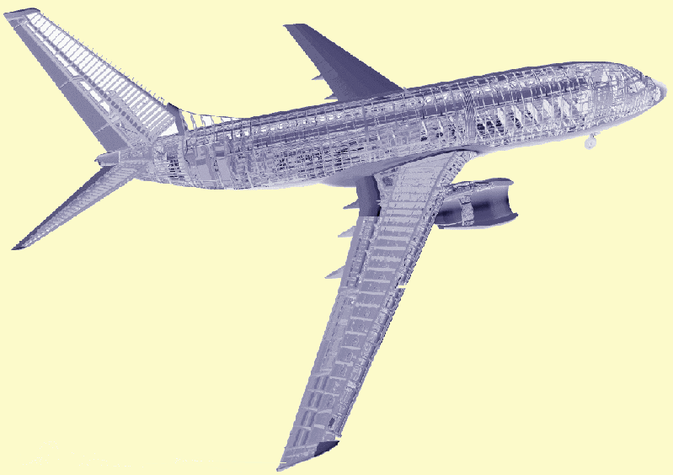
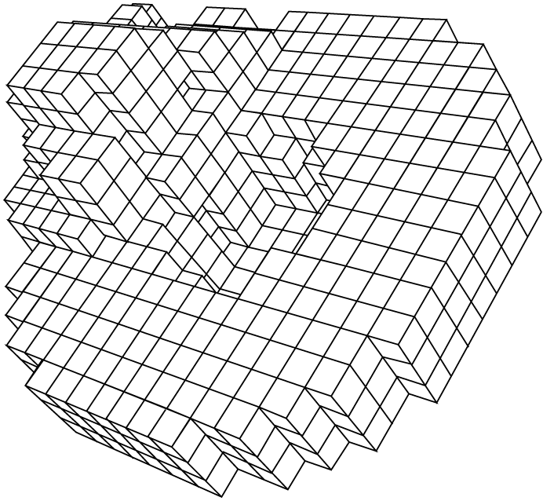

Fuzzy Decomposition
of
Spatially Extended Objects
Hans-Peter Kriegel, Martin Pfeifle,
Database Group
SSDBM 2005,
Santa Barbara (CA), USA
27. - 29. June, 2005
Institute for Computer Science
University of Munich, Germany

Slide 2
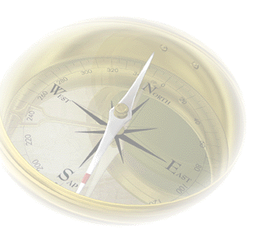
Outline
Introduction
Clustering-Based Decomposition
Fuzzy Intersection Queries
SOUT
Conclusions

Slide 3
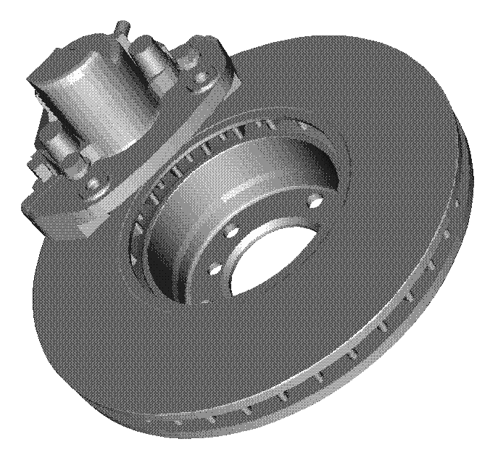
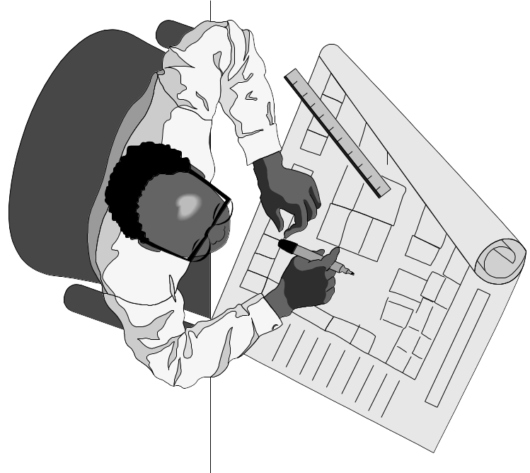

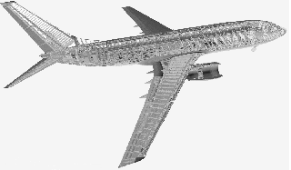
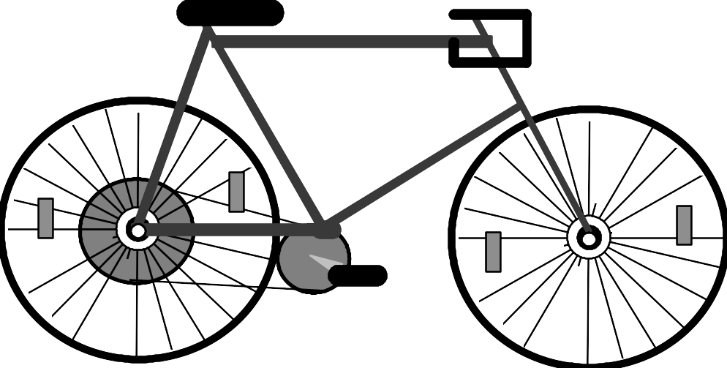

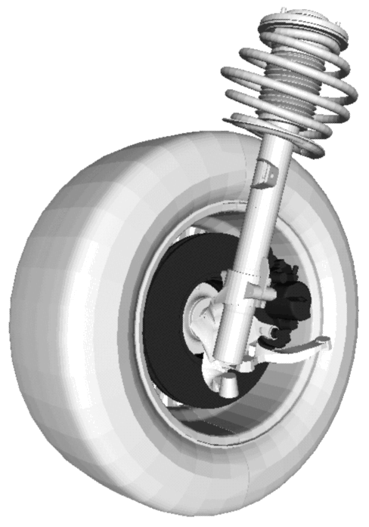


Introduction
Spatial Database Systems
box queries
collision queries
complex
spatial
objects
Spatial Database
Management Systems
(based on extensible ORDBMS)

Slide 4
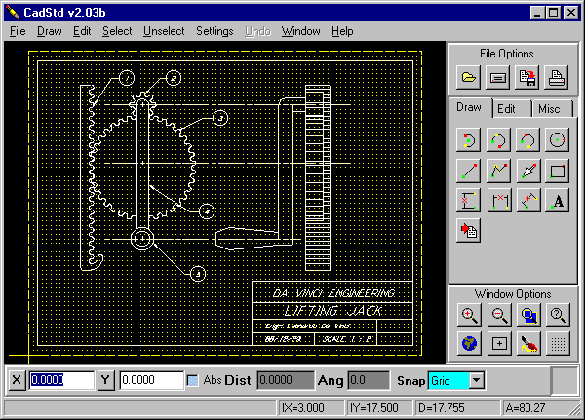
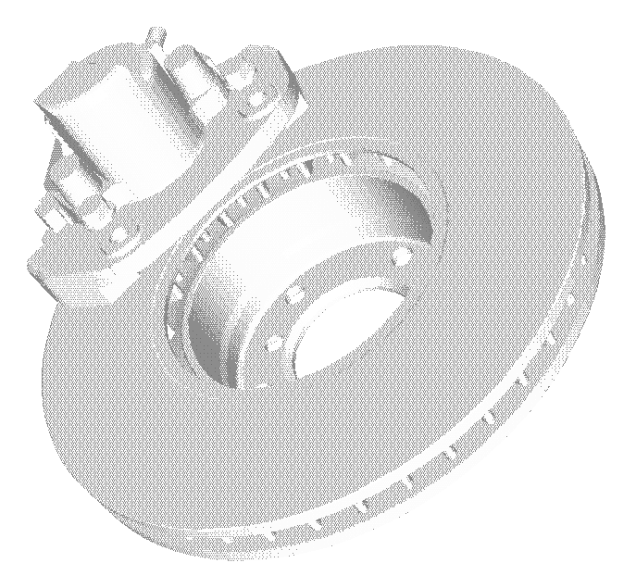
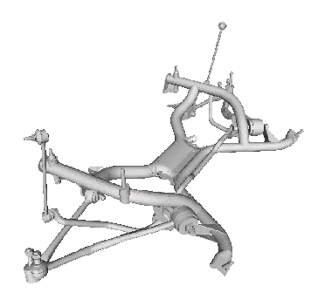
Introduction
Intersection Queries
spatial application,
e.g. CAD system,
or GIS system
triangulated object
CADOBJECTS
id geom
…
4710
4711
…
SELECT id FROM
CADOBJECTS t
WHERE
geom_intersects (t.geom, :query.geom)

Slide 5
Intersection Queries
spatial application,
e.g. CAD system
triangulated object
CADOBJECTS
id geom
app
…
4710
4711
…
SELECT id FROM
CADOBJECTS t
WHERE
app_intersects (t.app, :query.app)
AND
geom_intersects (t.geom, :query.geom)

Slide 6
Intersection Queries
spatial application,
e.g. CAD system
triangulated object
CADOBJECTS
CADAPPROX
id geom
id
app
…
…
4710
4710
4711
4711
…
…
}
extensible
indexing
Relational R-Tree
(Ravi Kanth et al. 99)
SELECT id FROM
CADOBJECTS t
WHERE
geom_intersects (t.geom, :query.geom)
SELECT t.id FROM
CADOBJECTS t, CADAPPROX a
WHERE
app_intersects (a.app, :query.app)
AND a.id=t.id AND
geom_intersects (t.geom, :query.geom)
user-defined indexing

Slide 7
Intersection Queries
spatial application,
e.g. CAD system
triangulated object
voxel set
CADOBJECTS
CADAPPROX
id geom
id
app
…
…
4710
4710
4711
4711
…
…
}
extensible
indexing
B-Tree
(Bayer et al. 72)
SELECT id FROM
CADOBJECTS t
WHERE
geom_intersects (t.geom, :query.geom)
SELECT t.id FROM
CADOBJECTS t, CADAPPROX a
WHERE
app_intersects (a.app, :query.app)
AND a.id=t.id AND
geom_intersects (t.geom, :query.geom)
user-defined indexing

Slide 8
Intersection Queries
spatial application,
e.g. CAD system
triangulated object
voxel set
set of intervals
CADOBJECTS
CADAPPROX
id geom
id
app
…
…
4710
4710
4711
4711
…
…
}
extensible
indexing
Relational Interval Tree
(Kriegel et al. 01)
SELECT id FROM
CADOBJECTS t
WHERE
geom_intersects (t.geom, :query.geom)
SELECT t.id FROM
CADOBJECTS t, CADAPPROX a
WHERE
app_intersects (a.app, :query.app)
AND a.id=t.id AND
geom_intersects (t.geom, :query.geom)
user-defined indexing

Slide 9
Intersection Queries
spatial application,
e.g. CAD system
triangulated object
voxel set
set of tiles
CADOBJECTS
CADAPPROX
id geom
id
app
…
…
4710
4710
4711
4711
…
…
}
extensible
indexing
Relational Quadtree
(Freytag et al. 01)
SELECT id FROM
CADOBJECTS t
WHERE
geom_intersects (t.geom, :query.geom)
SELECT t.id FROM
CADOBJECTS t, CADAPPROX a
WHERE
app_intersects (a.app, :query.app)
AND a.id=t.id AND
geom_intersects (t.geom, :query.geom)
user-defined indexing

Slide 10
Intersection Queries
spatial application,
e.g. CAD system
triangulated object
voxel set
set of boxes
CADOBJECTS
CADAPPROX
id geom
id
app
…
…
4710
4710
4711
4711
…
…
}
extensible
indexing
Relational R-Tree
(Ravi Kanth et al. 99)
SELECT id FROM
CADOBJECTS t
WHERE
geom_intersects (t.geom, :query.geom)
SELECT t.id FROM
CADOBJECTS t, CADAPPROX a
WHERE
app_intersects (a.app, :query.app)
AND a.id=t.id AND
geom_intersects (t.geom, :query.geom)
user-defined indexing

Slide 11
Outline
Introduction
Clustering-Based Decomposition
Fuzzy Intersection Query
SOUT
Conclusions

Slide 12

Clustering-Based Decomposition
database object
database object
MBR
σ₂
x
σ₁
centroid (c₁, c₂)
several thousands of
voxels
k = 2 clusters
Database object is described by a set o k clusters
Possible clustering algorithms
  k-means (MacQueen 67)
  k-medoid,
  e.g. PAM (Kaufmann & Rousseeuw 90), CLARANS (Ng & Han 94)
Each cluster is described by
  the centroid
  the standard deviations
  number of voxels of a cluster
  the minimal bounding rectangle

Slide 13
Outline
Introduction
Clustering-Based Decomposition
Fuzzy Intersection Query
SOUT
Conclusions

Slide 14
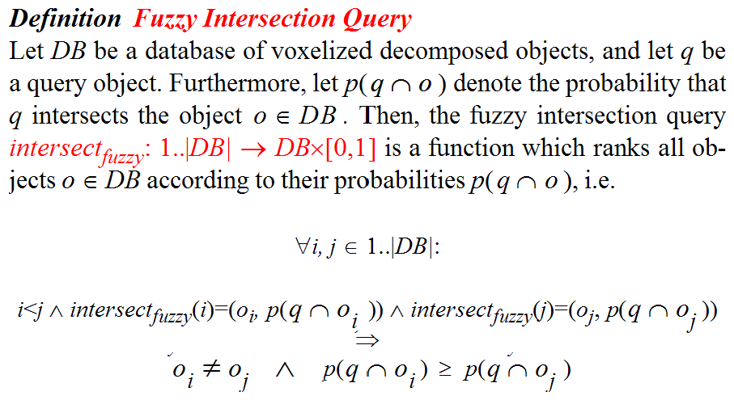
Fuzzy Intersection Query

Slide 15

Fuzzy Intersection Queries
SQL-statement
CAD system
triangulated object
voxel set
set of clusters
id
MBR
stat
CADTABLE
…
4710
one cluster
4710
…
}
Relational R-Tree
SELECT id, CompProb(stat, :query) as P
FROM CADTABLE
WHERE mbr_intersects (mbr, :query)
GROUP BY id
ORDER BY P DESC

Slide 16
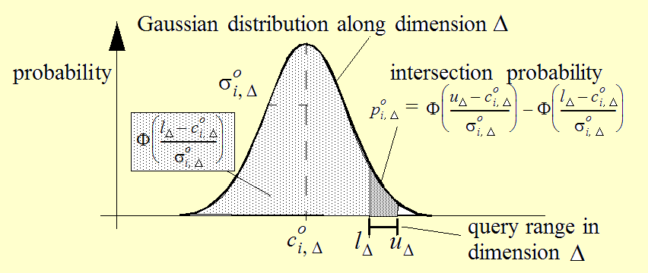
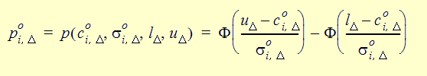

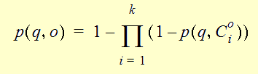
Fuzzy Intersection Query
Window Query
x
(u₁, u₂)
σ₂
x
(l₁, l₂)
x
σ₁
centroid (c₁, c₂)
Compute for each voxel of
a cluster the probability that
it is included in [l _{Δ}, u _{Δ} ] :
Compute the probability
that at least one voxel of
the cluster is inside the
window query:
Compute the probability
that the object intersects
the window query:

Slide 17
Outline
Introduction
Clustering-Based Decomposition
Fuzzy Intersection Query
SOUT
Conclusions
Notes:
Teil 3: 3:35

Slide 18
Conclusions and Future Work
Conclusions:
Clustering-Based Decomposition
  Only a small number of clusters is necessary
  to describe an object accurately
  Standard techniques available to determine
  an appropriate number k of clusters
Fuzzy Intersection Queries
  No refinement step on the
  voxel representations and on
  the exact geometry.
  Computed probability values contain
  even more information
  than boolean intersection queries
?
?
?
?
?
Questions?
?
Future Work:
Detailed Experimental Evaluation
  Clustering algorithms,
  e.g. k-means, PAM, CLARANS, ...
Further Query Types
  Collision Queries
?
?
?

Slide 19
k-means example
k=2
Pick seeds
Reassign clusters
Compute centroids
Reassign clusters
x
x
x
Compute centroids
x
x
x
Reassign clusters
Converged!

