Slide 1
Source-aware Join Strategies for Sensor Data Streams
Department of Computer Science, Institute for System Architecture, Database Technology Group

Slide 2
Outline
Introduction
  ... the need for sophisticated join operators
Data Stream Model / Classification
  ... the prerequisites
Data Stream Joins
  ... utilization of stream characteristics
Summary and Conclusion

Slide 3
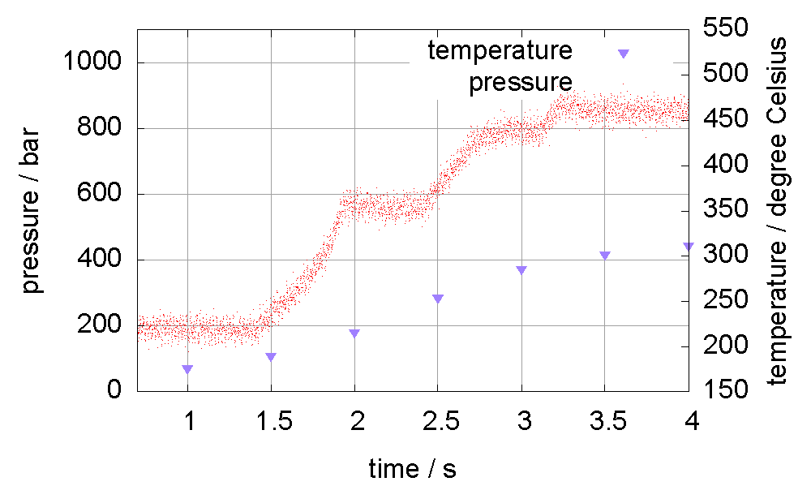
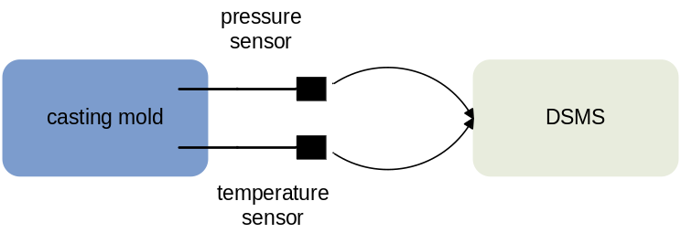
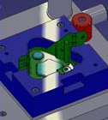
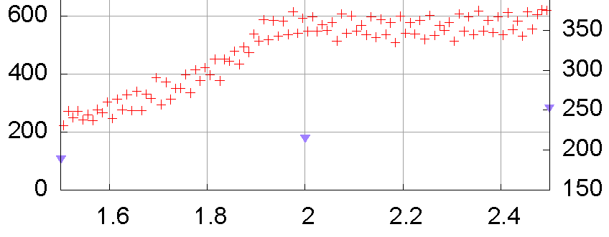
Introduction
Situation today
  different data sources (e.g. sensors)
  lot of information is produced as data streams
    transient data, on-the-fly analysis
  Data Stream Management System (DSMS)
Example
  monitoring a casting process

Slide 4

Introduction (2)
SELECT pressure,
temperature
FROM pstream
JOIN tstream USING (TS)
WHERE pressure > 100
Expectation
  consistent view of both signals
  regarding timeline
Data Stream Joins
N:M (window based join)
1:1 join (interpolation)
window 2
window 1
  wrong representation of temperature stream
  temporal relationship between consecutive timestamps not considered
  How to utilize the data stream properties?

Slide 5
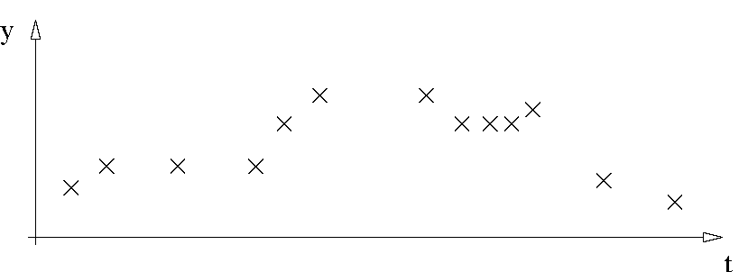
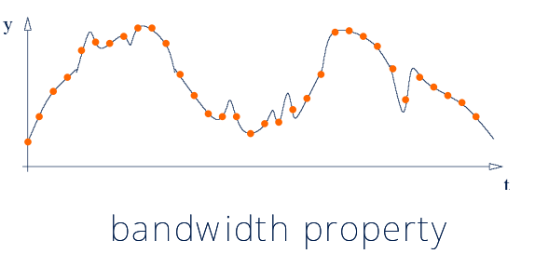
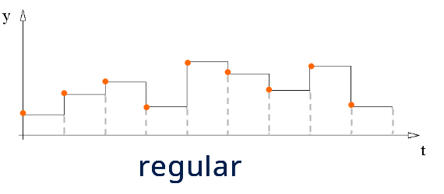
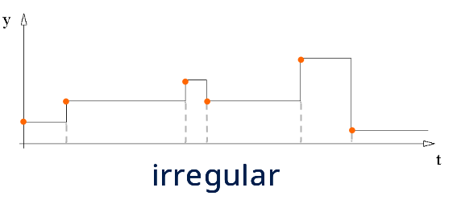
Data Stream Model / Classification
Data stream model
  infinite sequence of tuples T_{i}(TS_{i}, A_{i})
    TS_{i} timestamp attribute
    A_{i} attribute value (e.g. pressure, temperature)
Classification
  event data stream (ES)
  discontinuous data stream (DS)
  continuous data stream (CS)

Slide 6




Data Stream Joins
Assumption
  joining stream tuples on the timestamp attribute (TS)
Join Classification
 | continuous data stream (CS) | discontinuous data stream (DS) | event data stream (ES)
continuous data stream (CS)
discontinuous data stream (DS)
event data stream (ES) |  |  | -

Slide 7
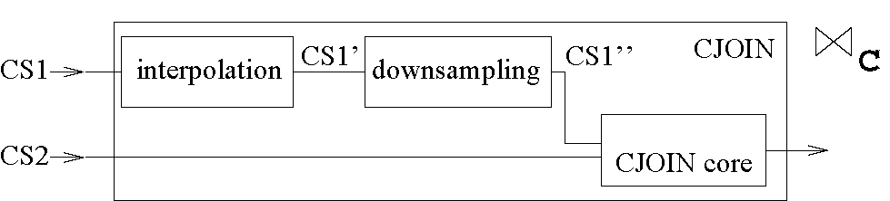
Data Stream Joins – CJOIN
Time-consistent combination of two continuous data streams
bandwidth adaptation
joining tuples
  bandwidth adaptation (bandwidth adjustment)
    interpolation (upsampling) the stream with the lower bandwidth (BW₂ > BW₁)
    downsampling the stream with the higher bandwidth
    (BW₂ < BW₁)
    interpolation and downsampling
    (BW₂ > BW₁ and BW₂/BW₁ ∉ N or
    BW₁ > BW₂ and BW₁/BW₂ ∉ N)
  CJOIN core: identification of join partners

Slide 8
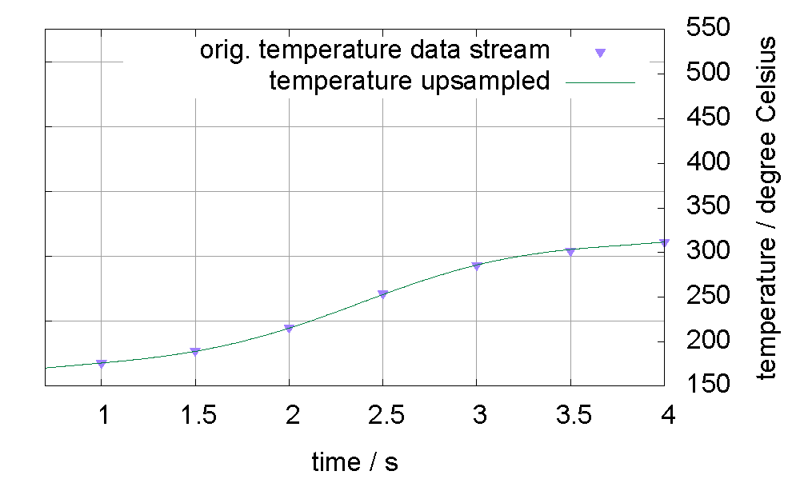
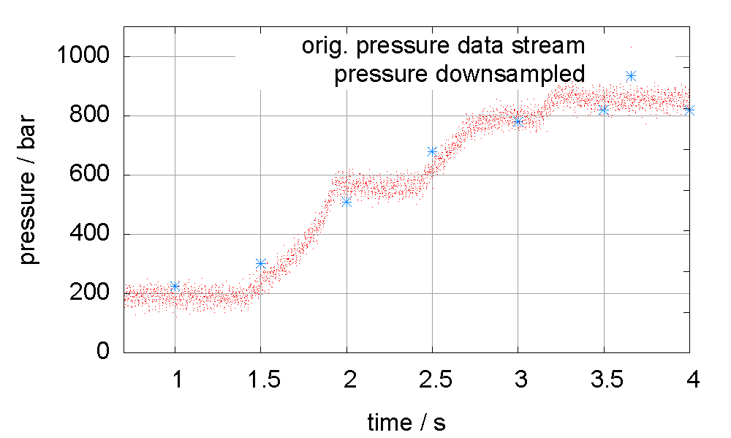
Data Stream Joins – CJOIN (2)
Bandwidth adaptation (sampling theorem)
  interpolation (bandwidth-aware)
    considers temporal relationship of a sequence of tuples
    enables perfect value reconstruction
  downsampling (bandwidth reduction)
    loss of information with well defined semantics
    keeps signal characteristics
interpolation
downsampling

Slide 9
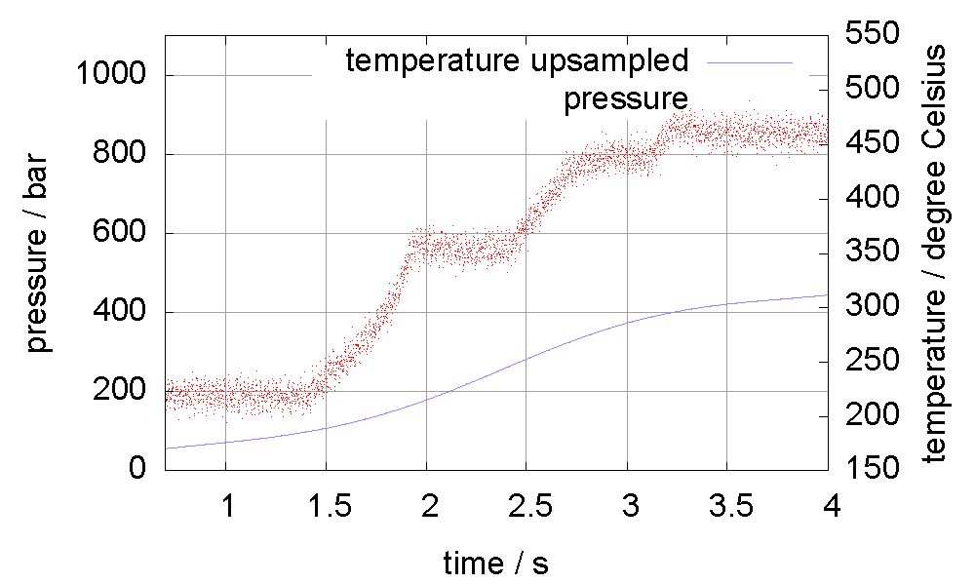
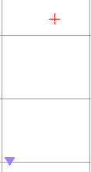

Data Stream Joins – CJOIN (3)
CJOIN core
  identification of join partners
  timestamps are considered equal within a period of validity (P_{V})
  result: continuous result stream
Example
  SELECT pressure, temperature
  FROM pstream JOIN tstream
  USING CJOIN (SAMPLING = UPSAMPLING)
  WHERE pressure > 100
P_{V}
T
T

Slide 10
Data Stream Joins
  Further Join Semantics

Slide 11
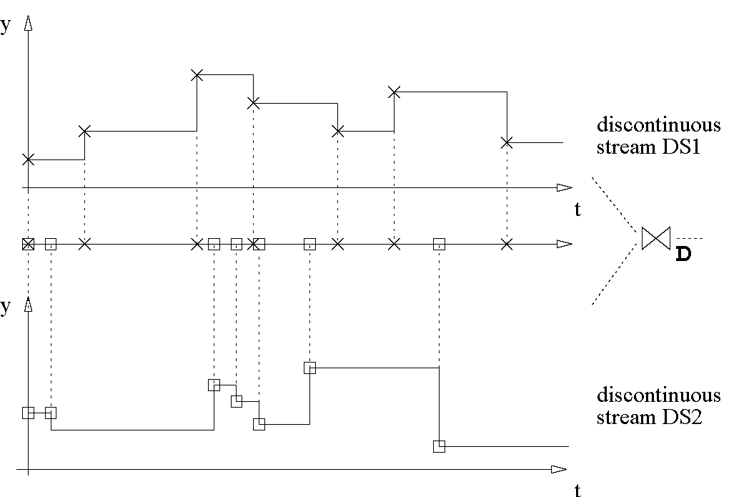
Data Stream Joins – DJOIN
Combination of two discontinuous data streams (DS)
DS: no bandwidth property ⇨ no resampling!
no matching tuple of DS1
(TS_{DS2}, V_{DS1,last} , V_{DS2})
V_{DS1}
V_{DS1,last}
V_{DS1}
perfect match
(TS_{DS1}, V_{DS1}, V_{DS2})
V_{DS2,last}
V_{DS2}
V_{DS2}
no matching tuple of DS2
(TS_{DS1}, V_{DS1}, V_{DS2,last})

Slide 12
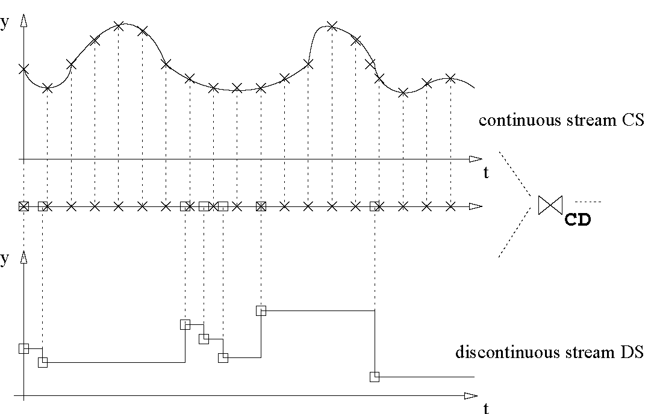
Data Stream Joins – CDJOIN
Combination of a continuous and a discontinuous data stream
DS is irregular
  based on the discontinuous stream
  based on the continuous stream
V_{CS,last}
V_{CS}
based on DS
(TS_{DS}, V_{CS,last}, V_{DS})
V_{DS}
based on CS
(TS_{CS}, V_{CS}, V_{DS,last})
V_{DS,last}

Slide 13
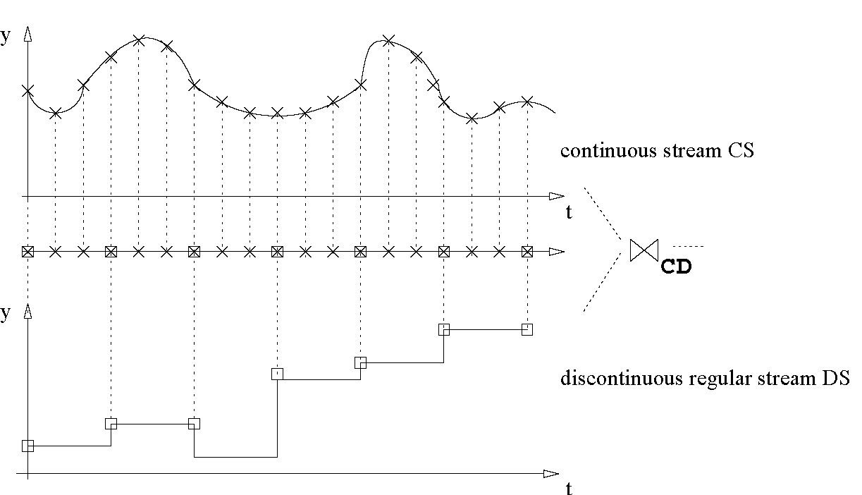
Data Stream Joins – CDJOIN (2)
DS is regular
  resample CS
V_{CS,last}
based on DS
(TS_{DS}, V_{CS,last}, V_{DS})
V_{DS}

Slide 14
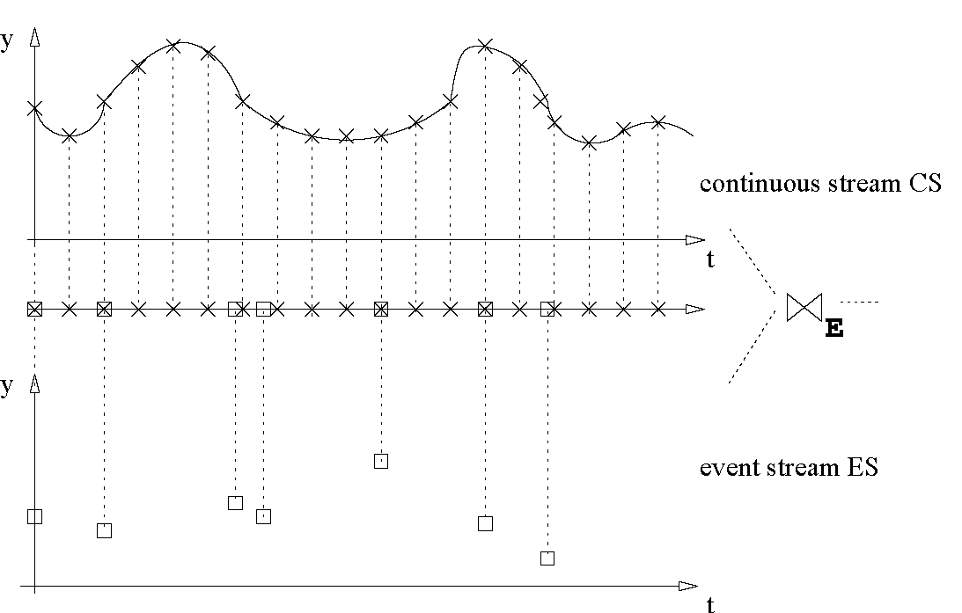
Data Stream Joins – EJOIN
Combination of a continuous/discontinuous
and an event data stream
  based solely on the event data stream
V_{CS,last}
result tuple
(TS_{ES}, V_{ES}, V_{CS,last})
V_{ES}

Slide 15
Summary and Conclusion
Summary
  reasoning for specialized join operators
  proposition of data stream classification
  sophisticated join operators for different stream classes
Conclusion
  utilization of stream characteristics ⇨ more meaningful and consistent join results possible
  semantics of join result increases
Thank you for your attention.
Questions ?

Slide 16
Source-aware Join Strategies for Sensor Data Streams
Department of Computer Science, Institute for System Architecture, Database Technology Group

Slide 17
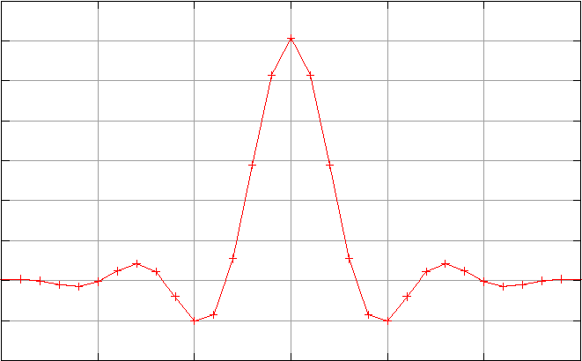
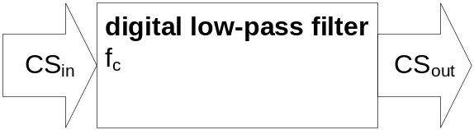
Continuous Data Stream Adaptation
Processing continuous data streams
  Basis: application of digital signal processing techniques
  Digital low-pass filter
    Bandwidth reduction with cut-off frequency f_{c}
    Coefficient vector L (approximation of transfer function)
    Filtering (time domain): application of convolution
    CS_{out} = CS_{in} * L
sinc function

Slide 18
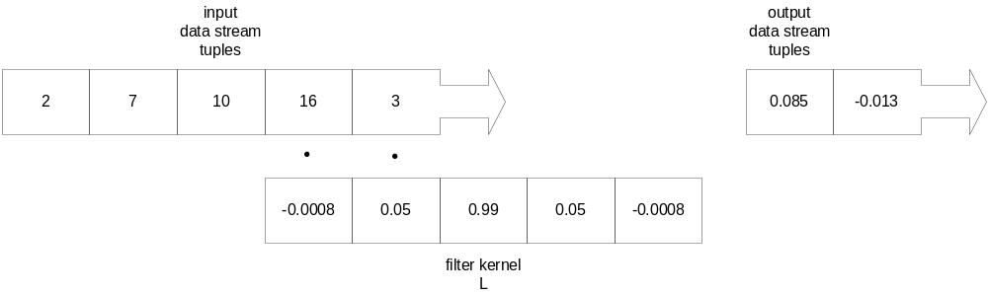
Continuous Data Stream Adaptation (2)
Stream-based convolution

Slide 19
Data Stream Joins – CJOIN (2)
Bandwidth adaptation
(sampling theorem)
  interpolation (bandwidth-aware)
    considers temporal relation-ship of a sequence of tuples
    enables perfect value reconstruction
interpolation
  downsampling (bandwidth reduction)
    loss of information with well defined semantic
    keeps signal characteristics
downsampling

