Slide 1

Mining The Most General Multidimensional Summarization of “Probable Groups” in Data Warehouses
The 17th International Scientific and Statistical Database Management
Conference (SSDBM’05), Santa Barbara, California, U.S.A.
Hui Yu¹ Jian Pei²
Shiwei Tang¹ Dongqing Yang¹
¹ Peking University, Beijing, China
² Simon Fraser University, Canada
http://www.cs.sfu.ca/~jpei

Slide 2
Data Cubes and Data Warehouses
Base table of credit card customers
Data cube
Dimensions |  |  | Measure
Age | Married | Gender | Overdue
30s | Y | Male | No
30s | N | Female | Yes
20s | N | Female | Yes
… | … | … | …
Dimensions |  |  | Measure
Age | Married | Gender | Overdue %
30s | Y | Male | 25%
30s | N | Male | 23%
30s | N | Female | 10%
30s | * | Male | 24%
30s | * | * | 16%
… | … | … | …
* | * | * | 20%
Aggregation

Slide 3
Summarization and Classification
Can we summarize/classify the common features of low-risk customers?
  A data warehouse of customers’ records helps!
  High accuracy and good understandability
  Actionable knowledge: promotions, campaigns, customer segmentation, …
Many existing methods
  Classification methods, e.g., decision trees, Bayesian networks
  Concept summarization and attribute-oriented induction

Slide 4
The Challenge: Minor Classes
Hard to build accurate classifier for lung cancer from census data!
  Smoking may lead to lung cancer
  More than 90% of smokers will not end up getting lung cancer
  Lung cancer happens in less than 0.1% of average population
The available attributes in census data may not be sufficient to characterize the minor class

Slide 5
Summarization instead of Classification
Smoking + family history of lung cancer have 50+% more probability to get lung cancer than the average
More practical but less accurate than classification
  More investigations on the high risk cases should follow

Slide 6
MD Summarization Problem
Probable group queries
  Given a multidimensional database, find the most general summarization of the probable groups
  Contribution 1: A new type of summarization queries
How to mine the most general summarization efficiently?
  Contribution 2: an extension of BUC with a heuristic dynamic ordering method

Slide 7
Probable Group Queries
In table B(gender, isSmoking, isMarried), Prob((*, smoking, *), lung_cancer) is the probability (in the database) of a smoker being a lung cancer patient
  No matter whether the object is male or female, married or not
Given a base table B, a target class c and a minimum probability threshold min_prob, retrieve the complete set of probable groups w (i.e., prob(w, c) ≥ min_prob)

Slide 8
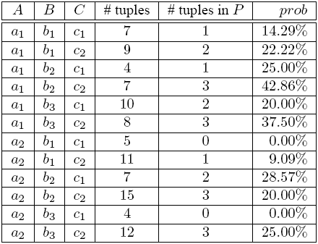
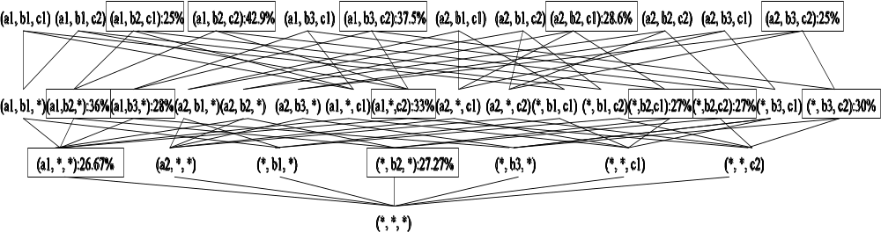
Example
Probable groups are not monotonic!
Min_prob = 25%

Slide 9
Probably Groups Are Weak Monotonic
If prob((*, smoking, *), lung_cancer) ≥ 1%, then there must be one subgroup (e.g., (female, smoking, *)) also has a probability at least 1%
All probable groups stem from the probable groups in the base table
  The groups do not have *’s
The most general probable groups summarize the probable groups
  A probable group is the most general if any more general group of it is not probable

Slide 10
Most General Probable Groups
13 probable cells
3 probable cells in the base table
3 most general probable cells
Given a base table, a target class, and a minimum probability threshold, can we find the complete set of most general probable cells?

Slide 11
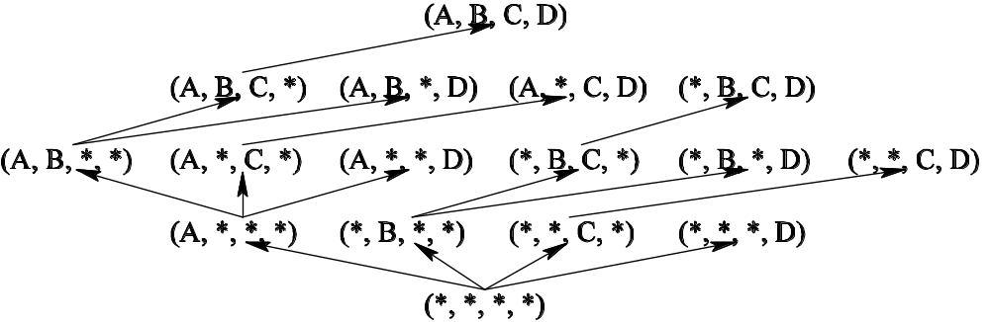
Bottom-Up Cubing (BUC)
BUC is efficient in computing the complete data cube, but it cannot use the weak monotonic property of the probable groups to prune unpromising cells in the cube

Slide 12
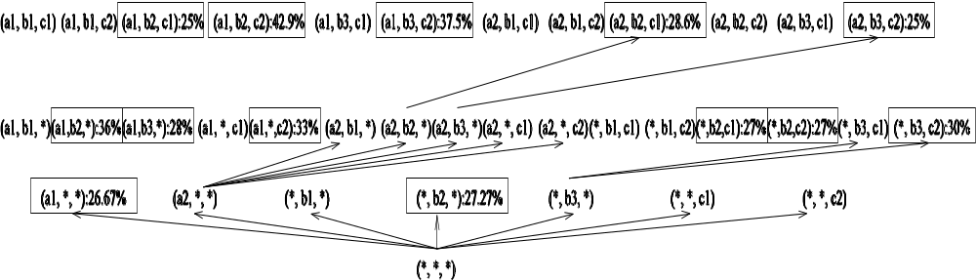
eBUC – Extending BUC
An aggregate cell is a probable group only if it is a base probable group or it is a more general group of some base probable group

Slide 13
Searching Cube Lattice: A 2nd Visit
In depth-first search, when an aggregate cell has multiple children to be searched, the left-most child covers the largest number of descendants

Slide 14
Pruning by Dynamic Ordering
If a cell is probable, do not need to search any of its descendents
All children should be ordered such that the more promising a cell or its descendants are probable, the more left the cell is put

Slide 15
Controlled Children Generation
All probable groups stem from the probable groups in the base table
When expanding to children cells, only the dimension values that appear in some base probable cells that are descendants of the current cell should be used

Slide 16
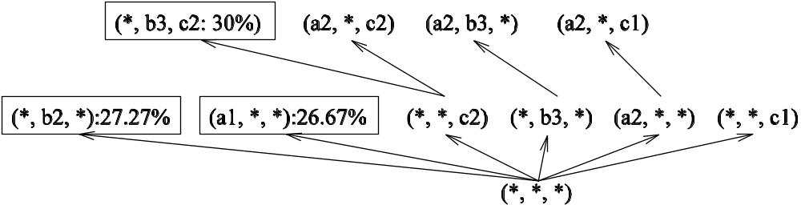
Algorithm DYNO

Slide 17
Empirical Evaluation – Default
Dimensionality 10
Cardinality 100
Target class in the base cells follows the Half-Normal Distribution in [0,1]
  Mean 0, standard deviation 1/ө

Slide 18
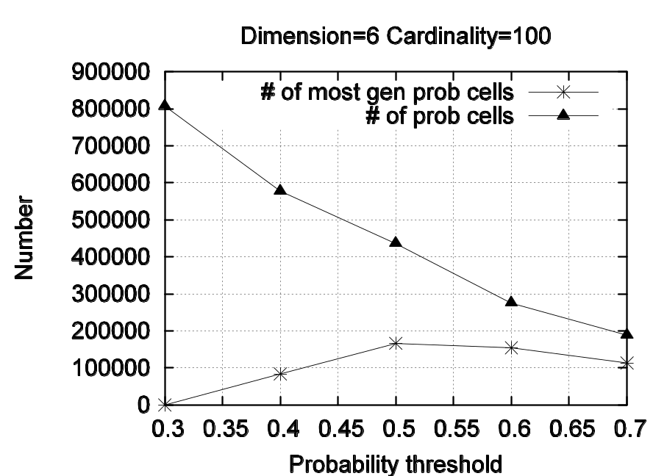
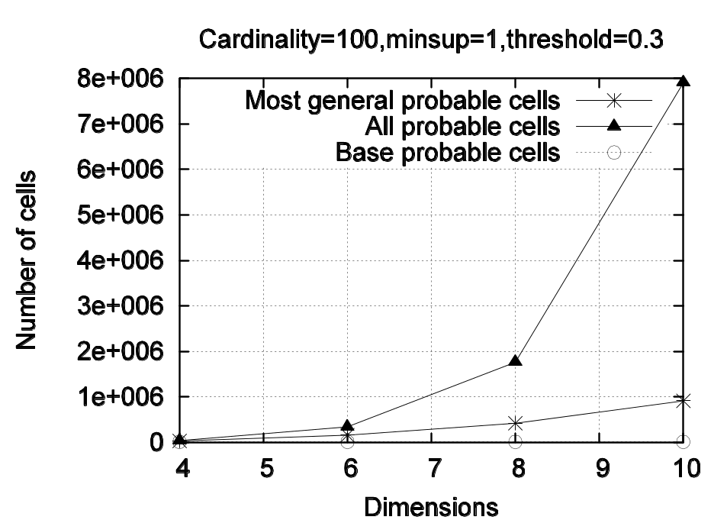
# Probable Cells

Slide 19
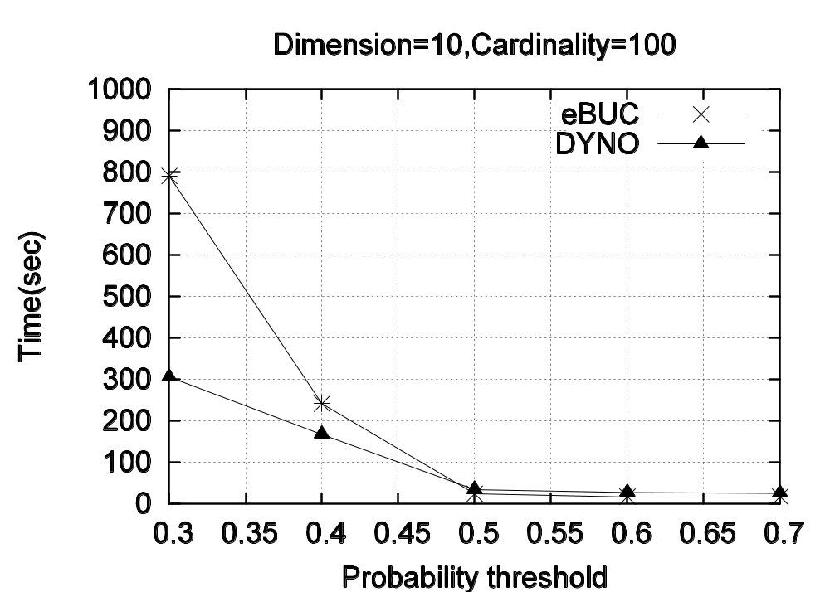
Scalability w.r.t. Min_prob

Slide 20
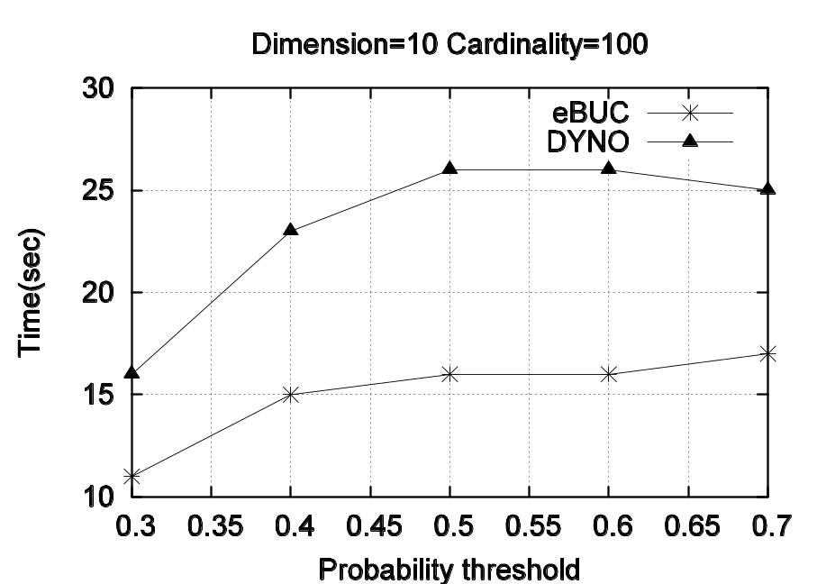
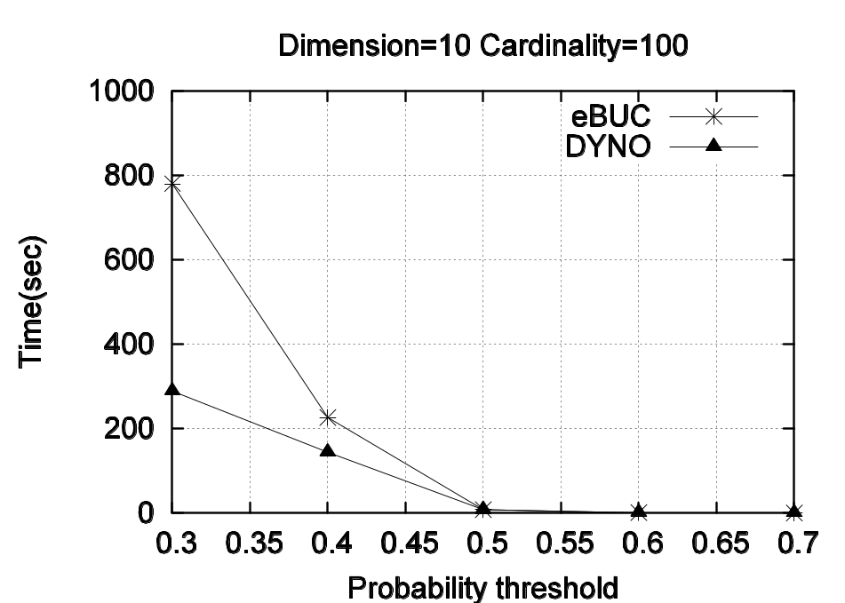
Understanding the Difference
eBUC generates much more probable groups than DYNO
Post processing
Search time

Slide 21
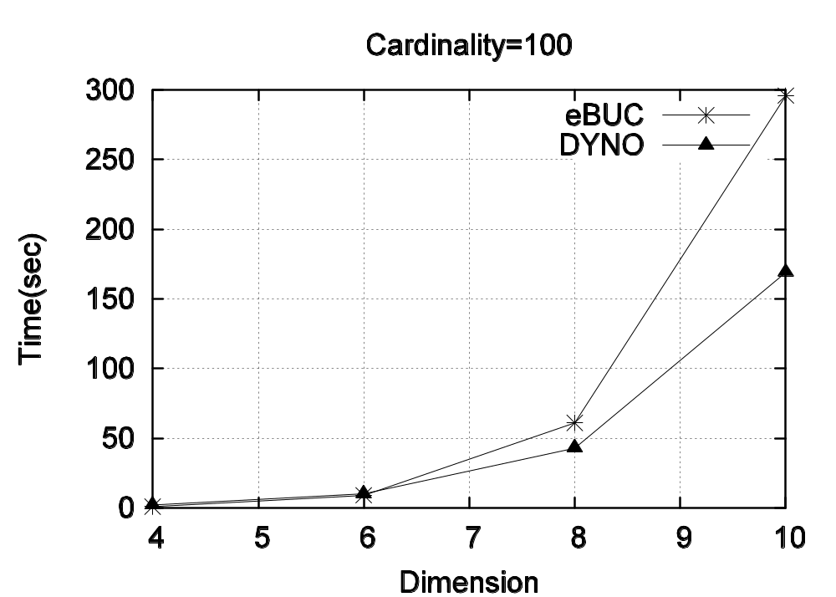
Scalability w.r.t. Dimensionality

Slide 22
Conclusions and Future Work
Contributions
  Probable group queries: a new type of summarization queries
  Mining the most general summarization of probable groups
  Efficient algorithms to answer probable group queries
Future work
  Further improvements on DYNO
  Effective methods for minor class analysis

Slide 23
References
[1] D. Barbara and M. Sullivan. Quasi-cubes: Exploiting approximation in multidimensional databases. SIGMOD Record, 26:12–17, 1997.
[2] D. Barbara and X. Wu. Using loglinear models to compress datacube. In WAIM’2000, pages 311–322, 2000.
[3] K. Beyer and R. Ramakrishnan. Bottom-up computation of sparse and iceberg cubes. In Proc. 1999 ACM-SIGMOD Int. Conf. Management of Data (SIGMOD’99), pages 359–370, Philadelphia, PA, June 1999.
[4] Y. Cai, N. Cercone, and J. Han. An attribute-oriented approach for learning classification rules from relational databases. In Proc. 1990 IEEE Int. Conf. Data Engineering (ICDE’90), pages 281–288, Los Angeles, CA, Feb. 1990.
[5] T. Cormen, C. Leiserson, and R. Rivest. Introduction to Algorithms. The MIT Press, Cambridge, MA, 1990.
[6] R. Duda and P. Hart. Pattern Classification and Scene Analysis. John Wiley & Sons, 1973.
[7] M. Fang, N. Shivakumar, H. Garcia-Molina, R. Motwani, and J. D. Ullman. Computing iceberg queries efficiently. In Proc. 1998 Int. Conf. Very Large Data Bases (VLDB’98), pages 299–310, New York, NY, Aug. 1998.
[8] Y. Feng, D. Agrawal, A. E. Abbadi, and A. Metwally. Range Cube: Efficient cube computation by exploiting data correlation. In Proc. 2004 Int. Conf. Data Engineering (ICDE’04), pages 658–669, Boston, MA, April 2004.

Slide 24
References
[9] J. Gray, A. Bosworth, A. Layman, and H. Pirahesh. Data cube: A relational operator generalizing group-by, cross-tab and sub-totals. In Proc. 1996 Int. Conf. Data Engineering (ICDE’96), pages 152–159, New Orleans, Louisiana, Feb. 1996.
[10] J. Han, J. Pei, G. Dong, and K. Wang. Efficient computation of iceberg cubes with complex measures. In Proc. 2001 ACM-SIGMOD Int. Conf. Management of Data (SIGMOD’01), pages 1–12, Santa Barbara, CA, May 2001.
[11] V. Harinarayan, A. Rajaraman, and J. D. Ullman. Implementing data cubes efficiently. In Proc. 1996 ACM-SIGMOD Int. Conf. Management of Data (SIGMOD’96), pages 205–216, Montreal, Canada, June 1996.
[12] L. Lakshmanan, J. Pei, and J. Han. Quotient cube: How to summarize the semantics of a data cube. In Proc. 2002 Int. Conf. Very Large Data Bases (VLDB’02), Hong Kong, China, Aug. 2002.
[13] L.V.S. Lashmanan, J. Pei, and Y. Zhao. QC-Trees: An efficient summary structure for semantic OLAP. In Proc. 2003 ACM SIGMOD Int. Conf. on Management of Data (SIGMOD’03), San Diego, California, June 2003.
[14] T. M. Mitchell. Generalization as search. Artificial Intelligence, 18:203–226, 1982.
[15] Raymond T. Ng, Alan S. Wagner, and Yu Yin. Iceberg-cube computation with PC clusters. In Proc. 2001 ACM-SIGMOD Int. Conf. Management of Data (SIGMOD’01), Santa Barbara, CA, May 2001.
[16] J. R. Quinlan. Induction of decision trees. Machine Learning, 1:81–106, 1986.

Slide 25
References
[17] K. Ross and D. Srivastava. Fast computation of sparse datacubes. In Proc. 1997 Int. Conf. Very Large Data Bases (VLDB’97), pages 116–125, Athens, Greece, Aug. 1997.
[18] Kenneth A. Ross and Kazi A. Zaman. Optimizing selections over datacubes. In Statistical and Scientific Database Management, pages 139–152, 2000.
[19] Jayavel Shanmugasundaram, Usama Fayyad, and P. S. Bradley. Compressed data cubes for olap aggregate query approximation on continuous dimensions. In Proceedings of the fifth ACM SIGKDD international conference on Knowledge discovery and data mining, pages 223–232, San Diego, California, United States, 1999. ACM Press.
[20] Yannis Sismanis, Nick Roussopoulos, Antonios Deligiannakis, and Yannis Kotidis. Dwarf: Shrinking the petacube. In Proc. 2002 ACM-SIGMOD Int. Conf. Management of Data (SIGMOD’02), Madison, Wisconsin, June 2002.
[21] J. S. Vitter, M. Wang, and B. R. Iyer. Data cube approximation and historgrams via wavelets. In Proc. 1998 Int. Conf. Information and Knowledge Management (CIKM’98), pages 96–104, Washington DC, Nov. 1998.
[22] K. Wang, Y. Jiang, J. X. Yu, G. Dong, and J. Han. Pushing aggregate constraints by divide-and-approximate. In Proc. 2003 Int. Conf. Data Engineering (ICDE’03), pages 291–302, Bangalore, India, March 2003.
[23] D. Xin, J. Han, X. Li, and B.W.Wah. Star-cubing: Computing iceberg cubes by top-down and bottom-up integration. In Proc. 2003 Int. Conf. on Very Large Data Bases (VLDB’02), pages 476–487, Berlin, Germany, Sept. 2003.
[24] Y. Zhao, P. M. Deshpande, and J. F. Naughton. An array based algorithm for simultaneous multidimensional aggregates. In Proc. 1997 ACM-SIGMOD Int. Conf. Management of Data (SIGMOD’97), pages 159–170, Tucson, Arizona, May 1997.

Slide 26
Thank You!
Check out http://www.cs.sfu.ca/~jpei for more about our research on data warehousing, OLAP and data mining
  Semantic OLAP and data cube compression
  Warehousing complex data
  Graph mining
Questions and comments are warmly welcome!

