Slide 1
Integrating Heterogeneous Multidimensional Databases
Luca Cabibbo and Riccardo Torlone
Università Roma Tre

Slide 2
Motivations
Scenarios
  autonomous data marts developed within different departments of a large company
  business oriented cooperation between different companies
  integration of a proprietary data warehouse with multidimensional data available on the Web
Problem
  integration of autonomous data marts
    independently developed and operated data marts
    a logical federation enabling drill across querying
“Easier” than database integration
  data marts are structured in a uniform way
  data quality is high

Slide 3
Goal
Identification of desirable properties of dimension matching
Definition of methods and algorithms for data mart integration
Development of a practical integration tool for multidimensional databases
Framework of investigation
  MD: a conceptual model for multidimensional databases

Slide 4
MD model
Dimensions:
  organized into a hierarchy of levels
  members of the bottom level are called basic and represent real world entities
  members of the other levels are groups of ground members
  roll-up functions map members of a level to members of an higher level (coarser grain)
F-tables (data mart)
  associate measures with members of dimensions

Slide 5
Sales data mart
year
brand
category
week
month
product (SKU)
Product
Dimension (p1)
day
Daily Sales Facts
Time
Dimension (t1)
Product
Day
Store
Promotion
state
Quantity Sold
Sales Dollar Amount
Cost Dollar Amount
city
media type
price red. type
store
promotion
Store
Dimension (s1)
Promotion
Dimension (m1)

Slide 6
Dimension algebra (DA)
Selection: selects a subset of basic members from a dimension
  σ_{{days in 2003-2004}}(DailySales)
Projection: selects a subset of levels from a dimension (including the bottom level)
  π_{{day, month, year}}(DailySales)
Aggregation: changes the bottom level
  ψ_{{week}}(DailySales)
DA expressions: combination of selections, projections and aggregations

Slide 7
A desirable property of DA expressions
A DA expression E is lossless if, whenever a member o belongs to E(d), then all the members that roll up to o in d belong to E(d) as well
if E is lossless, then the result of computing an aggregation of an f-table F over E(d) is coherent with the result of aggregating F over d

Slide 8
Dimension matching
country
state
state
zone
region
area
city
province
district
town
store
shop
Store
Dimension (d1)
Location
Dimension (d2)

Slide 9
Desirable properties of a matching μ
Coherence: for each pair of levels l and l' of d1
  l < l' if and only if μ(l) < μ(l')
Soundness: for each level l of d1
  the members l and μ(l) are the same
Consistency: for each pair of levels l < l' of d1
  the roll-up function from l to l’ coincides with the roll-up function from μ(l) to μ(l')
A perfect matching is a total matching that is coherent, sound and consistent

Slide 10
Dimension compatibility
Two dimensions d1 and d2 are compatible if:
  there exist two lossless DA expressions E1 and E2 over d1 and d2
  there is a perfect matching between E1(d1) and E2(d2)

Slide 11
A preliminary tool: the d-chase
country
state
store
city
zone
country
district
state
prov.
region
state
zone
region
1st
New York
v1
USA
v2
NY
v3
v4
area
2nd
Los Angeles
U2
USA
Melrose
CA
v5
v6
city
province
1er
Paris
E1
France
Marais
v7
v8
v9
district
town
1mo
Rome
E1
Italy
v10
v11
RM
Latium
1st
New York
U1
USA
v12
v13
v14
v15
store
shop
1er
Paris
E1
France
v16
v17
75
Ile de Fr.
Store
Dimension (d1)
Location
Dimension (d2)

Slide 12
Application of the d-chase
store
city
zone
country
district
state
prov.
region
1st
New York
U1
v1
USA
v2
NY
v3
v4
2nd
Los Angeles
U2
USA
Melrose
CA
v5
v6
1er
Paris
E1
France
Marais
v7
v8
75
v9
Ile de Fr.
1mo
Rome
E1
Italy
v10
v11
RM
Latium
1st
New York
U1
USA
v12
v13
v14
v15
1er
Paris
E1
France
v16
v17
75
Ile de Fr.

Slide 13
D-chase results
The d-chase terminates on any input with a unique end result
A matching between two dimensions d1 and d2 is consistent if and only by applying the d-chase on the matching tableau over d1 and d2 we do not encounter contradictions

Slide 14
Two approaches to dimension integration
loosely coupled integration (LCI):
  identification of the common information between the data sources
  queries are performed over the original sources
tightly coupled integration (TCI):
  derivation of a materialized view built by merging the sources
  queries are performed against the view

Slide 15
An algorithm for LCI
Test for coherence
Test for consistency
  based on the application of the d-chase
Derivation of two lossless DA expressions
Result:
  The algorithm returns two expressions that make the matching perfect if and only if the dimensions are compatible

Slide 16
The application of the LCI algorithm
country
state
country
state
state
zone
region
area
zone
area
city
province
city
town
district
town
store
shop
store
shop
Location
Dimension (d2)
Store
Dimension (d1)
Dimension E2(d2)
Dimension E1(d1)
  σ_{{1st}}(π_{{store,city,region,country}}(Store))
  σ_{{1st}}(π_{{shop,town,area,state}}(Location))

Slide 17
An algorithm for TCI
Test for coherence
Test for consistency
  based on the application of the d-chase
Derivation of a new dimension obtained by merging the original dimensions
Result:
  The algorithm returns a dimension that embeds the original dimensions

Slide 18
The application of the TCI algorithm
country
country
region
state
state
zone
state
zone
province
region
area
city
city
province
district
district
town
shop
store
store
shop
Store
Dimension (d1)
Location
Dimension (d2)
store and shop
New Store
Dimension (d)

Slide 19
Data mart integration
Based on drill across operations over autonomous data marts
  variant of a natural join operator
  on two f-tables over “common” dimensions

Slide 20
Sales data mart
year
brand
category
week
month
product (SKU)
Product
Dimension (p1)
day
Daily Sales Facts
Time
Dimension (t1)
Product
Day
Store
Promotion
state
Quantity Sold
Sales Dollar Amount
Cost Dollar Amount
city
media type
price red. type
store
promotion
Store
Dimension (s1)
Promotion
Dimension (m1)

Slide 21
Weather data mart
...
year
...
...
month
...
day
Weather Facts
Weather Condition
Dimension (wc2)
Time
Weather Condition
Weather Station
time of day
Temperature
Pressure
Humidity
state
Time
Dimension (t2)
city
weather station
Weather Station
Dimension (ws2)

Slide 22
Matchings between dimensions
year
year
month
week
month
day
day
time of day
state
state
city
city
store
weather station

Slide 23
Loosely coupled integration
year
month
Daily Sales Facts
by City
Weather Facts
by Day and City
day
Product
Day
Store city
Promotion
Time
Weather Condition
Location
Matched Time
Dimension (t1∩t2)
Quantity Sold
Sales Dollar Amount
Cost Dollar Amount
Avg Temperature
Avg Pressure
Avg Humidity
state
city
Matched Location
Dimension (s1∩ws2)

Slide 24
Tightly coupled integration
year
week
month
day
Daily Sales Facts
Weather Facts
time of day
Product
Day
Store
Promotion
Time
Weather Condition
Weather Station
Matched Time
Dimension (t1Ut2)
Quantity Sold
Sales Dollar Amount
Cost Dollar Amount
Temperature
Pressure
Humidity
state
city
store
weather station
s & w
Matched Location
Dimension (s1Uws2)

Slide 25
DaWaII
We have developed an interactive tool, called DaWaII (for Data Warehouse IntegratIon), able to:
  access data marts stored in a variety of systems (DB2, Oracle, SQL Server, among others);
  define matchings between autonomous dimensions by means of a graphical interface;
  test for coherence, consistency, and soundness of matchings;
  generate the intersection between two dimensions, according to the LCI approach;
  merge two dimensions, according to the the TCI approach.

Slide 26
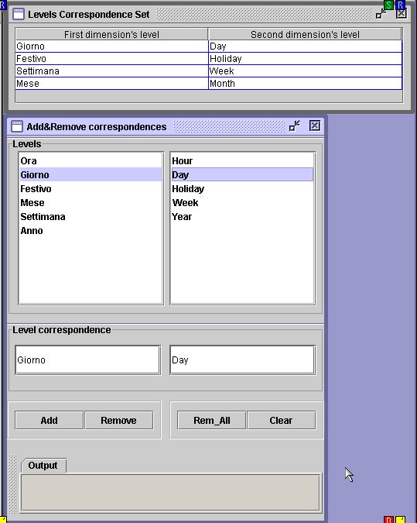
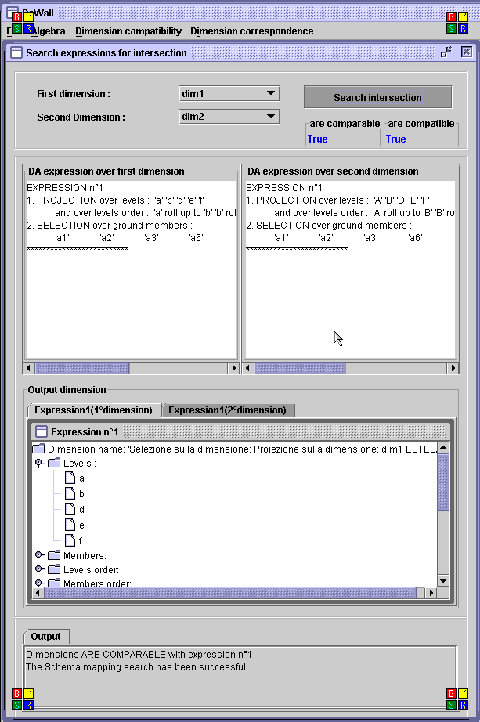
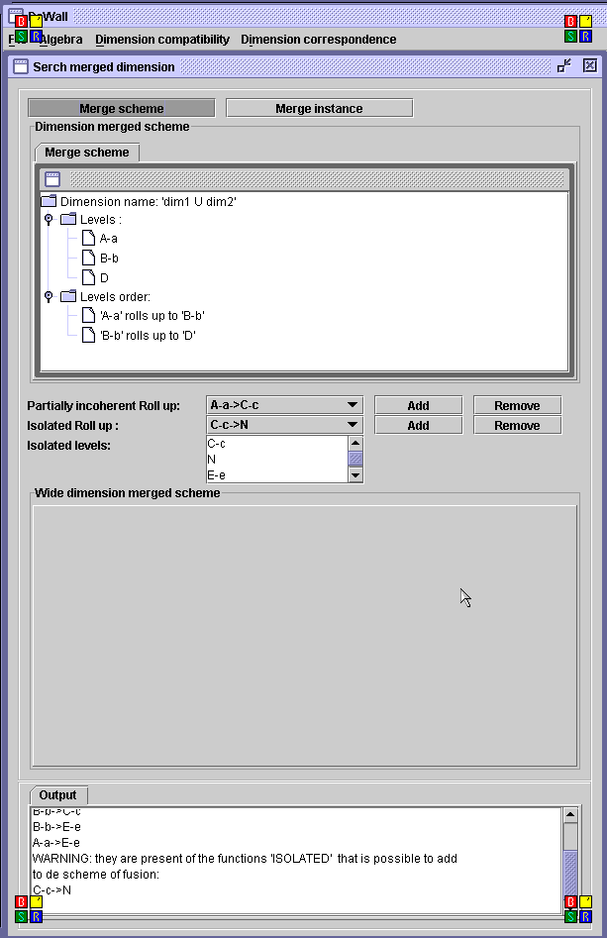
DaWaII at work

Slide 27
Conclusion
We have proposed a number of concepts and techniques for the integration of heterogeneous multidimensional databases
  general properties of dimension matchings
  d-chase process
  LCI and TCI algorithms
  development of a practical integration tool
Future work
  generalization of the approach
  extension and test of the integration tool

Slide 28
Thanks for your attention...
Questions?

