Slide 1
The “Best K” for Entropy-based Categorical Clustering
Keke Chen and Ling Liu
Georgia Tech
Presented by Keke Chen

Slide 2
Outline
Introduction
Entropy-based categorical clustering
Entropy characteristics of categorical data
ACE: a robust tool for identifying the Best Ks
Experiments
Conclusion and future work

Slide 3
Why categorical clustering?
Categorical data
Traditional method dealing with categorical data
  Extracting/constructing the numerical features – hard!
  Define domain-specific distance function -- hard!
Categorical data clustering works in many domains:
  Market basket analysis
  Information retrieval
  Microarray analysis
  Environmental data and more…
Attribute1 | Attrbute2 | Attribute3
Blue | True | 1
Red | False | 3
Green | True | 2

Slide 4
Problems with Categorical Clustering
Similarity measure
  Distance function?
    General distance functions are not intuitive for categorical values
    Domain-specific distance function
  “Purity measure” for bulk of records
    Putting similar records in a group -> high purity
    Entropy!
Cluster validation for categorical data
  1) Evaluate the quality of a K-cluster partition, with the given number K
  2) How to determine the best number of clusters – “Best K” !

Slide 5
Entropy-based categorical clustering
Aim: optimizing the quality of clustering result for categorical data
  Quality of clustering result is evaluated by “Expected Entropy”
  “Expected Entropy” ⇔ the general probabilistic clustering framework (Li04, ICML)
Intuition behind entropy criterion
  Similar records in a cluster -> higher purity of the cluster -> lower entropy of the cluster
  Lower EE -> lower cluster entropy on average for the clusters
  -> higher cluster purity on average
  -> better clustering result

Slide 6
Entropy-based categorical clustering
Clustering -> minimizing the expected entropy
  EE minimization is a NP-hard problem.
  Approximation is used in clustering algorithms
    Reduce the complexity
    Try to optimize the quality
Typical algorithms
  Coolcat algorithm [barbara02CIKM]
  Monte-Carlo algorithm [Li04ICML]
  ACE algorithm in this paper

Slide 7
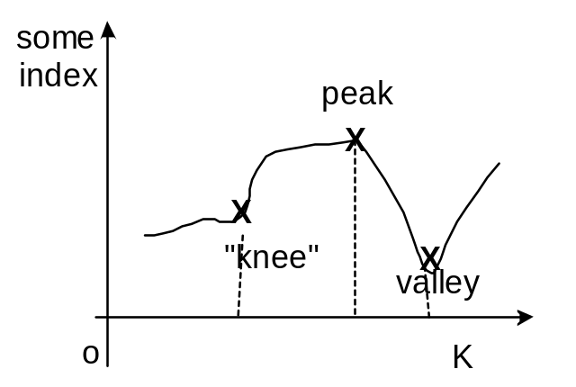
Idea to identify the best Ks
Typical method: observe the curve of “certain index”
  Find the particular points on the curve.
  Why are they optimal? – meaning …
Can we find such index for categorical clustering?
  Investigate the entropy characteristics of the partitions
  First Candidate: The plot of optimal expected-entropies for varying K

Slide 8
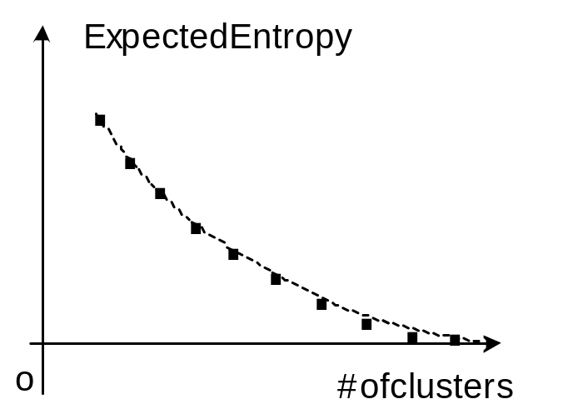
1) Expected-Entropy Graph
Exploring the characteristics of optimal partition schemes
  Optimal partition for k-clusters: k-cluster partition having minimum expected-entropy, EE_{opt}(C^{K})
  Entropies for varying K are bounded, decreasing with the increase of K
  no distinguishable points! Best K is not unique?!

Slide 9
2) Difference between the neighboring partitions
Neighboring partitions: C^{K}, C^{K+1}
  i.e., K-cluster partition vs. K+1-cluster partition
  Entropy difference: I(K) = EE_{opt}(C^{K}) - EE_{opt}(C^{K+1})
Two levels to understand I(K)
  First level:
    Small I(K) means the neighboring partitions are similar -> reducing the # of clusters does not change the clustering structure much.
    Larger I(K) -> second level: the pattern of I(K) changing?

Slide 10
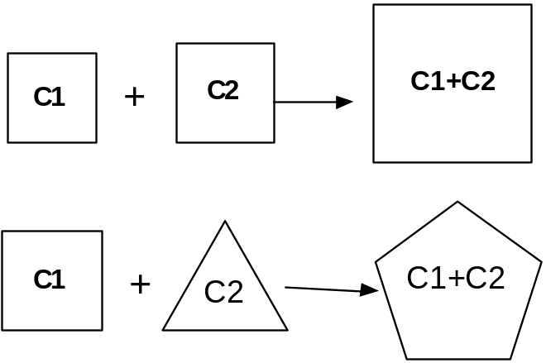
Two levels to understand I(K) (Cont.)
Second level
1) similar continuous changes: I(K) -> I(K+1)
-> the change of clustering structure is not distinguishable
Intuitive illustration: “similar merging of clusters”
Merging clusters that have similar
clustering structure
Merging clusters that have different
clustering structure

Slide 11
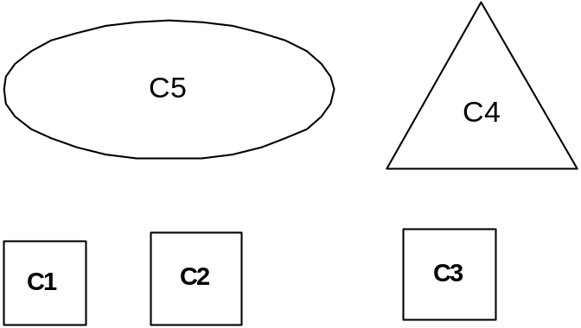
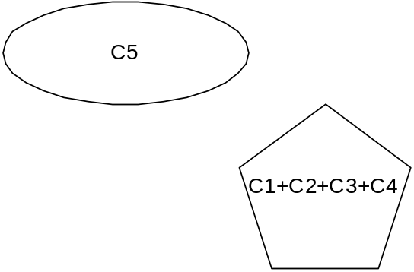
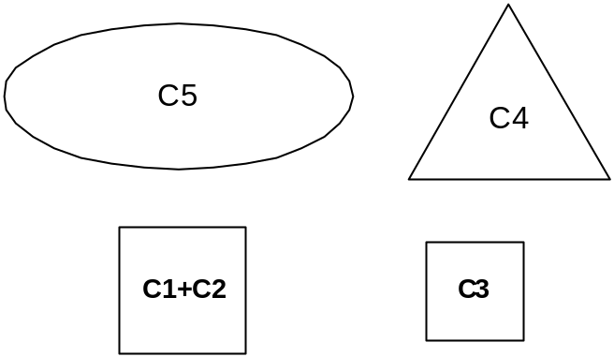
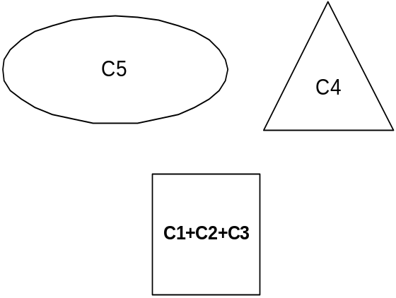
I(K+1) ≅ I(K) < I(K-1)
K is the critical number!
Partition with K+2 clusters:
Partition with K clusters:
Similar merging!
I(K+1)
Partition with K clusters:
Partition with K+1 clusters:
I(K-1)
I(K)
Optimal!

Slide 12
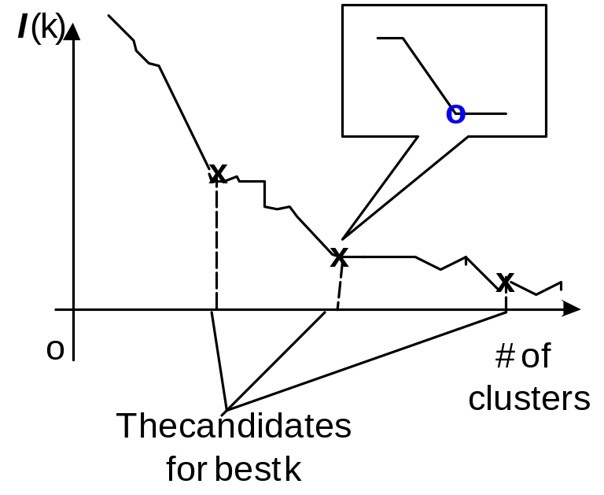
A typical I(k) plot
We will find the features
  “plateau”, similar change of clustering structure
  “critical points”, clustering structure is significantly changed.

Slide 13
Finding the critical points on I(K) plot
Finding the critical points
  2nd order differential of I(K) -> BkPlot
  Peaks/valleys on BkPlot -> critical points on I(K) plots
Clustering algorithms
-> Approximate EE minimization
-> Approximate BkPlot
Problem: algorithms to generate reliable BkPlots?
  The critical points are all included
  Only a few false identifications are allowed.
  ACE algorithm.

Slide 14
ACE categorical clustering algorithm
similarity between clusters
  Compare similarity between clusters rather than a pair of records
  incremental entropy
  C_{p}, C_{q}: two clusters
  I_{m} (C_{p}, C_{q}) = (n_{p}+n_{q})H(C_{p}+C_{q}) – (n_{p}H(C_{p}) + n_{q}H(C_{q}))
  Property:
  - I_{m} >= 0: merging partitions always increases entropy(or keeps entropy unchanged, when two clusters having the same structure)
  - The more similar in structure, the smaller the I_{m} is

Slide 15
ACE algorithm
Hierarchical algorithm based on Incremental Entropy (IE)
  Initial: each record is a cluster
  Choose a pair of clusters to merge in each iteration, merging them resulting in minimum IE
  minimize IE → approximately minimize Expected Entropy
Complexity O(dmN²)
  - d: # of dimensions,
  - m: average cardinality of each dimension
  - N: # of records
Sampling is effective for generating the similar quality BkPlots for big N

Slide 16
Experiments
Goals:
  Showing the effectiveness of BkPlots in determining the best Ks
  Showing ACE is an effective tool for generating reliable BkPlots

Slide 17
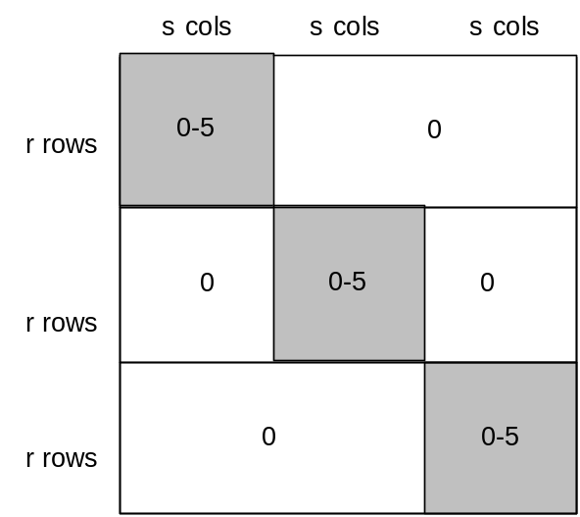
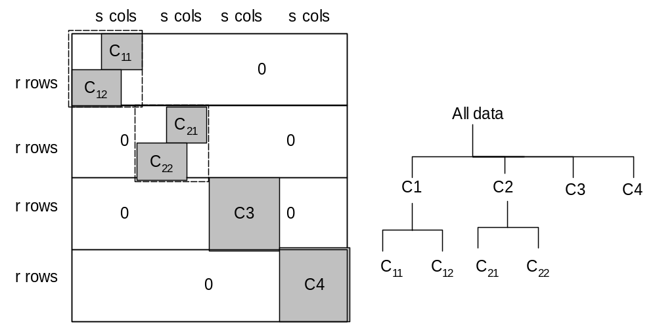
Experiments
Datasets
  Synthetic data:
    20 datasets for each structure are randomly generated.
  Real datasets: from UCI KDD archive

Slide 18
Experiments
Two compared algorithms for generating BkPlots
  Coolcat algorithm [Barbara02CIKM]
  Monte-Carlo method [Li04ICML]
Performance metrics:
  Coverage rate
  False discovery rate
  Expected entropy
  Purity: consistency between the class labels and the cluster labels generated by clustering algorithm.

Slide 19
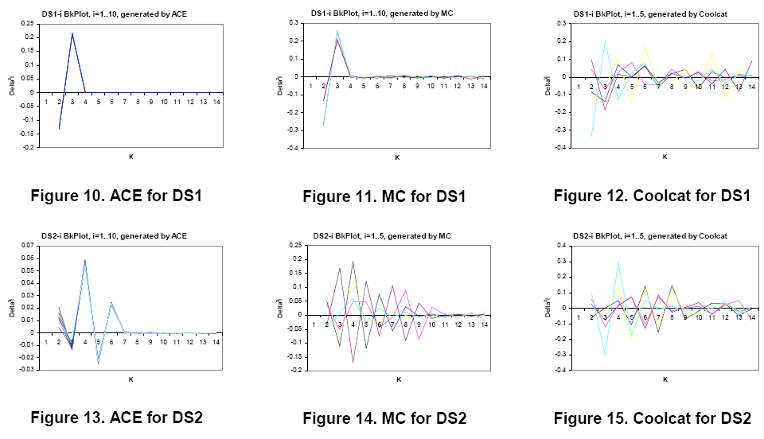
Results on synthetic data
★ ★ ★ ★ ★
★ ★
@#!$^%*

Slide 20
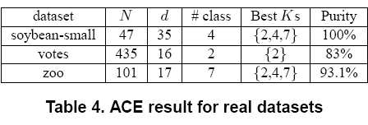
Results on real data

Slide 21
Discussion
ACE clustering results on the synthetic data have very small error, so the generated BkPlots precisely approximate the exact BkPlots
  It shows BkPlot is effective for identifying the best Ks!
ACE is an effective tool for generating reliable BkPlots, compared to the clustering algorithms using the same entropy criterion.
  ACE BkPlots are clear and precise
  The results on real data show high consistency with the given class labels, which means ACE+BkPlot is an effective method for analyzing categorical data.

Slide 22
Future work
Datasets without clustering structure!
Generating reliable BkPlots for large datasets and data streams.
Thank you!

