Slide 1
A Fast Approximation Scheme for Probabilistic Wavelet Synopses
Antonios Deligiannakis (University of Maryland)
Minos Garofalakis (Bell Labs, Lucent Technologies)
Nick Roussopoulos (University of Maryland)

Slide 2
Outline
Preliminaries & Motivation
  The need for data approximation
  Haar wavelet decomposition, conventional wavelet synopses
  The problem with conventional wavelet techniques
Earlier Approach: Probabilistic Wavelet Synopses [Garofalakis & Gibbons, SIGMOD’02]
  Error guarantees in constructed synopsis, but very inefficient
Our Approach: Sparse Dynamic Programming Scheme
  (1+ε) - approximation algorithm for maximum relative error
Conclusions & Ongoing Work

Slide 3
The Need for Data Approximation
Several applications collect large amounts of data
  Amounts are relevant to system capabilities
    OLAP systems, Environmental Applications: GB-TB
    Sensor nodes: KB-MB
Data needs to be
  Stored
  Processed
  Often communicated to distant areas
Data approximation needed when storage, running time or bandwidth constraints occur

Slide 4
The Need for Data Approximation (2)
Multiple corresponding benefits
  Reduced storage/bandwidth requirements
  Fast, approximate answers
    Small, memory resident data synopses
    Aggregate queries, quickly identifying areas of interest…
    Precision up to last decimal not always needed – if answers fairly accurate
    Ex: “What was the average precipitation in area A over last July”?
Construct effective data synopses ??
  Wavelets: Very good for relatively “smooth” data sets
    Many environmental: temperature, pressure, humidity…
    Wide application in signal/image databases

Slide 5
Haar Wavelet Decomposition
Wavelets: hierarchical decomposition of functions
Haar wavelets: simplest wavelet basis
  Recursive pair-wise averaging and differencing
Resolution Averages Detail Coefficients
0
[4]
[1]
1
[5, 3]
[5, ]
[-3, ]
[-3, 0]
2
[2, 8, 3, 3]
----
Haar wavelet decomposition:
[4, 1, -3, 0]
Natural extensions to multiple dimensions

Slide 6
Haar Wavelet Coefficients
Visualization in Error Tree
Coefficient “support region”
Point Queries use only coefficients on path to value
Range Queries use only coefficients to paths to low and high bound of range
4
1
+
-
-3
0
+
-
+
-
Data
2 8 3 3
13 = 3*4 +1*(2-1)
8 = 4 + 1 – (-3)
Resolution Averages Detail Coefficients
0
[4]
[1]
1
[5, 3]
[-3, 0]
2
[2, 8, 3, 3]
----

Slide 7
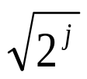
Wavelet Data Synopses
Haar wavelet decomposition
Coefficient thresholding: Only B << N = |Domain| coefficients can be kept
  B is determined by the available synopsis space
Conventional thresholding
  Normalization: divide coefficients at resolution j by
    j is resolution level of coefficient (level in error tree)
    Appropriately weight coefficients based on number of data values that they help reconstruct
  Store B coefficients with largest absolute normalized value
  All other coefficients are ignored (assumed to be zero)
  Provably optimal in terms of the overall Sum-Squared (L2) Error

Slide 8
Problems with Conventional Synopses
Sample data vector and wavelet synopsis (|D|=16, B=8 coefficients retained)
Always accurate!
Over 2,000% relative error!
Original Data Values 127 71 87 31 59 3 43 99 100 42 0 58 30 88 72 130
Wavelet Answers 65 65 65 65 65 65 65 65 100 42 0 58 30 88 72 130
Estimate = 195, actual values: d(0:2)=285, d(3:5)=93!
How accurate is each answer that we get?
Large variation in answer quality
  Within the same data set, when synopsis is large, when data values are about the same, when actual answers are about the same
Root causes
  Thresholding for aggregate L2 error metric
  Independent, greedy thresholding ( large regions without any coefficient!)

Slide 9
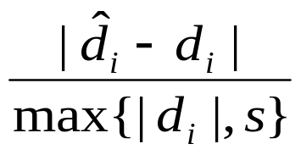
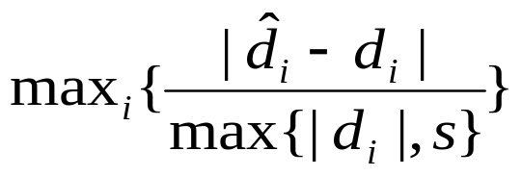
Solution: Optimize for Maximum Relative Error
Key metric for effective approximate answers: Relative error with sanity bound
  Sanity bound “s” to avoid domination by small data values
To provide tight error guarantees for all reconstructed data values
  Minimize maximum relative error in the data reconstruction
Minimize

Slide 10

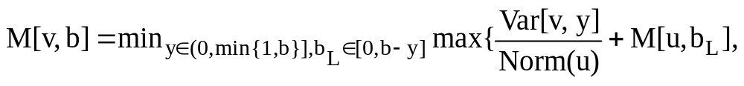
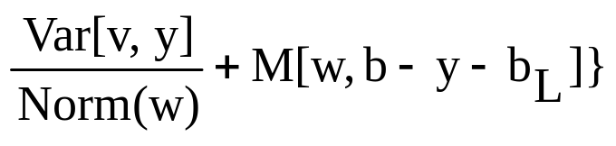
Earlier Approach: Probabilistic Wavelet Synopses [GG02]
v
Determine y_{v} = the probability of retaining c_{v} (multiples of 1/q)
  y_{v} = “fractional space” allotted to coefficient c_{v} ( )
  Flip biased coins to select coefficients for the synopsis
u
w
Probabilistically control maximum relative error by minimizing the maximum Normalized Standard Error (NSE) of all data values
M[v,b] = optimal value of the maximum NSE for the subtree rooted at coefficient c_{v} for a space allotment of b to entire subtree
  Based on b, check all possible allocations of space to node and left subtree
  For each space allocation, calculate NSE over left/right subtrees and take max
All allotments to node, left subtree
Node Contribution to NSE for subtree

Slide 11
Our Goal and Solution Sketch
Create an efficient thresholding technique for minimizing the maximum relative error
  Avoid large complexity of DP solution
    O(NB log B) time, O(NB) space
  Efficient computation and limited space
    Domain size N
    Size of synopsis B
Our solution
  Sparse DP algorithm
  Use a logarithmically small set of breakpoints
  Given an approximation factor ε, our solution will always be within a factor of (1+ε) from the optimal DP solution of [GG02]

Slide 12
Observations/Main Idea
Optimal M*[v,x] value is non-increasing with x
Several M*[] solutions at each node may have similar values for different x
Maintain at each node only a logarithmic set of breakpoints
Approximate M*[v,x] with M[v,b] from our algorithm
  b is the largest stored breakpoint lower than x
  Guarantee that M*[v,x] ≤ M[v,b] ≤ (1+ε) M*[v,x]
v
u
w

Slide 13
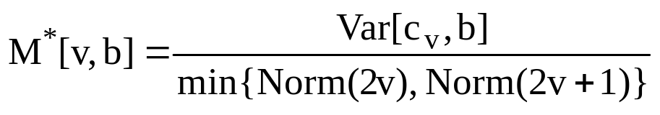
Base Case: Leaf Nodes in Error Tree
Consider a leaf node v (level 0 of error tree)
Find decreasing M*[v,b] values for b=0, 1/q, 2/q, …, min{B,1} as
Space of breakpoints increases
M[v,x] values decreasing
l_{v}
Store M[] values for only a subset b₁ < … < b_{h} of space allotments
  Store space allotment for space b₁ = 0
  Parse remaining space allotments from smaller to larger
  Store first b_{i+1} > b_{i}: M*[v,b_{i}] > (1+ε) M*[v,b_{i+1}]
∀x∈[b_{i}, b_{i+1}) answer using b_{i}
  M[v,b_{i}] ≤ (1+ε) M*[v, x]
Parse and trim breakpoints
Store b₁
x
l_{v}
b_{i} b_{i+1}
Since this did not hold for x
Answer using b_{i}

Slide 14
Inductive Step: Internal Nodes
v
u
w
Let l_{u}, l_{w} denote sorted list of children breakpoints
Compute M[] values, breakpoints at v using l_{u}, l_{w}
  Step essentially considers possible space allocation to 2 subtrees
  Do we need to consider |l_{u} |⋅|l_{w}| breakpoints in total?
  Luckily NO
∀ fractional space assignment y to v calculate NSE values for breakpoints in both subtrees
  Add node contribution to max NSE of each subtree leftVar/rightVar
  Let L_{u}/L_{w} denote the new sorted lists
Space of breakpoints increases
M[u,x] values decrease
a_{i-1} a_{i} a_{i+1}
l_{u}
add leftVar,
rightVar
l_{w}
b_{k-1}b_{k} b_{k+1}
L_{u}
L_{w}

Slide 15
Inductive Step (Cont.)
v
u
w
∀ fractional space assignment y = 0,1/q,…,min{1,B} to v
  L = merge(L_{u}, L_{w})
    Sorted list on M’[v,x], breakpoints from both subtrees
  M[] values at v determined by subtree with maximum NSE
  ∀a_{i}∈L_{u}, consider only leftmost b_{k} ∈ L_{w} value to its right in L
    Larger b values require more space, do not decrease M[]
  ∀a_{i}∈L_{u}, consider only rightmost b_{k} ∈ L_{w} value to its left in L
  Discard breakpoints with space more than B
  At most |l_{u} |+|l_{w}| breakpoints in total
Space of breakpoints increases
M[u,x] values decrease
L_{u}
L_{w}
a_{i} b_{k}
L
M[v, a_{i}+b_{k}+y] determined by subtree of a_{i} (u)

Slide 16
Inductive Step: Internal Nodes (Cont.)
Merge the O(q) sorted lists created
  1 sorted list for each space allotment to coefficient at root of subtree
Lemma: The computed breakpoints approximate M*[v,x] within an (1+ε) factor (same as subtrees)
  Proof in paper
Problem: Breakpoint list increases in upper tree levels: (2q)^{j}
  Solution: Trim breakpoints incurring another (1+ε) degradation
  Total degradation (1+ε)^{log N}
    N is domain size
    Can use ε’ = ε / log N to achieve desired approximation factor

Slide 17
Complexities
 | ε-ApproxRV | MinRelVar
Running Time | O(min{N log N / ε, NB}) | O(NB log B)
Space | O(min{N log N / ε, NB}) | O(NB)
Working Set | O(min{log N loglogN/ ε, B}) | O(B log N)
Improvements even for exact solution (ε = 0)
Usually B << N, but B >> log N

Slide 18
Extensions/Optimizations
Initial coefficient thresholding
  Most coefficient values typically have very small values
  Discard “unimportant” coefficients, apply algorithm to N_{z} << N remaining
  Complexity dependency on N_{z}, not N (very important)
Algorithm can be used for minimizing maximum absolute error also
Calculation of breakpoints in single pass
  Post-order calculation of breakpoints in nodes
  I/O efficiency: No swapping
Easy extensions to multiple dimensions
  Details in the paper

Slide 19
Experimental Evaluation
Compared our ε-ApproxRV algorithm with MinRelVar
  Running Time
  Achieved accuracy
Main findings for ε-ApproxRV
  Actual accuracy was significantly better than worst-case bound
  Significantly faster running times
    1-2 orders of magnitude
    Faster running times even for exact solution (ε = 0)

Slide 20
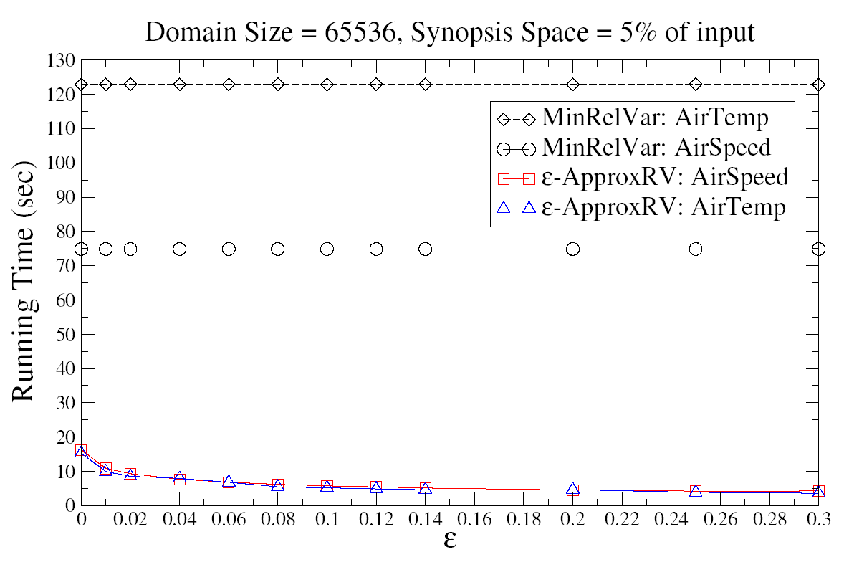
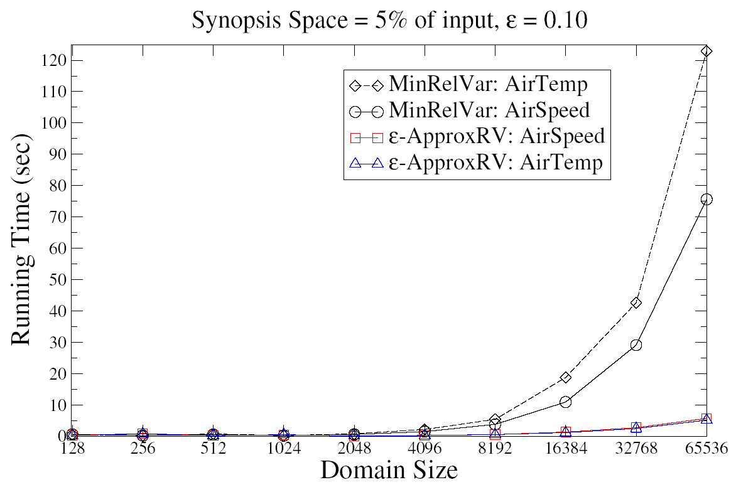
Experiments – Scalability
Scalability to ε
Scalability with domain size

Slide 21
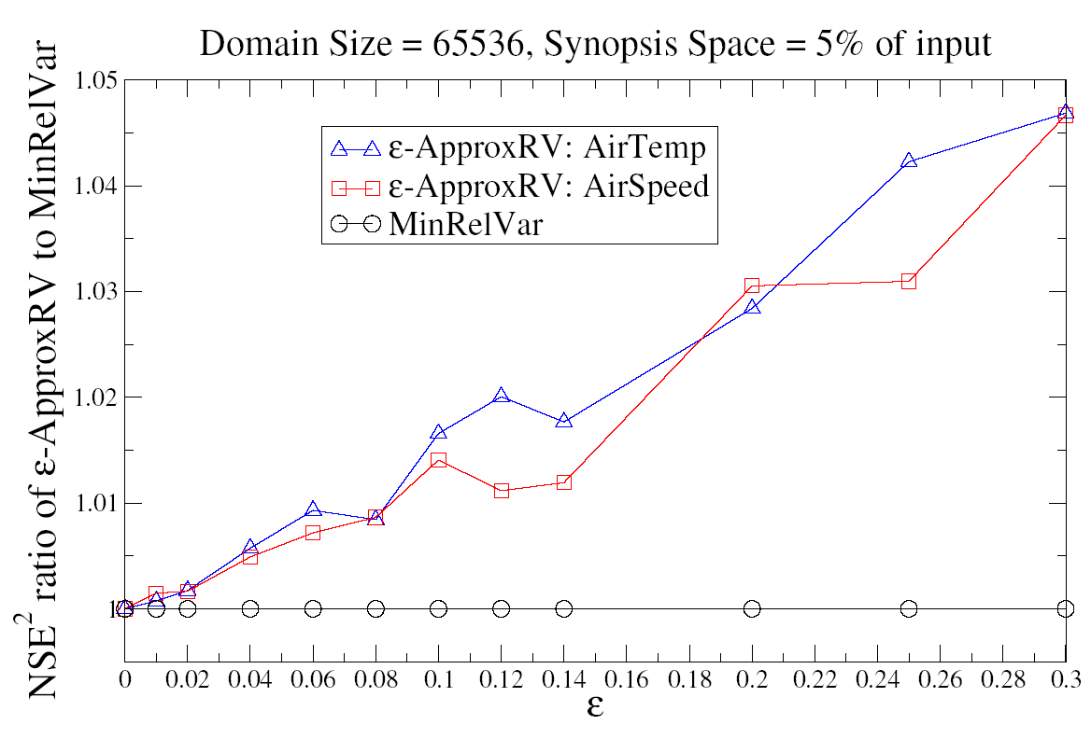
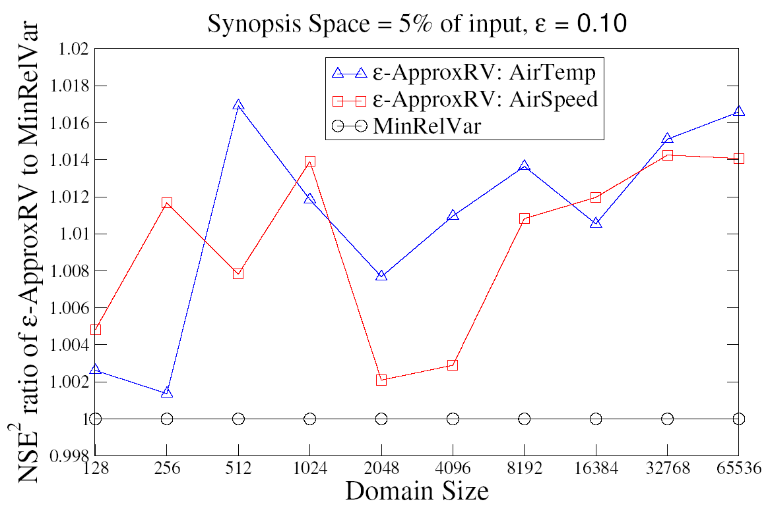
Experiments – Accuracy
Approximation factor
Varying ε
Varying the Domain Size

Slide 22
Conclusions
Novel, fast approximation scheme for wavelet synopses targeting the maximum relative error for large data sets
Sparse version of previous DP techniques
  Store logarithmic subset of breakpoints
I/O efficient computation
Extensions to multiple dimensions
Experimental validation demonstrated
  Scalability to large data sets
  Significantly tighter solutions that the target error factor ε

Slide 23
Ongoing Work
Need considerably more efficient algorithms for error metrics other than L2
  Goal: linear complexity, space
Greedy algorithm for even faster synopsis construction
  Much effort wasted on computed breakpoints that cannot be part of solution
  Gradually & greedily increases retention probabilities of coefficients
    Paths with maximum NSE (M[]) values
Observations
  No guaranteed deviation factor from optimal, but always near-optimal experimentally
  1-2 orders of magnitude improvements

Slide 24

Thank you - Questions?

Slide 25

Approximate Query Processing
Decision
Support
Systems
(DSS)
SQL Query
Exact Answer
GB/TB
Long Response Times!
Compact Data Synopses
“Transformed” Query
Approximate Answer
KB/MB
FAST!!
Exact answers NOT always required
  DSS applications usually exploratory: early feedback to help identify “interesting” regions
  Aggregate queries: precision to “last decimal” not needed
    e.g., “What percentage of the US sales are in NJ?”
Synopses also useful when transmitting data, to preserve bandwidth
Construct effective data synopses ??

Slide 26
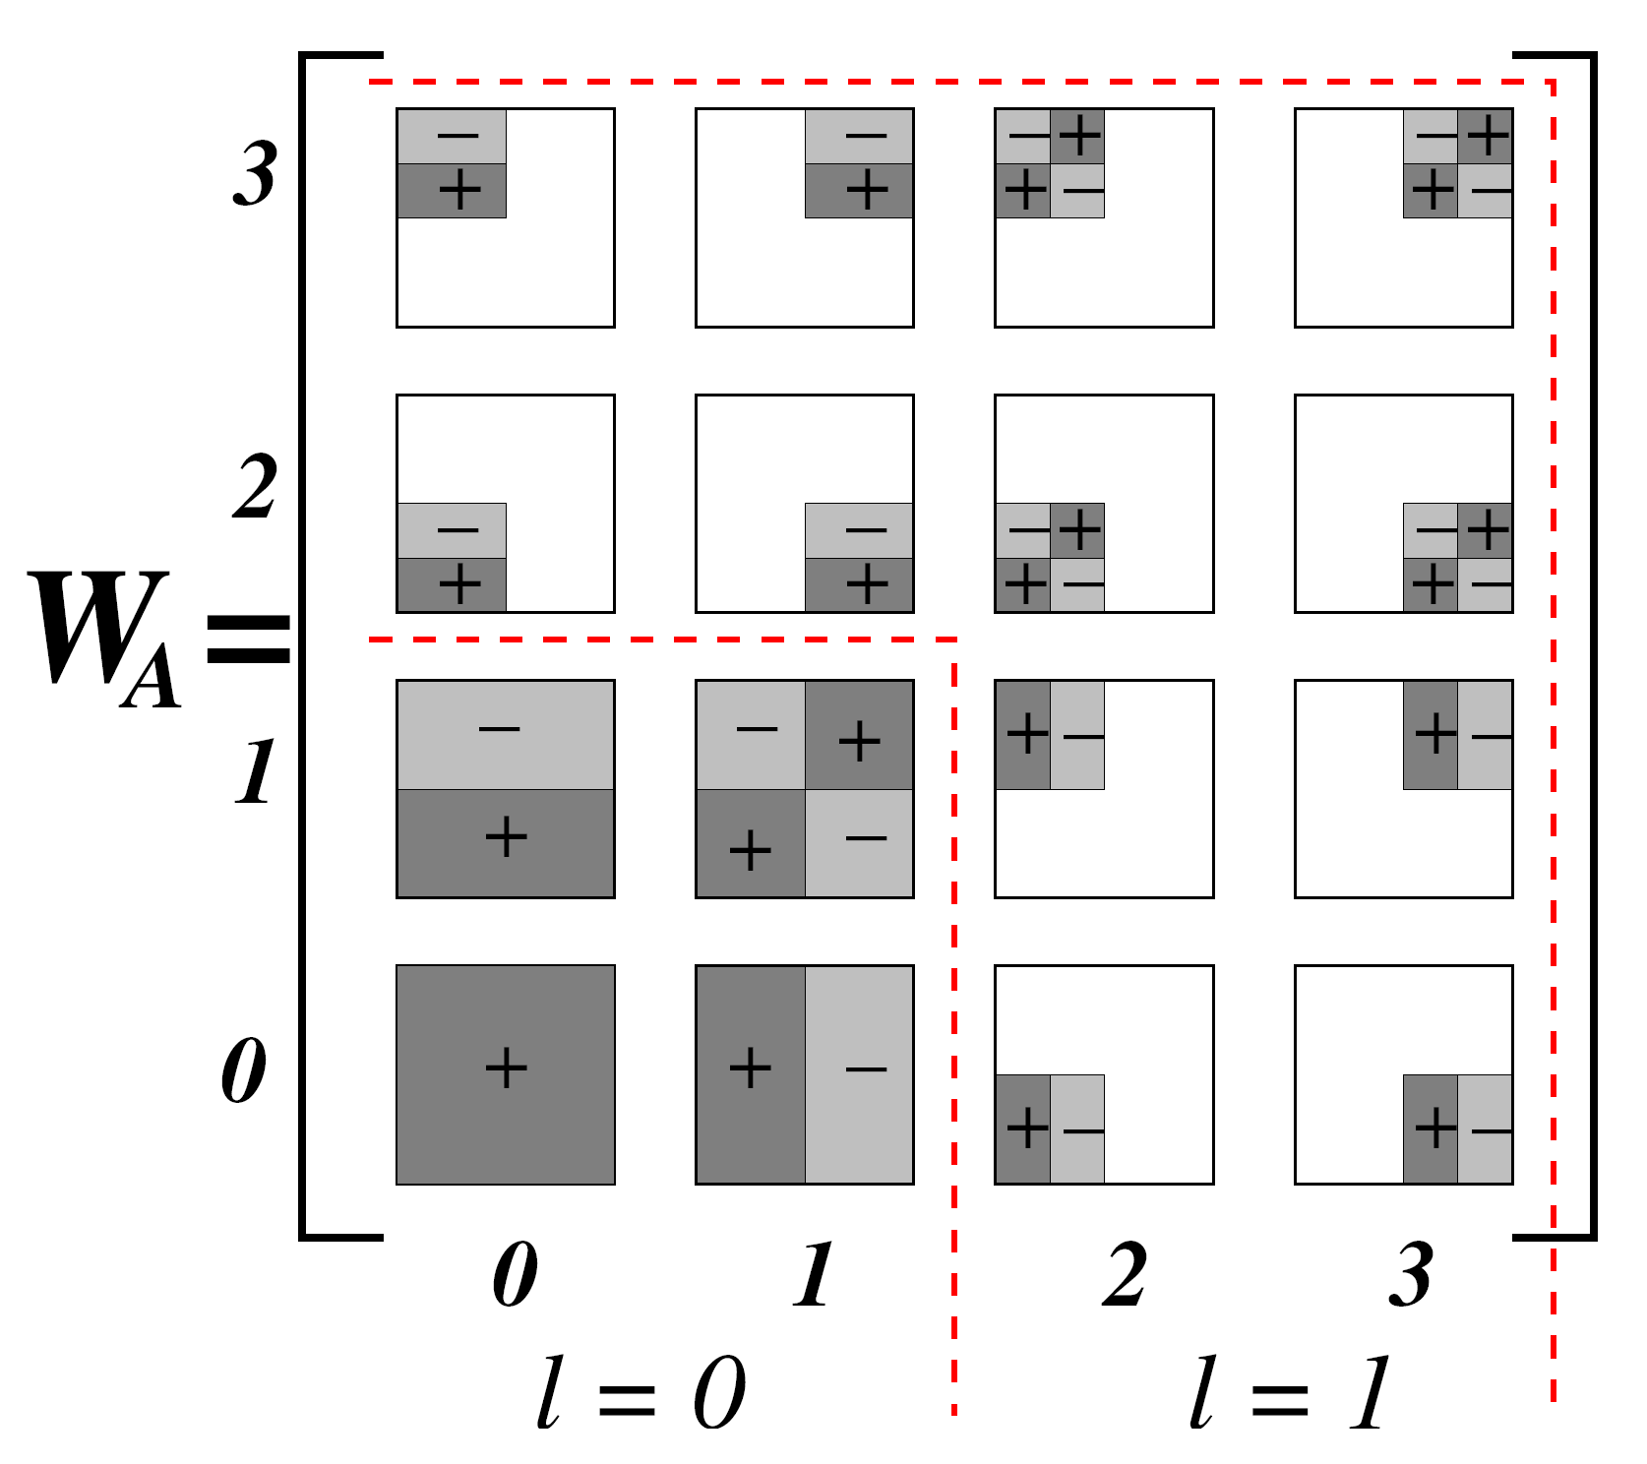
Multiple Dimensions
Decomposition extends naturally to multiple dimensions
Each subtree helps reconstruct data in sub-cube
  Error tree nodes have 2^{D} children
Each node contains up to 2^{D}-1 coefficients
  Signed combinations of 2^{D} averages
+
-
+
-
+
-
+
-
+
-
+
-
-
-
+
-
-
-
+
-
+
-
+
+
+
-
+
+
+
-
+
+
-
-
+
-
+
-
+
-
+

Slide 27
Conventional Wavelet Data Synopses
Conventional thresholding: Take B largest coefficients in absolute normalized value
  Normalized Haar basis: divide coefficients at resolution j by
    Gives appropriate weight to coefficients that reconstruct many data values
  All other coefficients are ignored (assumed to be zero)
  Provably optimal in terms of the overall Sum-Squared (L2) Error
Unfortunately, this methodology gives no meaningful approximation-quality guarantees for
  Individual reconstructed data values
  Individual range-sum query results

Slide 28
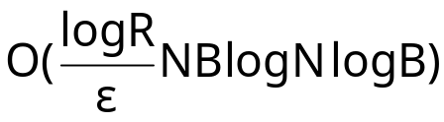
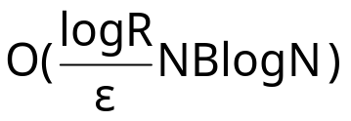
Earlier Approach (2): Deterministic Wavelet Thresholding for Maximum Relative Error [GK04]
Dynamic programming formulation for optimally deciding coefficients to maintain
O(N²BlogB) time, O(N²B) total space, O(NB) in-memory space
Complexity increases rapidly for multi-dimensional data
Sparse DP formulation for ε-additive error guarantee
  Solution within εR/s from optimal maximum relative error
    R is maximum absolute value of a coefficient
  running time
  space
Even approximation algorithm exhibits large NB dependency

Slide 29
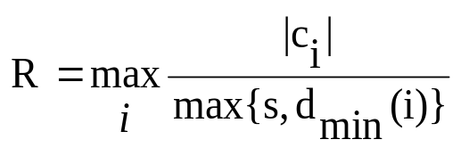
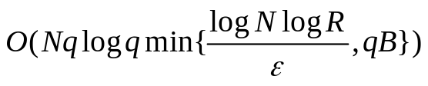
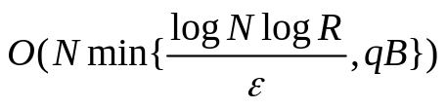
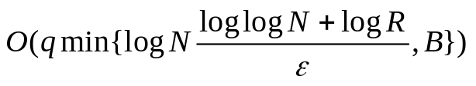
Complexities
Important to derive complexities: # breakpoints at node of level j: min{qB, log_{(1+ε)}(j+1)R²}
  maximum coefficient normalized value
 | ε-ApproxRv | MinRelVar | MinMaxErr
Running Time |  | O(Nq²B log(qB)) | O(N²BlogB)
Space |  | O(NqB) | O(N²B)
Working Set |  | O(qB log N) | O(NB)
Improvements even for exact solution (ε = 0)

Slide 30
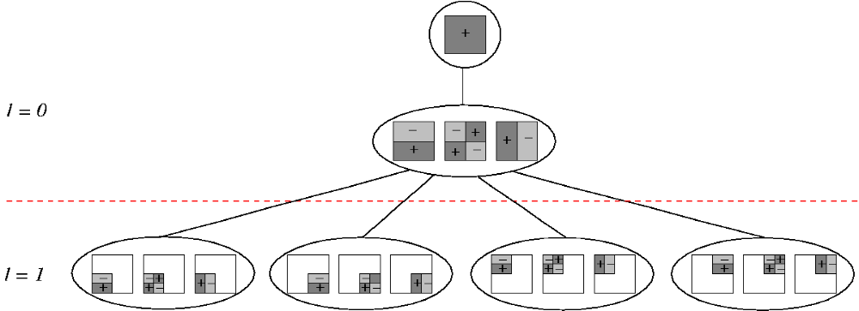
Multi-dimensional Haar Error Trees
Conceptual tool for data reconstruction – more complex structure than in the 1-dimensional case
  Internal node = Set of (up to) 2^{d}-1 coefficients (identical support regions, different quadrant signs)
  Each internal node can have (up to) 2^{d} children (corresponding to the quadrants of the node’s support)
Maintains linearity of reconstruction for data values/range sums
Error-tree structure for 2-dimensional
4X4 example (data values omitted)

Slide 31
Inductive Step: Internal Nodes
v
u
w
Let l_{u}, l_{w} denote sorted list of children breakpoints
Compute breakpoints at v using l_{u}, l_{w}
∀ fractional space assignment y = 0,1/q,…,min{1,B} to v
  Add node variance leftVar = Var(v,y) / Norm(u) to l_{u} values. Let L_{u} denote the new sorted list (similarly, L_{w} for right subtree)
  L = merge(L_{u}, L_{w})
    Sorted list on M’[v,x], breakpoints from both subtrees
  M[] values at v determined by subtree with maximum NSE
  ∀a_{i}∈L_{u}, consider only rightmost b_{k} ∈ L_{w} value to its left in L
    Smaller values require more space, do not decrease M[]
  ∀a_{i}∈L_{u}, consider only leftmost b_{k} ∈ L_{w} value to its right in L
  |l_{u} |+|l_{w}| breakpoints in total
Space of breakpoints decreases
M[u,x] values increase
a_{i+1} a_{i} a_{i-1} a₂ a₁
l_{u}
add leftVar,
rightVar
l_{w}
b_{k+1}b_{k} b_{k-1} b₁
L_{u}
L_{w}
b_{k} a_{i}
L
Useless breakpoints
M[v, a_{i}+b_{k}+y] determined by subtree of a_{i} (u)

Slide 32
Complexities
Important to derive complexities: # breakpoints at node of level j: min{qB, log_{(1+ε)}(j+1)R²}
  maximum coefficient normalized value
 | ε-ApproxRv | MinRelVar
Running Time |  | O(q²NB log(qB))
Space |  | O(qNB)
Working Set |  | O(qB log N)
Improvements even for exact solution (ε = 0)

Slide 33
Complexities
Maximum coefficient normalized value
 | ε-ApproxRv | MinRelVar
Running Time |  | O(q²NB log(qB))
Space |  | O(qNB)
Working Set |  | O(qB log N)
Improvements even for exact solution (ε = 0)

