Slide 1
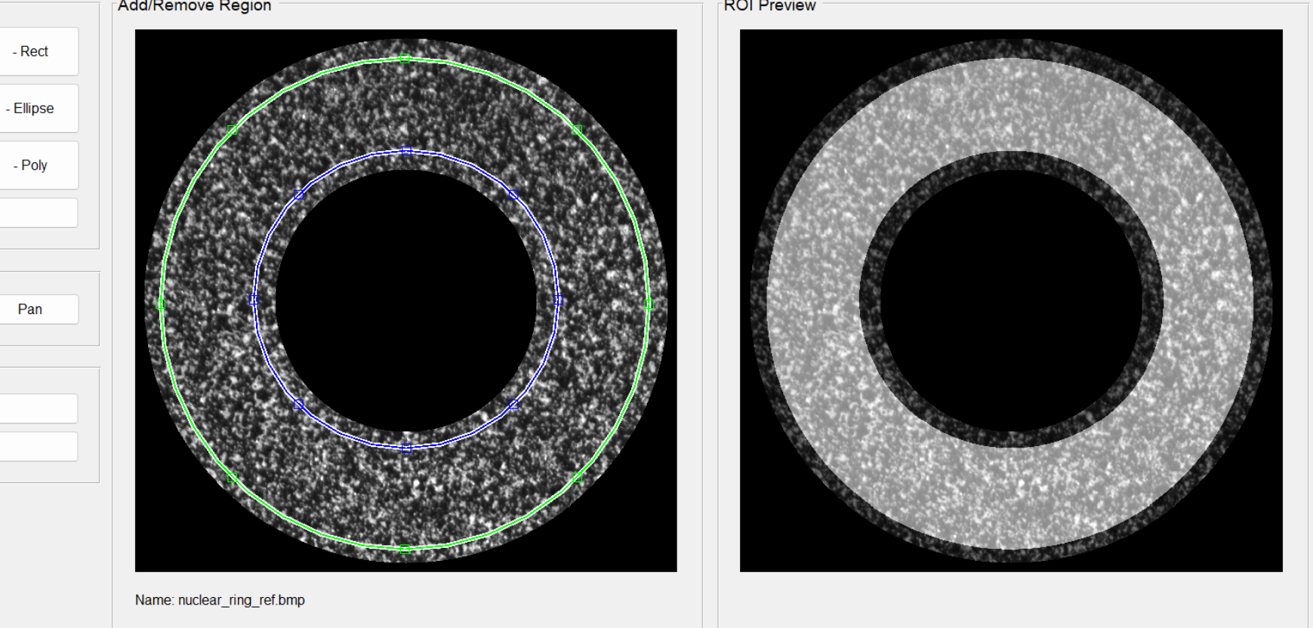
Subset-DIC: Ncorr

Slide 2
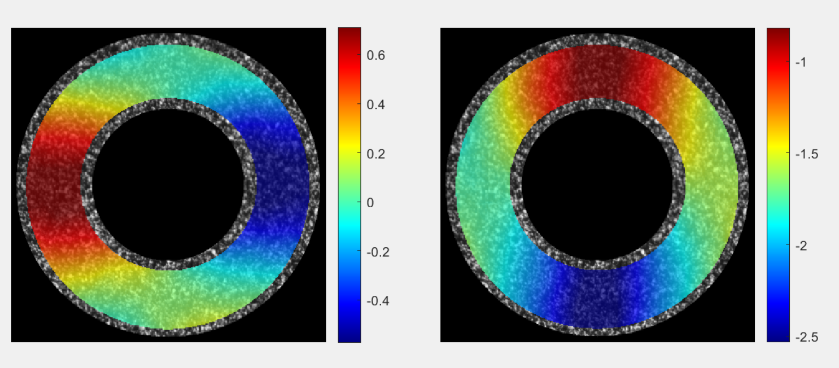
Subset-DIC: Ncorr

Slide 3

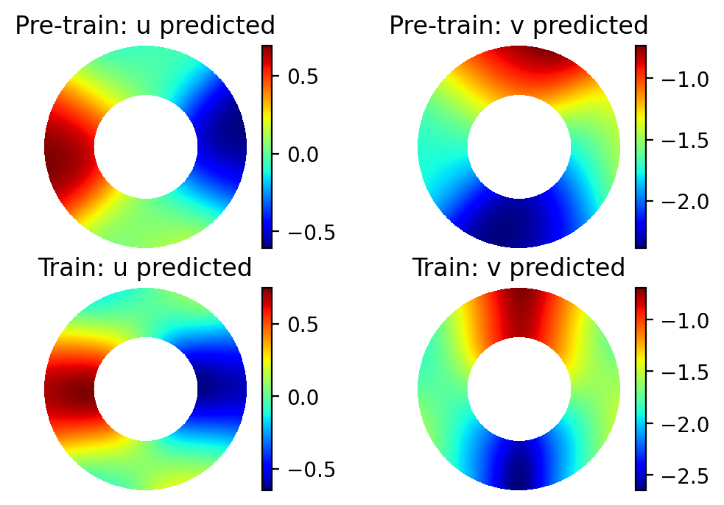
PINN-bDIC

