Slide 1


Semi-supervised learning and multi-target prediction Hands On
Jurica Levatić Institute for Research in Biomedicine, Barcelona, Spain
Assistant: Matej Mihelčić Ruđer Bošković Institute, Zagreb, Croatia
September 26th, 2018
SSDS 2018, Split

Slide 2


CLUS
Decision tree and rule induction software that implements the predictive clustering framework
Tasks: (hierarchical) multi-label classification, (hierarchical) multi-target regression, network regression, time-series prediction, ...
Supports: ensemble learning, feature ranking, supervised, unsupervised and semi-supervised learning
Available at: source.ijs.si/ktclus/clus-public (executable, no source)
sourceforge.net/projects/clus/ (source, old version)

Slide 3
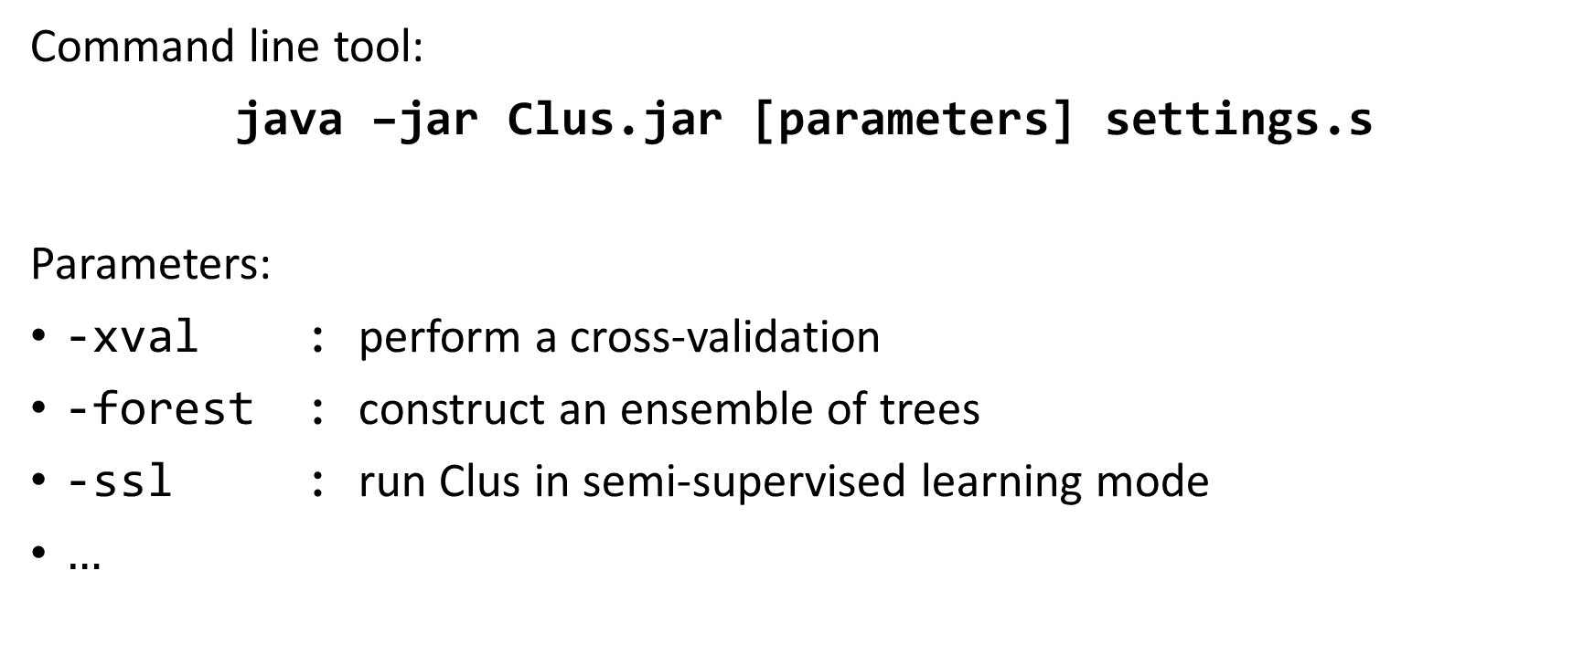
CLUS
Command line tool:
java –jar Clus.jar [parameters] settings.s
Parameters:
-xval : perform a cross-validation
-forest : construct an ensemble of trees
-ssl : run Clus in semi-supervised learning mode
$…$

Slide 4
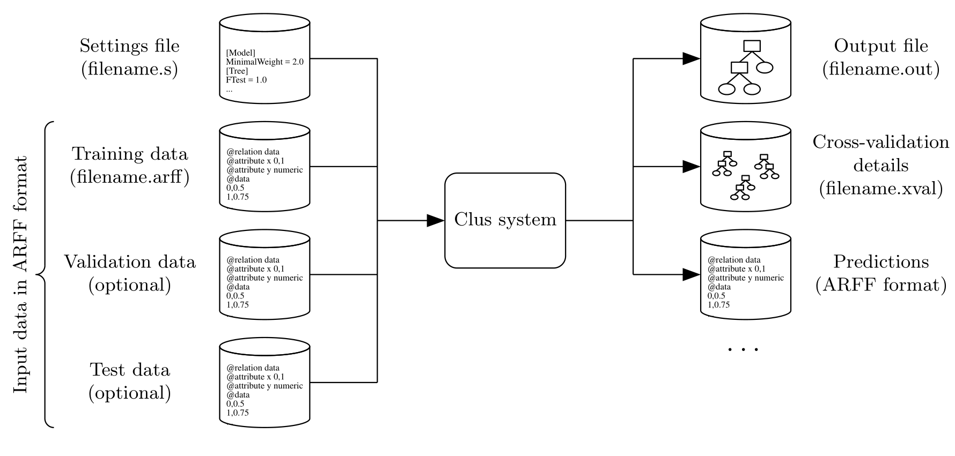
CLUS

Slide 5
Settings (.s) file
[Data] % section header
File = weather.arff % training data
XVal = 10 % number of folds in cross-validation
[Attributes]
Key = 1 % ID attribute of examples, not used for learning
Target = 3-4 % the attributes for which the predictions are made
Descriptive = 1-2 % used to construct the tests in the nodes of the tree
Disable = 2 % disable an attribute (it will not be used for learning)
[Model]
MinimalWeight = 10 % minimal number of examples allowed in a tree node
[Tree]
PruningMethod = C4.5 % the post-pruning method for trees
* For list of all options and section headers, see CLUS manual (clus-manual.pdf)

Slide 6
.arff file format
@RELATION name
@ATTRIBUTE name domain
@ATTRIBUTE name domain
...
@DATA
value₁, value₂, ..., value_{n}
value₁, value₂, ..., value_{n}
...
Domain can be:
numeric
{nomvalue₁, ..., nomvalue_{n}}
string (only Key att.)
hierarchical (only Target att.)
timeseries (only Target att.)

Slide 7
Example 1: Build a multi-target decision tree
Task: Multi-label classification
Data: water-quality.arff
1060 examples
16 Descriptive attributes (numeric)
14 Target ({0, 1}, nominal)
Description: Prediction of water organisms that live in the water of Slovenian rivers¹. The data was collected during six years (1990 to 1995) of water monitoring Environmental Agency of Slovenia. Multiple labels correspond to different species of the organisms.
¹ Džeroski et al. (2000) Applied Intelligence

Slide 8
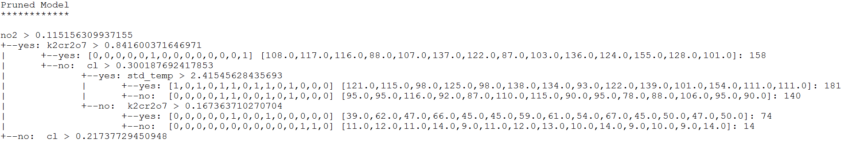
Output: Tree for multi-label classification
Number of examples with a label (i.e., majority class) to the corresponding prototype label
Split on a descriptive attribute
Leaf prototype (labels predicted for examples in that leaf)
Number of examples in a leaf
if(NO₂ > 0.115 AND K₂Cr₂O₇ > 0.842) then Bacillariophyta Nitzschia palea AND
Oligochaeta Tubifex sp.

Slide 9
Exercise 1
Data: water-quality.arff
Estimate the performance with 5-fold cross validation.
Do we get better performance with pruned or original tree?
Build „reasonably” large tree for interpretation (max 20 nodes)

Slide 10
Exercise 1
Data: water-quality.arff
Estimate the performance with 5-fold cross validation.
Do we get better performance with pruned or original tree?
Build „reasonably” large tree for interpretation (max 20 nodes)
java –jar ../Clus.jar -xval water-quality.s
[Data]
File = ../Data/water-quality.arff
XVal = 5
[Attributes]
Target = 17-30
[Model]
MinimalWeight = 15
[Data]
File = ../Data/water-quality.arff
XVal = 5
[Attributes]
Target = 17-30
[Tree] [Constraints]
PruningMethod = Garofalakis MaxSize = 20
Solution A
Solution B

Slide 11
Example 2: Multi-target regression
Data: water-quality-MTR.arff
Description: Same dataset as before, but instead of presence of species, their abundance is recorded.

Slide 12
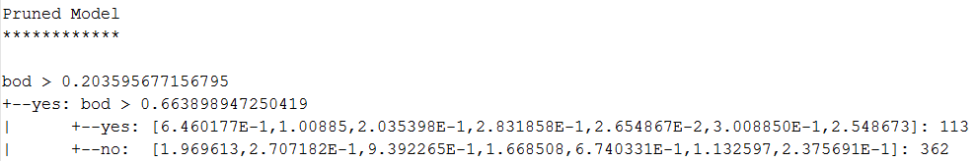
Example 2: Multi-target regression
Data: water-quality-MTR.arff
Description: Same dataset as before, but instead presence of species, their abundance is recorded.
Split on a descriptive attribute
Number of examples in a leaf
Leaf prototype
(average of target attributes of examples in a leaf)

Slide 13
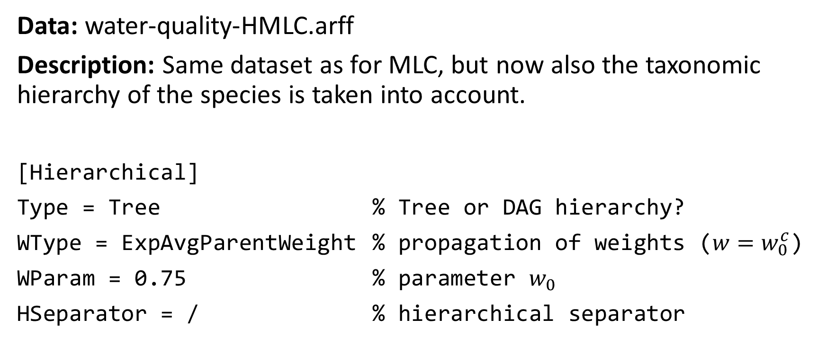
Example 3: Hierarchical multi-label classification
Data: water-quality-HMLC.arff
Description: Same dataset as for MLC, but now also the taxonomic hierarchy of the species is taken into account.
[Hierarchical]
Type = Tree % Tree or DAG hierarchy?
WType = ExpAvgParentWeight % propagation of weights ($w=w_{0}^{c}$)
WParam = 0.75 % parameter $w_{0}$
HSeparator = / % hierarchical separator

Slide 14
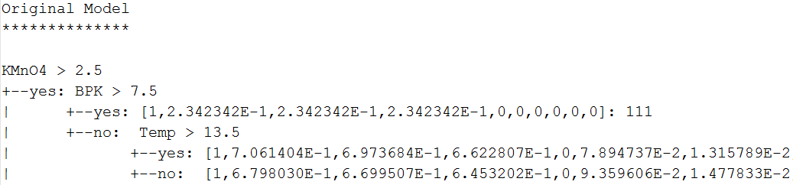
Example 3: Hierarchical multi-label classification
Data: water-quality-HMLC.arff
Description: Same dataset as for MLC, but now also the taxonomic hierarchy of the species is taken into account.
Number of examples in a leaf
Split on a descriptive attribute
Empirical probabilities (proportion of examples with a given label, as they are listed in the hierarchy)

Slide 15
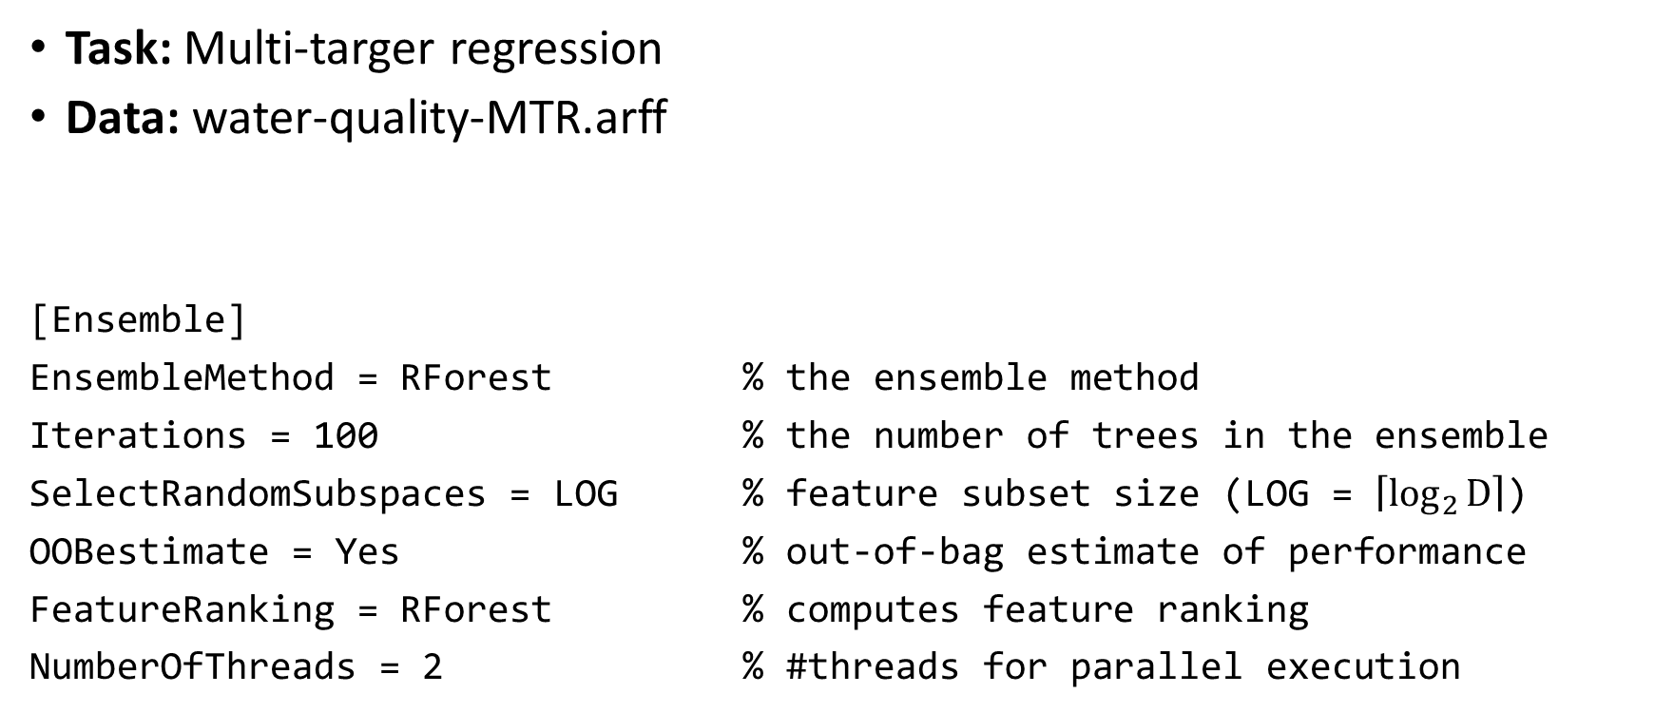
Example 4: Multi-target ensembles
Task: Multi-targer regression
Data: water-quality-MTR.arff
[Ensemble]
EnsembleMethod = RForest % the ensemble method
Iterations = 100 % the number of trees in the ensemble
SelectRandomSubspaces = LOG % feature subset size (LOG = $\left\lceil \log_{2}{D}\right\rceil$)
OOBestimate = Yes % out-of-bag estimate of performance
FeatureRanking = RForest % computes feature ranking
NumberOfThreads = 2 % #threads for parallel execution
java –jar Clus.jar –forest settings.s

Slide 16
Exercise 2
Verify which of the descriptive features are important for the predictive performance (RMSE)
Can we remove some features without the decrease in the predictive performance (RMSE)?

Slide 17
Example 5: Semi-supervised PCTs
Task: Multi-label classification
Data: genbase-Labeled.arff, genbase-Unlabeled.arff, genbase-Test.arff
Description: On the basis of structural motifs, classify proteins into several important protein families¹.
[SemiSupervised]
SemiSupervisedMethod = PCT % semi-supervised PCTs
UnlabeledData = file.arff % alternatively can be given in training file
InternalFolds = 5 % the numer of folds for tuning of w parameter
PossibleWeights = [0, 0.1, ...,1] % values of w to consider for tuning
[Tree]
Heuristic = VarianceReduction % for SSL-PCTs, set to VarianceReduction!
java –jar Clus.jar –ssl settings.s
¹ Diplaris et al. (2005) LNCS

Slide 18
Exercise 3
Compare the performance using pooledAUPRC on a given Test set:
supervised vs. semi-supervised predictive clustering trees (unpruned)
supervised vs. semi-supervised Random Forest ensembles with 100 trees

Slide 19
Exercise 3
Compare the performance using pooledAUPRC on a given Test set:
supervised vs. semi-supervised predictive clustering trees (unpruned)
supervised vs. semi-supervised Random Forest ensembles with 100 trees
pooledAUPRC
Supervised PCTs: java –jar Clus.jar genbase.s
0.907
Semi-supervised PCTs: java –jar Clus.jar -ssl genbase.s
0.915
Supervised RF: java –jar Clus.jar -forest genbase.s
0.870
Semi-supervised RF: java –jar Clus.jar –ssl -forest genbase.s
0.938
Add [Ensemble] settings!

Slide 20
Exercise 3
Compare the performance using pooledAUPRC on a given Test set:
supervised vs. semi-supervised predictive clustering trees (unpruned)
supervised vs. semi-supervised Random Forest ensembles with 100 trees
pooledAUPRC
Supervised PCTs: java –jar Clus.jar genbase.s
0.907
RF performs worse than PCT?!
Semi-supervised PCTs: java –jar Clus.jar -ssl genbase.s
0.915
Supervised RF: java –jar Clus.jar -forest genbase.s
0.870
Semi-supervised RF: java –jar Clus.jar –ssl -forest genbase.s
0.938
Add [Ensemble] settings!

Slide 21
Why RF performs worse than PCT?
If most of the features are uninformative, the performance of Random Forest can suffer!
Solutions:
A Increase SelectRandomSubspaces (e.g., ¼)
(or use Bagging -> slower)
B Feature selection (remove bad features)

Slide 22
Example 6: Self-training
Task: Multi-label classification
Data: genbase-Labeled.arff, genbase-Unlabeled.arff, genbase-Test.arff
java –jar Clus.jar –ssl -forest settings.s
[SemiSupervised]
SemiSupervisedMethod = SelfTraining | % | semi-supervised method
UnlabeledData = file.arff | % | unlabeled data
ConfidenceMeasure = ClassesProbabilities | % | confidence metric
UnlabeledCriteria = KMostConfident K = 50 | % | criteria for selection of unlabeled examples
StoppingCriteria = Airbag | % | „smart” stopping criteria
[Ensemble] OOBestimate = Yes | % | nedded for Airbag&AutomaticOOB

Slide 23
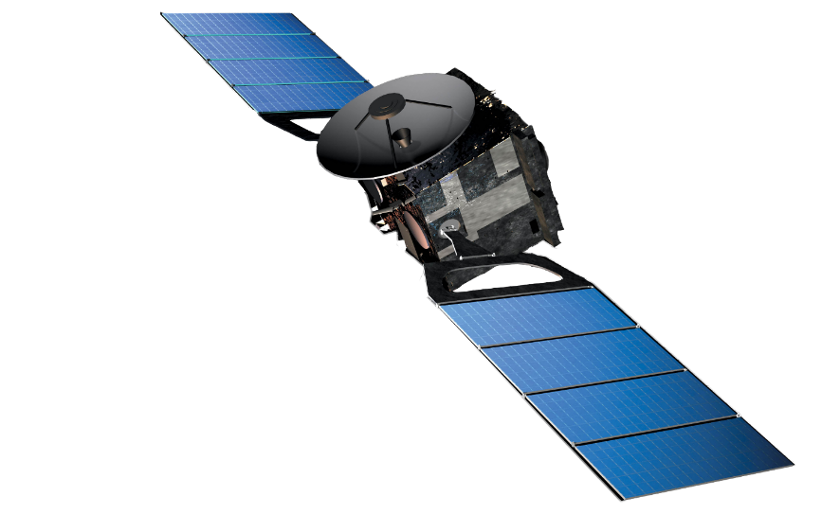

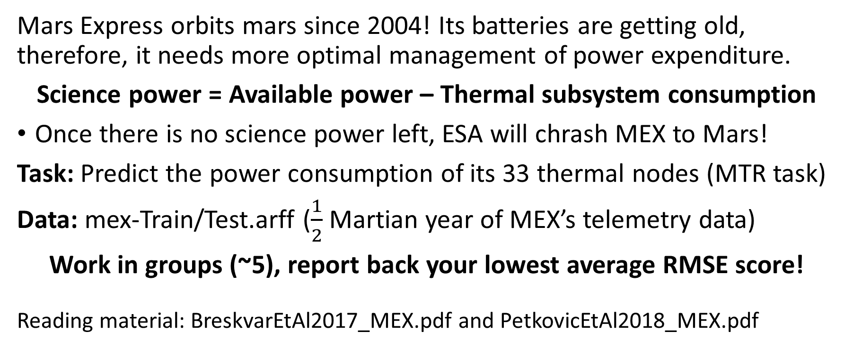
Homework: Save the MEX satellite!
Mars Express orbits mars since 2004! Its batteries are getting old, therefore, it needs more optimal management of power expenditure.
Science power = Available power – Thermal subsystem consumption
Once there is no science power left, ESA will chrash MEX to Mars!
Task: Predict the power consumption of its 33 thermal nodes (MTR task)
Data: mex-Train/Test.arff ($\frac{1}{2}$ Martian year of MEX’s telemetry data)
Work in groups (~5), report back your lowest average RMSE score!
Reading material: BreskvarEtAl2017_MEX.pdf and PetkovicEtAl2018_MEX.pdf

Slide 24
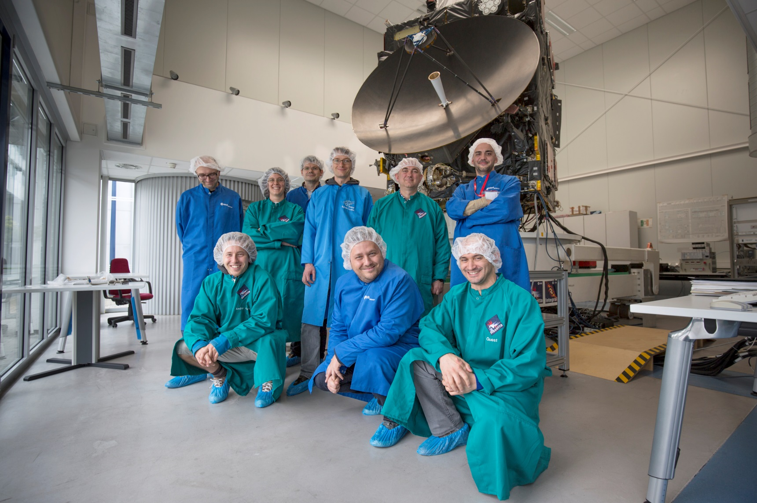
CLUS won ESA‘s Marx Express Power Challenge!

Slide 25
Summary
CLUS - tree and rule induction for:
multi-target regression
(hierarchical) multi-label classification
Supervised, unsupervised and semi-supervised learning
and much more….
Alternative softwares (multi-label classification only):
MULAN (mulan.sourceforge.net/)
MEKA (waikato.github.io/meka/)
scikit-learn (scikit-learn.org)

