Slide 1

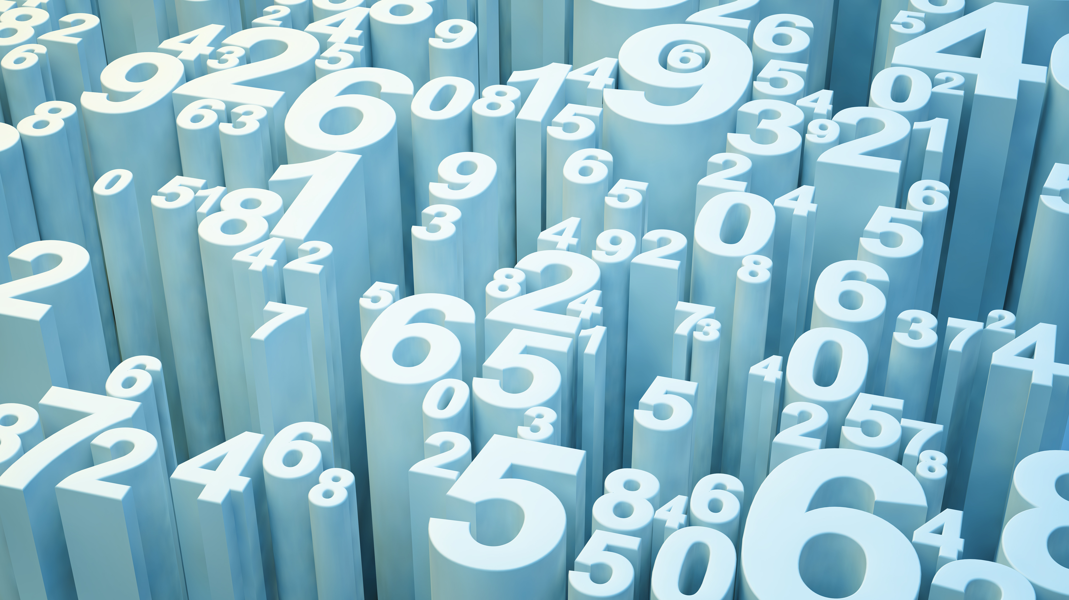
On Mechanical Program Verification
Robert Shostak
Menlo College
5-27-25

Slide 2
Infamous Consequences of Buggy Code
1945 -- Moth gets caught between relay contacts in a Harvard Mark II computer at the Smithsonian – said to be first bug!
1985 – Therac-25 medical radiation machine kills 5 people owing to race condition
1994 – Bug in floating point package produces errors, estimated cost- $475M
1995 – Ariane-5 rocket self-destructs owing to UI interface failure – backup failed - $400M payload bytes the dust.
2001 – “Code Red” worm in Microsoft web server IIS. Estimated hosts infected per day: 359,000

Slide 3
What do we mean by “correct”?
Roughly speaking, correctness in this context means that a program conforms to a formal specification that defines the set of valid inputs and the functional relationship between each such input and its corresponding output.
This definition implicitly demands that the computation of the output for a given input (eventually) terminates, for every valid input.

Slide 4
Program Verification
Specification
Verifier
Correct or Incorrect or
“Can’t Decide”
Program
The specification is formulated as a statement in an axiomatic system of logic, such as first-order logic, and the verification process aims to result in a proof of that statement.
However, in general, verification is undecidable so not always guaranteed to work!

Slide 5
Propositional Logic
Expressions in propositional logic are built from:
Letter variables (also called propositions) such as P, Q, and R
The logical operators ∧ (And), ∨ (Or), -> (If .. then..), ↔ (If and only if), and ¬ (Not)
Note that the English equivalents above are not always exact. For example, consider the two English
statements:
If Trump was president in 2024, then the president in 2024 was a Republican.
If Harris was president in 2024, then the president in 2024 was a Republican.
Now most people would consider (1) to be true and (2) to be false, but since the premise of (2) is false,
the truth table entry for -> will be true irrespective of the truth of the Then clause.

Slide 6
First-Order Logic (also called Predicate Calculus)
Here’s the recipe:
Start with Propositional Logic
Add predicates that may take arguments - e.g., P(x, y)
Add quantifiers: ∀ (for all) and ∃ (there exists)
Now we’re really cooking, because the quantifiers and predicates with arguments greatly enhance the expressive power of the language, especially if we also allow function symbols and interpreted predicate and function symbols.
For example, we might introduce the predicate LessThan(x, y) or x < y for short, and the function symbol Plus(x, y), or x + y for short. Now we can write formulas involving operations that appear in programs, even though unlike Propositional Logic, Predicate Calculus is undecidable.
.

Slide 7
The Hoare Logic Method of Verification
Invented by Charles Anthony Richard (C. A. R.) Hoare in 1969, inspired by Bob Floyd
Underlies many methods of verification
Used for proving partial correctness only – i.e., termination must be proved separately
Method is based on the Hoare Triple, which is of the form:
{Precondition} Program Fragment {Postcondition}
where Precondition, and Postcondition are predicates on the variables of the program. The meaning of the triple is that if the Precondition holds and the program fragment is then executed, then the Postcondition will hold as well.

Slide 8
Hoare Triple Example
{ x > 0 } while (x != 0) x = x-1; { x == 0 }
Here, x is assumed to be an integer program variable. If x were assumed to be a floating point number instead, the code fragment would never terminate on some inputs.
It’s notable that variables in early verification systems were usually untyped. Modern systems, such as SRI’s PVS and the Rocaq system developed at INRIA in France don’t have this deficiency, and PVS even allows you to define subtypes that are very useful for treating corner cases.

Slide 9
Hoare Logic
Hoare defined a set of axioms and inference rules for a simple programming language
These axioms and rules are cast using Hoare triples that define the semantics of the statements in the language
Example: The assignment axiom triple { P[x =: e] } x := e { P } formally defines the meaning of the assignment statement. Here, P is an arbitrary expression in Hoare Logic, and P[x =: e] denotes the substitution of e for every occurrence of x in P.
As another example, the composition rule looks like this:
{P} C1 {R} {R} C2 {Q}
_____________________
{P} C1; C2 {Q}
This one simply means that if P, R, and Q are arbitrary predicates, C1, C2 statements, and {P} C1 {R} and {R} C2 {Q} both hold, then {P} C1; C2 {Q) must also hold.

Slide 10
Hoare Logic (Continued)
Exercise: Use the two rules to prove the correctness of:
{true} x:=0; x:=x + 1; {x = 1}
(Answer provided by Sorav Bansal in his video at youtube.com/watch?v=RXmaFcKBYrc)

Slide 11
Practical Verification Systems
In practical verification systems, the user doesn’t have to manually apply axioms or rules.
All that’s usually required are the input assertion, output assertion, and assertions for each loop or recursive call within the code. The verifier system knows how to “push” the input assertions over the straight-line paths through the code, and the paths around the loops, thus creating a new assertion at each step. If the code branches (as in the case of a conditional statement) then all such branches must be followed recursively.
During this process, if a loop or output assertion is encountered, it creates a formula A -> B, where A is the current pushed assertion for the path, and B is the loop or output assertion encountered.
The formula A -> B is then passed to a theorem prover, which may be interactive. In the case of a loop assertion, mathematical induction is often used.

Slide 12
Resolution Theorem Proving
Developed by John A. Robinson (1965)
Likely the first prover method used for program verification, partly because it worked on formulas without existential quantifiers.
Works for formulas in propositional calculus as well as first-order formulas having predicates with variables and function symbols.
Produces a refutation of a formula, i.e., works on the negation of the formula, represented as the conjunction of “clauses” which themselves consist of a disjunction of predicates, and shows that representation to be unsatisfiable (if it indeed was).

Slide 13
Troubles
Resolution theorem proving operated at the syntactic level
First-order predicate calculus alone wasn’t sufficiently expressive to model real problems
Verification assertions arising from the Hoare method were loaded with interpreted predicates and functions such as arithmetic operators that couldn’t easily be dealt with
Combinatorial explosion was a real problem – especially with the computing power of the early ’80’s machines
It was obvious that more “smarts” about the problem domain had to built into the process

Slide 14
Decision Procedures
Mojzesz Presburger had shown that a first-order theory of natural numbers with addition was actually decidable as early as 1929 using a quantifier elimination technique
Presburger arithmetic offered hope that semantic smarts could be built into theorem provers
In the 80’s we saw a flurry of work on decision procedures for various classes of formulas.
As the verification conditions typically did not need existential quantifiers, these procedures, like resolution, were mainly for formulas with only universal quantification

Slide 15
Work on Decision Procedures
Reasoning about expressions involving natural or rational numbers
(W. Bledsoe, K. Kunen, R. Shostak)
Reasoning about Hierarchical Deduction
(T. Wang, W. Bledsoe)
Reasoning about combined theories
(D. Oppen, N. Shankar, H. Ruess, R. Shostak)
Reasoning about equality
(R. Shostak)

Slide 16
Evolution of Program Verification Systems
Over the years, verification systems have matured very substantially
Old systems that ran on ‘70s era computers were fighting the combinatorial explosions encountered while proving results modeled in low-level theories such as first-order logic
It soon became clear that first-order logic was not expressive enough to allow the modeling of complex or real-world problems in a tractable way, let alone proving properties of them
All this has prompted an international effort to develop high-order typed logic-based practical verification systems, such as the PVS system at SRI and Rocq (formerly Coq) at INRIA, France

Slide 17
The PVS Specification & Proof System
Authored my S. Owre, N. Shankar, J. Rushby, and others at SRI
Started development ~1993
Many useful and interesting features:
Modeling Features | Prover Features
Recursive Data Types | Several Decision Procedures
Inductive and Recursive Definitions | Automatic Simplification
Theory Interpretations | Term Rewriting
Predicate Subtypes (!!) | Induction
Judgments | Model Checking

Slide 18
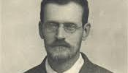
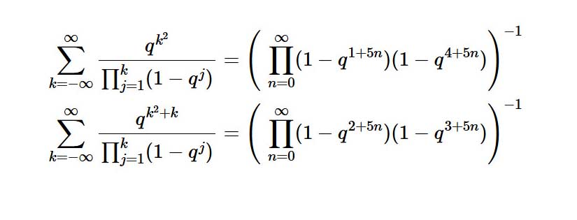

One of the Most Impressive Proofs Yet
The Rogers-Ramanujan Identities for Integer Partitions
Leonard Rogers
1832-1933
Srinivasa Ramanujan
1887-1920

Slide 19

Srinivasan Ramanujan Facts
ஈரோடு
ஈரோடு
Born in December, 1887 in Erode, Tamil Nadu
Regarded as one of the greatest mathematicians of all time
Had almost no formal training in mathematics
Solved many math problems considered unsolvable
Began an email exchange with G. H. Hardy of
U. of Cambridge starting in 1913
Set sail to Cambridge to work with Hardy in 1914
Passed away in 2020
Had almost 4,000 original results to his credit
Murugan Temple,
Erode

