Slide 1


PREDICTIVE MODELING
Ulya Bayram
PhD student
Electrical and Computer Engineering
University of Miami
Supervisor: Prof. Eric Rozier

Slide 2
Overview:
2 main research topics:
  Labor contraction prediction
  User disk usage behavior modeling for reliable systems

Slide 3
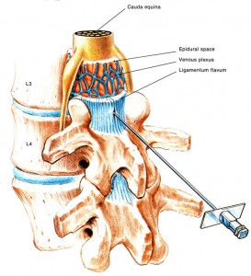
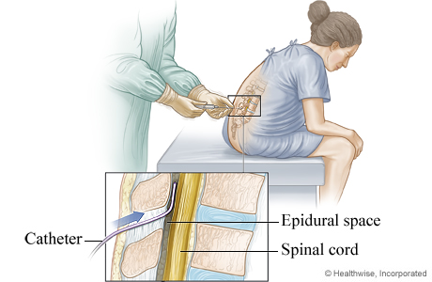

Contraction Prediction
Why?
http://babaklix.com/cute-newborn-baby-pictures/cute-newborn-baby-pictures3/
http://img.webmd.com/dtmcms/live/webmd/consumer_assets/site_images/media/medical/hw/h9991523_001.jpg
http://www.e-steroid.com/wp-content/uploads/2009/06/adverse-reaction-of-epidural-steroid-injections-273x300.jpg
Notes:
What is epudural? How dangerous can it be?

Slide 4
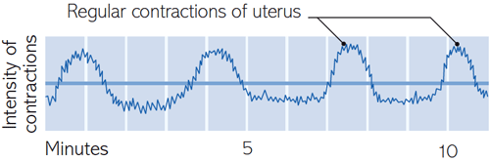
Contractions
http://womenworld.org/image/062012/1st%20Stage%20of%20Labor_18.jpg

Slide 5
Features:
  Number of peaks within 10 minutes
  Duration of a contraction
  Range of contractions (min & max peak values)
  Average fetal heart rate that is stable during 2 minutes
  Duration between two contractions
  …

Slide 6
Prediction:
  Feature elimination, search for more features, application of smart heuristics, cueology
  Building classifiers, e.g. Kalman filters, or basins of attraction
  HMMs, Baum-Welch or the Viterbi algorithm for path determination using the forwards/backwards approach

Slide 7
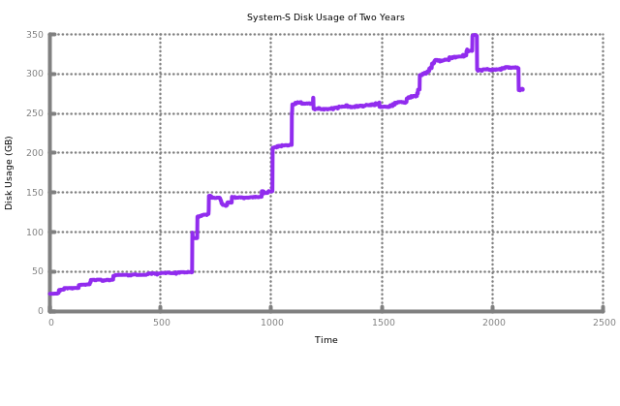
Reliable Systems-User Behavior Modeling
Why?
  Problem of looking for cues of what a user will do next!
Notes:
System admins decide on storage amount, too less and too much is a problem

Slide 8
Points:
    Under-prediction
    Over-prediction
    More space we have, more reliable the system can become

Slide 9
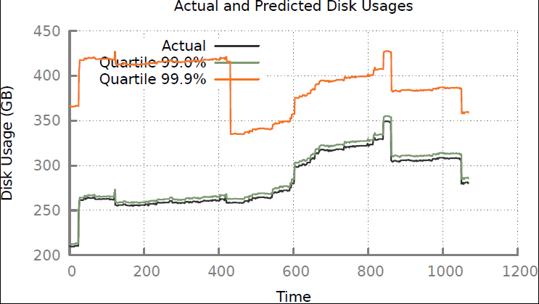
    Why not use a not-intelligent/simple method?

Slide 10
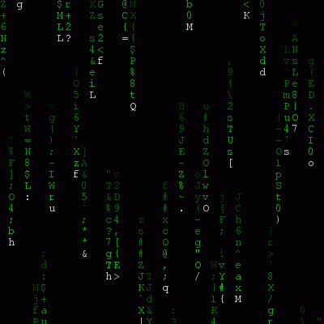
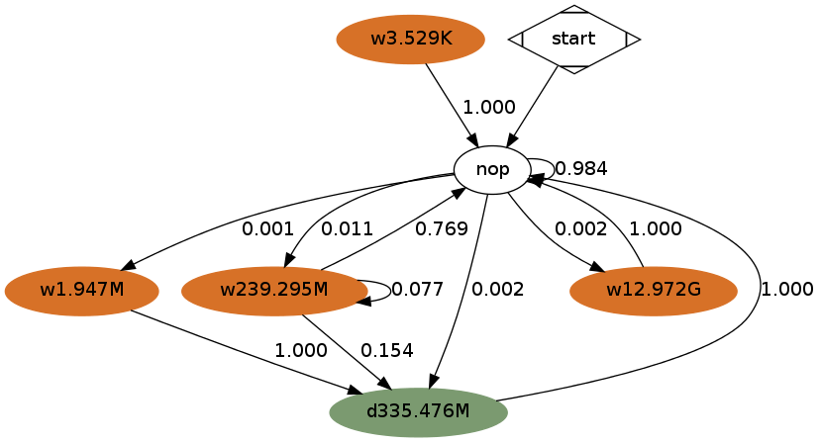

HMMs
  How to create HMMs?
  Which clustering method is the best? Is there a difference in performance (run-time predictions etc.)?
  YES!
Notes:
As in matrix movie: symbol sequences were describing matrix world, our symbol sequences describe user behavior

Slide 11
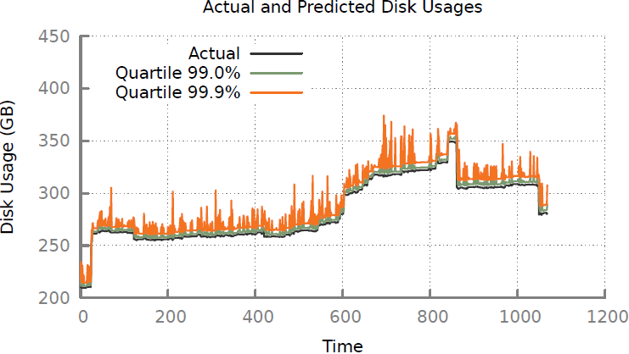
K-means

Slide 12
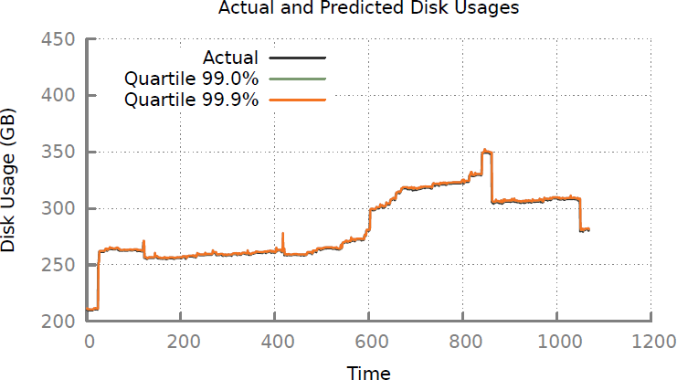
Mean-shift

Slide 13
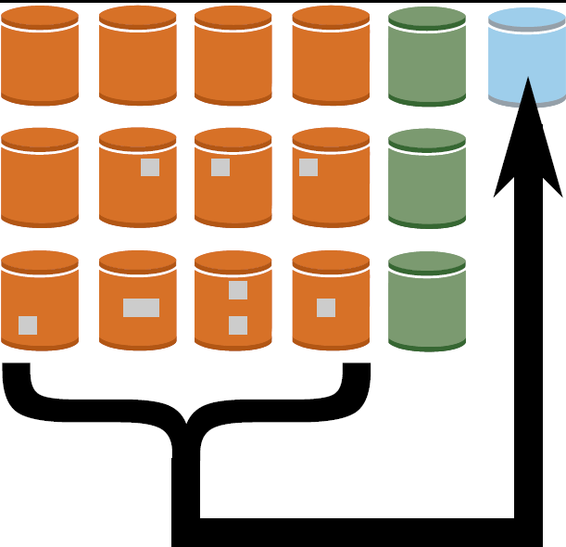
What are we going to do with the excess space?

Slide 14
Paper submitted to SRDS 2014
Ulya Bayram, Eric Rozier, Pin Zhou, and Dwight Divine, “An appendix to Overbooking for Reliability in Smart Software Defined Data Centers”, SRDS 2014.
For more details, experiments:
Website:
http://dataengineering.org/research/SSDDC/

Slide 15


