Slide 1
Abstraction, Decomposition, Relevance Coming to Grips with Complexity in Verification
Ken McMillan
Microsoft Research
TexPoint fonts used in EMF: AAAAA

Slide 2
Need for Formal Methods that Scale
We design complex computing systems by debugging
Design something approximately correct
Fix it where it breaks (repeat)
As a result, the primary task of design is actually verification
Verification consumes majority of resources in chip design
Cost of small errors is huge ($500M for one error in 1990’s)
Security vulnerabilities have enormous economic cost
The ugly truth: we don’t know how to design correct systems
Correct design is one of the grand challenges of computing
Verification by logical proof seems a natural candidate, but...
Constructing proofs of systems of realistic scale is an overwhelming task
Automation is clearly needed

Slide 3
Model Checking
Logical
Specification
G(p ) F q)
yes!
Model
Checker
no!
p
System
Model
p
q
q
Counterexample
A great advantage of model checking is the ability to produce
behavioral counterexamples to explain what is going wrong.

Slide 4


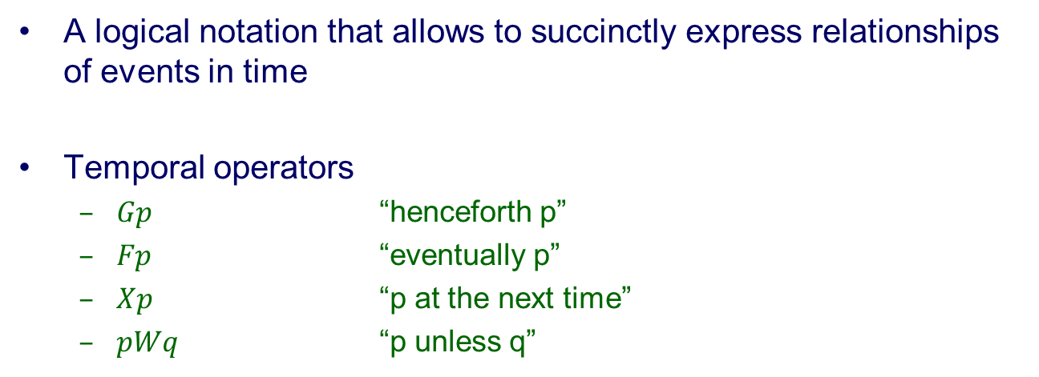











Temporal logic (LTL)
A logical notation that allows to succinctly express relationships of events in time
Temporal operators
$Gp$ “henceforth p”
$Fp$ “eventually p”
$Xp$ “p at the next time”
$pWq$ “p unless q”
$$p$$
$$¬p$$
$$¬p$$
$$¬p$$
$$p$$
$$p$$
$$p$$
...
$$¬Gp$$
$$¬Gp$$
$$¬Gp$$
$$¬Gp$$
$$Gp$$
$$Gp$$
$$Gp$$

Slide 5
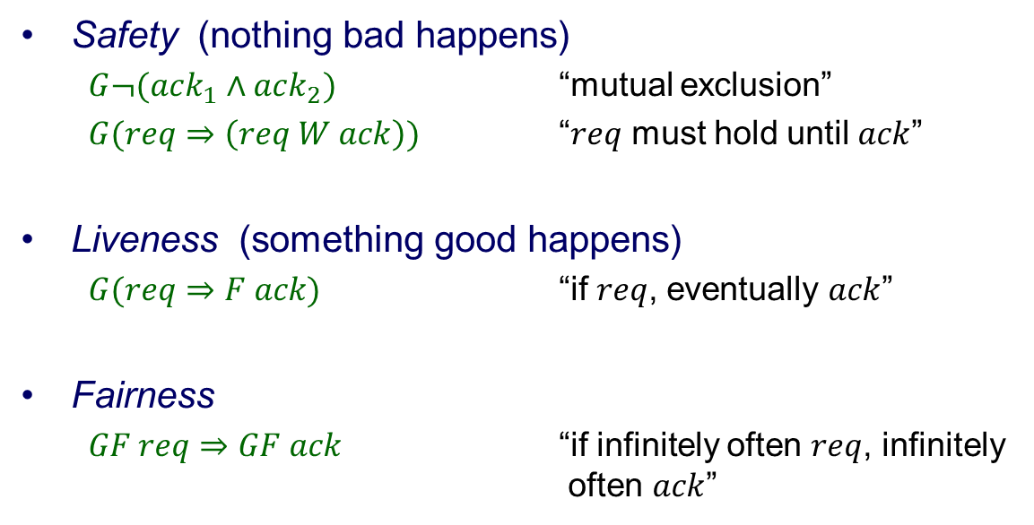
Types of temporal properties
Safety (nothing bad happens)
$G¬(ack_{1}∧ack_{2})$ “mutual exclusion”
$G(req⇒\left(req W ack\right))$ “$req$ must hold until $ack$”
Liveness (something good happens)
$G(req⇒F ack)$ “if $req$, eventually $ack$”
Fairness
$GF req⇒GF ack$ “if infinitely often $req$, infinitely often $ack$”
We will focus on safety properties.

Slide 6
Safety and reachability
Transitions = execution steps
Breadth-first search
Counterexample!
Initial state(s)
Bad state(s)
States = valuations of state variables
I
F

Slide 7
Reachable state set
Fixed point = reachable state set
Breadth-first search
Remove the “bug”
I
Safety property verified!
Model checking is a little more complex than this, but
reachability captures the essence for our purposes.
Model checking can find very subtle bugs in circuits
and protocols, but suffers from state explosion.
F

Slide 8
Symbolic Model Checking
Avoid building state graph by using succinct representation for large sets
Binary Decision Diagrams (Bryant)
a
a
0
1
1
0
b
b
0
b
1
0
1
0
1
c
c
c
c
c
1
1
0
1
0
1
0
1
0
1
0
d
d
d
d
d
d
d
d
d
0
0
0
0
0
1
1
0
0
0
1
0
0
0
1
1
1
1
1

Slide 9
Symbolic Model Checking
Avoid building state graph by using succinct representation for large sets
Multiprocessor Cache Coherence Protocol
Abstract
model
host
S/F network
other
hosts
protocol
Symbolic Model Checking detected very subtle bugs
Allowed scalable verification, avoiding state explosion

Slide 10
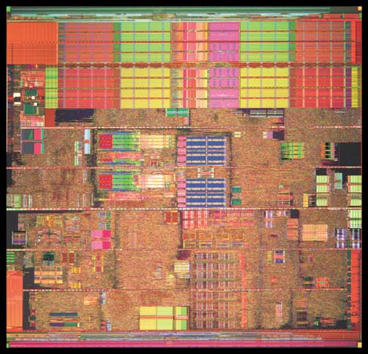
The Real World
How do we cope with the complexity of real systems?
Must deal with order 100K state holding elements (registers)
State space is exponential in the number of registers
Software complexity is greater
To make model checking a useful tool for engineers, we
had to find ways to cut this problem down to size. To do this, we apply three key concepts: decomposition, abstraction and refinement.

Slide 11
Deep v. Shallow Properties
A property is shallow if, in some sense, you don’t have to know very much information about the system to prove it.
Shallow property: Bus bridge never drops transactions
Deep property: System implements x86
Our first job is to reduce a deep property to a multitude of shallow properties that we can handle by abstraction.

Slide 12
Functional Decomposition
Abstract
model
host
S/F network
other
hosts
protocol
Shallow properties track individual transactions though RTL...
~30K lines of verilog
TABLES
CAM

Slide 13
Abstraction
Problem: verify a shallow property of a very large system
Solution: Abstraction
Extract just the facts about the system state that are relevant to the proving the shallow property.
An abstraction is a restricted deduction system that focuses our reasoning on relevant facts, and thus makes proof easier.

Slide 14
Relevance and refinement
Problem: how do we decide what deductions are relevant?
Is relevance even a well defined notion?
Relevance:
A relevant deduction is one that is used in a simple proof of the desired property.
Generalization principle:
Deductions used in the proof of special cases tend to be relevant to the overall proof.

Slide 15
Proofs
A proof is a series of deductions, from premises to conclusions
Each deduction is an instance of an inference rule
Usually, we represent a proof as a tree...
Premises
P₁
P₂
P₃
P₄
P₅
P₁ P₂
C
Conclusion
C
If the conclusion is “false”, the proof is a refutation

Slide 16


Inference rules
The inference rules depend on the theory we are reasoning in
Boolean logic
Linear arithmetic
Resolution rule:
Sum rule:
x₁ · y₁
p $⇒$ Γ
: p $⇒$ Δ
x₂ · y₂
Γ _ Δ
x₁+x₂ · y₁+y₂

Slide 17
Inductive invariants
Forms a barrier between the initial states and bad states
A Boolean-valued formula over the system state
Partitions the state space into two regions
φ
:φ
I
No transitions cross this way
F
Reachable states: complex
Inductive invariant: simple!

Slide 18
Invariants and relevance
A predicate is relevant if it is used in a simple inductive invariant
l₁: x = y = 0;
l₂: while(*)
l₃: x++, y++;
l₄: while(x != 0)
l₅: x--, y--;
l₆: assert (y == 0);
state variables: pc, x, y
property: pc = l₆ ) y = 0
inductive invariant = property +
pc = l₁ Ç x = y
Relevant predicates: pc = l₁ and x = y
Irrelevant (but provable) predicate: x ¸ 0

Slide 19
Three ideas to take away
An abstraction is a restricted deduction system.
A proof decomposition divides a proof into shallow lemmas, where shallow means "can be proved in a simple abstraction"
Relevant abstractions are discovered by generalizing from particular cases.
These lectures are divided into three parts, covering these three ideas.

Slide 20
Abstraction

Slide 21
What is Abstraction
By abstraction, we mean something like "reasoning with limited information".
The purpose of abstraction is to let us ignore irrelevant details, and thus simplify our reasoning.
In abstract interpretation, we think of an abstraction as a restricted domain of information about the state of a system.
Here, we will take a slightly broader view:
An abstraction is a restricted deduction system
We can think of an abstraction as a language for expressing facts, and a set of deduction rules for inferring conclusions in that language.

Slide 22
The function of abstraction
The function of abstraction is to reduce the cost of proof search by reducing the space of proofs.
Abstraction
Rich
Deduction
System
Automated tool
can search this space
for a proof.
An abstraction is a way to express our knowledge of what deductions may be relevant to proving a particular fact.

Slide 23
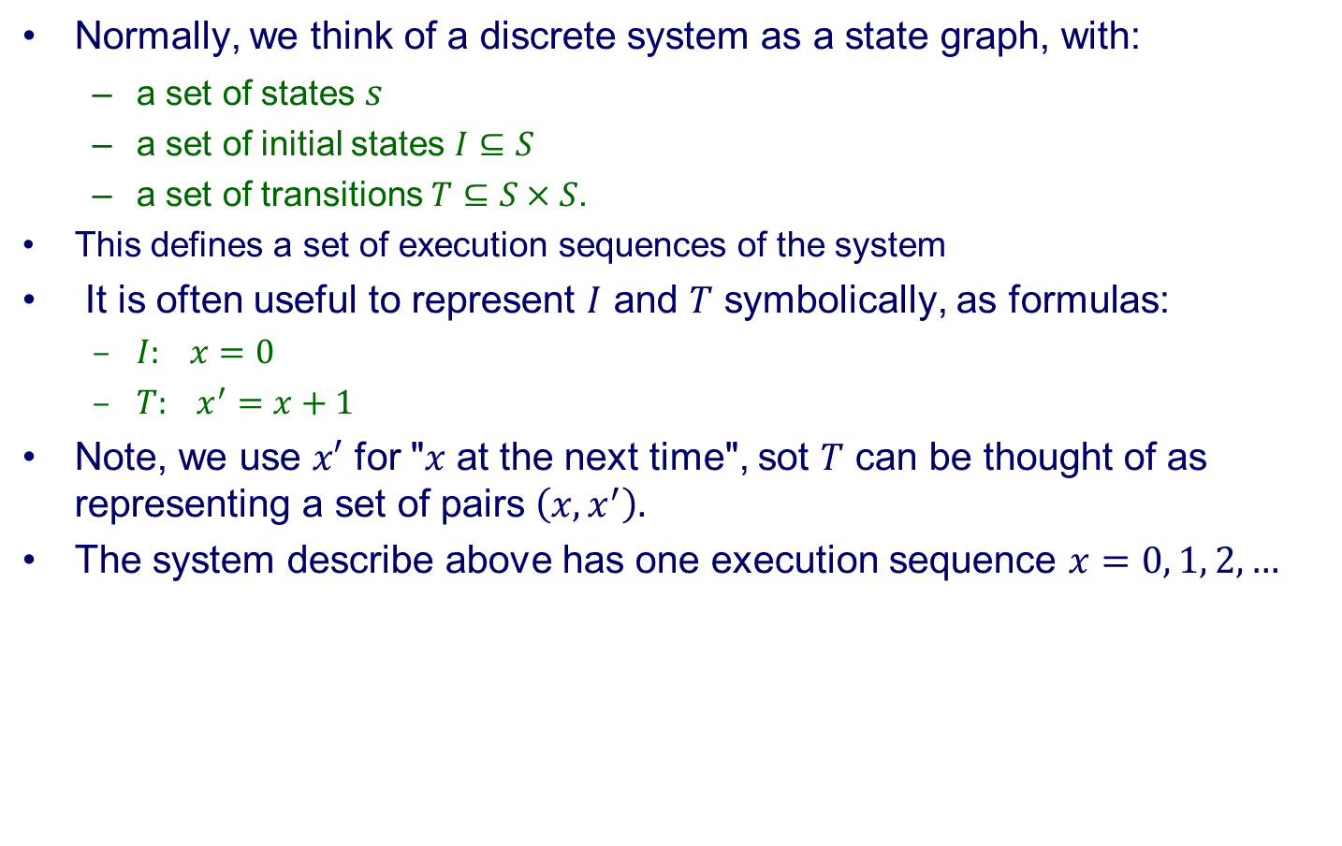
Symbolic transition systems
Normally, we think of a discrete system as a state graph, with:
a set of states $s$
a set of initial states $I⊆S$
a set of transitions $T⊆S×S$.
This defines a set of execution sequences of the system
It is often useful to represent $I$ and $T$ symbolically, as formulas:
$I: x=0$
$T: x^{′}=x+1$
Note, we use $x′$ for "$x$ at the next time", sot $T$ can be thought of as representing a set of pairs $\left(x,x^{′}\right).$
The system describe above has one execution sequence $x=0, 1, 2, …$

Slide 24
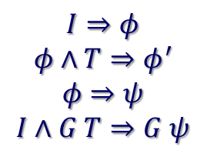
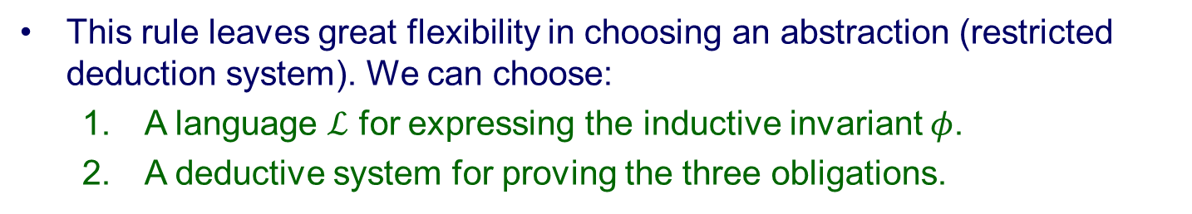
Proof by Inductive Invariant
In a proof by inductive invariant, we prove a safety property $Gψ$according to the following proof rule:
$$I⇒φ$$
$$φ∧T⇒φ^{′}$$
$$φ⇒ψ$$
$$I∧G T⇒G ψ$$
This rule leaves great flexibility in choosing an abstraction (restricted deduction system). We can choose:
A language $ℒ$ for expressing the inductive invariant $φ$.
A deductive system for proving the three obligations.
Many different choices have been made in practice. We will discuss
a few...

Slide 25


Abstraction languages
Difference bounds
$ℒ$ is all conjunctions of constraints like $x≤c$ and $x−y≤c$.
Affine equalities
$ℒ$ is all conjunctions of constraints $Σ_{i}c_{i}x_{i}=c_{0}$.
Houdini (given a fixed finite set of formulas $P).$
$ℒ$ is all conjunctions of formulas in $P$.

Slide 26


Abstraction languages
Predicate abstraction (given a fixed finite set of formulas $P)$
$ℒ$ is all Boolean combinations of formulas in $P$.
Note $\left|ℒ\right|=2^{2^{\left|P\right|}}$
Program invariants (given language $ℒ_{D}$of data predicates)
$ℒ$ is all conjunctions of $(pc=l_{i})⇒φ$ where $φ∈ℒ_{D}$.

Slide 27










Example
Let's try some abstraction languages on an example...
l₁: x = y = 0;
l₂: while(*)
l₃: x++, y++;
l₄: while(x != 0)
l₅: x--, y--;
l₆: assert (y == 0);
$$\left(pc=l_{2}\right)⇒x=y$$
$\left(pc=l_{2}\right)⇒x≥y∧x≤y$
$$\left(pc=l_{3}\right)⇒x=y$$
$\left(pc=l_{3}\right)⇒x≥y∧x≤y$
$\left(pc=l_{4}\right)⇒x=y$
$\left(pc=l_{4}\right)⇒x≥y∧x≤y$
$\left(pc=l_{5}\right)⇒x=y$
$\left(pc=l_{5}\right)⇒x≥y∧x≤y$
$\left(pc=l_{6}\right)⇒x=0∧y=0$
$\left(pc=l_{6}\right)⇒x=0∧y=0$
Difference bounds
Affine equalities
Houdini with $P=\{x=y,y=0\}$

Slide 28
















Another example
Let's try an even simpler example...
l₁: x = 0;
l₂: if(*)
l₃: x++;
l₄: else
l₅: x--;
l₆: assert (x != 0);
$\left(pc=l_{2}\right)⇒x≥0∧x≤0$
$\left(pc=l_{2}\right)⇒x≥0∧x≤0$
$\left(pc=l_{2}\right)⇒x≥0∧x≤0$
$$\left(pc=l_{2}\right)⇒x=0$$
$\left(pc=l_{3}\right)⇒x≥0∧x≤0$
$\left(pc=l_{3}\right)⇒x≥0∧x≤0$
$\left(pc=l_{3}\right)⇒x≥0∧x≤0$
$$\left(pc=l_{3}\right)⇒x=0$$
$\left(pc=l_{4}\right)⇒x≥0∧x≤0$
$\left(pc=l_{4}\right)⇒x≥0∧x≤0$
$\left(pc=l_{4}\right)⇒x≥0∧x≤0$
$\left(pc=l_{4}\right)⇒x=0$
$\left(pc=l_{5}\right)⇒x≥0∧x≤0$
$\left(pc=l_{5}\right)⇒x≥0∧x≤0$
$\left(pc=l_{5}\right)⇒x≥0∧x≤0$
$$\left(pc=l_{5}\right)⇒x=0$$
$$\left(pc=l_{6}\right)⇒true$$
$$\left(pc=l_{6}\right)⇒¬x≤0∨¬x≥0$$
$$\left(pc=l_{6}\right)⇒x≥−1∧x≤1$$
$$\left(pc=l_{6}\right)⇒true$$
Difference bounds
Affine equalities
Houdini with $P=\{x≤0,x≥0\}$
Predicate abstraction with $P=\{x≤0,x≥0\}$

Slide 29
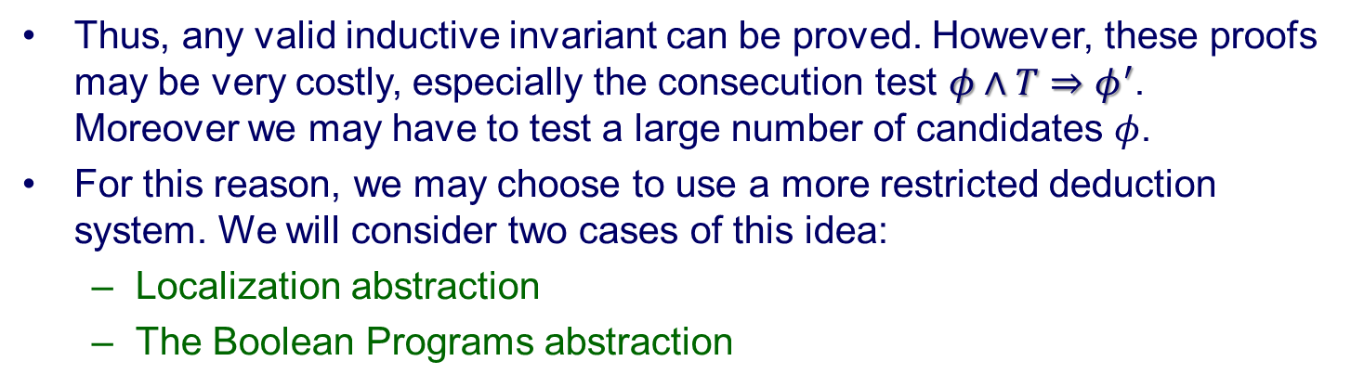
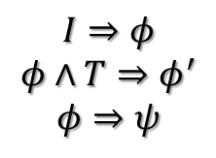
Deduction systems
Up to now, we have implicitly assumed we have an oracle that can prove any valid formulas of the forms:
$$I⇒φ$$
$$φ∧T⇒φ^{′}$$
$$φ⇒ψ$$
Thus, any valid inductive invariant can be proved. However, these proofs may be very costly, especially the consecution test $φ∧T⇒φ^{′}$. Moreover we may have to test a large number of candidates $φ$.
For this reason, we may choose to use a more restricted deduction system. We will consider two cases of this idea:
Localization abstraction
The Boolean Programs abstraction

Slide 30
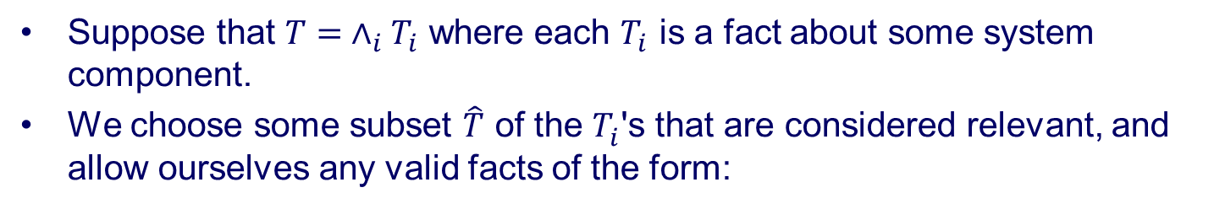

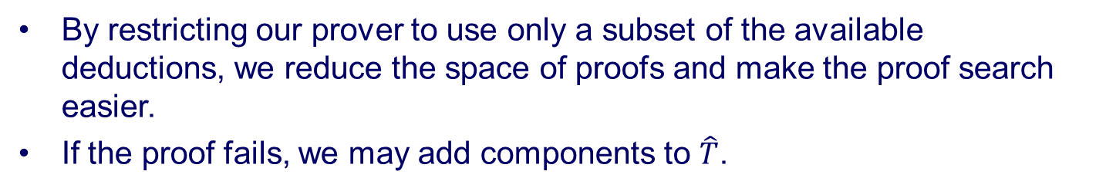
Localization abstraction
Suppose that $T= ∧_{i}T_{i}$ where each $T_{i}$ is a fact about some system component.
We choose some subset $\hat{T}$ of the $T_{i}^{}$'s that are considered relevant, and allow ourselves any valid facts of the form:
$$φ∧\hat{T}⇒φ^{′}$$
By restricting our prover to use only a subset of the available deductions, we reduce the space of proofs and make the proof search easier.
If the proof fails, we may add components to $\hat{T}$.

Slide 31
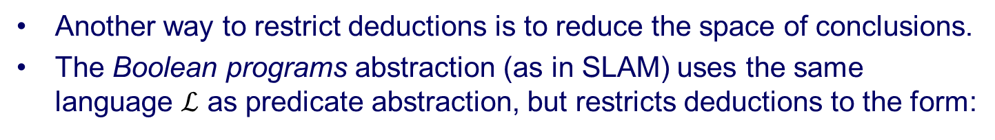
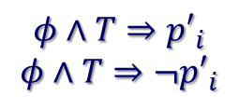




Boolean Programs
Another way to restrict deductions is to reduce the space of conclusions.
The Boolean programs abstraction (as in SLAM) uses the same language $ℒ$ as predicate abstraction, but restricts deductions to the form:
$$φ∧T⇒{p′}_{i}$$
$$φ∧T⇒{¬p′}_{i}$$
where $p_{i}∈P$ and $φ∈ℒ$
A Boolean program is defined by a set of such facts.
Example
Let $P=\{x=0,x>0\}$
l₁: int x = *;
l₂: if(x > 0){
l₃: x--;
l₄: assert(x >= 0);
l₅: }
In practice, we may add some disjunctions to our set
of allowed deductions, to avoid adding more predicates.
$\left(pc=l_{3}\right)⇒x>0$
$\left(pc=l_{4}\right)⇒x>0∨x=0$

Slide 32
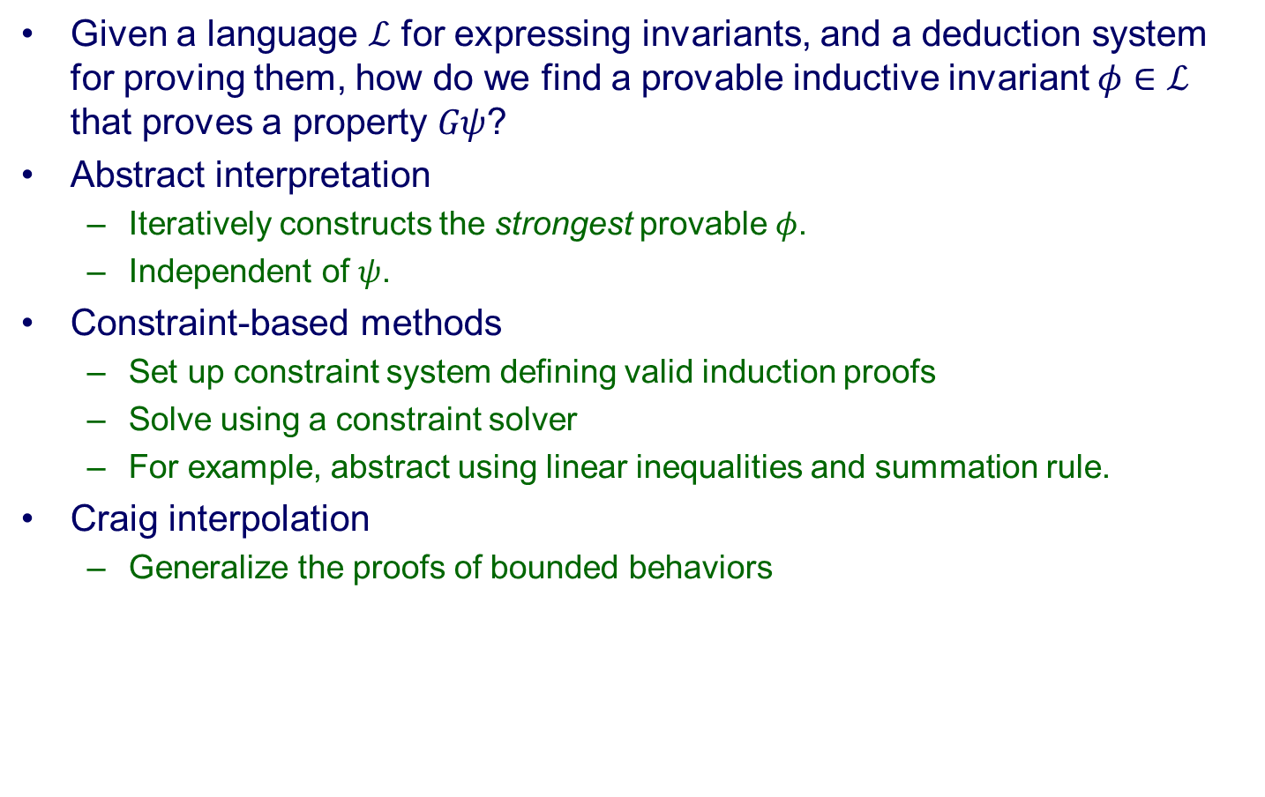
Proof search
Given a language $ℒ$ for expressing invariants, and a deduction system for proving them, how do we find a provable inductive invariant $φ∈ℒ$ that proves a property $Gψ$?
Abstract interpretation
Iteratively constructs the strongest provable $φ$.
Independent of $ψ$.
Constraint-based methods
Set up constraint system defining valid induction proofs
Solve using a constraint solver
For example, abstract using linear inequalities and summation rule.
Craig interpolation
Generalize the proofs of bounded behaviors
In general, making the space of proofs smaller will make the proof
search easier.

Slide 33
Relevance and abstraction
The key to proving a property with abstraction is to choose a small space of deductions that are relevant to the property.
How do we choose...
Predicates for predicate abstraction?
System components for localization?
Disjunctions for Boolean programs?
In the section on relevance, we will observe that deductions that are relevant to particular cases tend to be relevant in general. This gives us a methodology of abstraction refinement.
Next section: how to decompose big verification problems
into small problems that can be proved with simple abstractions.

Slide 34
Decomposition

Slide 35
Proof decomposition
Our goal in proof decomposition is to reduce proof of a deep property of a complex system to proofs of shallow lemmas that can be proved with simple abstractions.
We will consider some basic strategies for decomposing a proof, and consider how they might affect the abstractions we need.
We consider two basic categories of decomposition:
Non-temporal: reasoning about system states
Temporal: reasoning about sequences of states
As we go along, we’ll look at a system called Cadence SMV that implements these proof decompositions, and corresponding abstractions.

Slide 36
Cadence SMV basics
Type declarations
typedef MyType 0..2;
typedef MyArray array MyType of {0,1};
Variables and assignments
v : MyType;
init(v) := 0;
next(v) := 1 - v;
v = 0,1,0,1,0,...
Temporal assertions
p : assert G (v < 2);
SMV can automatically verify this assertion by model checking.

Slide 37

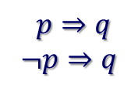

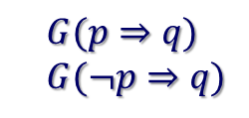
Case splitting
The simplest way to breakdown a proof is by cases:
$p⇒q$
$$¬p⇒q$$
$q$
Here is a temporal version of case splitting:
$G(p⇒q)$
$G(¬p⇒q)$
$G q$
p
:p
p
:p
:p
p
p
q
q
q
q
q
q
q

Slide 38
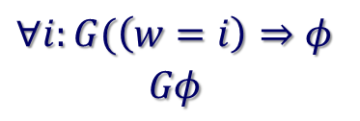
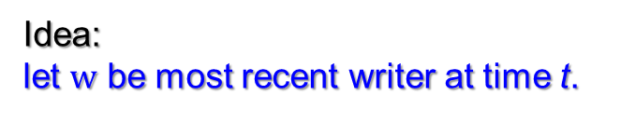
Temporal case splitting
Here is a more general version of temporal case splitting:
$$∀i:G(\left(w=i\right)⇒φ$$
$$Gφ$$
p₁
p₂
p₃
p₄
p₅
...
v₁
φ: I'm O.K. at
time t.
Idea:
let $w$ be most recent writer at time t.

Slide 39
Temporal case splitting in SMV
v : T;
s : assert G p ;
forall (i in T)
subcase c[i] of s for v = i;
c[0] : assert G (v=0 ) p) ;
c[1] : assert G (v=1 ) p) ;
...

Slide 40
Invariant decomposition
In a proof using an inductive invariant, we often decompose the invariant into a conjunction of many smaller invariants that are mutually inductive:
Á₁ Æ Á₂ Æ T ) Á’₁
Á₁ Æ Á₂ Æ T ) Á’₂
{Á₁ Æ Á₂} s {Á₁}
{Á₁ Æ Á₂} s {Á₂}
Á₁ Æ Á₂ Æ T ) Á’₁ Æ Á’₂
{Á₁ Æ Á₂} s {Á₁ Æ Á₂}
To prove each conjunct inductive, we might use a different abstraction.
Often we need to strengthen an invariance property with many additional invariants to make it inductive.

Slide 41
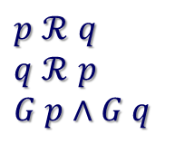

Temporal Invariant Decomposition
To prove a property holds at time t, we can assume that other properties hold at times less than t. The properties then hold by mutual induction.
We can express this idea using the releases operator:
p $ℛ$ q
"p fails before q fails"
If no property is the first to fail, then all properties are always true.
$p$ $ℛ$ $q$
$q$ $ℛ$ $p$
$G p$ $∧G q$
These premises can be checked with a model checker.

Slide 42
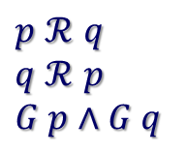
Invariant decomposition in SMV
This argument:
$p$ $ℛ$ $q$
$q$ $ℛ$ $p$
$G p$ $∧G q$
can be expressed in SMV like this:
p : assert G ...;
q : assert G ...;
using (p) prove q;
using (q) prove p;

Slide 43
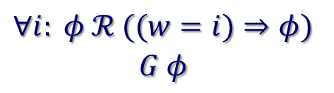
Combine with case splitting
p₁
p₂
p₃
p₄
p₅
...
v₁
φ: I'm O.K. at
time t.
To prove case $w=i$ at time $t$, assume general case up to $t−1$:
$$∀i: φ ℛ ((w=i)⇒φ)$$
$$G φ$$

Slide 44

Combining in SMV
This argument:
$$∀i: φ ℛ ((w=i)⇒φ)$$
$$G φ$$
Can be expressed like this in SMV:
w : T;
p : assert G ...;
forall(i in T)
subcase c[i] of p for w = i;
forall(in in T)
using (p) prove c[i];

Slide 45
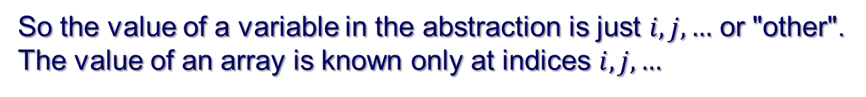
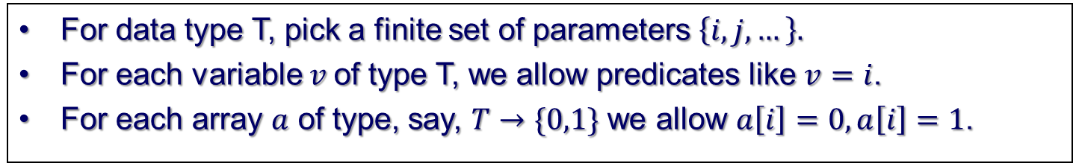
Abstractions
Having decomposed a property into a collection of simpler properties, we need an abstraction to prove each property.
Recall, an abstraction is just a restricted proof system.
SMV uses a very simple form of predicate abstraction called a data type reduction.
Data type abstraction
For data type T, pick a finite set of parameters $\left\{i,j,…\right\}.$
For each variable $v$of type T, we allow predicates like $v=i$.
For each array $a$ of type, say, $T→\{0,1\}$ we allow $a\left[i\right]=0, a\left[i\right]=1$.
So the value of a variable in the abstraction is just $i, j, …$ or "other".
The value of an array is known only at indices $i,j,…$

Slide 46



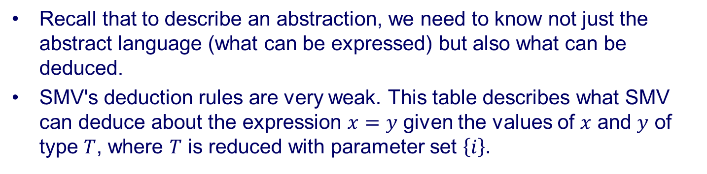





Deduction rules
Recall that to describe an abstraction, we need to know not just the abstract language (what can be expressed) but also what can be deduced.
SMV's deduction rules are very weak. This table describes what SMV can deduce about the expression $x=y$ given the values of $x$ and $y$ of type $T$, where $T$ is reduced with parameter set $\left\{i\right\}.$
$$x=y$$
$$y=i$$
$$y≠i$$
$$x=i$$
$$1$$
$$0$$
$$x≠i$$
$$0$$
When $x$ and $y$ are not $i$, we can't deduce anything about $x=y$.

Slide 47
Data type reductions in SMV
This code proves a property parameterize on $i$ by reducing data type $T$ to just the abstract values $=i$ and $≠i$.
typedef T 0..999;
forall(i in T)
p[i] : assert G ...;
forall(i in T)
using T -> {i} prove p[i];

Slide 48
A simple example
An array of processes with one state variable each and a one shared variable. At each time, the scheduled process swaps its own variable with the shared variable.
typedef T 0..999;
typedef Q 0..2;
v : Q
a : array T of Q;
sched : T;
init(v) := {0,1};
forall(i in T)
a[i] := {0,1};
next(a[sched]) := v;
next(v) := a[sched];

Slide 49
A simple example
We want to prove the shared variable always less than 2:
p : assert G (v < 2);
Split cases on most recent writer of shared variable:
w : T;
next(w) := sched;
forall(i in T)
subcase c[i] of p for w = i;
Use mutual induction to prove the cases, with a data type reduction:
forall(i)
using p, T->{i} prove c[i];

Slide 50
Functional decompositions
This combination of temporal case splitting and invariant decomposition can support a general approach to decomposing proofs of complex systems.
Use case splitting to divide the proof into “units of work” or "transactions".
For a CPU, this might be instructions, loads, stores, etc...
For a router, units of work might be packets.
Each transaction can assume all earlier transactions are correct.
Since each unit of work uses only a small collection of system resources, a simple abstraction will prove each.

Slide 51
Example : packet router
input buffers
output buffers
Switch
fabric
Unit of work is a packet
Packets don’t interact
Each packet uses finite resources
allows abstraction to finite state

Slide 52
Illustration: Tomasulo’s algorithm
Execute instructions in data flow order
VAL/TAG
REG
FILE
VAL/TAG
VAL/TAG
TAGGED RESULTS
VAL/TAG
OP,DST
EU
opra
oprb
INSTRUCTIONS
OP,DST
OPS
EU
opra
oprb
OP,DST
EU
opra
oprb

Slide 53
Data types in Tomasulo
The following data types are used in Tomasulo
REG (register file indices)
TAG (reservation station indices)
EU (execution unit indices)
WORD (data words)

Slide 54
Specification via reference model
Reference
model
Reference model describes simple in-order instruction execution.
Invariant properties specify values in the out-of-order system relative to the reference model.
Specifications
System

Slide 55
Invariant decomposition
Decompose into two lemmas
Lemma 2:
Correct results
REG
FILE
VAL/TAG
VAL/TAG
TAGGED RESULTS
VAL/TAG
VAL/TAG
OP,DST
opra
oprb
EU
INSTRUCTIONS
OP,DST
OPS
EU
opra
oprb
Lemma 1:
Correct operands
OP,DST
EU
opra
oprb
"Correct" means same value as reference model computes.

Slide 56
Lemmas in SMV
Lemma 1: The A operand in reservation station k is correct:
forall (k in TAG)
lemma1[k] : assert G
rs[k].valid & rs[k].opra.valid ->
rs[k].opra.val = aux[k].opra;
Lemma 2: Values on result bus with tag i are correct:
forall (i in TAG)
lemma2[i] : assert G
rb.tag = i & rb.valid ->
rb.val = aux[i].res;
Note: only two system signals specified in proof decomposition

Slide 57
Case splitting in Tomasulo
For each operand, split cases on the tag of the operand.
REG
FILE
VAL/TAG
VAL/TAG
TAGGED RESULTS
VAL/TAG
VAL/TAG
OP,DST
opra
oprb
EU
INSTRUCTIONS
OP,DST
OPS
EU
opra
oprb
OP,DST
EU
opra
oprb

Slide 58
Proving Lemma 1
To prove correctness of operands, split cases on tag and reg:
forall (i in TAG; j in REG; k in TAG; d in WORD)
subcase lemma1c[i][j][k][d] of lemma1[i]
for rs[i].opra.tag = j
& rs[i].tag = j & aux[i].opra = d;
Then assume all results of earlier instructions are correct and reduce data types to just relevant values:
forall (i in TAG; j in REG; k in TAG; d in WORD)
using (lemma2),
TAG->{i,k}, REG->{j}, WORD->{d}, EU->{}
prove lemma1c[i][j][k][d];

Slide 59
Uninterpreted functions
Verify Tomasulo for arbitrary EU function f(a,b).
SPEC
RESULTS
INSTRUCTIONS
f(a,b)
REG
FILE
VAL/TAG
VAL/TAG
TAGGED RESULTS
VAL/TAG
VAL/TAG
OP,DST
opra
oprb
f(a,b)
INSTRUCTIONS
OP,DST
OPS
opra
oprb
OP,DST
f(a,b)
opra
oprb
(related: Burch, Dill, Jones, etc...)

Slide 60

Case splitting for lemma 2
Break correctness of EU's into cases based on data values:
$$opr_{a}=i, opr_{b}=j, f\left(i,j\right)=k$$
REG
FILE
VAL/TAG
VAL/TAG
k
VAL/TAG
VAL/TAG
OP,DST
i
j
f(a,b)
INSTRUCTIONS
OP,DST
OPS
f(a,b)
opra
oprb
OP,DST
f(a,b)
opra
oprb

Slide 61
Result
SMV can reduce the verification of the lemmas to finite-state model checking
Max 25 state bits to represent abstract values
Total verification time less than 4 seconds
Tomasulo implementation proved for
Arbitrary number of registers, reservation stations
Arbitrary data word size and EU function
(unbounded EU’s requires one more lemma)
Note the strategy we applied:
1) Case split into "units of work" (operand fetch, result comp)
2) Specify units of work relative to reference model
3) Choose abstraction for each unit of work.

Slide 62
A more complex example
REG
FILE
VAL/TAG
VAL/TAG
RETIRED RESULTS
VAL/TAG
VAL/TAG
d
e
c
OP,DST
BUF
PM
opra
oprb
EU
INSTRUCTIONS
OP,DST
opra
oprb
OPS
EU
RES
BUF
OP,DST
EU
BUF
PC
branch results
opra
oprb
branch
predictor
DM
LSQ
Unit of work = instruction

Slide 63
Scaling problem
Must consider up to three instructions:
instruction we want to verify
up to two previous instructions
Resulting abstractions too complex
Soln: break instruction execution into smaller units of work
write more intermediate specifications
Compared to similar proof using manual inductive invariants...
manual invariant proof approx. 2MB (!)
temporal decomposition and abstraction proof approx. 20 KB

Slide 64
Cache coherence (Eiriksson 98)
P
P
Nondeterministic abstract model
Atomic actions
Single address abstraction
Verified coherence, etc...
M
INTF
IO
to net
host
host
host
Distributed
cache
coherence
protocol
protocol
protocol
S/F network

Slide 65
Mapping Protocol to RTL
Abstract
model
host
S/F network
other
hosts
protocol
Shallow properties track individual transactions though RTL...
~30K lines of verilog
TABLES
CAM

Slide 66
Conclusions
Proof decomposition means breaking down a proof into lemmas that can be proved in simpler deduction systems (abstractions).
A functional decomposition approach divides the proof based on "units of work" or "transactions".
This can be accomplished by two basic decomposition steps:
Temporal case splitting
Temporal invariant decomposition
Since each unit of work uses few resources, this style of decomposition lends itself to proof with fairly primitive abstractions, such as data type reductions.
Next section: more sophisticated abstractions and how we
discover them.

Slide 67
Relevance

Slide 68
Relevance and Refinement
Having decomposed a verification problem into shallow temporal lemmas, we need to choose an abstraction to prove each lemma.
That is, we are looking for a small space of relevant deductions in which to search for a proof of a property.
In this section, we will focus on the question of how we determine what is relevant and on how we apply this notion to the problem of abstraction refinement.
Refinement is the process of choosing the deduction system that defines our abstraction. This is usually, but not always does as a process of gradual refinement of the abstraction, adding information until the property is proved.

Slide 69
Basic framework
Abstraction and refinement are proof systems
spaces of possible proofs that we search
prog.
pf. of special case
Abstractor
Refiner
pf.
special case
cex.
General proof system
Specialized proof system
Incomplete
Complete
Refinement = augmenting abstractor’s proof system to replicate
proof of special case generated by refiner.
Narrow the abstractor’s proof space to relevant facts.

Slide 70
Background
Simple program statements (and their Hoare axioms)
{ψ ) φ}
[ψ]
{φ}
{φ[e/x]}
x := e
{φ}
{8 x φ}
havoc x
{φ}
A compound stmt is a sequence simple statements σ₁;...; σ_{k}
A CFG (program) is an NFA whose alphabet is compound statements.
The accepting states represent safety failures.
x = 0;
while(*)
x++;
assert x >= 0;
x := x +1
x := 0
[x<0]

Slide 71
Hoare logic proofs
Write H(L) for the Hoare logic over logical language L.
A proof of program C in H(L) maps vertices of C to L such that:
the initial vertex is labeled True
the accepting vertices are labeled False
every edge is a valid Hoare triple.
x := x +1
x := 0
[x<0]
{True}
{x ¸ 0}
{False}
This proves the failure vertex not reachable, or
equivalently, no accepting path can be executed.

Slide 72
Path reductiveness
An abstraction is path-reductive if, whenever it fails to prove program C, it also fails to prove some (finite) path of program C.
Example, H(L) is path-reductive if
L is finite
L closed under disjunction/conjunction
Path reductiveness allows refinement by proof of paths.
In place of “path”, we could use other program fragments, including restricted paths (with extra guards), paths with loops, procedure calls...
We will focus on paths for simplicity.

Slide 73
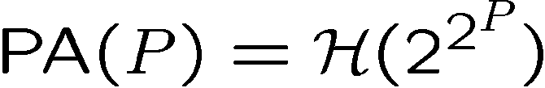
Example
x = y = 0;
while(*)
x++; y++;
while(x != 0)
x--; y--;
assert (y == 0);
x:=0;y:=0
x:=x+1; y:=y+1
[x≠ 0]; x:=x-1; y:=y-1
[x=0]; [y≠ 0]
Try to prove with predicate abstraction, with predicates {x=0,y=0}
Predicate abstraction with P is Hoare logic over the Boolean combinations of P

Slide 74
Unprovable path
{True}
Cannot prove with PA({x=0,y=0})
{True}
{True}
x = y = 0;
x++; y++;
x++; y++;
[x!=0];
x--; y--;
[x!=0];
x--; y--;
[x == 0]
[y != 0]
{x=0 Æ y=0}
Ask refiner to prove it!
{x = y}
{x = y Æ x=0}
{x = y}
{x = y Æ x≠0}
{x≠0 Æ y≠0}
Augment P with new predicate x=y.
PA can replicate proof.
{x = y}
{True}
{x = y}
{x = y}
{True}
{x = y}
Abstraction refinement:
Path unprovable to abstraction
Refiner proves
Abstraction replicates proof
{True}
{x = y}
{x = y}
{False}
{False}
{True}

Slide 75
Path reductiveness
Path reductive abstractions can be characterized by the path proofs they can replicate
Predicate abstraction over P replicates all the path proofs over Boolean combinations of P.
The Boolean program abstraction replicates all the path proofs over the cubes of P.
For these cases, it is easy to find an augmentation that replicates a proof (if the proof is QF).
In general, finding the least augmentation might be hard...
But where do the path proofs come from?

Slide 76
Refinement methods
Strongest postcondition (SLAM1)
Weakest precondition (Magic,FSoft,Yogi)
Interpolant methods
Feasible interpolation (BLAST, IMPACT)
Bounded provers (SATABS)
Constraint-based (ARMC)
Local proof

Slide 77
Interpolation Lemma
[Craig,57]
If A ∧ B = false, there exists an interpolant A' for (A,B) such that:
A ⇒ A'
A' ^ B = false
A' 2 L(A) \ L(B)
Example:
A = p ∧ q, B = ¬q ∧ r, A' = q
In many logics, an interpolant can be derived in linear
time from a refutaion proofs of A ^ B.

Slide 78
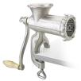
Interpolants as Floyd-Hoare proofs
True
{True}
x = y
x₁= y₀
x=y;
)
1. Each formula implies the next
x₁=y₀
{x=y}
2. Each is over common symbols of prefix and suffix
y++
y₁=y₀+1
y++;
)
y₁>x₁
{y>x}
3. Begins with true, ends with false
x₁=y₁
[x == y]
[x=y]
)
False
{False}
Proving in-line programs
SSA
sequence
proof
Hoare
Proof
Prover
Interpolation

Slide 79
Local proofs and interpolants
TRUE
x₁=y₀
x=y;
x₁ · y₀
y₀ · x₁
x₁ · y
y++;
y₁=y₀+1
y₀+1 · y₁
y₁ · y₀+1
x₁+1 · y₁
y₁ · x₁+1
x₁+1 · y₁
y₁·x₁
1 · 0
[y · x]
FALSE
FALSE
This is an example of a local proof...

Slide 80
Definition of local proof
x₁=y₀
{x₁,y₀}
x₁ · y₀
y₀
y₁=y₀+1
x₁
y₀+1 · y₁
{x₁,y₀,y₁}
deduction “in scope” here
y₁
x₁+1 · y₁
Local proof:
Every deduction written
in vocabulary of some
frame.
y₁·x₁
{x₁,y₁}
vocabulary of frame = set of variables “in scope”
scope of variable = range of frames it occurs in

Slide 81
Forward local proof
TRUE
x₁=y₀
{x₁,x₀}
x₁ · y₀
x₁ · y
y₁=y₀+1
y₀+1 · y₁
{x₁,y₀,y₁}
x₁+1 · y₁
x₁+1 · y₁
y₁·x₁
1 · 0
{x₁,y₁}
FALSE
FALSE
Forward local proof: each deduction can be assigned a frame
such that all the deduction arrows go forward.
For a forward local proof, the (conjunction of) assertions
crossing frame boundary is an interpolant.

Slide 82
Reverse local proof
FALSE
TRUE
x₁=y₀
1 · 0
{x₁,x₀}
x₁ · y₀
: y₀+1 · x₁
y₁=y₀+1
y₀+1 · x₁
{x₁,y₀,y₁}
y₀+1 · y₁
: y₁· x₁
y₁·x₁
{x₁,y₁}
FALSE
Reverse local proof: each deduction can be assigned a frame
such that all the deduction arrows go backward.
For a reverse local proof, the negation of assertions
crossing frame boundary is an interpolant.

Slide 83
General local proof
TRUE
x₁=3y₀
{x₁,y₀}
x₁ · 0
x₁·2 ) x₁·0
x₁ · 2
{x₁}
x₁ · 0
1 · x₁
1 · 0
{x₁}
FALSE
FALSE
General local proof: each deduction can be assigned a frame,
but deduction arrows can go either way.
For a general local proof, the interpolants contain implications.

Slide 84
Refinement methods
Strongest postcondition (SLAM1)
Weakest precondition (Magic,FSoft,Yogi)
Interpolant methods
Feasible interpolation (BLAST, IMPACT)
Bounded provers (SATABS)
Constraint-based (ARMC)
Local proof

Slide 85
Refinement with SP
The strongest post-condition of φ w.r.t. progam σ, written SP(σ,φ), is the strongest ψ such that {φ} σ {ψ}.
The SP exactly characterizes the states reachable via σ.
Refinement with SP:
Syntactic SP computation:
True
{True}
{φ}
[ψ]
{φ Æ ψ}
x = y
x₁= y₀
x=y;
x₁=y₀
{x=y}
{φ}
x := e
{9 v φ[v/x] Æ x = e[v/x]}
y++
y₁=y₀+1
y++;
y₁>x₁
{φ}
havoc x
{9 x φ}
{y=x+1}
x₁=y₁
[x=y]
[y·x]
False
This is viewed as symbolic execution,
but there is a simpler view.
{False}

Slide 86
SP as local proof
Order the variables by their creation in SSA form:
x₀ Â y₀ Â x₁ Â y₁ Â ☹
Refinement with SP corresponds to local deduction with these rules:
φ x = e
Γ
x max. in φ
Γ unsat.
φ[e/x]
FALSE
We encode havoc specially in the SSA:
havoc x
x = Θ_{i}
where Θ_{i} is a
fresh Skolem constant
Think of the Θ_{i}’s as implicitly existentially quantified

Slide 87
SP example
TRUE
y₀ = Θ₁
x₁=y₀
{x₁,y₀}
x₁ = Θ₁
9Θ₁ (x₁=Θ₁ Æ y₀ = Θ₁)
x₁ = y₀
y₁=y₀+1
y₁ = Θ₁+1
{x₁,y₀,y₁}
9Θ₁ (x₁=Θ₁ Æ y₁ = Θ₁+1)
y₁ = x₀ + 1
y₁·x₁
y₁ · Θ₁
{x₁,y₁}
Θ₁+1·Θ₁
FALSE
FALSE
Ordering of rewrites ensures forward local proof.
The (conjunction of) assertions crossing frame boundary
is an interpolant with Θ_{i}’s existentially quantifed.
We can use quantifier elimination if our logic supports it.

Slide 88
Witnessing quantifiers
What happens if we can’t eliminate the quantifiers?
We can witness them by adding auxiliary variables to the program.
Refinement with SP:
True
{True}
havoc y
Θ₁ = y
x = y
havoc y
x = y
x₁= y₀
x=y;
{x=Θ₁ Æ y = Θ₁}
{9Θ₁ (x=Θ₁ Æ y = Θ₁)}
Predicate abstraction
can’t reproduce this proof!
y++
y₁=y₀+1
y++;
{x=Θ₁ Æ y = Θ₁+1}
{9Θ₁ (x=Θ₁ Æ y = Θ₁+1)}
x₁=y₁
[x=y]
[y · x]
False
{False}
Will the auxiliary variables
get out of control?

Slide 89
Proof reduction
By dropping unneeded inferences, we can weaken the interpolant and eliminate irrelevant predicates.
TRUE
y₀ = Θ₁
x₁=y₀+1
{x₁,y₀}
x₁ = Θ₁+1
9Θ₁ (x₁=Θ₁+1 Æ y₀ = Θ₁)
z₁=x₁+1
z₁ = Θ₁+2
{x₁,y₀,z₁}
9Θ₁ (x₁=Θ₁ Æ y₁ = Θ₁+1
Æ z₁=Θ₁+1)
9Θ₁ (x₁=Θ₁ Æ y₁ = Θ₁+1)
x₁·y₀
y₀ · z₁
x₁ · Θ₁
Θ₁ · Θ₁+2
{x₁,y₀,z₁}
Θ₁+1·Θ₁
FALSE
FALSE
Newton does this to eliminate irrelevant predicates.

Slide 90
Refinement methods
Strongest postcondition (SLAM1)
Weakest precondition (Magic,FSoft,Yogi)
Interpolant methods
Feasible interpolation (BLAST, IMPACT)
Bounded provers (SATABS)
Constraint-based (ARMC)
Local proof

Slide 91
Refinement with WP
The weakest (liberal) pre-condition of φ w.r.t. progam σ, written WP(σ,φ), is the weakest ψ such that {ψ} σ {φ}.
The WP characterizes the states may not reach :φ.
Refinement with WP:
Syntactic WP computation:
True
{True}
{ψ ) φ}
[ψ]
{φ}
x = y
x₁= y₀
x=y;
x₁=y₀
{x < y+1}
x := e
{φ[e/x]}
{φ}
y++
y₁=y₀+1
y++;
y₁>x₁
{8 x φ}
havoc x
{φ}
{x<y}
x₁=y₁
[x=y]
[y·x]
False
This can also be viewed as
local proof.
{False}

Slide 92
WP as local proof
Order the variables by their creation in SSA form:
x₀ Â y₀ Â x₁ Â y₁ Â ☹
Refinement with WP corresponds to local deduction with these rules:
φ x = e
Γ
x min. in φ
Γ unsat.
φ[e/x]
FALSE
We encode havoc specially in the SSA:
havoc x
x = Θ_{i}
where Θ_{i} is a
fresh Skolem constant
Think of the Θ_{i}’s as implicitly existentially quantified

Slide 93
WP example
FALSE
TRUE
y₀ = Θ₁
x₁=y₀
Θ₁+1· Θ₁
{x₁,x₀}
y₀+1 · y₀
: y₀+1 · x₁
y₁=y₀+1
y₀+1 · x₁
{x₁,y₀,y₁}
: y₁· x₁
y₁·x₁
{x₁,y₁}
FALSE
No need for quantifier elimination in this example.
Ordering of rewrites ensures reverse local proof.
The negation of assertions crossing frame boundary
(with Θ_{i}’s existentially quantified) is an interpolant.

Slide 94
Observations
WP allows proof reductions, just like SP
We are allowed to mix forward and backward rewriting (SP and WP)
Result is a general local proof, which we can interpolate.
However, forward rewriting may have advantages for Boolean programs, since it always produces conjunctions.

Slide 95
Abstracting paths
Removing irrelevant assignments and constraints can prevent SP and WP from introducing irrelevant predicates.
Proof using SP...
{True}
After quantifier elimination...
havoc b;
c := b;
Θ₁ = b;
{b = c}
{b = Θ₁ Æ c = Θ₁}
havoc a;
irrelevant!
a := 3c + b;
Θ₂ = a;
{b = Θ₁ Æ c = Θ₁ Æ a = 4Θ₁}
{b = c}
{b = Θ₁ Æ c = Θ₁ Æ a = Θ₂}
[a < b];
{4Θ₁ < Θ₁ Æ c = Θ₁ Æ a = 4Θ₁}
{a < c}
{Θ₂ < Θ₁ Æ c = Θ₁ Æ a = Θ₂}
[c < a]
{False}
Abstracting paths very important to keep SP and WP simple

Slide 96
Quantifier divergence
SP and WP introduce quantifiers
Quantifiers can diverge as we consider longer paths through loops
Example program:
a = 1;
b = 0;
while (*) {
a : = 3a^3 – b;
if (a > 0)
b = b + a;
}
assert b >= 0;
(Complicated, but irrelevant)

Slide 97
Quantifier divergence
Proof using SP...
{True}
After quantifier elimination...
a:= 1;
b := 0;
{b = 0}
havoc a;
[a > 0];
b := b + a;
{a = 1 Æ b = 0}
irrelevant!
a := 3a³ - b;
[a > 0];
b := b + a;
This predicate is sufficient for PA.
{Θ₁ > 0 Æ b = Θ₁}
havoc a;
[a > 0];
b := b + a;
{b ¸ 1}
irrelevant!
a := 3a³ - b;
[a > 0];
b := b + a;
{Θ₁ > 0 Æ Θ₂ > 0 Æ b = Θ₁ + Θ₂}
{b ¸ 2}
[b < 0]
{False}
Skolem constants diverging!
QE is difficult, but necessary for loops with SP and WP.

Slide 98
Refinement quality
Refinement with SP and WP is incomplete
May exists a refinement that proves program but we never find one
These are weak proof systems that tend to yield low-quality proofs
Example program:
x = y = 0;
while(*)
x++; y++;
while(x != 0)
x--; y--;
assert (y == 0);
invariant:
{x == y}

Slide 99
Execute the loops twice
{True}
Refine with SP (and proof reduction)
{True}
x = y = 0;
x++; y++;
x++; y++;
[x!=0];
x--; y--;
[x!=0];
x--; y--;
[x == 0]
[y != 0]
{y = 0}
Same result with WP!
{x = y}
{x = y}
{y = 1}
{x = y}
{y = 2}
This simple proof
contains invariants
for both loops
{x = y}
{y = 1}
{y = 0}
{x = y}
Predicates diverge as we unwind
A practical method must somehow prevent this kind of divergence!
{False}
{False}
We need refinement methods that can generate simple proofs!

Slide 100
Refinement methods
Strongest postcondition (SLAM1)
Weakest precondition (Magic,FSoft,Yogi)
Interpolant methods
Feasible interpolation (BLAST, IMPACT)
Bounded provers (SATABS)
Constraint-based (ARMC)
Local proof

Slide 101
Bounded Provers [SATABS]
Define a (local) proof system
Can contain whatever proof rules you want
Define a cost metric for proofs
For example, number of distinct predicates after dropping subscripts
Exhaustive search for lowest cost proof
May restrict to forward or reverse proofs
φ x = e
Γ
x max. in φ
Γ unsat.
φ[e/x]
FALSE
Allow simple arithmetic rewriting.

Slide 102
Loop example
cost: 2N
cost: 2
TRUE
TRUE
x₀ = 0
y₀ = 0
x₀ = y₀
x₀= 0Æ y₀ = 0
x₀ = y₀
x₁=x₀+1
y₁=y₀+1
x₁ = 1
x₁ = y₀+1
y₁ = 1
x₁ = y₁
x₁=1 Æ y₁ = 1
x₁= y₁
x₂=x₁+1
y₂=y₁+1
x₂ = 2
x₂ = y₁+1
y₂ = 2
x₂ = y₂
x₂=2 Æ y₂ = 2
x₂= y₂
...
...
...
...
...
Lowest cost proof is simpler, avoids divergence.

Slide 103
Lowest-cost proofs
Lowest-cost proof strongly depends on choice of proof rules
This is a heuristic choice
Rules might include bit vector arithmetic, arrays, etc...
May contain SP or WP (so complete for refuting program paths)
Search for lowest cost proof may be expensive!
Hope is that lowest-cost proof is short
Require fixed truth value for all atoms (refines restricted case)
Divergence is still possible when a terminating refinement exists
However, heuristically, will diverge less often than SP or WP.

Slide 104
Refinement completeness
Refinement completeness: if, within the abstraction framework, an abstraction exists that proves a given program safe, then refinement eventually produces such an abstraction.
Example: predicate abstraction over LRA. If there exists an inductive invariant proving safety in QFLRA, then the predicate set eventually contains the atomic predicates of such an invariant.
Some kinds of bounded provers can achieve refinement completeness:
For a stratified language {L_{i}}, when the L_{i}-bounded local proof system is complete for consequence generation in L_{i}.
Under certain conditions, for bounded local saturation provers, including first-order superposition calculus provers.
So we know that local provers can avoid divergence.
The key question is whether the cost of finding the
best proofs is justified in practice.

Slide 105
Refinement methods
Strongest postcondition (SLAM1)
Weakest precondition (Magic,FSoft,Yogi)
Interpolant methods
Feasible interpolation (BLAST, IMPACT)
Bounded provers (SATABS)
Constraint-based (ARMC)
Local proof

Slide 106
Constraint-based interpolants
Farkas’ lemma: If a system of linear inequalities is UNSAT, there is a refutation proof by summing the inequalities with non-neg. coefficients.
Farkas’ lemma proofs are local proofs!
0 · 0
Intermediate sums are
the interpolants!
x₀ · 0
0 · y₀
1 (x₀ · 0)
1 (0 · y₀)
x₀ · y₀
x₀ · y₀
Coefficients can be found
by solving an LP.
x₁·x₀+1
z₁·x₁-1
1 (x₁·x₀+1)
0 (z₁·x₁-1)
x₁ · y₀
x₁ · y₀
Interpolants can be
controlled with additional
constraints.
y₀+1·y₁
y₁+1·x₁
1 (y₀+1·y₁)
1 (y₁+1·x₁)
1 · 0
1 · 0
.

Slide 107
Refinement methods
Strongest postcondition (SLAM1)
Weakest precondition (Magic,FSoft,Yogi)
Interpolant methods
Feasible interpolation (BLAST, IMPACT)
Bounded provers (SATABS)
Constraint-based (ARMC)
Local proof

Slide 108
Interpolation of non-local proofs
In some logics, we can translate a non-local proof into interpolants.
propositional logic
linear arithmetic (integer or real)
equality, function symbols, arrays
In most case, QF formulas yield QF interpolants, solvingthe quantifier divergence problem.
use of the array theory is limited
This is an advantage, since searching for a non-local proof is easier
can be accomplished with standard decision procedures

Slide 109
Non-local to local
We can think of interpolation as translating a non-local proof into a local proof.
Interpolation re-orders the
sum to make the proof local.
0 · 0
x₀ · y₀
x₂ · y₀-2
x₀ · y₀
x₁·x₀-1
x₁· y₀-1
x₂ · x₀-2
x₁ · y₀-1
Non-local!
x₂· x₁-1
y₀·x₂
x₂· y₀-2
0·-2
0 · -2
0 · -2
Interpolation makes proof search easier, but can substantially reduce the cost of the proof, possibly leading to divergence,

Slide 110
Refinement methods
Strongest postcondition (SLAM1)
Weakest precondition (Magic,FSoft,Yogi)
Interpolant methods
Feasible interpolation (BLAST, IMPACT)
Bounded provers (SATABS)
Constraint-based (ARMC)
Local proof
These methods can be viewed as different strategies to search for
a local proof, trading off the cost of the search and the quality of
the interpolants.

Slide 111
Basic Framework
Abstraction and refinement are proof systems
spaces of possible proofs that we search
prog.
pf. of special case
Abstractor
Refiner
pf.
special case
cex.
General proof system
Specialized proof system
Incomplete
Complete
Degree of specialization can strongly affect refinement quality

Slide 112
Predicate abstraction
In predicate abstraction, we typically build a graph in which the vertices are labeled with minterms over P (abstract states).
The proof is complete when it folds into a Hoare logic proof of C.
An unprovable path looks like this:
φ₁
φ₂
φ₃
φ₄
φ₅
σ₁
σ₂
σ₃
σ₄
σ₅
no individual transition refutable
To refine, translate to restricted program path:
[φ₁];σ₁
[φ₂];σ₂
[φ₃];σ₃
[φ₄];σ₄
[φ₅];σ₅
Any proof of this restricted path rules out the original, but...

Slide 113
Overspecialization
Restricting paths can affect the quality of the refinement.
Restricted path, from PA({x=0,x=1,x=2})
[x=0]
x=0
Lowest-cost proof leads to divergence!
{True}
[x=0]
Lowest-cost proof without restriction.
x++
{0 · x}
[x=1]
x++
{0 · x}
Restricting paths can make the refiner’s
job easier. However, it also skews the
proof cost metric. This can cause the
refiner to miss globally optimal proofs,
leading to divergence.
[x=2]
x++
{x=3}
{0 · x}
[x∉ 0,1,2]
[x < 0]
{False}
{False}

Slide 114
Synergy algorithm
The Synergy algorithm produces a very local refinement by strongly restricting the refinement path.
Shortest infeasible prefix
φ₁
φ₂
φ₃
Æψ
φ₄
φ₅
Restrict to concrete states.
σ₁
σ₂
σ₃
σ₄
σ₅
{ψ}
φ₃Æ:ψ
φ₄
Refinement only here!
...splits just one state!
σ₃
Synergy produces small incremental refinements at low cost.
However, extreme specialization can reduce quality of refinements leading to divergence for loops.

Slide 115
Summary
Abstraction and refinement can be thought of as two proof systems:
Abstractor is general, but incomplete
Refiner is specialized, but complete.
Abstraction is path-reductive is, when it fails, it fails for one path.
Refiner generates path proof
Abstractor replicates proof
Existing refiners can be viewed as local proof systems
Quality of proof depends on proof system, search strategy
Low refinement quality leads to divergence
Different refines represent different cost/quality trade-offs
Abstractors vary in the refinement proof goals generated
Specialization reduces cost, but also refinement quality.
In general, the more the refiner sees, the better the refinement

Slide 116
Three ideas to take away
An abstraction is a restricted deduction system.
A proof decomposition divides a proof into shallow lemmas, where shallow means "can be proved in a simple abstraction"
Relevant abstractions are discovered by generalizing from particular cases.
By applying these three ideas, we can increase the
degree of automation in proofs of complex systems.

