Slide 1
ROBOSYNTH: SMT-Based Synthesis of Integrated Task and Motion Plans from Plan Outlines
Srinivas Nedunuri, Sailesh Prabhu, Mark Moll, Swarat Chaudhuri, and Lydia E. Kavraki
Department of Computer Science
Rice University
June 2, 2014

Slide 2
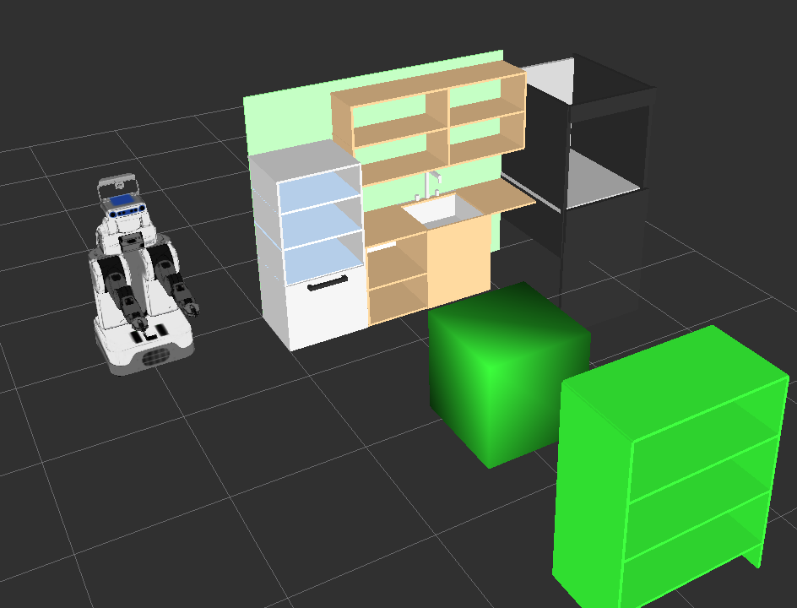

Objective of ROBOSYNTH: Make it easier to write task plans that are motion level feasible
Example: Want all dirty dishes in the kitchen cleaned and stored away
Notes:
To better understand what I’m talking about lets looks at our running eg of Kitchen env.
What makes this problem challenging is.. Discrete task pl layer, even in the case of p p pl

Slide 3
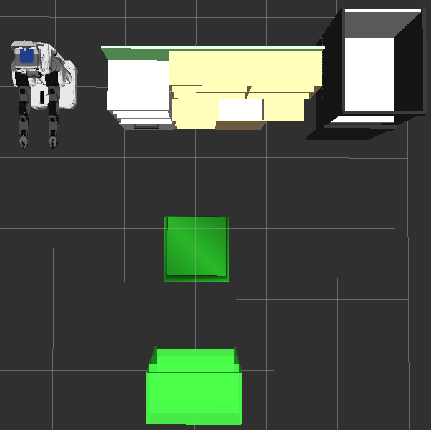
There may be constraints on the solution
E.g. Constraints on paths followed by the robot
Dishwasher
Countertop
Island
Food Prep
Storage

Slide 4
The difficulty? Two distinct layers!
Task Layer
Logical representation of the task
Discrete abstraction of the robot/environment
Motion Layer
Collision-free path generation
Continuous - cannot indiscriminately discretize
Task Layer
Motion Layer

Slide 5
E.g., Move dishes to Dishwasher: C program with suitable abstractions
ROBOSYNTH plan outline
actions
#define paths_ok(path1,path2) \
|path1| + |path2| < 10 && !crosses(path1, FOODPREP)
for (dish=0; dish < NUM_DISHES; dish++)
{ loc1 = findPlace(Dishwasher);
while (path1 = get_path(CURR(), dish.loc))
while (path2 = get_path(DIRTY[dish].loc, tgt_loc))
if (paths_ok(path1,path2)) break;
if (!path1 || !path2) error(…);
pickup(DIRTY[dish],DIRTY[dish].loc,path1);
place(DIRTY[dish],tgt_loc,path2);
}
{ for dish in DIRTY do
{ findPlace(?loc1,Dishwasher);
pickup(dish,?somewhere,?path1);
place(dish,?loc1,?path2);
}
}
@goal: contains(Dishwasher,DIRTY)
@invariant: (||?path|| <= 10) & ~crosses(?path,FoodPrep)
eg. DIRTY = {Cup1,Plate3,Glass5}
Program unknown (hole)
Assume a library of actions and suitable abstractions of underlying frameworks
Set-theoretic constraint
Linear arithmetic constraint
Notes:
Consider half the problem: move the dirty dishes to the dishwasher

Slide 6
Related Approaches
Integrated Task and Motion Planning (ITMP)
Answer Set solver based [Havir et al. '13, Erdem et al. ’12, Caldiran ‘09]
OTS heuristic planner based [Dornhege et al.’13, Srivastava et al. ‘13]
Hierarchical Planning in the Now [Kaelbling & Lozano-Perez '11]
HTN-based [Marthi et al. ‘08, Wolfe et al. '10]
Multiple graphs [Cambon et al.'03]
Template driven program synthesis:
Solar-Lezama et al. '06, Srivastava et al. '10
SAT Planning:
Kautz and Selman ‘92, Rintanen '12
Notes:
One big difference is that program synthesis pure s/w abstractions.. We physical world
Seperates us from fully automated approaches in our use of programmer info. Illustr next..

Slide 7
ITMP
Answer Set solver based [Havir et al., '13]: Use automated solver, but cause of motion level failures not propagated up to motion level
OTS heuristic planner based [Srivastava et al., ’13, Dornhege et al.,’13]:
Srivastava et al., ’13: Skolemize continuous variables, implement choice function, Dornege et al., ‘13: Expose motion level primitives at task plan level; combinatorially explosive
Hierarchical Planning in the Now [Kaelbling & Lozano-Perez, '11]: Solve planning problem at abstract level, then refine. Relies on compositionality (?)
HTN-based [Wolfe et al., '10]: Domain knowledge in form of HTN. Needs domain expertise

Slide 8
Key Idea #1: Use programmer knowledge!
in
For dish
in!
DIRTY do
{ findPlace(?loc1,Dishwasher);
pickup(dish,?somewhere,?path1);
place(dish,?loc1,?path2);
}
@goal: contains(Dishwasher,DIRTY)
@invariant: (||?path|| <= 10) & ~crosses(?path,FoodPrep)
Dish can be moved only once!
Notes:
As another example, suppose programmer is told that DIRTY dishes may be obstructing each o

Slide 9
Key Idea #1: Use programmer knowledge!
in
For dish
in!
DIRTY do
{ findPlace(?loc1,Dishwasher);
pickup(dish,?somewhere,?path1);
place(dish,?loc1,?path2);
}
@goal: contains(Dishwasher,DIRTY)
@invariant: (||?path|| <= 10) & ~crosses(?path,FoodPrep)
Dish can be moved only once!
@pre: pickup(obj,rgn,_):
while (obstructs(?obst,obj))
{ pickup(?obst,rgn,?pathR);
place(?obst,?safeR,?pathR);
}
Event handler
Notes:
As another example, suppose programmer is told that DIRTY dishes may be obstructing each o

Slide 10




Inputs and Output of ROBOSYNTH
Architecture of ROBOSYNTH
Key Idea #1
Key Idea #2
Plan Outline
Robot Model
Scene Description
Executable Plan
Scene
Environment
ROBOSYNTH
Placement Graph Generator
Placement Graph Generator
Plan Extractor
Placement Graph
Key Idea #3
Formula
Generator
Model
Formula
Y
SMT Solver
Solveable?
Report Problem
N
Notes:
Domain = Problem Area eg Kitchen, or Warehouse or Transportation

Slide 11
What happens when the Domain and Scene are conflated
Workspace
Observations
These paths need not be planned out in the entire configuration space
Only a small part of the configuration changes between each move,

Slide 12
Key Idea #2: Represent motion level information that doesn’t change over plans
Base node
ROBOSYNTH tracks actual object locations as plan evolves
Robot base movement
e2
Blocking edge
e3
Reachability edge
location
Placement Graph

Slide 13
S-point & B-point generation and usage
Manually identify place for robot base close to Countertop, Dishwasher, etc. → B-point
Manually identify stable location for object and required end-effector position → S-point
Collision-aware Inverse Kinematics (IK) solver returns corresponding arm configuration
Motion planner (KPIECE) returns a collision-free path from B-point to S-point

Slide 14
Architecture of ROBOSYNTH
Plan Outline
Robot Model
Scene Description
Executable Plan
Scene
Environment
Placement Graph Generator
Plan Extractor
Formula
Generator
Model
Y
SMT Solver
Satisfiable?
Report Problem
N

Slide 15
AI Planning vs. ROBOSYNTH
AI Planning
ROBOSYNTH
loc(Cup1)ϵ rchOf(B2) ˄ ¬blocks(loc(x),loc(Cup1))
˄...
Start State
Action 1
Action 2
Action n
Statement 1
Statement 2
Statement n
holes
Goal State
Goal State
Given initial & goal states,
determine plan
Given goal state & plan outline, constraint generator produces weakest precond. formula

Slide 16
Idea behind the Formula Generator
loc(Cup1)ϵ rchOf(B2) ˄ ¬blocks(loc(x),loc(Cup1))
˄...
Statement 1
Statement 2
Statement n
holes
Goal State
Given goal state & plan outline, formula generator produces weakest precond. formula

Slide 17
What does the formula represent?
States! Examples:
Robot@B2, Cup1@s3, Cup2@d1
Robot@B2, Cup1@s2, Cup2@d2
Robot@B2, Cup1@s3, Cup2@s2
What do these have in common?
They are characterized by the formula
loc(Cup1)ϵ rchOf(B2) ˄ ¬∃x·blocks(loc(x),loc(Cup1))

Slide 18
Calculating Weakest Precondition
E.g.: simple one-action plan outline body
pickup(Cup1,Countertop,?p)
Suppose goal and constraint is
holding(Cup1) ˄ energy(?p) <= BATT_CAP
Then (using defn. of pickup action) weakest precondition is
Defined using pre and post conditions
Fluent tracked by ROBOSYNTH
loc(Cup1) ϵ Countertop
˄ loc(Cup1) ϵ rchOf(b)
Interpreted
over
Placement
graph
˄ ¬blocks(loc(o’), loc(Cup1))
˄ path(p,CURR,b)˄ energy(p) <= BATT_CAP
Notes:
Similar to PDDL defs for those of you familiar

Slide 19
Filling in the holes in Weakest Precondition Key Idea #3
Formula
Generator
loc(Cup1) ϵ Countertop
˄ loc(Cup1) ϵ rchOf(b))
˄ ¬blocks(loc(o'),loc(Cup1))
˄ path(p,CURR,b) ˄ energy(p) <= BATT_CAP
loc(Cup1) ϵ Countertop
˄ loc(Cup1) ϵ rchOf(b))
˄ ¬blocks(loc(o'),loc(Cup1))
˄ path(p,CURR,b) ˄ energy(p) <= BATT_CAP
SMT Solver
model
b = B__Ctr
p = [e5,e7,e1]

Slide 20
Weakest Precondition for Entire Plan Outline
Can do other actions similar to pick (place, moveTo, findLoc)
Weakest precondition for compound statements (sequence, conditional, for, while) can be automatically determined using Dijkstra's rules
Result: weakest precondition for body of entire plan outline

Slide 21
Architecture of ROBOSYNTH
Plan Outline
Robot Model
Scene Description
Executable Plan
Scene
Environment
Placement Graph Generator
Plan Extractor
Formula Generator
Model
Y
SMT Solver
Satisfiable?
Report Problem
N

Slide 22
Output: concrete plan executed by intepreter
moveTo(B_tmp, e25)
moveTo(B_Ctr, e27)
pick(B_Ctr, s1106)
moveTo(B_DW, e39)
place(B_DW, s1174)
moveTo(B_Stg, e51)
...
Edge on placement graph
Robot base node on placement graph
Location node on placement graph

Slide 23
Results
Locations
Goal: Move DIRTY dishes from arbitrary (but known) locations to the Dishwasher and then from Dishwasher to Storage

Slide 24
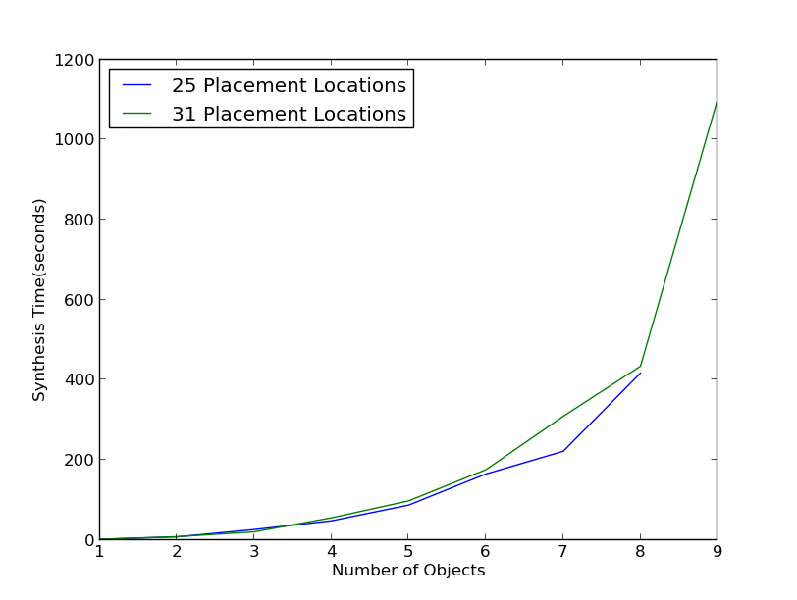
Results I: Time vs. Number of objects

Slide 25
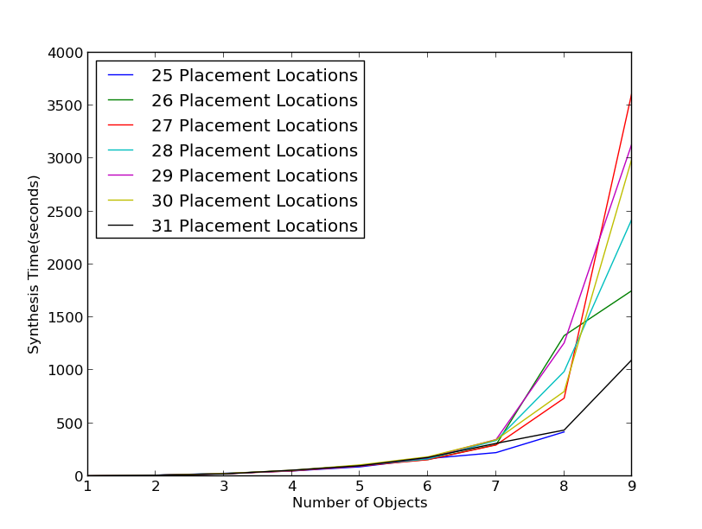
Results I: Time vs. Number of objects

Slide 26
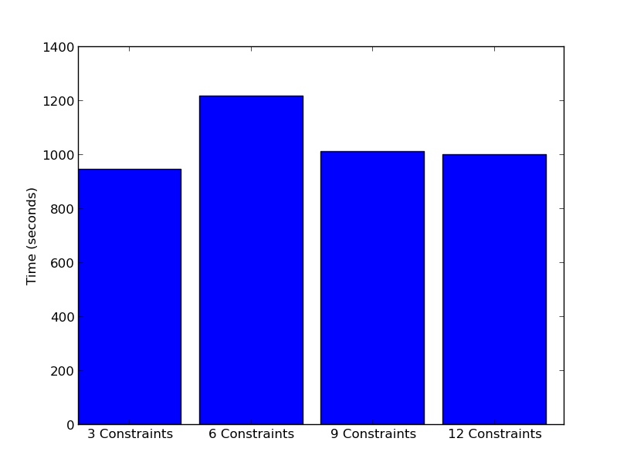
Results II: Time vs. Number of Constraints
for o in! DIRTY_DISHES
...
@goal: contains(Dishwasher,DIRTY)
@invariant: (||?path|| <= 10) & ~crosses(?path,FoodPrep)

Slide 27
Summary
Integrated Task and Motion plans can be effectively synthesized by using programmer knowledge and automated solvers
3 Main Contributions
Plan outline language for programmer to express broad knowledge of plan
Compactly represent pre-computed motion level info
Handle both plan outlines and (linear) constraints -> automated solvers
Future Work
Reactivity – allow environment to change from underneath robot
Dynamic and lazy construction of placement graph

Slide 28
Basic Plan Outline to move DIRTY dishes
for o
in
in
DIRTY do
{ findPlace(?loc1,Dishwasher);
pickup(o,?somewhere,?path1);
place(o,?loc1,?path2);
}
@goal: contains(Dishwasher,DIRTY)
@invariant: (||?path|| <= 10) & ~crosses(?path,FoodPrep)

Slide 29
Videos 1a, 1b
Locations
Videos show DIRTY dishes can be located anywhere in kitchen and robot path avoids Food Prep

Slide 30
When DIRTY dishes obstruct each other
for o
in
In!
DIRTY do
{ findPlace(?loc1,Dishwasher);
pickup(o,?somewhere,?path1);
place(o,?loc1,?path2);
}
@goal: contains(Dishwasher,DIRTY)
@invariant: (||?path|| <= 10) & ~crosses(?path,FoodPrep)

Slide 31
Video 2a, 2b
Locations
Videos show DIRTY dishes can be obstructing each other

Slide 32
With other objects obstructing DIRTY dishes
for o
in
in!
DIRTY do
{ findPlace(?loc1,Dishwasher);
pickup(o,?somewhere,?path1);
place(o,?loc1,?path2);
}
@goal: contains(Dishwasher,DIRTY)
@invariant: (||?path|| <= 10) & ~crosses(?path,FoodPrep)
@pre: pickup(obj,rgn,_):
while (obstructs(?obst,obj))
{ pickup(?obst,rgn,?pathR);
place(?obst,?tempR,?pathR);
}

Slide 33
Video 3
Locations
Video shows DIRTY dishes can be obstructed by some other item

