Slide 1
Check point No: 1 Capstone project No 3 : CandidateRenege_DataDescription Capstone project No: 3 Batch Name: E Group No:3 Group members: Pradyumna Bopanna Ravi Guntakala Harsha Vardhan Etcherla Hema Sri Gandi Swarna Deepika Guruvindapudi

Slide 2
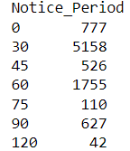
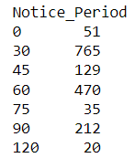
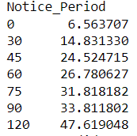
Task No: 1.1 (Data Manipulation using Python)
Q1. Analysis of percentage joined of offer released.
Joined% : 81.30072262367982
Not Joined % : 18.69927737632018
82.52% percentage Male Candidates are joined
17.48% percentage Female Candidates are joined
26.8% percentage joined from Agency
53.84% percentage joined from Direct Source
19.36% percentage joined from Employee Referral
Q2.What are the key drivers that influence the candidate joining/not joining a company?
Key Driver 1
18.69927737632018
Key Driver 2
over all count of candidates candidates not joined % candidates not joined

Slide 3
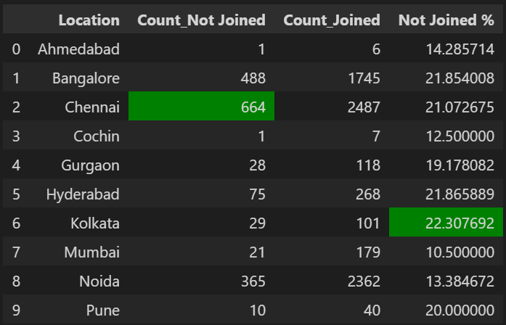
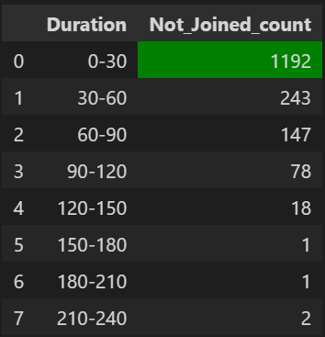
Q3.Are there specific locations where candidates are not joining?
Q4.Joining status depends on the duration to accept an offer?

Slide 4
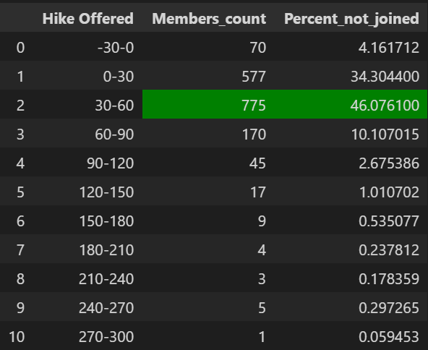
Q5.Hike offered has an impact on joining status?

Slide 5
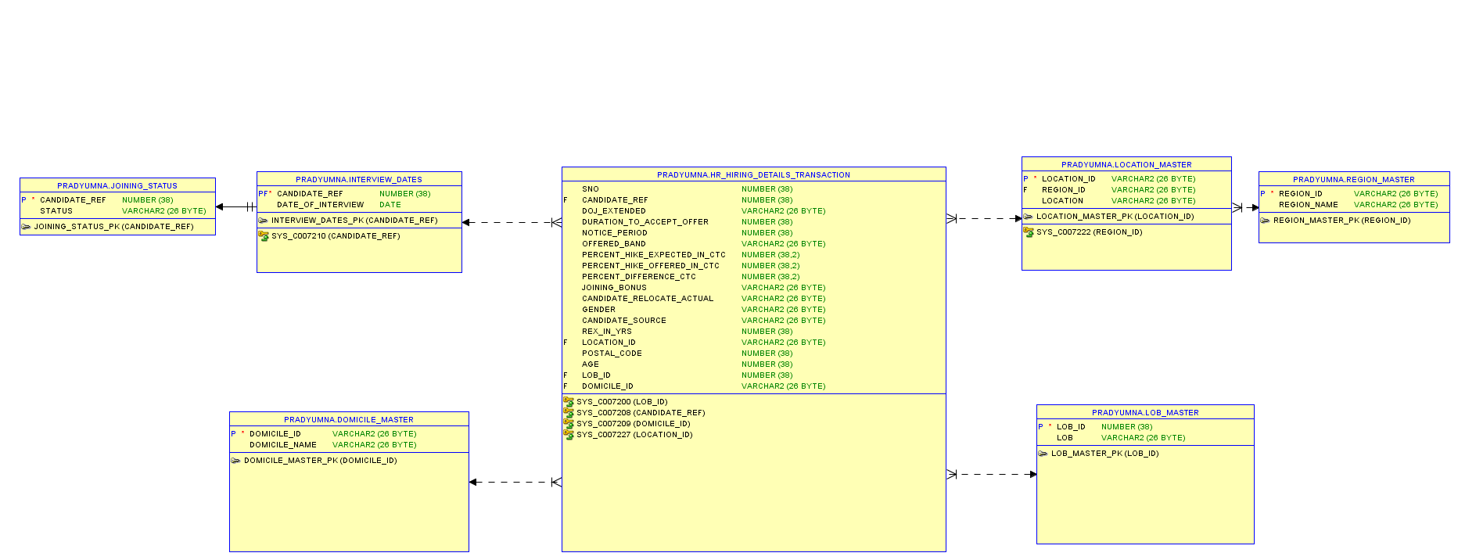
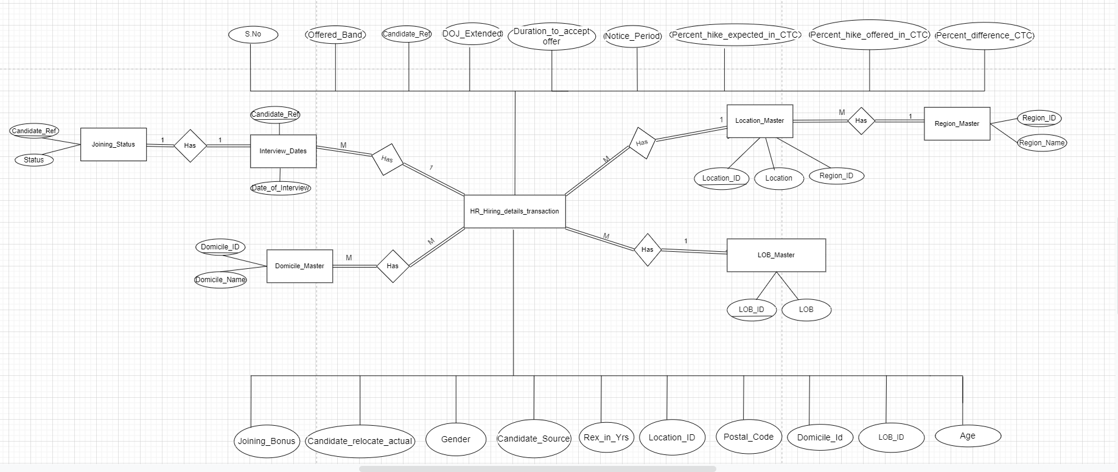
Task 1.2 (SQL-Oracle)
Stage 1:
Construct an ER-Diagram for the above-mentioned Requirement

Slide 6
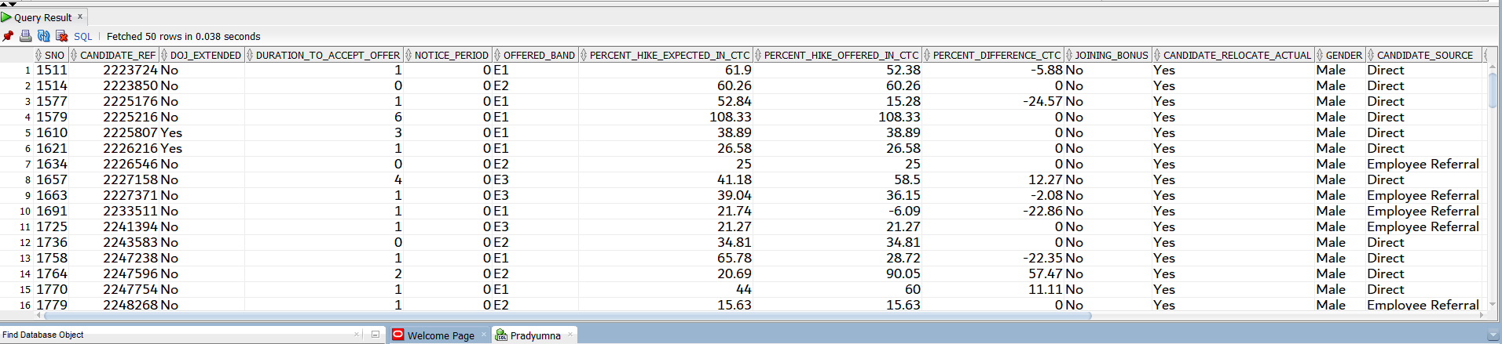
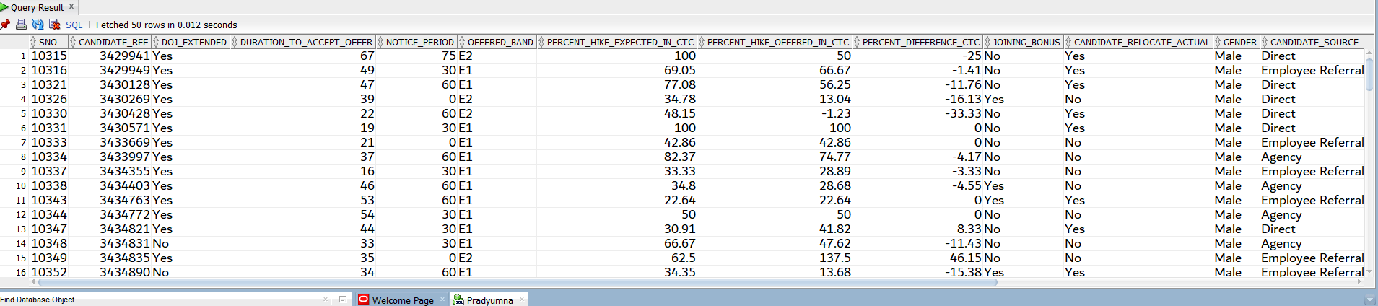
1. Generate Info those candidates who have accepted offer and joining time is less then 30 days and candidates who are ready to re-locate.
2. Generate Info those candidates who have accepted offer and also display list the candidates who have been offered and yet to accept the offer within 10 days.

Slide 7
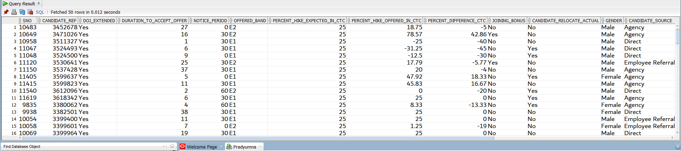
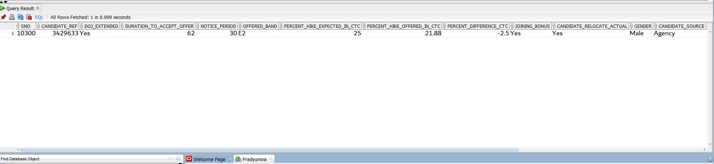
3. Generate Info those candidates who are willing to join and the ECTC is 25% hike from their CTC
4. Generate Info those candidates who are willing to join and the ECTC is 25% hike from their CTC joining time is less then 30 days and candidates who are ready to re-locate and joining bonus is offered.

Slide 8
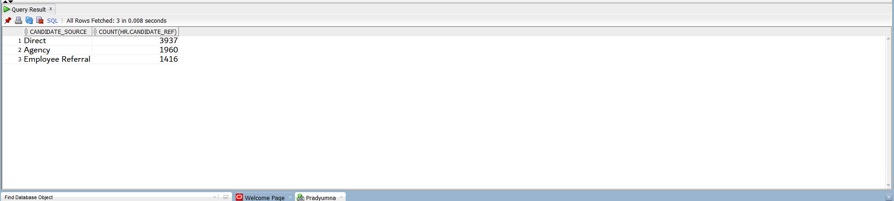
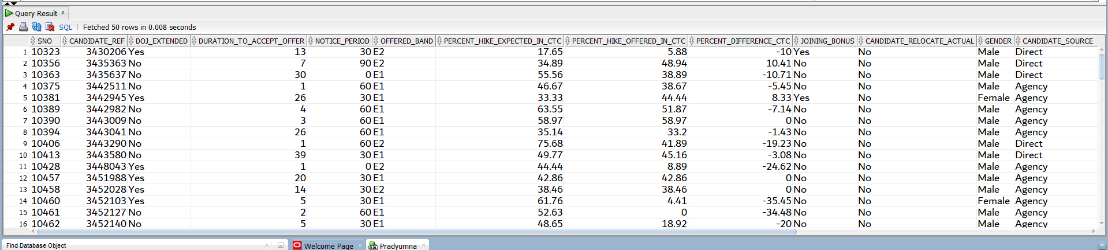
5. Generate the count of the candidates who are hired through what source and also who have joined and declined the offer.
6. Generate the count of the candidates who are hired through what source and also who have declined the offer.

Slide 9
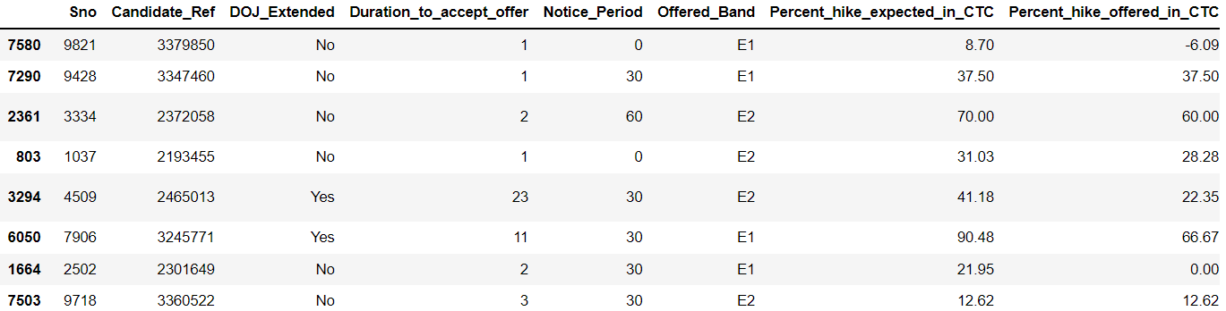
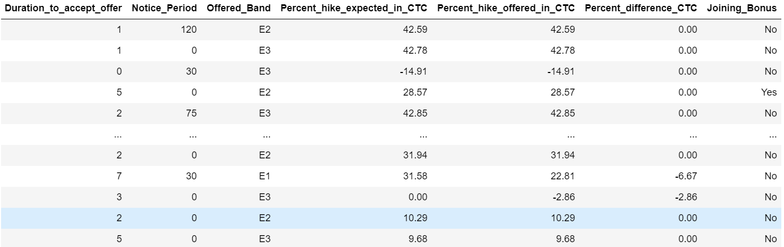
Task 1.3 (Statistical Analysis using Python)
Q1.Descriptive statistics for both numerical and categorical and draw few insights from them.
1.Numerical Descriptive statistics

Slide 10
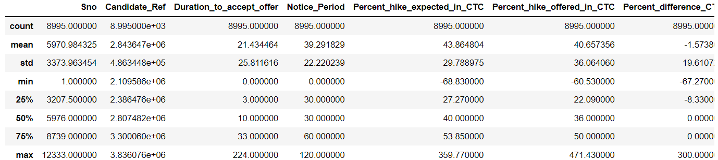
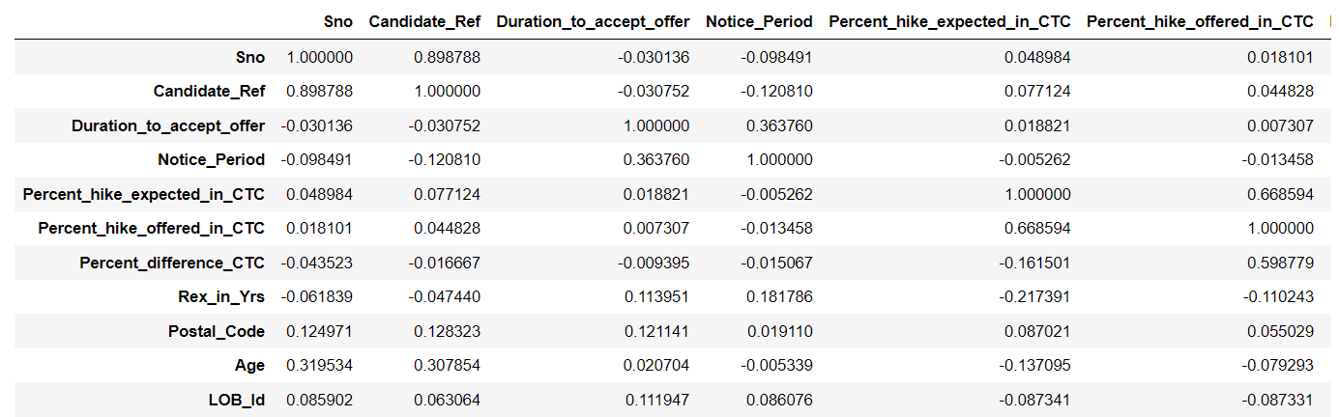

Slide 11
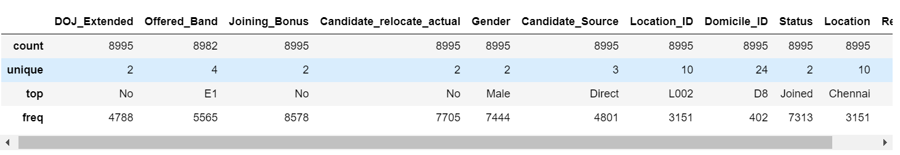
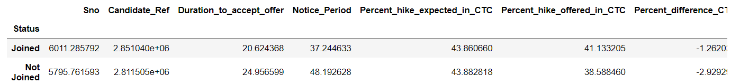
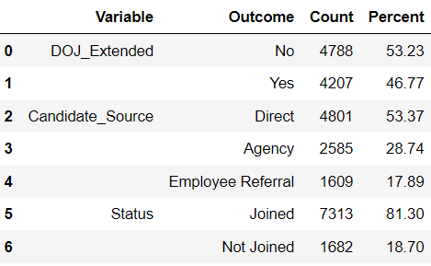
2.Categorical Descriptive statistics

Slide 12
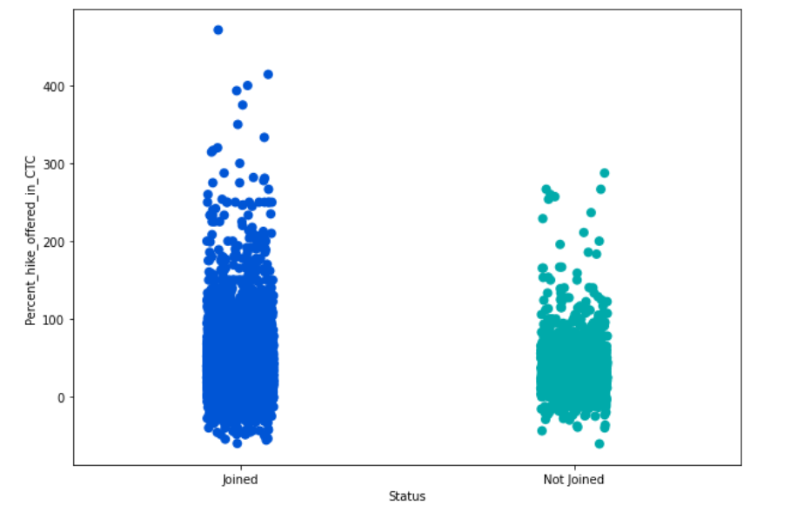
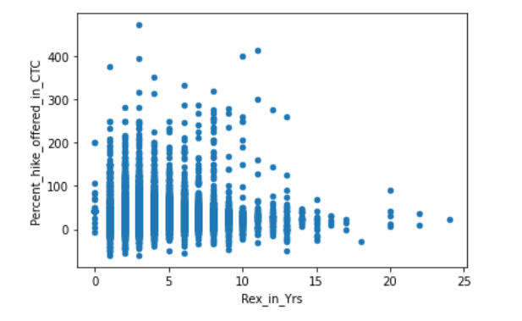
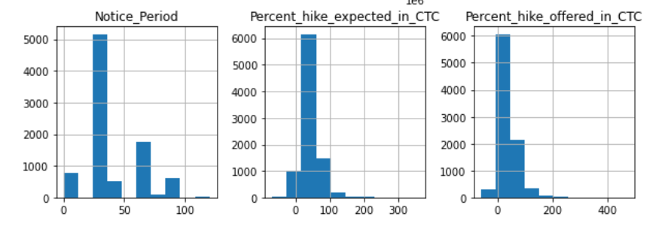
3.Insights

Slide 13

1.3 ( Hypothesis Testing) 1. T Testing H0=Same distributions of Percenatage in Hike Offered in CTC H1=Different Distribution of Percenatge in Hike Offered in CTC
2.CHI Square Test
H0 There is No relationship between 2 catgorical variables('Gender','Candidate_relocate_actual')
H1 There is a relationship between 2 catgorical variables
3.Anova Test
H0=The Average of hike offered is same in all the candidate sources H1=The Aerage of hike offered is not same in all the candidate sources

Slide 14

Thank You

