Slide 1

TASK DOCUMENT
DATA SCIENCE POSITION

Slide 2
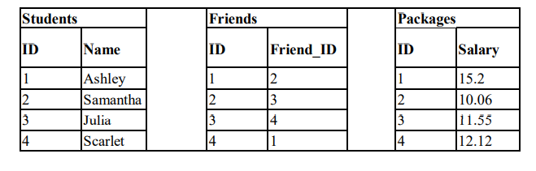
TASK 1
Description: You are given three tables: Students, Friends and Packages. Students contains two columns: ID and Name. Friends contains two columns: ID and Friend_ID (ID of the ONLY best friend). Packages contain two columns: ID and Salary (offered salary in $ thousands per month).
Provide solution and approach for the following:
Write a query to output the names of those students whose friends got offered a higher salary than them. Names must be ordered by the salary amount offered to the best friends. It is guaranteed that neither of the two students got the same salary offer.

Slide 3
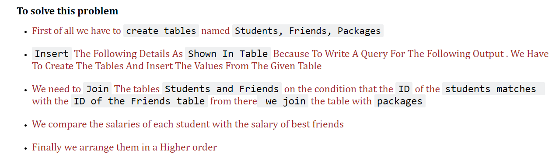

Slide 4
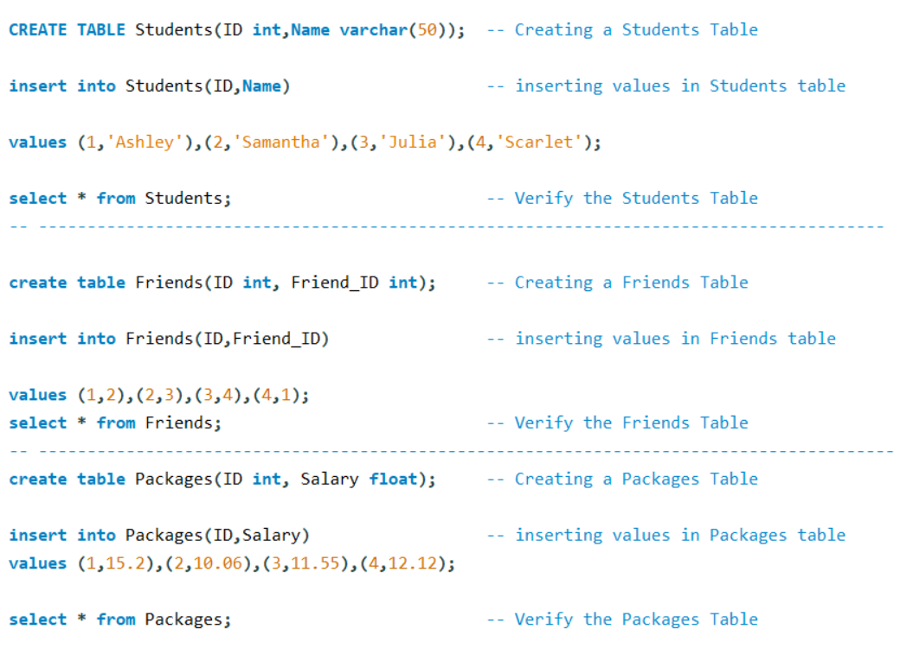
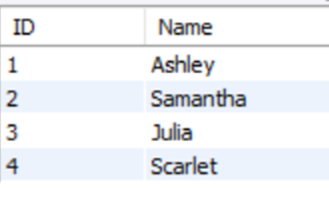
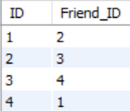
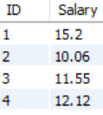
Output

Slide 5
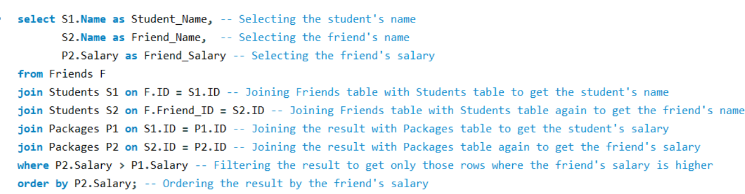

Final Query & Output

Slide 6
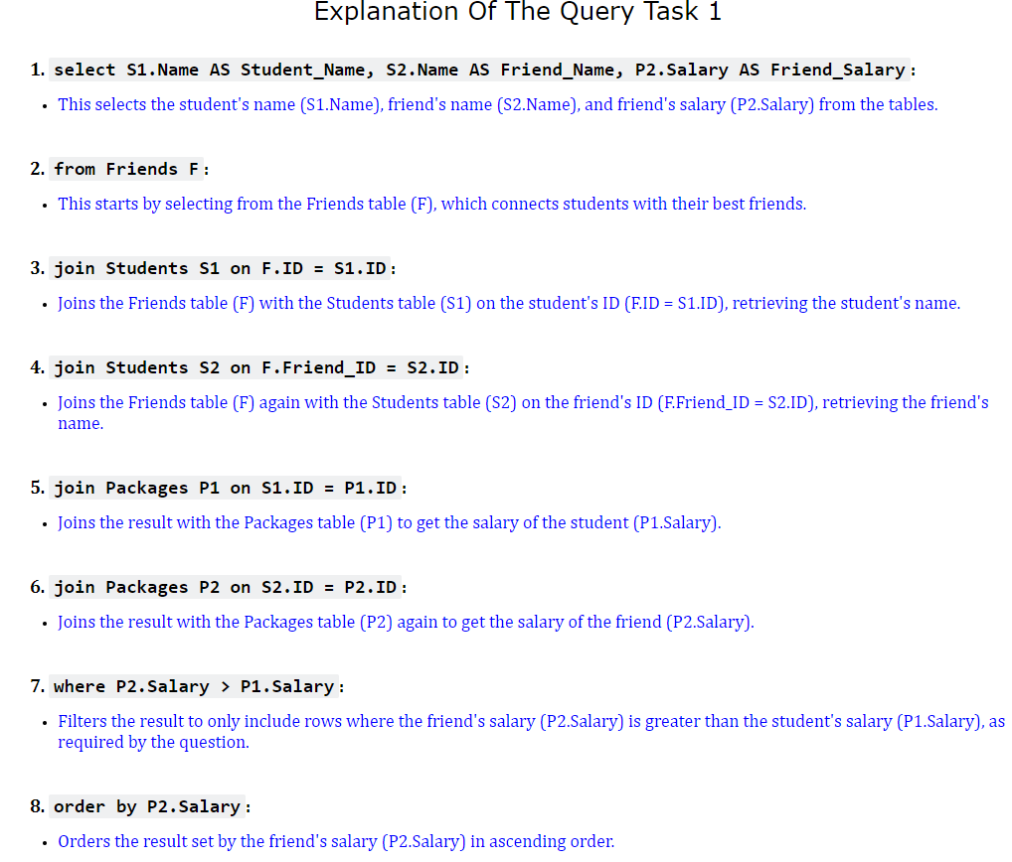

Slide 7
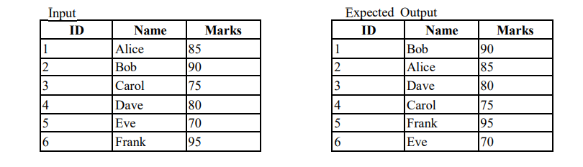
TASK 2
Description: You are working with a student management system that stores student information in a table. The table has the following schema: ID, Name, Marks
Provide solution and approach for the following:
You are required to write a SQL query to swap the Name and Marks values where Id is odd with even Id. The Id values must remain unchanged, ensuring that only the Name and Marks values are swapped between these two specific rows.

Slide 8
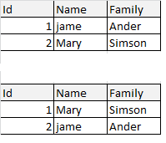
What is swapping ? And
How It Works In Terms Of SQL
Swapping means to exchange their position or values of two items. In the context of data swapping refers to exchanging the value of two variables or table columns
Example: If we have 2 variables a & b and their respective values are 3 & 4 if we use the swapping the values of a & b will be 4 & 3
In SQL swapping refers to exchanging the values between columns and rows in a table. This operation is useful in various scenarios like reorganizing data , correcting errors or Updating the records
Example: From the above table swapping is used. Swapping is done on rows exchanging the rows of name and Family.
As you see the table
id 1 jame is Swap by the Mary & same Mary Swap by jame

Slide 9
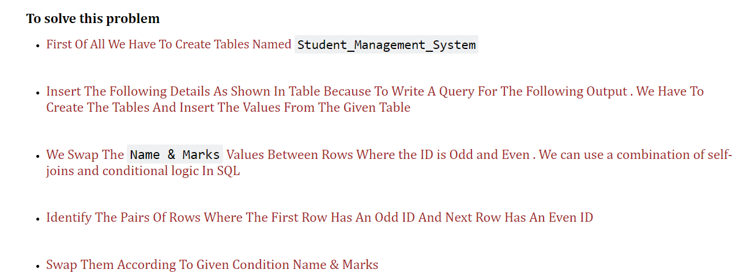

Slide 10
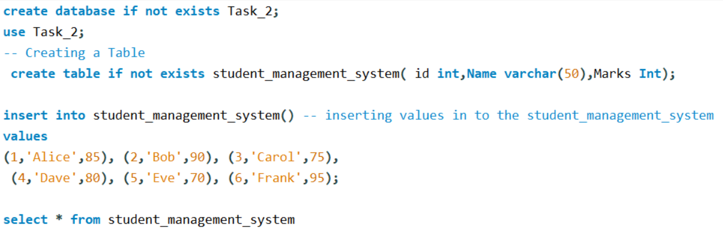
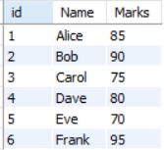

Slide 11
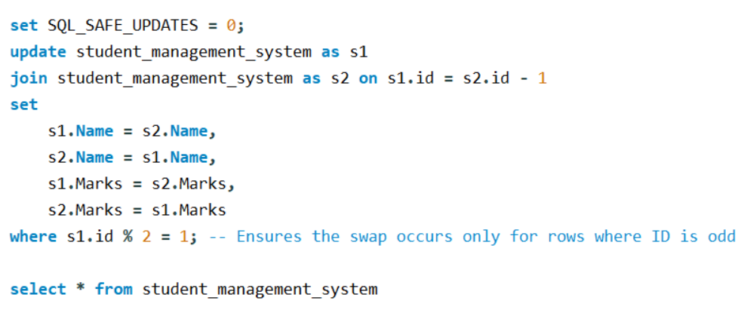
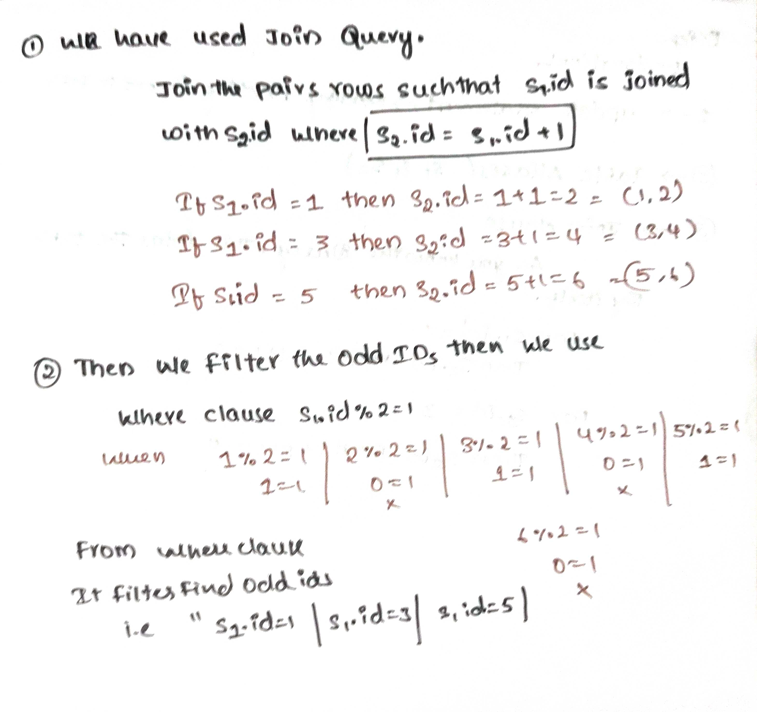
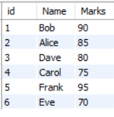
Final Query & Output

Slide 12
