Slide 1
Course Introduction Big Data Engineering in the Cloud
Dec 2017

Slide 2
Introduction
Aims
Pre-requisites
Contents
Objectives
Resources
Rules of Engagement
Introductions

Slide 3
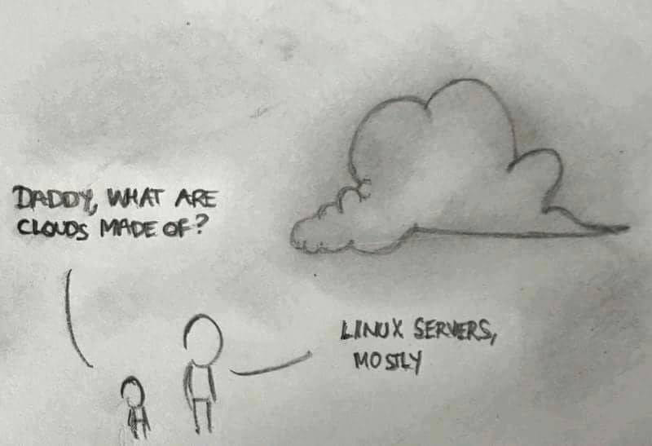

Slide 4
Aims
Understanding principles of Big Data
Theoretical background and origins
Practical experience of modern big data processing systems technologies
Architecture and design
Wider context

Slide 5
Pre-requisites
Covered by the Pre-Study Guide
Command line tooling and Unix commands
Some Python programming and text editors

Slide 6
Format
A mixture of lectures and practical labs
Lectures aim to provide the wider context and background
Independent of specific technologies
Labs are based on specific technologies
Designed to demonstrate the principles

Slide 7
Lab model
Local Virtual Machine
Ubuntu
Pre-installed big data software
E.g. Apache Spark, Cassandra, Python
Amazon Web Services
Virtual machines in the cloud

Slide 8
Contents
Big Data motivation and overview
Using Python for Data Analysis
Map Reduce and Directed Acyclic Graphs
Apache Spark
Spark and SQL
Theory of scaling
Running Spark on Amazon
Introduction to NoSQL databases
Introduction to Machine Learning

Slide 9
Practicals
Python Data Analysis
Spark, SparkSQL
Spark on Amazon
Cassandra and NoSQL
Machine Learning libraries
Visualisation

Slide 10
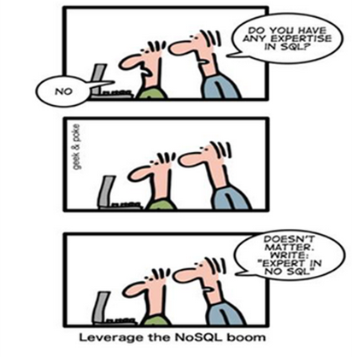
Improve your CV?

Slide 11
Beyond the scope of this course
Detailed Data Science techniques
Understanding all of Hadoop, Spark, HDFS, Machine Learning

Slide 12
Rules of Engagement
Ask questions as we go along
We will “park” any that are better answered later
Don’t wait till the end to ask or raise concerns
If you don’t ask we can’t help you

Slide 13

There might will be bugs!
Please help out:
Please create new issues on the Github repository
https://github.com/pzfreo/big/issues/new

Slide 14
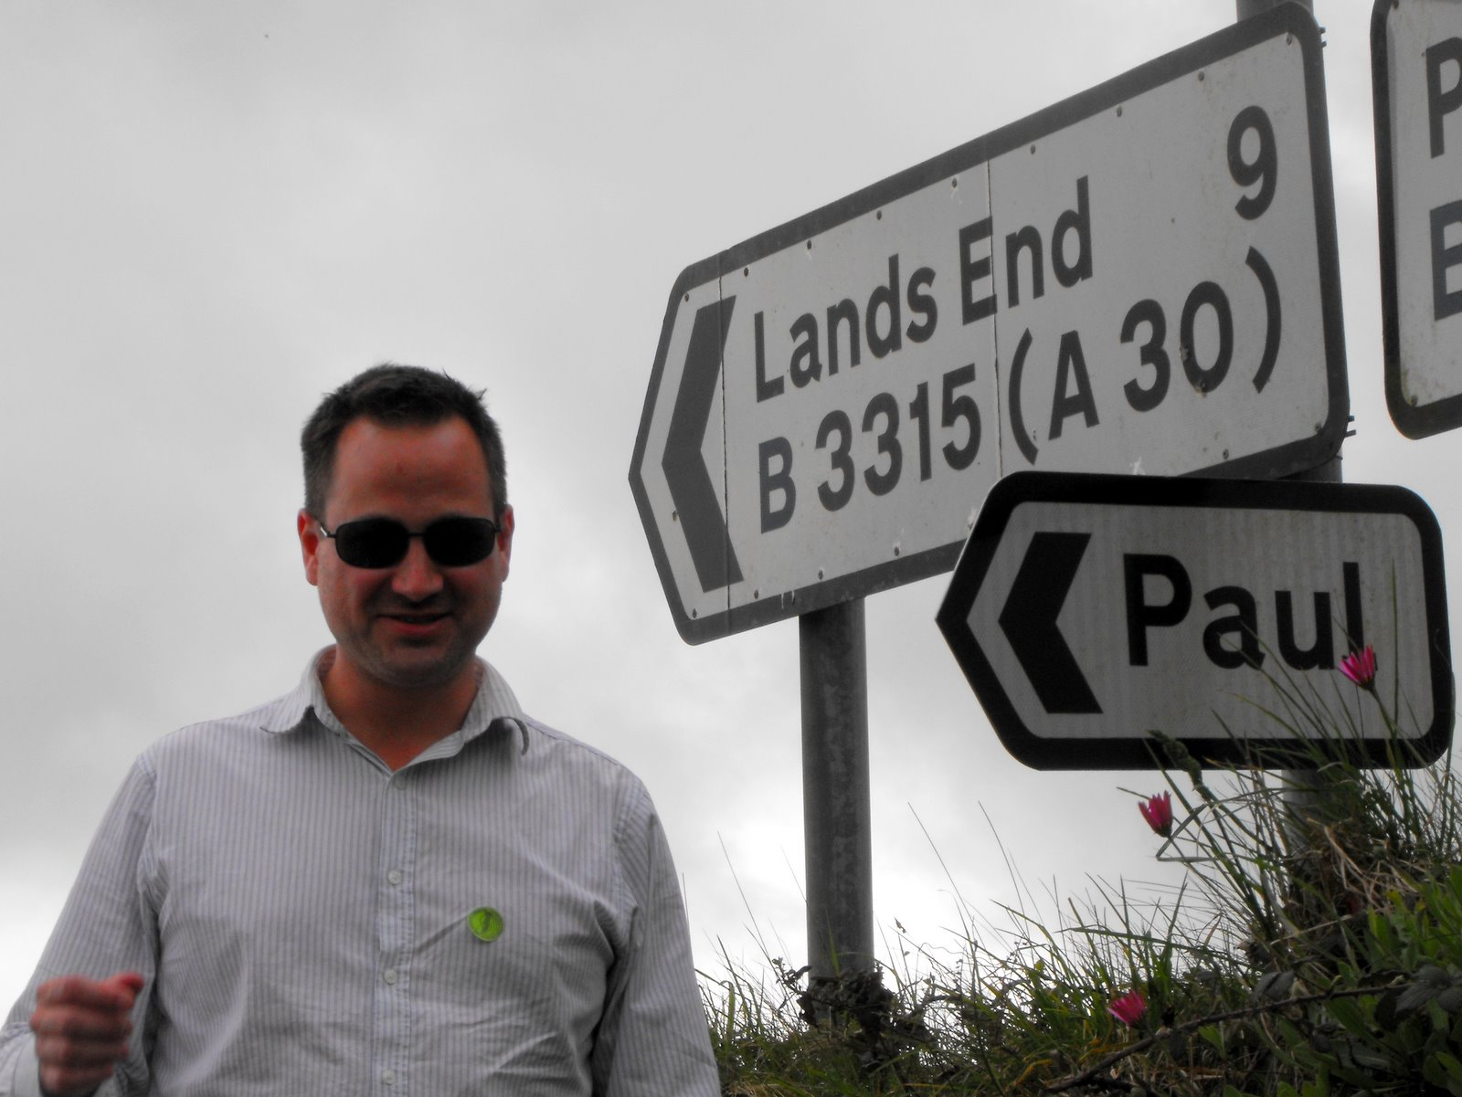
Paul Fremantle
CTO and Co-Founder of WSO2
Previously Senior Technical Staff Member, IBM WebSphere architecture
Visiting Lecturer, Oxford University
VP, Apache Synapse and Member of Apache
PhD in Computing (2017)
IoT security and privacy

Slide 15

David Johnson
Senior Researcher, e-Science, Oxford University
Founding Member, Data Science Institute, Imperial
PhD, Reading University, 2010
Awarded University of Oxford Teaching Award, 2016

Slide 16
You?

Slide 17
Approximate Schedule
Weds
Introductions
Overview and Motivation
Data Analysis with Python and Pandas
Map Reduce
Apache Spark
Thursday
SQL
Theoretical background on scaling systems
Scaling Spark on AWS
Visualisation
Friday
Introduction to Machine Learning
Realtime systems
Architecting big data systems
Completion of labs

Slide 18

Let’s get started

