Slide 1
Map-Reduce and Scaling Big Data Processing

Slide 2
Contents
Understanding Map Reduce
Functional programming patterns applied for scalability
Hadoop
Map-reduce in Hadoop
Python
Java
HDFS
Yarn
Pig and Hive
Further reading

Slide 3
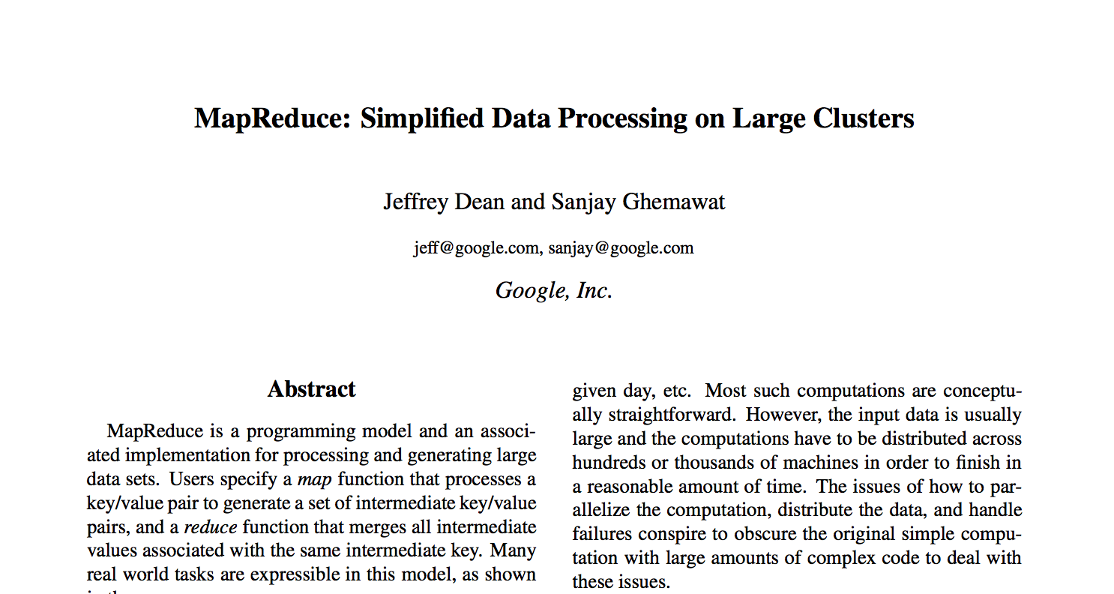
Original 2008 Google Paper

Slide 4
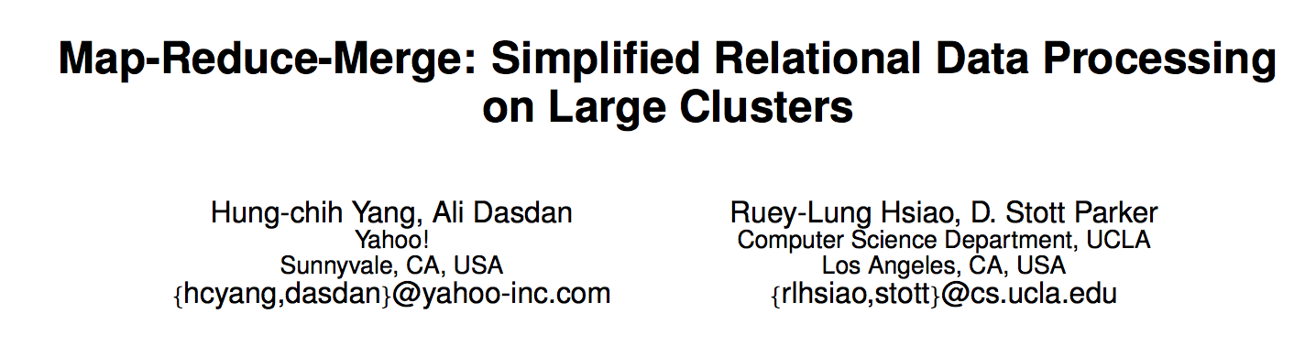
Yahoo 2007

Slide 5
Class Exercise
Find a small piece of paper and write your university and day/month of birth on one.
You don’t need the year
Portsmouth 5 October

Slide 6
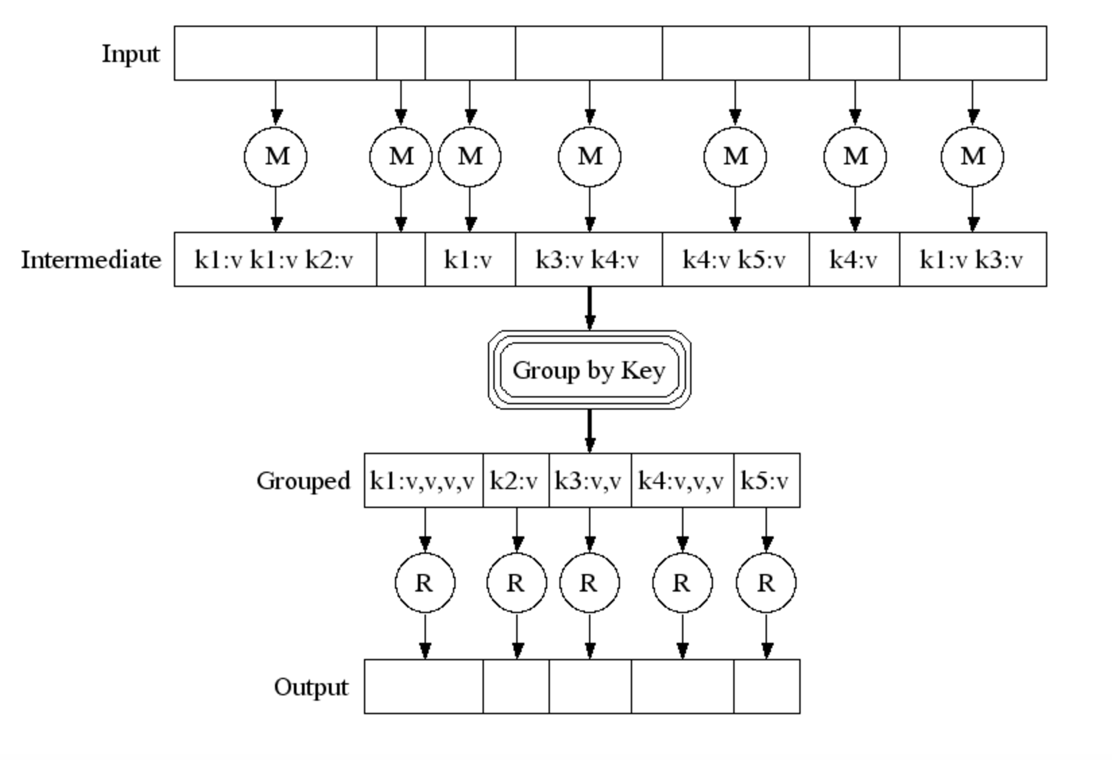
Pictorially

Slide 7
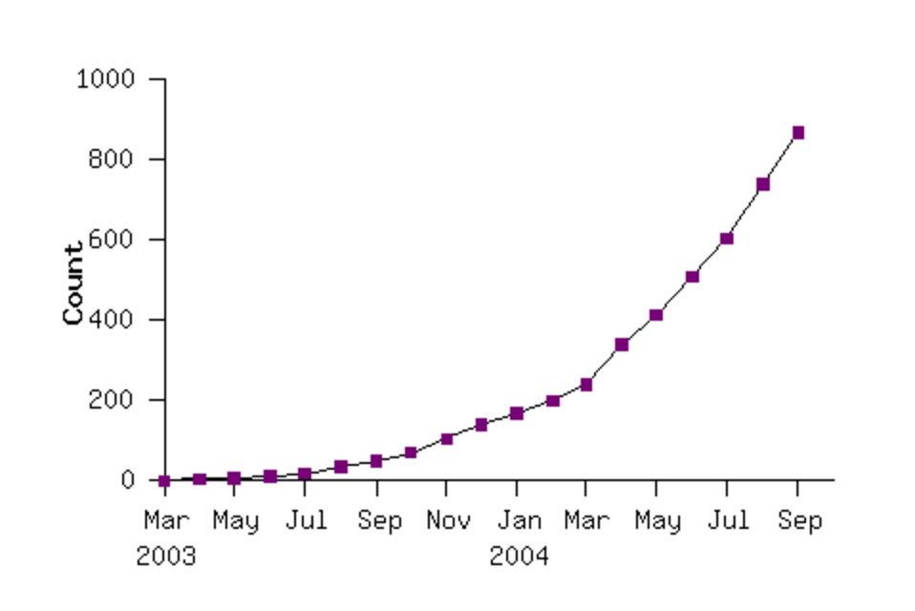
Google’s early use of MR Map Reduce programs in their code repository

Slide 8
Map Reduce example in words
Do a word count on 1000 books:
First count each book (map wc onto book)
Then reduce the outputs to a global wordcount across all books

Slide 9
Efficiency
Reduce phase:
We can theoretically process each word in parallel
How?
Shuffle / Sort the results from the map phase by key (word)
Partition by keys
Parallelize the reduce phase

Slide 10
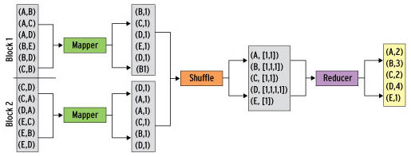
Map/Shuffle/Reduce

Slide 11
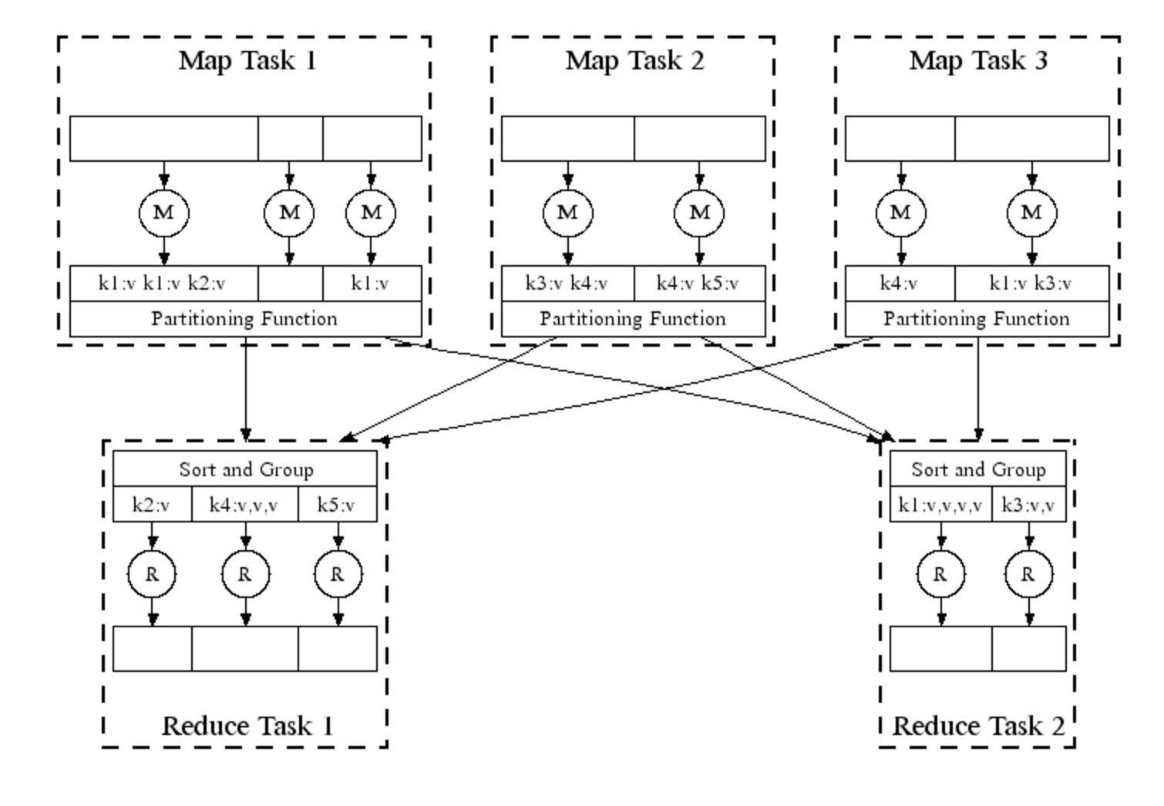

Slide 12
Map Reduce in Real Life
Analysing web logs
Summarise by user / cookie
Then aggregate to identify who did what
Analysing twitter data
Who retweeted
Who was retweeted the most
Almost all big data problems can be re-factored into Map Reduce
Some more efficiently than others

Slide 13
Tuning
Fault tolerance
Simply re-execute work that fails
Performance:
Partitioning the data
Moving the work to near the data

Slide 14
Apache Hadoop
The most famous and popular Map Reduce framework
Open Source
Written in Java, but supports other languages
Runs Map Reduce workloads across a cloud or cluster of machines
Supports a distributed filesystem to store data for these jobs
Provides reliability when servers in the cluster fail

Slide 15
Components of Hadoop
Map Reduce or Other Workloads
Java, Scala, Python, Apache Pig, Apache Hive, etc
YARN (Yet Another Resource Negotiator)
Cluster Resource Management
Hadoop Distributed File System (HDFS)
Redundant Reliable Distributed File System

Slide 16
HDFS in a nutshell
Client
NameNode
Secondary
NameNode
metadata
checkpoint
Data access
DataNode
DataNode
DataNode
DataNode

Slide 17
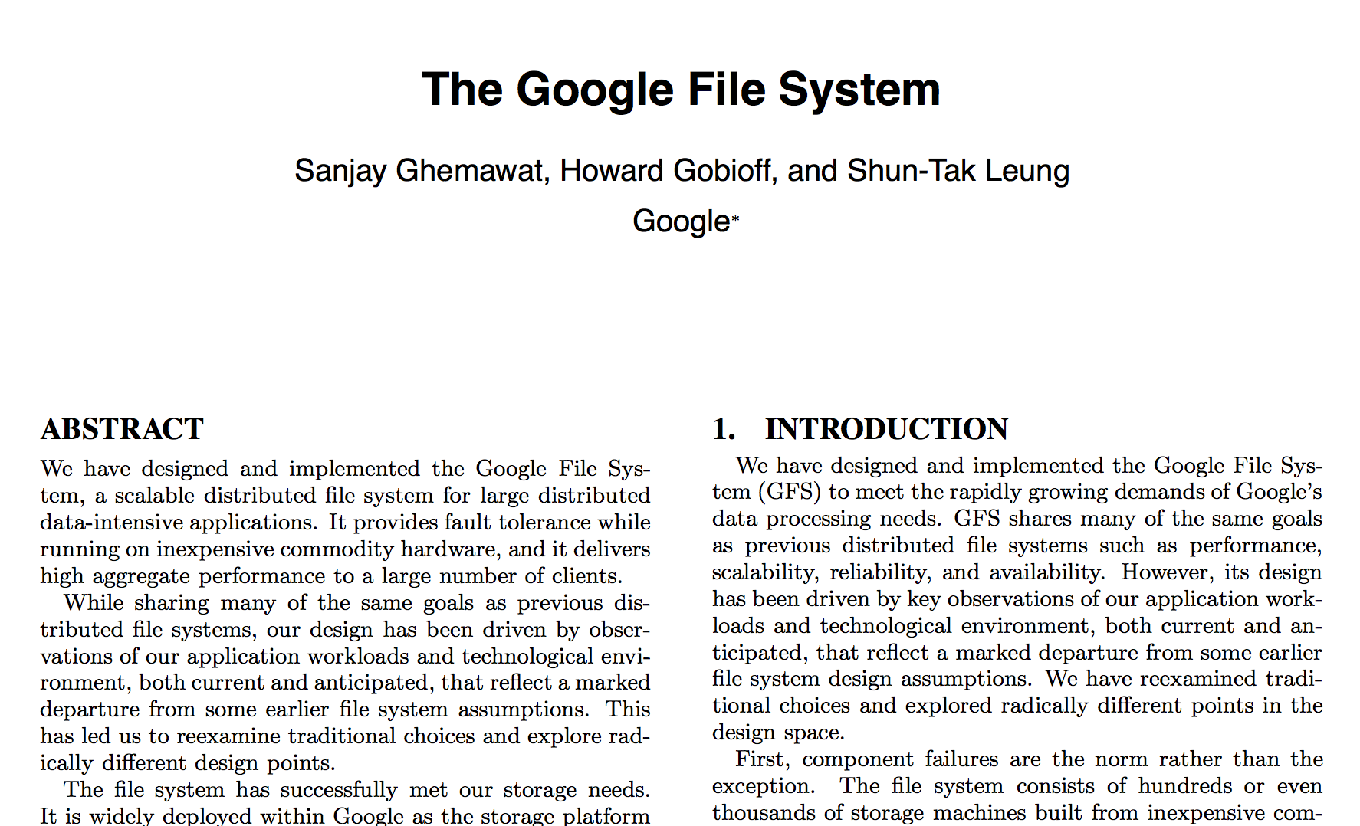
HDFS inspiration
Google File System
Sanjay Ghemawat, Howard Gobioff, and Shun-Tak Leung. 2003. The Google file system. In Proceedings of the nineteenth ACM symposium on Operating systems principles (SOSP '03). ACM, New York, NY, USA, 29-43.

Slide 18
HDFS overview
Good for streaming access to large files, reliability, scale
Not good for random access, small files
Blocks of data 64Mb in size (configurable)
Each block can be replicated across multiple data nodes for High Availability (HA)

Slide 19
Summary
Understanding the Map Reduce Model
How is it implemented in Hadoop
HDFS
Yarn

Slide 20
Questions?

Slide 21
HDFS Usage
Spotify has 1600+ nodes, storing 60+ petabytes of data
https://www.usenix.org/system/files/conference/fast17/fast17-niazi.pdf
One of the Facebook's largest clusters (based on HDFS) holds more than 100 PB of data, processing more than 60,000 Hive queries a day
https://www.facebook.com/notes/facebook-engineering/under-the-hood-scheduling-mapreduce-jobs-more-efficiently-with-corona/

Slide 22
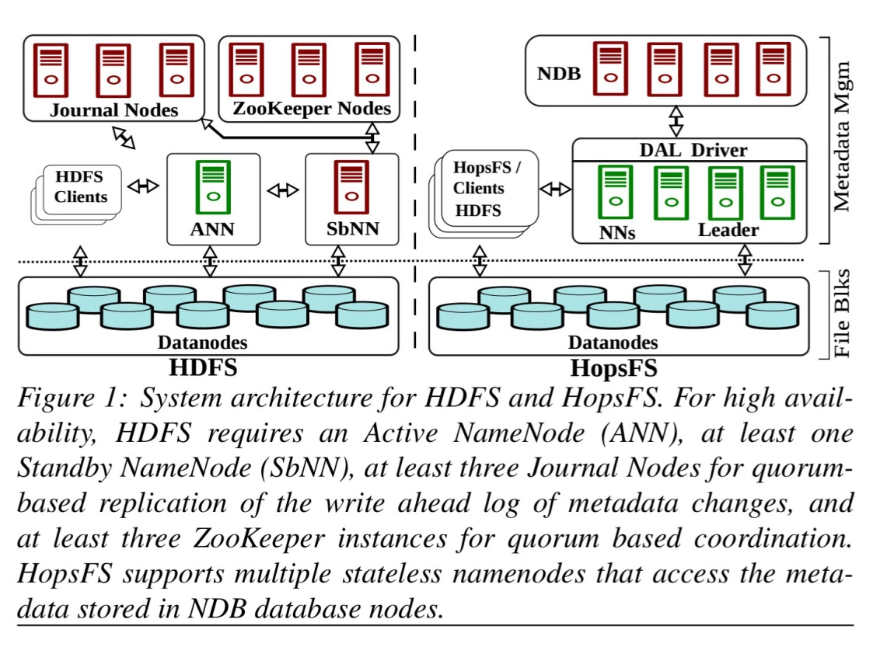
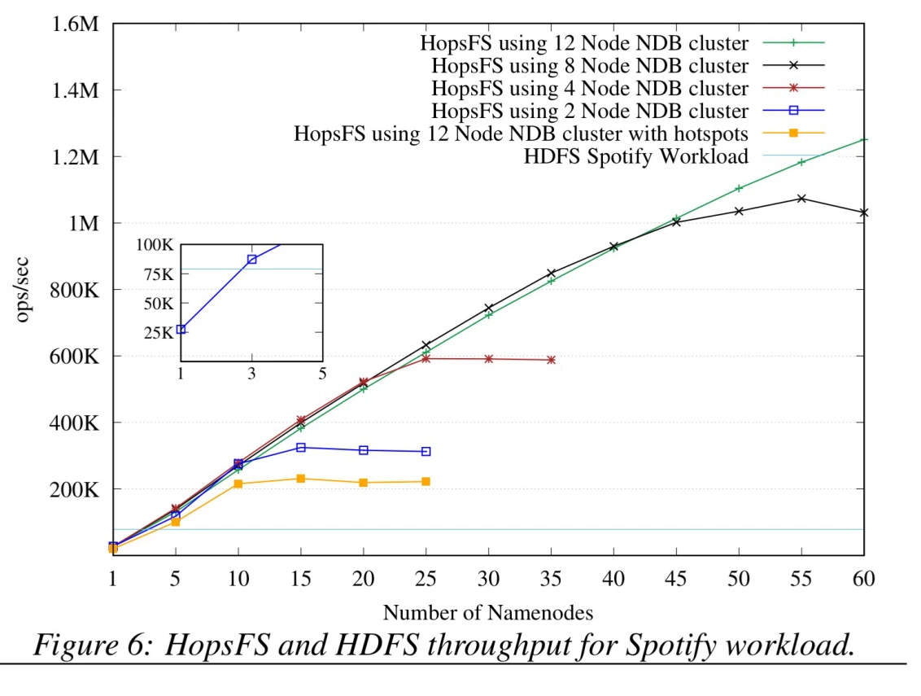
HopFS
HopFS is a drop-in replacement for HDFS, based on HDFS v2.0.4.

Slide 23
What is YARN?
YARN is the system that runs your code on multiple nodes
Hadoop 2.0 replacement for the cluster manager
Basically a model to distribute and manage workloads
Not just MapReduce but supports other workloads

Slide 24
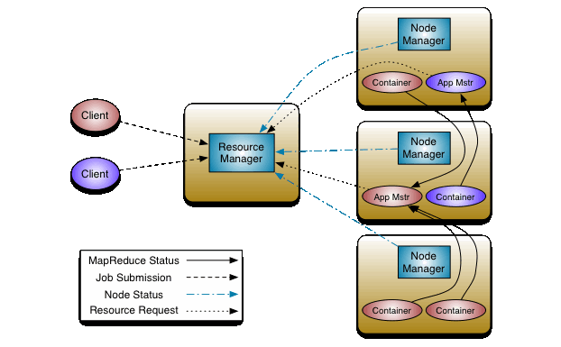
YARN architecture

