Slide 1
Big Data Engineering Other Tools and Libraries

Slide 2
Spark packages
A wide set of plugins
Currently 148 community donated plugins
Data connectors
Cassandra, Couchbase, Mongo, CSV, etc
Machine Learning, Neural networks
Streaming
etc

Slide 3
Using Spark Packages
Automatic download from the web:
bin/spark-shell
--packages com.databricks:spark-csv_2.11:1.2.0

Slide 4
Locality
Spark understands the locality of data:
Already in memory
HDFS location
Cassandra location

Slide 5
Spark Extras
Spark
SQL
Spark Streaming
Spark
MLlib
SparkR
GraphX
Spark Core

Slide 6
Spark Extras
Spark Streaming
Realtime analysis in Spark
Spark MLLib
Like Mahout – Machine learning in Spark
GraphX
Graph processing in Spark
SparkR
R statistical analysis on Spark

Slide 7
Spark MLlib
Simple stats and correlation testing
Classification and regression
Collaborative Filtering
Alternating Least Squares
Clustering
k-means, etc
Frequent Pattern Mining
Plus more

Slide 8
MLlib example
from pyspark.mllib.fpm import FPGrowth
data = sc.textFile("data/mllib/sample_fpgrowth.txt")
transactions = data.map(lambda line: line.strip().split(' '))
model = FPGrowth.train(transactions, minSupport=0.2, numPartitions=10)
result = model.freqItemsets().collect()
for fi in result:
print(fi)

Slide 9
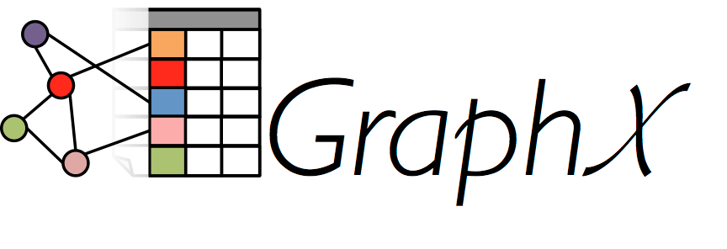
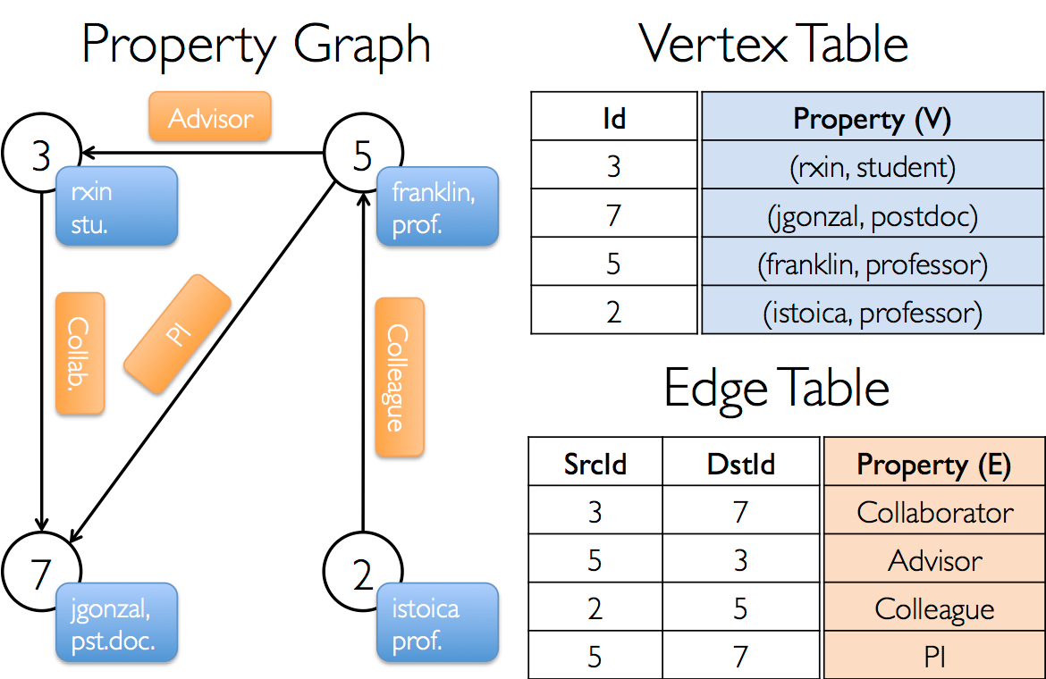
GraphX

Slide 10

R
R is an open source system for statistics and graphics
Based on the S language from AT&T Bell Labs
Supports a wide variety of statistical techniques and graphing tools
An extensible set of packages that provide extra functions via CRAN
The Comprehensive R Archive Network

Slide 11
SparkR
A lightweight approach to use Spark from within R
Also works with MLlib for machine learning
Allows complex statistical analysis to be done on a Spark cluster

Slide 12
Apache Avro
A compact data storage and transmission system
Uses schemas of data to ensure it can be read by the receiver
Supports dynamic typing
Used by RPC or data collection systems
Fast binary protocols
Also supports storage
Hence used by many Big Data apps including Hadoop and Spark

Slide 13
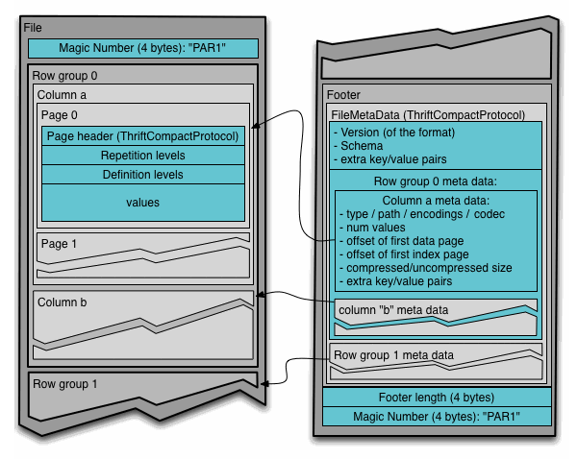
Apache Parquet
Apache Parquet is a columnar data storage model
Works with Hadoop, Spark and many others
Efficient storage of data
Based on another Google system called Dremel

Slide 14
Apache Tez http://tez.apache.org
Support for complex Directed Acyclic Graphs (DAGs) on top of YARN
Supports in memory jobs
Simplifies work that would previously be in multiple MR jobs
Designed to support Pig and Hive

Slide 15
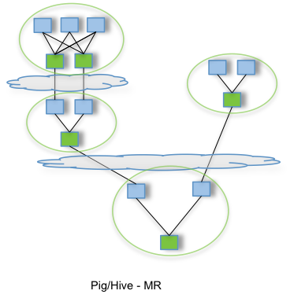
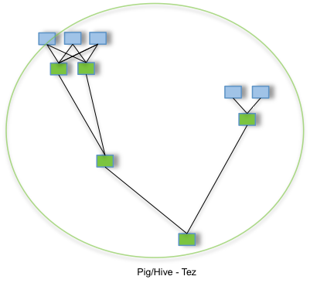
Tez

Slide 16
Questions?

