Slide 1
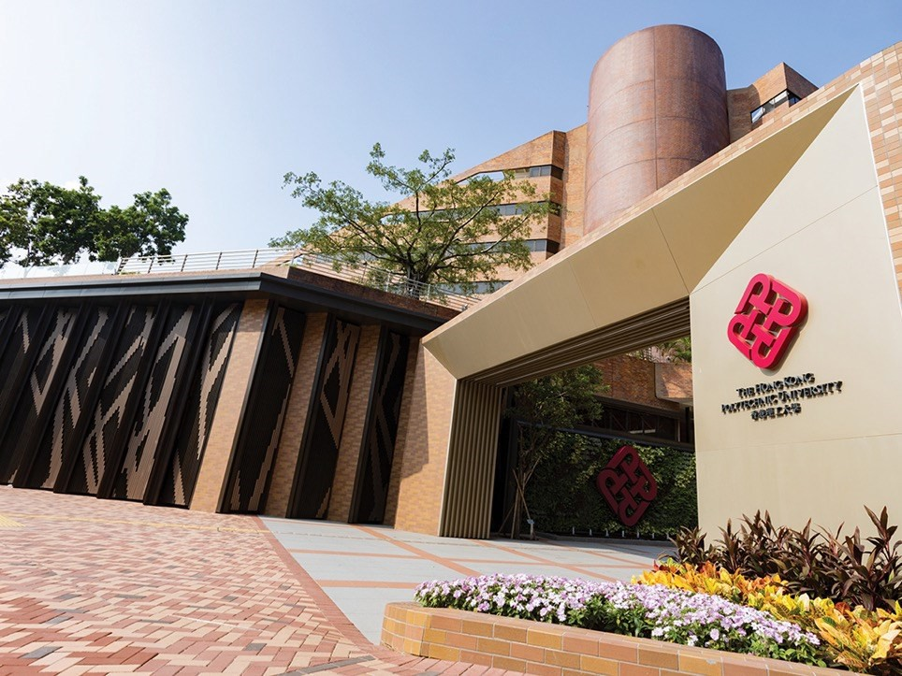


Introduction to the Subject
Electric Energy Storage and New Energy Sources for Electric Vehicles (EE546)
Dr. Lucian Wei LIU
Assistant Professor
Electric Vehicles & Smart Mobility (EVSM) Group Research Centre for Electric Vehicles (RCEV)
Department of Electrical and Electronic Engineering (EEE)
The Hong Kong Polytechnic University

Slide 2
Briefing
Lecturer 1: Dr. Wei Lucian LIU (Subject Leader)
Address: CF626, 6/F, Core F, Department of EEE, PolyU
Tel: 2766 4404
Email: wei.liu@polyu.edu.hk
Website: www.eee.hku.hk/~liuwei
Teaching and learning are mutually motivating
Please feel free to give your suggestions on our teaching and learning
Lecturer 2: Dr. Jinpeng TIAN
Address: CF632, 6/F, Core F, Department of EEE, PolyU
Tel: 2766 6181
Email: jinpeng.tian@polyu.edu.hk
Teaching Assistants (TAs):
Tianyi LIU, andrew-ty.liu@connect.polyu.hk
Jian SONG, eee-jian.song@connect.polyu.hk
Junkai LI, junkai.li@connect.polyu.hk
Muqing GE, 24152567r@connect.polyu.hk
1

Slide 3
Location and Time
Lectures:
Location: ST111
Time & Date: 18:30 – 21:20, Tuesday, 2 Sept 2025 – 25 Nov 2025
Total number of lectures: 13 (incl. summary and review)
Office hours:
Time & Date: 14:00 – 17:00, Friday
You may email me in advance to double check my availability.
2

Slide 4
Introduction to the Subject

Slide 5
Can you answer these? (target questions)
How does energy storage play a beneficial role in energy sustainability and addressing the climate change issue?
What types of energy sources are used by electric vehicles (EVs)? And what are the advantages and disadvantages of them?
Which type of energy source do you think is most likely to become mainstream for the EV in the next decade, and why?
What is the hybrid energy system and why do we need it?
What are the potential safety concerns associated with energy storage systems in EVs, and how can they be
mitigated?
4

Slide 6
Learning Outcomes
Understand the importance of energy storage as it pertains to environmental concerns, energy sustainability and climate change.
Understand various underpinning technologies for conventional and modern energy storage including both portable and stationary systems, such as batteries, supercapacitors, compressed air, flow batteries, new fuel, and fuel cells.
Explain the role of energy storage in new energy in electric vehicles (EV) and discuss how energy storage devices can be optimally integrated for these applications.
5

Slide 7
Energy Storage in EV Technologies
The basic EV parts:
Conductive charger
Battery
Fuel cell
Basic battery management system (BMS)
Motor
Driver
Our Electric Vehicles & Smart Mobility (EVSM) Research Group and Research Centre for Electric Vehicles (RCEV) have the following EV advanced technology:
Wireless charger
In-wheel motor & In-wheel vehicle
All electric active suspension
Fuel cell or new fuel vehicle
Distributed energy storage for EV
Autonomous vehicle
Wireless motor
Wireless EV energy network
Advanced power electronics technology
6

Slide 8






What will be taught?
Classification of electric vehicle (EV) energy source
Batteries
Supercapacitors
Ultrahigh-speed flywheels
Fuel cells
Hybridisation of energy sources
Case study
Magnetic energy storage
Lithium-ion batteries and battery management systems
Battery models
Battery state of charge and state of health
Battery impedance and electrochemical impedance spectroscopy
13. New energy for vehicles
7

Slide 9
The Subject Coursework
Assessment, homework, miniproject, in-class test, and final exam

Slide 10

Assessment & Homework
Assessment
Assignment: 10% (Homework)
In-Class Test: 25% (Two 60-min in-class short tests, each test 12.5%)
Miniproject: 15% (Report and presentation)
Examination: 50% (One three-hour examination)
Homework
The assignment may be given after some lectures as homework.
The assignment should be returned to the lecturer through
BLACKBOARD at the following lecture.
The deadline for each homework is specified in the schedule (see
Subject Description).
Rubrics: All problems must be supported with an appropriate amount of work. Generally, this means that enough work is shown to demonstrate that the student worked through all steps of the problem. Answers without supporting work will receive no credit.
9

Slide 11
Miniproject
Students will be divided by themselves into around 9 miniproject topics (each topic can have at maximum 4 groups, and each group is around 3-5 students)
Each group selects a project from the miniproject list
In each class, we could accommodate 3 to 4 presentations
Students will then present the project and submit the report (10 – 20
pages) two week (i.e. 10 working days) after the presentation
Rubrics: Presentation skill, report’s technical content, and impact. Each group may have the same topic but their content, focus and presentation are different.
Miniproject List
Start-of-the-Art Batteries for EVs
Supercapacitor Technology in EVs
Flywheels & Fuel Cells
Hybridisation of Energy Sources
Battery Faults
Remaining Useful Life of Batteries
Reuse of Retired EV Batteries
Battery Charging Strategies
Machine Learning in Battery Management
Fill in the student group and select the project via Google Excel Link:
https://docs.google.com/spreadsheets/d/1UBGuKWeS-
IF0jtL0MoKL_WkYejF2ovTwYkoTO1ugh9k/edit?gid=0#gid=0
10

Slide 12
Quiz & Final Exam
In-Class Test
The quiz (in-class test) is face-to-face in the class.
It usually covers the course materials right before the In-Class Test.
The quiz is open-book and open-note, and you are only allowed to refer to your own note, instructor’s note, text/reference books, electronic notes, and the information in Blackboard. No other materials are allowed. No internet access to outside is allowed.
Final Exam
It is closed book. You have to come in person to take the exam.
11

Slide 13
Coursework and Miniproject Report Submission
By Email: DO NOT send by email as it may not be received or go to spam.
By Blackboard: Submission must be submitted electronically to the
Blackboard.
Format of the file name
For MiniProject report: MiniPNo_StudentName.pdf or MiniPNo
_StudentName.doc
For Homework: AssNo_StudentName_StudentNo.pdf or AssNo_StudentName
_StudentNo.doc
Notes
All homework submissions must be done individually and no group submission. For Miniproject report, nominate one of the group members to submit the report. The report must be written with all members’ names and student ID. Your mark may be the same as your group member.
The solution to the homework will be released after the marking,
usually within 2-3 weeks.
12

Slide 14
The Subject Policies
Academic integrity, late policy, and illness

Slide 15
Academic Integrity
Among these is turning in another’s work as your own, committing plagiarism, which is the copying of portions of another’s words from a published or electronic source without acknowledgement of that source and consulting solution keys not authorized by the instructor.
The penalty for a breach of academic integrity is a double- zero (−100%) for the work in question on the first offense and a failing grade for the course as a whole with repeated offenses.
Academic Integrity issues during the quiz (in-class test) and exam is needed to report to the Academic Secretary or Head of the Department.
14

Slide 16
Late Policy and Illness
Late Policy
Late on day due:
One calendar day late:
Two calendar days late:
10% penalty
20% penalty
40% penalty
Illness
If you are ill, especially with a fever, please stay home and rest.
If it is during a quiz (in-class test) or exam, doctor’s note is needed.
Please notify the instructor via email if you are missing class due to
illness.
15

Slide 17
The Subject Syllabus & Schedule

Slide 18

Syllabus & Schedule
Week | Date |  |  | Descriptions | Lecturer | Assignment/ report/text
1 | 2 Sept |  |  | LESSON 1: INTRODUCTION & CLASSIFICATION OF EV ENERGY SOURCES - Miniproject announcement | Liu
2 | 9 Sept |  |  | LESSON 2: BATTERIES | Liu
3 | 16 Sept |  |  | LESSON 3: SUPERCAPACITORS | Liu
4 | 23 Sept |  |  | LESSON 4: ULTRAHIGH-SPEED FLYWHEELS | Liu | Homework 1: due in 2 weeks
5 | 30 Sept |  |  | LESSON 5: FUEL CELLS | Liu
6 | 7 Oct (Public |  |  | LESSON 6: HYBRIDISATION OF ENERGY SOURCES Oct 11, 9:30am – 12:20noon / 14:00 – 17:20pm | Liu | TBC
 |  | holiday)
7 | 14 Oct |  |  | LESSON 7: CASE STUDY | Liu | In-class test
8 | 21 Oct |  |  | LESSON 8: LITHIUM-ION BATTERIES AND BATTERY MANAGEMENT SYSTEMS | Tian
9 | 28 Oct |  |  | LESSON 9: BATTERY MODELS | Tian | Homework 2: due in 2 weeks
10 | 7 Nov |  |  | LESSON 10: BATTERY STATE OF CHARGE | Tian
17

Slide 19
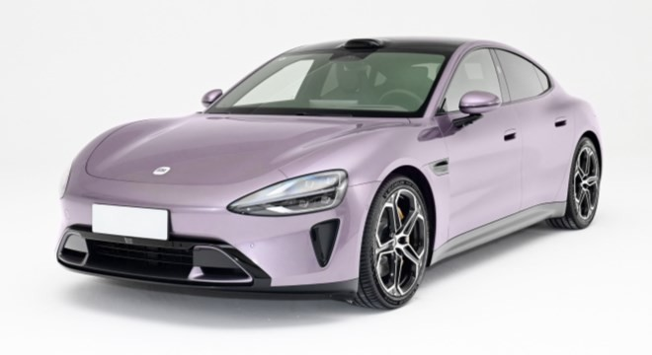
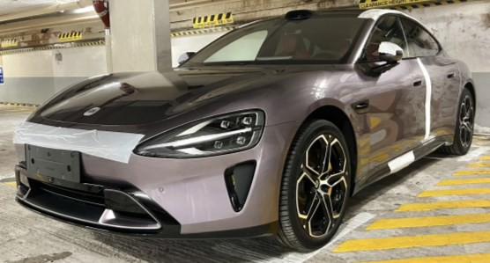

Syllabus & Schedule (Cont’d)
Week | Date | Descriptions | Lecturer | Assignment/ report/text
11 | 11 Nov | LESSON 11: BATTERY STATE OF HEALTH | Tian
12 | 18 Nov | LESSON 12: BATTERY IMPEDANCE AND ELECTROCHEMICAL IMPEDANCE SPECTROSCOPY | Tian
13 | 25 Nov | LESSON 13: NEW ENERGY FOR VEHICLES Summary and review | Tian | In-class test
 | 1 Dec – 21 Dec | FINAL EXAM | Liu, Tian | In-person Exam
University-Industry Collaboration Platform
Xiaomi
PolyU
Donation for
collaboration
18

Slide 20
Project Presentation List
Week | Date | Descriptions
1 | 2 Sept | No presentation
2 | 9 Sept | No presentation (allow students to have more time for preparation)
3 | 16 Sept | Topic 1: Start-of-the-Art Batteries for EVs
4 | 23 Sept | Topic 2: Supercapacitor Technology in EVs
5 | 30 Sept | Topic 3: Flywheels & Fuel Cells
6 | 7 Oct (Public holiday) | Topic 4: Hybridisation of Energy Sources Oct 11, 9:30am – 12:20noon / 14:00 – 17:20pm
7 | 14 Oct | Test – No Presentation
8 | 21 Oct | Topic 5: Battery faults
9 | 28 Oct | Topic 6: Remaining useful life of batteries
10 | 4 Nov | Topic 7: Reuse of retired EV batteries
11 | 11 Nov | Topic 8: Battery charging strategies
12 | 18 Nov | Topic 9: Machine learning in battery management
13 | 25 Nov | Test – No Presentation
19

