Slide 1



Overview
Electric Energy Storage and New Energy Sources for Electric Vehicles (EE546)
Dr. Lucian Wei LIU
Assistant Professor
Electric Vehicles & Smart Mobility (EVSM) Group Research Centre for Electric Vehicles (RCEV)
Department of Electrical and Electronic Engineering (EEE)
The Hong Kong Polytechnic University

Slide 2
Briefing
Lecturer 1: Dr. Wei Lucian LIU (Subject Leader)
Address: CF626, 6/F, Core F, Department of EEE, PolyU
Tel: 2766 4404
Email: wei.liu@polyu.edu.hk
Website: www.eee.hku.hk/~liuwei
Teaching and learning are mutually motivating
Please feel free to give your suggestions on our teaching and learning
Lecturer 2: Dr. Jinpeng TIAN
Address: CF632, 6/F, Core F, Department of EEE, PolyU
Tel: 2766 6181
Email: jinpeng.tian@polyu.edu.hk
Teaching Assistants (TAs):
Tianyi LIU, andrew-ty.liu@connect.polyu.hk
Jian SONG, eee-jian.song@connect.polyu.hk
Junkai LI, junkai.li@connect.polyu.hk
Muqing GE, 24152567r@connect.polyu.hk
1

Slide 3

Classification of Electric Vehicles (EVs)
Battery electric vehicles (BEVs)
Plug-in hybrid electric vehicles (PHEVs)
Hybrid electric vehicles (HEVs)
Fuel cell electric vehicles (FCEVs)
ICE
ICE
Motor
Motor
Motor
Fuel tank
Battery
Fuel tank
Battery
Battery
Driven by motor
Powered by battery only
Large battery capacity
Driven by both motor
and ICE
Powered by gasoline and battery
Medium battery capacity
Driven by both ICE and motor
Powered by gasoline and battery
Small battery capacity
Driven by motor
Powered by hydrogen
fuel and battery
Small battery capacity
ICE, Internal combustion engine
2

Slide 4
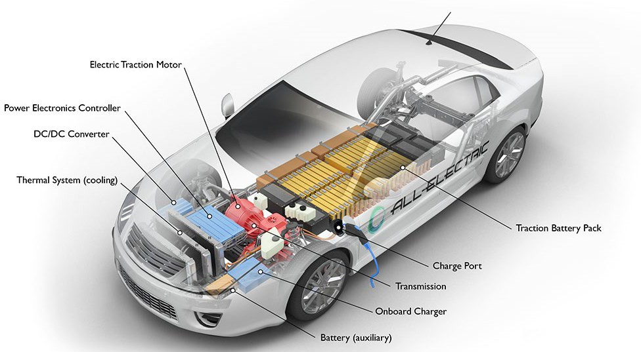
Classification of Electric Vehicles (EVs)
1. Battery EVs
Battery electric vehicles (BEVs), also referred to as all-electric vehicles, have an electric motor instead of an internal combustion engine. The EV uses a large traction battery pack to power the electric motor. Because it runs on electricity, the EV emits no exhaust from a tailpipe and does not contain the typical liquid fuel components, such as a fuel pump, fuel line or fuel tank.
3

Slide 5
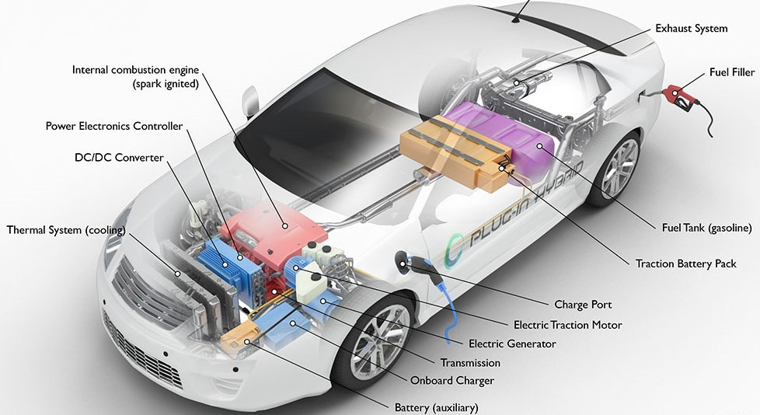
Classification of Electric Vehicles (EVs)
2. Plug-In Hybrid EVs
Plug-in hybrid electric vehicles (PHEVs) use batteries to power an electric motor and another fuel, such as gasoline, to power an internal combustion engine (ICE). The PHEV batteries can be charged using a wall outlet or charging equipment, by the ICE, or through regenerative braking. The vehicle typically runs on electric power until the battery is nearly depleted, and then the car automatically switches over to use the ICE.
4

Slide 6
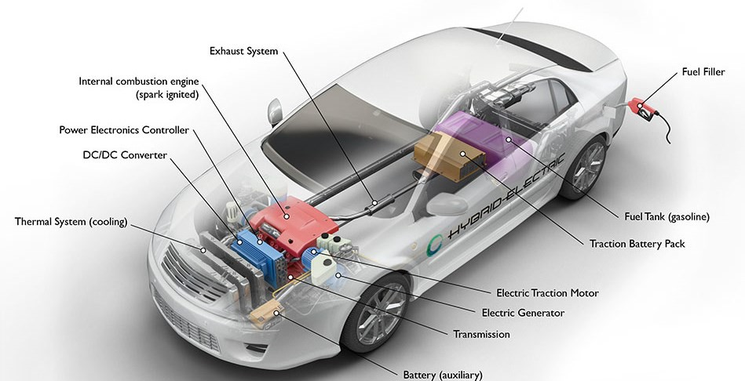
Classification of Electric Vehicles (EVs)
3. Hybrid Electric Vehicles
Hybrid electric vehicles (HEVs) are powered by an internal combustion engine and one or more electric motors, which uses energy stored in batteries. A HEV cannot be plugged in to charge the battery. Instead, the battery is charged through regenerative braking and by the internal combustion engine. The extra power provided by the electric motor can potentially allow for a smaller engine. The battery can also power auxiliary loads and reduce engine idling when stopped. Together, these features result in better fuel economy without sacrificing performance.
5

Slide 7
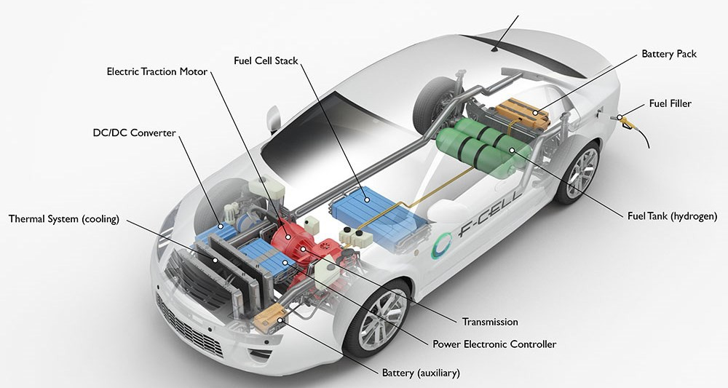
Classification of Electric Vehicles (EVs)
4. Fuel Cell EVs
Like all-electric vehicles, fuel cell electric vehicles (FCEVs) use electricity to power an electric motor. In contrast to other EVs, FCEVs produce electricity using a fuel cell powered by hydrogen, rather than drawing electricity from only a battery. Most FCEVs today use the battery for recapturing braking energy, providing extra power during short acceleration events, and smoothing out the power delivered from the fuel cell with the option to idle or turn off the fuel cell during low power needs. The amount of energy stored onboard is determined by the size of the hydrogen fuel tank.
6

Slide 8
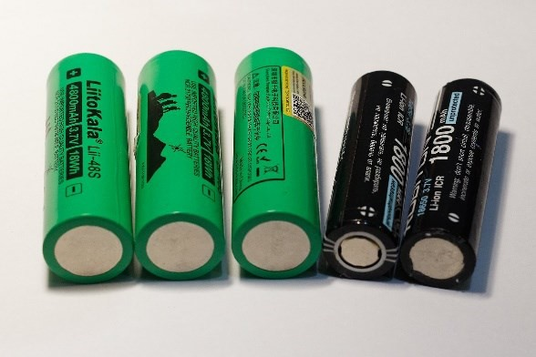
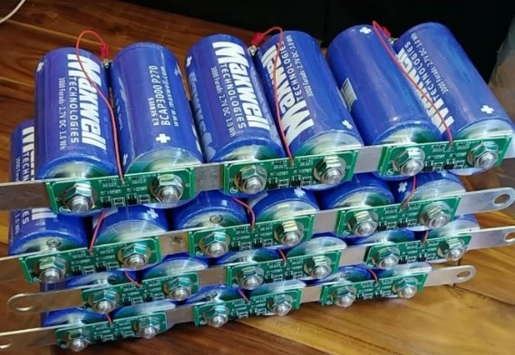

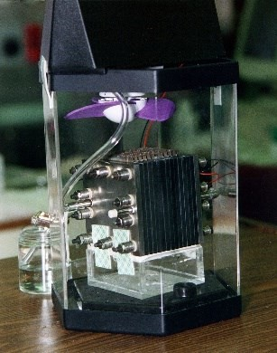
Classification of EV Energy Sources
Batteries
based on electrochemical means to
store electrical energy
REF: https://commons.wikimedia.org/wiki/File:Comparison_ of_18650_and_21700_batteries_01.jpg
Ultracapacitors
based on electrostatic means to store electrical energy
REF: https://studentlesson.com/definition-applications- diagram-working-specifications-characteristics-construction- properties-types-ultracapacitors/
Ultrahigh-speed flywheels
based on electromechanical means to
store electrical energy
REF: https://commons.wikimedia.org/wiki/File:Yauza_ 209-1_(disassembly)_-_capstan-flywheel,_upright_01.jpg
Fuel cells
based on electrochemical means to
generate electrical energy
REF: https://commons.wikimedia.org/wiki/File:Fuel_cell_NASA_
7
p48600ac.jpg

Slide 9
Lesson 2: Batteries
In the foreseeable future, batteries are the major energy source for EVs. Major types of batteries that have been developed for EVs are:
Valve-regulated lead acid (VRLA)
Nickel-cadmium (Ni-Cd)
Nickel-metal hydride (Ni-MH)
Zinc/air (Zn/air)
Sodium/sulfur (Na/S)
Lithium-ion (Li-ion)
Sodium-ion (Na-ion)
Solid-state battery
Memory effect
CATL
Performance Comparison
 | Specific energy (Wh/kg) | Specific power (W/kg) | Cycle life (Cycles) | Cost (USD/kWh)
VRLA | 30-45 | 200-300 | 400-600 | 150
Ni-Cd | 40-60 | 150-350 | 600-1200 | 300
Ni-MH | 60-120 | 150-400 | 600-1200 | 200-350
Zn/air | 230 | 105 | NA | 90-120
Na/S | 100 | 200 | 800 | 250-450
Li-ion | 90-160 | 250-450 | 1200-2000 | 600-1000
Contemporary Amperex Technology Co., Limited (CATL)
8

Slide 10
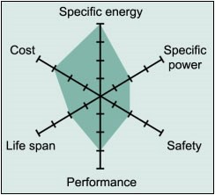
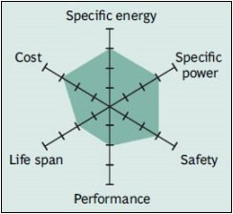
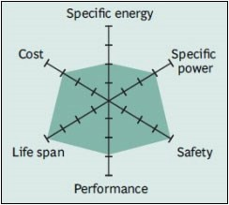
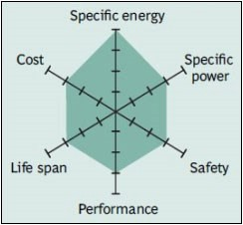
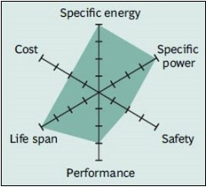
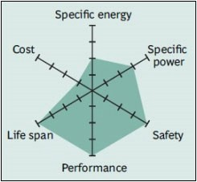
Lesson 2: Batteries
Current research on battery technology is being focused on the
development of various Li-ion batteries:
Lithium cobalt oxide (LCO)
Lithium manganese oxide (LMO)
Lithium iron phosphate (LFP)
Lithium nickel manganese cobalt oxide (NMC)
Lithium nickel cobalt aluminum oxide (NCA)
Lithium titanate (LTO)
Comparison of emerging Li-ion batteries
LCO
LMO
LFP NMC
Note
Cost: Cost-effectiveness
Life span: Cycle life
Performance: Low-temperature performance
Safety: Safety operation
NCA
LTO
REF: http://batteryuniversity.com/learn/article/explaining_lithium_ion_chemistries
9

Slide 11
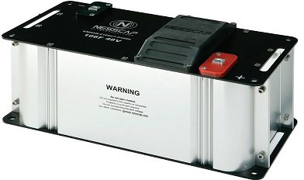
Lesson 3: Ultracapacitors
The ultracapacitor technology is promising for EVs since it offers
exceptionally high specific power and practically unlimited cycle
life. Nevertheless, it needs significant improvement before
practically applicable as the sole energy source for EVs:
Its specific energy (5-6 kW/kg) needs to be greatly increased.
Its initial cost (2,400-6,000 USD/kWh) has to be greatly reduced.
48V capacitor module
High power supply performance
Low internal resistance
REF: http://www.tongman-sh.com/proshow_01.html
Current research on ultracapacitor technology is being focused on the improvement of its specific energy, such as the use of graphene and carbon nanotubes to increase the usable surface area and hence the energy storage capacity.

Slide 12
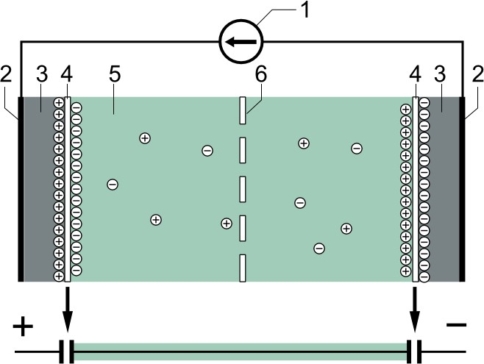
Lesson 3: Ultracapacitors
Basic design
power source
collector
polarized electrode
Helmholtz double layer
electrolyte having positive and negative ions
separator
Electrochemical capacitors (supercapacitors) consist of two electrodes separated by an ion-permeable membrane (separator), and an electrolyte ionically connecting both electrodes. When the electrodes are polarized by an applied voltage, ions in the electrolyte form electric double layers of opposite polarity to the electrode's polarity.
REF: https://commons.wikimedia.org/wiki/File:Electric_double-layer_capacitor_(2_models)_-1_NT.PNG

Slide 13
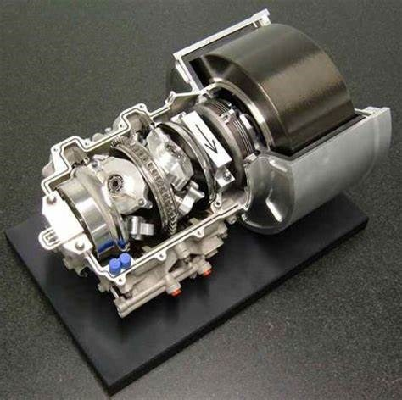
Lesson 4: Ultrahigh-Speed Flywheels
The ultrahigh-speed flywheel technology exhibits potentiality for EVs. By providing vacuum environment to remove the air friction and magnetic bearings to eliminate the bearing loss, the flywheel can spin up to 60,000 rpm so as to achieve high specific energy
and high round-trip efficiency.
97% mechanical efficiency, and
85% round trip efficiency
Magnetic bearing
Flywheel
Vacuum
Rotor of PM brushless machine Stator of PM brushless machine
PM
Casing
Terminals
Magnetic bearing
REF: http://www.cbea.com/www/zy/20150922/4874312.html

Slide 14
Lesson 4: Ultrahigh-Speed Flywheels
It suffers from the problem of safety concern. When the tensile strength of a flywheel is exceeded or the flywheel is accidentally damaged, the flywheel shatters and instantaneously releases all of its stored energy – so-called flywheel explosion which is as dangerous as a bomb.
Current research on ultrahigh-speed flywheel technology is focused on improving its safety precaution such as the use of composite materials which can disintegrate into tiny powder rather than large chunks, or extending its application to energy storage for EV charging stations where the whole flywheel is embedded in the ground.
For application to charging station, the ultrahigh-speed flywheel can be used as a stationary energy storage system (25-kWh capacity and 130-kW capability) to provide rapid recharging for EVs. Thus, it offers the ability to release high power for rapid recharging while minimizing the corresponding peak power demand on power system.

Slide 15
Lesson 5: Fuel Cells
The leading types of fuel cells include:
Direct methanol fuel cell (DMFC)
Alkaline fuel cell (AFC)
Proton exchange membrane fuel cell (PEMFC)
Phosphate acid fuel cell (PAFC)
Molten carbonate fuel cell (MCFC)
Solid oxide fuel cell (SOFC)
Performance Comparison
 | Power level (MW) | Power density (W/cm2) | Operating temp. (°C) | System efficiency (%)
DMFC | <0.001 | 0.04-0.23 | 90-120 | 10-20
AFC | <0.1 | 0.2-0.3 | 60-100 | 62
PEMFC | <0.5 | 0.35-0.6 | 50-120 | 30-50
PAFC | <10 | 0.2-0.25 | 150-200 | 40
MCFC | <100 | 0.1-0.2 | 600-650 | 47
SOFC | <100 | 0.24-0.3 | 500-1100 | 55-60

Slide 16
Lesson 5: Fuel Cells
The proton exchange membrane fuel cell (PEMFC) is a natural choice for the fuel-cell vehicle (FEV) because of its solid electrolyte nature, low-temperature operation, quick start-up, proper power level, high power density and good system efficiency.
To enable the FEV offering affordable price, the fuel-cell initial cost
(about 4,800 USD/kW) has to be dramatically reduced.
Current research on fuel cell technology is being focused on the reduction of platinum usage for the PEMFC which requires such noble metal as the electrocatalyst, and the reduction of operating temperature for the solid oxide fuel cell (SOFC) which does not desire noble metal as the electrocatalyst.

Slide 17
Lesson 5: Fuel Cells
Storing hydrogen
There are three practical ways to store hydrogen in the FEV:
compressed hydrogen gas (CHG)
metal hydride (MH)
liquid hydrogen (LH)
Performance Comparison
 | Specific energy (Wh/kg) | Energy density (Wh/L)
CHG ª | 33600 | 600
LH ^{b} | 33600 | 2400
Magnesium MH | 2400 | 2100
Vanadium MH | 700 | 4500
Methanol | 5700 | 4500
Petrol | 12400 | 9100
a b
At ambient temperature and 20 MPa At cryogenic temperature and 0.1 MPa

Slide 18
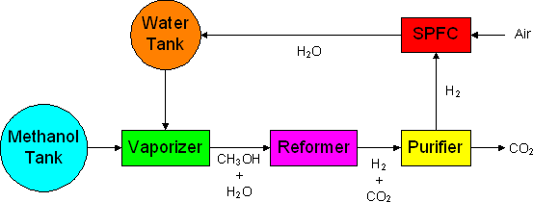
Lesson 5: Fuel Cells
Hydrogen gas can be real-time produced from a tank of liquid fuel such as methanol by using an on-board reformer. It takes the definite advantage of liquid fuel which does not require complicated and energy-consumed storage methods for hydrogen. Also, it can fully utilize the existing refueling infrastructure for conventional vehicles.
The use of methanol as the fuel has the drawback of CO₂ emission. Although this technology seems to be contradictory to the pursuit of zero-emission vehicles, it is still environmentally friendly as it does not generate harmful emissions such as CO, NOx and HC.
Solid polymer fuel cell (SPFC)
17

Slide 19
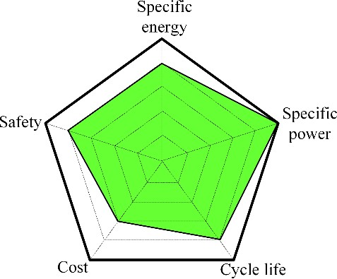
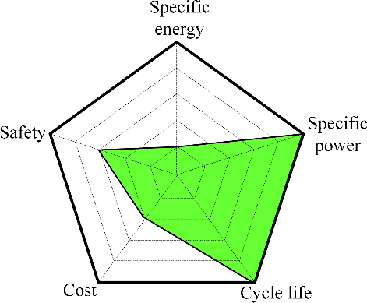
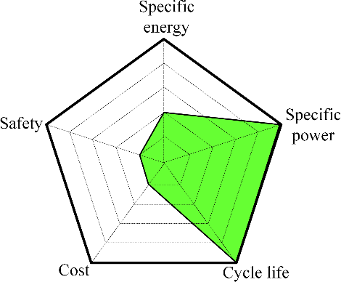
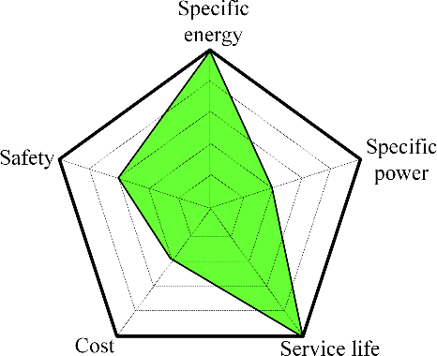
Lesson 6: Hybridisation of Energy Sources
Performance Comparison of Energy Sources
Li-ion battery Ultracap Ultrafly PEMFC
It compares their performances in terms of the specific energy, specific power, cycle life (equivalent to service life for fuel cells), cost and safety.
It can be observed that the Li-ion battery is still most preferable,
holistically.
Proton exchange membrane fuel cell (PEMFC)
18

Slide 20
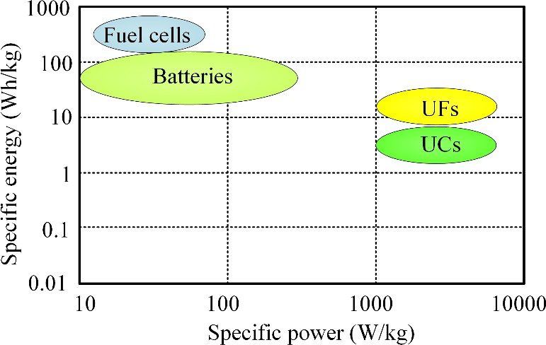
Lesson 6: Hybridisation of Energy Sources
Performance Comparison of Energy Sources
A Ragone chart indicates that none of them can simultaneously offer high specific energy and high specific power. For the battery electric vehicles (BEVs), the specific energy governs the driving range per charge while the specific power determines the acceleration rate.
In general, a compromise between the specific energy and specific
power is necessary, but with more preference on the specific energy.
If allowable in terms of cost, space and complexity, a hybridization of two energy sources (one with high specific energy and another with high specific power) is preferred.
19

Slide 21

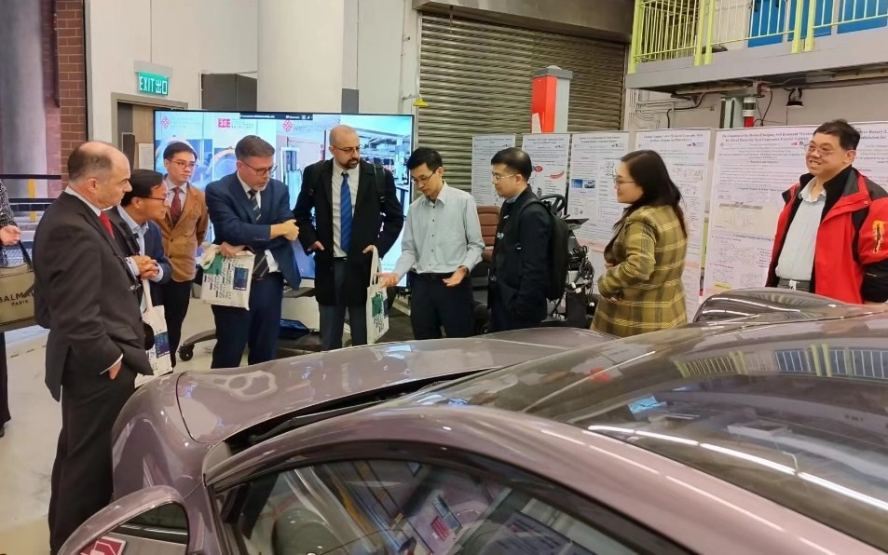
Lesson 7: Case Study
The course topic is to be confirmed with our students, possibly simulation model of
wireless charging system for EVs or introduction of EV model.
Xiaomi SU7 Max – First Xiaomi electric vehicle in overseas
Xiaomi
Battery parameters
Capacity:101 kWh
Type: Ternary lithium
CTB integrated technology
Vehicle performance
Acceleration time of 100 km/h:
2.78 s
Maximum speed: 265 km/h
CLTC range: 500 km
Fast Charging Time (10%- 80%): 19 min
15 min charging and
replenishment : 510 km
Donation for collaboration
PolyU
EV models are to be confirmed.
20
REF: https://www.xiaomiev.com/car-config
CTB, Cell-to-body
CLTC, China light-duty vehicle test cycle

Slide 22
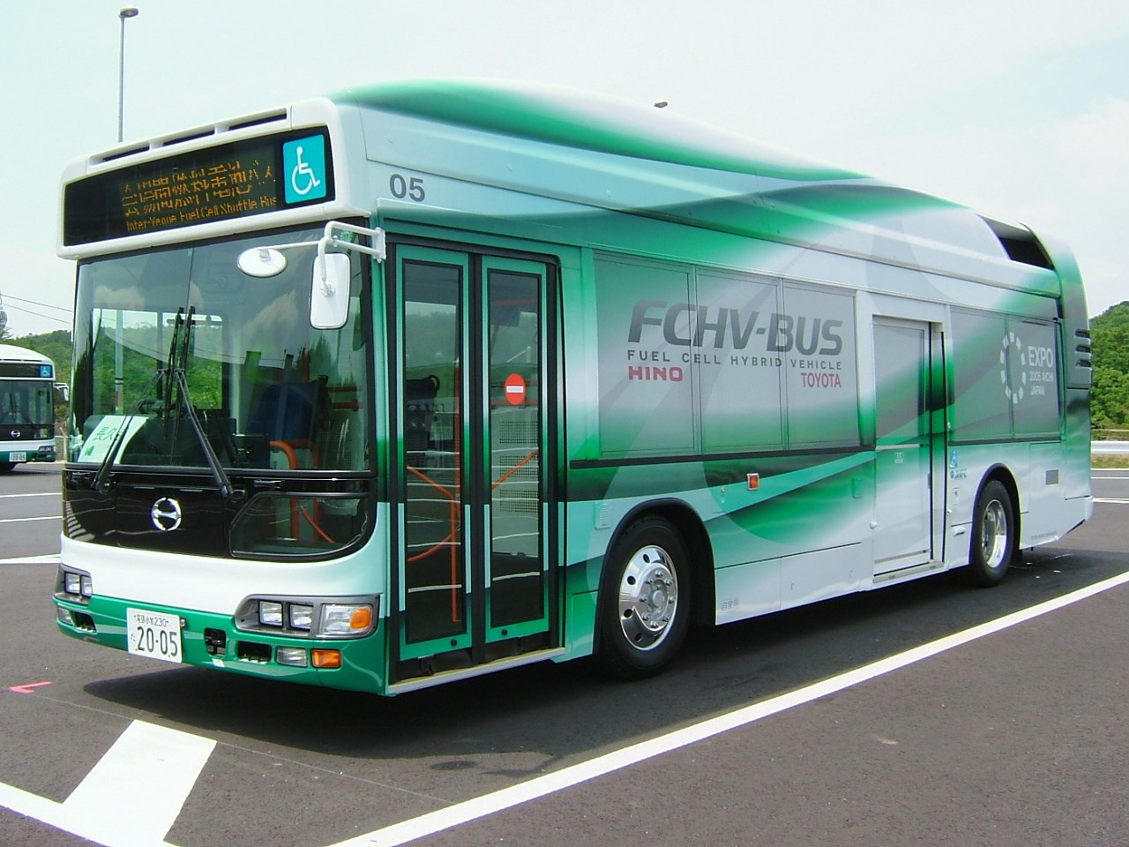
Lesson 7: Case Study
Hydrogen Bus
FCHV Information
90 kW PEFC Fuel cell stack: twice
Motor: AC synchronous 80
kW twice
Hydrogen tank: Compressed hydrogen gas 35 MPa / 150 liter, five (version 2002) or seven (version 2005)
Passenger capacity: 63 (included 22 seats)
REF: https://en.wikipedia.org/wiki/Toyota_FCHV#FCHV-BUS
FCHV, Fuel cell hybrid vehicle PEFC, Polymer electrolyte fuel cell
21

Slide 23
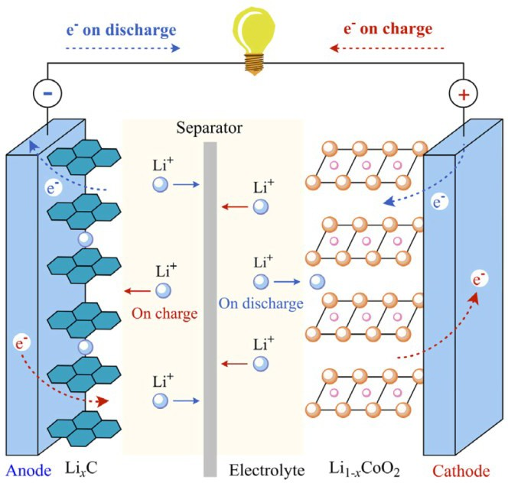
Lesson 8: Lithium-Ion Batteries and BMS
A lithium-ion (Li-ion battery) is a of rechargeable battery
type that uses the of Li⁺ ions store
reversible intercalation
into electronically conducting solids to
energy. In comparison with other commercial rechargeable batteries, Li-ion batteries are characterized by higher specific energy, higher energy density, higher energy efficiency, longer cycle life, and longer calendar life.
During cell discharge, the negative electrode is the anode, and the positive electrode is the cathode.
Electrons flow from the anode to the cathode through the external circuit. An oxidation half-reaction at the anode produces positively charged lithium ions and negatively charged electrons.
The oxidation half-reaction may also produce uncharged material that remains at the anode. Lithium ions move through the electrolyte; electrons move through the external circuit toward the cathode where they recombine with the cathode material in a reduction half-reaction.
REF: W. Liu, T. Placke, and K.T. Chau, “Overview of batteries and battery management for electric vehicles,” Energy Reports, vol.
8, pp. 4058–4084, Nov. 2022.

Slide 24
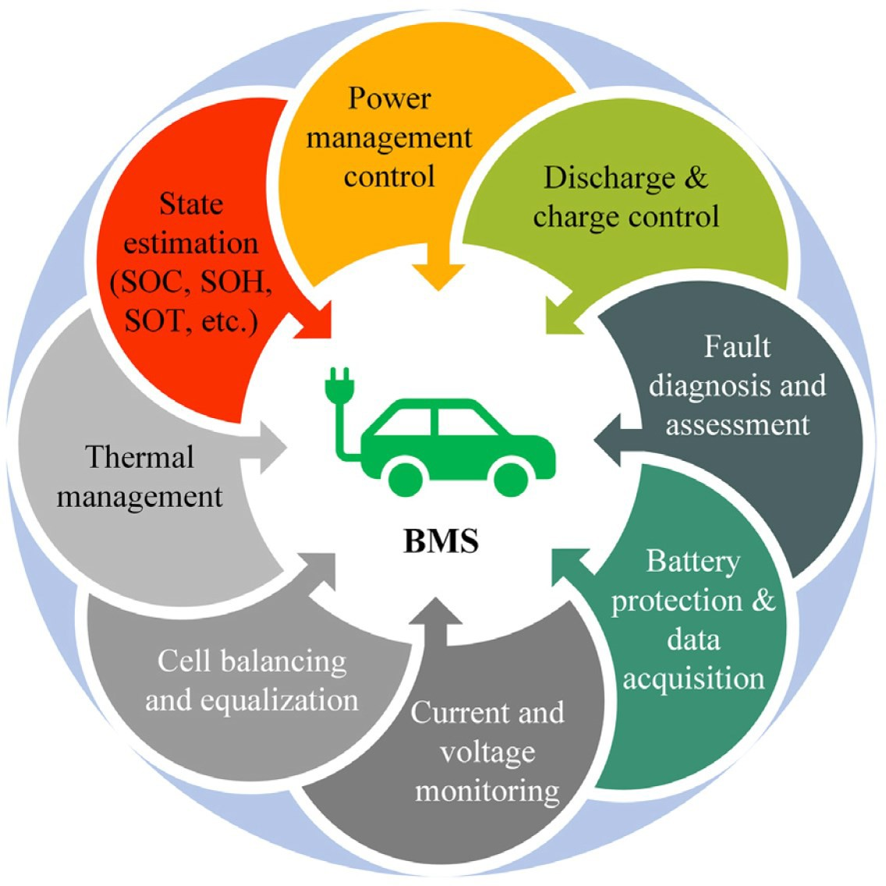
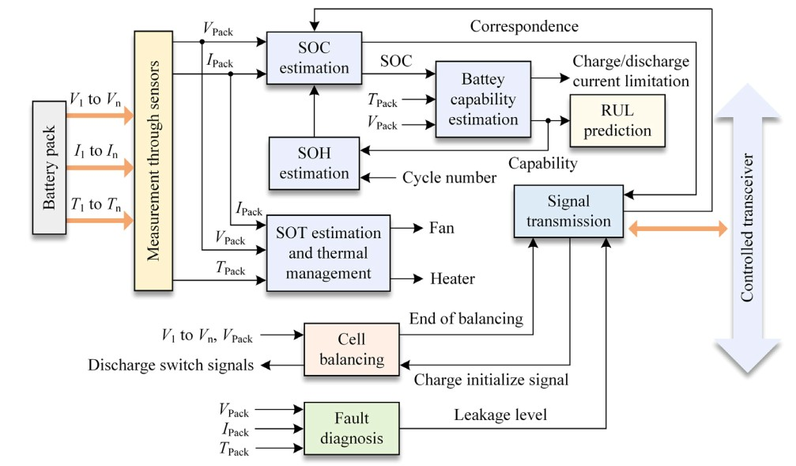
Lesson 8: Lithium-Ion Batteries and BMS
Battery Management System (BMS)
Functional block diagram of battery
management system for electric vehicles
REF: W. Liu, T. Placke, and K.T. Chau, “Overview of batteries and battery management for electric vehicles,” Energy Reports, vol.
8, pp. 4058–4084, Nov. 2022.

Slide 25
Lesson 8: Lithium-Ion Batteries and BMS
Battery Management System (BMS)
Functions
Monitor: A BMS may monitor the state of the battery as represented by various items, such as:
Voltage: total voltage, voltages of individual cells, or voltage of periodic taps
Temperature: average temperature, coolant intake temperature, coolant output temperature, or temperatures of individual cells
Coolant flow: for liquid cooled batteries
Current: current in or out of the battery
Health of individual cells
State of balance of cells
Electric vehicle systems: energy recovery
Computation Communication Protection
Battery connection to load circuit Balancing
REF: https://en.wikipedia.org/wiki/Battery_management_system
24

Slide 26
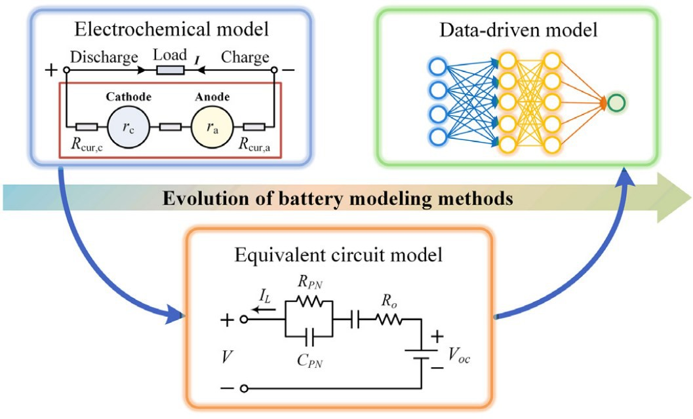
Lesson 9: Battery Models
Battery modeling turns into one of the most significant prerequisites for BMSs, concluding the main significances of battery modeling. To represent the EV batteries, three modeling methods, including:
Electrochemical Model Single-particle model pseudo-two-dimensional model | Equivalent Circuit Model Integral-order model Fractional-order model | Data-Driven Model Neural network Machine learning
Evolutions map of battery modeling methods
REF: W. Liu, T. Placke, and K.T. Chau, “Overview of batteries and battery management for electric vehicles,” Energy Reports, vol.
8, pp. 4058–4084, Nov. 2022.
25

Slide 27
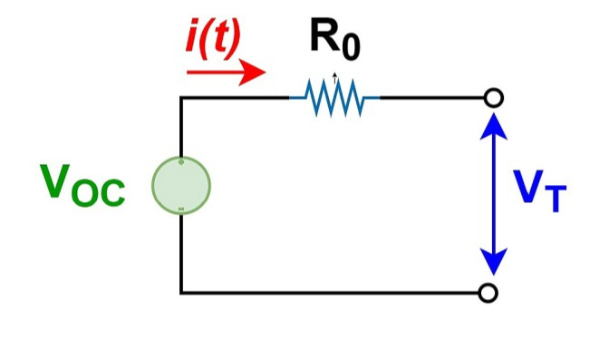
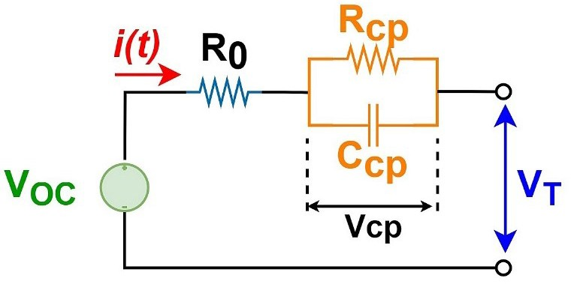
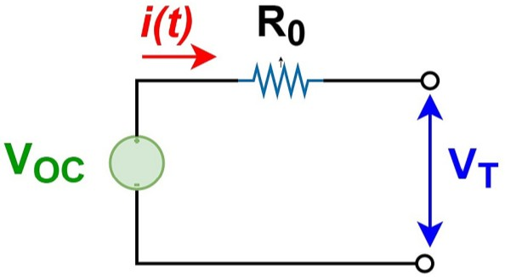
Lesson 9: Battery Models
Common Integer-Order Equivalent Circuit Models
The Rint model
The Thevenin model
The Rint model: It uses an ideal voltage source V_{OC} and the battery DC internal resistance R₀ in series to describe the dynamic characteristics of the power battery. Also, R₀ and V_{OC} are functions of state of charge (SoC) and temperature.
The Thevenin model: It is based on the Rint model, adding a parallel RC network to simulate the polarization effect of the battery. This model has a relatively simple structure and high simulation accuracy.
REF: Zhou W, Zheng Y, Pan Z, Lu Q. Review on the Battery Model and SOC Estimation Method. Processes. 2021; 9(9):1685. https://doi.org/10.3390/pr9091685
26

Slide 28
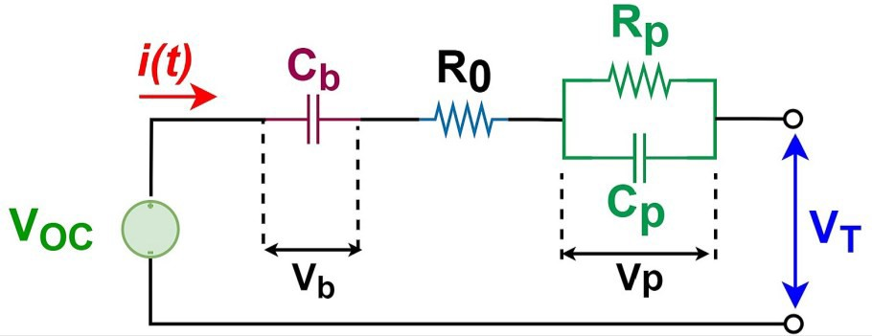
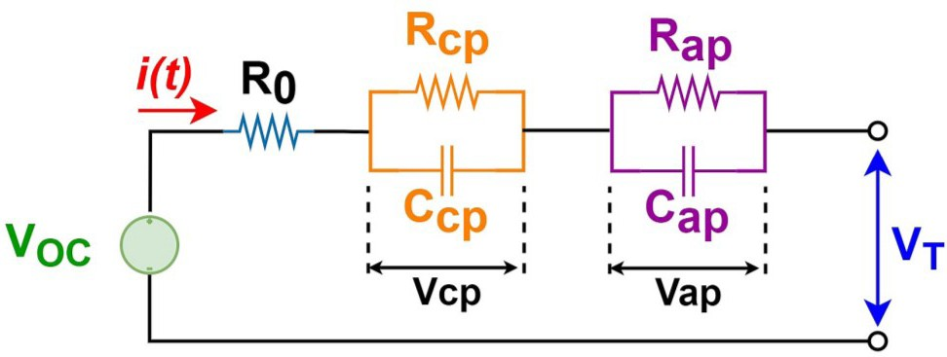
Lesson 9: Battery Models
Common integer-order equivalent circuit models
The PNGV model
Dual Polarization (DP) model
The PNGV model: On the basis of the Thevenin model, a capacitor C_{b} can be connected in series to form a PNGV model. This capacitor is used to describe the change in battery open circuit voltage caused by the current integration during the battery’s long-term charging and discharging process.
The Dual Polarization (DP) model: In addition to the ohmic and concentration polarizations used by the Thevenin model, the DP model implements activation polarization. The phenomenon of activation polarization occurs at the electrode surface.
Partnership for a new generation of vehicle (PNGV)
REF: Tekin M, Karamangil M İ. Comparative analysis of equivalent circuit battery models for electric vehicle battery management
systems. Journal of Energy Storage, 2024, 86: 111327.
27

Slide 29


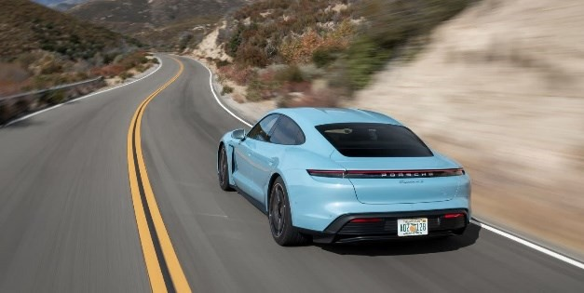
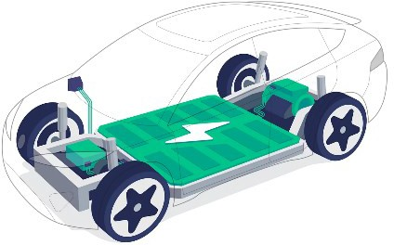
Lesson 10: Battery State of Charge
Definition
State of Charge (SoC): Current charge level
of a battery (0% = empty, 100% = full).
REF: https://www.takomabattery.com/ how-to-check-state-of-charge-of-lithium- battery/
Importance in EVs
Driving Range SoC affects how far an EV can travel on a single charge.
Battery Health Proper SoC manage- ment prolongs battery lifespan.
Safety Prevent overcharging and deep discharging.
REF: https://autos.yahoo.com/ev-ran
ge-everything-know-132000750.html
REF: https://commons.wikimedia.org/
wiki/File:Antu_battery-charging-080.svg
REF: https://www.evpedia.co.in/ev- blog/stay-charged-and-safe-your-ev- battery-safety-checklist

Slide 30
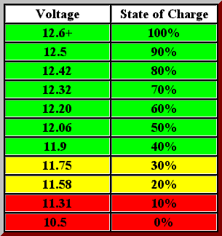

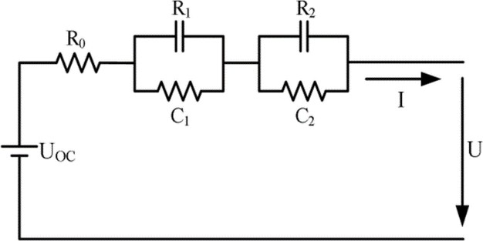
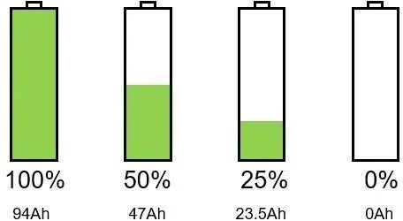
Lesson 10: Battery State of Charge
Measurement Methods
Voltage Method
Coulomb Counting
Impedance Method
Measure open-circuit voltage.
Tracks charging
/discharging currents.
Analyse internal impedance changes.
REF: https://www.rvtechlibrary.com/ battery/bat_volts.php
REF: https://www.batterydesign.net/ soc-estimation-by-coulomb-counting/
REF: https://www.researchgate.net/ figure/The-battery-equivalent-circuit_ fig1_343796730

Slide 31

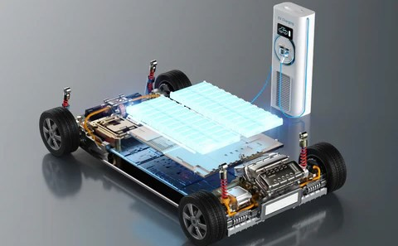
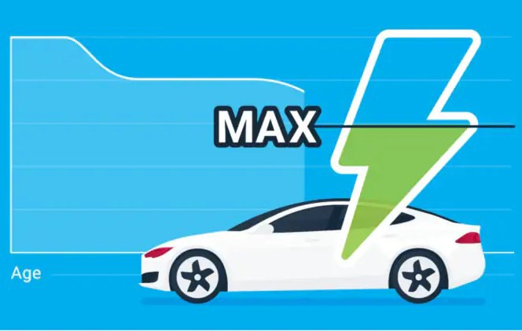
Lesson 11: Battery State of Health
Definition
State of Health (SoH): A measure of a battery’s overall condition compared to its ideal or original state (100% = new condition).
50% SoH
REF: https://www.biologic.net/topics/battery- states-state-of-charge-soc-state-of-health-soh/
Importance in EVs
Performance Indicator SoH reflects the battery’s ability to hold and deliver charge, impacting driving range and efficiency.
Lifespan Assessment SoH helps predict the remaining useful life of the battery, informing replacement decisions.
Safety Considerations Monitoring SoH can pre- vent unexpected failures and enhance vehicle safety.
REF: https://ev-lectron.com/blogs/blog/ ev-battery-charging-best-practices
REF: https://www.carandbike.com/news/ how-to-maintain-health-of-evs-battery- 2951541
REF: https://ev-lectron.com/blogs/blog/
ev-battery-charging-best-practices
30

Slide 32

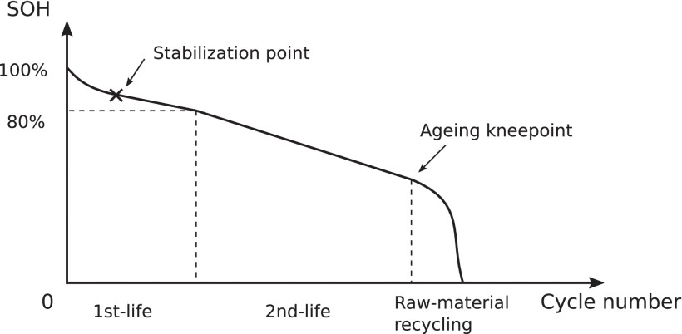
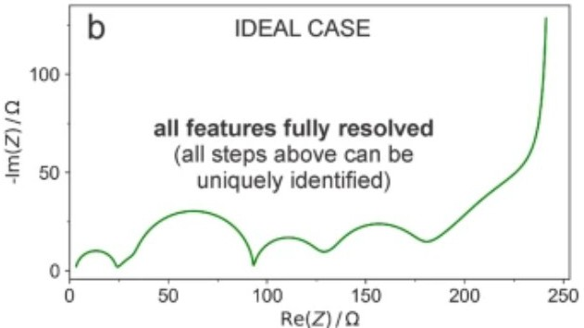
Lesson 11: Battery State of Health
Measurement Methods
Electrochemical Impedance Spectroscopy (EIS)
Capacity Measurement Cycle Life Analysis
Compare the current capacity of the battery to its original rated capacity to assess degradation.
Evaluate the number of charge/discharge cycles to determine the impact of usage on battery health.
Analyse the battery’s impedance at various frequencies to gain insights into its health.
REF: https://www.youtube.com/watch?v= pGsglGnybdM
REF: M. Tran, J. Sihvo and T. Roinila, “Internal Impedance in Determining Usability of Used Lithium-Ion Batteries in Second-Life Applications,” in IEEE Transactions on Industry Applications, vol. 59, no. 5, pp. 6513-6521, Sept. 2023, DOI: 10.1109/TIA.2023.3280466.
REF: M. Gaberšček, “Understanding Li- based battery materials via electrochemical impedance spectroscopy,” in Nature Communications, vol. 12, no. 1, Nov. 2021, DOI: 10.1038/s41467-021-26894-5.
31

Slide 33
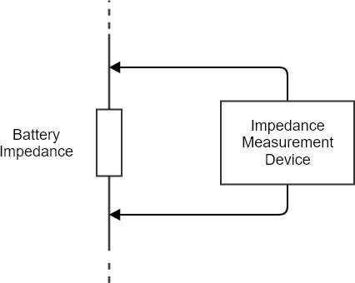
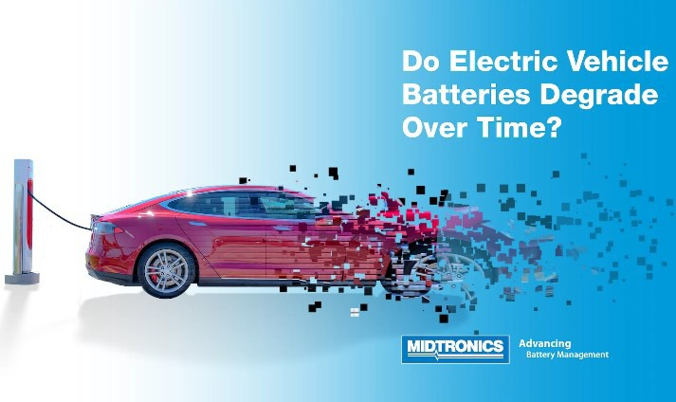
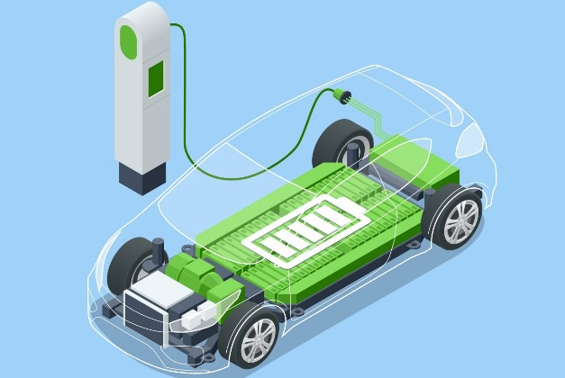

Lesson 12: Battery Impedance and EIS
Definition
Battery Impedance: The impedance that a battery presents to the flow of alternating current (AC).
Electrochemical Impedance Spectroscopy (EIS): A technique that measures the impedance of a battery by applying a small AC signal
REF: https://info.powershield.com/ blog/battery-internal-ohmic- measurements-part-2
Importance in EVs
Performance Assessment
EIS provides detailed insights into battery health, efficiency, and state of charge.
Degradation
Monitoring Changes in impedance can indicate aging, capacity loss, and potential failure modes.
Safety
Considerations Monitoring SoH can prevent unexpected failures and enhance vehicle safety.
REF: https://www.greenwaveev.com/the- facts-on-ev-battery-health-and-longevity/
REF: https://www.midtronics.com/blog/do- electric-car-ev-batteries-degrade-over-time/
REF: https://ev-lectron.com/blogs/blog/
ev-battery-charging-best-practices
32

Slide 34
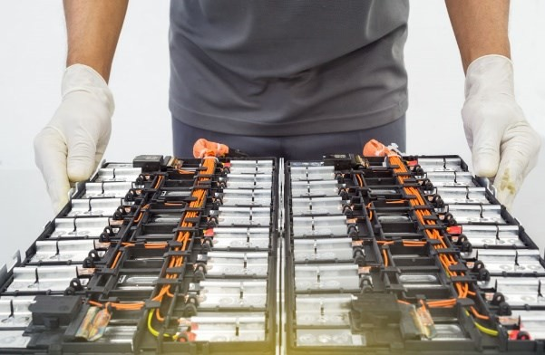
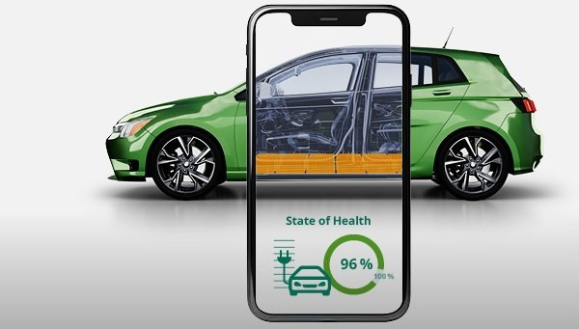
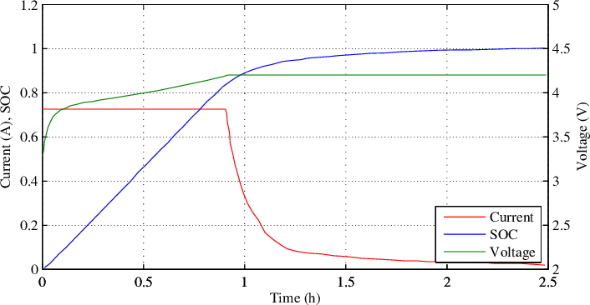
Lesson 12: Battery Impedance and EIS
Applications in EVs
Battery Diagnostics Analyze the batteries’ impedance to assess health and detect issues.
SoH Estimation Evaluate the batteries’ internal resistance and capacity over time.
Optimization of
Charging Strategies Provide data on battery impedance, helping to determine the best charging strategy.
REF: https://ennovi.com/technical- literature/understanding-the-ev-battery- issues-regarding-resale-recycling-and- reuse/
REF: https://www.dekra.com/en/battery- test-for-electric-cars/
REF: A. Sassone, D. Shin, A. Bocca, A. Macii, E. Macii, and M. Poncino, “Modeling of the charging behavior of li-ion batteries based on manufacturer’s data,” Proceedings of the 24th Edition of the Great Lakes Symposium on VLSI, Houston, USA,
May 2014.
33

Slide 35









Lesson 13: New Energy for Vehicles
New Energy for Vehicles
Hydropower
generation
Chemical power
generation
Geothermal power
generation
Nuclear power
generation
Wind power
generation
Solar electric
power generation
Biomass power
generation
Tidal power
generation
Wave power
generation
34
Images from Flaticon.com

Slide 36
Lesson 13: New Energy For Vehicles
New Energy for Vehicles
Solar power: Solar power, also known as solar electricity, is the conversion of energy from sunlight into electricity, either directly using photovoltaics (PV) or indirectly using concentrated solar power.
Hydropower: Hydropower, also known as water power, is the use of falling or fast-running water to produce electricity or to power machines.
Nuclear power: Nuclear power is the use of nuclear reactions to produce electricity. Nuclear power can be obtained from nuclear fission, nuclear decay and nuclear fusion reactions.
Tidal power: Tidal power or tidal energy is harnessed by converting energy from tides into useful forms of power, mainly electricity using various methods.
Wave power: Wave power is the capture of energy of wind waves to do useful work – for example, electricity generation, water desalination, or pumping water. A machine that exploits wave power is a wave energy converter (WEC) or generator.
Biomass power: Types of biomass commonly used for bioenergy include wood, food crops such as corn, energy crops and waste from forests, yards, or farms
……..

Slide 37
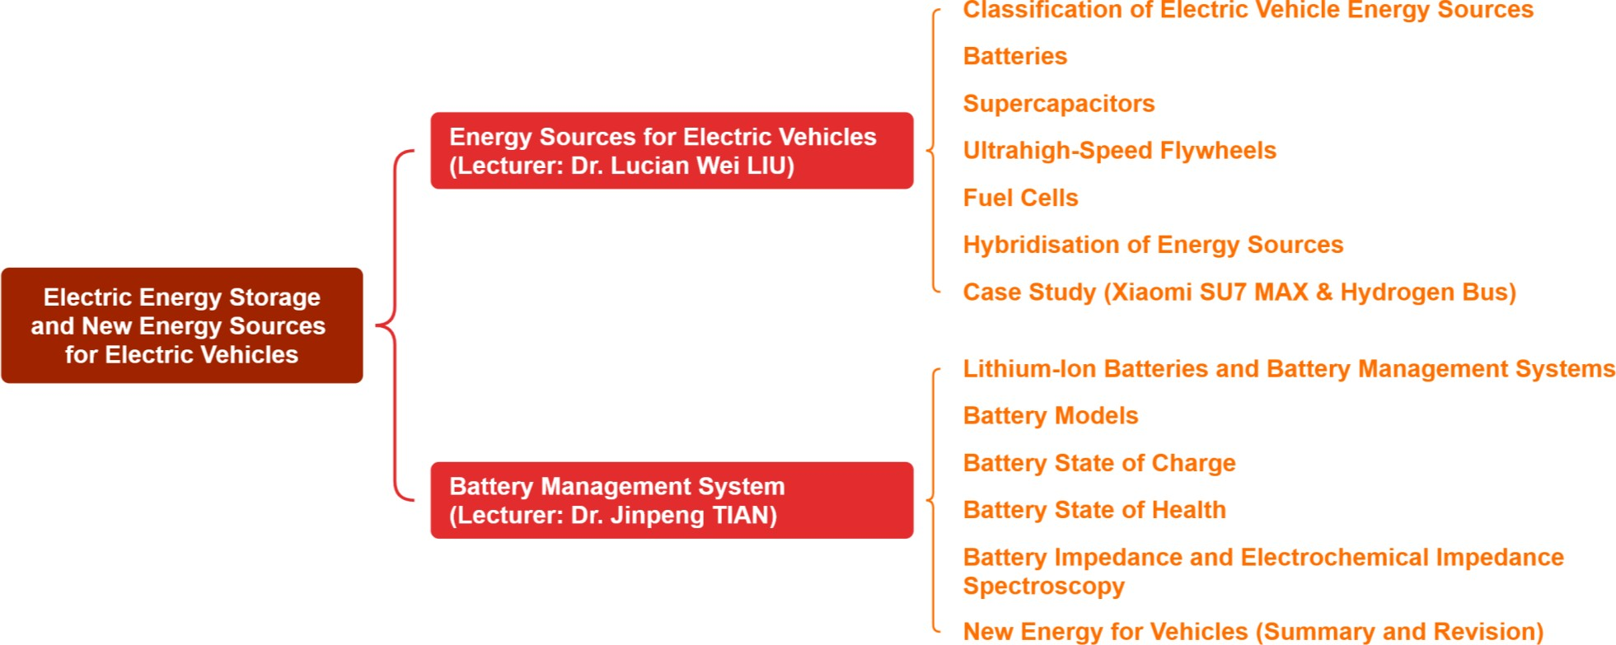
Summary and Review

