Slide 1

Lathraea Rhodopea

Slide 2
OUR TEAM
Scrum Trainer - Vasilen Mihaylov
Front-end Developer - Mariq Ilcheva
Front-end Developer - Vesela Dekova
Back-end Developer - Stoqn Ivanov
QA Engineer – Polina Petrova

Slide 3
Realization
Front-end
Back-end
QA

Slide 4
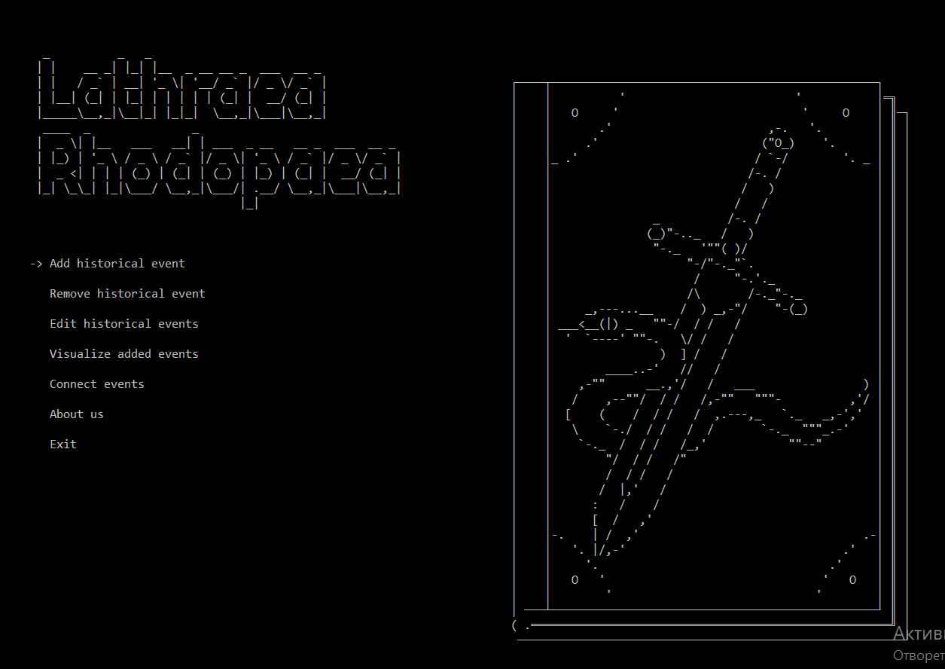
Essence of the project

Slide 5





Tools we used to create our project

Slide 6
Repository

Slide 7
Demonstration

Slide 8
Thank you for your attention!

