Slide 1


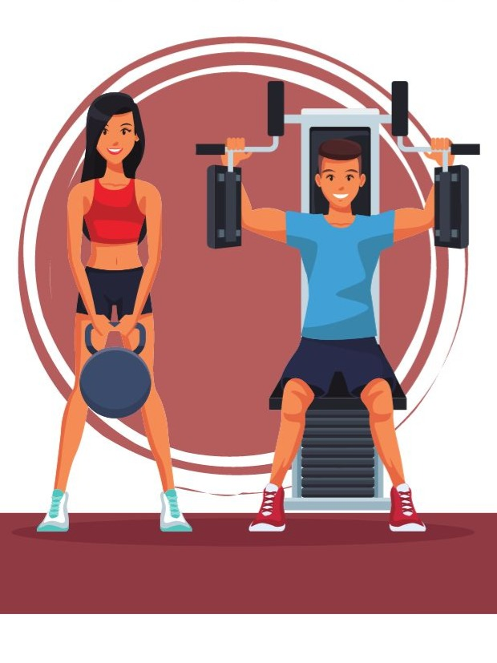
AI-Based Fitness Bot
Batch Members:
Inigho Benjamin L - 811722001016
Loga Prasath S S - 811722001028
Vasil Hassan R - 811722001054
Guided by:
Mrs. A. Sumathi, Assistant Professor/AI

Slide 2
OBJECTIVE
To design and implement an AI-powered fitness assistant that leverages large language models and context-aware algorithms to deliver personalized workout and nutrition guidance based on individual user profiles, lifestyle factors, and fitness goals.

Slide 3
EXISTING SYSTEM
In current practice, fitness and nutritional guidance is typically delivered through manual consultation and static content platforms, lacking real-time personalization or adaptive intelligence.
Limitations of the Existing System:
Manual Consultations
Generic Fitness Apps
Lack of Context Awareness

Slide 4
PROPOSED SYSTEM
The proposed system introduces an AI-driven, interactive fitness bot that leverages Large Language Models (LLMs) and context-aware computation to deliver personalized, real-time workout and dietary guidance through a conversational interface.
Key Components:
User Profiling Module
Chatbot Engine
Workout Recommendation Module

Slide 5
LITERATURE SURVEY
S.No | Title | Year | Author | Technique Used | Demerits
1 | AI in Personal Fitness Training | 2021 | Dr. Smith | Supervised ML | Lacks real-time interaction
2 | Fitness Chatbots using NLP | 2022 | J. Kumar | Transformer NLP Model | Not personalized enough
3 | Diet Planning with ML | 2020 | A. Lee | Clustering | Limited food database
4 | IoT & AI in Health Monitoring | 2023 | R. Gupta | IoT + AI Hybrid | Privacy issues
5 | AI-based Recommendation Systems | 2019 | N. Patel | Collaborative Filtering | Cold-start problem
6 | Artificial Intelligence: A Modern Approach | 2020 (3rd Ed.) | Stuart Russell & Peter Norvig | Broad AI Techniques (NLP, ML, Planning) | Not specific to fitness domain

Slide 6
ARCHITECTURE / DATA FLOW DIAGRAM
Frontend
User interface
Prompt Constructor
User
AI-Model
Output
Output Formatter

Slide 7
SYSTEM & SOFTWARE SPECIFICATIONS
Hardware Requirements:
GPU: Nvidia 4050 or higher
VRAM: 8 GB minimum
Storage: 15 GB
Software Requirements:
Python 3.11, Flask
OpenAI/Together API
MongoDB
HTML, CSS, JavaScript
Postman for API testing

Slide 8
MODULES
User Input Acquisition And Personalization Layer
Chatbot Interaction
Workout Recommendation System
Diet Recommendation System

Slide 9
MODULE 1: USER INPUT ACQUISITION AND PERSONALIZATION LAYER
The Fitness AI system initiates its personalized recommendation engine by collecting comprehensive user-specific data through a structured input interface. This enables tailored workout and nutritional planning aligned with individual fitness goals and contextual factors.
Key Input Parameters:
Age and Body Weight
Workout Experience Level
Geographic Region
Food Preference

Slide 10
MODULE 1: USER INPUT ACQUISITION AND PERSONALIZATION LAYER
Technical Implementation Notes:
Data is captured through structured forms or API endpoints and normalized for integration with downstream models.
User profiles are stored in a secure, scalable database (e.g., MongoDB, PostgreSQL) with support for update and retrieval operations.
The input data serves as feature vectors for machine learning models that generate fitness and nutrition recommendations using fine-tuned transformer-based LLMs (e.g., Mistral-7B via Together API).

Slide 11
MODULE 2 : CHATBOT INTERACTION
This module establishes real-time, intelligent dialogue between the user and the Fitness AI system using a transformer-based large language model. It acts as the core engine for personalized response generation, ESS routines, dietary advice, and clarification of health queries.
Model Specification:
Model Used: mistralai/Mistral-7B-Instruct-v0.2
Architecture:
Decoder-only transformer architecture utilizing Grouped-Query Attention (GQA) and Sliding Window Attention

Slide 12
MODULE 2 : CHATBOT INTERACTION
Technical Workflow:
Input Preprocessing
Prompt Engineering
Model Inference
Post-processing & UI Rendering

Slide 13
MODULE 3 : WORKOUT RECOMMENDATION
To deliver structured and progressive fitness routines tailored to the user’s current capabilities, preferences, and long-term goals (e.g., fat loss, hypertrophy, endurance, strength training).
Technical Workflow:
User Feature Vector Construction
Model-Assisted Generation
Rule-Based Post-Processing
Program Structuring

Slide 14
MODULE 3 : WORKOUT RECOMMENDATION
Implementation Stack:
Model Inference Layer: Mistral 7B via Together API
Logic Layer: Python-based rule engine for safety and structure checks
Output Renderer: Dynamic HTML/JSON rendering for chatbot and web app frontend

Slide 15
MODULE 4 : DIET RECOMMENDATION
To create adaptive, goal-specific meal plans that align with the user’s caloric requirements, macronutrient ratios, and dietary restrictions or preferences (e.g., vegetarian, vegan, high-protein).
Technical Workflow
User Profile Parsing
TDEE & Macronutrient Estimation
Prompt-Driven Meal Plan Generation
Nutritional Constraint Enforcement
Meal Plan Structuring & Delivery

Slide 16
MODULE 4 : DIET RECOMMENDATION
Implementation Stack:
Inference Engine: Mistral 7B via Together API
Calculation Module: Python-based engine for BMR/TDEE/macros
Validation Layer: Nutritional ruleset + optional database integration (e.g., USDA FoodData Central API)
Frontend Output: Web-based or chatbot meal card rendering

Slide 17
ADVANTAGES
Highly Personalized
24/7 AI Interaction
Scientifically Optimized
Cost-Effective
Region-Aware
Modular & Scalable
Goal-Oriented

Slide 18
APPLICATIONS
Personal Fitness Coaching
Mobile Wellness Apps
Mental & Holistic Health
Corporate Wellness
Preventive Healthcare
AI R&D

Slide 19
CONCLUSION
The AI-Based Fitness Bot effectively integrates large language models (LLMs) into personalized health and wellness systems, offering scalable, goal-oriented fitness planning through AI-generated content and 24/7 interactive support via natural language processing.It overcomes limitations of traditional platforms by providing culturally relevant guidance and a modular architecture compatible with mobile apps, wearables, and health platforms.

Slide 20
REFERENCES
1. Jagjit Singh Dhatterwal, Anupam Baliyan and Om Prakash, "Reliability Driven and Dynamic Re-synthesis of Error Recovery in Cyber-Physical Biochips" in Cyber Physical Systems, Chapman and Hall/CRC, pp. 15-34, 2023.
2. Jagjit Singh Dhatterwal, Kuldeep Singh Kaswan and Naresh Kumar, "Telemedicine-based Development of M-Health Informatics using AI", Deep Learning for Healthcare Decision Making, pp. 159, 2023.
3. Kuldeep Singh Kaswan, Jagjit Singh Dhatterwal, Naresh Kumar and Sandeep Lal, "Artificial Intelligence for Financial Services" in Contemporary Studies of Risks in Emerging Technology Part A, Emerald Publishing Limited, pp. 71-92, 2023.
4. T. Karras et al., "A Style-Based Generator Architecture for Generative Adversarial Networks", Conference on Neural Information Processing Systems, 2019.
5. T. Park et al., "SPADE: Semantic Image Synthesis with Spatially-Adaptive Normalization", IEEE Conference on Computer Vision and Pattern Recognition, 2019.

