Slide 1
Mart's Minimart Payroll System
Empowering Efficiency, Accuracy, and Employee Satisfaction
Group 15 | BSIT - 3B | November 14, 2023

Slide 2
Table of Contents
Project Objective
Current System Overview
Proposed System Overview
Final ERD
Final Database Design

Slide 3
Project Objective
Implement a user-friendly DTR system.
Create a centralized staff management system.
Develop a Payroll System.
Reduce the time and effort required for payroll processing

Slide 4
Current System Overview Manual Processes and Limitations
Currently, Mart’s Minimart relies on manual methods for recording employee attendance through Daily Time Records (DTR). The absence of an integrated payroll system leads to challenges in accurate salary calculations. Additionally, there is a lack of an account management system, resulting in scattered employee data and inefficient HR processes. These manual systems pose risks of errors, data loss, and inefficiencies.

Slide 5
Proposed System Overview Automated Payroll Management System
The proposed system introduces an integrated Payroll Management System to address the current challenges. This system includes an automated DTR module to eliminate manual errors and enhance accuracy in attendance tracking. It integrates seamlessly with a payroll processing system to automate salary calculations, tax deductions, and other payroll-related tasks. Furthermore, an employee account management module centralizes and secures employee data, streamlining HR processes. The system aims to provide a user-friendly interface, ensuring accessibility, security, and efficiency in managing HR operations.

Slide 6
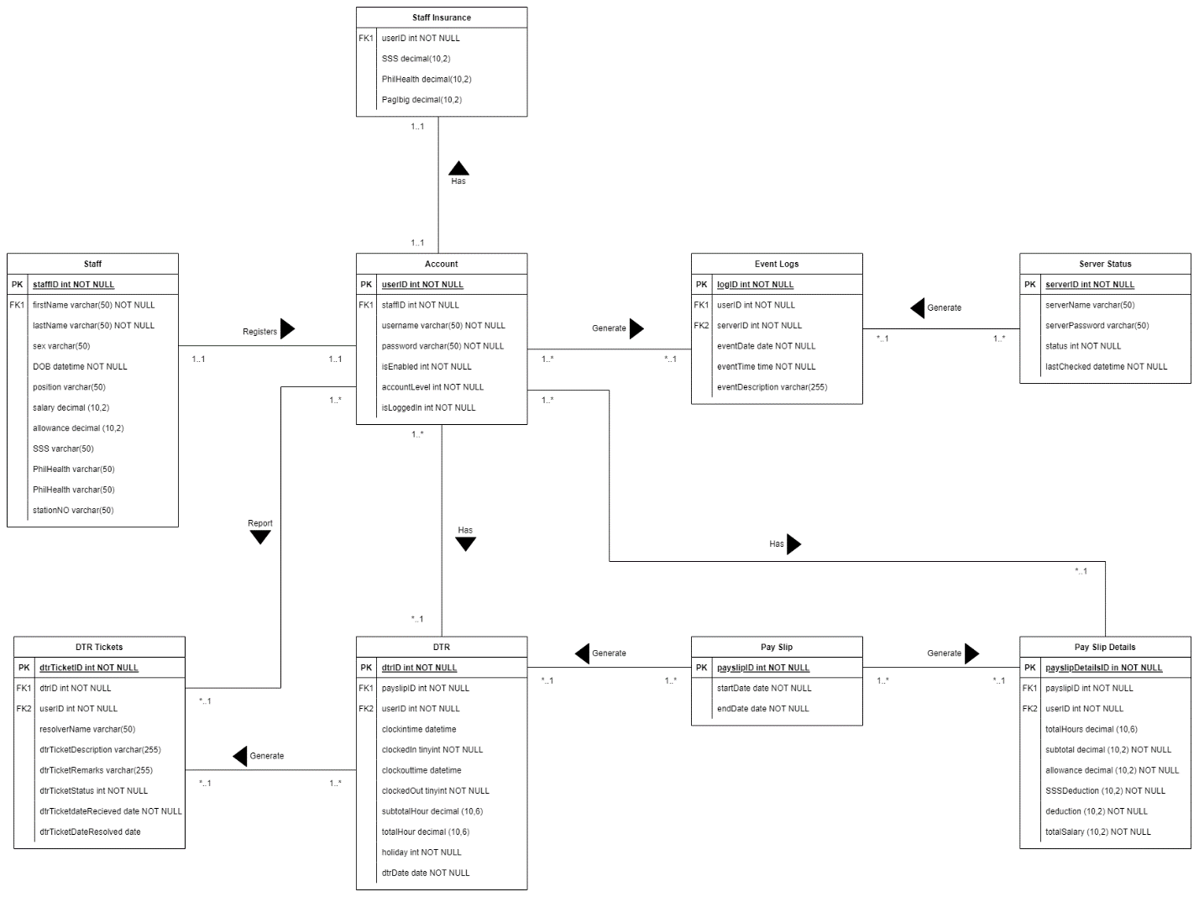
Final ERD

Slide 7
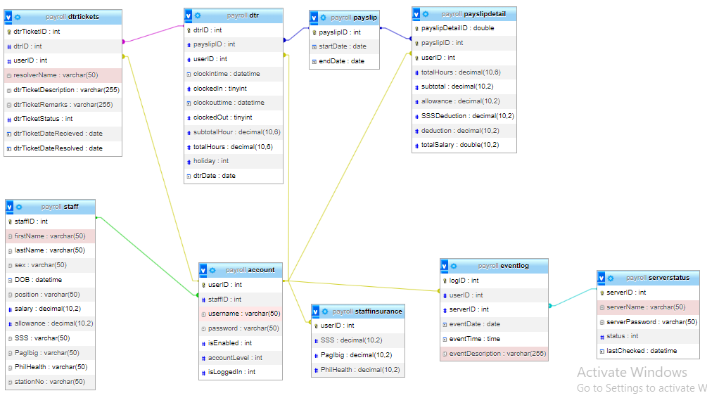
Final Database Design

Slide 8
Next Steps
The project will proceed with detailed analysis, system design, and implementation phases to achieve the outlined objectives. The ultimate aim is to revolutionize Mart’s Minimart’s HR processes, ensuring accuracy, efficiency, and employee satisfaction.

Slide 9
THANK YOU
John Rey J. Silverio
John Matthew N. Morillo

