Slide 1

PREDICTING SONG POPULARITY USING AUDIO FEATURES
Presented by :
Sayali Nagarkar
Charu Cheeema

Slide 2

OUTLINE
Introduction
Problem Statement
Data Cleaning & Data Wrangling
Exploratory Data Analysis
Modelling & Conclusion
Potential Applications
References

Slide 3
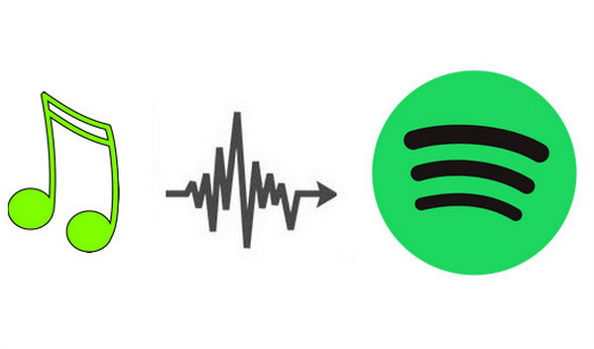
INTRODUCTION
Spotify is a digital music, podcast and video service that gives users access to millions of songs and other content from creators all over the world.
It carries a wealth of music catalog with thousands of new tracks added every day.
60,000 songs uploaded on Spotify daily in 2021

Slide 4

PROBLEM STATEMENT
Task is to generate a prediction model so that listeners would get recommendations for potentially popular music on Spotify
This model should predict the popularity of songs to refine the quality of recommendation system
This model will also help artist and music producers to better target their potential customers

Slide 5
DATASETS
US 1921 – 2020 dataset :
The audio feature dataset for top charting songs from 1921 to 2020 consist of 20 features
which are categorized in four categories.
1. Mood: danceability, valence, energy, tempo
2. Properties: loudness, speechiness, instrumentalness
3. Context: liveness, acousticness
4. Others: remaining features
US 2021 dataset :
The dataset for top charting songs in 2021 has 13 features.

Slide 6
SPOTIFY AUDIO FEATURES
Duration: The duration of the track in milliseconds.
Danceability: Describes how suitable a track is for dancing.
Energy: Represents a perceptual measure of intensity and activity.
Loudness: The overall loudness of a track in decibels (dB).
Mode: Indicates the modality (major or minor) of a track, the type of scale from which its melodic content is derived.
Speechiness: This detects the presence of spoken words in a track.
Acousticness: A confidence measure from 0.0 to 1.0 of whether the track is acoustic.
Instrumentalness: Predicts whether a track contains no vocals. “Ooh” and “aah” sounds are treated as instrumental in this context.
Liveness: Detects the presence of an audience in the recording.
Valence: Describes the musical positiveness conveyed by a track.
Tempo: The overall estimated tempo of a track in beats per minute (BPM).
Time signature: An estimated overall time signature of a track.

Slide 7
DATA CLEANING & DATA WRANGLING
For US 1921-2020 dataset:
There were null values in the ‘name’ feature. This was dropped as song_id serves the purpose.
Column ‘release date’ was renamed to ‘year’.
For US 2021 dataset:
There was no audio data. So extracted ‘track-names’ and ‘artist-names’ features to use with Spotify API.

Slide 8
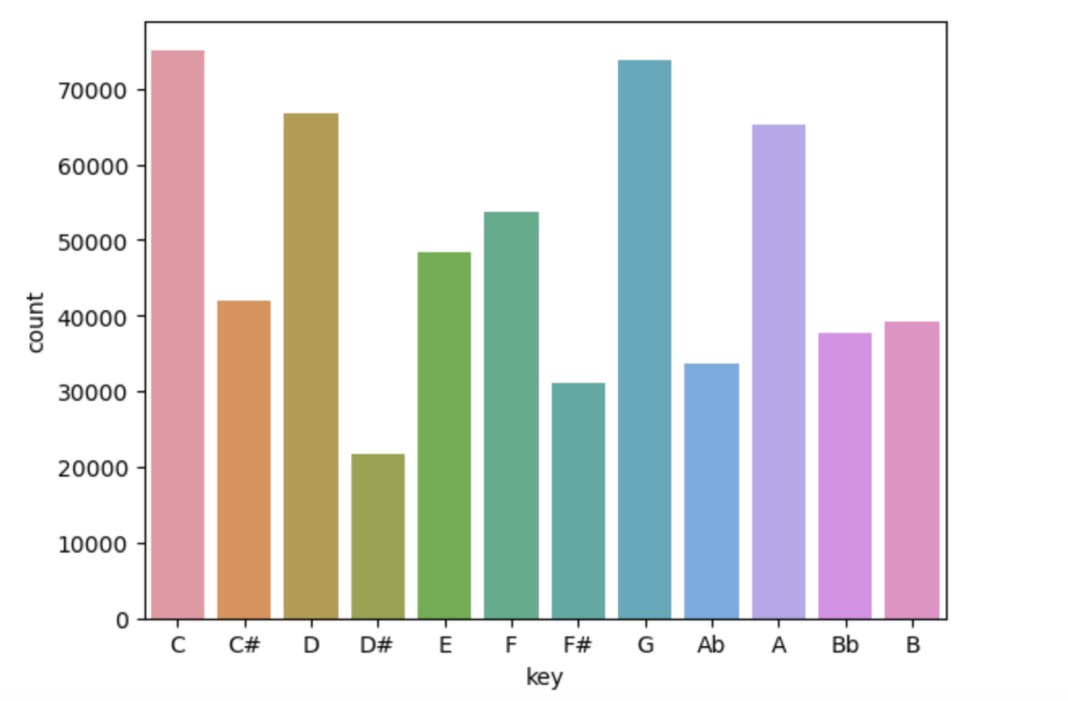
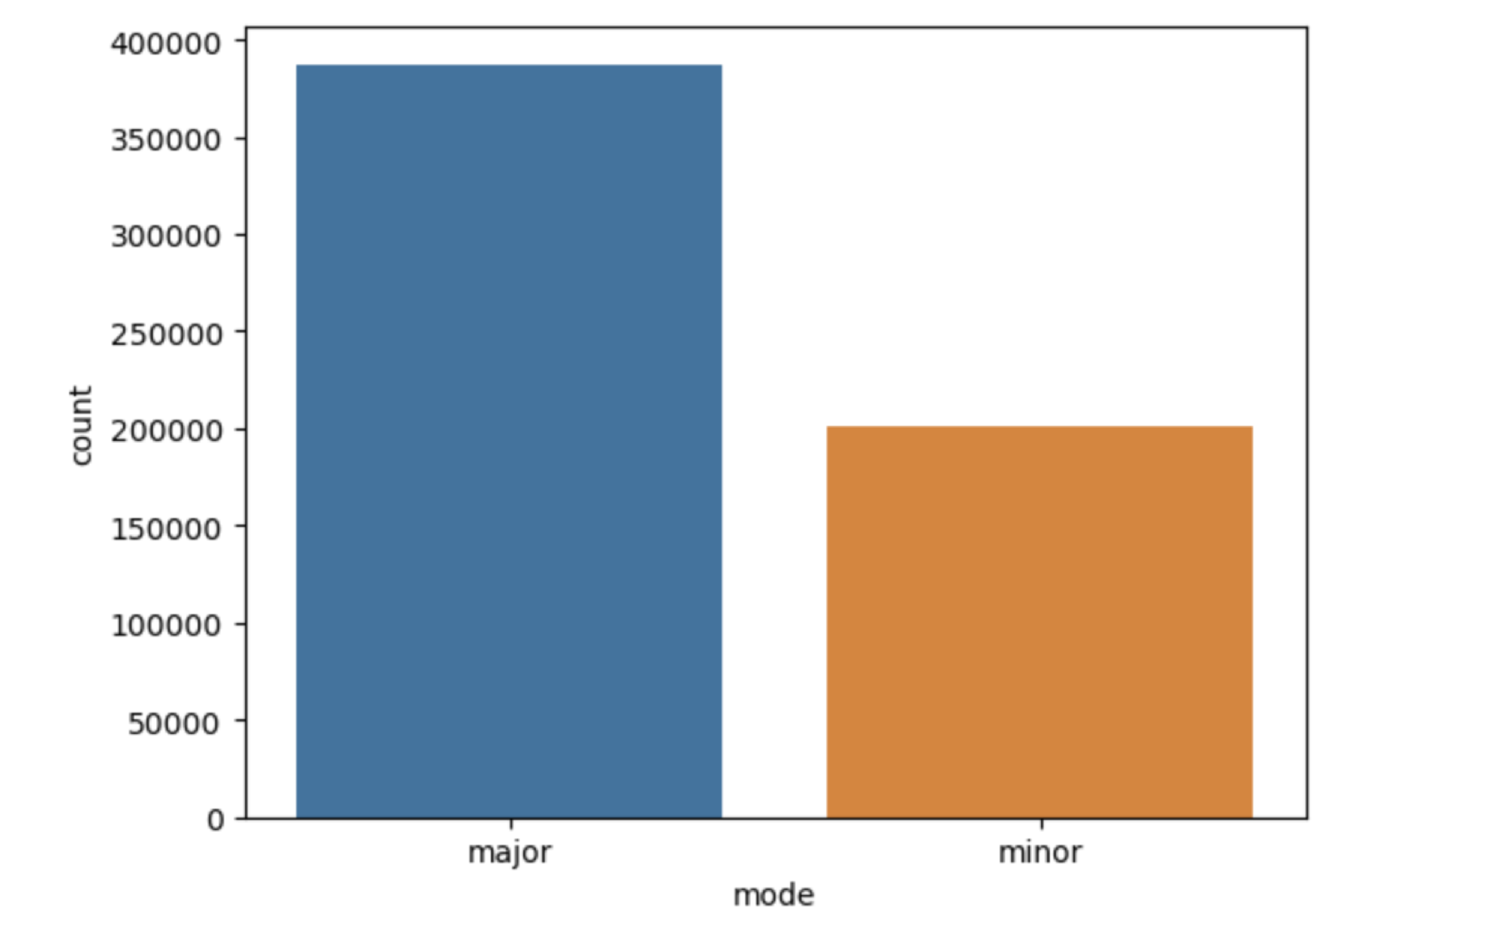
EXPLORATORY DATA ANALYSIS
1. Keys :
The most common keys in popular songs
were C and G as seen in graph.
2. Modes :
More songs are in major mode
as seen in graph.

Slide 9
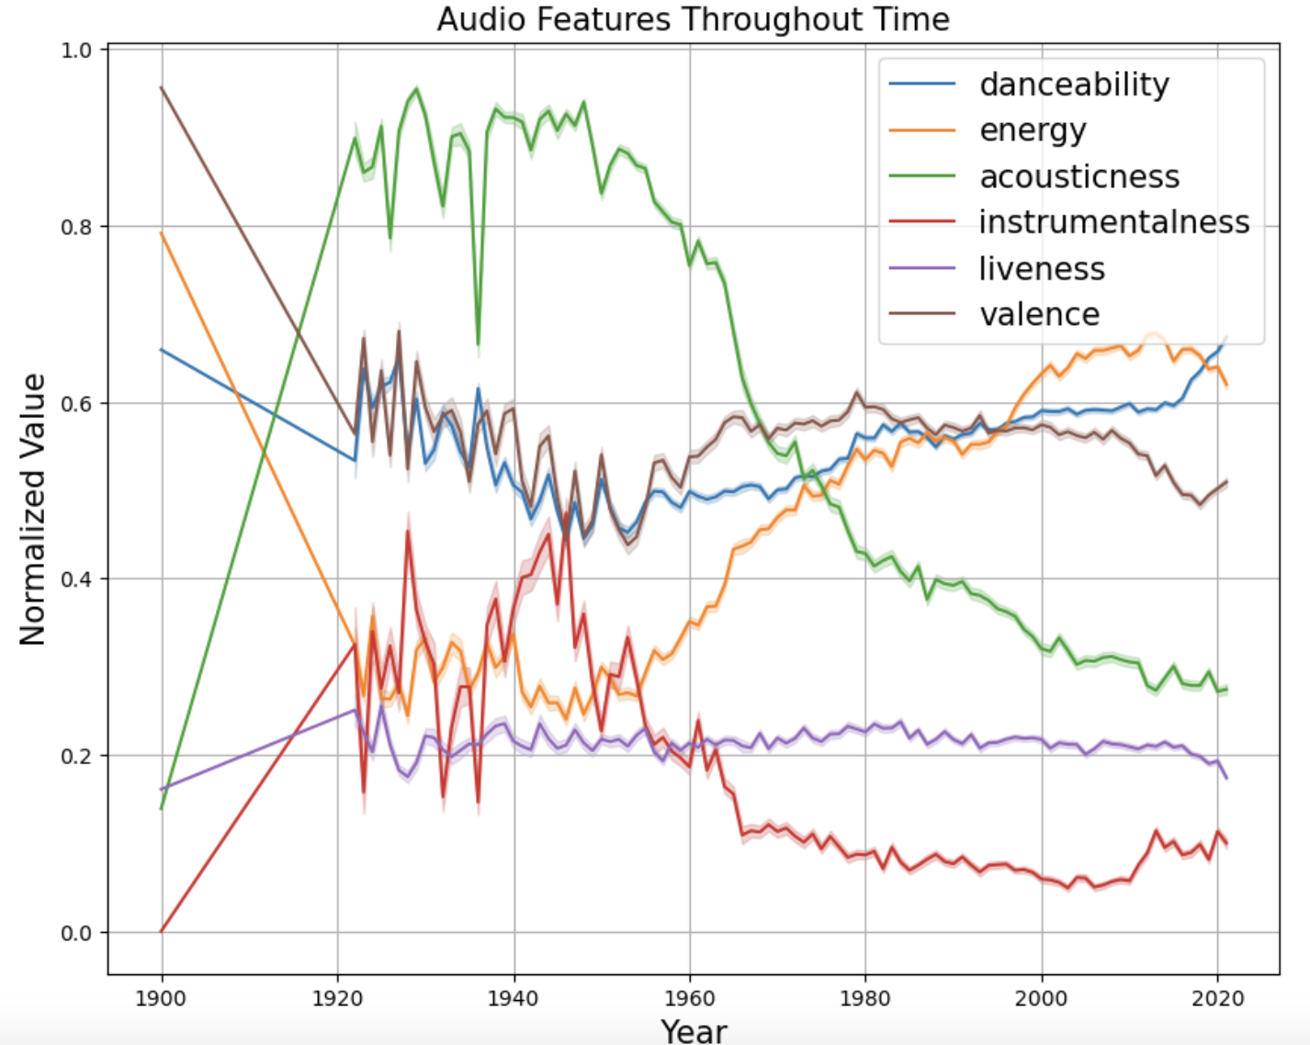
3. Individual feature Throughout Time*
Feature | Trend
Acousticness | High from 1920-1950 but trends downward later
Danceability | Steady Increase from 1960
Valence | Downward trend until 1950, then increase until 1980, then a slow decline afterwards
Energy | Constant until 1950 and then upward trend until 2020
Liveliness | Consistently low from 1920-2020
Instrumentalness | Constant decreases from 1950
Feature | Trend
Acousticness | High from 1920-1950 but trends downward later
Danceability | Steady Increase after 1950
Valence | Downward trend until 1950, then increase until 1980, then a slow decline afterwards
Energy | Constant until 1950 and then upward trend until 2020
Liveliness | Consistently low from 1920-2020
Feature | Trend
Acousticness | High from 1920-1950 but trends downward later
Danceability | Steady Increase after 1950
Valence | Downward trend until 1950, then increase until 1980, then a slow decline afterwards
Energy | Constant until 1950 and then upward trend until 2020
Feature | Trend
Acousticness | High from 1920-1950 but trends downward later
Feature | Trend
Acousticness | High from 1920-1950 but trends downward later
Danceability | Steady Increase after 1950
Valence | Downward trend until 1950, then increase until 1980, then a slow decline afterwards
Feature | Trend
Acousticness | High from 1920-1950 but trends downward later
Danceability | Steady Increase after 1950
*Trends before 1922 are ignored as there is only 1 observation

Slide 10
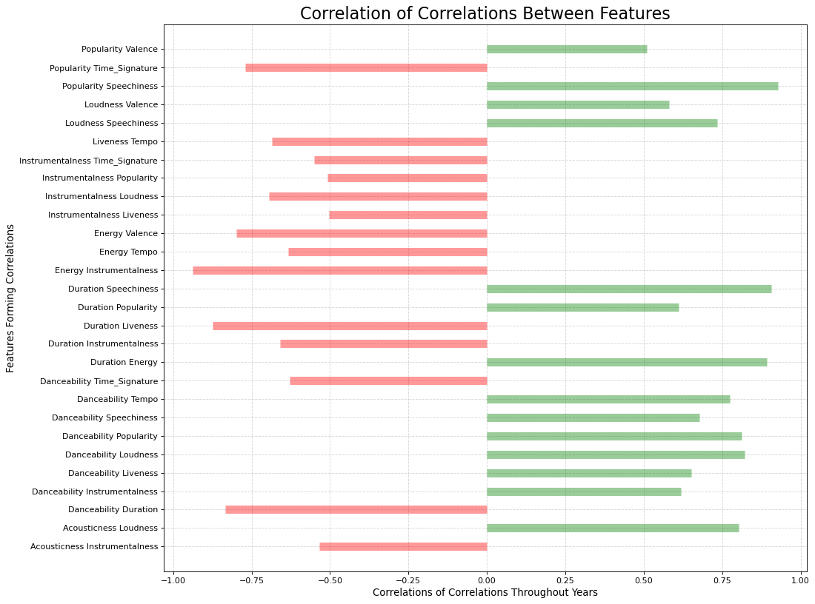
Correlation of features throughout Years

Slide 11
MODELLING & CONCLUSION
Models used to predict the accuracy of our processed data:
- KNN classifier and Random Forest classifier
KNN classifier performs with accuracy score of 0.83 (83%) for predicting song popularity.
Random Forest classifier performs with accuracy score of 0.88 (88%) for predicting song popularity.
Model | Accuracy
KNN classifier | 83%
Random Forest Classifier | 88%

Slide 12
POTENTIAL APPLICATIONS
This predictive model can be used on its own to recommend new songs that users have little information about their popularity
This model can help artist and audio technicians to learn and engineer their tracks to have audio features in popular songs

Slide 13
REFERENCES
https://www.billboard.com/pro/how-much-music-added-spotify-streaming-services-daily/
https://developer.spotify.com/discover/

