Slide 1
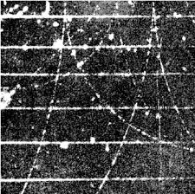
Hough Lines and Transforms

Slide 2
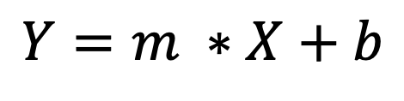
In cartesian space, a line is defined by two parameters (slope & intercept)
$$Y=m ∗X+b$$

Slide 3

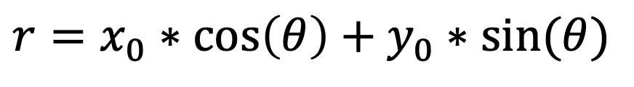
In cartesian space, a line is defined by two parameters (slope & intercept)
$$Y=m ∗X+b$$
In polar space, a line is defined by the angle and distance from the origin to a point perpendicular to the line
R
$$r=x_{0}∗\cos\left(θ\right)+y_{0}∗sin⁡(θ)$$
$$θ$$

Slide 4
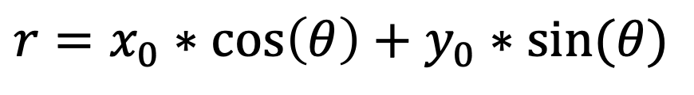
In cartesian space, a line is defined by two parameters (slope & intercept)
$$Y=m ∗X+b$$
In polar space, a line is defined by the angle and distance from the origin to a point perpendicular to the line
R
The polar parameter space spanned by EVERY possible line going a point (xo, yo) is given by:
$$r=x_{0}∗\cos\left(θ\right)+y_{0}∗sin⁡(θ)$$
$$θ$$

Slide 5
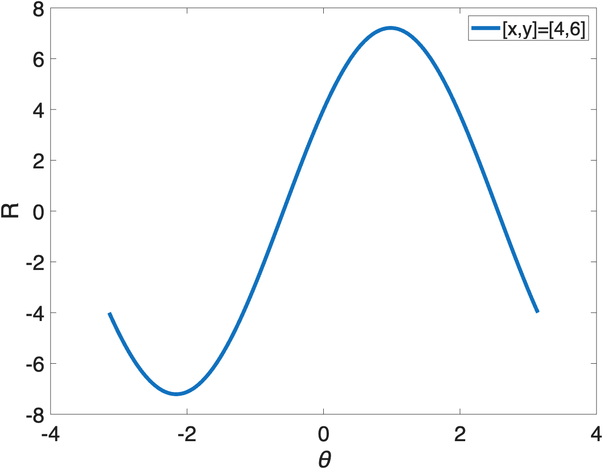
R
The polar parameter space spanned by EVERY possible line going a point (xo, yo) is given by:
$$r=x_{0}∗\cos\left(θ\right)+y_{0}∗sin⁡(θ)$$
$$θ$$

Slide 6
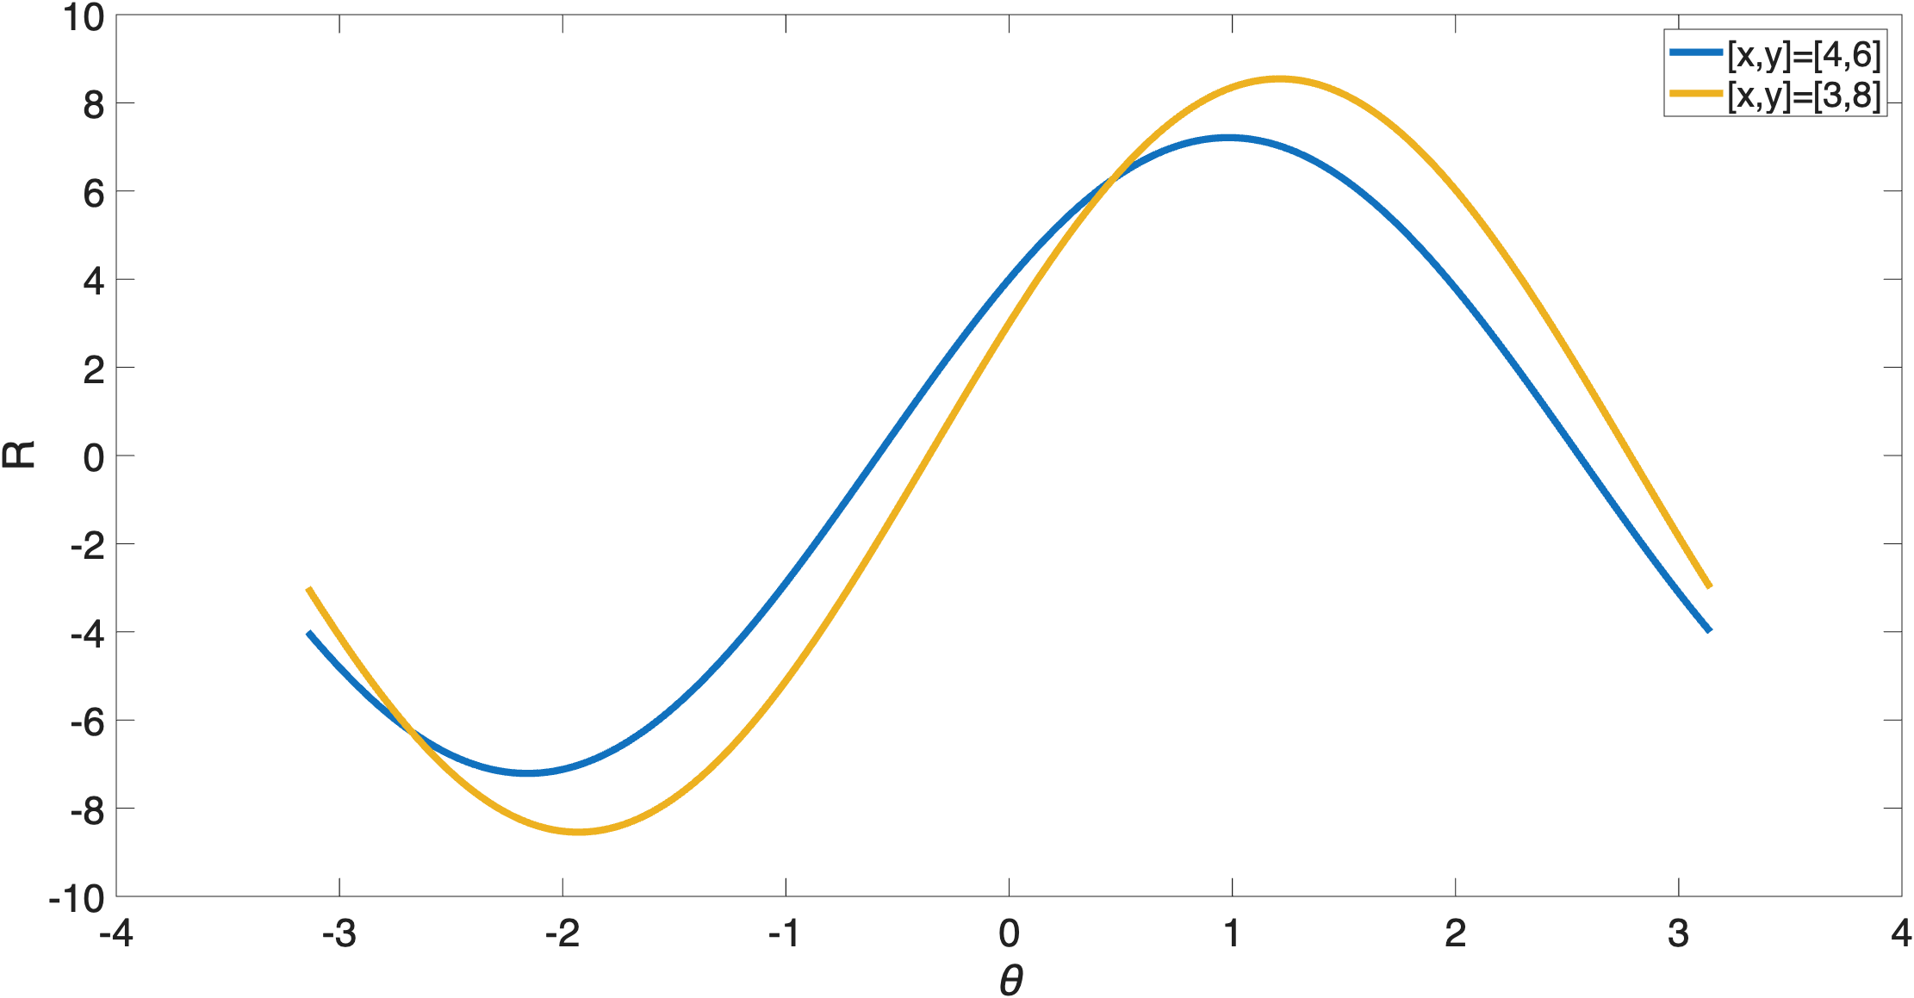
R
The polar parameter space spanned by EVERY possible line going a point (xo, yo) is given by:
$$r=x_{0}∗\cos\left(θ\right)+y_{0}∗sin⁡(θ)$$
$$θ$$

Slide 7
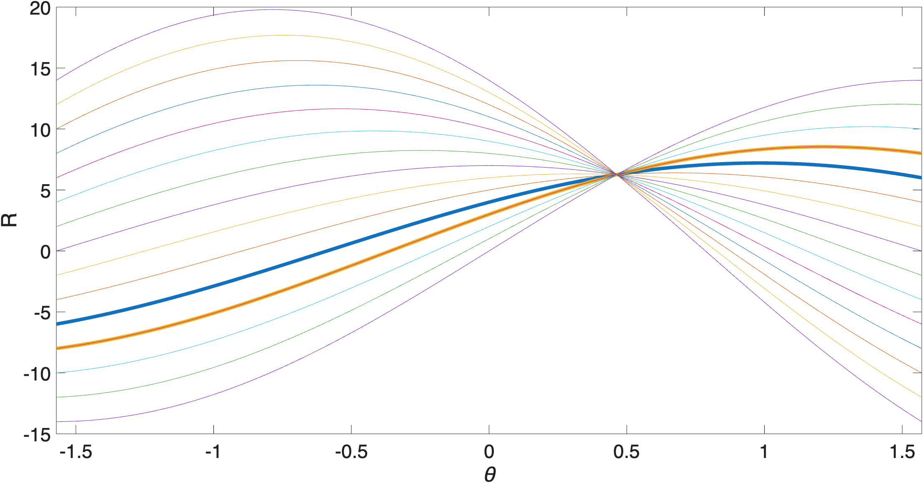

R=6.4
$$θ=0.471$$
The polar parameter space spanned by EVERY possible line going a point (xo, yo) is given by:
$$r=x_{0}∗\cos\left(θ\right)+y_{0}∗sin⁡(θ)$$

Slide 8
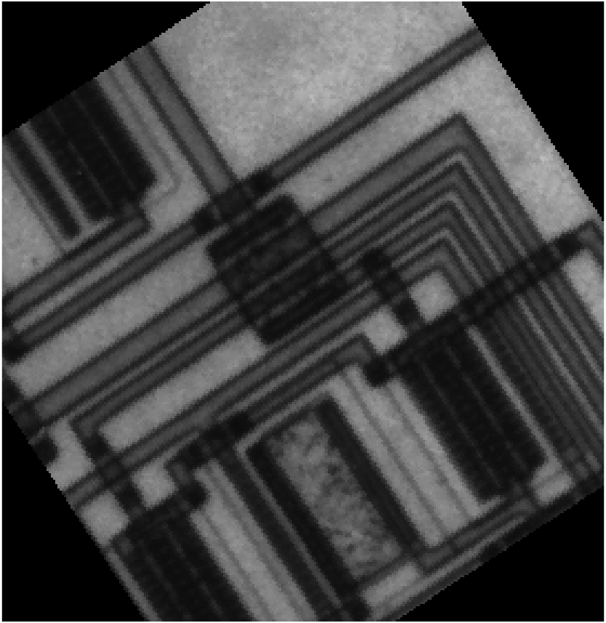
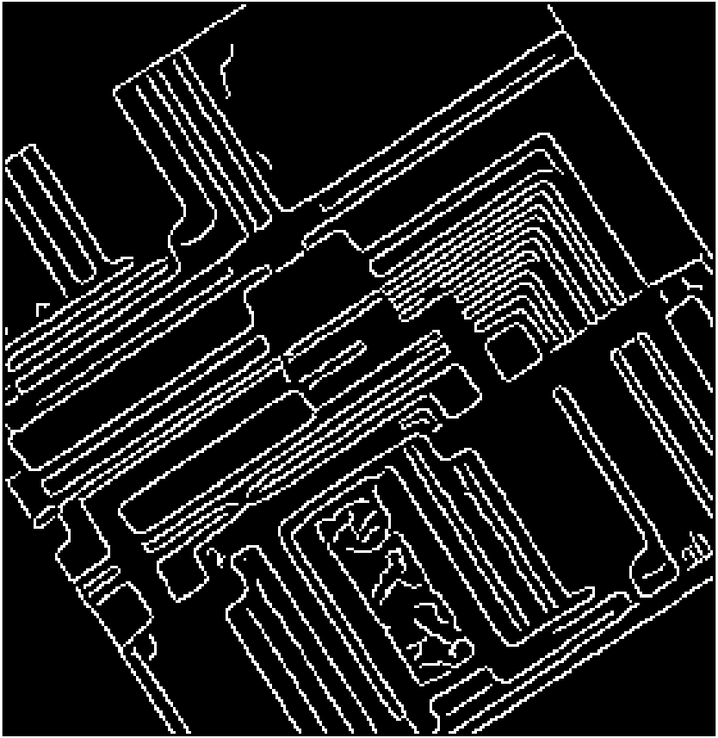
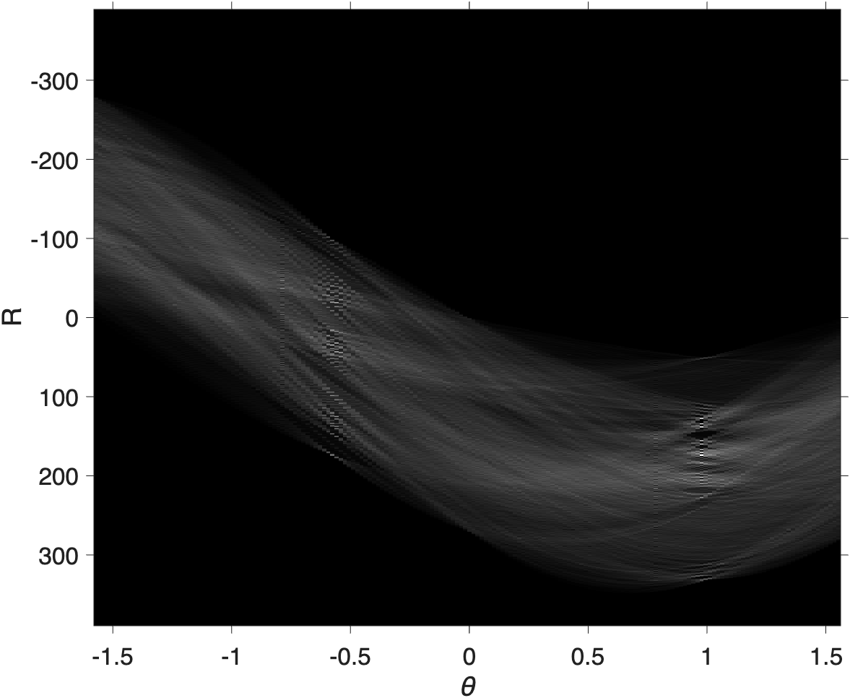
Cany Edge Filter & Binary mask
Hough Transform of all Canny Edge points
Original Image

Slide 9
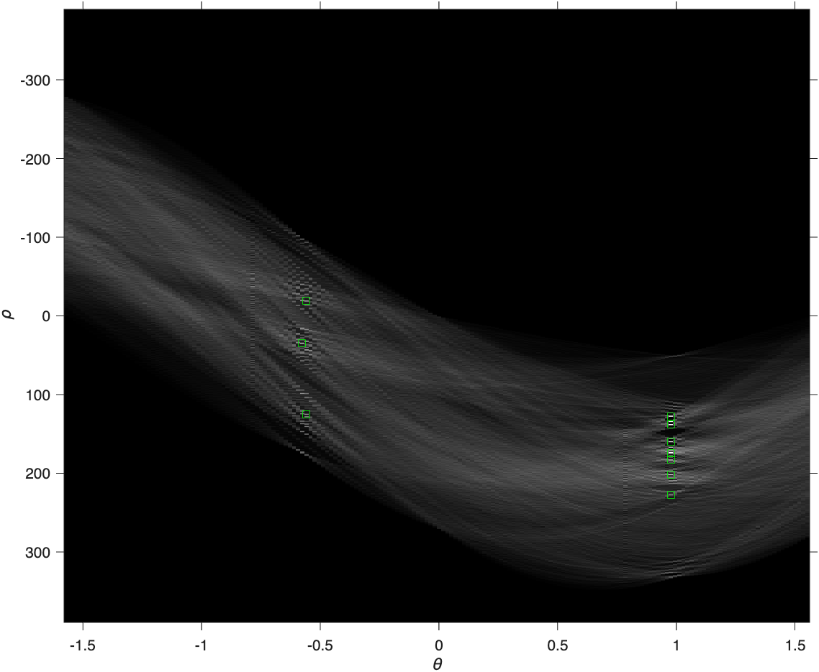
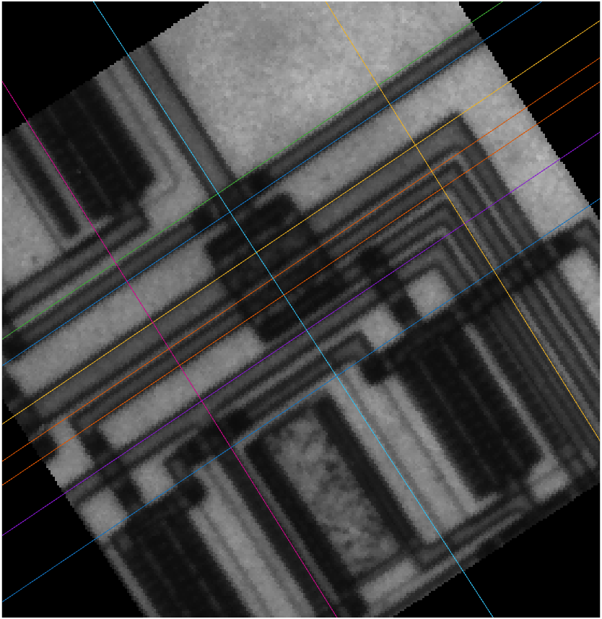
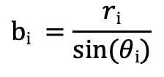
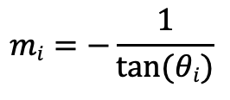
Find the most intense spots on the image
Top 10 crossings
$$mi=−\frac{1}{tan(θi)}$$
$$bi =\frac{ri}{sin(θi)}$$

Slide 10
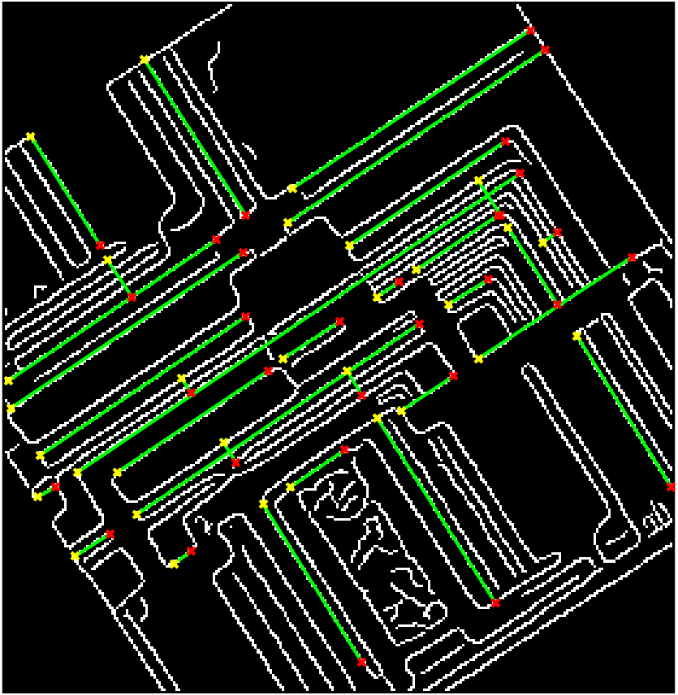
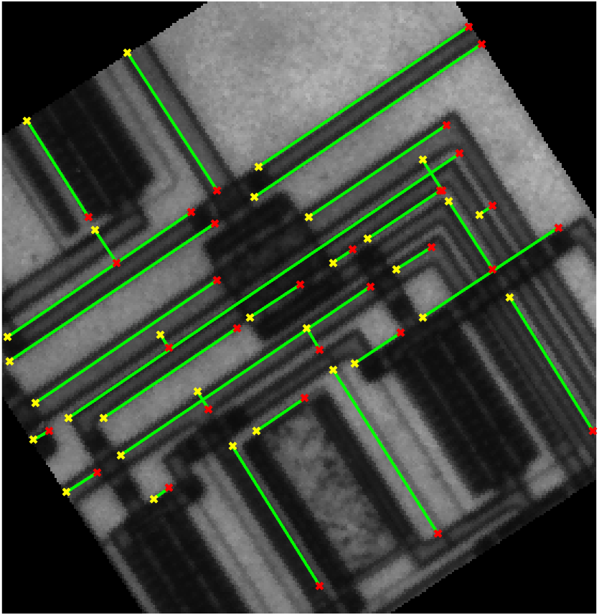

Slide 11
Hough Circles
There is a circle of radius R centered here

