Slide 1
Lecture 2 Operations on Images
ECE 1390/2390
Learning Objectives:
Mathematical operations
Bitwise/Logical operations
Dealing with overflow
Masking and thresholding

Slide 2
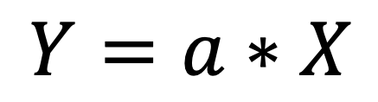
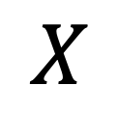
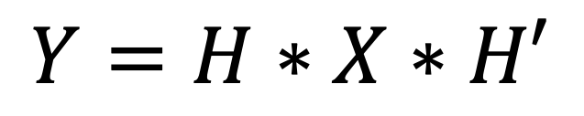
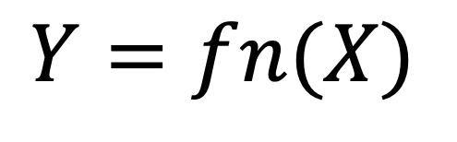
An image is a matrix of information
(tensor for color images)
Math based operations
$$Y=a∗X$$
$$Y=fn(X)$$
$$X$$
$$Y=H∗X∗H′$$
Morphological operations
E.g. Dilate/Erode
For (i=0; i<n; i++)
do something at {i}
end

Slide 3
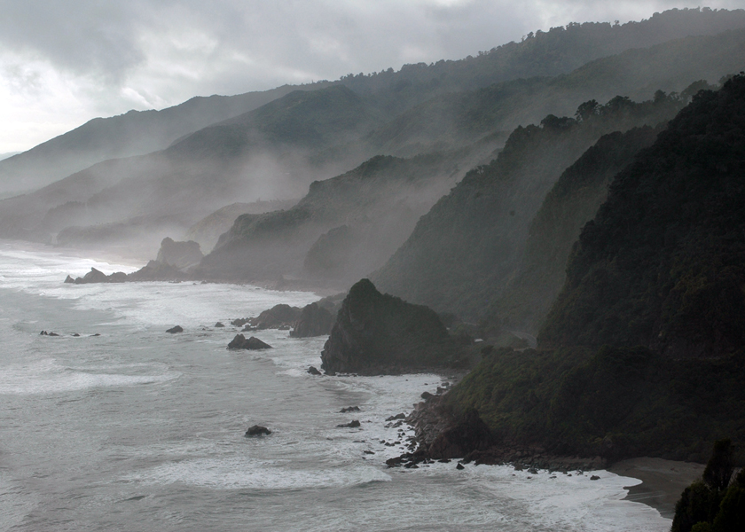
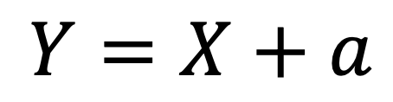
Brightness
$$Y=X+a$$
Changing the brightness of an image means adding/subtracting a scalar from the image

Slide 4

Harder to differentiate
Easier to differentiate
Harder to differentiate
Gamma correction (and similar) designed to adjust intensity → brightness (next lecture)

Slide 5
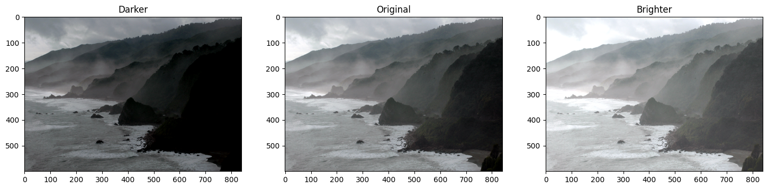
From Lecture1/04_Image_Enhancement.ipnb
matrix = np.ones(img_rgb.shape, dtype="uint8") * 50
img_rgb_brighter = cv2.add(img_rgb, matrix)
img_rgb_darker = cv2.subtract(img_rgb, matrix)

Slide 6
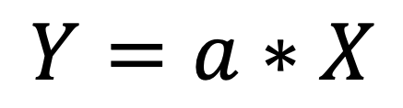
Contrast
$$Y=a∗X$$
Contrast is the range of values in the image. Multiplying by a scalar changes the contrast

Slide 7
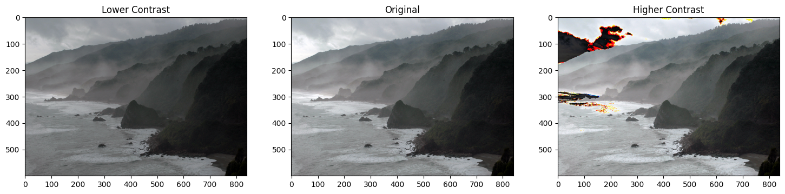
From Lecture1/04_Image_Enhancement.ipnb
matrix_low_contrast = np.ones(img_rgb.shape) * 0.8
matrix_high_contast = np.ones(img_rgb.shape) * 1.2
img_rgb_darker = np.uint8(cv2.multiply(np.float64(img_rgb), matrix_low_contrast))
img_rgb_brighter = np.uint8(cv2.multiply(np.float64(img_rgb), matrix_high_contast))

Slide 8
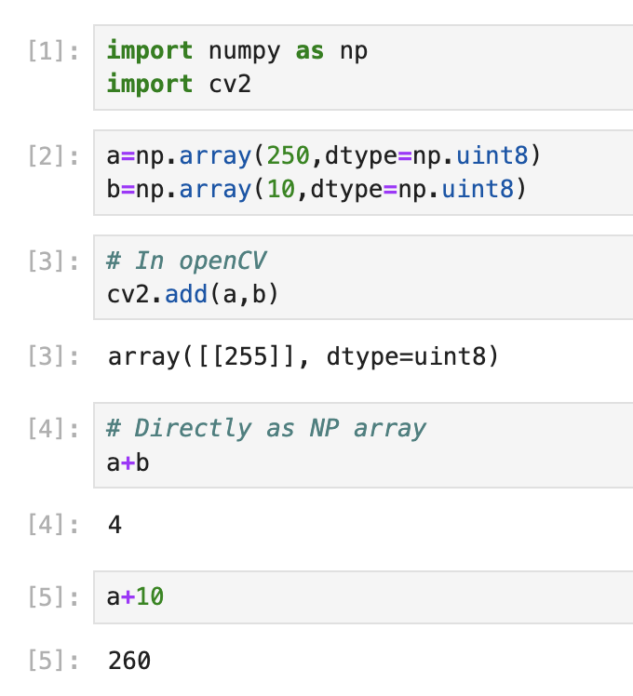
Clipping
Python:
OpenCV clips at 255
numpy rolls over (260 -> 255, 0, 1, 2, 3, 4)
np + scalar => converts type

Slide 9
Clipping
Python:
a = [100 150 200 250] → convert to uint16
b = [10 10. 10. 10 ] → convert to uint16
a + b = [110 160 210 260] (uint16)
Normalize
= [110 160 210 260] * 255 /260
= [107 157 206 255]

Slide 10

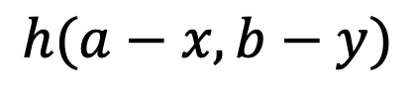
Point Spread Function
General
$$h(x,a,y,b)$$
b
Operation varies depending on which position (x,y) in the image
(x,y)
a
Shift invariant
$$h(a−x,b−y)$$
Operation is independent of the position (x,y) in the image

Slide 11
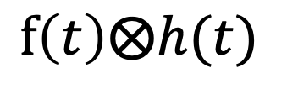
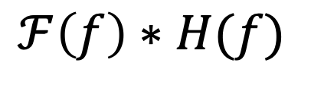
Windowed FIR Filters
$$ℱ\left(f\right)∗H(f)$$
$$f\left(t\right)⨂h(t)$$
Multiplication in the Fourier domain
Convolution in the Time domain

Slide 12
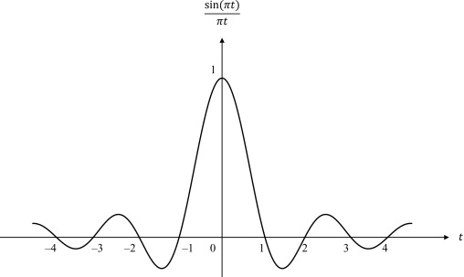

Windowed FIR Filters
$$ℱ\left(f\right)∗H(f)$$
$$f\left(t\right)⨂h(t)$$
Multiplication in the Fourier domain
Convolution in the Time domain
$$hLPF(t)$$
$$H_{LPF}\left(f\right)$$
Ideal low-pass filter
Wiggles extend forever →
-f
f
0

Slide 13
Windowed FIR Filters
$$ℱ\left(f\right)∗H(f)$$
$$f\left(t\right)⨂h(t)$$
Multiplication in the Fourier domain
Convolution in the Time domain
$$hLPF(t)$$
$$H_{LPF}\left(f\right)$$
Ideal low-pass filter
Truncate or taper the response to zero
-f
f
0

Slide 14
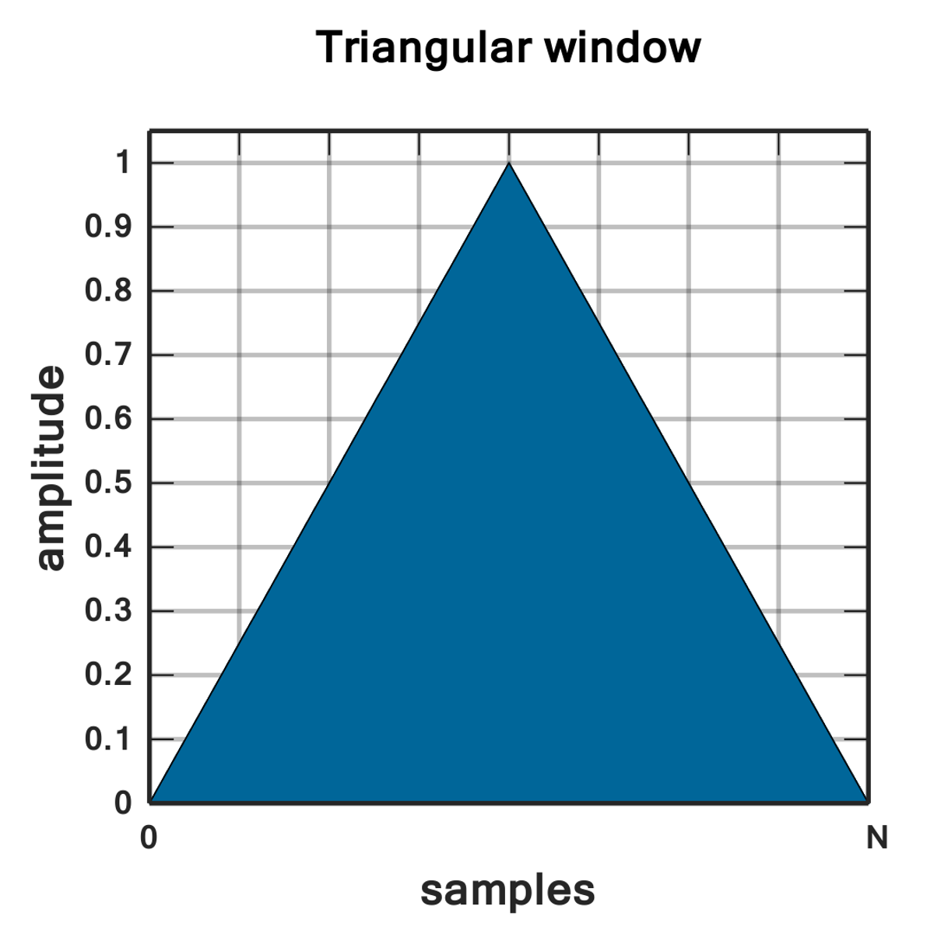
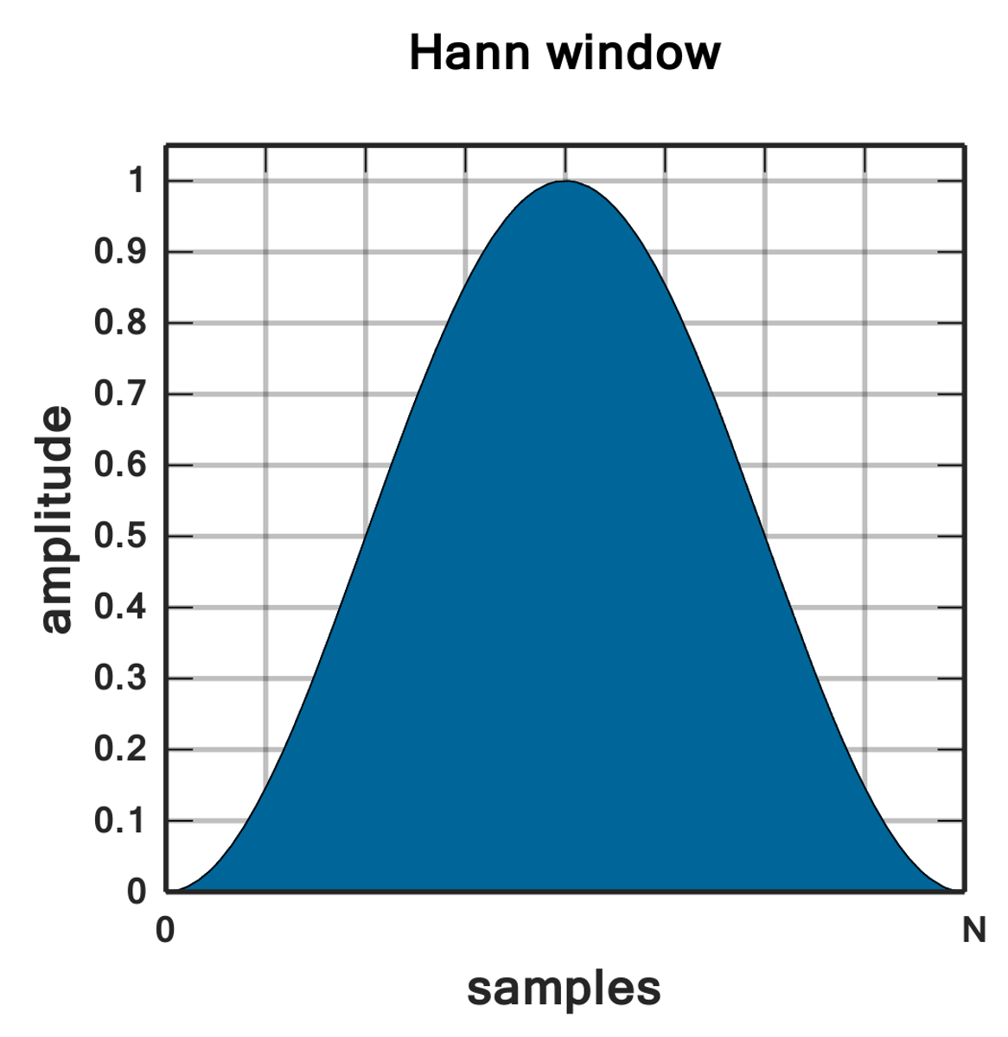
Windowed FIR Filters
Truncated window (square window)
The larger the window & more side lobes of the Sinc included
the sharper the transition in the Fourier domain
The smoother the window transitions to zero
the fewer ripples in the pass/stop band in the Fourier domain
Triangle window
Hann window

Slide 15
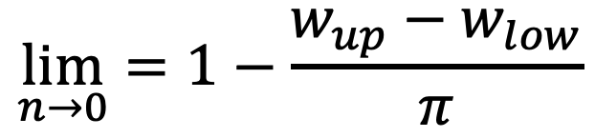
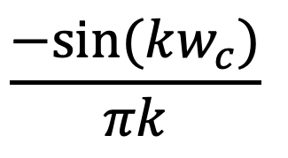
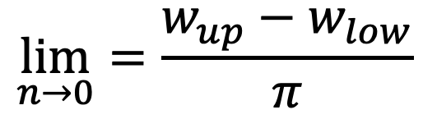
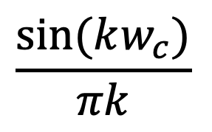
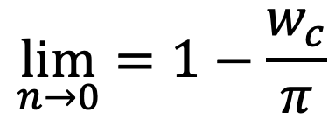
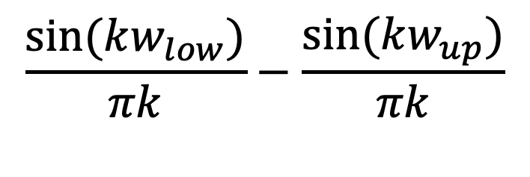
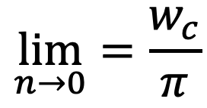
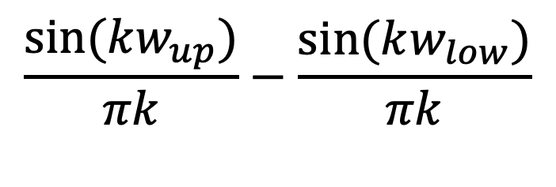
Low-pass
$$\lim_{n→0}{=\frac{w_{c}}{π}}$$
$$\frac{sin⁡(kw_{c})}{πk}$$
High-pass
$$\frac{−sin⁡(kw_{c})}{πk}$$
$$\lim_{n→0}{=1−\frac{w_{c}}{π}}$$
Band-pass
$$\frac{sin⁡(kw_{up})}{πk}−\frac{sin⁡(kw_{low})}{πk}$$
$$\lim_{n→0}{=\frac{w_{up}−w_{low}}{π}}$$
Notch
$$\frac{sin⁡(kw_{low})}{πk}−\frac{sin⁡(kw_{up})}{πk}$$
$$\lim_{n→0}{=1−\frac{w_{up}−w_{low}}{π}}$$

Slide 16
1 | 2 | 1
2 | 4 | 2
1 | 2 | 1
1/16*
-1 | -2 | -1
-2 | 12 | -2
-1 | -2 | -1

Slide 17
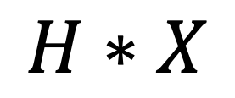
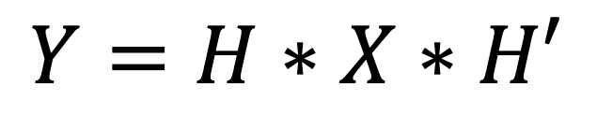
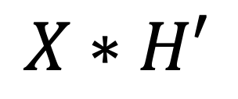
$$Y=H∗X∗H′$$
$$H∗X$$
$$X∗H′$$
Out = kron( kron(H,X), H')
Out = np.convolution( np.convolution(X,H,axis=0), H,axis=1)

Slide 18

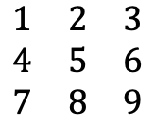
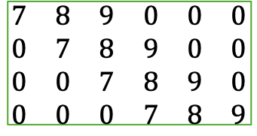
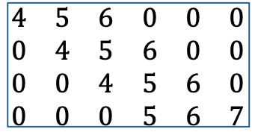
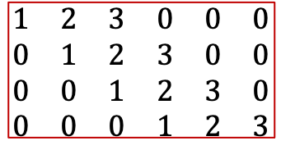
2D convolution as a matrix operation
$$\begin{matrix}a & b & c & d & e & f \\ g & h & … & & & \\ ⋮ & & & & & \\ & & & & & \\ & & & & & \\ & & & & & z\end{matrix}$$
6
$$\begin{matrix}1 & 2 & 3 \\ 4 & 5 & 6 \\ 7 & 8 & 9\end{matrix}$$
$$\begin{matrix}1 & 2 & 3 & 0 & 0 & 0 \\ 0 & 1 & 2 & 3 & 0 & 0 \\ 0 & 0 & 1 & 2 & 3 & 0 \\ 0 & 0 & 0 & 1 & 2 & 3\end{matrix}$$
n = (6 – 3) +1
< 6 x 6 >
< 3 x 3 >
$$\begin{matrix}4 & 5 & 6 & 0 & 0 & 0 \\ 0 & 4 & 5 & 6 & 0 & 0 \\ 0 & 0 & 4 & 5 & 6 & 0 \\ 0 & 0 & 0 & 5 & 6 & 7\end{matrix}$$
$$\begin{matrix}7 & 8 & 9 & 0 & 0 & 0 \\ 0 & 7 & 8 & 9 & 0 & 0 \\ 0 & 0 & 7 & 8 & 9 & 0 \\ 0 & 0 & 0 & 7 & 8 & 9\end{matrix}$$
Construction of “H” matrix

Slide 19
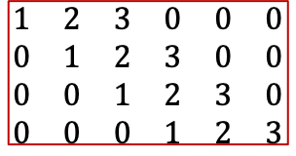
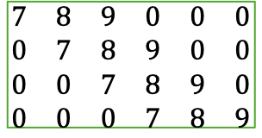
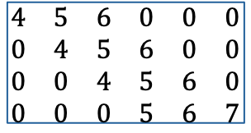
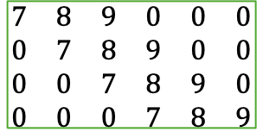
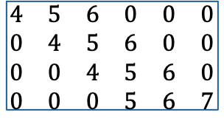
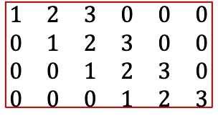
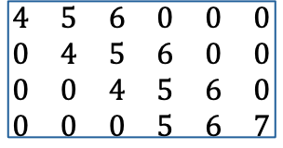
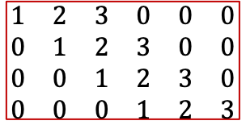
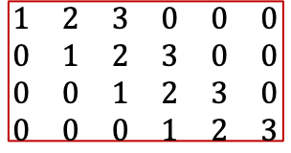
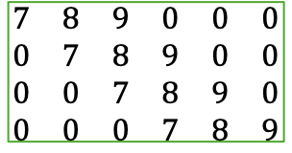
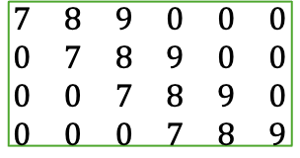
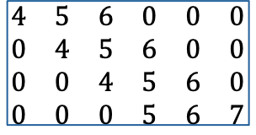
2D convolution as a matrix operation
$$\begin{matrix}1 & 2 & 3 & 0 & 0 & 0 \\ 0 & 1 & 2 & 3 & 0 & 0 \\ 0 & 0 & 1 & 2 & 3 & 0 \\ 0 & 0 & 0 & 1 & 2 & 3\end{matrix}$$
$$\begin{matrix}4 & 5 & 6 & 0 & 0 & 0 \\ 0 & 4 & 5 & 6 & 0 & 0 \\ 0 & 0 & 4 & 5 & 6 & 0 \\ 0 & 0 & 0 & 5 & 6 & 7\end{matrix}$$
$$\begin{matrix}7 & 8 & 9 & 0 & 0 & 0 \\ 0 & 7 & 8 & 9 & 0 & 0 \\ 0 & 0 & 7 & 8 & 9 & 0 \\ 0 & 0 & 0 & 7 & 8 & 9\end{matrix}$$
= H
<16 x 36 >
$$\begin{matrix}1 & 2 & 3 & 0 & 0 & 0 \\ 0 & 1 & 2 & 3 & 0 & 0 \\ 0 & 0 & 1 & 2 & 3 & 0 \\ 0 & 0 & 0 & 1 & 2 & 3\end{matrix}$$
$$\begin{matrix}4 & 5 & 6 & 0 & 0 & 0 \\ 0 & 4 & 5 & 6 & 0 & 0 \\ 0 & 0 & 4 & 5 & 6 & 0 \\ 0 & 0 & 0 & 5 & 6 & 7\end{matrix}$$
$$\begin{matrix}7 & 8 & 9 & 0 & 0 & 0 \\ 0 & 7 & 8 & 9 & 0 & 0 \\ 0 & 0 & 7 & 8 & 9 & 0 \\ 0 & 0 & 0 & 7 & 8 & 9\end{matrix}$$
$$\begin{matrix}1 & 2 & 3 & 0 & 0 & 0 \\ 0 & 1 & 2 & 3 & 0 & 0 \\ 0 & 0 & 1 & 2 & 3 & 0 \\ 0 & 0 & 0 & 1 & 2 & 3\end{matrix}$$
$$\begin{matrix}4 & 5 & 6 & 0 & 0 & 0 \\ 0 & 4 & 5 & 6 & 0 & 0 \\ 0 & 0 & 4 & 5 & 6 & 0 \\ 0 & 0 & 0 & 5 & 6 & 7\end{matrix}$$
$$\begin{matrix}7 & 8 & 9 & 0 & 0 & 0 \\ 0 & 7 & 8 & 9 & 0 & 0 \\ 0 & 0 & 7 & 8 & 9 & 0 \\ 0 & 0 & 0 & 7 & 8 & 9\end{matrix}$$
n = (6 – 3) +1
$$\begin{matrix}1 & 2 & 3 & 0 & 0 & 0 \\ 0 & 1 & 2 & 3 & 0 & 0 \\ 0 & 0 & 1 & 2 & 3 & 0 \\ 0 & 0 & 0 & 1 & 2 & 3\end{matrix}$$
$$\begin{matrix}4 & 5 & 6 & 0 & 0 & 0 \\ 0 & 4 & 5 & 6 & 0 & 0 \\ 0 & 0 & 4 & 5 & 6 & 0 \\ 0 & 0 & 0 & 5 & 6 & 7\end{matrix}$$
$$\begin{matrix}7 & 8 & 9 & 0 & 0 & 0 \\ 0 & 7 & 8 & 9 & 0 & 0 \\ 0 & 0 & 7 & 8 & 9 & 0 \\ 0 & 0 & 0 & 7 & 8 & 9\end{matrix}$$

Slide 20
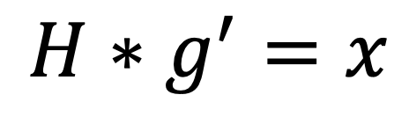


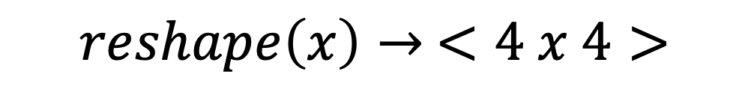
2D convolution as a matrix operation
$$\begin{matrix}a & b & c & d & e & f \\ g & h & … & & & \\ & & & & & \\ & & & & & \\ & & & & & \\ & & & & & \end{matrix}$$
<16 x 36 >
<36 x 1 >
< 6 x 6 >
$$H∗g^{′}=x$$
$$\begin{matrix}a \\ b \\ c \\ d \\ e \\ f \\ g \\ ⋮\end{matrix}$$
$$reshape\left(x\right)→ <4 x 4>$$
= g’

Slide 21


2D convolution as a matrix operation
If you want the same size output as input image:
N=6
= (8 – 3)
need to pad the image from <6x6> to <8x8>
In MATLAB: conv2(B,A,'valid')
H = kron(eye(N),reshape(A’,1,[] )
g = reshape(B’,1,[] )
x = reshape(H*g’ , N, N )
$$\begin{matrix}a & a & b & c & d & e & f & f \\ a & a & b & c & d & e & f & f \\ g & g & h & i & j & k & l & l \\ ⋮ & & & & & & & ⋮ \\ & & & & & & & \\ & & & & & & & \\ & & & & & & & \\ & & & & & & z & z\end{matrix}$$
$$\begin{matrix}0 & 0 & 0 & 0 & 0 & 0 & 0 & 0 \\ 0 & a & b & c & d & e & f & 0 \\ 0 & g & h & i & j & k & l & 0 \\ ⋮ & & & & & & & ⋮ \\ & & & & & & & \\ & & & & & & & \\ & & & & & & & \end{matrix}$$
$$<6 x 6> ∗ <3 x 3> = <4 x 4>$$
N = (6 – 3) +1

Slide 22
2D convolution as a matrix operation
kernel= np.ones((3,3))/9
img_smooth = cv2.filter2D(img,-1,kernel)
Depth
-1 : gives output image data type as input
cv2.CV_8U = 0 uint8
cv2.CV_8S = 1 int8
cv2.CV_16U = 2 uint16
cv2.CV_16S = 3 int16
cv2.CV_32S = 4 int32
cv2.CV_32F = 5 float32
cv2.CV_64F = 6 float64

Slide 23
Boolean (Bit-wise) operations
AND
OR
XOR

Slide 24
Morphological Operations
Erosion/Dilation
Kernel is Boolean (mask)
Structure/Kernel
Anchor point
*

Slide 25
Erosion/Dilation
For {i,j} in image:
move kernel anchor to {i,j}
list = find (kernel ==true)
newVal{i,j} = fcn (image[list] )
Anchor point
Structure/Kernel
Dilation - MAX ( image[list] )
Erosion - MIN ( image[list] )
Denoising - MEDIAN ( image[list] )
Smoothing - MEAN ( image[list] )
*

Slide 26
Erosion/Dilation
*
*

Slide 27
Convolutional (Filtering) Operations
Anchor point
Structure/Kernel
For {i,j} in image:
move kernel anchor to {i,j}
newVal{i,j} = sum(image .* kernel)
*

Slide 28

Thresholding
thres, img_out = cv2.threshold(img, thres, replacement value, type)

Slide 29
Thresholding
thres, img_out = cv2.threshold(img, thres, replacement value, type)
Types:
THRESH_BINARY If x > thresh; x= rep_value; else x=0
THRESH_BINARY_INV If x > thresh; x= 0; else x= rep_value
THRESH_TRUNC If x > thresh; x= x ; else x= thresh
THRESH_TOZERO If x > thresh; x= x; else x= 0
THRESH_TOZERO_INV If x > thresh; x= 0; else x= x

Slide 30


Otsu’s thresholding
Nobuyuki Otsu (1979). "A threshold selection method from gray-level histograms". IEEE Transactions on Systems, Man, and Cybernetics. 9 (1): 62–66.
Variance values above thresh
Variance values below thresh
$$σ^{2}=w_{0}∙{σ_{0}}^{2}+w_{1}∙{σ_{1}}^{2}$$
Probability of values below thresh
Probability of values above thresh

Slide 31

Adaptive thresholding

Slide 32



Adaptive thresholding
$$thres\{i,j\}=\left(\frac{1}{n∗m}\sum_{i=1}^{n}{\sum_{j=1}^{m}{x[i,j]}}\right)−C$$
thes{i,j} $=\left(\frac{1}{\sum_{i=1}^{n}{\sum_{j=1}^{m}{G\left[i,j\right]}}}\sum_{i=1}^{n}{\sum_{j=1}^{m}{G\left[i,j\right]∗x[i,j]}}\right)−C$

