Slide 1
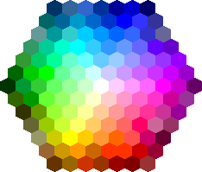
Lecture 3 Image Color-spaces & Statistics
ECE 1390/2390
Learning Objectives:
Histograms
Color schemes
Gamma-correction
Hue, saturation

Slide 2
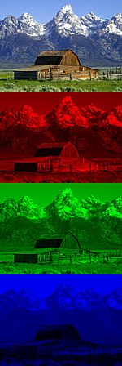
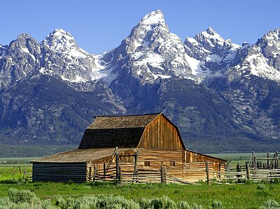

RGB

Slide 3
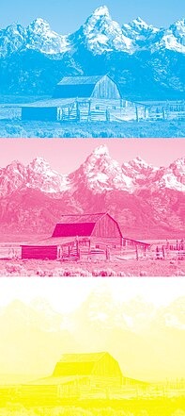
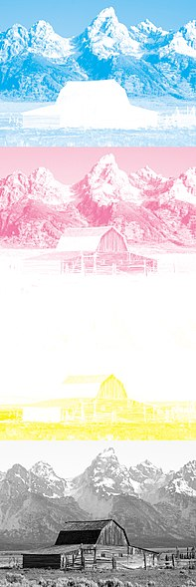
CMY/CMYK

Slide 4
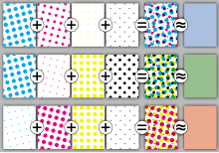
CMY/CMYK
Half toning
CMYK works well for half-toning. Colors are created from varied size/density of dots. The human eye blends these together to get a color.
Saves ink in printing
Image from wikipedia

Slide 5
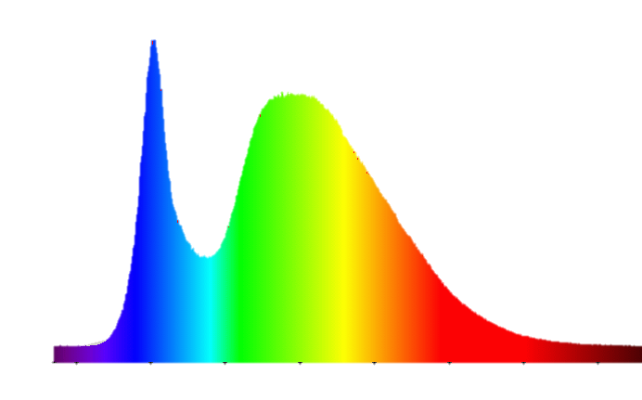
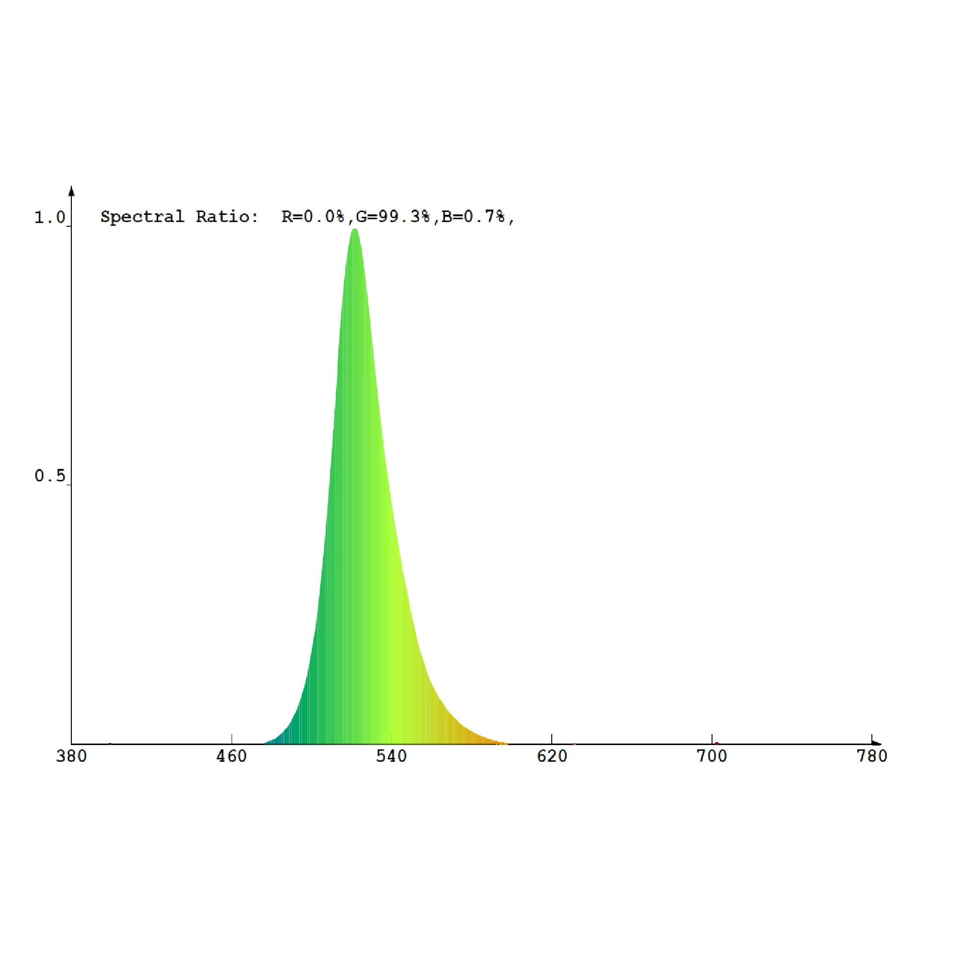
More Brightness
Brightness: Mean of intensity over the
power spectrum
Colorfulness: inverse of “variance”
of power spectrum
Saturation: Brightness/Colorfulness
Radiance. Light power through a solid angle
Units: W . sr ^{-1 .} m⁻² [sr = steradian; 𝜽=𝝓=1 radian]
Luminance. Radiance * sensitivity of human eye
Units: cd . m⁻² [cd = candela]
More colorfulness
More Saturation

Slide 6
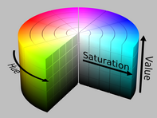
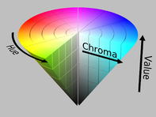
HSV (Hue-Saturation-Value)
Hue. The "attribute of a visual sensation according to which an area appears to be similar to one of the perceived colors: red, yellow, green, and blue”
Red = 0º
Yellow = 60º
Green = 120º
Blue = 240º
Purple = 300º
Saturation. The "colorfulness of a stimulus relative to its own brightness"
Value. The "attribute of a visual sensation according to which an area appears to emit more or less light"
0 = Black
1 = Full color
Image from wikipedia

Slide 7
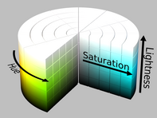
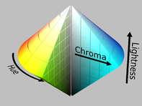
HSL (Hue-Saturation-Lightness)
Hue. The "attribute of a visual sensation according to which an area appears to be similar to one of the perceived colors: red, yellow, green, and blue”
Red = 0º
Yellow = 60º
Green = 120º
Blue = 240º
Purple = 300º
Saturation. The "colorfulness of a stimulus relative to its own brightness"
Lightness. The "brightness relative to the brightness of a similarly illuminated white”
0 = Black
1 = White
Image from wikipedia

Slide 8
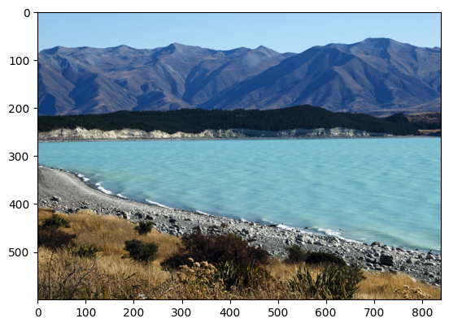
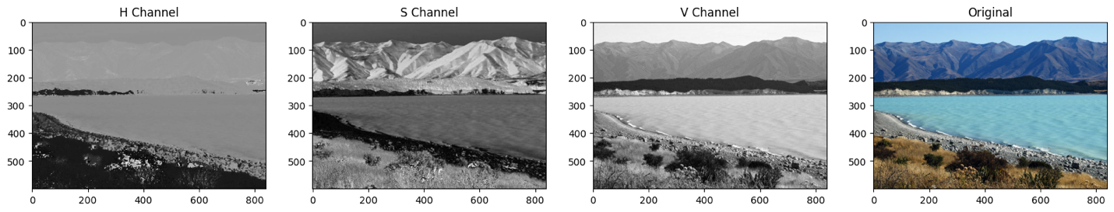
In 08_ColorSpaces.ipynb
# convert to BGR to HSV
lake_img_hsv = cv2.cvtColor(lake_img,cv2.COLOR_BGR2HSV)
# Split the HSV (monochromatic images)
H,S,V = cv2.split(lake_img_hsv)
Image from opencv.org

Slide 9
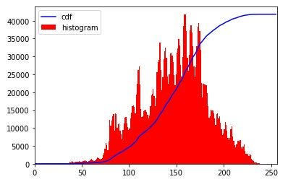
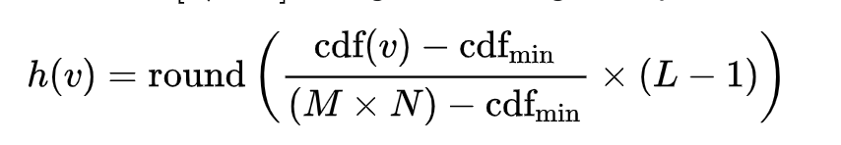
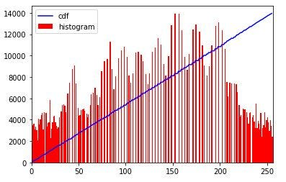
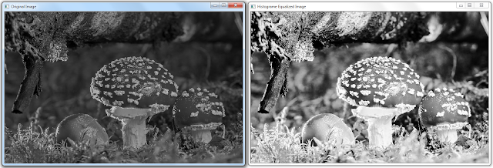
Equalization

Slide 10
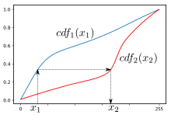
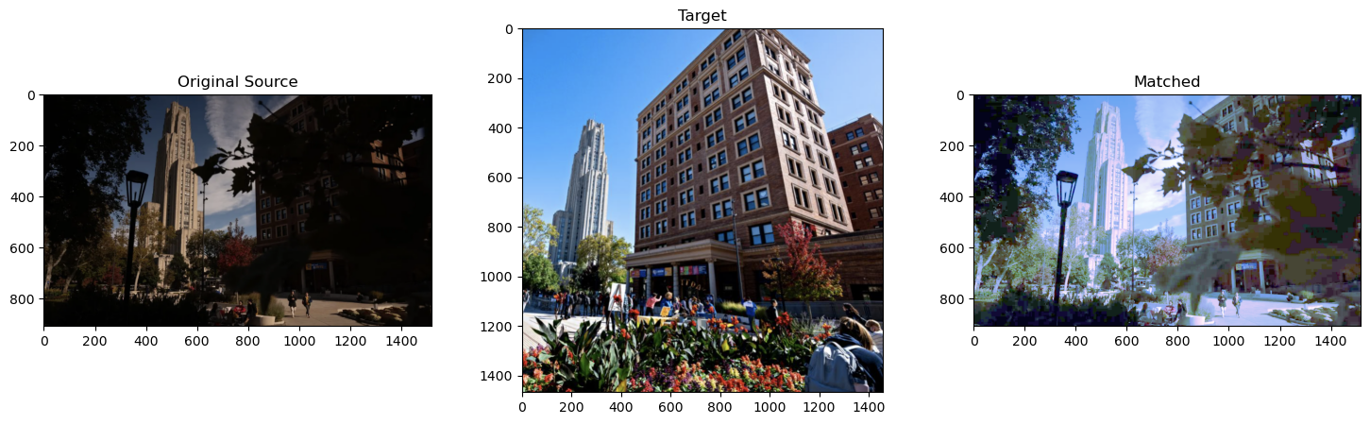
Histogram matching

Slide 11
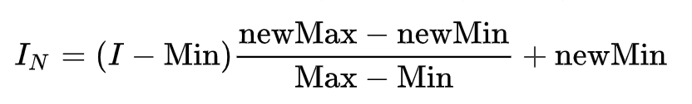
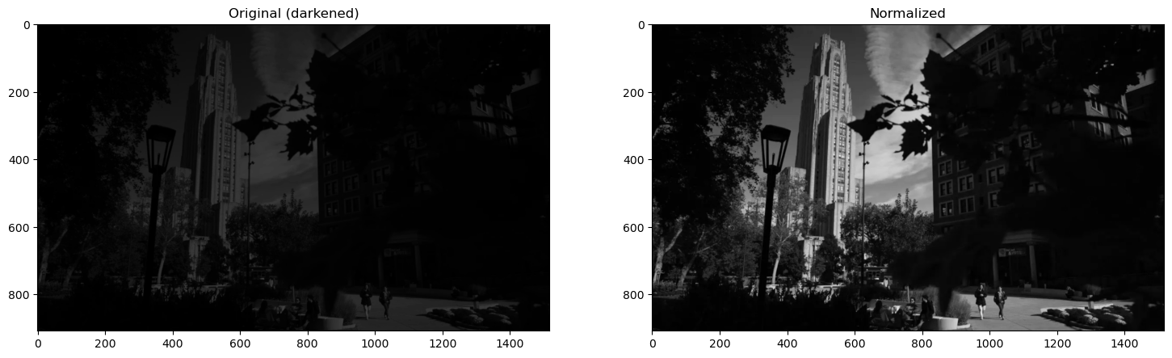
Normalization
Match the contrast level (range of intensities)

Slide 12
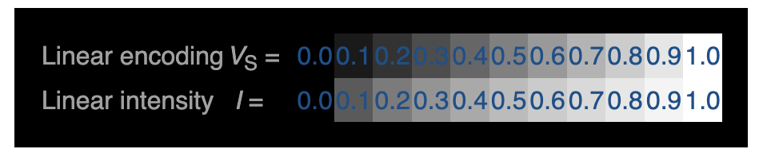
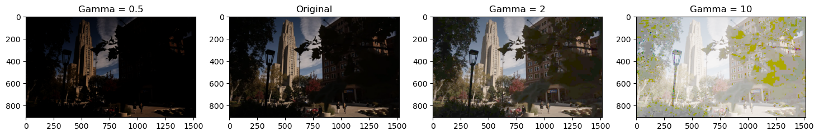
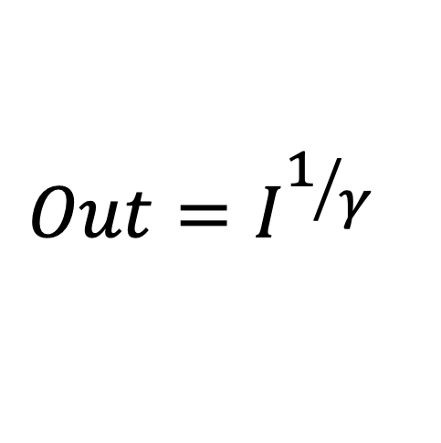
Gamma correction
Your eye is not linear to intensity
$$Out=I^{1/γ}$$

Slide 13
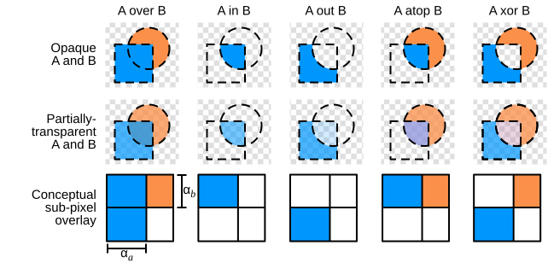
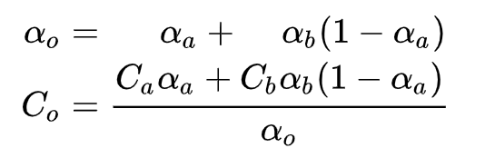
Alpha Blending

