Slide 1
Introduction to GitHub Teams/Organizations/Classroom

Slide 2
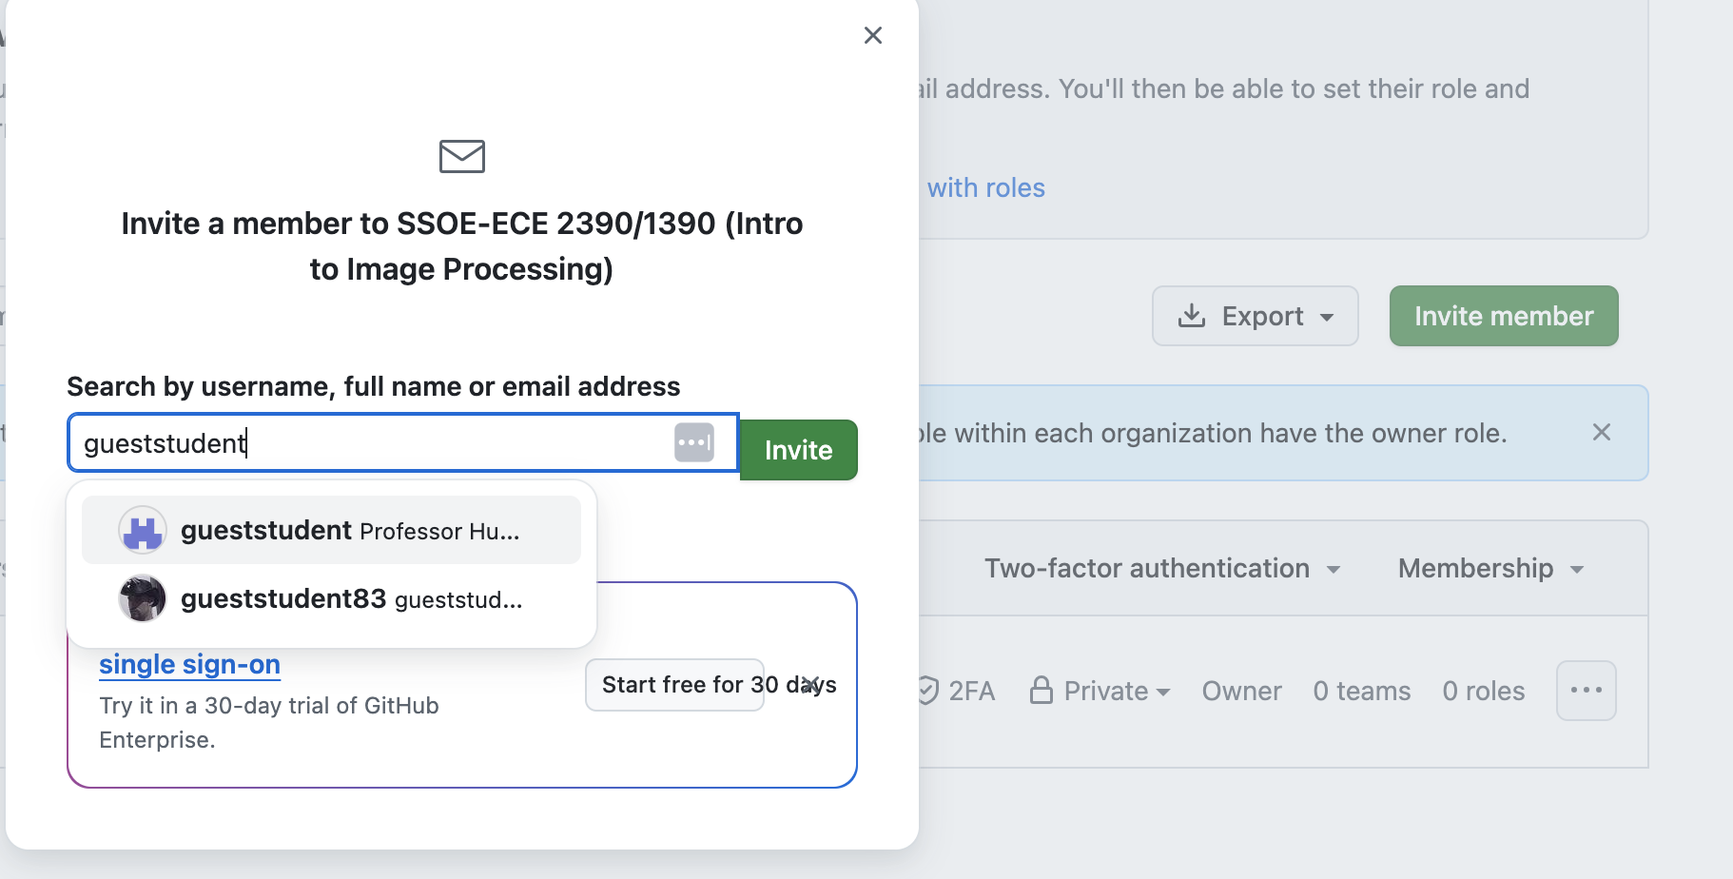
Git Organization for course
https://github.com/SSOE-ECE1390

Slide 3
Companies search your GitHub !
Chose your GitHub username appropriately (and professionally)
Private vs Public Repos

Slide 4
Homework 0
Install VS-Code
https://code.visualstudio.com/
Add extensions for
GitHub Pull Requests (the official GitHub one)
GitHub Classroom
Python Language Support

Slide 5
Homework 0
Python 3.12 (not 3.13)
Create dedicated virtual env
install:
opencv-python
matplotlib
numpy
mediapipe

Slide 6
Homework 0
Clone the assignment repo (link found in canvas)
How this works with the org:
https://github.com/orgs/SSOE-ECE1390
Creates a fork of the template repo (assignment) with your Git name. E.g. homework0_huppertt
Make edits, commit, and push your assignment to GitHub
Either within VS-code or command line, etc
If you want to change/update your answer, send a new commit to GitHub.
We will grade based on what is on GitHub and (when appropriate) make comments/grading as push requests into your repo

Slide 7
Group Project
https://github.com/SSOE-ECE1390
Once you accept the first homework assignment and link it to your GitHub account, I can add you to the organization group.
Once you have a team for your project, then one person from will create a new Team within the organization. Then add the other members of the team
Create a Project in your team
Create a Repo in your team

Slide 8
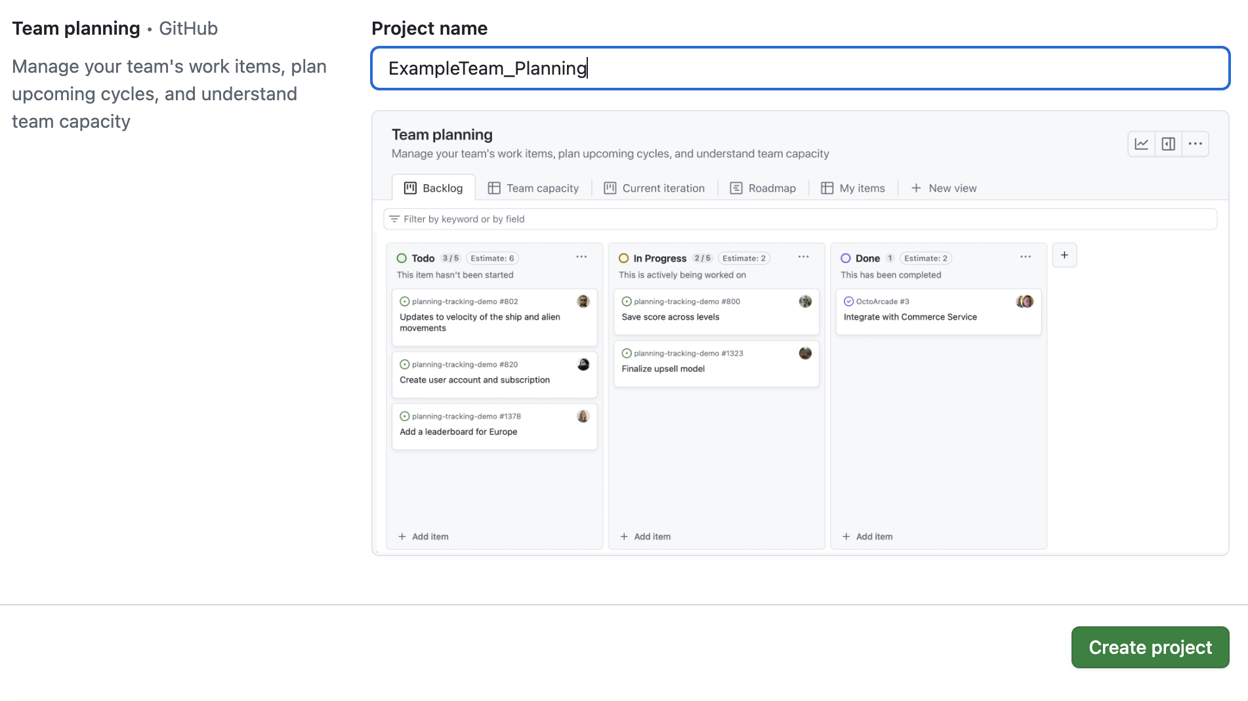
GitHub Projects
Not actual code
Milestones/tasks/roadmaps
Might refer to management of multiple repos as part of a larger project
In the semester project, you will use this to assign tasks and to document who did what for the project!

Slide 9
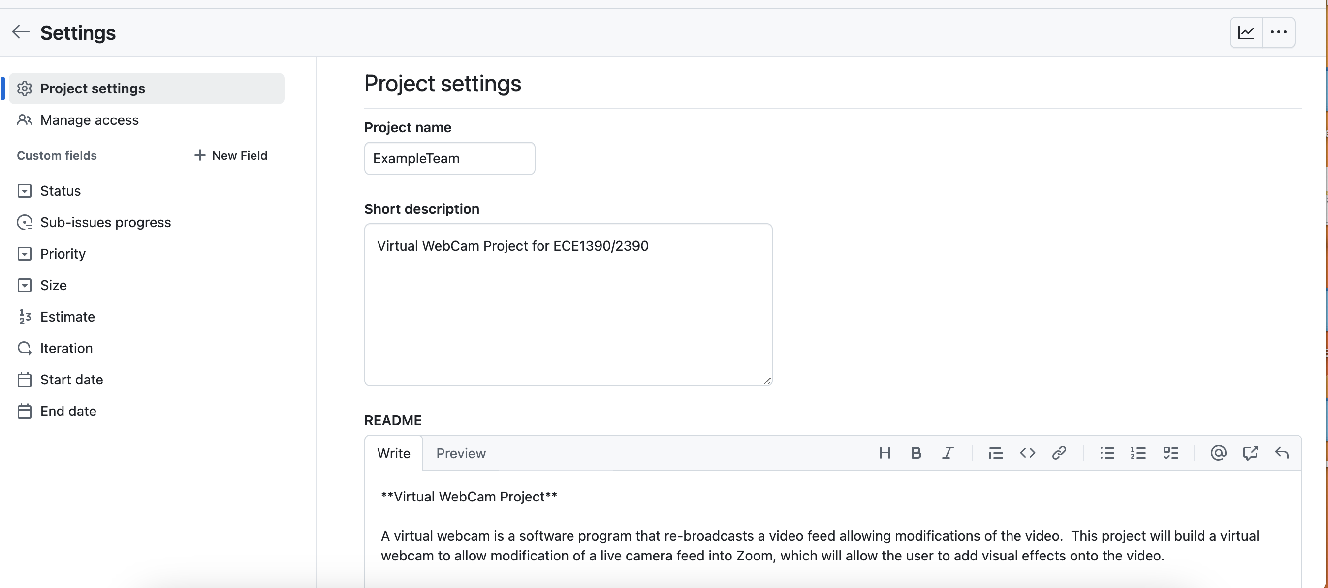

Slide 10
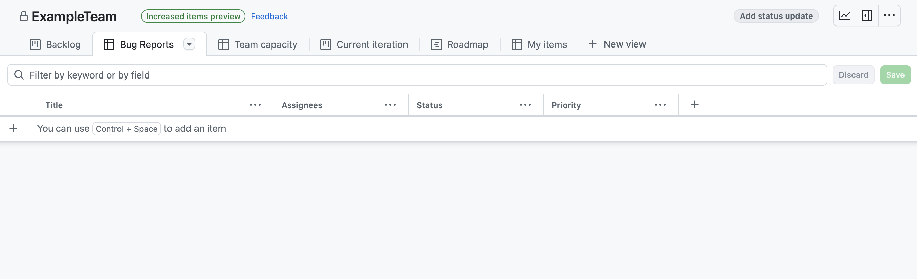

Slide 11
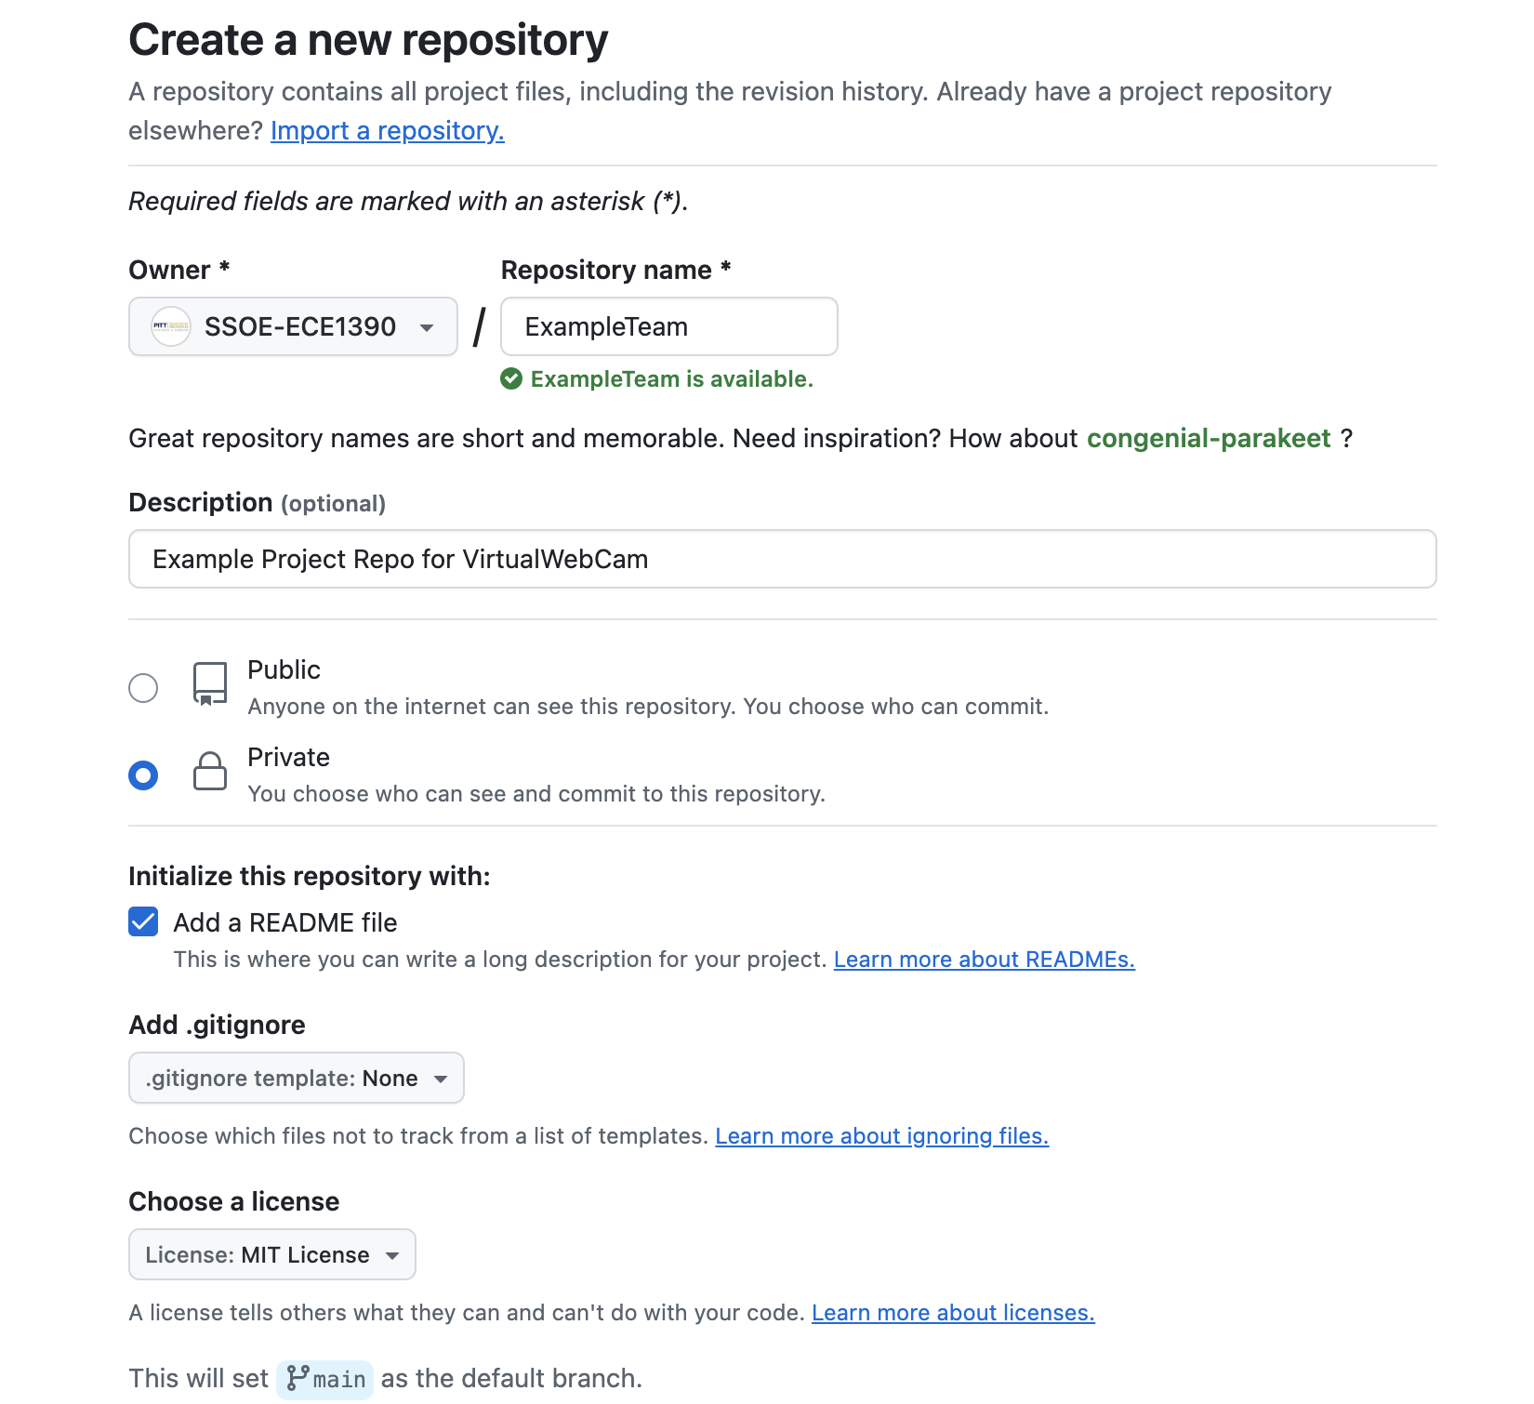
GitHub Repos
Is the actual code
You will have one main repo for your project; however, you will create branches from this repo such that each group member can work on their part of the code.
I would like to see push requests and code review (for ECE 2390 groups, this is a requirement).

Slide 12
Creating a fork, making edits, and requesting review for a pull request
In the GitHub ORG site on your team, select the parent repo and create a fork
This creates a copy in YOUR GitHub account that only you have access to
Clone this repo from your account and make any edits. Commit and push the changes to your account.
When done, on the repo on your account, open a pull request. Add details about the changes. Select a reviewer for the request.
The reviewer will then get a notice that a pull request has been created and is ready for review. They can make comments and send back or approve and merge the request.

Slide 13
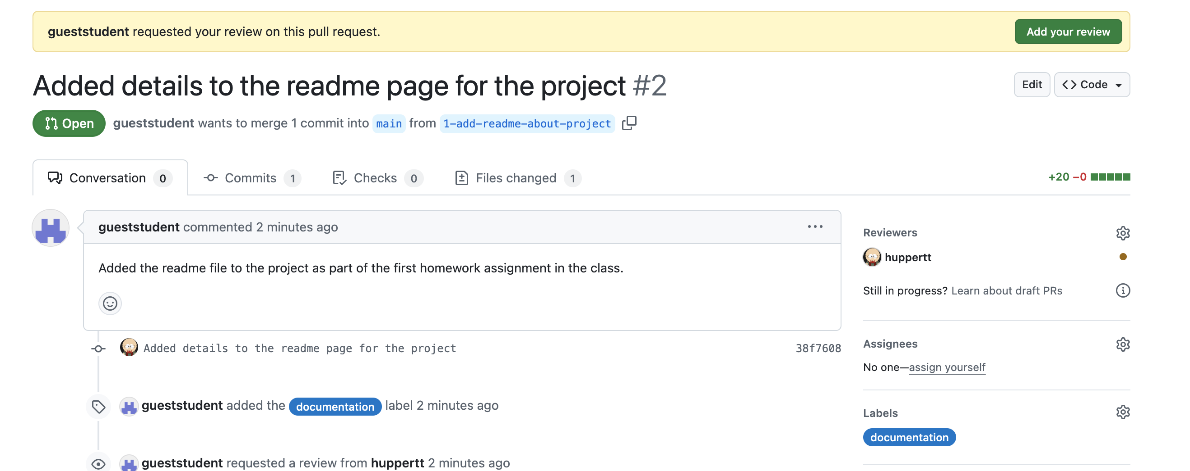

Slide 14
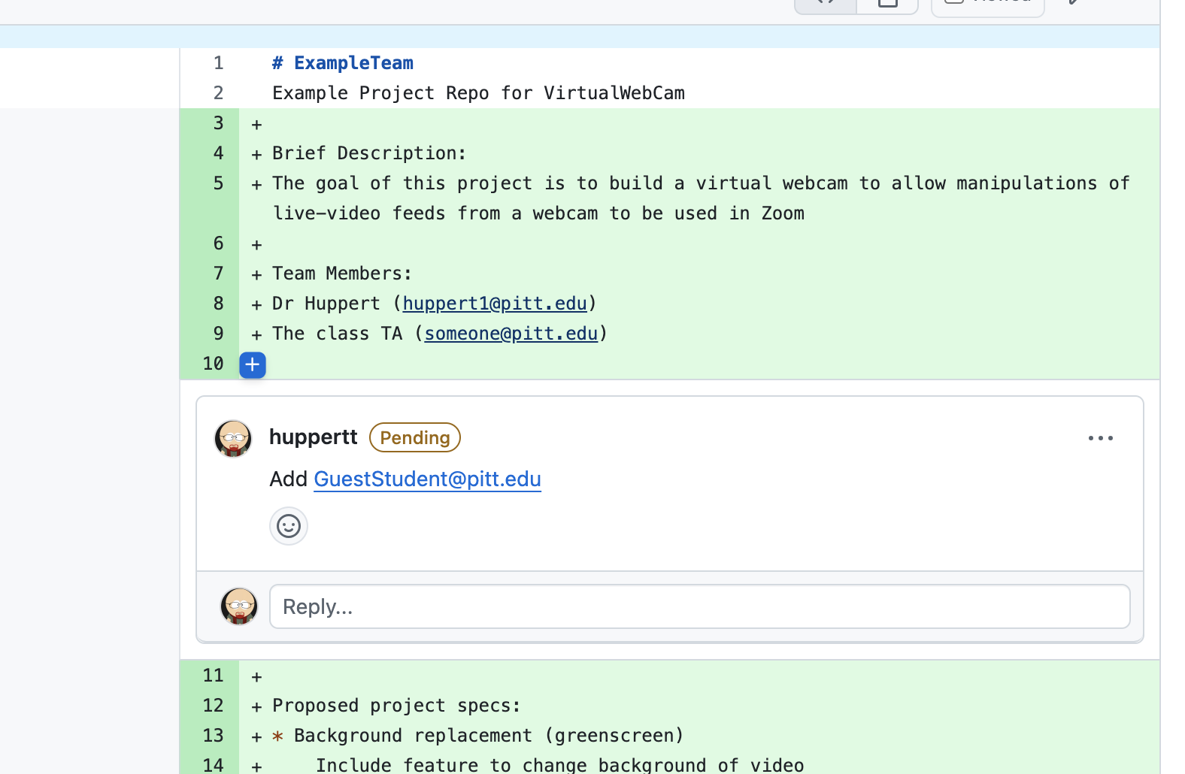

Slide 15
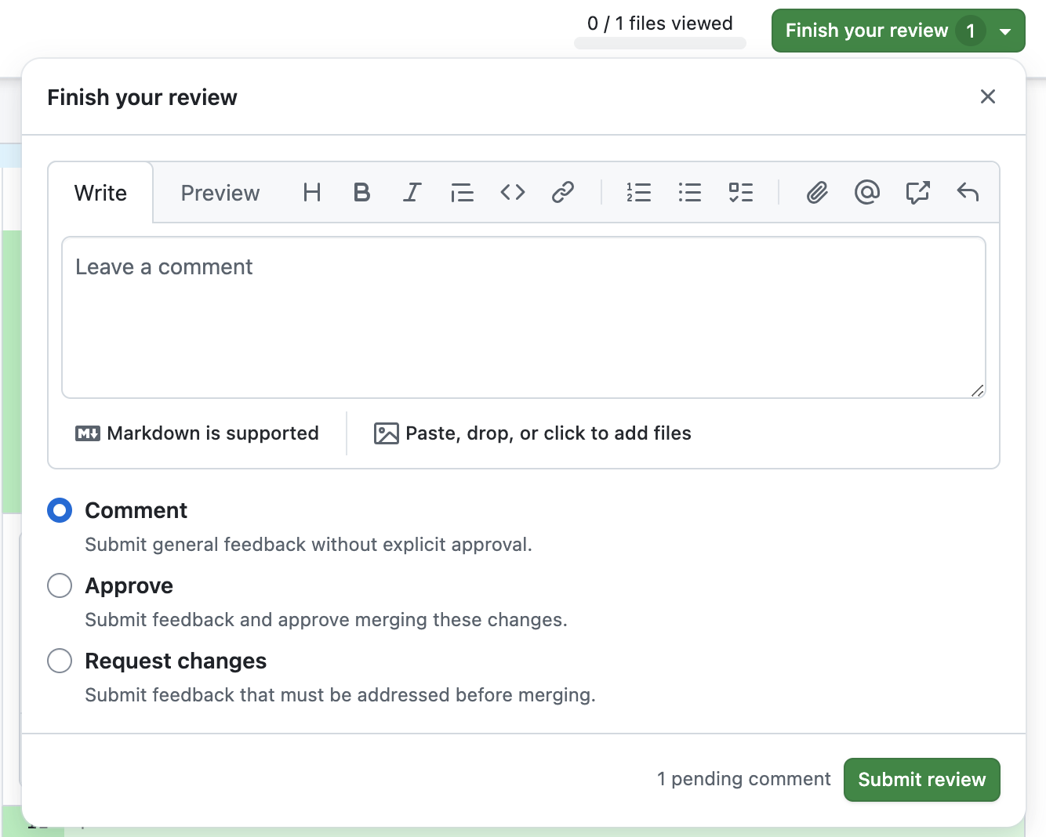

Slide 16
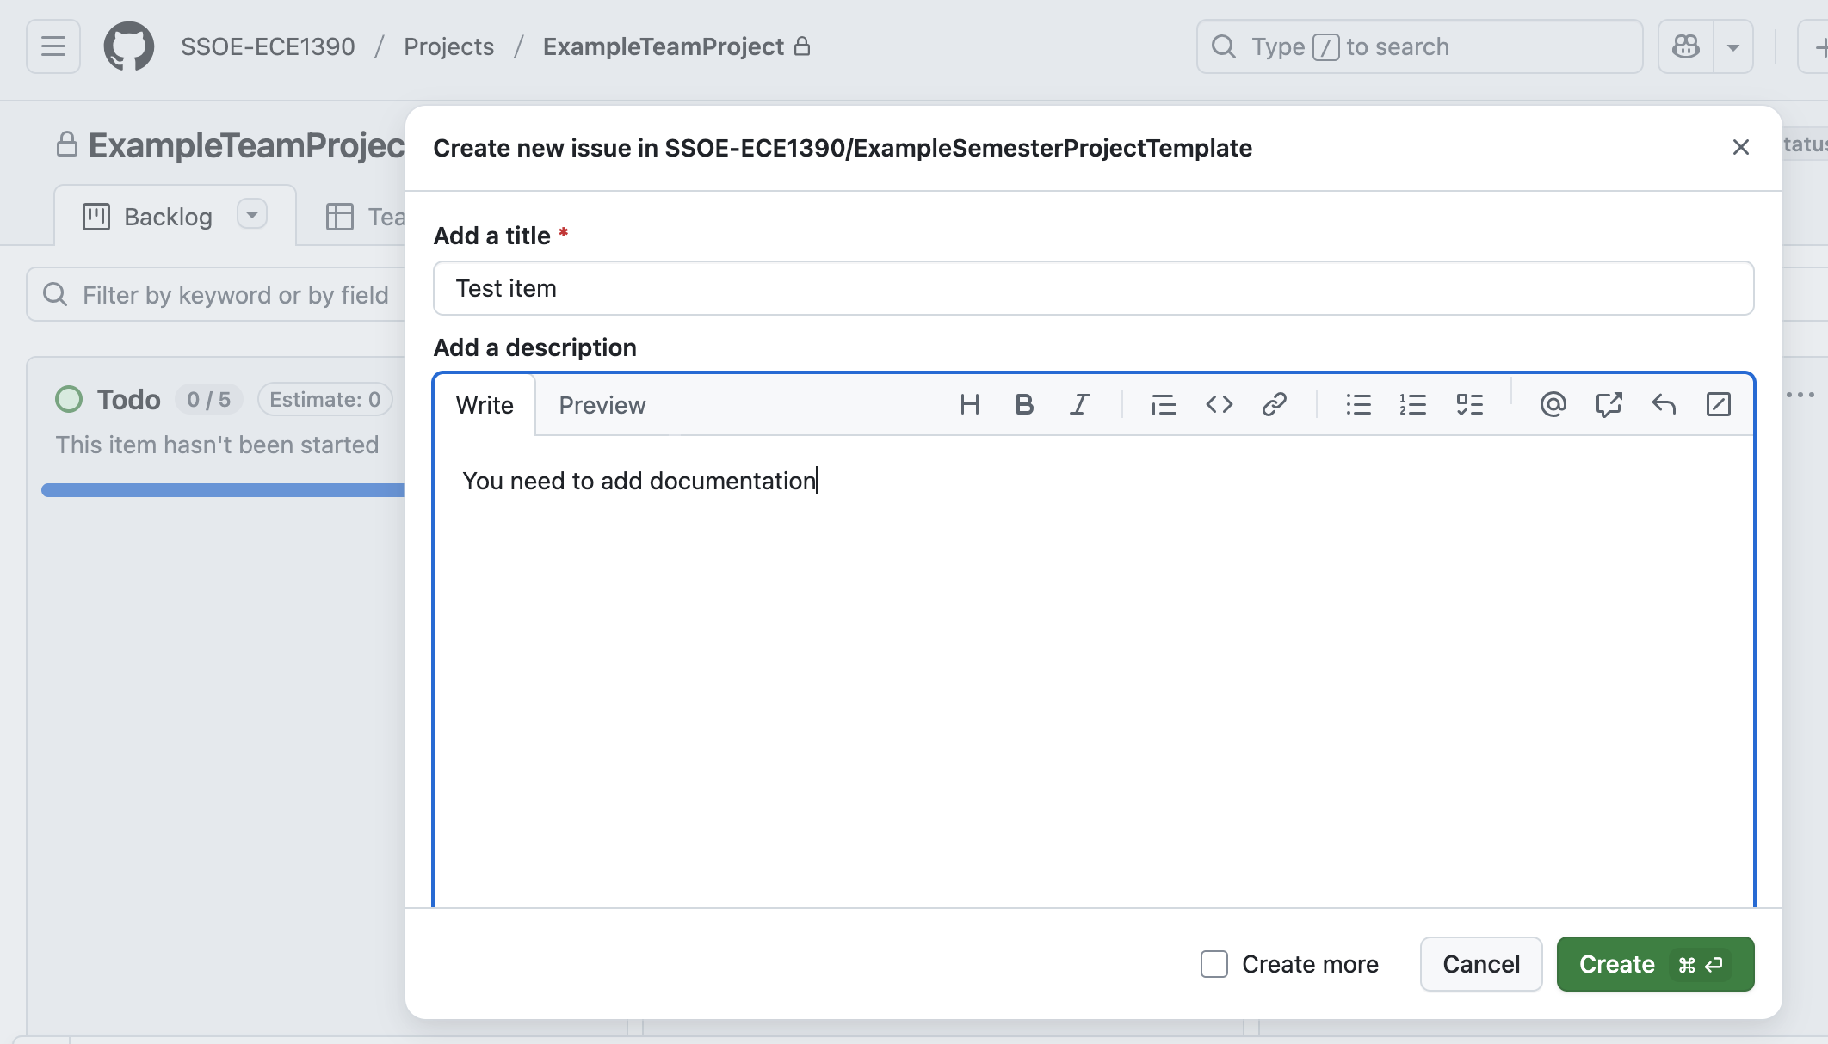
Acting on issues
In the Project, create an issue by adding it to the workflow

Slide 17
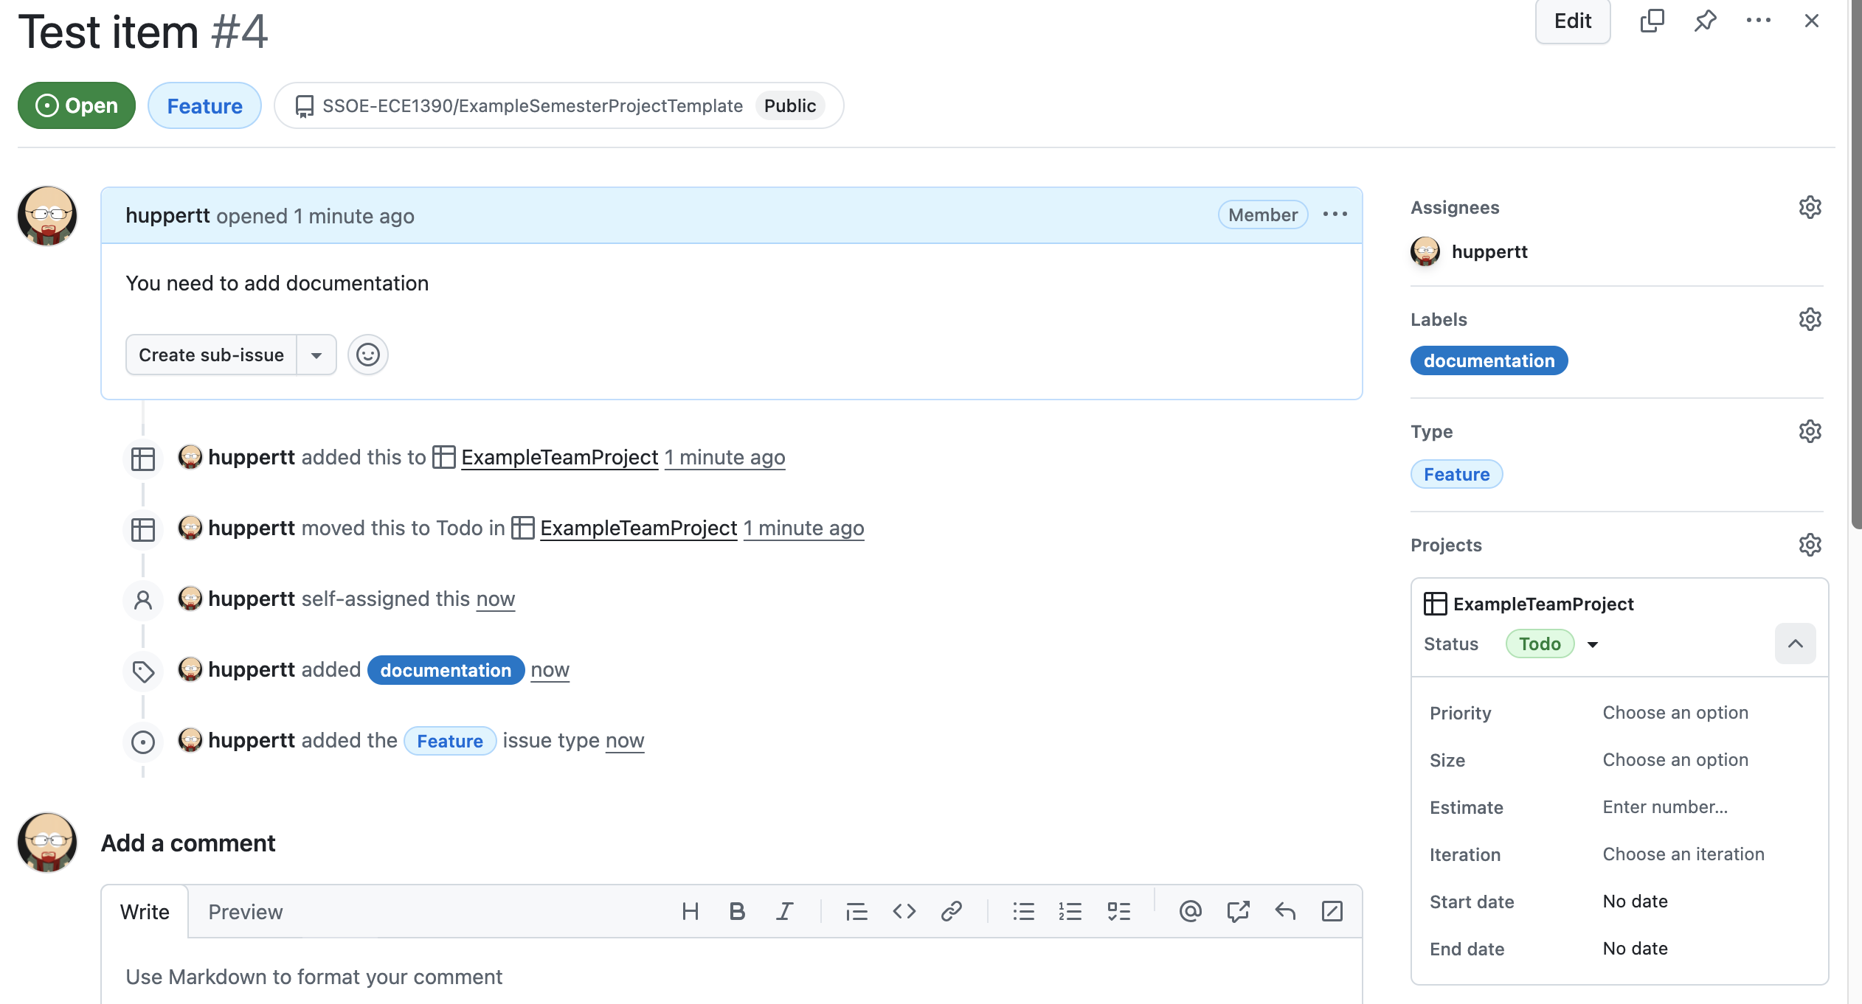
Acting on issues
Once created, you can open the issue and add more details
Assign to a person on the team
Add info about what type of issue this is
Add comments or attach files

Slide 18
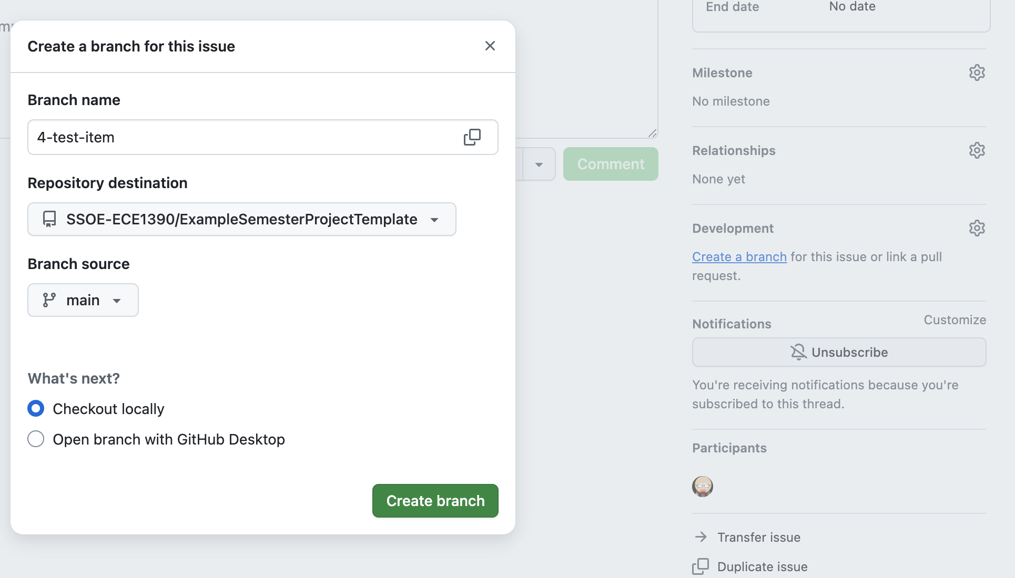
Acting on issues
At the bottom, you can create a branch or assign it to an existing pull request.
Branches – stay with the Org account. These are sub-repos
Forks – your local GitHub. These are copies of the repo.

Slide 19
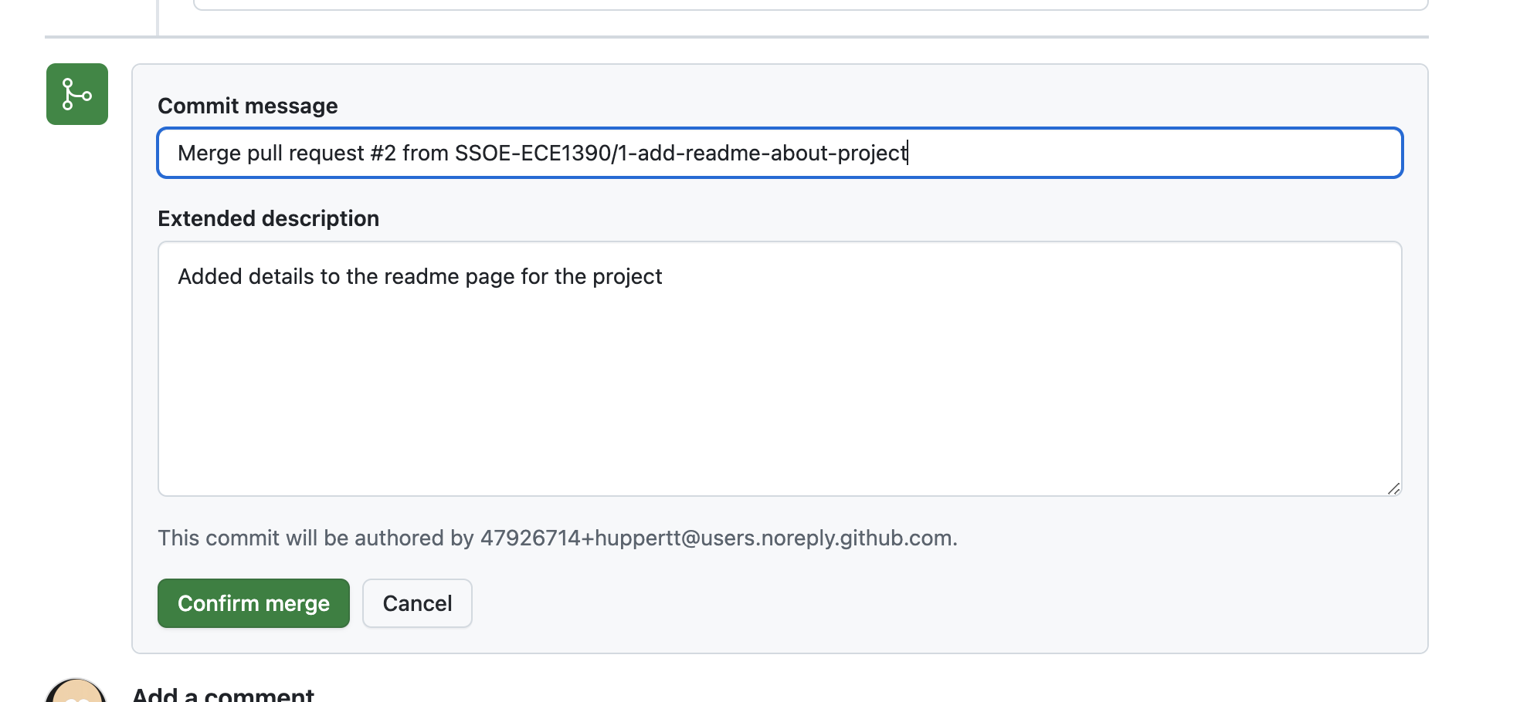
Acting on issues
If you are working with branches, you need to switch the branch you are working on, make edits, and then eventually merge with a pull request.
If you are working with forks, you need to clone the fork, make edits, and then eventually merge with a pull request.

Slide 20
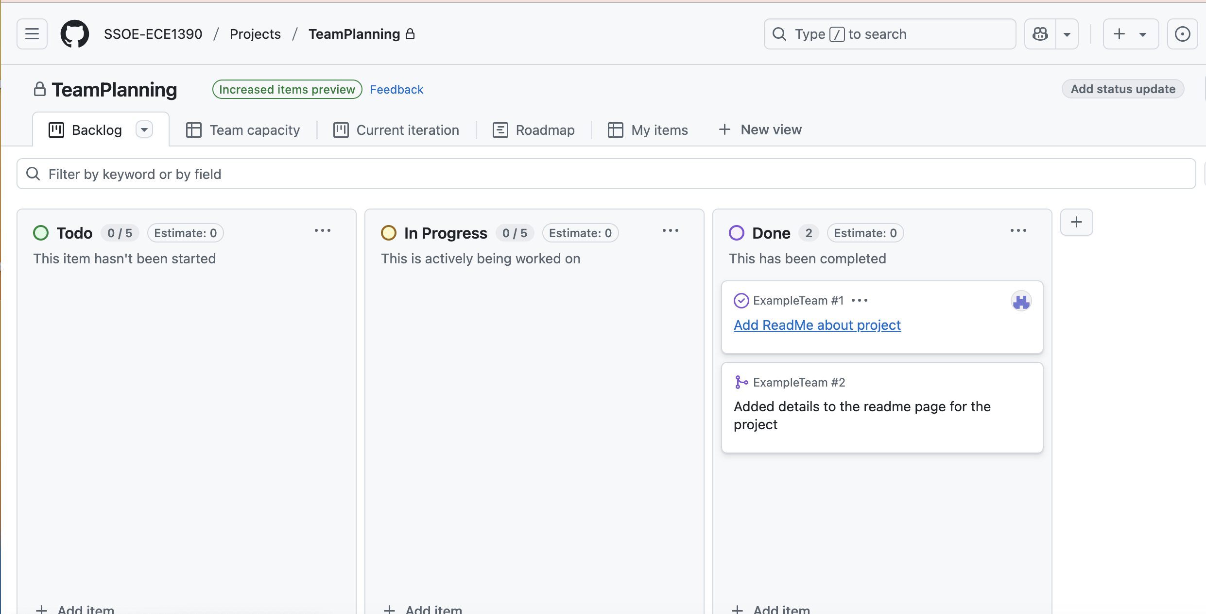
Acting on issues
Once an issue is completed, move it to the DONE category.
If you close an issue, it disappears (which is fine if you aren’t tracking issues), but companies often want to save documentation of such changes.

