Slide 1
Lecture 10 Image Feature Detection
ECE 1390/2390

Slide 2
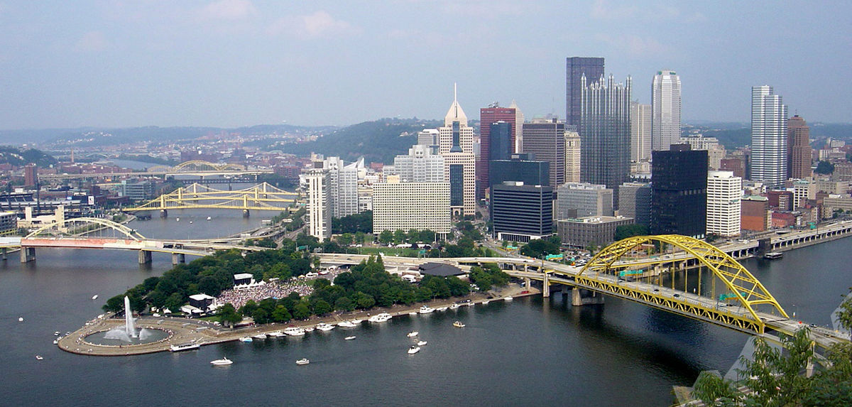
What is an image feature?

Slide 3
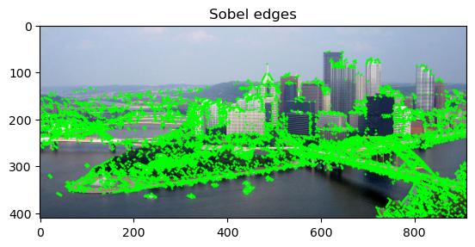
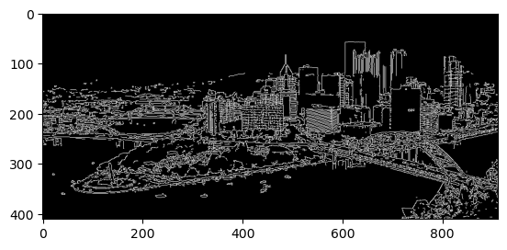
What is an image feature?
Edges

Slide 4
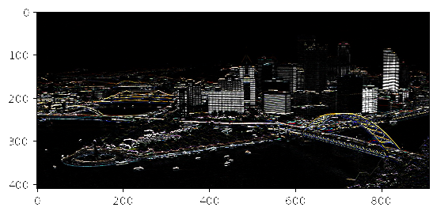
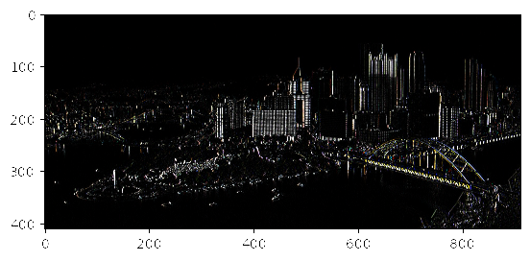


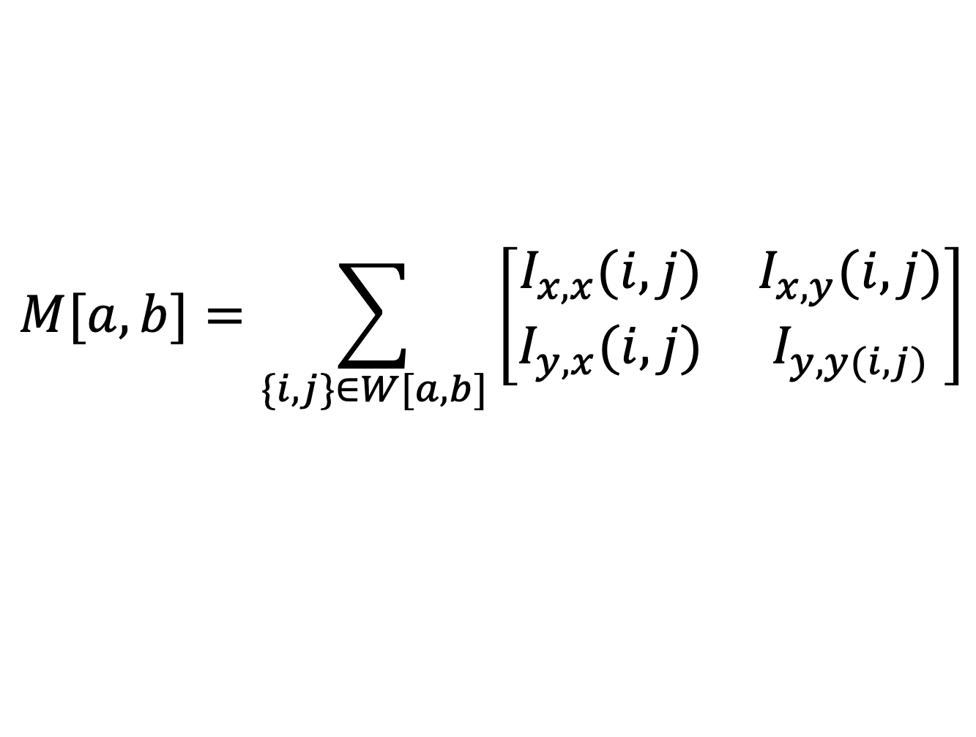
What is an image feature?
Harris Corners
$$Kernel=\left[\begin{matrix}−1 & 1\end{matrix}\right]$$
$$Kernel=\left[\begin{matrix}−1 \\ 1\end{matrix}\right]$$
$$M[a,b]=\sum_{\{i,j\}∈W[a,b]}{\left[\begin{matrix}I_{x,x}(i,j) & I_{x,y}(i,j) \\ I_{y,x}(i,j) & I_{y,y(i,j)}\end{matrix}\right]}$$
Structure matrix

Slide 5
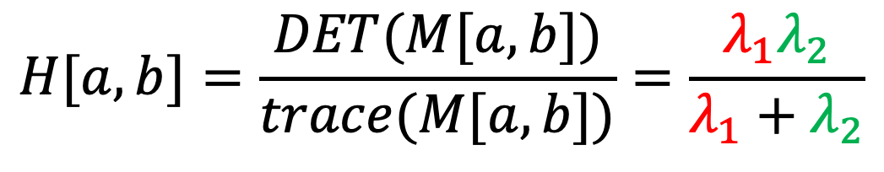
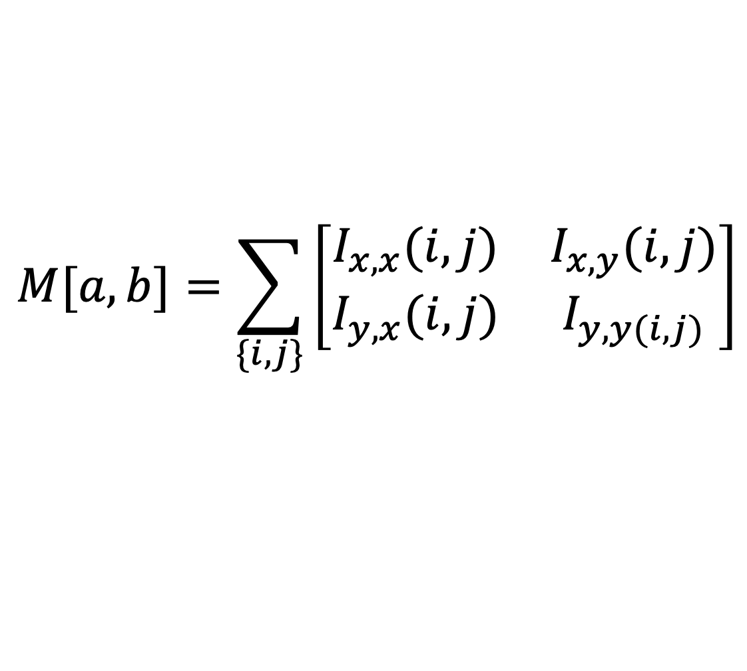
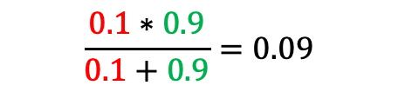
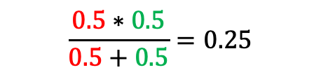
What is an image feature?
Harris Corners
$$M[a,b]=\sum_{\{i,j\}}{\left[\begin{matrix}I_{x,x}(i,j) & I_{x,y}(i,j) \\ I_{y,x}(i,j) & I_{y,y(i,j)}\end{matrix}\right]}$$
$$H[a,b]=\frac{DET(M[a,b])}{trace(M[a,b])}=\frac{λ_{1}λ_{2}}{λ_{1}+λ_{2}}$$
$$\frac{0.5∗0.5}{0.5+0.5}=0.25$$
$$\frac{0.1∗0.9}{0.1+0.9}=0.09$$

Slide 6
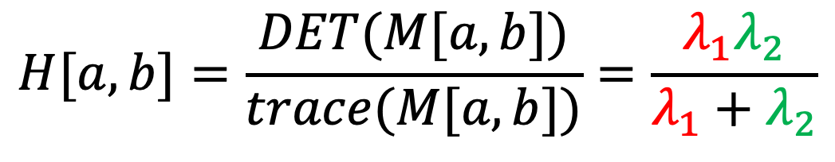
What is an image feature?
Harris Corners
$$H[a,b]=\frac{DET(M[a,b])}{trace(M[a,b])}=\frac{λ_{1}λ_{2}}{λ_{1}+λ_{2}}$$
Non-maximum suppression
$$HNMS\left[a,b\right]=Morph Max Filter(H\left[a,b\right], <3x3>)$$

Slide 7

What is an image feature?
Harris Corners
$$H[a,b]=\frac{DET(M[a,b])}{trace(M[a,b])}=\frac{λ_{1}λ_{2}}{λ_{1}+λ_{2}}$$
$$\frac{0.5∗0.5}{0.5+0.5}=0.25$$
$$\frac{0.1∗0.9}{0.1+0.9}=0.09$$
$${Both λ}_{1} and λ_{2} are large →Corner$$
$${Only λ}_{1} is large →edge$$
$${Both λ}_{1} and λ_{2} are small →no interest$$

Slide 8
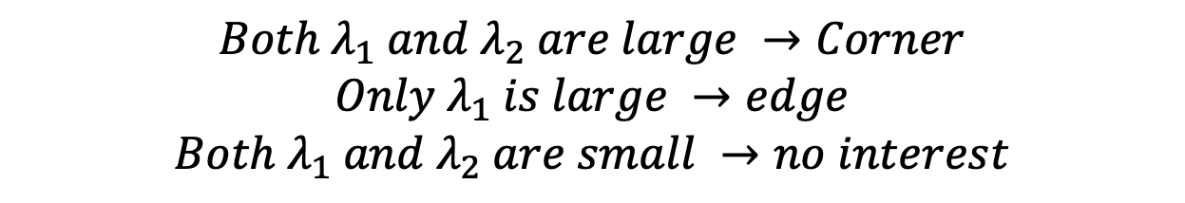
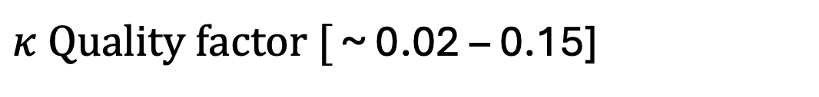

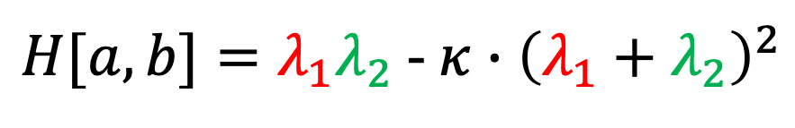
What is an image feature?
Harris Corners
$$H[a,b]=\frac{DET(M[a,b])}{trace(M[a,b])}=\frac{λ_{1}λ_{2}}{λ_{1}+λ_{2}}$$
$H[a,b]=λ_{1}λ_{2}$ - $κ∙{\left(λ_{1}+λ_{2}\right)}^{2}$
$$\frac{0.5∗0.5}{0.5+0.5}=0.25$$
$κ Quality factor [$ ~ 0.02 – 0.15]
$$\frac{0.1∗0.9}{0.1+0.9}=0.09$$
$${Both λ}_{1} and λ_{2} are large →Corner$$
$${Only λ}_{1} is large →edge$$
$${Both λ}_{1} and λ_{2} are small →no interest$$

Slide 9
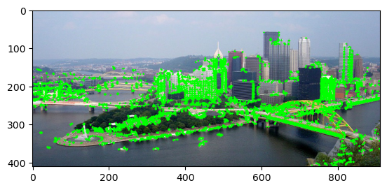
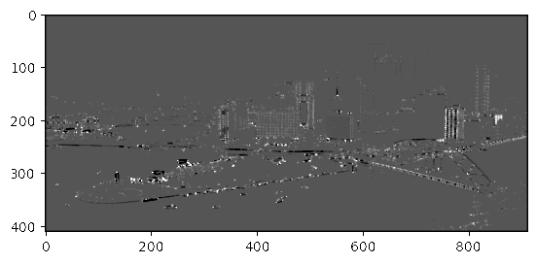
What is an image feature?
Corners

Slide 10
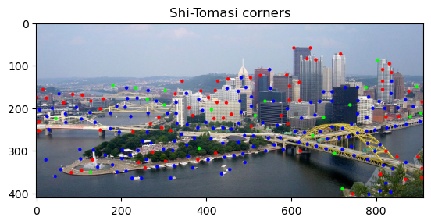
What is an image feature?
Harris Corners
$$H[a,b]=\frac{DET(M[a,b])}{trace(M[a,b])}=\frac{λ_{1}λ_{2}}{λ_{1}+λ_{2}}$$
$H[a,b]=λ_{1}λ_{2}$ - $κ∙{\left(λ_{1}+λ_{2}\right)}^{2}$
$κ Quality factor [$ ~ 0.02 – 0.15]
$${Both λ}_{1} and λ_{2} are large →Corner$$
$${Only λ}_{1} is large →edge$$
$${Both λ}_{1} and λ_{2} are small →no interest$$

Slide 11
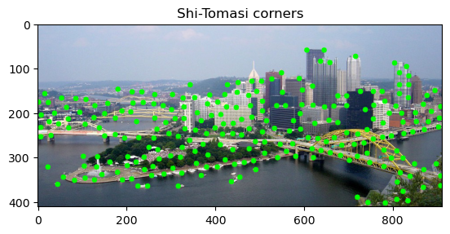
What is an image feature?
Corners
Harris Corners

Slide 12
What is an image feature?
Blob detection
Differences of Gaussians approach
More Blurred
Image
”Band-Pass Filtered” Image
subtract
Less Blurred

Slide 13
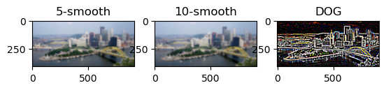
What is an image feature?
Blob detection
im2= cv2.GaussianBlur(im,(15,15),5,5)
im3= cv2.GaussianBlur(im,(15,15),10,10)

Slide 14
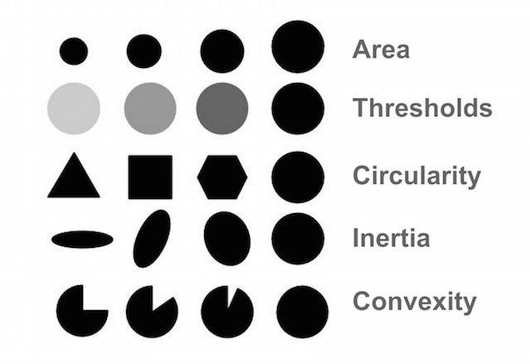
What is an image feature?
params = cv2.SimpleBlobDetector_Params()
params.filterByArea = True
params.minArea = 50
params.filterByCircularity = False
params.filterByConvexity = False
params.filterByInertia = False

Slide 15
Blobs
params = cv2.SimpleBlobDetector_Params()
params.filterByArea = True
params.minArea = 50
params.filterByCircularity = False
params.filterByConvexity = False
params.filterByInertia = False
detector = cv2.SimpleBlobDetector_create(params)
keypoints = detector.detect(im_blob)

Slide 16
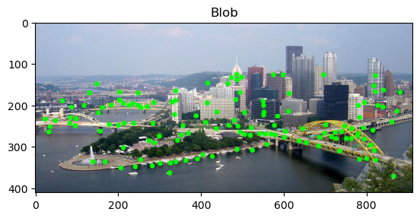
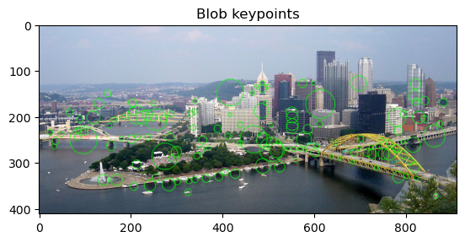
What is an image feature?
Blobs

Slide 17
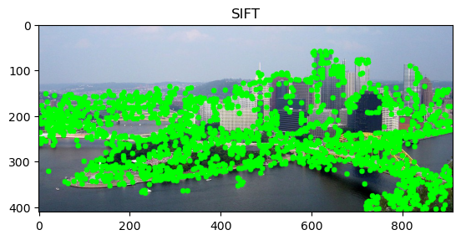
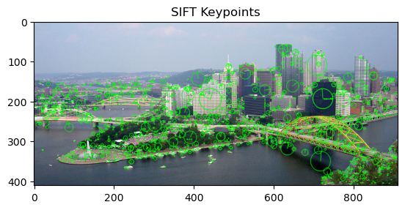
What is an image feature?
SIFT

Slide 18
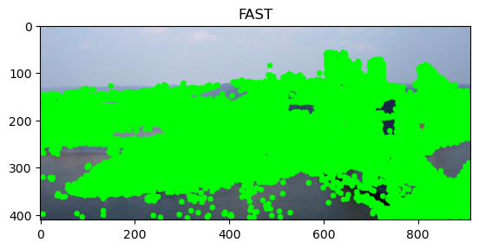
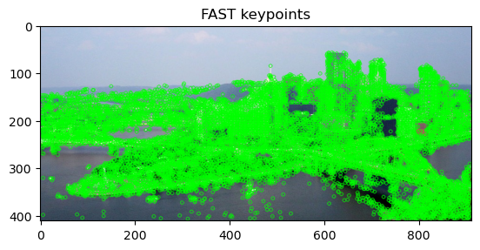
What is an image feature?
FAST

Slide 19
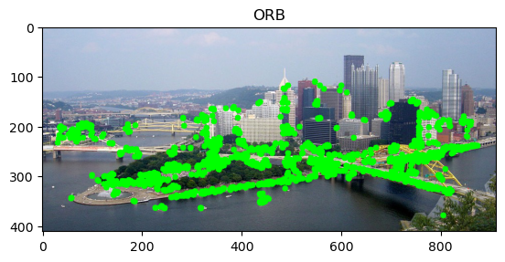
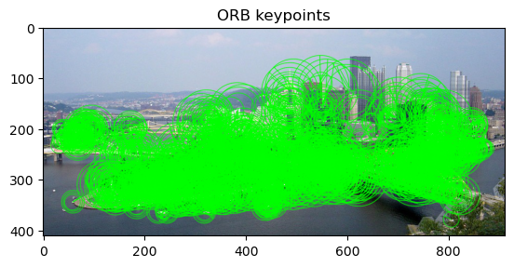
What is an image feature?
ORB

