Slide 1
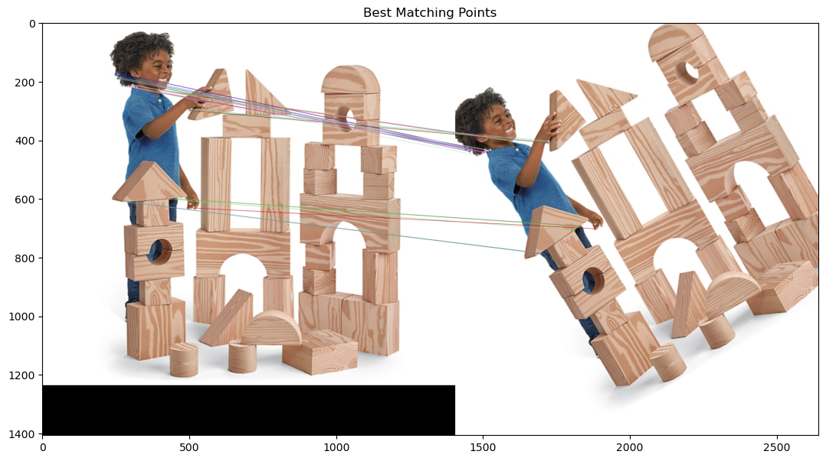
Lecture 11 Image Homology and Registration
ECE 1390/2390

Slide 2
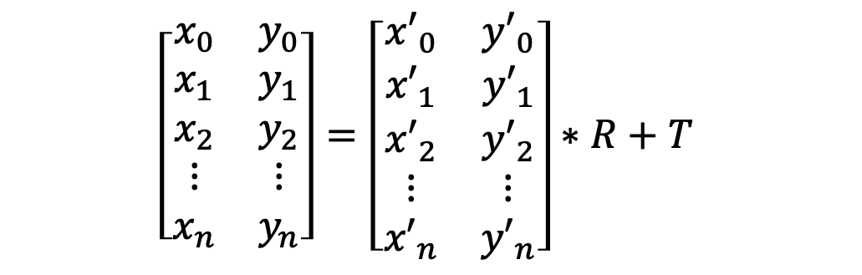
Affine transform
$$\left[\begin{matrix}x_{0} & y_{0} \\ x_{1} & y_{1} \\ x_{2} & y_{2} \\ ⋮ & ⋮ \\ x_{n} & y_{n}\end{matrix}\right]=\left[\begin{matrix}{x′}_{0} & {y′}_{0} \\ {x′}_{1} & {y′}_{1} \\ {x′}_{2} & {y′}_{2} \\ ⋮ & ⋮ \\ {x′}_{n} & {y′}_{n}\end{matrix}\right]∗R+T$$
Corresponding pairs

Slide 3
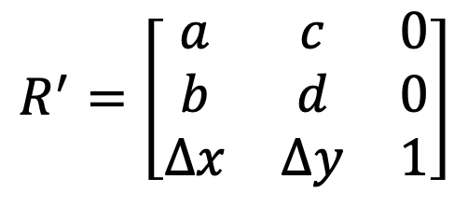
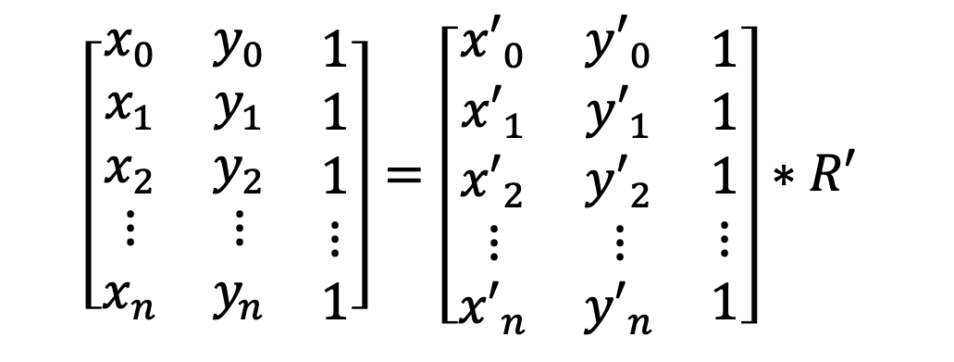
Affine transform
$$\left[\begin{matrix}\begin{matrix}x_{0} & y_{0} \\ x_{1} & y_{1} \\ x_{2} & y_{2} \\ ⋮ & ⋮ \\ x_{n} & y_{n}\end{matrix} & \begin{matrix}1 \\ 1 \\ 1 \\ ⋮ \\ 1\end{matrix}\end{matrix}\right]=\left[\begin{matrix}\begin{matrix}{x′}_{0} & {y′}_{0} \\ {x′}_{1} & {y′}_{1} \\ {x′}_{2} & {y′}_{2} \\ ⋮ & ⋮ \\ {x′}_{n} & {y′}_{n}\end{matrix} & \begin{matrix}1 \\ 1 \\ 1 \\ ⋮ \\ 1\end{matrix}\end{matrix}\right]∗R′$$
$$R^{′}=\left[\begin{matrix}a & c & 0 \\ b & d & 0 \\ ∆x & ∆y & 1\end{matrix}\right]$$

Slide 4
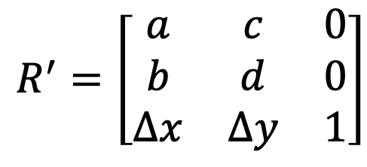



Affine transform
$$A=B∗R′$$
$$B^{−1}∗A=R′$$
$${\left(B^{T}∗B\right)}^{−1}∗B^{T}∗A=R^{′}$$
$$R^{′}=\left[\begin{matrix}a & c & 0 \\ b & d & 0 \\ ∆x & ∆y & 1\end{matrix}\right]$$

Slide 5
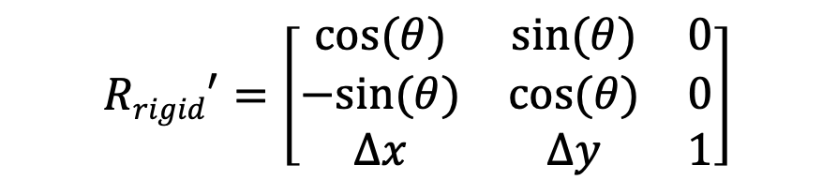
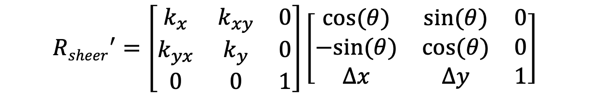
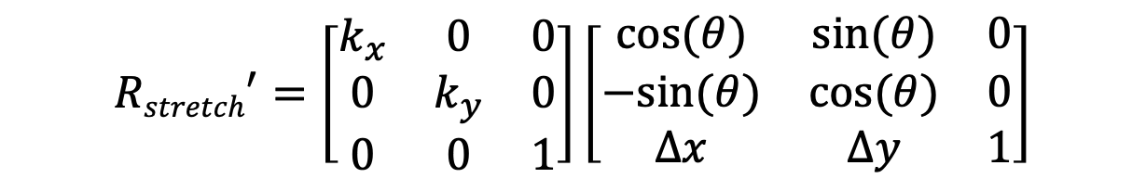
Rigid-body transform
$$A=B∗R′$$
$${Rrigid}^{′}=\left[\begin{matrix}cos⁡(θ) & sin⁡(θ) & 0 \\ −sin⁡(θ) & cos⁡(θ) & 0 \\ ∆x & ∆y & 1\end{matrix}\right]$$
$${Rstretch}^{′}=\left[\begin{matrix}k_{x} & 0 & 0 \\ 0 & k_{y} & 0 \\ 0 & 0 & 1\end{matrix}\right]\left[\begin{matrix}cos⁡(θ) & sin⁡(θ) & 0 \\ −sin⁡(θ) & cos⁡(θ) & 0 \\ ∆x & ∆y & 1\end{matrix}\right]$$
$${Rsheer}^{′}=\left[\begin{matrix}k_{x} & k_{xy} & 0 \\ k_{yx} & k_{y} & 0 \\ 0 & 0 & 1\end{matrix}\right]\left[\begin{matrix}cos⁡(θ) & sin⁡(θ) & 0 \\ −sin⁡(θ) & cos⁡(θ) & 0 \\ ∆x & ∆y & 1\end{matrix}\right]$$
Same as affine

Slide 6
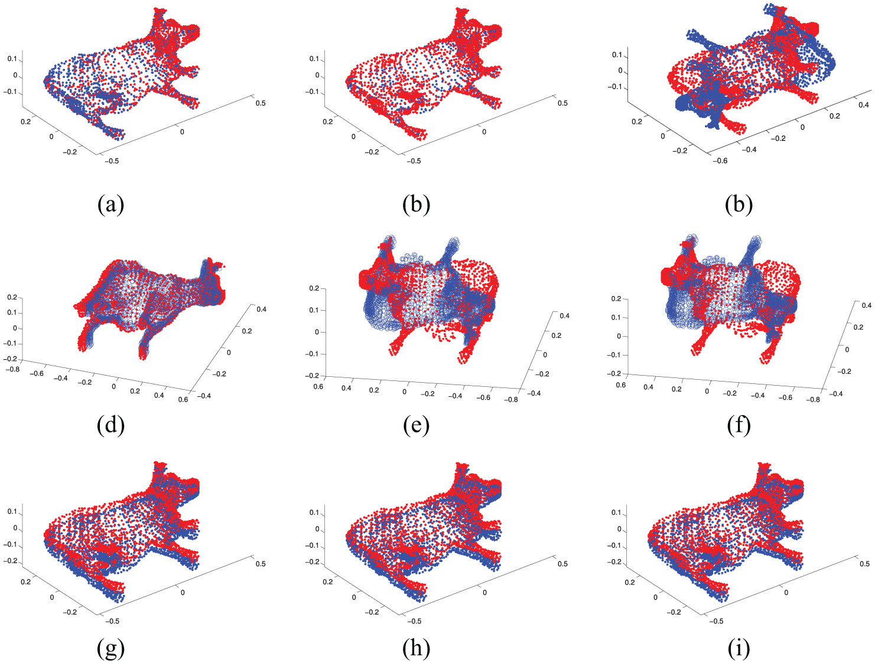
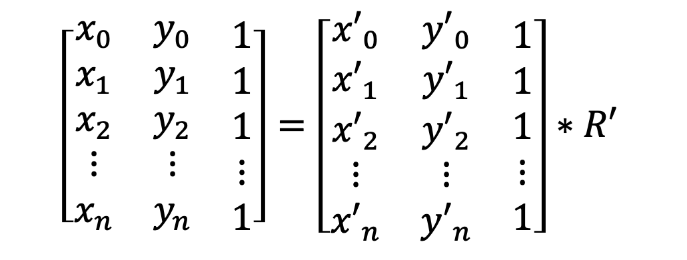
ICP (iterative closest point)
$$\left[\begin{matrix}\begin{matrix}x_{0} & y_{0} \\ x_{1} & y_{1} \\ x_{2} & y_{2} \\ ⋮ & ⋮ \\ x_{n} & y_{n}\end{matrix} & \begin{matrix}1 \\ 1 \\ 1 \\ ⋮ \\ 1\end{matrix}\end{matrix}\right]=\left[\begin{matrix}\begin{matrix}{x′}_{0} & {y′}_{0} \\ {x′}_{1} & {y′}_{1} \\ {x′}_{2} & {y′}_{2} \\ ⋮ & ⋮ \\ {x′}_{n} & {y′}_{n}\end{matrix} & \begin{matrix}1 \\ 1 \\ 1 \\ ⋮ \\ 1\end{matrix}\end{matrix}\right]∗R′$$
Initial Guess of correspondence (lst1,lst12)
While( ):
A(lst1) = R * B(lst2)
Calculate transform
Apply transform
Remove bad points
update correspondence (lst1,lst12)

Slide 7
ICP (iterative closest point)
$$\left[\begin{matrix}\begin{matrix}x_{0} & y_{0} \\ x_{1} & y_{1} \\ x_{2} & y_{2} \\ ⋮ & ⋮ \\ x_{n} & y_{n}\end{matrix} & \begin{matrix}1 \\ 1 \\ 1 \\ ⋮ \\ 1\end{matrix}\end{matrix}\right]=\left[\begin{matrix}\begin{matrix}{x′}_{0} & {y′}_{0} \\ {x′}_{1} & {y′}_{1} \\ {x′}_{2} & {y′}_{2} \\ ⋮ & ⋮ \\ {x′}_{n} & {y′}_{n}\end{matrix} & \begin{matrix}1 \\ 1 \\ 1 \\ ⋮ \\ 1\end{matrix}\end{matrix}\right]∗R′$$

Slide 8

ICP (iterative closest point)
$$Distance=\sqrt{{\left(x−x′\right)}^{2}+{\left(y−y′\right)}^{2}}$$
$$Distance=\sqrt{{\left(x−x′\right)}^{2}+{\left(y−y′\right)}^{2}+{\left(shape−shape′\right)}^{2}}$$

Slide 9
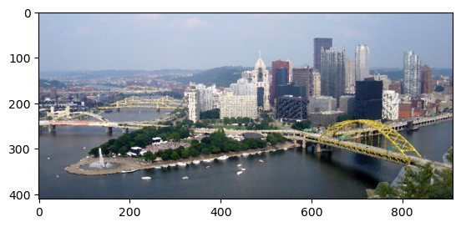
Feature Descriptors
Color information
Dominant color
Most prominent color in a region around point
Grab pixels in kernel around point
Bin to histogram or k-means cluster
Report largest bin

Slide 10
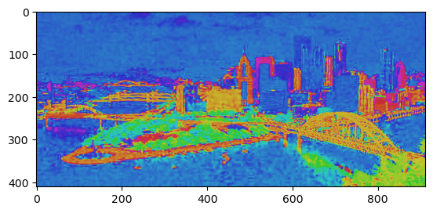
Feature Descriptors
Color information
Scalable color
Convert to HSV → hue
Convert to HSV
Discard S and V channels
Report Hue

Slide 11
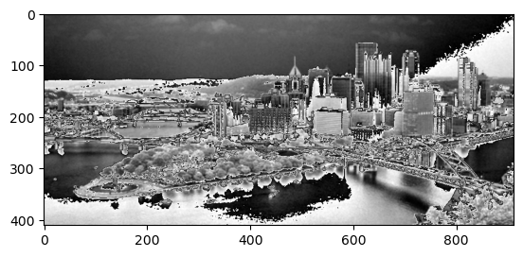
Feature Descriptors
Color layout description
Spatial color information around point
Convert to YCrCb format
Discrete Cosine Transform
Convert to YCrCr (brightness (luma), Blue-luma, Red-luma)
Run a DCT on brightness
Report DCT coefficients

Slide 12
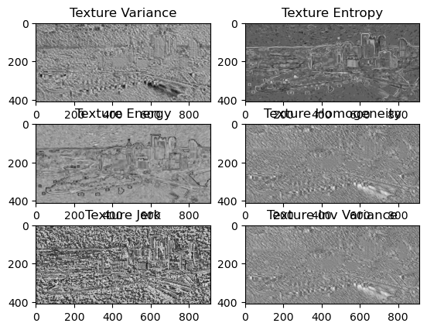
Feature Descriptors
Statistical Texture Descriptors
Compute the statistical properties in a region
Variance (<x^2>)
Jerk (<x^3>)
Homogeneity <1/(1+|x|)>
Inverse Var <1/(x^2)>
Entropy <prob*log(prob)>
Energy <prob^2>

Slide 13
Feature Descriptors
Texture Energy Descriptors
Convolution kernels
[1 4 6 4 1] (ridge)
[-1 -2 0 +2 +1] (edge)
[-1 0 2 0 -1] (spot)
[+1 -4 +6 -4 +1] (ripple)
[-1 +2 0 -2 +1] (wave)

Slide 14
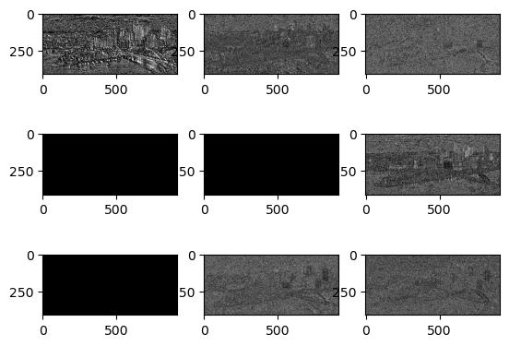
Feature Descriptors
Texture Energy Descriptors
Convolution kernels
4 x 4
discard symmetric
= 9 terms

Slide 15
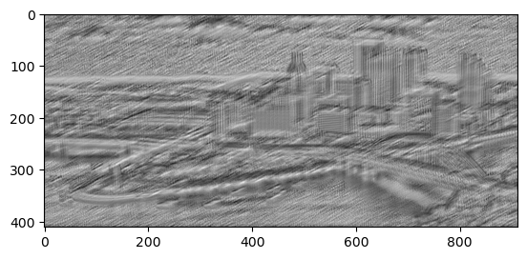
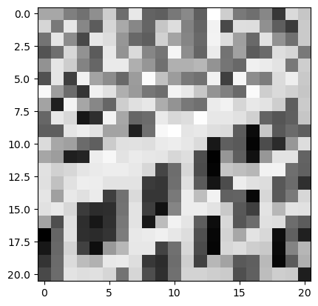
Feature Descriptors
Structured Texture Descriptors
Convolution kernel is texture sample
Regional correlation with texture sample

