Slide 1

Lecture 12 Camera Calibration
Lecture 12 Camera Calibration
Lecture 12 Camera Calibration
Lecture 12 Camera Calibration
ECE 1390/2390

Slide 2
Syllabus
Week | Date | Topic | In class work | Due date
8 | 10/14/2024 | FALL Break [No Class]
 | 10/16/2024 | Camera Calibration | Python problems (HW5) | Due 10/23
9 | 10/21/2024 | Depth estimation | Group Project work
 | 10/23/2024 | 3D Reconstruction and Pose estimation | Python problems (HW6) | Due 10/30
10 | 10/28/2024 | Haar Cascade Classifiers | Python problems (HW7) | Due 11/4
 | 10/30/2024 | HOG and Custom Detectors | Project updates
11 | 11/4/2024 | Object Tracking | Project updates
 | 11/6/2024 | OCR Text Detection | Python problems (HW8) | Due 11/13
12 | 11/11/2024 | MediaPipe/SLAM | Group Project work
 | 11/13/2024 | OpenCV DNN | Python problems (HW9) | Due 11/20
13 | 11/18/2024 | Super Resolution | Python problems (HW10) | Due 12/4
 | 11/20/2024 | Image compression | Python problems
14 | 11/25/2024 | Thanksgiving recess
 | 11/27/2024 | Thanksgiving recess
15 | 12/2/2024 | Group Project work | Group Project work
 | 12/4/2024 | Group Project work | Group Project work | Final project commit
16 | 12/9/2024 | Final Projects | Project presentations | Final group ratings

Slide 3
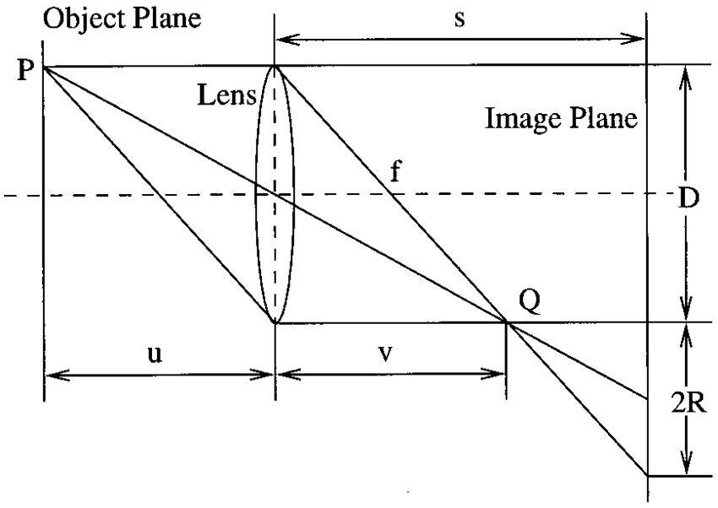
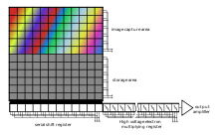
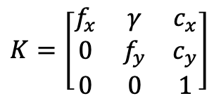
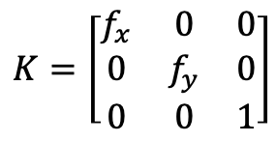
Camera Calibration
Ideal camera
$$K=\left[\begin{matrix}f_{x} & 0 & 0 \\ 0 & f_{y} & 0 \\ 0 & 0 & 1\end{matrix}\right]$$
Real camera
X/Y CCD grid skew
$$K=\left[\begin{matrix}f_{x} & γ & c_{x} \\ 0 & f_{y} & c_{y} \\ 0 & 0 & 1\end{matrix}\right]$$
Offset of CCD center
from optical axis
CCD Grid

Slide 4
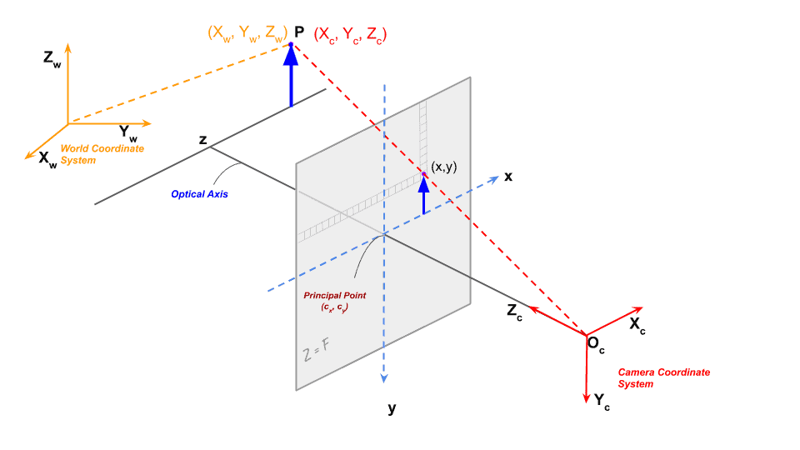
Camera Calibration

Slide 5
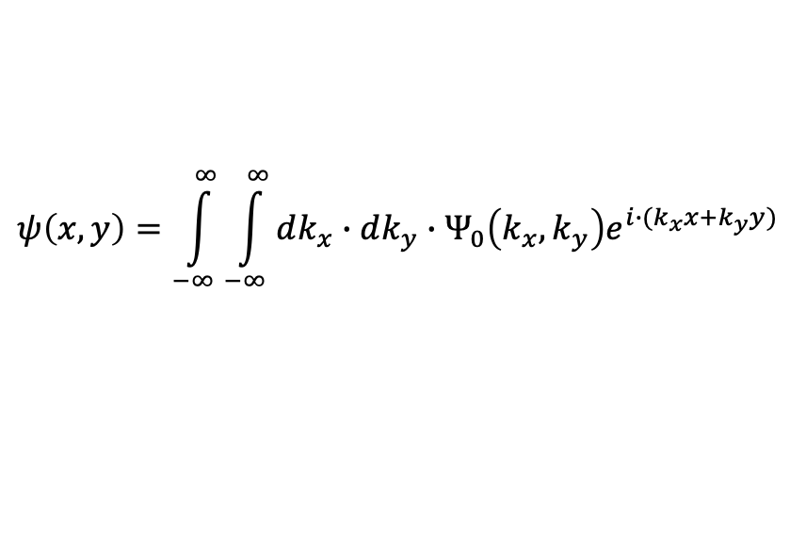
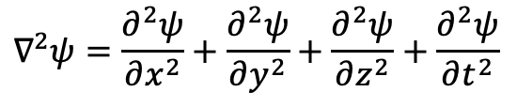
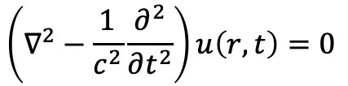



Fourier Optics
$$kx=\frac{2πf_{x}}{c}$$
$$\left(∇^{2}−\frac{1}{c^{2}}\frac{∂^{2}}{∂t^{2}}\right)u\left(r,t\right)=0$$
$$ψ\left(x,y\right)=\int_{−∞}^{∞}{\int_{−∞}^{∞}{{dk_{x}∙dk_{y}∙Ψ}_{0}\left(k_{x},k_{y}\right)e^{i∙(k_{x}x+k_{y}y)}}}$$
$$∇^{2}ψ=\frac{∂^{2}ψ}{∂x^{2}}+\frac{∂^{2}ψ}{∂y^{2}}+\frac{∂^{2}ψ}{∂z^{2}}+\frac{∂^{2}ψ}{∂t^{2}}$$
Solving for the spherical wave propagation at point (x,y)
$ℱ\left\{ψ\left(x,y\right)\right\}$= $Ψ_{0}\left(k_{x},k_{y}\right)$
$ℱ^{−1}\left\{Ψ_{0}\left(k_{x},k_{y}\right)\right\}$= $ψ′\left(x,y\right)$
Free-space propagation of the light wave is a Fourier Transform
A confocal lens is an inverse Fourier Transform

Slide 6


Fourier Optics
Higher spatial frequencies
X
$ℱ\left\{ψ\left(x,y\right)\right\}$= $Ψ_{0}\left(k_{x},k_{y}\right)$
$ℱ^{−1}\left\{Ψ_{0}\left(k_{x},k_{y}\right)\right\}$= $ψ′\left(x,y\right)$
Low spatial frequencies
An ideal lens is a top-hat
low-pass-filter (multiplication)
in the spatial-frequency domain
X
Higher spatial frequencies

Slide 7
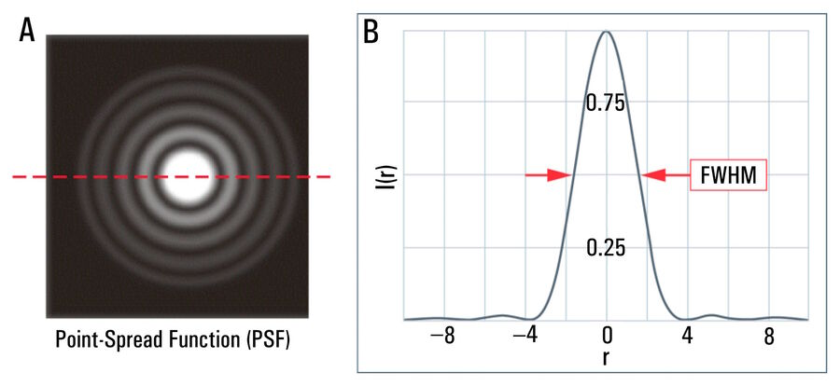
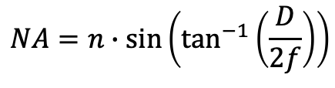
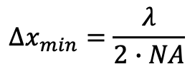



Fourier Optics
$${Δx}_{min}=\frac{λ}{2∙NA}$$
Diffraction resolution
limit of a microscope
$$Numerical Aperture$$
$$NA=n∙\sin\left(θ\right)$$
$$NA=n∙\sin\left(\tan^{−1}\left(\frac{D}{2f}\right)\right)$$
f (focal length)
$$θ$$
D (lens diameter)
An ideal lens is a top-hat
low-pass-filter (multiplication)
in the spatial-frequency domain
$n$= Index of refraction (air = 1)

Slide 8



Fourier Optics
I_{photo}$\left(u,v \right)=K∗ℱ^{−1}\left\{ℱ\left\{Iobject\left(x,y \right)\right\}∙l(kx,ky,λ)\right\}$
I_{photo}$\left(u,v \right)=K∗(Iobject\left(x,y \right)⨂L(x,y,λ)$)
$ℱ\left\{ψ\left(x,y\right)\right\}$= $Ψ_{0}\left(k_{x},k_{y}\right)$
$ℱ^{−1}\left\{Ψ_{0}\left(k_{x},k_{y}\right)\right\}$= $ψ′\left(x,y\right)$
An ideal lens is a top-hat
low-pass-filter (multiplication)
in the spatial-frequency domain

Slide 9
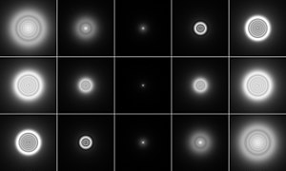



Fourier Optics
$$Δf<0$$
$$Δf=0$$
$$Δf>0$$
Negative aberration
Spherical aberration
Ideal
Positive aberration
Image from Wikipedia
Spherical aberration

Slide 10
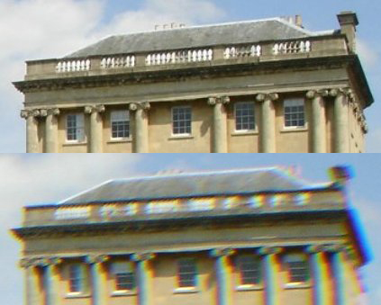
Fourier Optics
Chromatic aberration
Image from Wikipedia
Wavelength dependent aberration
V-I-B-G-Y-O-R

Slide 11
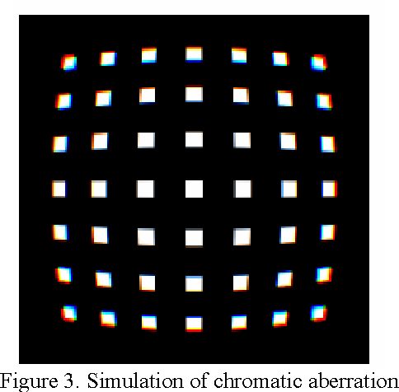
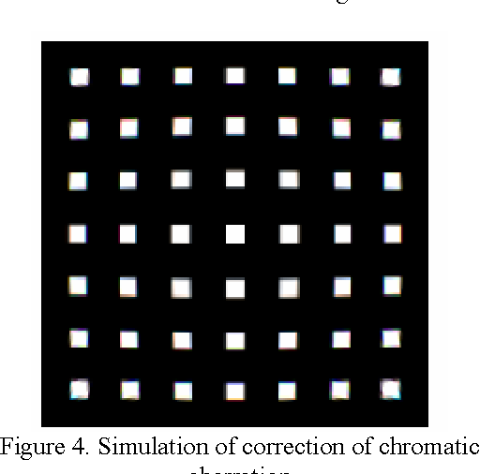
Deconvolution (Wiener Filter)
$$l(kx,ky,c) =ℱ\left\{\text{I}\text{Ra}w\left(u,v,c \right)\right\}/ℱ\left\{\text{I}Target\left(u,v,c \right)\right\}$$
$$ICorrected\left(x,y,c \right)=ℱ^{−1}\left\{ℱ\left\{\text{I}\text{Ra}w\left(u,v,c \right)\right\}/l(kx,ky,c)\right\}$$
Calibration Target
Photograph Raw
Corrected
Imperfect
Ng, Yiu-Ming Harry. “Correcting the Chromatic Aberration in Barrel Distortion of Endoscopic Images.” (2003).

Slide 12
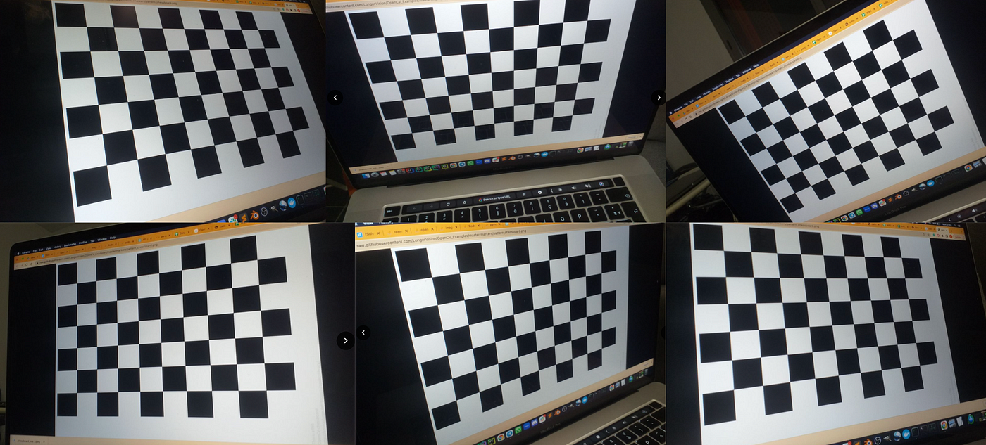
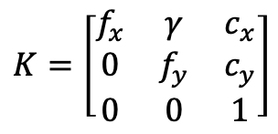
OpenCV Camera Calibration
Internal
Focal
Optical center
Radial Distortion
External
Orientation of target relative to camera
$$K=\left[\begin{matrix}f_{x} & γ & c_{x} \\ 0 & f_{y} & c_{y} \\ 0 & 0 & 1\end{matrix}\right]$$

Slide 13
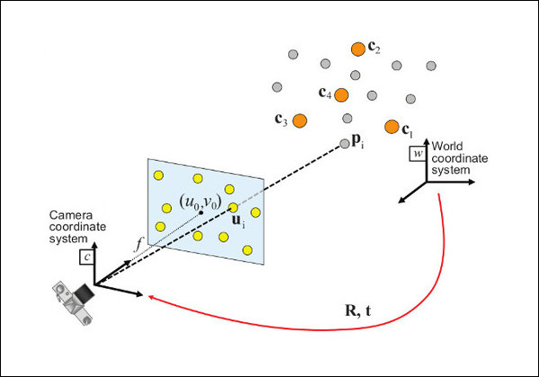
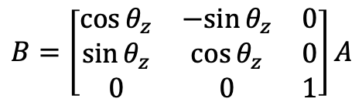
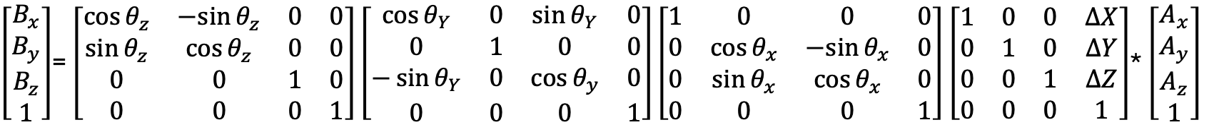
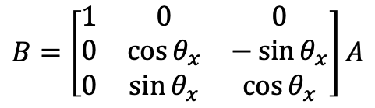
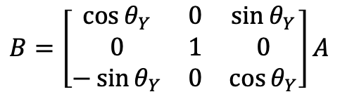
Prospective-n-Point (PnP)
Y
X
𝜽_{x}
Z
$$B=\left[\begin{matrix}1 & 0 & 0 \\ 0 & \cos{θ_{x}} & −\sin{θ_{x}} \\ 0 & \sin{θ_{x}} & \cos{θ_{x}}\end{matrix}\right]A$$
(x₀,y₀,0)
(x₁,y₁,0)
(x₂,y₂,0)
(x₃,y₃,0)
𝜽_{y}
$$B=\left[\begin{matrix}\cos{θ_{Y}} & 0 & \sin{θ_{Y}} \\ 0 & 1 & 0 \\ −\sin{θ_{Y}} & 0 & \cos{θ_{Y}}\end{matrix}\right]A$$
𝜽_{z}
$$B=\left[\begin{matrix}\cos{θ_{z}} & −sin{θ_{z}} & 0 \\ \sin{θ_{z}} & \cos{θ_{z}} & 0 \\ 0 & 0 & 1\end{matrix}\right]A$$
$\left[\begin{matrix}B_{x} \\ B_{y} \\ B_{z} \\ 1\end{matrix}\right]$= $\left[\begin{matrix}\cos{θ_{z}} & −sin{θ_{z}} & 0 & 0 \\ \sin{θ_{z}} & \cos{θ_{z}} & 0 & 0 \\ 0 & 0 & 1 & 0 \\ 0 & 0 & 0 & 1\end{matrix}\right]\left[\begin{matrix}\cos{θ_{Y}} & 0 & \sin{θ_{Y}} & 0 \\ 0 & 1 & 0 & 0 \\ −\sin{θ_{Y}} & 0 & \cos{θ_{y}} & 0 \\ 0 & 0 & 0 & 1\end{matrix}\right]\left[\begin{matrix}1 & 0 & 0 & 0 \\ 0 & \cos{θ_{x}} & −sin{θ_{x}} & 0 \\ 0 & \sin{θ_{x}} & \cos{θ_{x}} & 0 \\ 0 & 0 & 0 & 1\end{matrix}\right]$ $\left[\begin{matrix}1 & 0 & 0 & ∆X \\ 0 & 1 & 0 & ∆Y \\ 0 & 0 & 1 & ∆Z \\ 0 & 0 & 0 & 1\end{matrix}\right]$* $\left[\begin{matrix}A_{x} \\ A_{y} \\ A_{z} \\ 1\end{matrix}\right]$

Slide 14
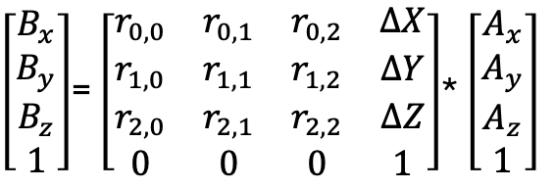


Prospective-n-Point (PnP)
$\left[\begin{matrix}B_{x} \\ B_{y} \\ B_{z} \\ 1\end{matrix}\right]$= $\left[\begin{matrix}r_{0,0} & r_{0,1} & r_{0,2} & ∆X \\ r_{1,0} & r_{1,1} & r_{1,2} & ∆Y \\ r_{2,0} & r_{2,1} & r_{2,2} & ∆Z \\ 0 & 0 & 0 & 1\end{matrix}\right]$* $\left[\begin{matrix}A_{x} \\ A_{y} \\ A_{z} \\ 1\end{matrix}\right]$
3D to 2D projection
$$\left[\begin{matrix}u_{ideal} \\ v_{ideal} \\ 1\end{matrix}\right]=\left[\begin{matrix}1 & 0 & 0 & 0 \\ 0 & 1 & 0 & 0 \\ 0 & 0 & 1 & 0\end{matrix}\right]\left[\begin{matrix}B_{x} \\ B_{y} \\ B_{z} \\ 1\end{matrix}\right]$$
Intrinsic Camera distortion
$$\left[\begin{matrix}u \\ v \\ 1\end{matrix}\right]=\left[\begin{matrix}f_{x} & γ & c_{x} \\ 0 & f_{y} & c_{y} \\ 0 & 0 & 1\end{matrix}\right]\left[\begin{matrix}u_{ideal} \\ v_{ideal} \\ 1\end{matrix}\right]$$

Slide 15
Prospective-n-Point (PnP)
$\left[\begin{matrix}B_{x} \\ B_{y} \\ B_{z} \\ 1\end{matrix}\right]$= $\left[\begin{matrix}r_{0,0} & r_{0,1} & r_{0,2} & ∆X \\ r_{1,0} & r_{1,1} & r_{1,2} & ∆Y \\ r_{2,0} & r_{2,1} & r_{2,2} & ∆Z \\ 0 & 0 & 0 & 1\end{matrix}\right]$* $\left[\begin{matrix}A_{x} \\ A_{y} \\ A_{z} \\ 1\end{matrix}\right]$
3D to 2D projection
$$\left[\begin{matrix}u_{ideal} \\ v_{ideal} \\ 1\end{matrix}\right]=\left[\begin{matrix}1 & 0 & 0 & 0 \\ 0 & 1 & 0 & 0 \\ 0 & 0 & 1 & 0\end{matrix}\right]\left[\begin{matrix}B_{x} \\ B_{y} \\ B_{z} \\ 1\end{matrix}\right]$$
Intrinsic Camera distortion
$$\left[\begin{matrix}u \\ v \\ 1\end{matrix}\right]=\left[\begin{matrix}f_{x} & γ & c_{x} \\ 0 & f_{y} & c_{y} \\ 0 & 0 & 1\end{matrix}\right]\left[\begin{matrix}u_{ideal} \\ v_{ideal} \\ 1\end{matrix}\right]$$

Slide 16
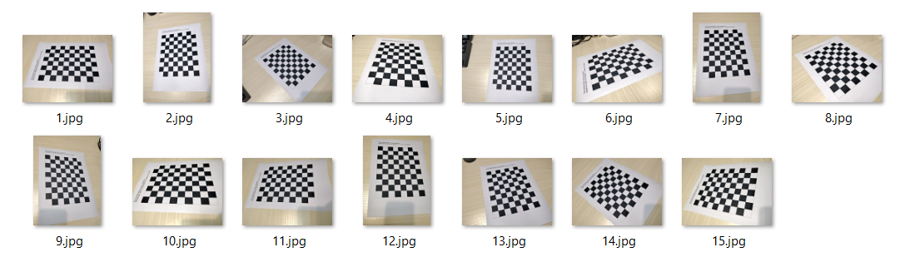
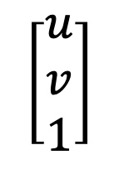
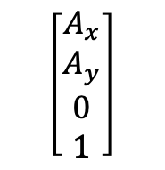
Prospective-n-Point (PnP)
$\left[\begin{matrix}B_{x} \\ B_{y} \\ B_{z} \\ 1\end{matrix}\right]$= $\left[\begin{matrix}r_{0,0} & r_{0,1} & r_{0,2} & ∆X \\ r_{1,0} & r_{1,1} & r_{1,2} & ∆Y \\ r_{2,0} & r_{2,1} & r_{2,2} & ∆Z \\ 0 & 0 & 0 & 1\end{matrix}\right]$* $\left[\begin{matrix}A_{x} \\ A_{y} \\ A_{z} \\ 1\end{matrix}\right]$
Differs per image
3D to 2D projection
$$\left[\begin{matrix}u \\ v \\ 1\end{matrix}\right]$$
$$\left[\begin{matrix}u_{ideal} \\ v_{ideal} \\ 1\end{matrix}\right]=\left[\begin{matrix}1 & 0 & 0 & 0 \\ 0 & 1 & 0 & 0 \\ 0 & 0 & 1 & 0\end{matrix}\right]\left[\begin{matrix}B_{x} \\ B_{y} \\ B_{z} \\ 1\end{matrix}\right]$$
Same across images
Intrinsic Camera distortion
$$\left[\begin{matrix}A_{x} \\ A_{y} \\ 0 \\ 1\end{matrix}\right]$$
$$\left[\begin{matrix}u \\ v \\ 1\end{matrix}\right]=\left[\begin{matrix}f_{x} & γ & c_{x} \\ 0 & f_{y} & c_{y} \\ 0 & 0 & 1\end{matrix}\right]\left[\begin{matrix}u_{ideal} \\ v_{ideal} \\ 1\end{matrix}\right]$$

Slide 17
OpenCV Camera Calibration
img_points =[]
obj_points = []
for gray in images:
Step 1.
retval,corners = cv2.findChessBoardCorners(image=gray, patternSize=(10,8))
(optional)
corners = cv2.cornerSubPix(gray,corners,(11,11),(-1,-1),criteria)
(optional)
cv2.drawChessboardCorners
Step 2.
img_points.append(corners)
obj_points .append(real_coors)
Step 3.
ret, cameramtx, distcorr, rot, trans = cv2.calibrateCamera(obj_points,img_points,gray.shape[::-1],None,None)
Finds corners of checkerboard
Estimates sub-pixel position of corners
These two arrays need to have corresponding points
Camera (K) matrix
Estimated rotation/translation of each image
Distortion parameters

Slide 18
OpenCV Camera Calibration
# shape of image needed to design undistortion filter
h,w = img.shape[:2]
# make camera matrix and valid ROI
newcameramtx, roi = cv2.getOptimalNewCameraMatrix(cameramtx, distcorr, (w,h), 1, (w,h))
# undistort image
dst = cv.undistort(img, mtx, dist, None, newcameramtx)
# crop the image
x,y,w,h = roi
dst = dst[y:y+h, x:x+w]
From previous steps

