Slide 1
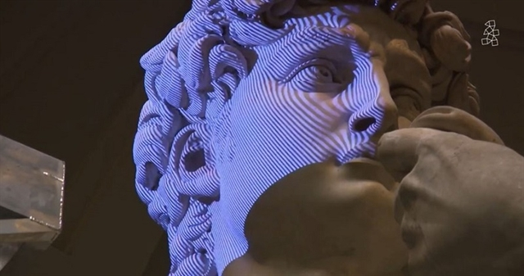
Lecture 15 Structure from Motion (SFM)
ECE 1390/2390

Slide 2
Requirements:
Everyone
Written in Python using OpenCV
Code compliant with MIT use license
Documented and maintained on GitHub
Include demonstration/example code
ECE 1390 Students
Load/Save and process still images
include an image enhancement method
Include an image filtering method
Include an edge detection method
Demonstrate segmentation
Include some object recognition
Incorporate 1 additional methods from class code
ECE 2390 Students
Load/Save and process still images
Process video feed
include an image enhancement method
Include an image filtering method
Include an edge detection method
Demonstrate segmentation
Include some object recognition
Include some object tracking
Incorporate 3 additional methods from class code

Slide 3
Syllabus
Week | Date | Topic | In class work | Due date
8 | 10/14/2024 | FALL Break [No Class]
 | 10/16/2024 | Camera Calibration | Python problems (HW5) | Due 10/23
9 | 10/21/2024 | Depth estimation | Group Project work
 | 10/23/2024 | 3D Reconstruction and Pose estimation | Python problems (HW6) | Due 10/30
10 | 10/28/2024 | Haar Cascade Classifiers | Python problems (HW7) | Due 11/4
 | 10/30/2024 | HOG and Custom Detectors | Project updates
11 | 11/4/2024 | Object Tracking | Project updates
 | 11/6/2024 | OCR Text Detection | Python problems (HW8) | Due 11/13
12 | 11/11/2024 | MediaPipe/SLAM | Group Project work
 | 11/13/2024 | OpenCV DNN | Python problems (HW9) | Due 11/20
13 | 11/18/2024 | Super Resolution | Python problems (HW10) | Due 12/4
 | 11/20/2024 | Image compression | Python problems
14 | 11/25/2024 | Thanksgiving recess
 | 11/27/2024 | Thanksgiving recess
15 | 12/2/2024 | Group Project work | Group Project work
 | 12/4/2024 | Group Project work | Group Project work | Final project commit
16 | 12/9/2024 | Final Projects | Project presentations | Final group ratings

Slide 4
Project Updates (10/30 & 11/4)
What do I expect?
Progress update
10min informal presentation
Can use your own laptop or give me slides
Show off what you have done so far
Have you tried things that didn’t work?
What class lessons have you incorporated into the project? Any insights?
Have your objectives changed?
Has there been any unanticipated issues?
10/30
BokehSwap
DC not DC
AutonomousDriving
RepVision
FaceEmojiSwap
11/4
Team Sebastian, Timothy, Jake, & Tyler
Shopkeepr
The Riddlers
Touchfree

Slide 5
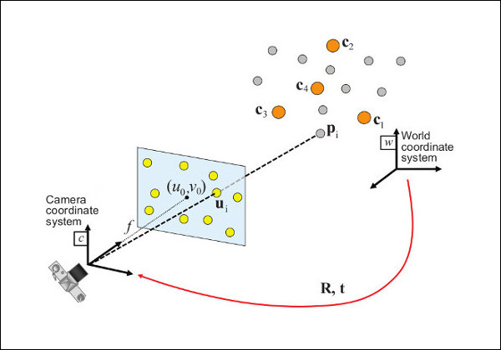
$\left[\begin{matrix}B_{x} \\ B_{y} \\ B_{z} \\ 1\end{matrix}\right]$= $\left[\begin{matrix}r_{0,0} & r_{0,1} & r_{0,2} & ∆X \\ r_{1,0} & r_{1,1} & r_{1,2} & ∆Y \\ r_{2,0} & r_{2,1} & r_{2,2} & ∆Z \\ 0 & 0 & 0 & 1\end{matrix}\right]$* $\left[\begin{matrix}A_{x} \\ A_{y} \\ A_{z} \\ 1\end{matrix}\right]$
3D to 2D projection
$$\left[\begin{matrix}u_{ideal} \\ v_{ideal} \\ 1\end{matrix}\right]=\left[\begin{matrix}1 & 0 & 0 & 0 \\ 0 & 1 & 0 & 0 \\ 0 & 0 & 1 & 0\end{matrix}\right]\left[\begin{matrix}B_{x} \\ B_{y} \\ B_{z} \\ 1\end{matrix}\right]$$
Intrinsic Camera distortion (K)
$$\left[\begin{matrix}u \\ v \\ 1\end{matrix}\right]=\left[\begin{matrix}f_{x} & γ & c_{x} \\ 0 & f_{y} & c_{y} \\ 0 & 0 & 1\end{matrix}\right]\left[\begin{matrix}u_{ideal} \\ v_{ideal} \\ 1\end{matrix}\right]$$

Slide 6
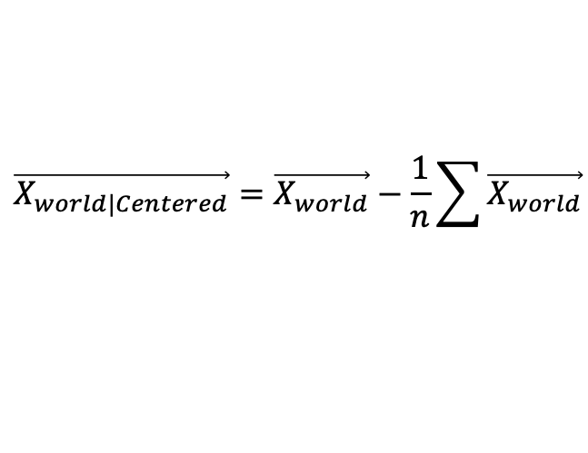



$$\vec{X_{world|Centered}}=\vec{X_{world}}−\frac{1}{n}\sum{\vec{X_{world}}}$$
$$\vec{X_{world|Centered}}=\vec{X_{world}}−\vec{t}$$
$$\vec{U_{image|Centered}}=S∗\vec{X_{world|Centered}}$$
$$\vec{U_{image|Centered}}=S∗\vec{X_{world|Centered}}$$
V_{centered}
Y_{centered}

Slide 7

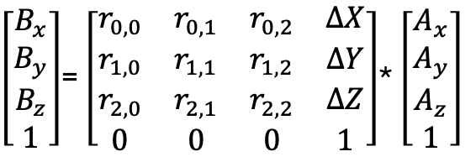
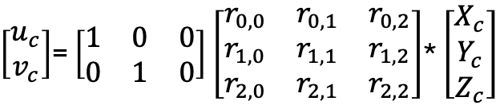

$$\vec{X_{world|Centered}}=\vec{X_{world}}−\frac{1}{n}\sum{\vec{X_{world}}}$$
$$\vec{X_{world|Centered}}=\vec{X_{world}}−\vec{t}$$
$\left[\begin{matrix}B_{x} \\ B_{y} \\ B_{z} \\ 1\end{matrix}\right]$= $\left[\begin{matrix}r_{0,0} & r_{0,1} & r_{0,2} & ∆X \\ r_{1,0} & r_{1,1} & r_{1,2} & ∆Y \\ r_{2,0} & r_{2,1} & r_{2,2} & ∆Z \\ 0 & 0 & 0 & 1\end{matrix}\right]$* $\left[\begin{matrix}A_{x} \\ A_{y} \\ A_{z} \\ 1\end{matrix}\right]$
$$\vec{U_{image|Centered}}=S∗\vec{X_{world|Centered}}$$
$$\left[\begin{matrix}u_{ideal} \\ v_{ideal} \\ 1\end{matrix}\right]=\left[\begin{matrix}1 & 0 & 0 & 0 \\ 0 & 1 & 0 & 0 \\ 0 & 0 & 1 & 0\end{matrix}\right]\left[\begin{matrix}B_{x} \\ B_{y} \\ B_{z} \\ 1\end{matrix}\right]$$
$\left[\begin{matrix}u_{c} \\ v_{c}\end{matrix}\right]$= $\left[\begin{matrix}1 & 0 & 0 \\ 0 & 1 & 0\end{matrix}\right]$ $\left[\begin{matrix}r_{0,0} & r_{0,1} & r_{0,2} \\ r_{1,0} & r_{1,1} & r_{1,2} \\ r_{2,0} & r_{2,1} & r_{2,2}\end{matrix}\right]$* $\left[\begin{matrix}X_{c} \\ Y_{c} \\ Z_{c}\end{matrix}\right]$
$$\left[\begin{matrix}u \\ v \\ 1\end{matrix}\right]=\left[\begin{matrix}f_{x} & γ & c_{x} \\ 0 & f_{y} & c_{y} \\ 0 & 0 & 1\end{matrix}\right]\left[\begin{matrix}u_{ideal} \\ v_{ideal} \\ 1\end{matrix}\right]$$

Slide 8
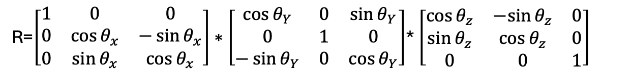
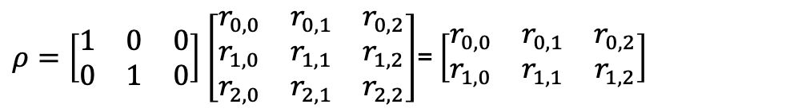
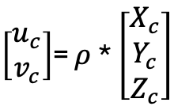
$$\vec{X_{world|Centered}}=\vec{X_{world}}−\frac{1}{n}\sum{\vec{X_{world}}}$$
$$\vec{X_{world|Centered}}=\vec{X_{world}}−\vec{t}$$
$$\vec{U_{image|Centered}}=S∗\vec{X_{world|Centered}}$$
R=$\left[\begin{matrix}1 & 0 & 0 \\ 0 & \cos{θ_{x}} & −\sin{θ_{x}} \\ 0 & \sin{θ_{x}} & \cos{θ_{x}}\end{matrix}\right]∗\left[\begin{matrix}\cos{θ_{Y}} & 0 & \sin{θ_{Y}} \\ 0 & 1 & 0 \\ −\sin{θ_{Y}} & 0 & \cos{θ_{Y}}\end{matrix}\right]$* $\left[\begin{matrix}\cos{θ_{z}} & −sin{θ_{z}} & 0 \\ \sin{θ_{z}} & \cos{θ_{z}} & 0 \\ 0 & 0 & 1\end{matrix}\right]$
$\left[\begin{matrix}u_{c} \\ v_{c}\end{matrix}\right]$= $ρ$* $\left[\begin{matrix}X_{c} \\ Y_{c} \\ Z_{c}\end{matrix}\right]$
$ρ=\left[\begin{matrix}1 & 0 & 0 \\ 0 & 1 & 0\end{matrix}\right]$ $\left[\begin{matrix}r_{0,0} & r_{0,1} & r_{0,2} \\ r_{1,0} & r_{1,1} & r_{1,2} \\ r_{2,0} & r_{2,1} & r_{2,2}\end{matrix}\right]$= $\left[\begin{matrix}r_{0,0} & r_{0,1} & r_{0,2} \\ r_{1,0} & r_{1,1} & r_{1,2}\end{matrix}\right]$

Slide 9
Tomasi-Kanade Factorization
2
1
3
5
4
5
4
1
3
2

Slide 10
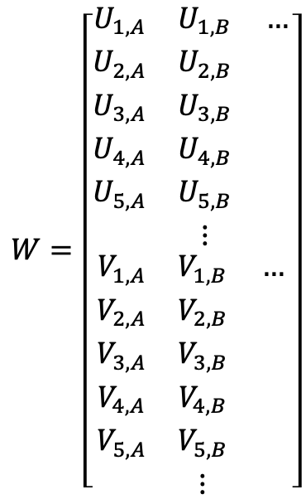
Tomasi-Kanade Factorization
Number of tracked points (centered)
$$W=\left[\begin{matrix}\begin{matrix}U_{1,A} & U_{1,B} & … \\ U_{2,A} & U_{2,B} & \\ U_{3,A} & U_{3,B} & \\ U_{4,A} & U_{4,B} & \\ U_{5,A} & U_{5,B} & \\ & ⋮ & \end{matrix} \\ \begin{matrix}V_{1,A} & V_{1,B} & … \\ V_{2,A} & V_{2,B} & \\ V_{3,A} & V_{3,B} & \\ V_{4,A} & V_{4,B} & \\ V_{5,A} & V_{5,B} & \\ & ⋮ & \end{matrix}\end{matrix}\right]$$
2
1
3
5
4
Number of frames (x2)
5
4
1
3
2

Slide 11

Tomasi-Kanade Factorization
Number of tracked points (centered) [M]
$$WT=Ρ∗X^{T}$$
$$W=\left[\begin{matrix}\begin{matrix}U_{1,A} & U_{1,B} & … \\ U_{2,A} & U_{2,B} & \\ U_{3,A} & U_{3,B} & \\ U_{4,A} & U_{4,B} & \\ U_{5,A} & U_{5,B} & \\ & ⋮ & \end{matrix} \\ \begin{matrix}V_{1,A} & V_{1,B} & … \\ V_{2,A} & V_{2,B} & \\ V_{3,A} & V_{3,B} & \\ V_{4,A} & V_{4,B} & \\ V_{5,A} & V_{5,B} & \\ & ⋮ & \end{matrix}\end{matrix}\right]$$
Sub-matrix that depends on movement (rho)
< 2N x 3 >
Sub-matrix that depends on shape (X)
< M x 3 >
W = < M x 2 N >
Number of frames (N x 2)

Slide 12
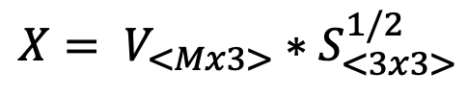
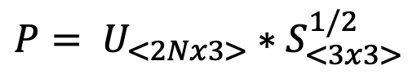

Tomasi-Kanade Factorization
Number of tracked points (centered)
$$WT=Ρ∗X^{T}$$
$$W=\left[\begin{matrix}\begin{matrix}U_{1,A} & U_{1,B} & … \\ U_{2,A} & U_{2,B} & \\ U_{3,A} & U_{3,B} & \\ U_{4,A} & U_{4,B} & \\ U_{5,A} & U_{5,B} & \\ & ⋮ & \end{matrix} \\ \begin{matrix}V_{1,A} & V_{1,B} & … \\ V_{2,A} & V_{2,B} & \\ V_{3,A} & V_{3,B} & \\ V_{4,A} & V_{4,B} & \\ V_{5,A} & V_{5,B} & \\ & ⋮ & \end{matrix}\end{matrix}\right]$$
SVD(W^{T}) → $WT$ = U * S * V^{T}
Number of frames (x2)
P is rank 3
X is rank 3
Therefore, W is also (ideally) rank 3
$$P= U_{<2Nx3>}∗S_{<3x3>}^{1/2}$$
$$X= V_{<Mx3>}∗S_{<3x3>}^{1/2}$$

Slide 13
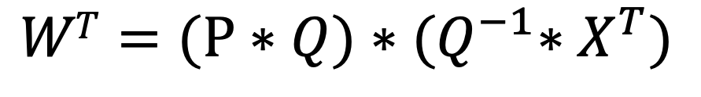
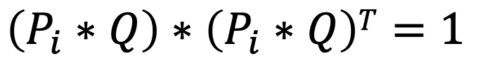
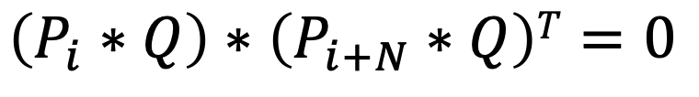
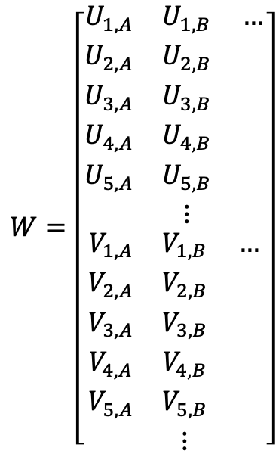
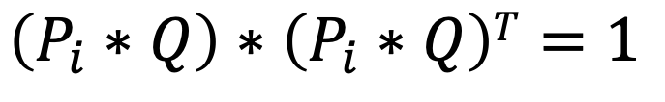
Tomasi-Kanade Factorization
$$WT=(Ρ∗Q)∗{(Q}^{−1}∗X^{T})$$
$$W=\left[\begin{matrix}\begin{matrix}U_{1,A} & U_{1,B} & … \\ U_{2,A} & U_{2,B} & \\ U_{3,A} & U_{3,B} & \\ U_{4,A} & U_{4,B} & \\ U_{5,A} & U_{5,B} & \\ & ⋮ & \end{matrix} \\ \begin{matrix}V_{1,A} & V_{1,B} & … \\ V_{2,A} & V_{2,B} & \\ V_{3,A} & V_{3,B} & \\ V_{4,A} & V_{4,B} & \\ V_{5,A} & V_{5,B} & \\ & ⋮ & \end{matrix}\end{matrix}\right]$$
However, this is not a unique solution:
Metric constraints:
We want a rotation matrix that uses orthogonal axes
For i in range(1:N)
$$\left(P_{i}∗Q\right)∗\left(P_{i}∗Q\right)T=1$$
For i in range(N+1:2*N)
$$\left(P_{i}∗Q\right)∗\left(P_{i}∗Q\right)T=1$$
For i in range(1:N)
$$\left(P_{i}∗Q\right)∗\left(P_{i+N}∗Q\right)T=0$$

Slide 14
Tomasi-Kanade Factorization
$$WT=(Ρ∗Q)∗{(Q}^{−1}∗X^{T})$$
$$W=\left[\begin{matrix}\begin{matrix}U_{1,A} & U_{1,B} & … \\ U_{2,A} & U_{2,B} & \\ U_{3,A} & U_{3,B} & \\ U_{4,A} & U_{4,B} & \\ U_{5,A} & U_{5,B} & \\ & ⋮ & \end{matrix} \\ \begin{matrix}V_{1,A} & V_{1,B} & … \\ V_{2,A} & V_{2,B} & \\ V_{3,A} & V_{3,B} & \\ V_{4,A} & V_{4,B} & \\ V_{5,A} & V_{5,B} & \\ & ⋮ & \end{matrix}\end{matrix}\right]$$
However, this is not a unique solution:
Metric constraints:
We want a rotation matrix that uses orthogonal axes
For i in range(1:N)
$$\left(P_{i}∗Q\right)∗\left(P_{i}∗Q\right)T=1$$
For i in range(N+1:2*N)
$$\left(P_{i}∗Q\right)∗\left(P_{i}∗Q\right)T=1$$
For i in range(1:N)
$$\left(P_{i}∗Q\right)∗\left(P_{i+N}∗Q\right)T=0$$

Slide 15

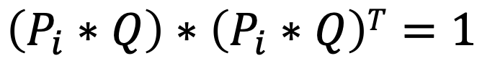
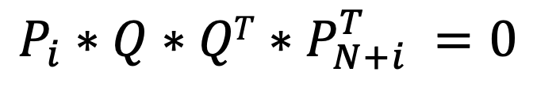
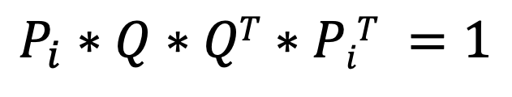
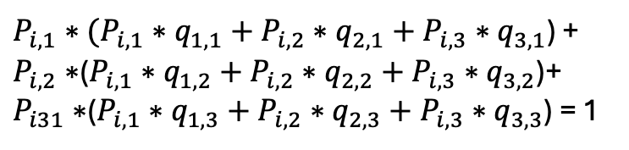
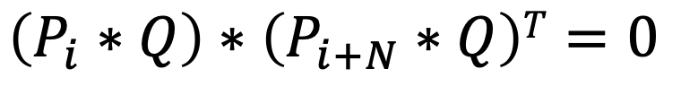
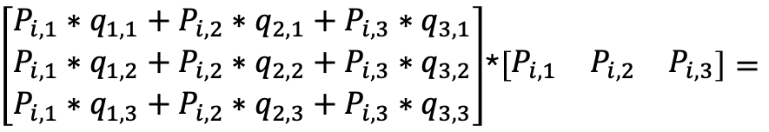
Tomasi-Kanade Factorization
Metric constraints:
We want a rotation matrix that uses orthogonal axes
For i in range(1:N)
$$P_{i}∗Q∗QT∗PiT =1$$
$$\left(P_{i}∗Q\right)∗\left(P_{i}∗Q\right)T=1$$
For i in range(N+1:2*N)
$$P_{i}∗Q∗QT∗P_{N+i}^{T} =0$$
$$\left(P_{i}∗Q\right)∗\left(P_{i}∗Q\right)T=1$$
For i in range(1:N)
$$\left[\begin{matrix}q_{1,1} & q_{1,2} & q_{1,3} \\ q_{2,1} & q_{2,2} & q_{2,3} \\ q_{3,1} & q_{3,2} & q_{3,3}\end{matrix}\right]=Q∗QT$$
$$\left(P_{i}∗Q\right)∗\left(P_{i+N}∗Q\right)T=0$$
$\left[\begin{matrix}P_{i,1}∗q_{1,1}+P_{i,2}∗q_{2,1}+P_{i,3}∗q_{3,1} \\ P_{i,1}∗q_{1,2}+P_{i,2}∗q_{2,2}+P_{i,3}∗q_{3,2} \\ P_{i,1}∗q_{1,3}+P_{i,2}∗q_{2,3}+P_{i,3}∗q_{3,3}\end{matrix}\right]$*$\left[\begin{matrix}P_{i,1} & P_{i,2} & P_{i,3}\end{matrix}\right]=$
$P_{i,1}∗(P_{i,1}∗q_{1,1}+P_{i,2}∗q_{2,1}+P_{i,3}∗q_{3,1}$) + $P_{i,2}∗$($P_{i,1}∗q_{1,2}+P_{i,2}∗q_{2,2}+P_{i,3}∗q_{3,2}$)+ $P_{i31}∗$($P_{i,1}∗q_{1,3}+P_{i,2}∗q_{2,3}+P_{i,3}∗q_{3,3}$) = 1

Slide 16
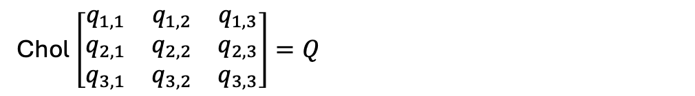
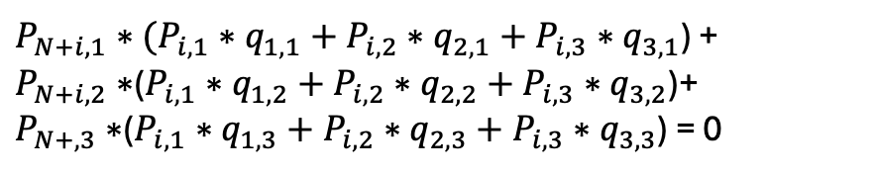
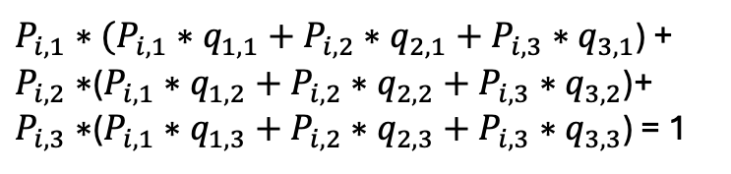
Tomasi-Kanade Factorization
Metric constraints:
We want a rotation matrix that uses orthogonal axes
$P_{i,1}∗(P_{i,1}∗q_{1,1}+P_{i,2}∗q_{2,1}+P_{i,3}∗q_{3,1}$) + $P_{i,2}∗$($P_{i,1}∗q_{1,2}+P_{i,2}∗q_{2,2}+P_{i,3}∗q_{3,2}$)+ $P_{i,3}∗$($P_{i,1}∗q_{1,3}+P_{i,2}∗q_{2,3}+P_{i,3}∗q_{3,3}$) = 1
For i in range(1:N)
$$\left(P_{i}∗Q\right)∗\left(P_{i}∗Q\right)T=1$$
For i in range(N+1:2*N)
$P_{N+i,1}∗(P_{i,1}∗q_{1,1}+P_{i,2}∗q_{2,1}+P_{i,3}∗q_{3,1}$) + $P_{N+i,2}∗$($P_{i,1}∗q_{1,2}+P_{i,2}∗q_{2,2}+P_{i,3}∗q_{3,2}$)+ $P_{N+,3}∗$($P_{i,1}∗q_{1,3}+P_{i,2}∗q_{2,3}+P_{i,3}∗q_{3,3}$) = 0
$$\left(P_{i}∗Q\right)∗\left(P_{i}∗Q\right)T=1$$
For i in range(1:N)
$$\left(P_{i}∗Q\right)∗\left(P_{i+N}∗Q\right)T=0$$
Chol$\left[\begin{matrix}q_{1,1} & q_{1,2} & q_{1,3} \\ q_{2,1} & q_{2,2} & q_{2,3} \\ q_{3,1} & q_{3,2} & q_{3,3}\end{matrix}\right]=Q$

Slide 17
Tomasi-Kanade Factorization
Steps:
Find matching points (M) across frames (N)
Construct the W matrix < M x 2*N >
SVD on W -> U*S*V^{T}. Keep only top 3 terms
P’ = U *S^{1/2} (non-unique P)
5. X ‘= V *S^{1/2} (non-unique X)
Use P’ to find Q^{T}Q
Chol(Q^{T}Q) = Q
P = P’*Q. (unique P)
X^{T} = Q⁻¹*X’^{T} (unique X)

Slide 18
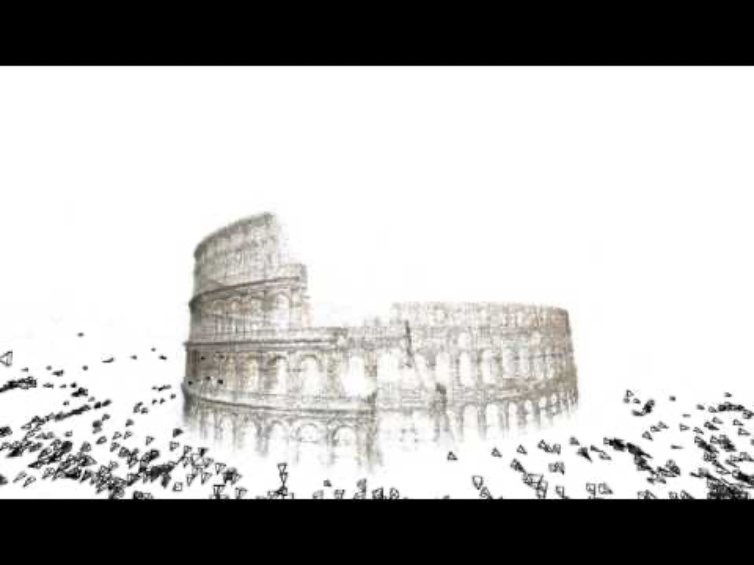
COLMAP
Building Rome in a Day Sameer Agarwal, Noah Snavely, Ian Simon, Steven M. Seitz and Richard Szeliski International Conference on Computer Vision, 2009, Kyoto, Japan.

Slide 19
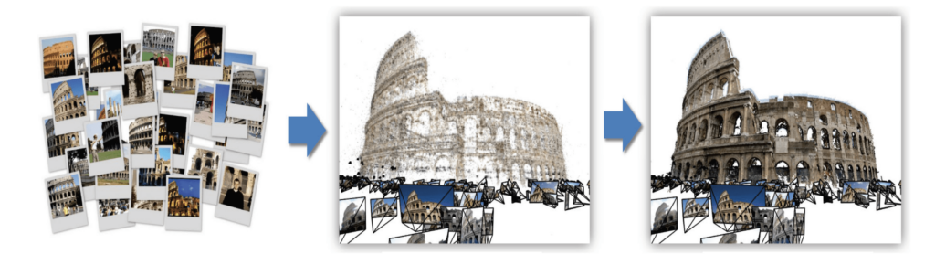
COLMAP
Building Rome in a Day Sameer Agarwal, Noah Snavely, Ian Simon, Steven M. Seitz and Richard Szeliski International Conference on Computer Vision, 2009, Kyoto, Japan.
Structure from Motion
Stereo Fusion

Slide 20
COLMAP
2
1
3
5
4
5
4
1
3
2
Moving the object is the same as moving the camera

Slide 21
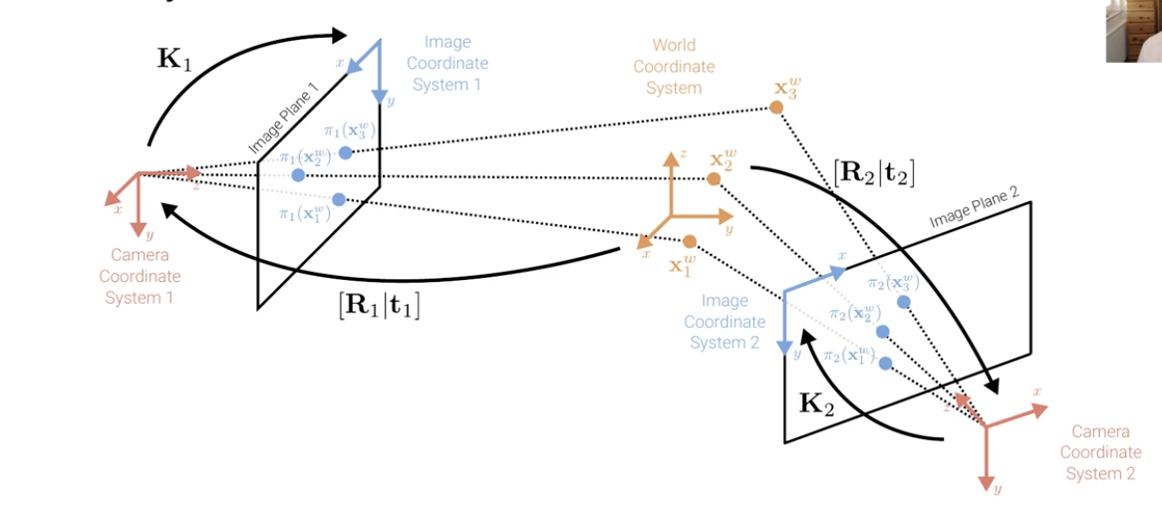

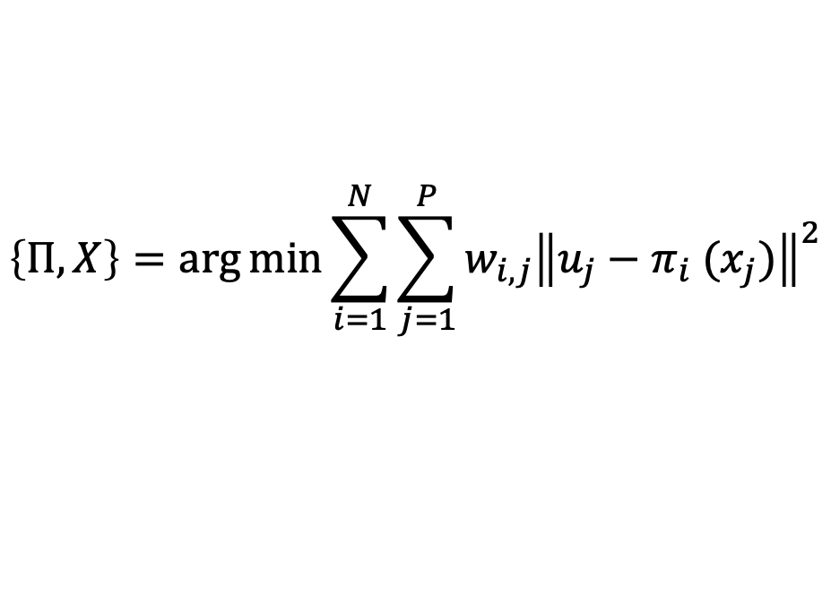

COLMAP
$Π=\{π_{i}$}: Intrinsic (K_{i}) and Extrinsic (R_{i,}T_{i}) properties for N cameras
$X=\{x_{j}$}: Set of P 3D points in the world
$U=\{u_{j}$}: Set of P 2D points in the image
Masking variable
$$\left\{Π,X\right\}=\arg{\min{\sum_{i=1}^{N}{\sum_{j=1}^{P}{w_{i,j}{\left\|u_{j}−π_{i} (x_{j})\right\|}^{2}}}}}$$
Image measured point
Image projected point
Camera projector function
$$π_{i} \left(x_{j}\right)=K_{i}\left(R_{i}x_{j}+t_{i}\right)$$

Slide 22
COLMAP
$Π=\{π_{i}$}: Intrinsic (K_{i}) and Extrinsic (R_{i,}T_{i}) properties for N cameras
$X=\{x_{j}$}: Set of P 3D points in the world
$U=\{u_{j}$}: Set of P 2D points in the image
Masking variable
Large scale minimization
Not convex (sensitive to local minima)
Requires good initial guess
Computationally intense
Solution is sparse (make use of sparse solvers e.g. Google’s Ceres)
$$\left\{Π,X\right\}=\arg{\min{\sum_{i=1}^{N}{\sum_{j=1}^{P}{w_{i,j}{\left\|u_{j}−π_{i} (x_{j})\right\|}^{2}}}}}$$
Image measured point
Image projected point
Camera projector function
$$π_{i} \left(x_{j}\right)=K_{i}\left(R_{i}x_{j}+t_{i}\right)$$

Slide 23
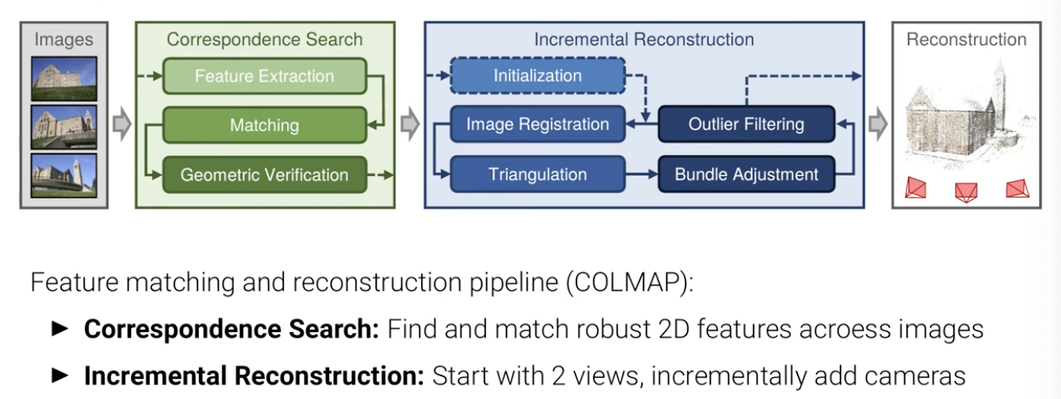

Slide 24
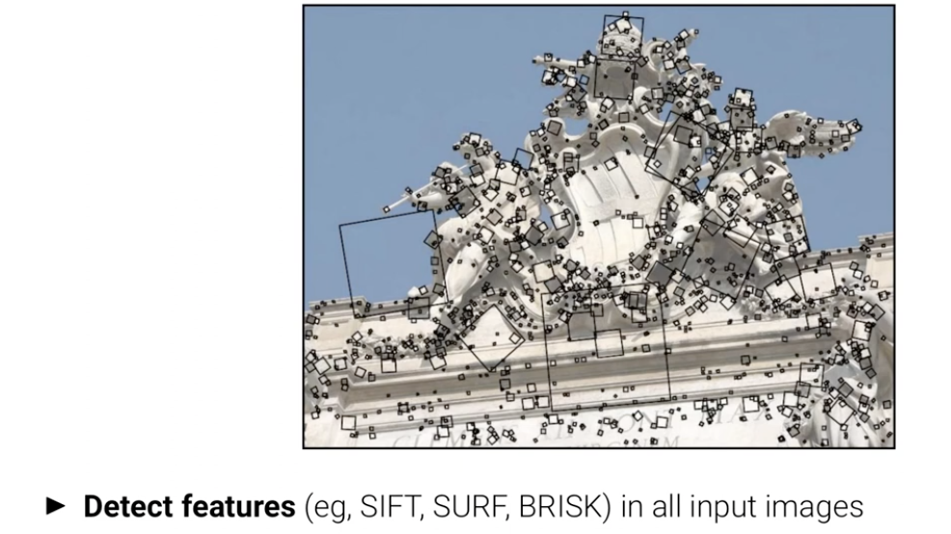
Step 1. Find the features for all images

Slide 25
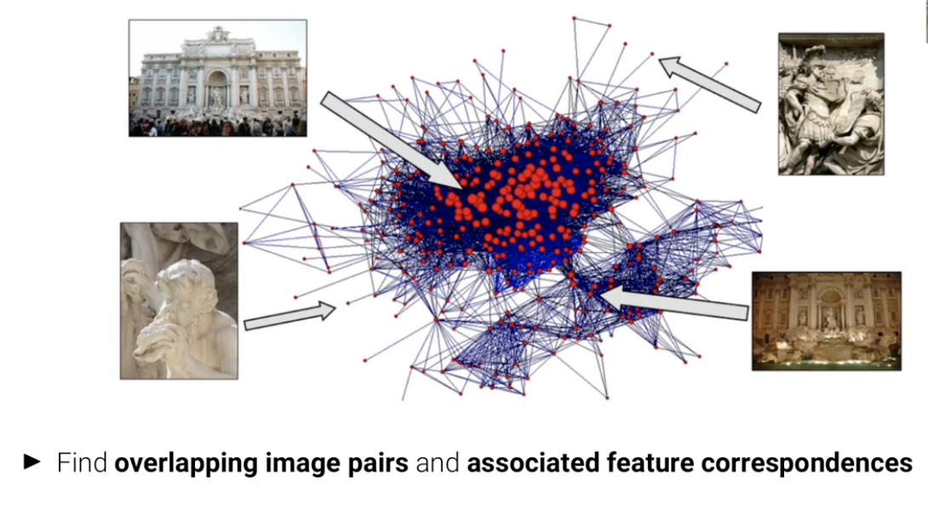
Step 2. Create graph of all-to-all image matches

Slide 26
Step 3. Prune matches (geometric verification)

Slide 27
Step 4. Find most centrally connected pair of images

Slide 28
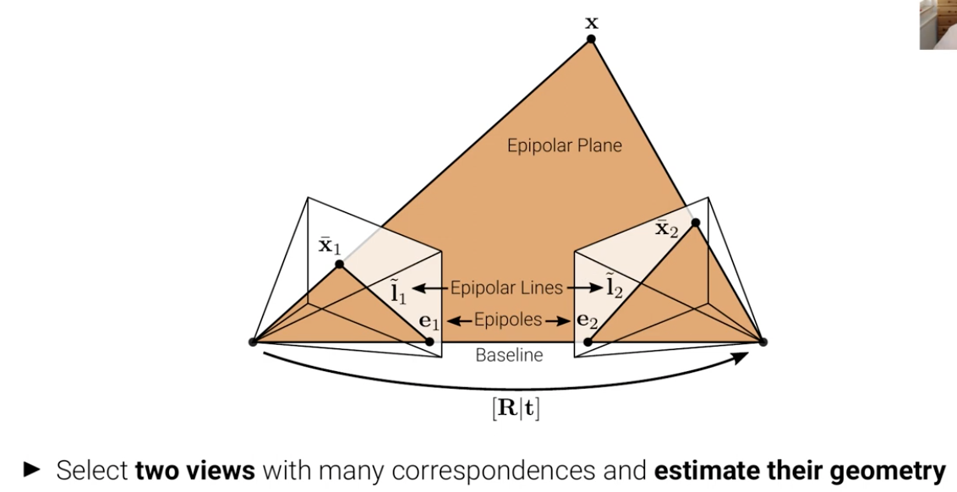
Step 5. Two image initialization

Slide 29
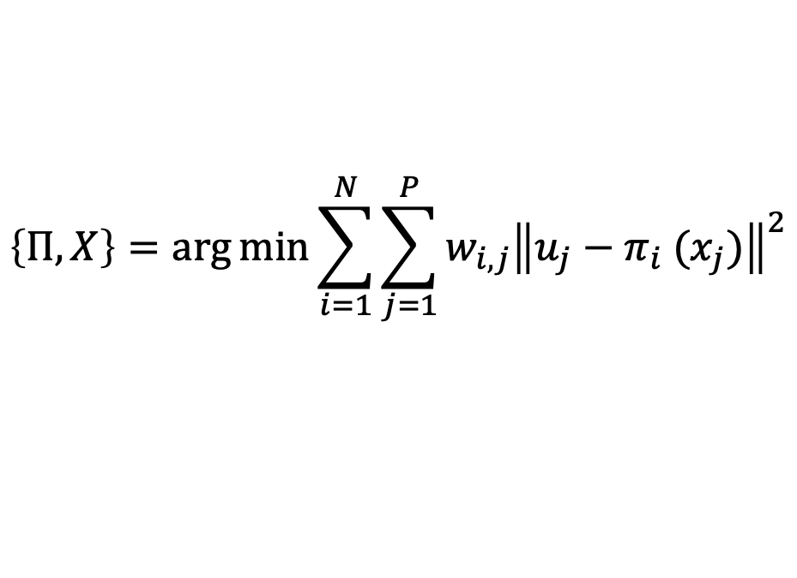
Step 6. Add new image
Already know this from previous step
$$\left\{Π,X\right\}=\arg{\min{\sum_{i=1}^{N}{\sum_{j=1}^{P}{w_{i,j}{\left\|u_{j}−π_{i} (x_{j})\right\|}^{2}}}}}$$
Solve this for the new image
$$π_{i} \left(x_{j}\right)=K_{i}\left(R_{i}x_{j}+t_{i}\right)$$

Slide 30
RANSAC:
Random Sampling Consensus
1) Grab small subsets of the data to solve the problem (e.g. features to solve the homography)
2) Based on that solution, compute for all other points if they are outliers or inliers
3) Repeat 1-2
4) Remove points that produce the lowest number inliers

Slide 31
Sparse Reconstruction
Dense Reconstruction

Slide 32
Sparse Reconstruction
Dense Reconstruction

Slide 33
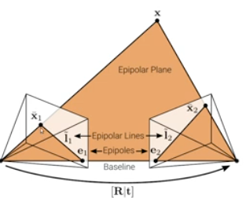
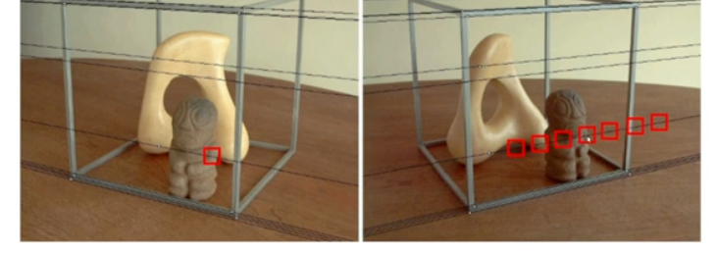
Epipolar coordinates
Projection by the Essential matrix produces a (epipolar) line
$$I2=E∗u1^{′}$$
$$I1=ET∗u2^{′}$$

Slide 34
E, mask = cv2.findEssentialMat(pts1, pts2, K, method=cv2.RANSAC, prob=0.999, threshold=1.0)
_, R, t, _ = cv2.recoverPose(E, pts1, pts2, K, mask=mask)

