Slide 1
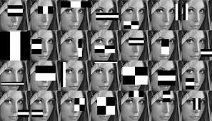
Lecture 16 Harr Cascades
ECE 1390/2390

Slide 2
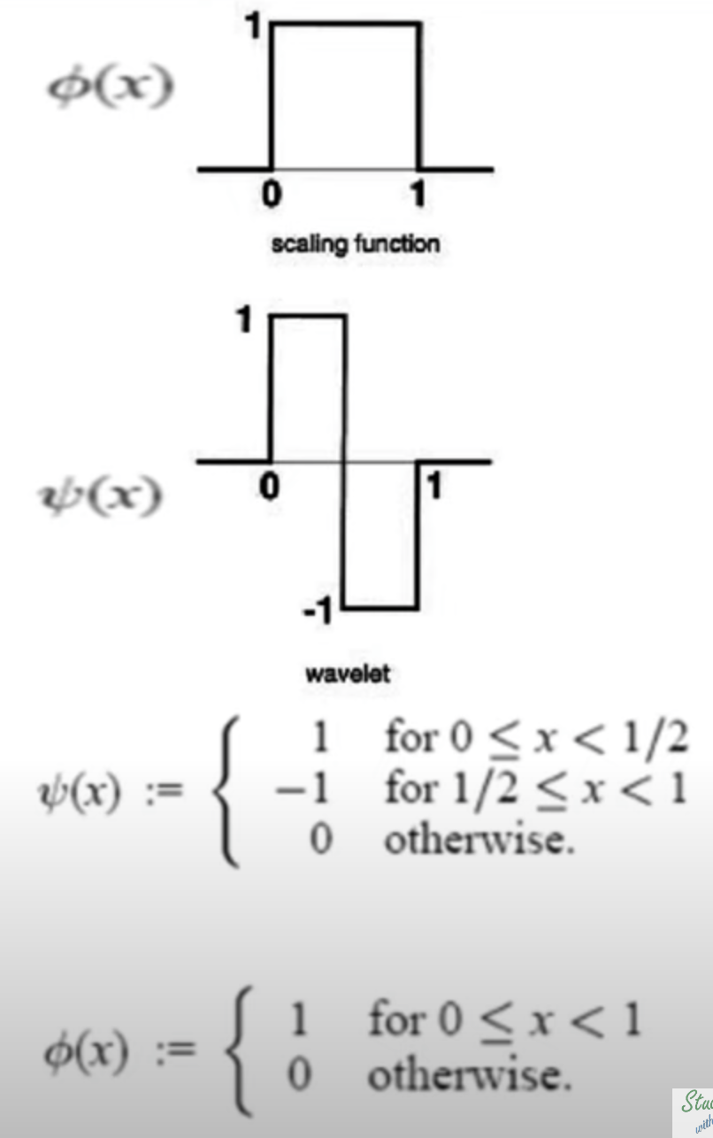
Haar wavelet
Integrator: Low-pass filter
$$H_{2x2}=\frac{1}{\sqrt{2}}\left[\begin{matrix}1 & 1 \\ 1 & −1\end{matrix}\right]$$
Differentiator: High-pass filter
$$φ\left(x\right)=\left\{\begin{matrix}1 & 0≤x<1 \\ 0 & else\end{matrix}\right.$$
$$ψ\left(x\right)=\left\{\begin{matrix}1 & 0≤x<1/2 \\ −1 & 1/2≤x<1 \\ 0 & else\end{matrix}\right.$$

Slide 3
Viola and Jones, "Rapid object detection using a boosted cascade of simple features", Computer Vision and Pattern Recognition, 2001
Haar-like feature extraction kernel (not actual Haar wavelets)
Series of convolution kernels to extract features
More features than pixels
E.g. 24 x 24 probe has 18,000 possible rectangle arrangements
`Uses only small subset of the possibilities
Horizontal Boundary
Vertical Boundary
Vertical Line
Crossing

Slide 4
Feature Extraction:
Sum over rectangular windows
A
A
C
A
C
B
D
B
D
A+B – (C+D)
A+D – (B+C)
→ 28 features
Each feature is very
weakly predictive

Slide 5
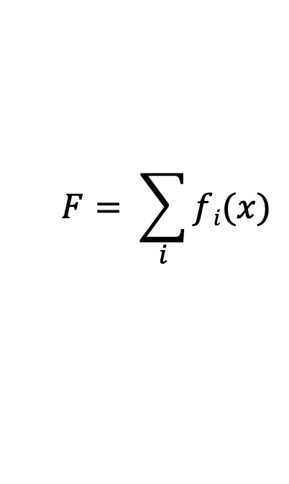
Adaboost (Adaptive boosting)
$$F= \sum_{i}{fi(x)}$$
Weak binary (-1,1) classifiers
Boasted
classifier
Yoav Freund and Robert Schapire (1995), A desicion-theoretic generalization of on-line learning and an application to boosting, Lecture Notes in Computer Science, Berlin, Heidelberg: Springer Berlin Heidelberg, pp. 23–37

Slide 6
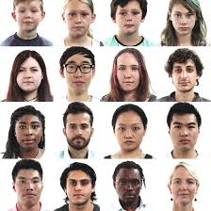



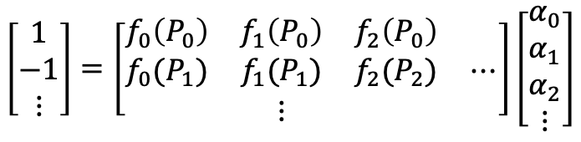
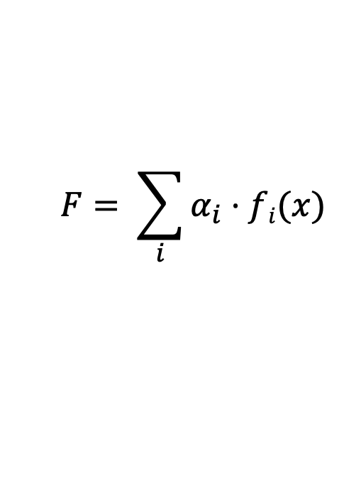
Positive Training Data
$$F= \sum_{i}{α_{i}⋅fi(x)}$$
Weak binary (-1,1) classifiers
Boasted
classifier
$$\left[\begin{matrix}1 \\ −1 \\ ⋮\end{matrix}\right]=\left[\begin{matrix}f_{0}\left(P_{0}\right) & f_{1}\left(P_{0}\right) & f_{2}\left(P_{0}\right) & \\ f_{0}(P_{1}) & f_{1}(P_{1}) & f_{2}(P_{2}) & ⋯ \\ & ⋮ & & \end{matrix}\right]\left[\begin{matrix}α_{0} \\ α_{1} \\ α_{2} \\ ⋮\end{matrix}\right]$$
Training Data
Negative Training Data

Slide 7
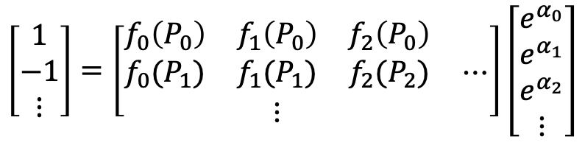
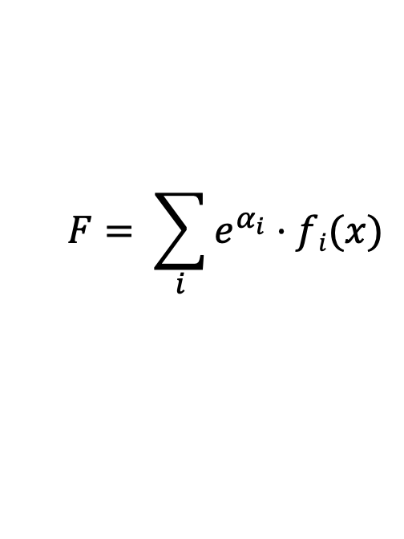
Positive Training Data
$$F= \sum_{i}{e^{α_{i}}⋅fi(x)}$$
Weak binary (-1,1) classifiers
Boasted
classifier
Training Data
$$\left[\begin{matrix}1 \\ −1 \\ ⋮\end{matrix}\right]=\left[\begin{matrix}f_{0}\left(P_{0}\right) & f_{1}\left(P_{0}\right) & f_{2}\left(P_{0}\right) & \\ f_{0}(P_{1}) & f_{1}(P_{1}) & f_{2}(P_{2}) & ⋯ \\ & ⋮ & & \end{matrix}\right]\left[\begin{matrix}e^{α_{0}} \\ e^{α_{1}} \\ e^{α_{2}} \\ ⋮\end{matrix}\right]$$
Ensure that coefficients are non-negative
Negative Training Data

Slide 8
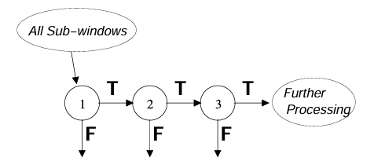
Classifier Cascade
Most negatives are discarded in first stages, reducing computation
100% TPR (10 blocks)
40% FPR (3396 blocks)
100% TPR (10 blocks)
20% FPR (800 blocks)
10,000 blocks
(e.g. 0.1% 10 true)
In original paper:
6000+ features with 38 stages
1, 10, 25, 25 and 50 features in the first five stages.

Slide 9
Training Haar models
Good working example:
https://github.com/bilardi/how-to-train-cascade
Not included in python install (need to install from source code)
https://github.com/opencv/opencv/apps/annotation
… /createsamples
… /traincascade
Notes:
https://www.robots.ox.ac.uk/~vgg/data/flowers/102/index.html
https://github.com/bilardi/how-to-train-cascade
https://imerit.net/blog/28-free-image-datasets-for-computer-vision-all-pbm/

Slide 10
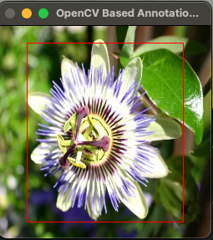
Training Haar models
Good working example:
https://github.com/bilardi/how-to-train-cascade
opencv_annotation
For interactive labeling of images using left mouse click followed by keystrokes
e.g. ./opencv/build/bin/opencv_annotation \
--images=/Users/theodorehuppert/Desktop/Haa/training/positives/ \
--annotations=/Users/theodorehuppert/Desktop/Haa/training/annotations.txt
Note- if you don’t give it the full pathnames, it doesn’t do anything (but also gives no help info)
Must hit “C’ (red box turns green) to add annotation. Each image can have multiple annotations
Pressing c : confirm the annotation, turning the annotation green and confirming it is stored
Pressing d : delete the last annotation from the list of annotations (easy for removing wrong annotations)
Pressing n : continue to the next image
Pressing ESC : this will exit the annotation software
Notes:
https://www.robots.ox.ac.uk/~vgg/data/flowers/102/index.html
https://github.com/bilardi/how-to-train-cascade
https://imerit.net/blog/28-free-image-datasets-for-computer-vision-all-pbm/

Slide 11
Training Haar models
Good working example:
https://github.com/bilardi/how-to-train-cascade
opencv_annotation
For interactive labeling of images using left mouse click followed by keystrokes
e.g. ./opencv/build/bin/opencv_annotation \
--images=/Users/theodorehuppert/Desktop/Haa/training/positives/ \
--annotations=/Users/theodorehuppert/Desktop/Haa/training/annotations.txt
/Users/theodorehuppert/Desktop/Haa/training/positives/image_00001.jpg 1 28 12 198 230
/Users/theodorehuppert/Desktop/Haa/training/positives/image_00002.jpg 1 45 17 194 231
/Users/theodorehuppert/Desktop/Haa/training/positives/image_00003.jpg 1 22 68 221 179
/Users/theodorehuppert/Desktop/Haa/training/positives/image_00004.jpg 1 63 31 154 206
/Users/theodorehuppert/Desktop/Haa/training/positives/image_00005.jpg 1 76 49 162 173
Notes:
https://www.robots.ox.ac.uk/~vgg/data/flowers/102/index.html
https://github.com/bilardi/how-to-train-cascade
https://imerit.net/blog/28-free-image-datasets-for-computer-vision-all-pbm/

Slide 12
Training Haar models
Good working example:
https://github.com/bilardi/how-to-train-cascade
opencv_annotation
Usage: ./opencv/build/bin/opencv_traincascade
-data: Folder (must exist) to store output data
-vec: Samples vector created by createsamples function
-bg: Negative samples list (TXT)
-numPos: Number of samples used in training for every stage
-numNeg: “
Useful options
-precalCalValBufSize: Preallocated memory (in Mb)
-precalCalIdxBufSize: Preallocated memory (in Mb)
-numThreads
-acceptanceRatioBreakValue: When to stop training model
Cascade Parameters
-numStages: number of stages (default=20)
-featureType: HAAR or LBP (local binary pattern)
-w: Width of samples (must match createsamples)
-h: Height of samples (must match createsamples)
-bt: AdaBoost type. {DAB, RAB, LB, GAB}
-minHitRate: Desired positive hit rate for each stage
-maxFalseAlarmRate: Max false positives for each stage
-mode: BASIC- only vertical HAAR. ALL—also 45degree rotated
Notes:
https://www.robots.ox.ac.uk/~vgg/data/flowers/102/index.html
https://github.com/bilardi/how-to-train-cascade
https://imerit.net/blog/28-free-image-datasets-for-computer-vision-all-pbm/

Slide 13
Training Haar models
Good working example:
https://github.com/bilardi/how-to-train-cascade
opencv_traincascade
Usage: ./opencv/build/bin/opencv_traincascade
-data: Folder (must exist) to store output data
-vec: Samples vector created by createsamples function
-bg: Negative samples list (TXT)
-numPos: Number of samples used in training for every stage
-numNeg: “
Useful options
-precalCalValBufSize: Preallocated memory (in Mb)
-precalCalIdxBufSize: Preallocated memory (in Mb)
-numThreads
-acceptanceRatioBreakValue: When to stop training model
Cascade Parameters
-numStages: number of stages (default=20)
-featureType: HAAR or LBP (local binary pattern)
-w: Width of samples (must match createsamples)
-h: Height of samples (must match createsamples)
-bt: AdaBoost type. {DAB, RAB, LB, GAB}
-minHitRate: Desired positive hit rate for each stage
-maxFalseAlarmRate: Max false positives for each stage
-mode: BASIC- only vertical HAAR. ALL—also 45degree rotated
Notes:
https://www.robots.ox.ac.uk/~vgg/data/flowers/102/index.html
https://github.com/bilardi/how-to-train-cascade
https://imerit.net/blog/28-free-image-datasets-for-computer-vision-all-pbm/

Slide 14
git clone https://github.com/bilardi/how-to-train-cascade
cd how-to-train-cascade
find ./positive_images -iname "*.jpg" > positives.txt
find ./negative_images -iname "*.jpg" > negatives.txt
# Note in the git repo, info.dat has already been created for you
../opencv/build/bin/opencv_createsamples -info info.dat -num 37 -w 80 -h 80 -vec samples.vec
../opencv/build/bin/opencv_traincascade -data classifier \
-vec samples.vec -bg negatives.txt -numStages 50 \
-minHitRate 0.999 -maxFalseAlarmRate 0.5 -numPos 37 \
-numNeg 16 -w 80 -h 80 -precalcValBufSize 1024
-precalcIdxBufSize 1024 -featureType HAAR -mode BASIC

Slide 15
Training Haar models
Good working example:
https://github.com/bilardi/how-to-train-cascade
Suggestions
HAAR classifers work for “rigid, textured objects”. (e.g. faces onward, but faces side-view would need a different filter)
Want to have around 1000-2000 positive images
Want to have about 2:1 positive:negative images
Total false discovery is (maxFalseAlarmRate [per stage])^number stages
Total true positive rate is: (minHitRate [per stage])^number stages
-minHitRate: Desired positive hit rate for each stage
-maxFalseAlarmRate: Max false positives for each stage
Notes:
https://www.robots.ox.ac.uk/~vgg/data/flowers/102/index.html
https://github.com/bilardi/how-to-train-cascade
https://imerit.net/blog/28-free-image-datasets-for-computer-vision-all-pbm/

Slide 16
Training Haar models
Useful list of a bunch of free (large) curated datasets:
https://imerit.net/blog/28-free-image-datasets-for-computer-vision-all-pbm/
https://image-net.org/. [requires registration with a .edu email]. (Basis for ResNet)
https://www.robots.ox.ac.uk/~vgg/data/
Trained models
https://github.com/opencv/opencv/data/haarcascades
eyes, front faces, profile faces, fullbody, upper body, lower body, smile, Russian license plates (???)

Slide 17
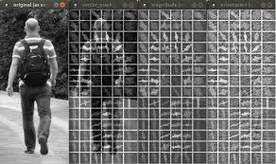
HOG (Histogram of oriented gradients)
https://github.com/lcit/HOG

Slide 18
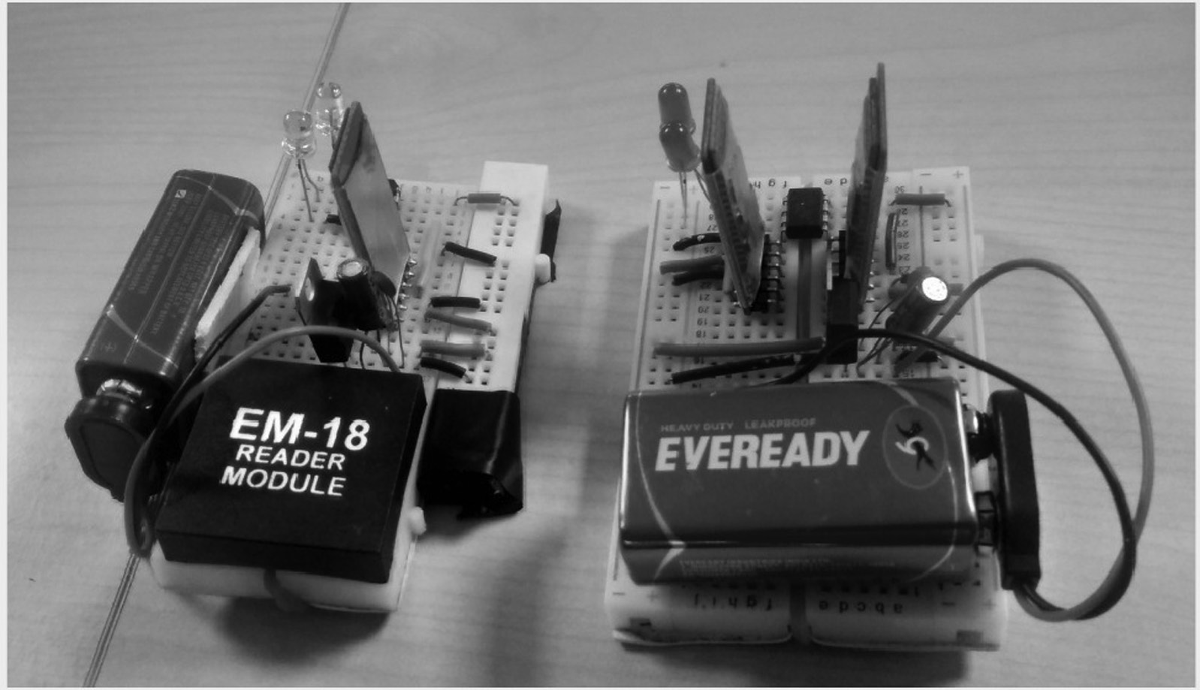
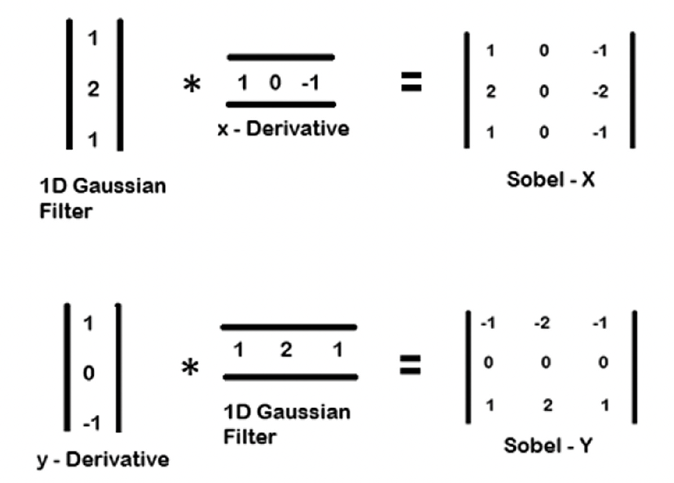
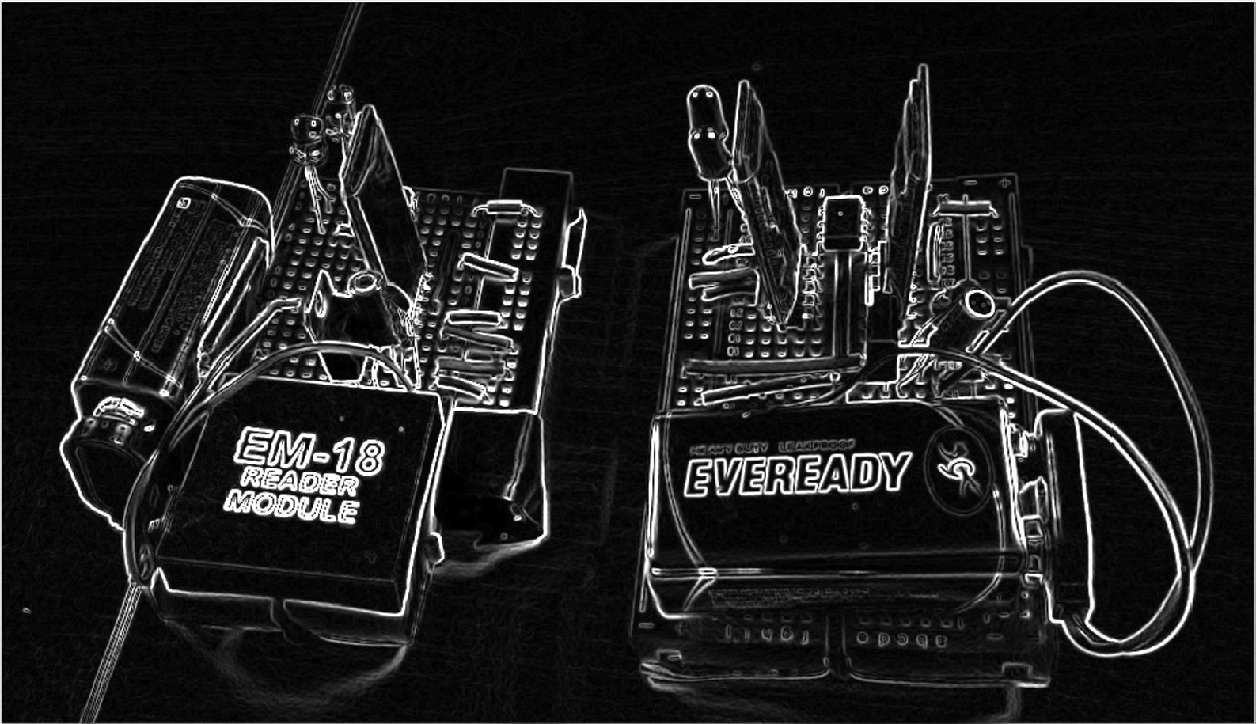
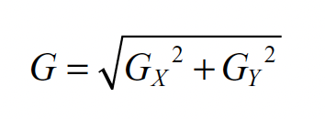
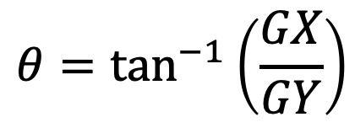
Sobel filter
Low-pass filter
High-pass filter
$$θ=\tan^{−1}\left(\frac{GX}{GY}\right)$$

Slide 19
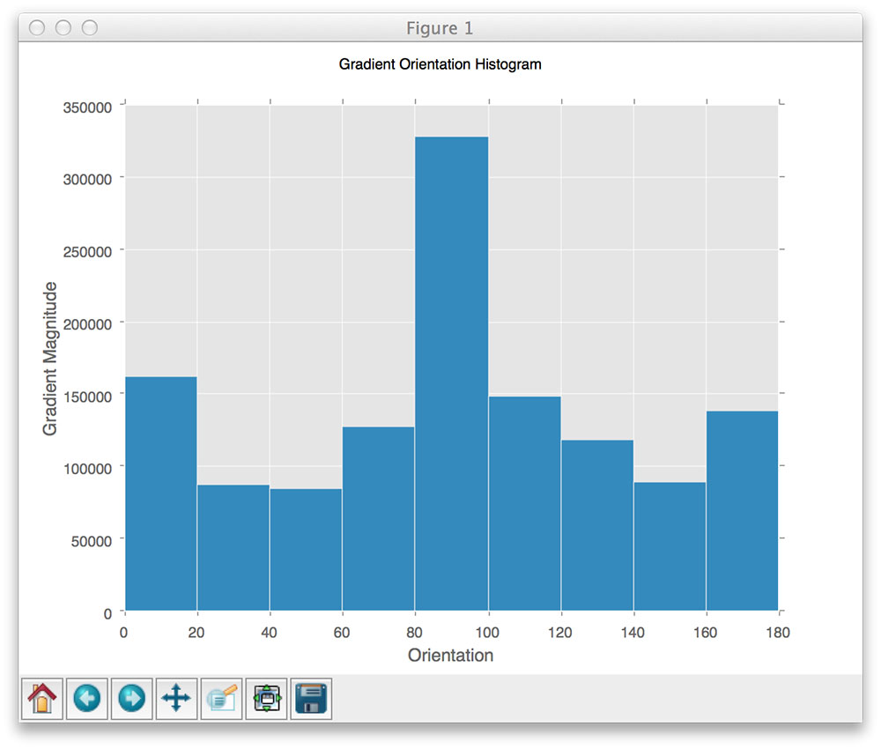
HOG (Histogram of oriented gradients)
Each block position provides
9 feature values (#bins used in this case)

Slide 20
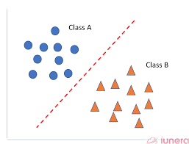
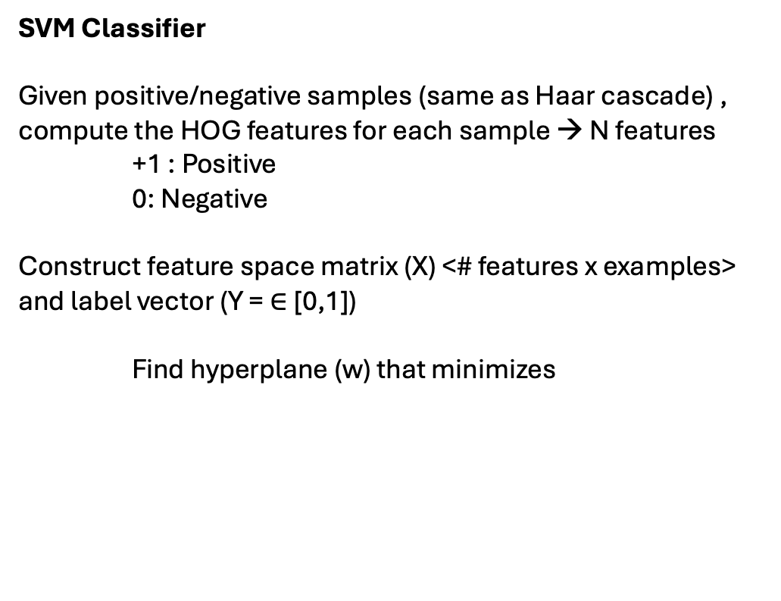
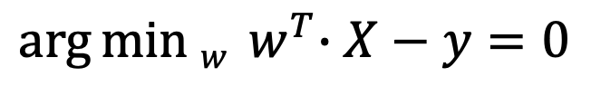
HOG (Histogram of oriented gradients)
SVM Classifier
Given positive/negative samples (same as Haar cascade) , compute the HOG features for each sample → N features
+1 : Positive
0: Negative
Construct feature space matrix (X) <# features x examples> and label vector (Y = $∈$[0,1])
Find hyperplane (w) that minimizes
$$\arg{min w{{ w}^{T}∙X−y=0}}$$

Slide 21
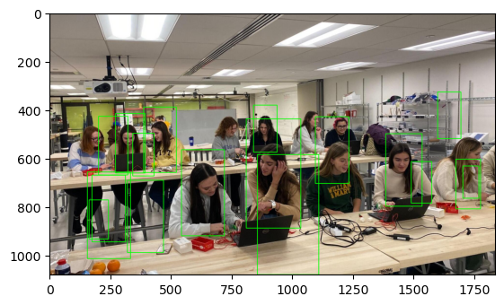
HOG (Histogram of oriented gradients)
hog = cv2.HOGDescriptor()
hog.setSVMDetector(cv2.HOGDescriptor_getDefaultPeopleDetector())
# Detect people in the image
(rects, weights) = hog.detectMultiScale(imgray, winStride=(4, 4),
padding=(8, 8), scale=1.05)

