Slide 1
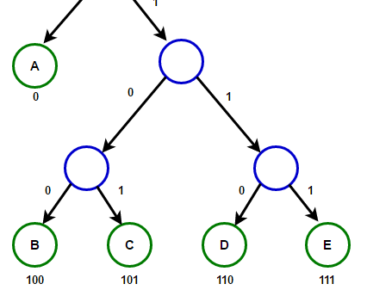
Lecture 20 Image Compression Methods
ECE 1390/2390

Slide 2
Lossy (non-lossless). (Lecture 4)
DCT
Wavelet
Haramord-Walsh
Color space transform (Lecture 3)
Lossless
Variable Length Coding (Huffman compression)

Slide 3
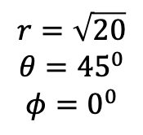
Color space transforms are lossy
RGB=[10,10,0]
$$r=\sqrt{20}$$
$$θ={45}^{0}$$
$$φ=0^{0}$$
r = 4.472… → not uint8

Slide 4

(From Lecture 1)
Raster data formats
GIF (Lossy in color)
Uses specific color maps
JPEG (Lossy in value)
Uses DCT → spasticity (followed by VLC compression)
PNG (mostly lossless)
24-bit color
Can be compressed with VLC (or similar)
Adds alpha channel
TIFF (Lossless)
Versatile bit depth and color-depth
Can be compressed with VLC (or similar)
Vector data formats (lossless/scale invariant)
EPS
SVG

Slide 5
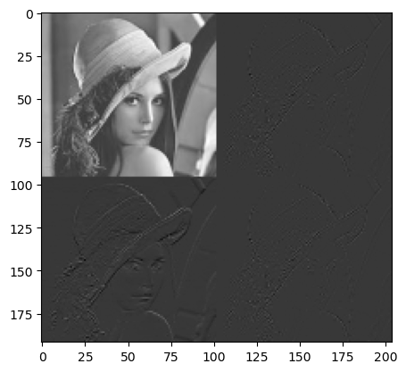
From Lecture 4
Horizontal
Vertical
Low-pass filter
M2↓
Low-pass filter
M2↓
High-pass filter
M2↓
X
Low-pass filter
M2↓
High-pass filter
M2↓
High-pass filter
M2↓

Slide 6
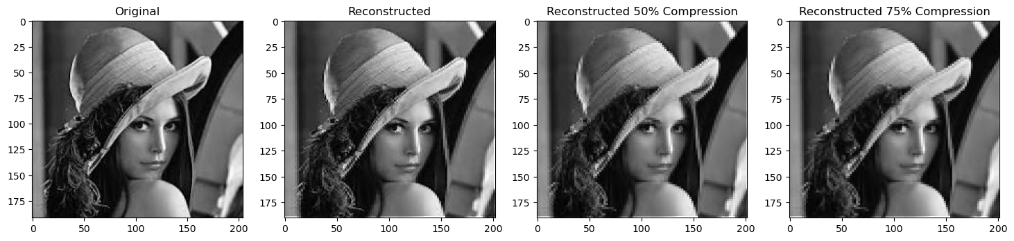

Slide 7
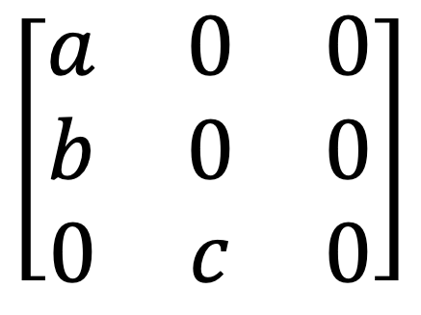
Original: 9 x uint8 values = 72 bits
As sparse:
Dimensions [3,3] → 2 x unit8 values
3 non-zeros →3 x 3 x uint8 values = 72 bits
------
= 88 bits total
3,3
0,0, a
0,1,b
1,2,c
$$\left[\begin{matrix}a & 0 & 0 \\ b & 0 & 0 \\ 0 & c & 0\end{matrix}\right]$$
As sparse

Slide 8
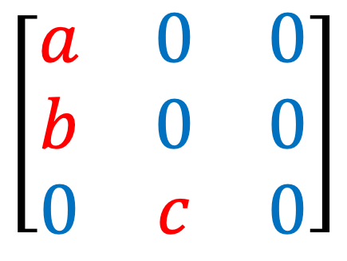
Huffman Compression Variable Length Coding (VLC)
Store as 8-bit
Store as 1-bit
3 x 8bit + 6 x 1bit = 30 bits
9 x 8bit = 72 bits
11 x 8bit = 88 bits
3,3
0,0, a
0,1,b
1,2,c
$$\left[\begin{matrix}a & 0 & 0 \\ b & 0 & 0 \\ 0 & c & 0\end{matrix}\right]$$
$$\left[\begin{matrix}a & 0 & 0 \\ b & 0 & 0 \\ 0 & c & 0\end{matrix}\right]$$
As VLC
As sparse

Slide 9
SWANSON_SCHOOL_OF_ENGINEERING
O: 4
N: 4
S: 3
_: 3
E: 3
G: 2
W: 1
A: 1
C: 1
H: 1
L: 1
F: 1
I: 1
R: 1

Slide 10
O: 4
N: 4
S: 3
_: 3
E: 3
G: 2
W: 1
A: 1
C: 1
H: 1
L: 1
F: 1
I: 1
R: 1
O: 4
N: 4
S: 3
_: 3
E: 3
G: 2
IR: 2
W: 1
A: 1
C: 1
H: 1
L: 1
F: 1
IR=2
I=1
R=1

Slide 11

O: 4
N: 4
S: 3
_: 3
E: 3
G: 2
W: 1
A: 1
C: 1
H: 1
L: 1
F: 1
I: 1
R: 1
O: 4
N: 4
S: 3
_: 3
E: 3
G: 2
IR: 2
W: 1
A: 1
C: 1
H: 1
L: 1
F: 1
O: 4
N: 4
S: 3
_: 3
E: 3
G: 2
IR: 2
LF: 2
CH: 2
WA: 2

Slide 12
O: 4
N: 4
S: 3
_: 3
E: 3
G: 2
W: 1
A: 1
C: 1
H: 1
L: 1
F: 1
I: 1
R: 1
O: 4
N: 4
S: 3
_: 3
E: 3
G: 2
IR: 2
W: 1
A: 1
C: 1
H: 1
L: 1
F: 1
O: 4
N: 4
S: 3
_: 3
E: 3
G: 2
IR: 2
LF: 2
CH: 2
WA: 2
O: 4
N: 4
S: 3
_: 3
E: 3
G: 2
WACH:4
LFIR: 4
WACH-4
LFIR-4
WA-2
CH-2
LF-2
IR-2
W-1
A-1
C-1
H-1
L-1
F-1
I-1
R-1

Slide 13
O: 4
N: 4
S: 3
_: 3
E: 3
G: 2
W: 1
A: 1
C: 1
H: 1
L: 1
F: 1
I: 1
R: 1
O: 4
N: 4
S: 3
_: 3
E: 3
G: 2
IR: 2
W: 1
A: 1
C: 1
H: 1
L: 1
F: 1
O: 4
N: 4
S: 3
_: 3
E: 3
G: 2
IR: 2
LF: 2
CH: 2
WA: 2
O: 4
N: 4
S: 3
_: 3
E: 3
G: 2
WACH:4
LFIR: 4
NO: 8
S_: 6
GE:5 WACH:4
LFIR: 4
GE-5
S_-6
NO-8
WACH-4
LFIR-4
G-2
E-3
S-3
_-3
N-4
O-4
WA-2
CH-2
LF-2
IR-2
W-1
A-1
C-1
H-1
L-1
F-1
I-1
R-1

Slide 14
O: 4
N: 4
S: 3
_: 3
E: 3
G: 2
W: 1
A: 1
C: 1
H: 1
L: 1
F: 1
I: 1
R: 1
O: 4
N: 4
S: 3
_: 3
E: 3
G: 2
IR: 2
W: 1
A: 1
C: 1
H: 1
L: 1
F: 1
O: 4
N: 4
S: 3
_: 3
E: 3
G: 2
IR: 2
LF: 2
CH: 2
WA: 2
O: 4
N: 4
S: 3
_: 3
E: 3
G: 2
WACH:4
LFIR: 4
NO: 8
S_: 6
GE:5 WACH:4
LFIR: 4
NO: 8
WACHLFIR: 8
S_: 6
GE:5
GES_: 11
NO: 8
WACHLFIR: 8
GES_-11
WACHLFIR-8
GE-5
S_-6
NO-8
WACH-4
LFIR-4
G-2
E-3
S-3
_-3
N-4
O-4
WA-2
CH-2
LF-2
IR-2
W-1
A-1
C-1
H-1
L-1
F-1
I-1
R-1

Slide 15
O: 4
N: 4
S: 3
_: 3
E: 3
G: 2
W: 1
A: 1
C: 1
H: 1
L: 1
F: 1
I: 1
R: 1
O: 4
N: 4
S: 3
_: 3
E: 3
G: 2
IR: 2
W: 1
A: 1
C: 1
H: 1
L: 1
F: 1
O: 4
N: 4
S: 3
_: 3
E: 3
G: 2
IR: 2
LF: 2
CH: 2
WA: 2
O: 4
N: 4
S: 3
_: 3
E: 3
G: 2
WACH:4
LFIR: 4
NO: 8
S_: 6
GE:5 WACH:4
LFIR: 4
NO: 8
WACHLFIR: 8
S_: 6
GE:5
GES_: 11
NO: 8
WACHLFIR: 8
NOWACHLFIR: 16
GES_: 11
GES_NOWACHLFIR-26
NOWACHLFIR-16
GES_-11
WACHLFIR-8
GE-5
S_-6
NO-8
WACH-4
LFIR-4
G-2
E-3
S-3
_-3
N-4
O-4
WA-2
CH-2
LF-2
IR-2
W-1
A-1
C-1
H-1
L-1
F-1
I-1
R-1

Slide 16
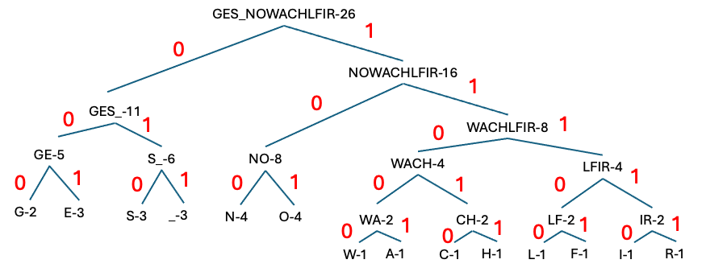

Slide 17
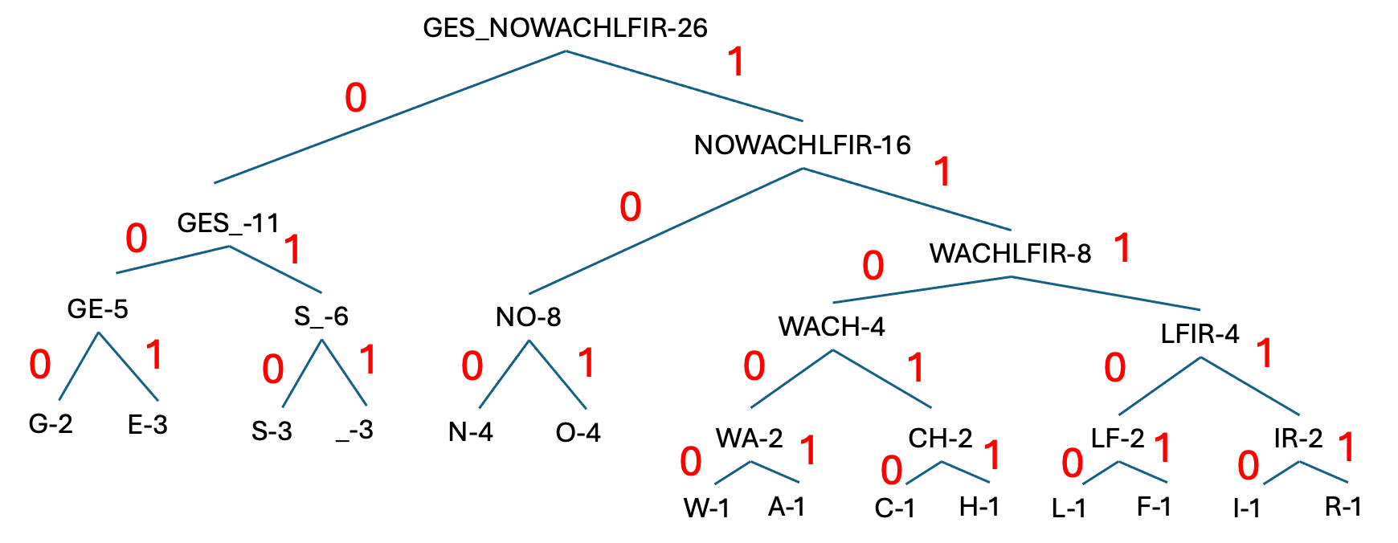
G: 000
E: 001
S: 010
_: 011
N: 100
O: 101
W: 11000
A: 11001
C: 11010
H: 11011
L: 11100
F : 11101
I : 11110
R : 11111

Slide 18
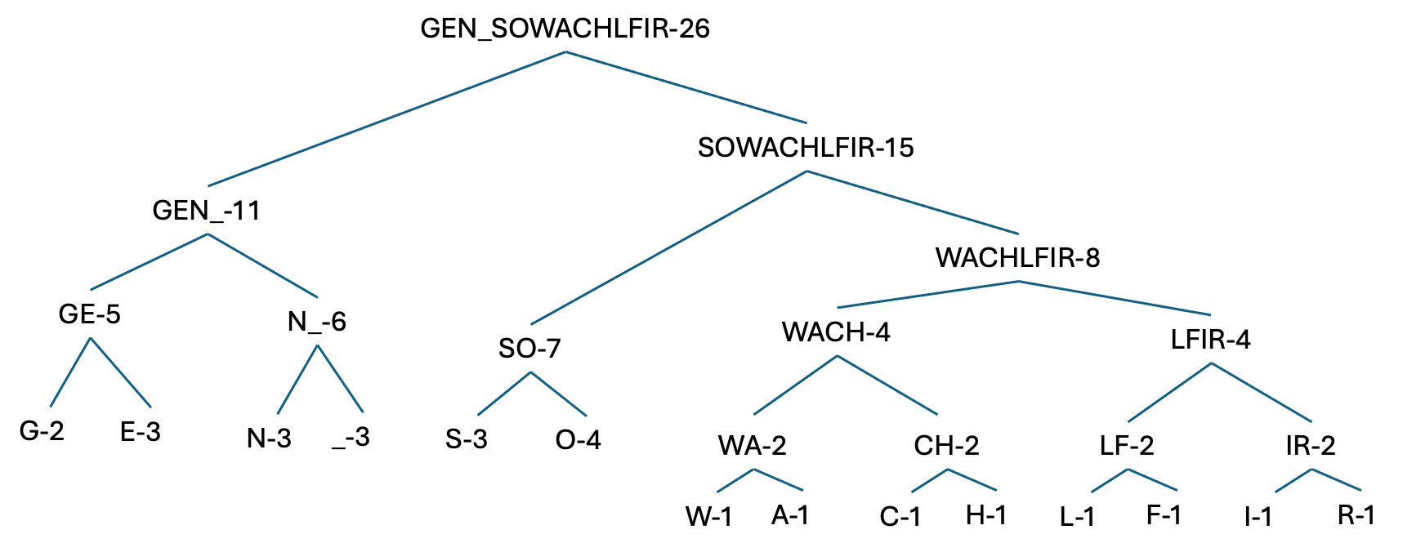
G: 000
E: 001
S: 010
_: 011
N: 100
O: 101
W: 11000
A: 11001
C: 11010
H: 11011
L: 11100
F : 11101
I : 11110
R : 11111
SWANSON_SCHOOL_OF_ENGINEERING
010 11000 11001 100 010 101 100 011 010 11010 11011 101 101 11100 011
101 11101011 001 100 11110 100 001 001 11111 11110 100 000
=102 bits
(ASCII) 29char x 8 bits/char =232 bits

Slide 19
G: 000
E: 001
S: 010
_: 011
N: 100
O: 101
W: 11000
A: 11001
C: 11010
H: 11011
L: 11100
F : 11101
I : 11110
R : 11111
010 11000 11001 100 010 101 100 011 010 11010 11011 101 101 11100 011
101 11101011 001 100 11110 100 001 001 11111 11110 100 000

Slide 20
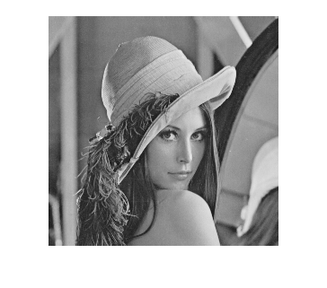

Slide 21
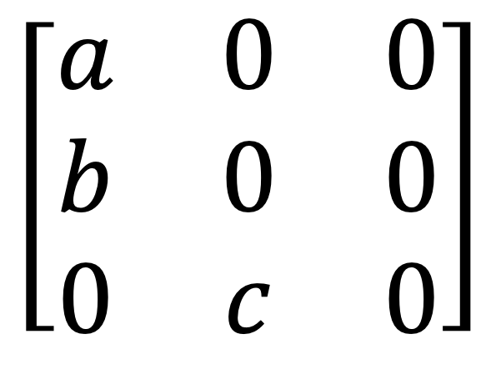
$$\left[\begin{matrix}a & 0 & 0 \\ b & 0 & 0 \\ 0 & c & 0\end{matrix}\right]$$

Slide 22
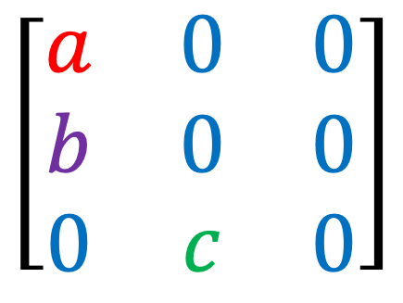
0: 6 → 0
a: 1 → 111
b: 1 → 110
c: 1 → 10
0cba
0
cba
c
ba
b
a
9 x 8bit = 72 bits
$$\left[\begin{matrix}a & 0 & 0 \\ b & 0 & 0 \\ 0 & c & 0\end{matrix}\right]$$
$$\left[\begin{matrix}a & 0 & 0 \\ b & 0 & 0 \\ 0 & c & 0\end{matrix}\right]$$
14 bits
As VLC
11100110000100

Slide 23
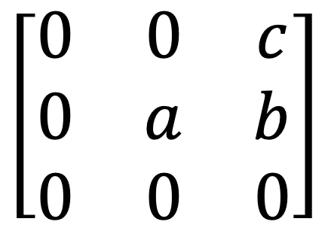
0: 6 → 0
a: 1 → 111
b: 1 → 110
c: 1 → 10
00100111110000
$$\left[\begin{matrix}0 & 0 & c \\ 0 & a & b \\ 0 & 0 & 0\end{matrix}\right]$$

Slide 24
0: 6 → 0
a: 1 → 111
b: 1 → 110
c: 1 → 10
00100111110000

