Slide 1
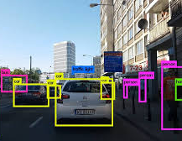
Lecture 21 CNNs, DNN, and OpenCV
ECE 1390/2390

Slide 2
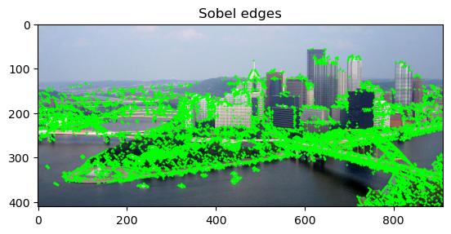
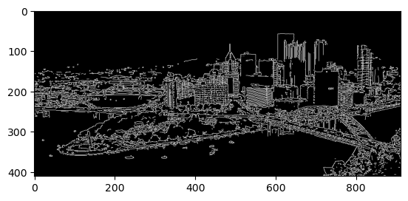
What is an image feature?
Edges

Slide 3
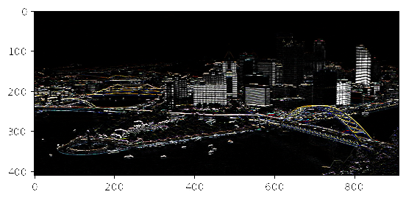
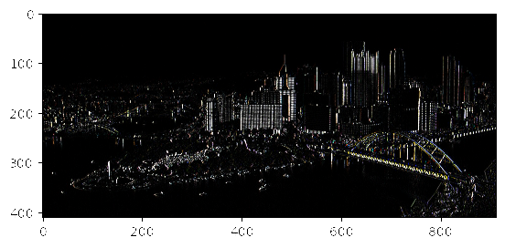
What is an image feature?
Harris Corners
$$Kernel=\left[\begin{matrix}−1 & 1\end{matrix}\right]$$
$$Kernel=\left[\begin{matrix}−1 \\ 1\end{matrix}\right]$$
$$M[a,b]=\sum_{\{i,j\}∈W[a,b]}{\left[\begin{matrix}I_{x,x}(i,j) & I_{x,y}(i,j) \\ I_{y,x}(i,j) & I_{y,y(i,j)}\end{matrix}\right]}$$
Structure matrix

Slide 4
Viola and Jones, "Rapid object detection using a boosted cascade of simple features", Computer Vision and Pattern Recognition, 2001
Haar-like feature extraction kernel (not actual Haar wavelets)
Series of convolution kernels to extract features
More features than pixels
E.g. 24 x 24 probe has 18,000 possible rectangle arrangements
`Uses only small subset of the possibilities
Horizontal Boundary
Vertical Boundary
Vertical Line
Crossing

Slide 5
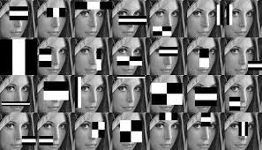
Feature Extraction:
Sum over rectangular windows
A
A
C
A
C
B
D
B
D
A+B – (C+D)
A+D – (B+C)
→ 28 features
Each feature is very
weakly predictive

Slide 6
Adaboost (Adaptive boosting)
$$F= \sum_{i}{fi(x)}$$
Weak binary (-1,1) classifiers
Boasted
classifier
Yoav Freund and Robert Schapire (1995), A desicion-theoretic generalization of on-line learning and an application to boosting, Lecture Notes in Computer Science, Berlin, Heidelberg: Springer Berlin Heidelberg, pp. 23–37

Slide 7
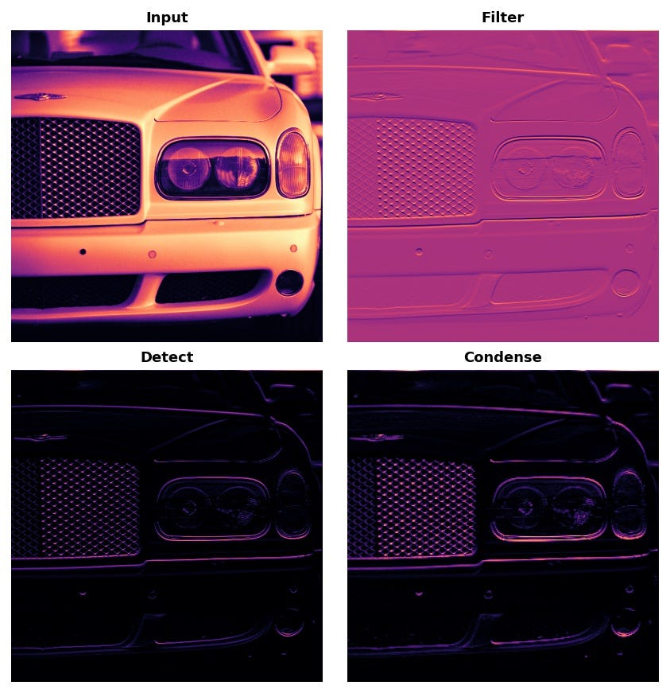
Convolutional Neural Networks
Convolution
Kernel size and count
CNN’s fit the convolution parameters as part of the model.
This gives more flexibility than simply an edge or Harr feature
Padding and Stride:
Padding can be added to the input to preserve spatial information and avoid the reduction in size during convolution.
Stride determines how much the filter moves during each step of the convolution operation.

Slide 8
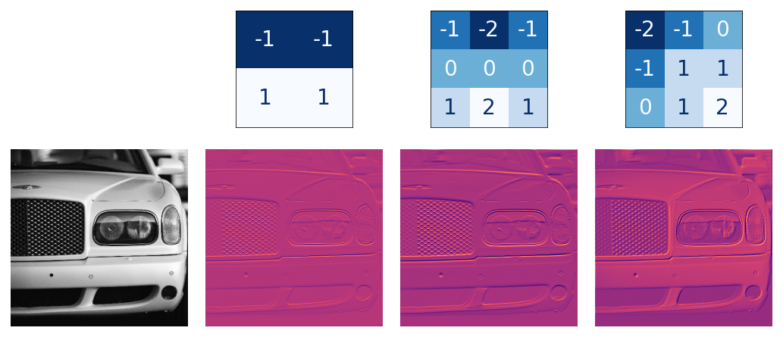
Convolutional Neural Networks

Slide 9
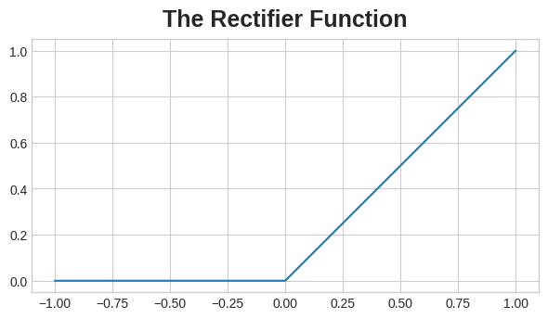
Convolutional Neural Networks
Detection
Detection/Activation layers
An activation function (commonly ReLU — Rectified Linear Unit) is applied element-wise to introduce non-linearity to the network.
The activation function helps the network learn complex, non-linear relationships in the data.

Slide 10
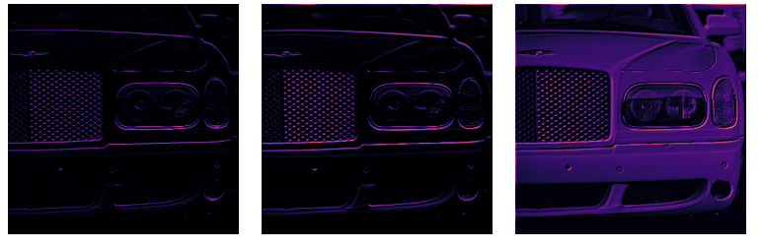
Convolutional Neural Networks

Slide 11
Convolutional Neural Networks
Pooling
Pooling Layers:
After convolution, pooling layers are often applied to reduce the spatial dimensions of the feature maps, decreasing the computational load and increasing the receptive field.
Max pooling and average pooling are common pooling operations.

Slide 12
Edges

Slide 13
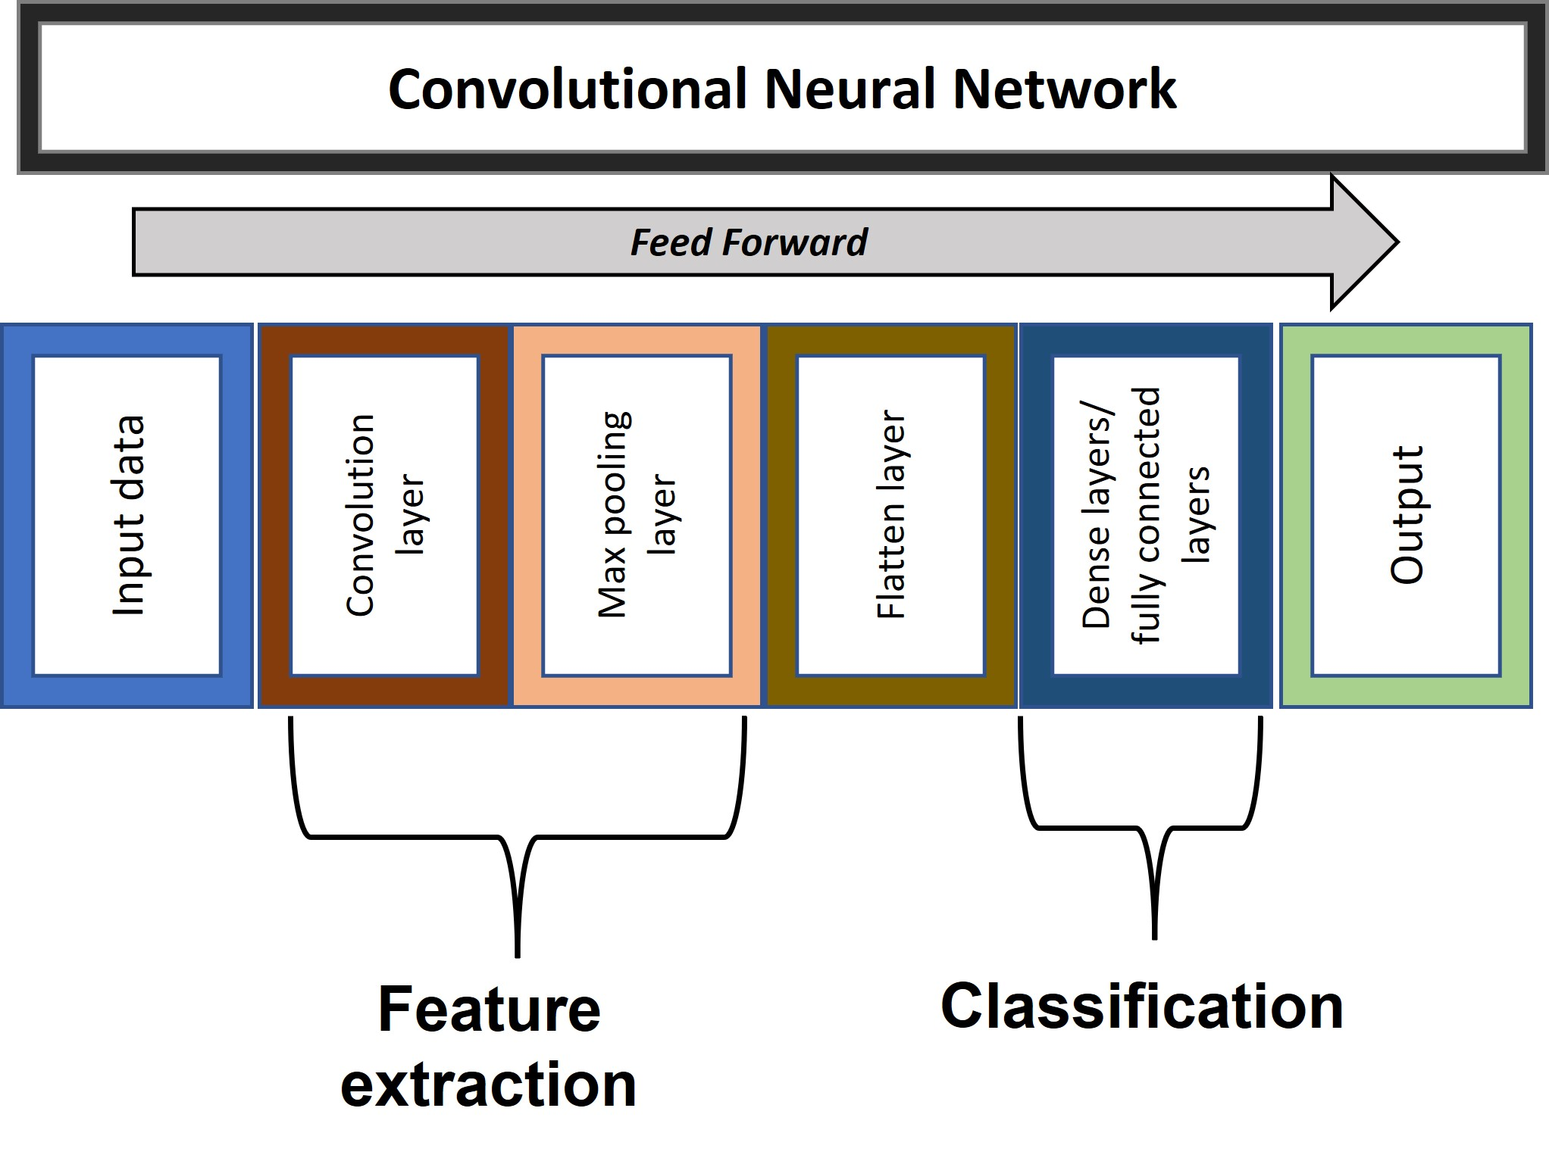

Slide 14
Model training
Training images
Training Labels
Back-projection
Some variation of steepest-decent
Active area of development
CNN designs to make back-projection more stable (e.g. ResNet)

Slide 15
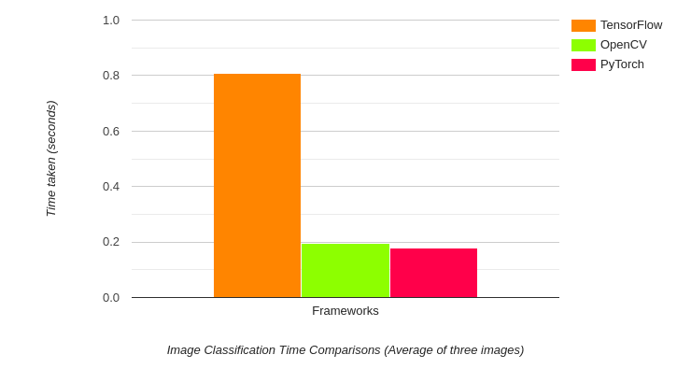
OpenCV 3 introduced the DNN (deep neural network) module as an interface to other machine learning models
TensorFlow
ONNX
Caffe
PyTorch
DarkNet
OpenCV
Benefits:
OpenCV
Abstracts TensorFlow/PyTorch/etc backend
Access to NVIDIA or Intel GPU models
Better implementation on mobile or RaspPi frameworks
(Claimed) Comparable or better forward model performance over native packages (especially for CPU based computations)

Slide 16
CNN Model Zoos
https://modelzoo.co/
https://github.com/opencv/opencv_zoo
Limitations:
OpenCV does NOT do model training or CNN construction
Limited to image-based inputs
Growing number of supported layer types (and can add custom ones)

Slide 17
Using cv2.dnn
cv2.dnn.readNet( .)
Generic CNN loading function. Works with many ML model structures
Inputs:
model: This is the path to the pre-trained weights file.
config: This is the path to the model configuration file,
framework: provide the framework name that we are loading the models. E.g. “Caffe”

Slide 18
Using cv2.dnn
readNetFromCaffe(): This is used to load pre-trained Caffe models and accepts two arguments. They are the path to the prototxt file and the path to the Caffe model file.
readNetFromTensorflow(): We can use this function to directly load the TensorFlow pre-trained models. This also accepts two arguments. One is the path to the frozen model graph and the other is the path to the model architecture protobuf text file.
readNetFromTorch(): We can use this to load Torch and PyTorch models which have been saved using the torch.save() function. We need to provide the model path as the argument.
readNetFromDarknet(): This is used to load the models trained using the DarkNet framework. We need to provide two arguments here as well. One of the path to the model weights and the other is the path to the model configuration file.
readNetFromONNX(): We can use this to load ONNX models and we only need to provide the path to the ONNX model file.

Slide 19
Preprocessing
Extend this dimension for multiple images
→ Image 4D array of size <1 x 3 x n x m>
Cv2.dnn.blobFromImage(s)( . )
Inputs:
image: This is the input image.
scalefactor: This value scales the image by the provided value. It has a default value of 1 which means that no scaling is performed. E.g. many CNN models expect data in the range of 0-1, so this might be 1/255 to rescale uint8’s
size: This is the size that the image will be resized to. This is set by the model being used.
mean: These are actually the mean values that are subtracted from the image’s RGB color channels. This normalizes the input and makes the final input invariant to different illumination scales. This is dictated by the model being used.
swapBR. Flag to swap BGR and RGB channels (used instead of cv2.cvtColor command)

Slide 20
Example: DenseNet121
ImageNet classified
1000 classes
1) Cloned from https://github.com/BVLC/caffe/wiki/Model-Zoo
Accept license from http://caffe.berkeleyvision.org/model_zoo.html#bvlc-model-license
DenseNet_121.caffemodel
DenseNet_121.protext
Imagenet_classes.txt
(Placed these in the LectureNotebooks/Lecture21 folder)

Slide 21
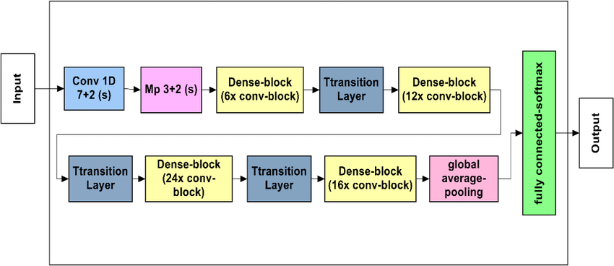
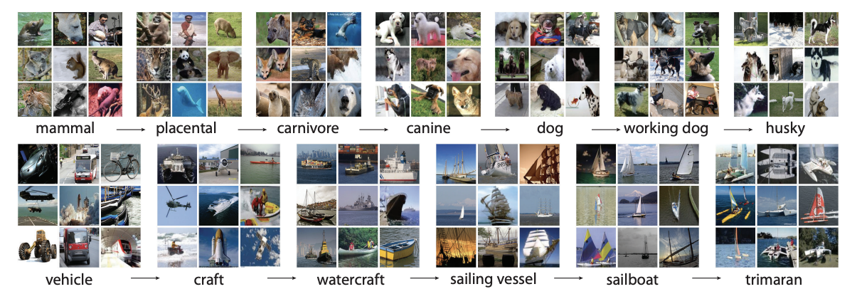
ImageNet
https://www.image-net.org/
1000 labels
1.2million training images
100,000 testing images

Slide 22
Download a sample image
# Download an example image from the pytorch website
import urllib
url, filename = ("https://github.com/pytorch/hub/raw/master/images/dog.jpg", "dog.jpg")
try: urllib.URLopener().retrieve(url, filename)
except: urllib.request.urlretrieve(url, filename)

Slide 23
Load Model
weights = os.path.relpath('./DenseNet_121.caffemodel’)
arch = os.path.relpath('./DenseNet_121.prototxt’)
net = cv2.dnn.readNetFromCaffe(arch,weights)
Preprocessing
blob = cv2.dnn.blobFromImage(img,1/255,(224,224),(103.94,116.78,123.68))
These numbers come from reading the ReadMe from DenseNet121 and are the image size and range that it expects for inputs

Slide 24
Set data for classifer model
net.setInput(blob)
Optional
net.setPreferableBackend(cv2.dnn.DNN_BACKEND_CUDA) net.setPreferableTarget(cv2.dnn.DNN_TARGET_CUDA)
The actual run command
outputs = model.forward()
Classifiers: The outputs will depend on the model being used. For classifier models (like DenseNet), this will be a vector of the classification scores for the 1000 possible classes

Slide 25
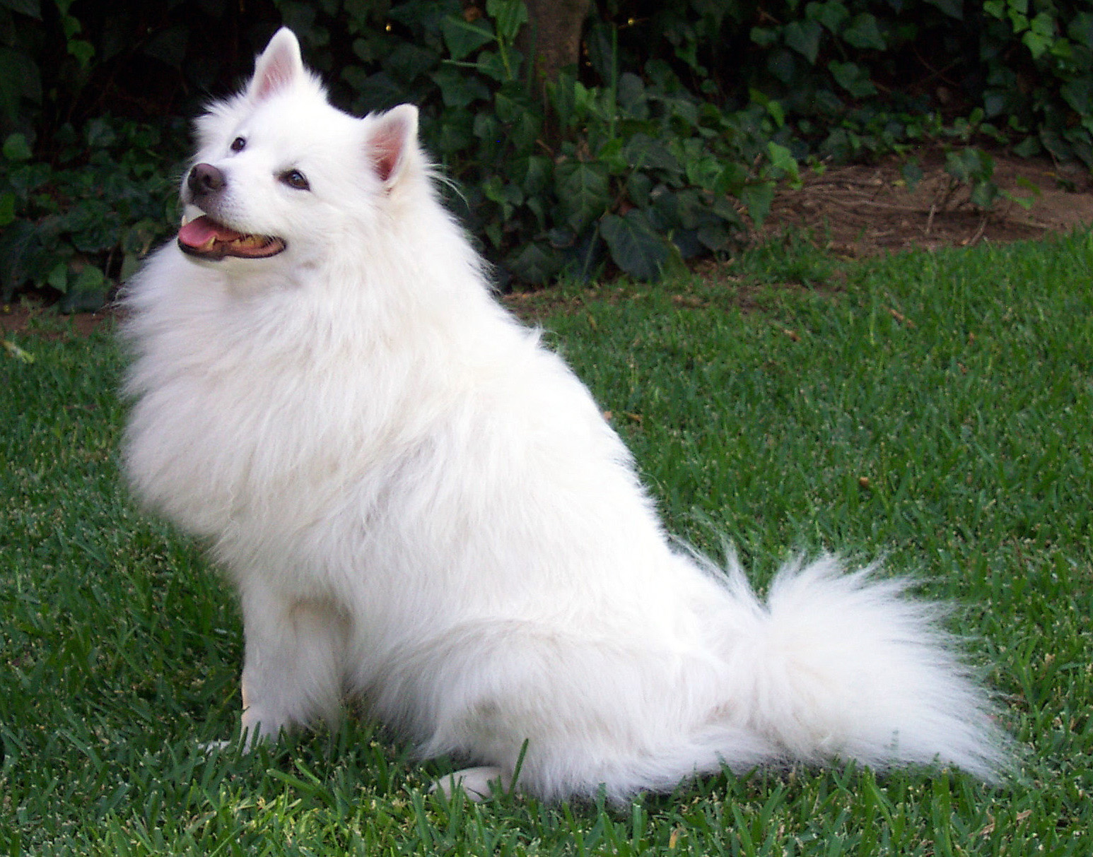

Softmax
Prob_{i} =$\frac{e^{\left({class_value}_{i}−max⁡(class_value\right))}}{\sum{e^{\left({class_value}_{i}−max⁡(class_value\right))}}}$
Predicted Samoyed
with probability 87.3%

Slide 26
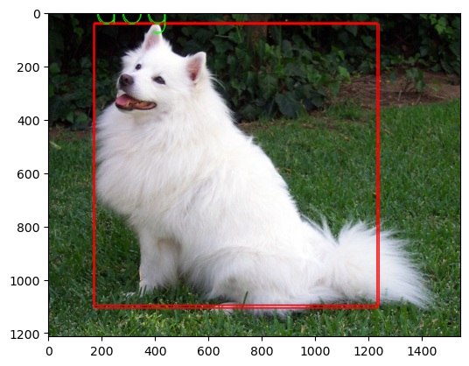
Detection model
Load Model
weights = os.path.relpath('./yolov4.weights')
arch = os.path.relpath('./yolov4.cfg')
net = cv2.dnn.readNet(weights,arch)
model = cv2.dnn.DetectionModel(net)
model.setInputParams(size=(416, 416), scale=1/255, swapRB=False)
class_label, class_probability, bounding location = model.detect(img)
array([16, 16], dtype=int32),
array([0.84245753, 0.81188846], dtype=float32)
array([[ 170, 44, 1238, 1096], [ 173, 39, 1231, 1107]], dtype=int32))

