Slide 1
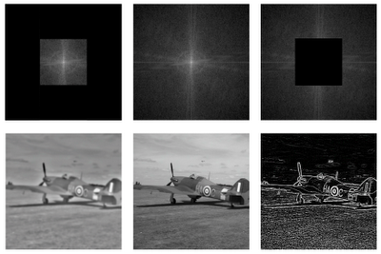
Lecture 4 Image Transforms
ECE 1390/2390
Learning Objectives:
DFT for images
DCT
Haramord-Walsh transform
Haar transform

Slide 2
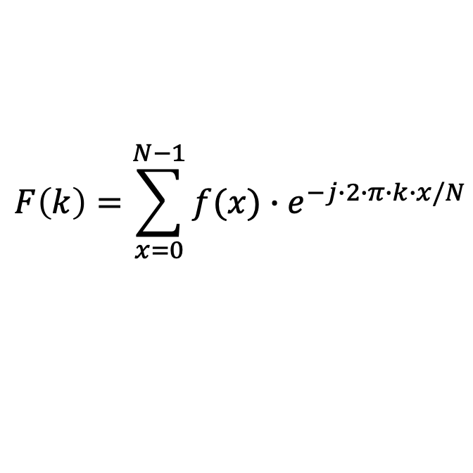
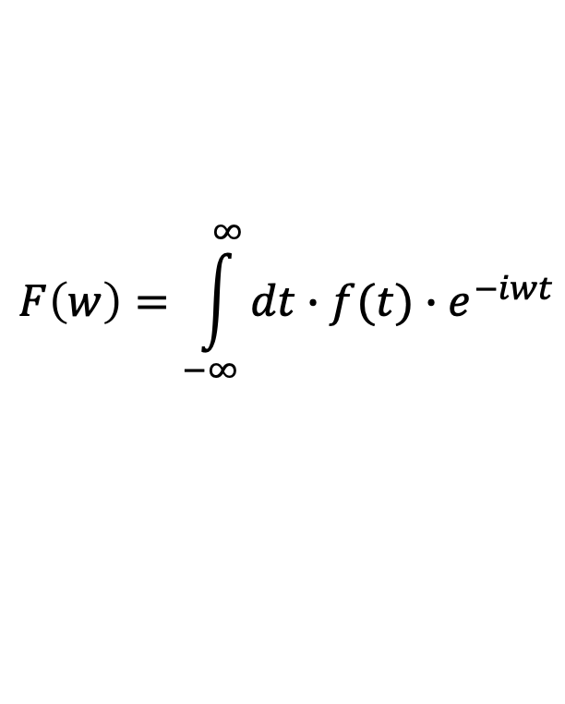
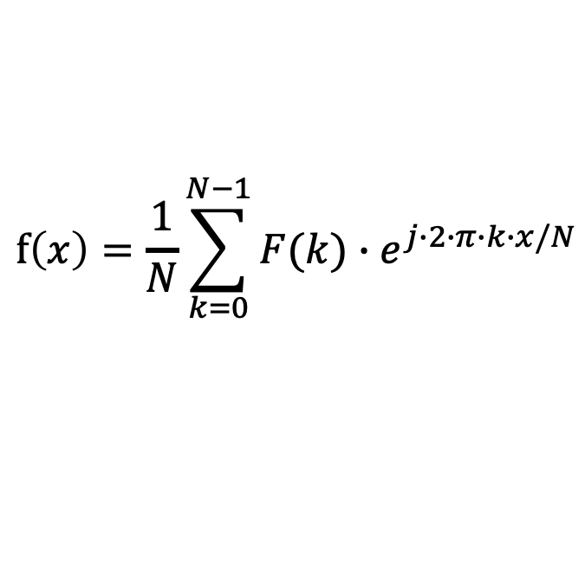
Discrete Fourier Transform (DFT)
$$F\left(w\right)=\int_{−∞}^{∞}{dt∙f(t)∙e^{−iwt}}$$
$$F\left(k\right)=\sum_{x=0}^{N−1}{f(x)∙e^{−j∙2∙π∙k∙x/N}}$$
$$f\left(x\right)=\frac{1}{N}\sum_{k=0}^{N−1}{F(k)∙e^{j∙2∙π∙k∙x/N}}$$

Slide 3





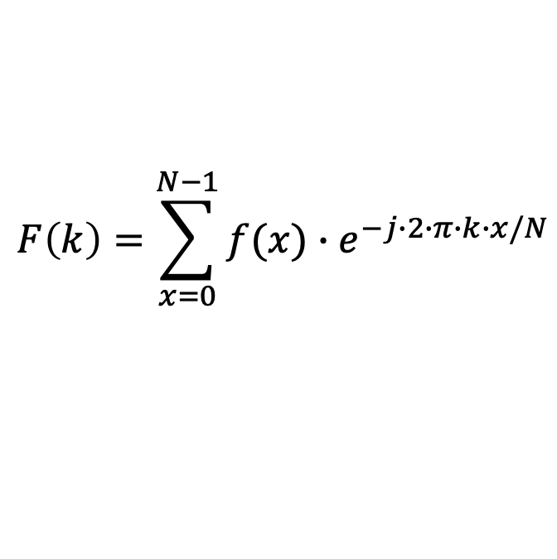


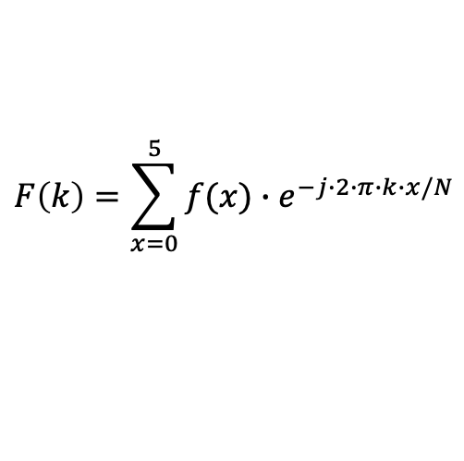

DFT
$$f\left(x\right)=[1 2 3 2 1 0]$$
$$N=6$$
$$F\left(k\right)=\sum_{x=0}^{5}{f(x)∙e^{−j∙2∙π∙k∙x/N}}$$
$$F\left(k\right)=\sum_{x=0}^{N−1}{f(x)∙e^{−j∙2∙π∙k∙x/N}}$$
$F\left(k\right)=$ ${1∙e}^{−j∙2∙π∙k∙\frac{0}{6}}$
$+$ ${2∙e}^{−j∙2∙π∙k∙\frac{1}{6}}$
$+$ ${3∙e}^{−j∙2∙π∙k∙\frac{2}{6}}$
$+$ ${2∙e}^{−j∙2∙π∙k∙\frac{3}{6}}$
$+$ ${1∙e}^{−j∙2∙π∙k∙\frac{4}{6}}$
$+$ ${0∙e}^{−j∙2∙π∙k∙\frac{5}{6}}$
K=0 = 9
K=1 = -2.11 – 1.53*j
K=2 = 0.12 + 0.36*j
K=3 = 0.12 - 0.36*j
K=4 = -2.11 + 1.53*j
K=4 = 9

Slide 4
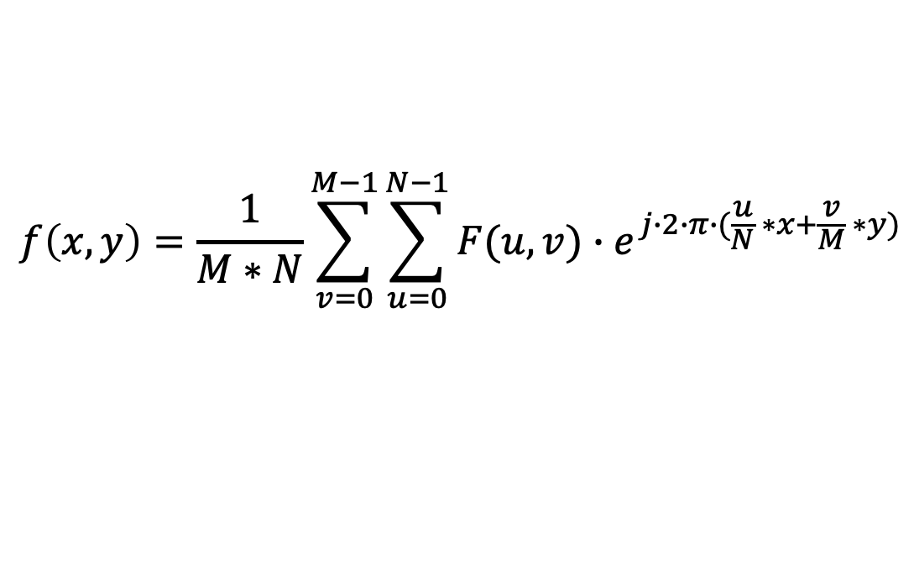
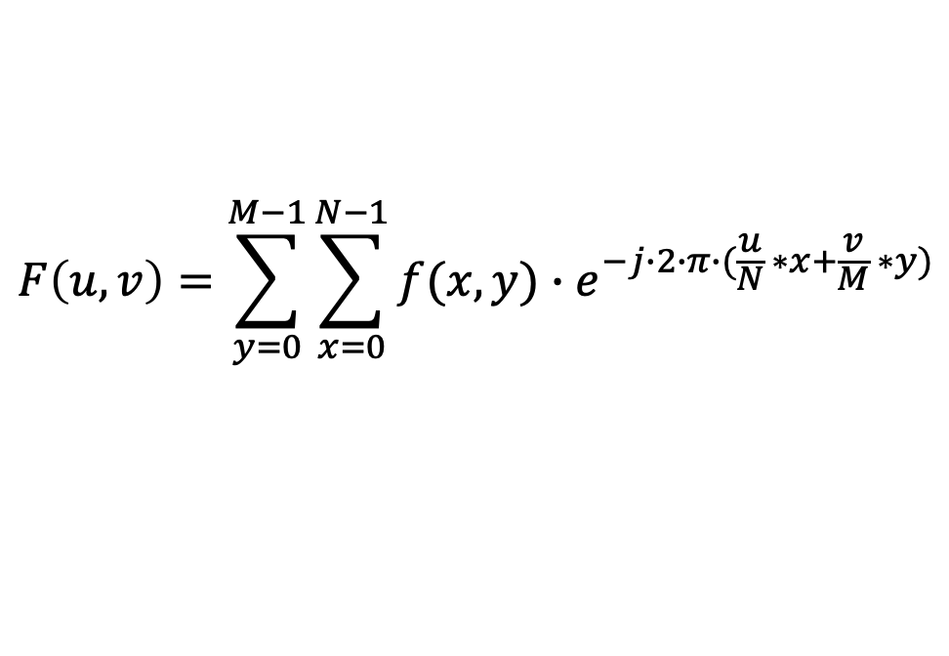
DFT-2D
$$F\left(u,v\right)=\sum_{y=0}^{M−1}{\sum_{x=0}^{N−1}{f(x,y)∙e^{−j∙2∙π∙(\frac{u}{N} ∗x+\frac{v}{M} ∗y)}}}$$
$$f\left(x,y\right)=\frac{1}{M∗N}\sum_{v=0}^{M−1}{\sum_{u=0}^{N−1}{F(u,v)∙e^{j∙2∙π∙(\frac{u}{N} ∗x+\frac{v}{M} ∗y)}}}$$

Slide 5
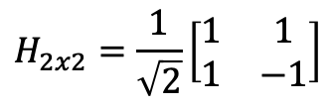
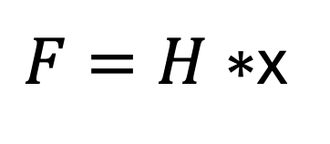
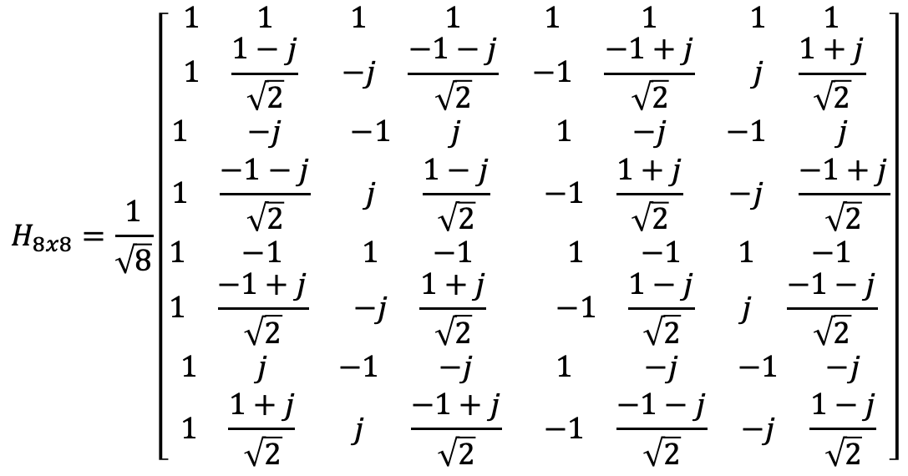
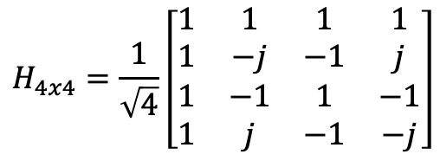
DFT Matrix form
$$H_{2x2}=\frac{1}{\sqrt{2}}\left[\begin{matrix}1 & 1 \\ 1 & −1\end{matrix}\right]$$
$$H_{4x4}=\frac{1}{\sqrt{4}}\left[\begin{matrix}1 & 1 & 1 & 1 \\ 1 & −j & −1 & j \\ 1 & −1 & 1 & −1 \\ 1 & j & −1 & −j\end{matrix}\right]$$
$F=H∗$x
$$H_{8x8}=\frac{1}{\sqrt{8}}\left[\begin{matrix}\begin{matrix}\begin{matrix}1 & 1 \\ 1 & \frac{1−j}{\sqrt{2}}\end{matrix} & \begin{matrix}1 & 1 \\ −j & \frac{−1−j}{\sqrt{2}}\end{matrix} \\ \begin{matrix}1 & −j \\ 1 & \frac{−1−j}{\sqrt{2}}\end{matrix} & \begin{matrix}−1 & j \\ j & \frac{1−j}{\sqrt{2}}\end{matrix}\end{matrix} & \begin{matrix}\begin{matrix}1 & 1 \\ −1 & \frac{−1+j}{\sqrt{2}}\end{matrix} & \begin{matrix}1 & 1 \\ j & \frac{1+j}{\sqrt{2}}\end{matrix} \\ \begin{matrix}1 & −j \\ −1 & \frac{1+j}{\sqrt{2}}\end{matrix} & \begin{matrix}−1 & j \\ −j & \frac{−1+j}{\sqrt{2}}\end{matrix}\end{matrix} \\ \begin{matrix}\begin{matrix}1 & −1 \\ 1 & \frac{−1+j}{\sqrt{2}}\end{matrix} & \begin{matrix}1 & −1 \\ −j & \frac{1+j}{\sqrt{2}}\end{matrix} \\ \begin{matrix}1 & j \\ 1 & \frac{1+j}{\sqrt{2}}\end{matrix} & \begin{matrix}−1 & −j \\ j & \frac{−1+j}{\sqrt{2}}\end{matrix}\end{matrix} & \begin{matrix}\begin{matrix}1 & −1 \\ −1 & \frac{1−j}{\sqrt{2}}\end{matrix} & \begin{matrix}1 & −1 \\ j & \frac{−1−j}{\sqrt{2}}\end{matrix} \\ \begin{matrix}1 & −j \\ −1 & \frac{−1−j}{\sqrt{2}}\end{matrix} & \begin{matrix}−1 & −j \\ −j & \frac{1−j}{\sqrt{2}}\end{matrix}\end{matrix}\end{matrix}\right]$$

Slide 6
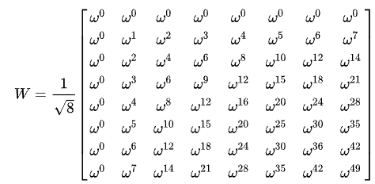
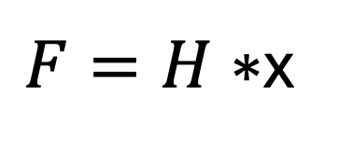

DFT Matrix form
$F=H∗$x
$$w=e^{−2πj/8}$$

Slide 7
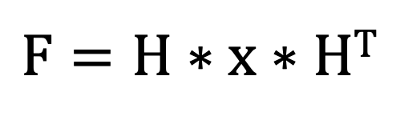
DFT-2D Matrix form
$F=H∗$ x $∗$H^{T}

Slide 8
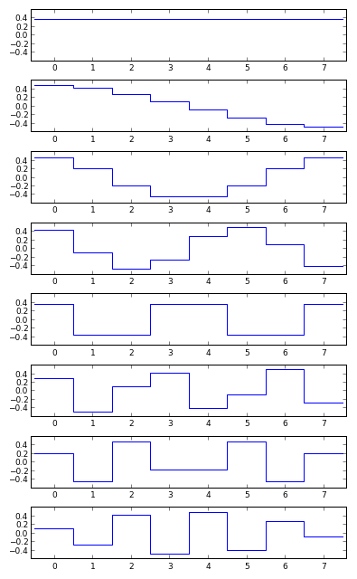

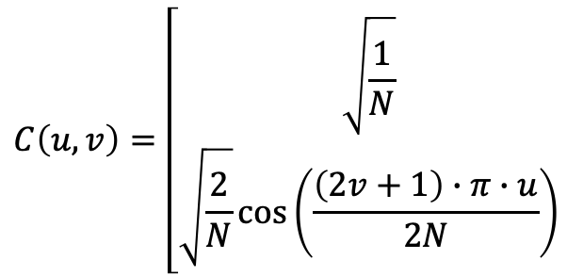

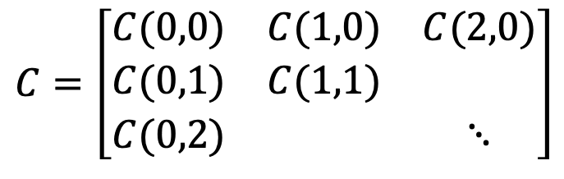



Discrete Cosine Transform (DCT)
Coefficients will only be real-valued (c.f. DFT)
$F=C∗$ x
$$C=\left[\begin{matrix}C(0,0) & C(1,0) & C(2,0) \\ C(0,1) & C(1,1) & \\ C(0,2) & & ⋱\end{matrix}\right]$$
$$u=0$$
$$C\left(u,v\right)=\left[\begin{matrix}\sqrt{\frac{1}{N}} \\ \sqrt{\frac{2}{N}}\cos\left(\frac{\left(2v+1\right)∙π∙u}{2N}\right)\end{matrix}\right.$$
$$0≤v≤N−1$$
$$0≤u≤N−1$$
$$0≤v≤N−1$$

Slide 9
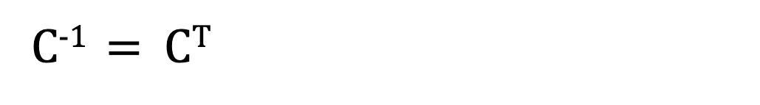
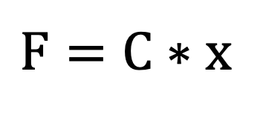
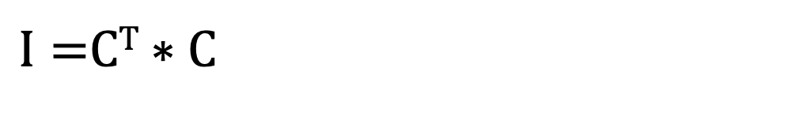
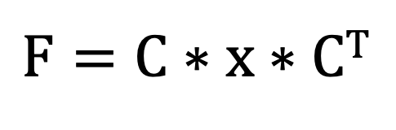
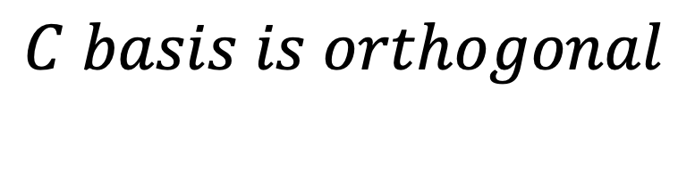
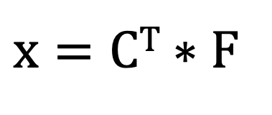
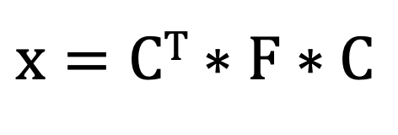
DCT DCT⁻¹
$$C basis is orthogonal$$
$I=$C^{T} $∗C$
C⁻¹ $=$ C^{T}
1D transform
$F=C∗$ x
$x=\text{C}\text{T}∗$ F
2D transform
$F=C∗$ x $∗$C^{T}
$x=\text{C}\text{T}∗$ F $∗C$

Slide 10
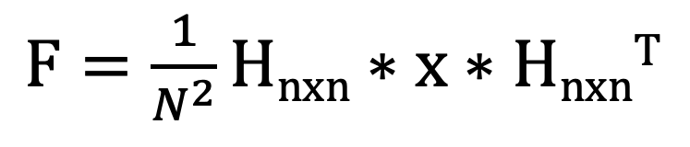
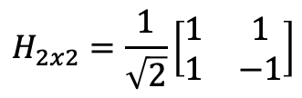
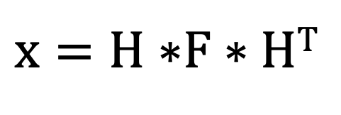

Hadamard Transform
$$H_{2x2}=\frac{1}{\sqrt{2}}\left[\begin{matrix}1 & 1 \\ 1 & −1\end{matrix}\right]$$
$F=\frac{1}{N^{2}}Hnxn∗$ x $∗$H$nxn$^{T}
The 2x2 is identical to the DFT 2x2
$$H_{2x2}=\left[\begin{matrix}1 & 1 \\ 1 & −1\end{matrix}\right]$$
$x=H∗$F $∗$H^{T}

Slide 11
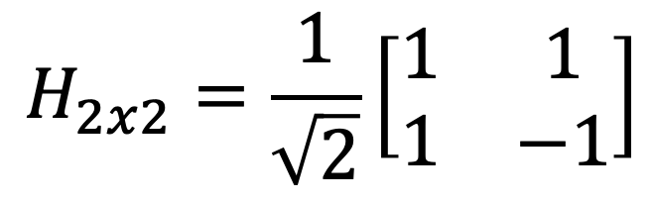
Integrator: Low-pass filter
$$H_{2x2}=\frac{1}{\sqrt{2}}\left[\begin{matrix}1 & 1 \\ 1 & −1\end{matrix}\right]$$
Differentiator: High-pass filter

Slide 12

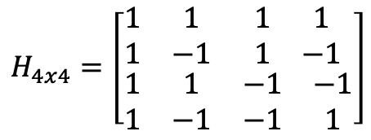



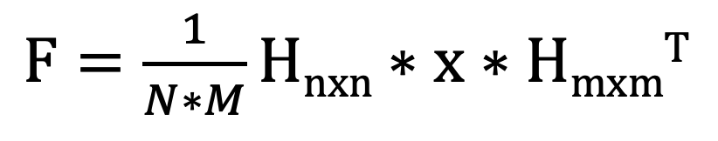
Hadamard Transform
$F=\frac{1}{N^{2}}Hnxn∗$ x $∗$H$nxn$^{T}
$$H_{2x2}=\left[\begin{matrix}1 & 1 \\ 1 & −1\end{matrix}\right]$$
Size of image must be powers of 2
$$H_{4x4}=\left[\begin{matrix}\begin{matrix}1 & 1 \\ 1 & −1\end{matrix} & \begin{matrix}1 & 1 \\ 1 & −1\end{matrix} \\ \begin{matrix}1 & 1 \\ 1 & −1\end{matrix} & \begin{matrix}−1 & −1 \\ −1 & 1\end{matrix}\end{matrix}\right]$$
$H_{4x4}=$($H_{2x2}⨂H_{2x2}$)
$H_{8x8}=$($H_{2x2}⨂H_{4x4}$)
$$H_{8x8}=\left[\begin{matrix}H_{4x4} & H_{4x4} \\ H_{4x4} & −H_{4x4}\end{matrix}\right]$$
$F=\frac{1}{N∗M}Hnxn∗$ x $∗$H$mxm$^{T}

Slide 13
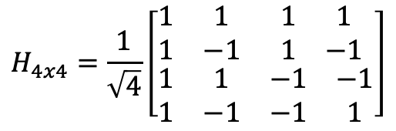
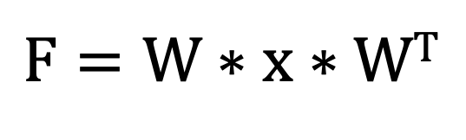
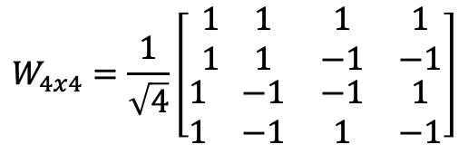
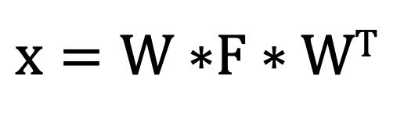
Welch Transform
Number of sign changes
Hadamard Matrix
$$H_{4x4}=\frac{1}{\sqrt{4}}\left[\begin{matrix}\begin{matrix}1 & 1 \\ 1 & −1\end{matrix} & \begin{matrix}1 & 1 \\ 1 & −1\end{matrix} \\ \begin{matrix}1 & 1 \\ 1 & −1\end{matrix} & \begin{matrix}−1 & −1 \\ −1 & 1\end{matrix}\end{matrix}\right]$$
0
3
1
2
$F=W∗$ x $∗$W^{T}
Welch Matrix
$$W_{4x4}=\frac{1}{\sqrt{4}}\left[\begin{matrix}\begin{matrix}1 & 1 \\ 1 & 1\end{matrix} & \begin{matrix}1 & 1 \\ −1 & −1\end{matrix} \\ \begin{matrix}1 & −1 \\ 1 & −1\end{matrix} & \begin{matrix}−1 & 1 \\ 1 & −1\end{matrix}\end{matrix}\right]$$
$x=W∗$F $∗$W^{T}

Slide 14
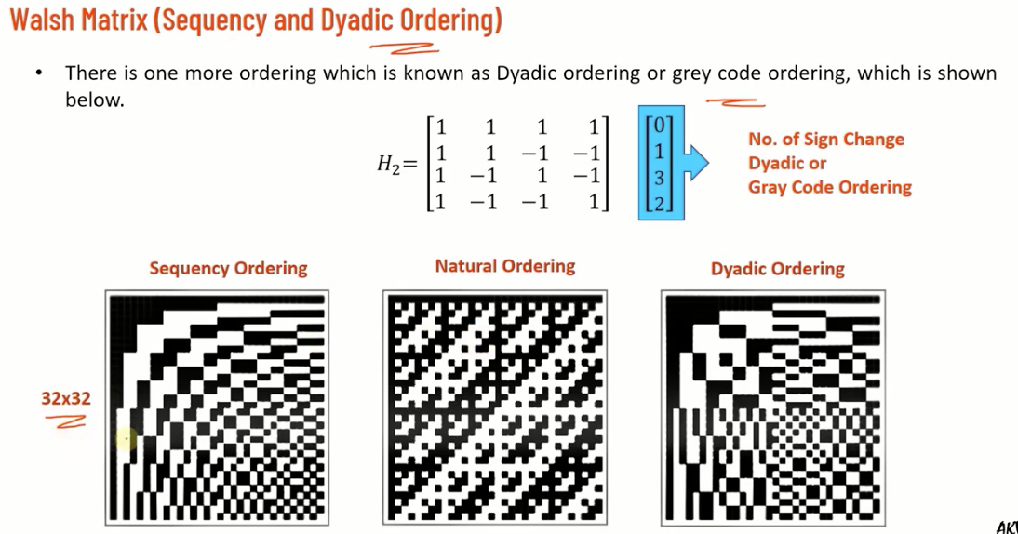
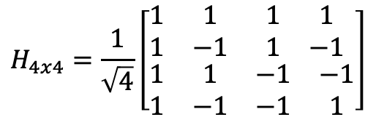
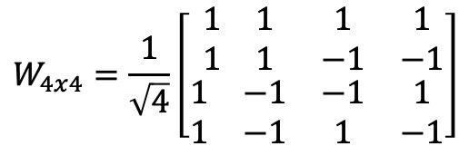
Hadamard
$$H_{4x4}=\frac{1}{\sqrt{4}}\left[\begin{matrix}\begin{matrix}1 & 1 \\ 1 & −1\end{matrix} & \begin{matrix}1 & 1 \\ 1 & −1\end{matrix} \\ \begin{matrix}1 & 1 \\ 1 & −1\end{matrix} & \begin{matrix}−1 & −1 \\ −1 & 1\end{matrix}\end{matrix}\right]$$
32x32
Welch
$$W_{4x4}=\frac{1}{\sqrt{4}}\left[\begin{matrix}\begin{matrix}1 & 1 \\ 1 & 1\end{matrix} & \begin{matrix}1 & 1 \\ −1 & −1\end{matrix} \\ \begin{matrix}1 & −1 \\ 1 & −1\end{matrix} & \begin{matrix}−1 & 1 \\ 1 & −1\end{matrix}\end{matrix}\right]$$
32x32

Slide 15
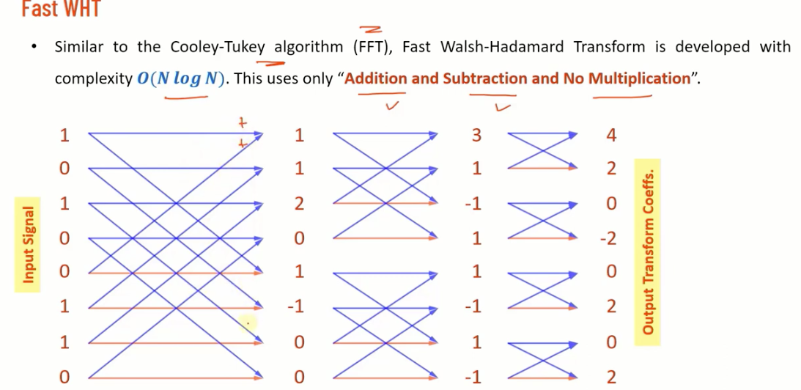
Fast Welch Transform
Akin to FFT, FWT is done using only shift and addition/subtraction operations allowing it to be done quickly
BLUE IS PLUS
RED IS MINUS

Slide 16
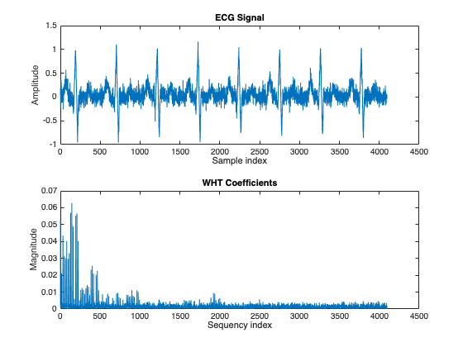
MATLAB/Examples/R2023a/signal/WalshHadamardExample
x1 = ecg(512); % Single ecg wave
x = repmat(x1,1,8);
x = x + 0.1.*randn(1,length(x)); % Noisy ecg signal
y = fwht(x); % Fast Walsh-Hadamard transform
subplot(2,1,1)
plot(x)
xlabel('Sample index')
ylabel('Amplitude')
title('ECG Signal')
subplot(2,1,2)
plot(abs(y))
xlabel('Sequency index')
ylabel('Magnitude')
title('WHT Coefficients')

Slide 17
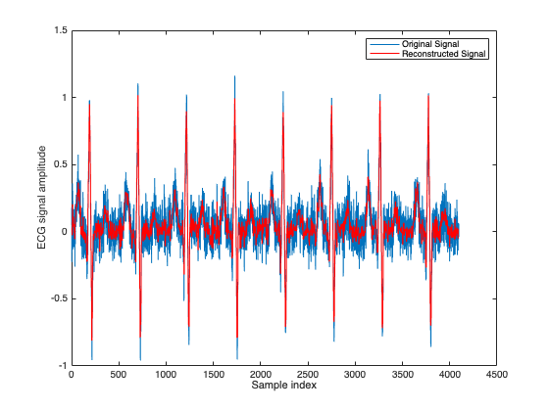
MATLAB/Examples/R2023a/signal/WalshHadamardExample
y(1025:length(x)) = 0; % Zeroing out the higher coefficients
xHat = ifwht(y); % Signal reconstruction using inverse WHT
figure
plot(x)
hold on
plot(xHat,'r')
xlabel('Sample index')
ylabel('ECG signal amplitude')
legend('Original Signal’,…
'Reconstructed Signal')

Slide 18
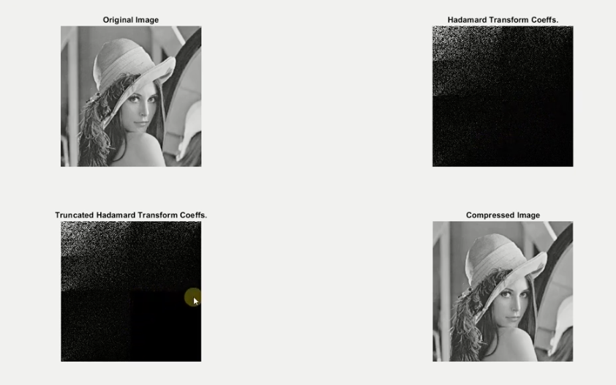
img = imread(‘Lena.jpg’)
whcoef = fwht( fwht(img)’)’;
whcoef(end/2+1:end, end/2+1:end) = 0
img_recovered = ifwht( ifwht(whcoef)’)’;

Slide 19

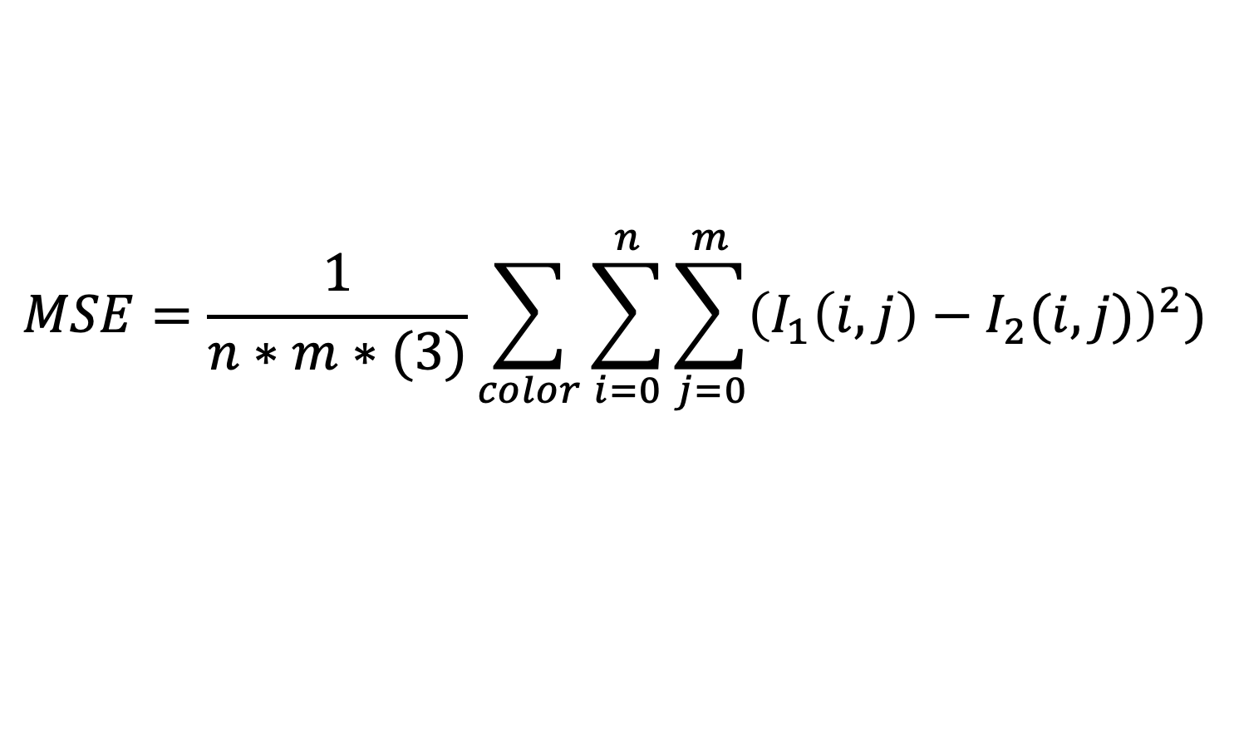
Peak signal-to-noise ratio (PSNR)
Original image
New image
$$MSE=\frac{1}{n∗m∗(3)}\sum_{color}{\sum_{i=0}^{n}{\sum_{j=0}^{m}{{\left(I_{1}\left(i,j\right)−I_{2}(i,j)\right)}^{2}}}})$$
$$PSNR=20∗\log_{10}\left(\frac{Max(I_{1})}{\sqrt{MSE}}\right)$$

Slide 20
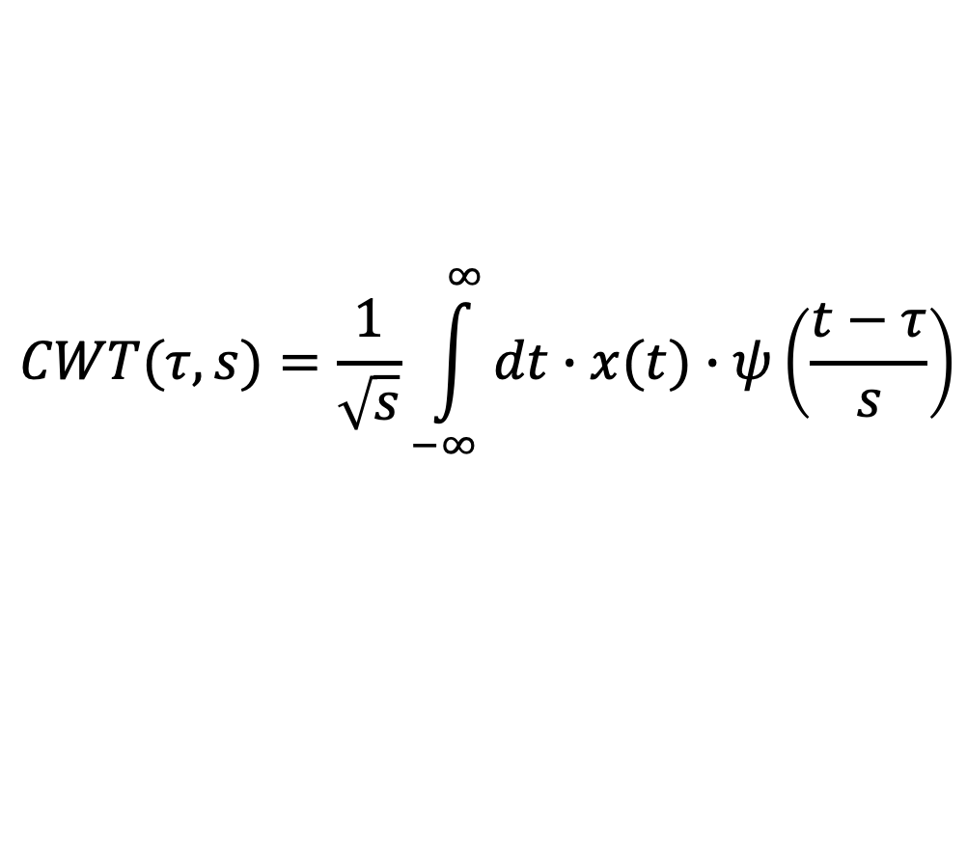
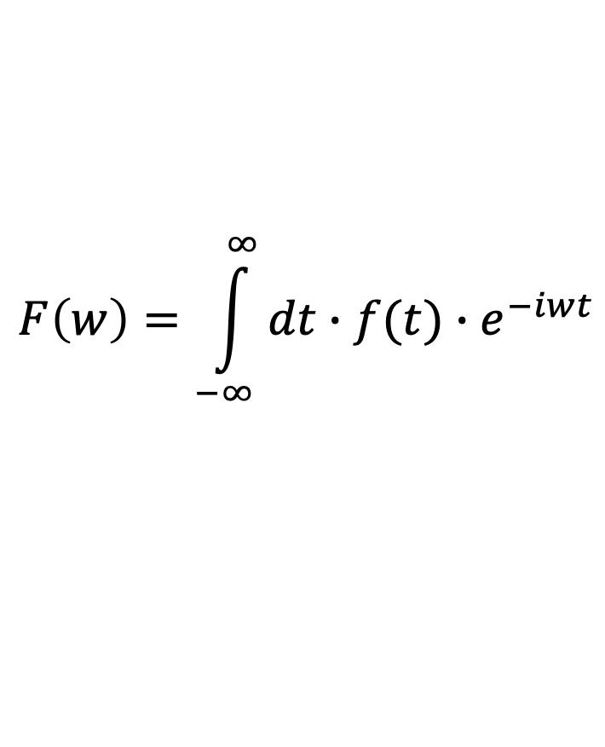
Wavelet Transform
$$F\left(w\right)=\int_{−∞}^{∞}{dt∙f(t)∙e^{−iwt}}$$
$$CWT(τ,s)=\frac{1}{\sqrt{s}}\int_{−∞}^{∞}{dt∙x(t)∙ψ\left(\frac{t−τ}{s}\right)}$$
Tau- time/shift
Scale – frequency
Large S = stretched wavelet (slow changes)
Small S = compressed (fine details)

Slide 21
Wavelet Transform
Low-pass filter
M2↓
Low-pass filter
M2↓
Low-pass filter
M2↓
High-pass filter
Low-pass filter
M2↓
M2↓
X
High-pass filter
M2↓
High-pass filter
M2↓
High-pass filter
M2↓

Slide 22
Decimator
Take every Mth sample
M↓
Interpolater
Expand by M samples
M↑

Slide 23
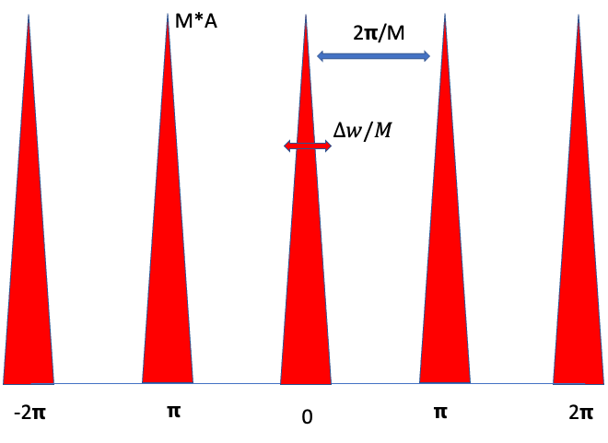
LPF with cutoff at 𝝿/M
LPF with cutoff at 𝝿/M
LPF
M↓
𝝿/M
0
M↑
LPF

Slide 24
Low –Low-Low
Low-pass filter
M2↓
Low-pass filter
M2↓
Low-pass filter
M2↓
Low –Low-High
X
High-pass filter
M2↓
High-pass filter
Low -High
M2↓
High-pass filter
High
M2↓

Slide 25
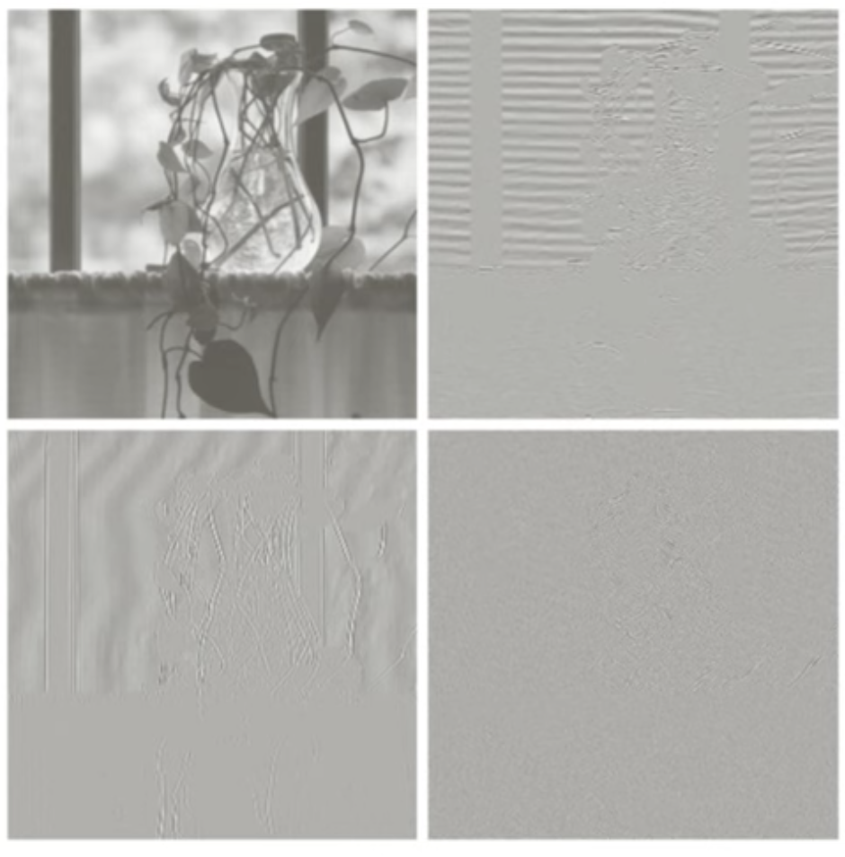
Horizontal
Vertical
Low-Low
High-Low
Low-pass filter
M2↓
Low-pass filter
M2↓
High-pass filter
M2↓
X
Low-pass filter
M2↓
High-pass filter
M2↓
High-pass filter
High-High
M2↓
Low-High

Slide 26
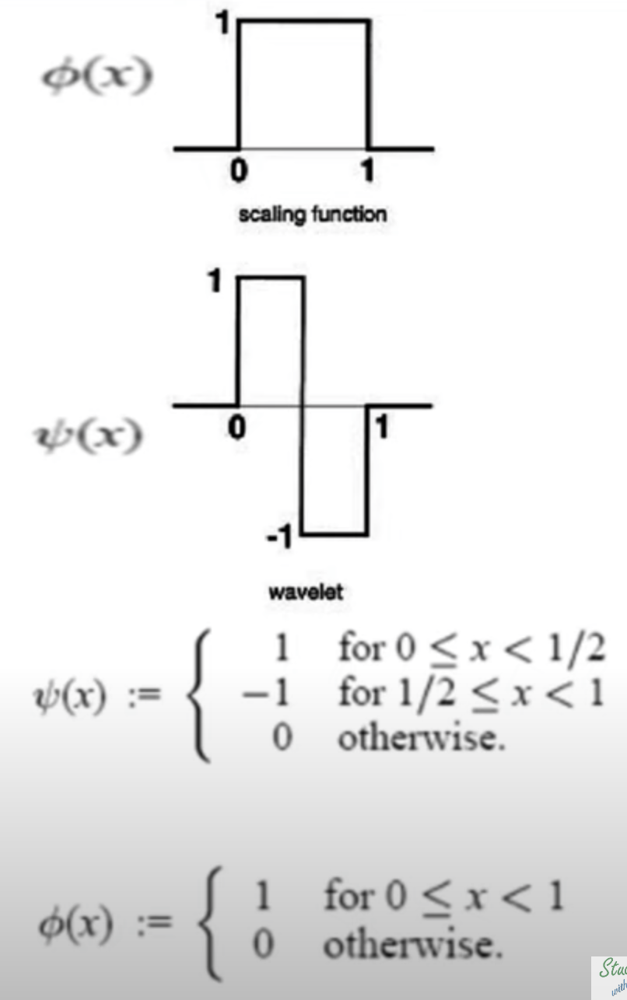
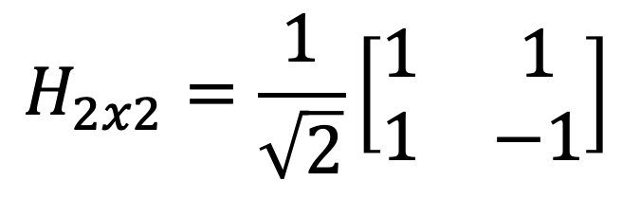


Haar wavelet
Integrator: Low-pass filter
$$H_{2x2}=\frac{1}{\sqrt{2}}\left[\begin{matrix}1 & 1 \\ 1 & −1\end{matrix}\right]$$
Differentiator: High-pass filter
$$φ\left(x\right)=\left\{\begin{matrix}1 & 0≤x<1 \\ 0 & else\end{matrix}\right.$$
$$ψ\left(x\right)=\left\{\begin{matrix}1 & 0≤x<1/2 \\ −1 & 1/2≤x<1 \\ 0 & else\end{matrix}\right.$$

Slide 27



$$H_{2}=\frac{1}{\sqrt{2}}\left[\begin{matrix}1 & 1 \\ 1 & −1\end{matrix}\right]$$
$$H_{4}=\frac{1}{\sqrt{2}}\left[\begin{matrix}H_{2} ⨂[\begin{matrix}1 & 1\end{matrix}] \\ I_{2}⨂[\begin{matrix}1 & −1\end{matrix}]\end{matrix}\right]=\frac{1}{2}\left[\begin{matrix}1 & 1 & 1 & 1 \\ 1 & 1 & −1 & −1 \\ \sqrt{2} & −\sqrt{2} & 0 & 0 \\ 0 & 0 & \sqrt{2} & −\sqrt{2}\end{matrix}\right]$$
$$H_{8}=\frac{1}{\sqrt{2}}\left[\begin{matrix}H_{4} ⨂[\begin{matrix}1 & 1\end{matrix}] \\ I_{4}⨂[\begin{matrix}1 & −1\end{matrix}]\end{matrix}\right]$$

Slide 28

Haar transform
$H^{T}∗H=I$ Real and Orthogonal
Y = $H∗X∗H^{T}$ Forward 2D Haar transform
X = $H^{T} ∗Y∗H$ Inverse 2D Haar transform

