Slide 1
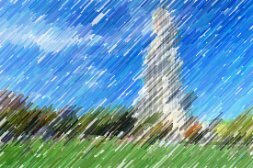
Lecture 5 Frequency and Spatial Domain Filters
ECE 1390/2390
Learning Objectives:
Frequency domain filtering
Window-method for FIR design

Slide 2
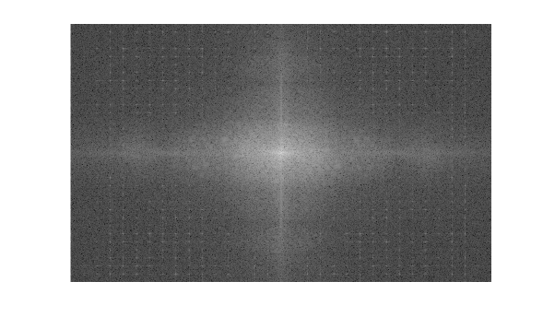
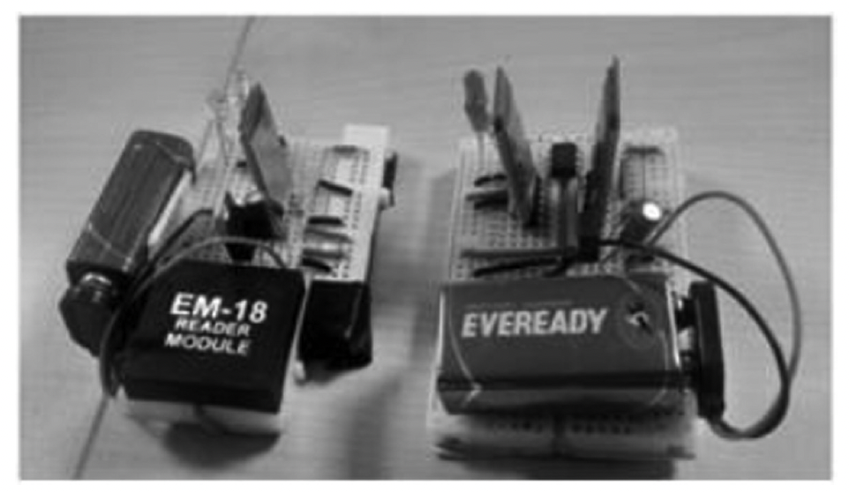
High spatial frequencies
Low spatial frequencies
DFT
Image Resolution
1000 x 1000 [15cm x 10cm]
= 0.15 mm/pixel in X-direction
= 0.10 mm/pixel in Y-direction
Sample Rate
1/0.15 pixel/mm = 6.7 pixel/mm
1/0.10 pixel/mm = 10.0 pixel/mm
Nyquist Spatial Frequency
3.3 pixel/mm = 3.3 mm⁻¹
5.0 pixel/mm = 5.0 mm⁻¹

Slide 3
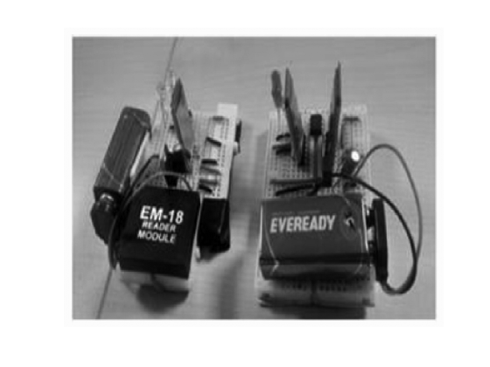
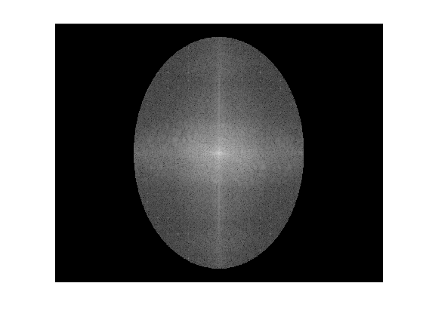
DFT
Low frequency mask
iDFT

Slide 4

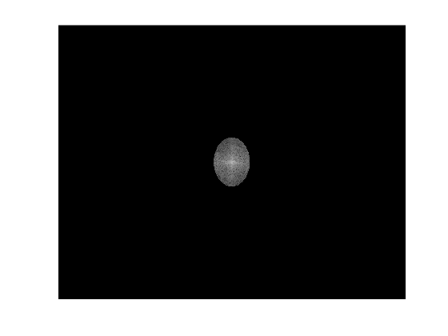
DFT
Low frequency mask
iDFT

Slide 5
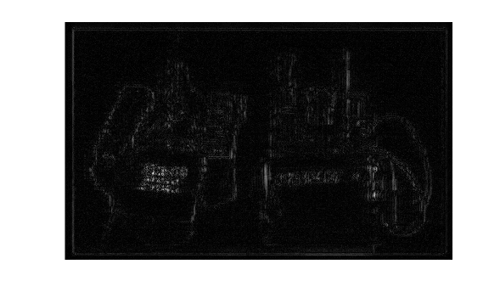
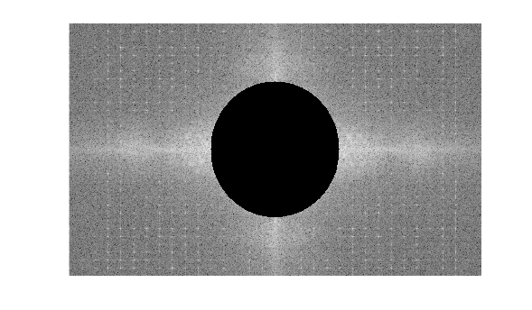
DFT
High frequency mask
iDFT

Slide 6

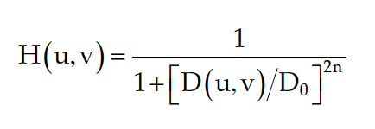
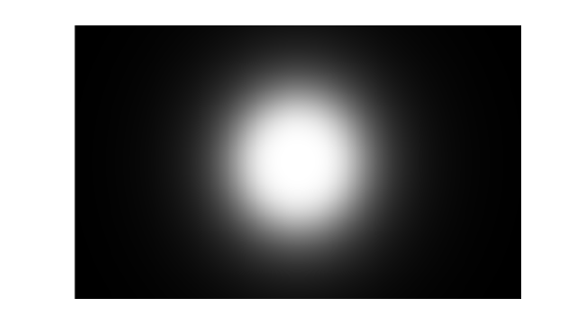
Butterworth
Corner frequency

Slide 7
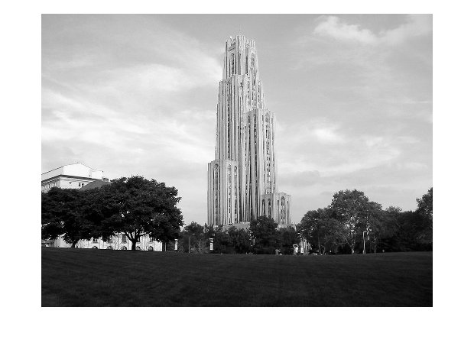
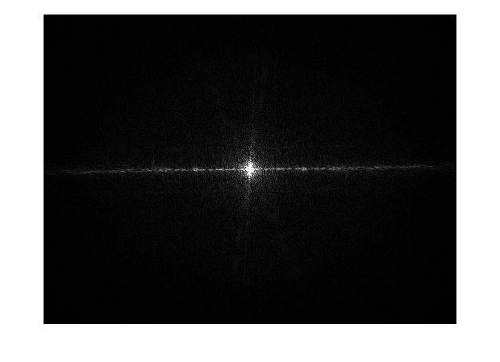
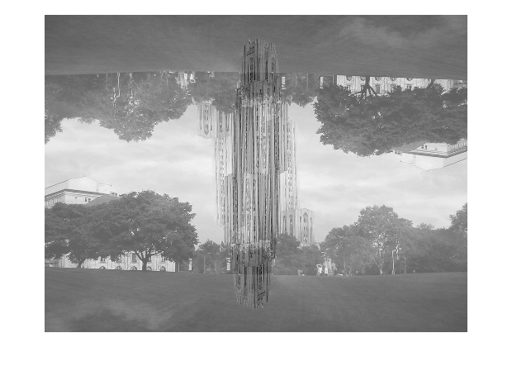
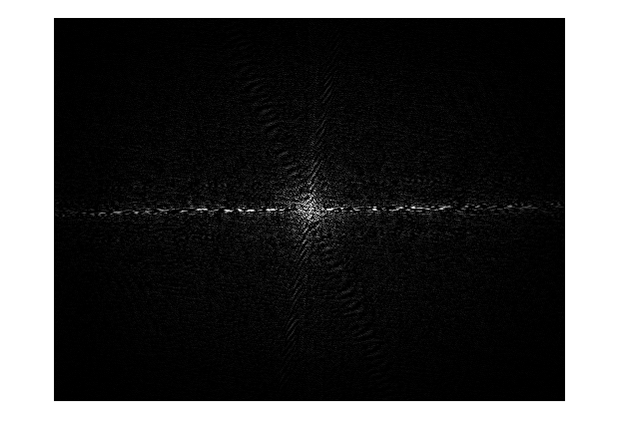


$$\left|F_{real}\left(i,j\right)+F_{imaginary}\left(i,j\right)\right|$$
$$\left|F_{real}\left(i,j\right)+F_{imaginary}\left(i,j\right)\right|$$

Slide 8
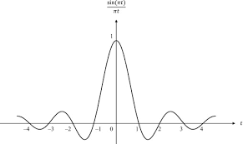
Frequency → Spatial domain
x
An ideal top-hat function in the frequency-domain would be a sinc function in the spatial domain.
But, the sinc function in the spatial domain would have infinite size.
Need to truncate the sinc kernel. Where?
DFT→
iDFT→
iDFT→
⊗

Slide 9
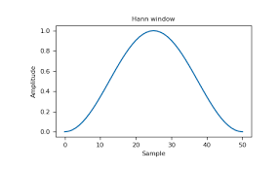
Window method for FIR design
DFT(Window)
)
(
x
⊗
DFT→
iDFT→
Window Weighting
(
)
iDFT→
⊗
x

Slide 10
Low-pass
$$\lim_{n→0}{=\frac{w_{c}}{π}}$$
$$\frac{sin⁡(kw_{c})}{πk}$$
High-pass
$$\frac{−sin⁡(kw_{c})}{πk}$$
$$\lim_{n→0}{=1−\frac{w_{c}}{π}}$$
Band-pass
$$\frac{sin⁡(kw_{up})}{πk}−\frac{sin⁡(kw_{low})}{πk}$$
$$\lim_{n→0}{=\frac{w_{up}−w_{low}}{π}}$$
Notch
$$\frac{sin⁡(kw_{low})}{πk}−\frac{sin⁡(kw_{up})}{πk}$$
$$\lim_{n→0}{=1−\frac{w_{up}−w_{low}}{π}}$$

Slide 11
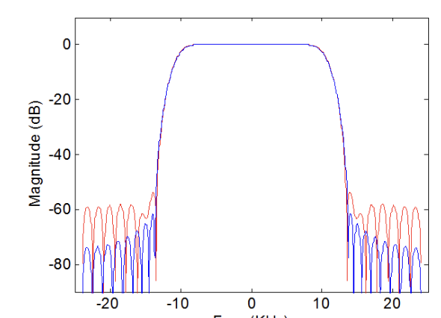

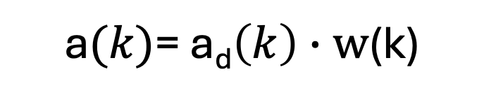
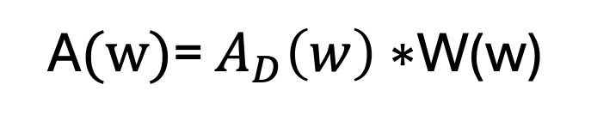
Window method for FIR design
W(w)
$$A_{D}\left(w\right)$$
A$(w)$= $A_{D}\left(w\right)∗$W(w)
$$a_{D}\left(k\right)$$
$$w(k)$$
a$(k)$= a_{d}$\left(k\right)∙w$(k)
$$H\left(e^{jw}\right)$$

Slide 12
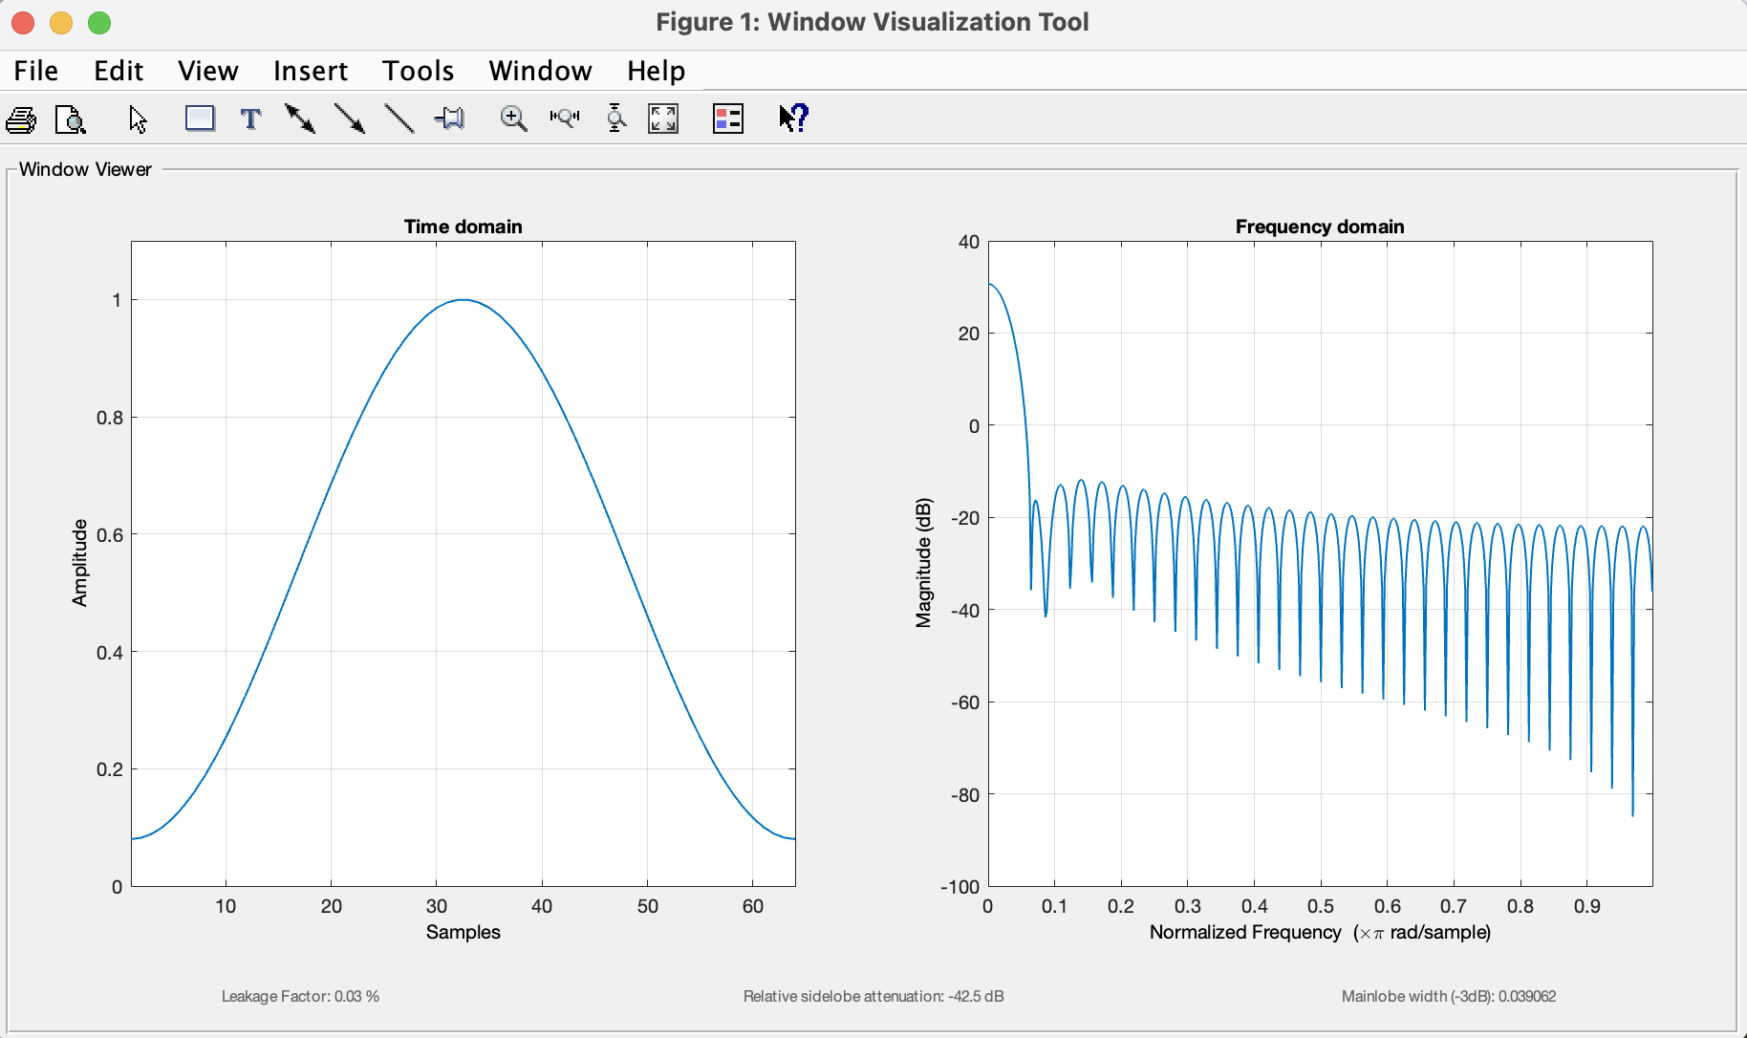
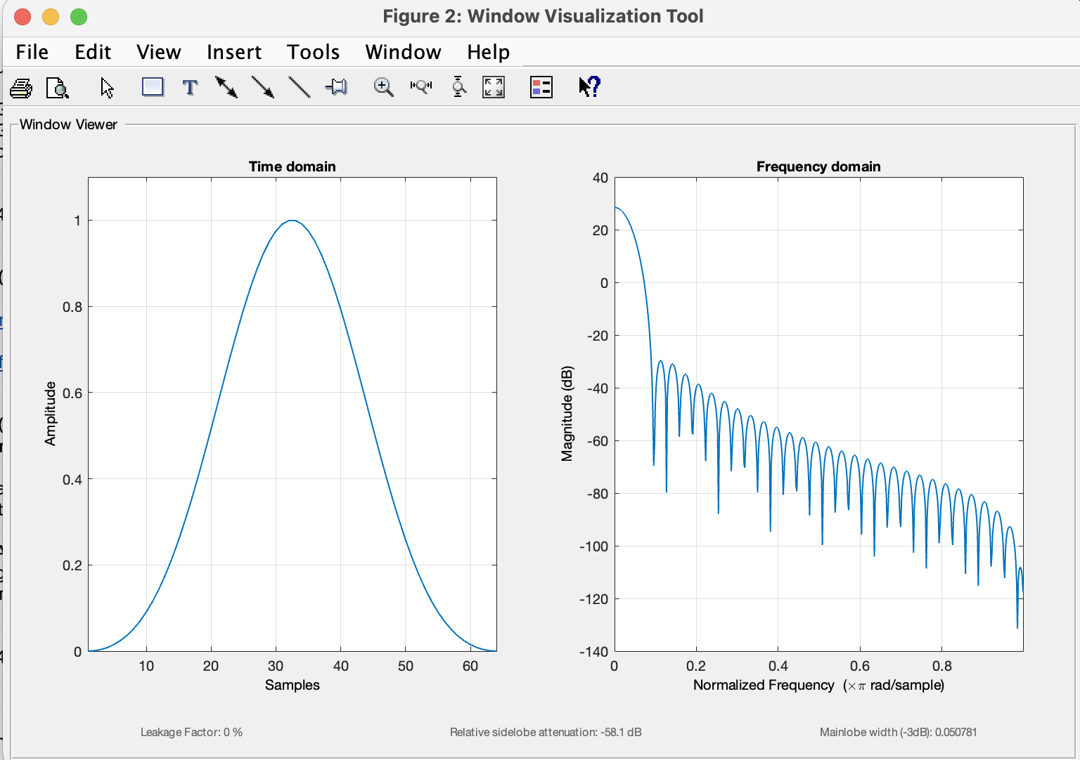
Hamming
Larger main-lobe width
↓
Sharper transition bandwidth
Blackman
More side lobes
↓
Less ripple in pass/stop band

Slide 13
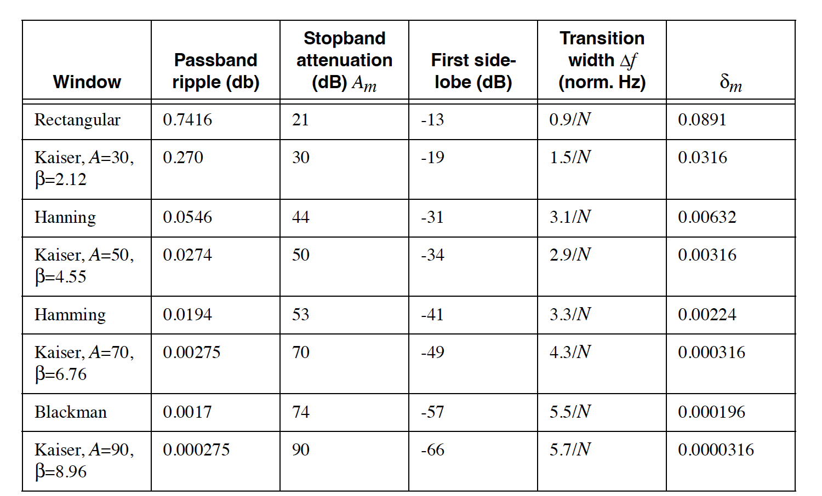
Sharpest transition/ Largest ripple
Kaiser- Adjustable trade-offs

Slide 14
2D FIR filtering
homogenous sampling
$$yf\left[n\right]=x\left[n\right]∗h[n]$$
$$yf\left[i,j\right]=x\left[i,j\right]∗h[i,j]$$
$$yf\left[i,j\right]=\sum_{n=−∞}^{∞}{\sum_{m=−∞}^{∞}{h\left[n,m\right]∙x[i−n,j−m]}}$$

Slide 15
Window method for FIR design
$$a_{D}\left(k\right)$$
$$w(k)$$
a$(k)$= a_{d}$\left(k\right)∙w$(k)
“T” – temporal sampling interval → “voxel size”
”F” – temporal frequency (s⁻¹) → spatial frequency (cm⁻¹)
“w” – frequency in radians/s → same definition
Images are typically a lot fewer samples than time (e.g. 1024x1024 vs #time-points)
Larger filter kernels will have more edge effects (edges on all 4 sides of an image)
Zero-padding needed

Slide 16

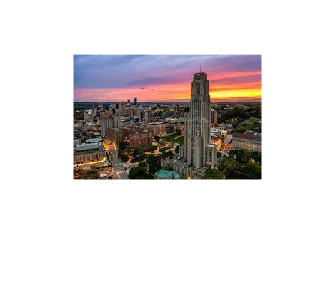
$$yf\left[i,j\right]=\sum_{n=−∞}^{∞}{\sum_{m=−∞}^{∞}{h\left[n,m\right]∙x[i−n,j−m]}}$$
Gaussian filter
FIR LPF
FIR HPF

Slide 17
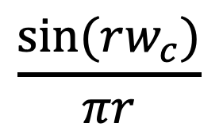
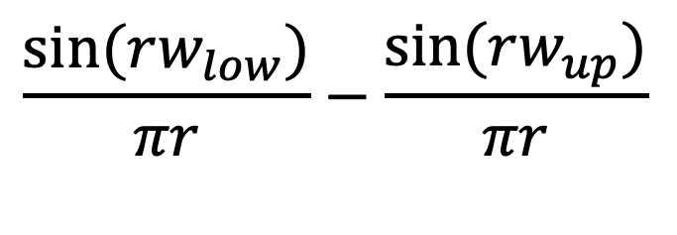


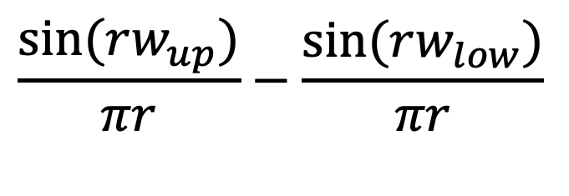

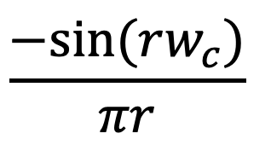

$$\frac{sin⁡(rw_{c})}{πr}$$
$$\lim_{r→0}{=\frac{w_{c}}{π}}$$
$$\frac{−sin⁡(rw_{c})}{πr}$$
$$\lim_{r→0}{=1−\frac{w_{c}}{π}}$$
$$\frac{sin⁡(rw_{up})}{πr}−\frac{sin⁡(rw_{low})}{πr}$$
$$\lim_{r→0}{=\frac{w_{up}−w_{low}}{π}}$$
$$\frac{sin⁡(rw_{low})}{πr}−\frac{sin⁡(rw_{up})}{πr}$$
$$\lim_{r→0}{=1−\frac{w_{up}−w_{low}}{π}}$$

