Slide 1
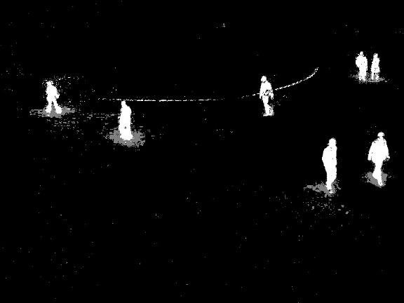

Lecture 8 Image Segmentation
ECE 1390/2390

Slide 2
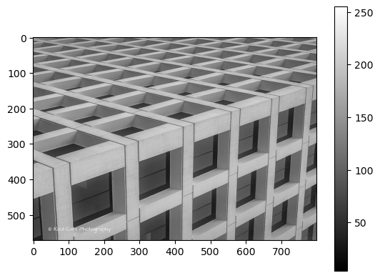
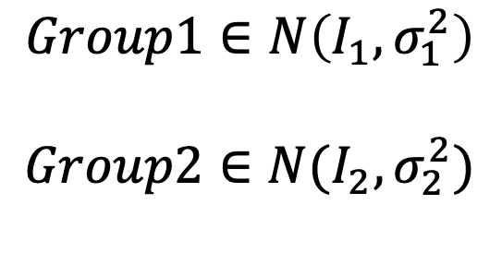
Gaussian Mixture Models
$$Group1∈N\left(I_{1},σ_{1}^{2}\right)$$
$$Group2∈N(I_{2},σ_{2}^{2})$$

Slide 3
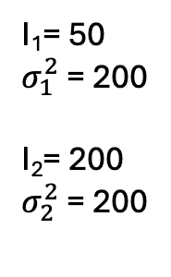

Gaussian Mixture Models
$$Group1∈N\left(I_{1},σ_{1}^{2}\right)$$
$$Group2∈N(I_{2},σ_{2}^{2})$$
#Step 1. Expectation Step (Initial)
Guess I₁,I₂, $σ_{1}^{2}$, $σ_{2}^{2}$
#Step 2. MaxiI1mization Step (Initial)
Assign probability of pixel to each group
while( . ):
# Step a. Expectation Step Update
$\left\langle I_{1}\right\rangle =\sum_{pixels}{Prob\left(G1 | X\left(i,j\right)\right)∗I(i,j)}$
$\left\langle σ_{1}^{2}\right\rangle =\sum_{pixels}{Prob\left(G1 | X\left(i,j\right)\right)∗{\left(I\left(i,j\right) −\left\langle I_{1}\right\rangle \right)}^{2}}$
# Step b. Maximization Step Update
$Prob\left(G_{1}\right)=$ $\frac{1}{\sqrt{2πσ_{1}^{2}}}e^{− \frac{{\left(I\left(i,j\right)−\left\langle I_{1}\right\rangle \right)}^{2}}{2σ_{1}^{2}}}$
I₁= 50
$σ_{1}^{2}$ = 200
I₂= 200
$σ_{2}^{2}$ = 200

Slide 4
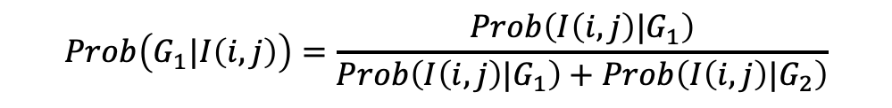
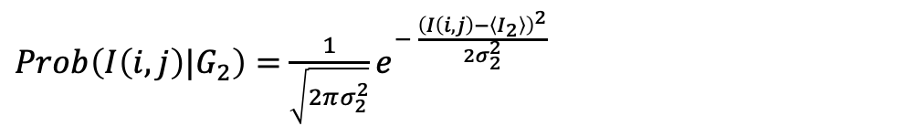
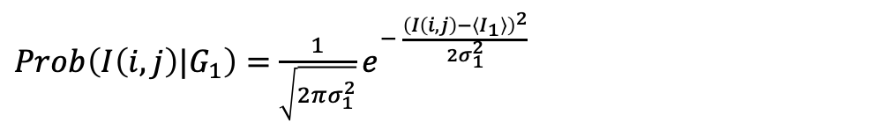

Gaussian Mixture Models
$$Group1∈N\left(I_{1},σ_{1}^{2}\right)$$
$$Group2∈N(I_{2},σ_{2}^{2})$$
#Step 1. Expectation Step (Initial)
Guess I₁,I₂, $σ_{1}^{2}$, $σ_{2}^{2}$
#Step 2. Maximization Step (Initial)
Assign probability of pixel to each group
while( . ):
# Step a. Expectation Step Update
$\left\langle I_{1}\right\rangle =\sum_{pixels}{Prob\left(G1 | X\left(i,j\right)\right)∗I(i,j)}$
$\left\langle σ_{1}^{2}\right\rangle =\sum_{pixels}{Prob\left(G1 | X\left(i,j\right)\right)∗{\left(I\left(i,j\right) −\left\langle I_{1}\right\rangle \right)}^{2}}$
# Step b. Maximization Step Update
$Prob\left(G_{1}\right)=$ $\frac{1}{\sqrt{2πσ_{1}^{2}}}e^{− \frac{{\left(I\left(i,j\right)−\left\langle I_{1}\right\rangle \right)}^{2}}{2σ_{1}^{2}}}$
$Prob\left({I\left(i,j\right)|G}_{1}\right)=$ $\frac{1}{\sqrt{2πσ_{1}^{2}}}e^{− \frac{{\left(I\left(i,j\right)−\left\langle I_{1}\right\rangle \right)}^{2}}{2σ_{1}^{2}}}$
$Prob\left({I\left(i,j\right)|G}_{2}\right)=$ $\frac{1}{\sqrt{2πσ_{2}^{2}}}e^{− \frac{{\left(I\left(i,j\right)−\left\langle I_{2}\right\rangle \right)}^{2}}{2σ_{2}^{2}}}$
$$Prob\left(G_{1}|I\left(i,j\right)\right)=\frac{Prob\left({I\left(i,j\right)|G}_{1}\right)}{Prob\left({I\left(i,j\right)|G}_{1}\right)+Prob\left({I\left(i,j\right)|G}_{2}\right)}$$

Slide 5
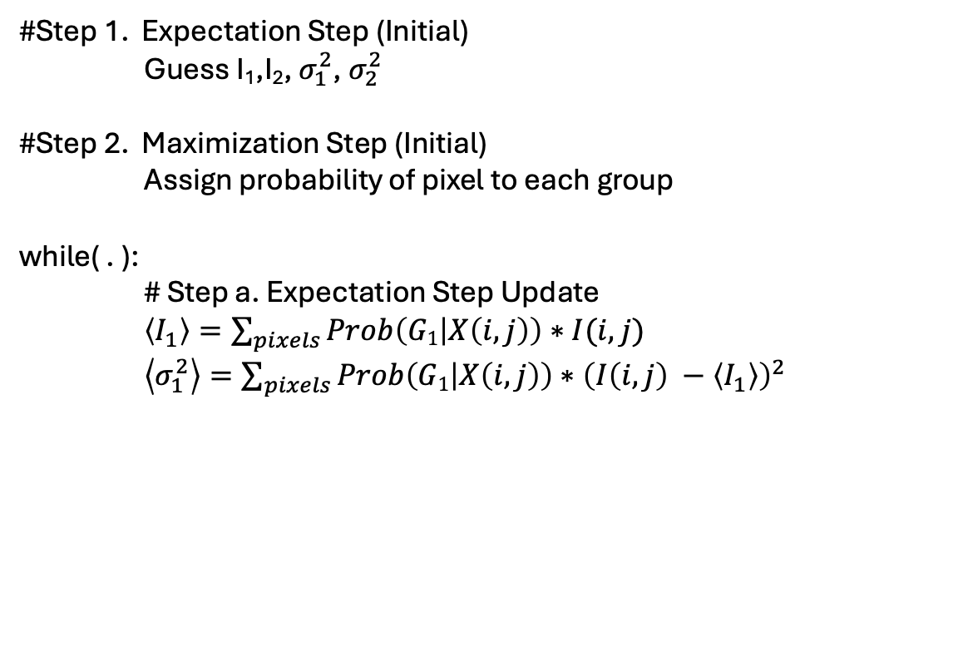
Gaussian Mixture Models
$$Group1∈N\left(I_{1},σ_{1}^{2}\right)$$
$$Group2∈N(I_{2},σ_{2}^{2})$$
#Step 1. Expectation Step (Initial)
Guess I₁,I₂, $σ_{1}^{2}$, $σ_{2}^{2}$
#Step 2. Maximization Step (Initial)
Assign probability of pixel to each group
while( . ):
# Step a. Expectation Step Update
$\left\langle I_{1}\right\rangle =\sum_{pixels}{Prob\left(G1 | X\left(i,j\right)\right)∗I(i,j)}$
$\left\langle σ_{1}^{2}\right\rangle =\sum_{pixels}{Prob\left(G1 | X\left(i,j\right)\right)∗{\left(I\left(i,j\right) −\left\langle I_{1}\right\rangle \right)}^{2}}$
# Step b. Maximization Step Update
$Prob\left(G_{1}\right)=$ $\frac{1}{\sqrt{2πσ_{1}^{2}}}e^{− \frac{{\left(I\left(i,j\right)−\left\langle I_{1}\right\rangle \right)}^{2}}{2σ_{1}^{2}}}$

Slide 6
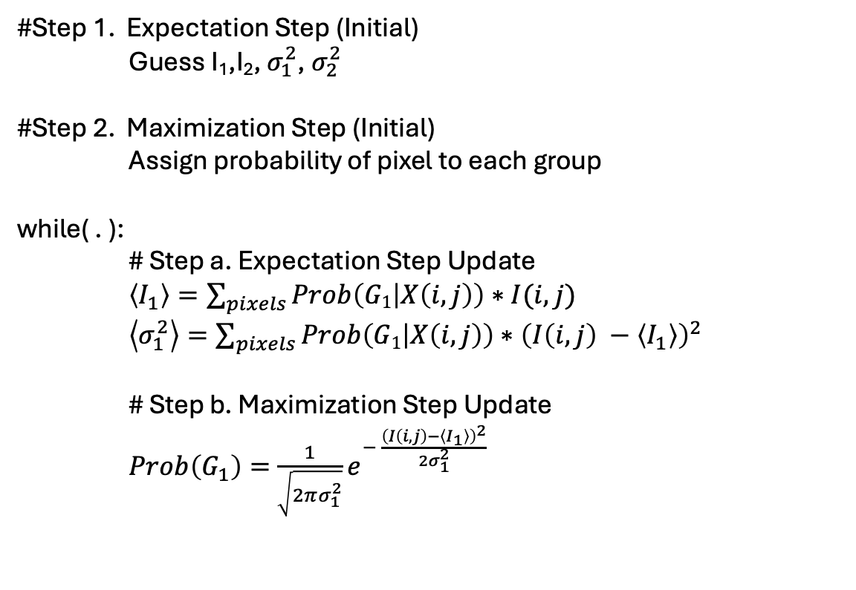
Gaussian Mixture Models
$$Group1∈N\left(I_{1},σ_{1}^{2}\right)$$
$$Group2∈N(I_{2},σ_{2}^{2})$$
#Step 1. Expectation Step (Initial)
Guess I₁,I₂, $σ_{1}^{2}$, $σ_{2}^{2}$
#Step 2. Maximization Step (Initial)
Assign probability of pixel to each group
while( . ):
# Step a. Expectation Step Update
$\left\langle I_{1}\right\rangle =\sum_{pixels}{Prob\left(G1 | X\left(i,j\right)\right)∗I(i,j)}$
$\left\langle σ_{1}^{2}\right\rangle =\sum_{pixels}{Prob\left(G1 | X\left(i,j\right)\right)∗{\left(I\left(i,j\right) −\left\langle I_{1}\right\rangle \right)}^{2}}$
# Step b. Maximization Step Update
$Prob\left(G_{1}\right)=$ $\frac{1}{\sqrt{2πσ_{1}^{2}}}e^{− \frac{{\left(I\left(i,j\right)−\left\langle I_{1}\right\rangle \right)}^{2}}{2σ_{1}^{2}}}$

Slide 7
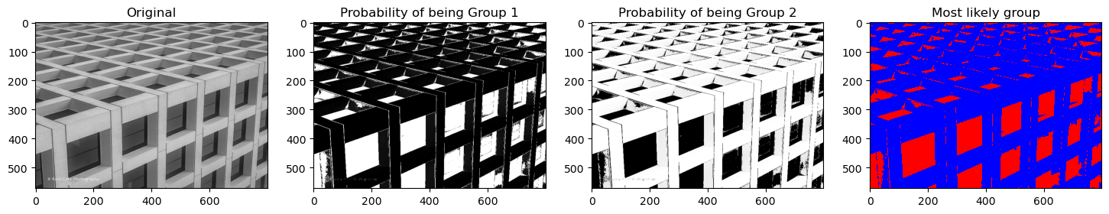
Gaussian Mixture Models
$$Group1∈N\left(I_{1},σ_{1}^{2}\right)$$
$$Group2∈N(I_{2},σ_{2}^{2})$$

Slide 8
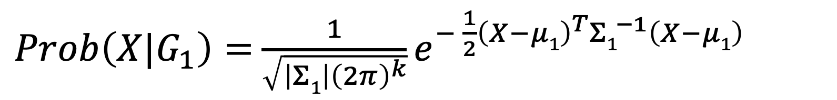
Gaussian Mixture Models (Color Extension)
$Prob\left({X|G}_{1}\right)=$ $\frac{1}{\sqrt{\left|Σ1\right|{\left(2π\right)}^{k}}}e^{− \frac{1}{2}{\left(X−μ1\right)}^{T}{Σ1}^{−1}\left(X−μ1\right)}$
Covariance < 3 x 3 >. [RGB]
Expected Color < 3 x 1 >. [RGB]
K=3 [RGB]

Slide 9
K-Nearest Neighbors

Slide 10
K-Nearest Neighbors
Step 1. Guess the number of groups
Step 2. Guess the center of the groups

Slide 11
K-Nearest Neighbors
Step 3. Calculate the distance from each sample to the center of each group

Slide 12
K-Nearest Neighbors
Step 4. Assign sample to closest group

Slide 13
K-Nearest Neighbors
[Step 5. Remove low membership groups]
Step 6. Update the center of the group

Slide 14
K-Nearest Neighbors
Repeat [3-6]

Slide 15
K-Nearest Neighbors
X = [ R, G, B]
Color only segmentation
X = [ i, j]
Position only segmentation
X = [ R,G,B, 𝜶*i, 𝜶* j ]
Position & Color segmentation
𝜶 → Large favors position
𝜶 → small favors color

Slide 16
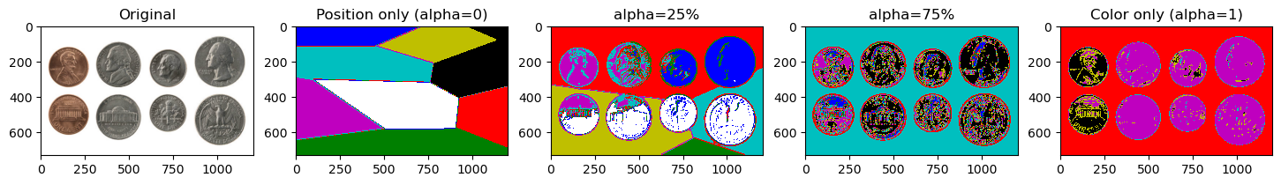
K-Nearest Neighbors

Slide 17
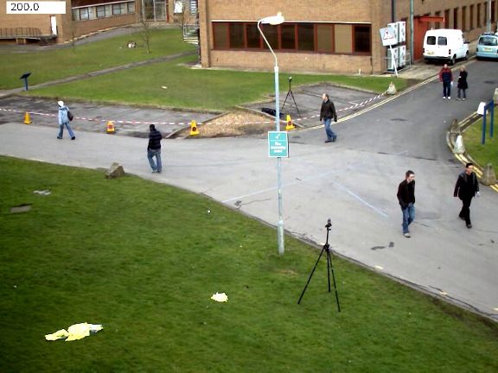
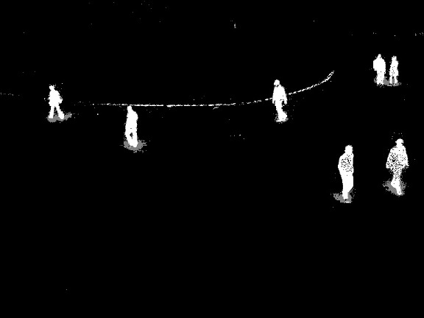
OpenCV Background Subtractor
cv.createBackgroundSubtractorMOG2()
cv.createBackgroundSubtractorKNN()

