Slide 1

Lecture 8 Morphological Segmentation
ECE 1390/2390

Slide 2
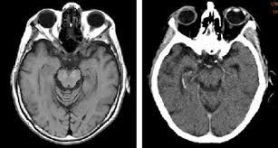
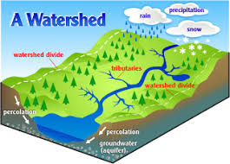
Watershed algorithm

Slide 3
Watershed algorithm
Watershed by flooding
Define a set of markers in the image
Define the flood priority from region into neighbors based on the gradient of the image
Flood the lowest priority neighbor (lowest gradient)

Slide 4
Watershed algorithm
Watershed by flooding
Define a set of markers in the image
Define the flood priority from region into neighbors based on the gradient of the image
Flood the lowest priority neighbor (lowest gradient)
10
14
12
10
13
16
20
35
10
24
25
17
10
14
20
19

Slide 5
Watershed algorithm
Watershed by flooding
Define a set of markers in the image
Define the flood priority from region into neighbors based on the gradient of the image
Flood the lowest priority neighbor (lowest gradient)
10
14
12
10
13
16
20
35
10
24
25
17
10
14
20
19

Slide 6
Watershed algorithm
Watershed by flooding
Define a set of markers in the image
Define the flood priority from region into neighbors based on the gradient of the image
Flood the lowest priority neighbor (lowest gradient)
10
14
12
10
13
16
20
35
10
24
25
17
10
14
20
19

Slide 7
Watershed algorithm
Watershed by flooding
Define a set of markers in the image
Define the flood priority from region into neighbors based on the gradient of the image
Flood the lowest priority neighbor (lowest gradient)
10
14
12
10
13
16
20
35
10
24
25
17
10
14
20
19

Slide 8
Watershed algorithm
Watershed by flooding
Define a set of markers in the image
Define the flood priority from region into neighbors based on the gradient of the image
Flood the lowest priority neighbor (lowest gradient)
10
14
12
10
13
16
20
35
10
24
25
17
10
14
20
19

Slide 9
Watershed algorithm
Watershed by flooding
Define a set of markers in the image
Define the flood priority from region into neighbors based on the gradient of the image
Flood the lowest priority neighbor (lowest gradient)
10
14
12
10
13
16
20
35
10
24
25
17
10
14
20
19

Slide 10
Watershed algorithm
Watershed by flooding
Define a set of markers in the image
Define the flood priority from region into neighbors based on the gradient of the image
Flood the lowest priority neighbor (lowest gradient)
10
14
12
10
13
16
20
35
10
24
25
17
10
14
20
19

Slide 11
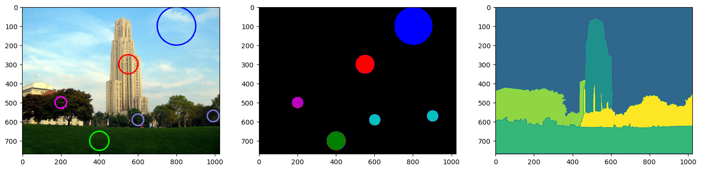
markersWS = cv2.watershed(im,markers)

Slide 12
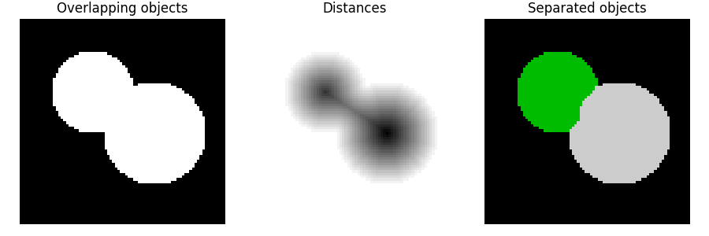
Watershed algorithm
Watershed by topographic distance

Slide 13
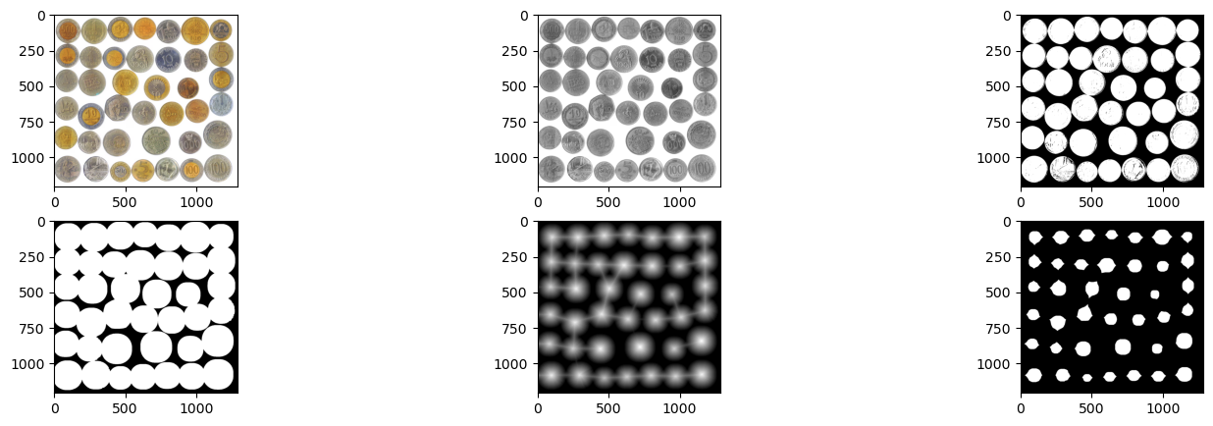
Watershed algorithm

Slide 14
Watershed algorithm
dist = cv2.distanceTransform(imbin_dil, cv2.DIST_L2, 5)
Mask size
Threshold

Slide 15
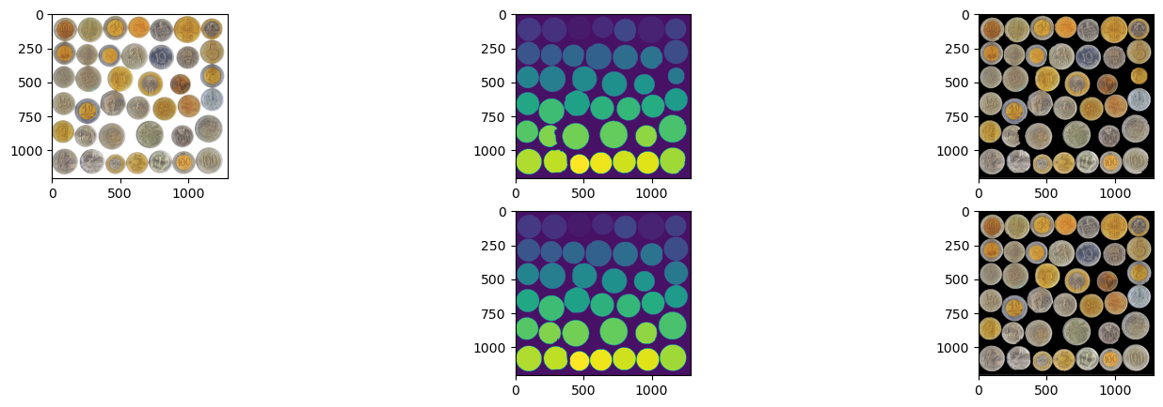
Watershed algorithm
_,markers = cv2.connectedComponents(coin_centers)
Watershed
Labels

Slide 16
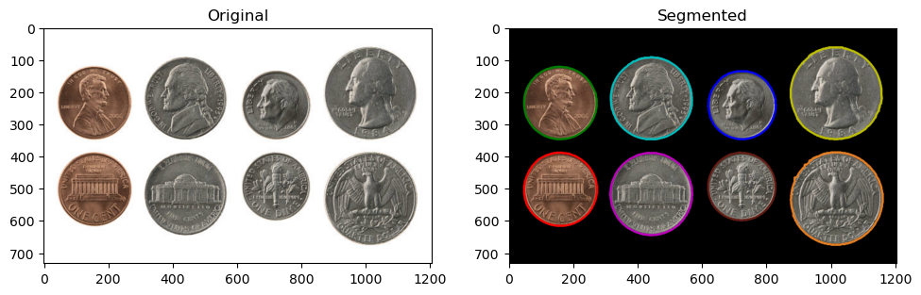
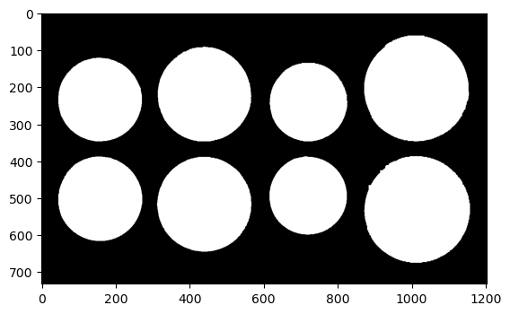
Contour segmentation

Slide 17
Contour segmentation
contours,hierarchy = cv2.findContours(thres,cv2.RETR_LIST,cv2.CHAIN_APPROX_SIMPLE)

Slide 18
Contour segmentation
area=np.zeros((len(sorted_contour)))
for i in range(0,len(sorted_contour)):
area[i]=cv2.contourArea(sorted_contour[i])

Slide 19
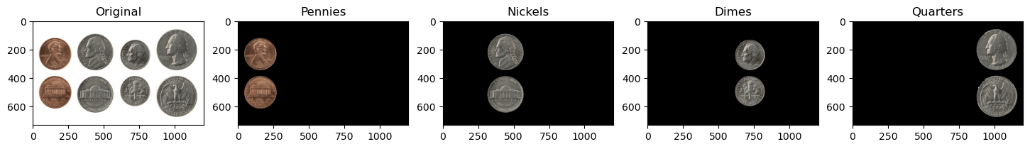
Contour segmentation
_,label,center=cv2.kmeans(area,4,None,criteria,10,cv2.KMEANS_RANDOM_CENTERS)

Slide 20
Minimum spanning forest
10
14
12
10
13
16
20
35
10
24
25
17
10
14
20
19

Slide 21
Minimum spanning forest
10
14
12
10
4
2
2
3
2
8
15
13
16
20
35
3
4
15
3
12
5
18
10
24
25
17
14
1
8
0
10
5
2
10
14
20
19
4
6
1

Slide 22
Minimum spanning forest
10
14
12
10
4
2
2
3
2
8
15
13
16
20
35
3
4
15
3
12
5
18
10
24
25
17
14
1
8
0
10
5
2
10
14
20
19
4
6
1

Slide 23
Minimum spanning forest
10
14
12
10
4
2
2
3
2
8
15
13
16
20
35
3
4
15
3
12
5
18
10
24
25
17
14
1
8
0
10
5
2
10
14
20
19
4
6
1

