Slide 1
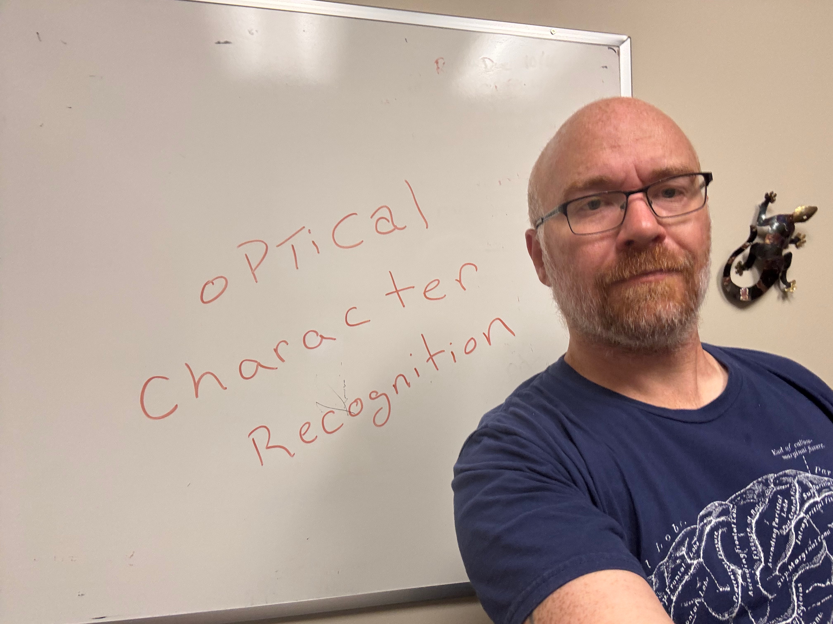
Lecture 18 0PfiCa1 Chaca c ter Recojation
ECE 1390/2390

Slide 2

Tesseract OCR Engine
Developed by HP 1984-1994
Purchased by Google 2006-2018
Now open-source Apache-2.0 license
Executable
https://github.com/tesseract-ocr
Python Wrapper
https://pypi.org/project/pytesseract/

Slide 3
Tesseract OCR Engine
Step 1. Line Finding
Find connected components in the image → “blobs”
Filter small/large blobs
Sort along horizontal axis
For left to right:
If not blob overlaps row
make new row
Else
expand vertical bounds of row
end
Row -1
Row 0

Slide 4
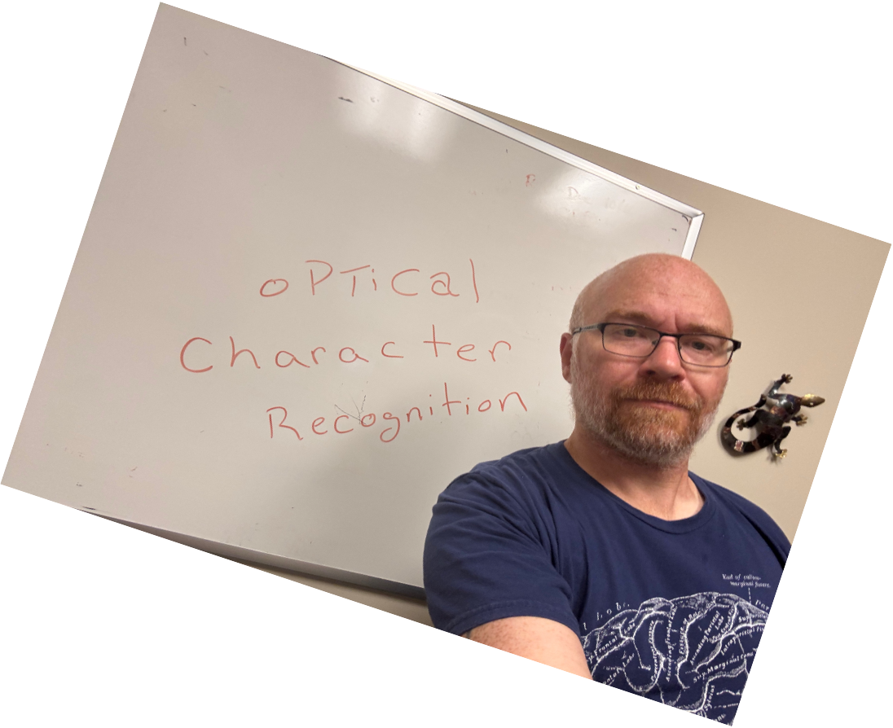

Tesseract OCR Engine
Step 2. Baseline Fitting

Slide 5

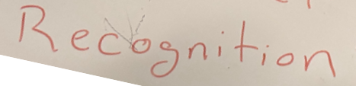
Tesseract OCR Engine
Step 3. Pitch Detection
and Chopping

Slide 6
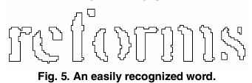
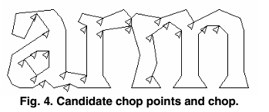
Tesseract OCR Engine
Loop.
Classify blobs to letters
if blob doesn’t match any letter
cut the blob
if cut blob doesn’t match any letter
associate broken segments

Slide 7
Limitations
Works best for printed characters (uniform spacing, uniform height, stylized lines)
Can handle oblique lines (or curves in baseline; book bindings)
Does not work with other stuff is in the image

Slide 8
EasyOCR
https://github.com/JaidedAI/EasyOCR
pip install easyocr
Trained on 80+ languages

Slide 9
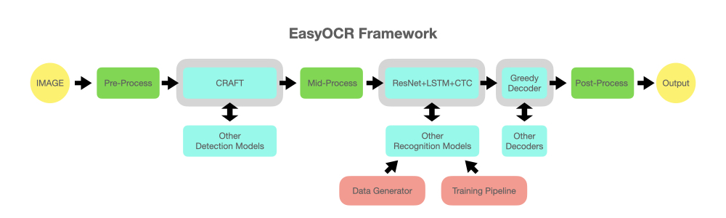
EasyOCR

Slide 10
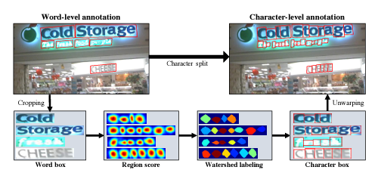
EasyOCR
CRAFT Detection
(Character Region Awareness for Text)
Trained U-net model to find center of character

Slide 11
Limitations
Works much better for real-world text
Code is a lot slower than Tesseract

Slide 12
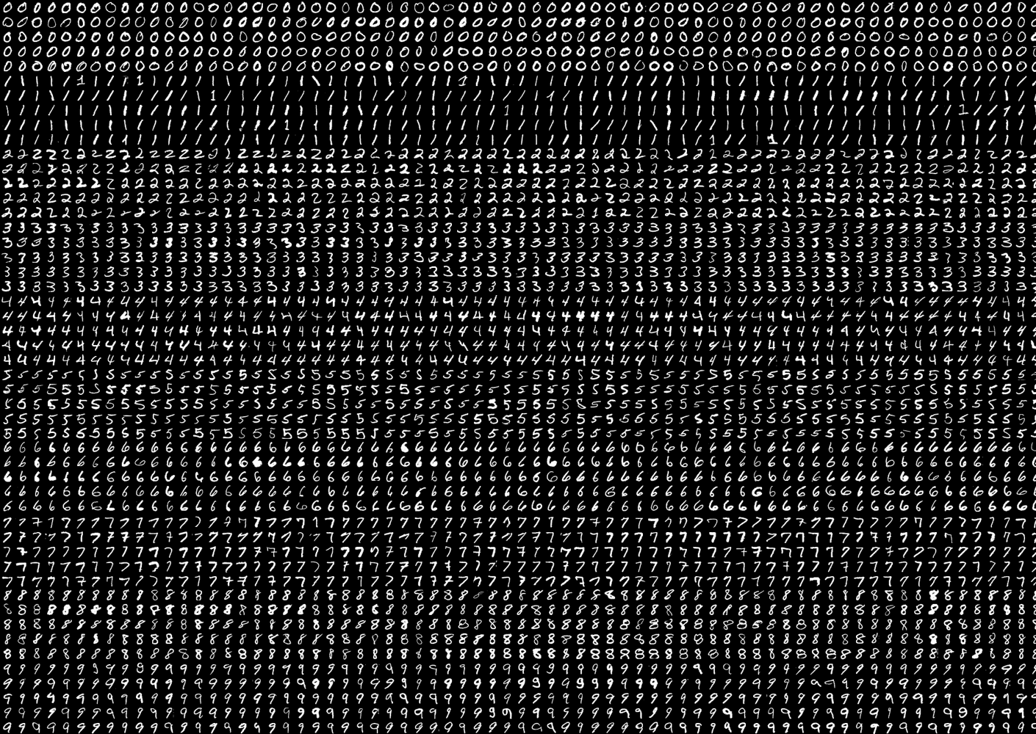
Digits example
From OpenCV Git samples
Example of HOG classifier

Slide 13
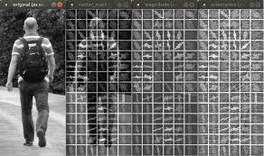
HOG (Histogram of oriented gradients)
https://github.com/lcit/HOG

Slide 14
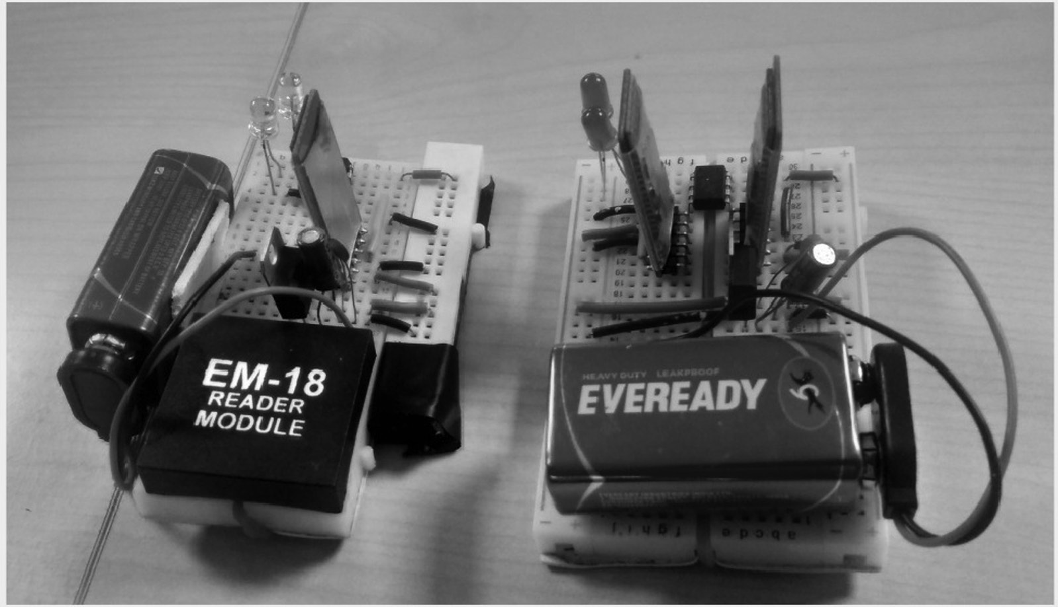
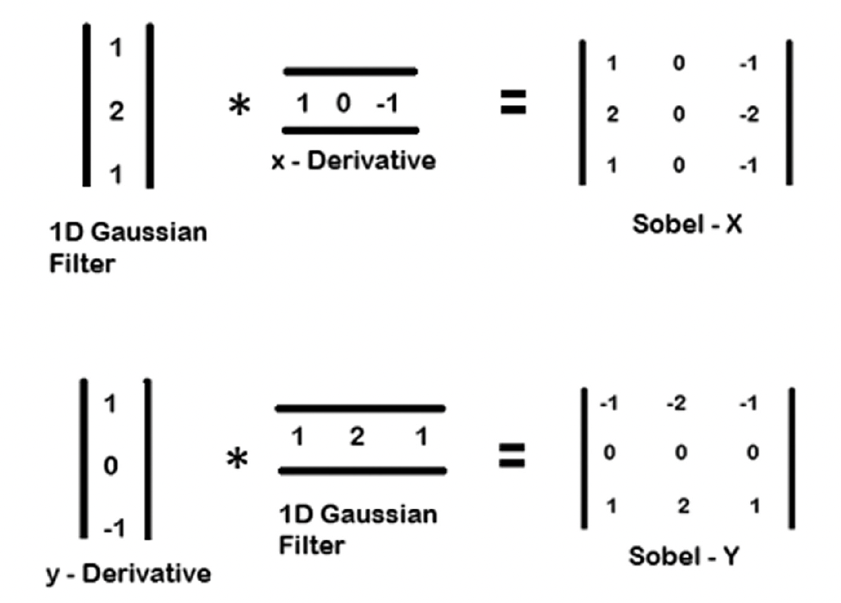
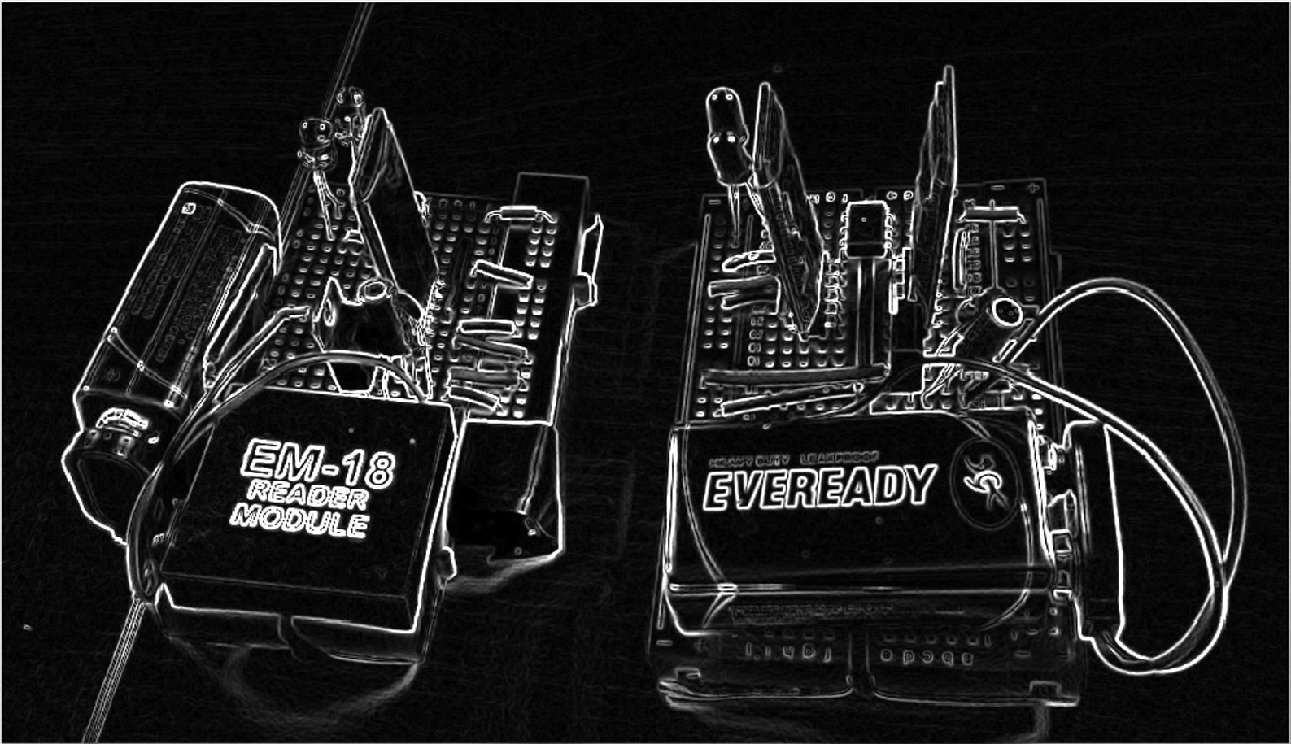
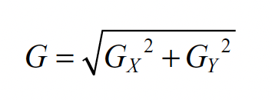
Sobel filter
Low-pass filter
High-pass filter
$$θ=\tan^{−1}\left(\frac{GX}{GY}\right)$$

Slide 15
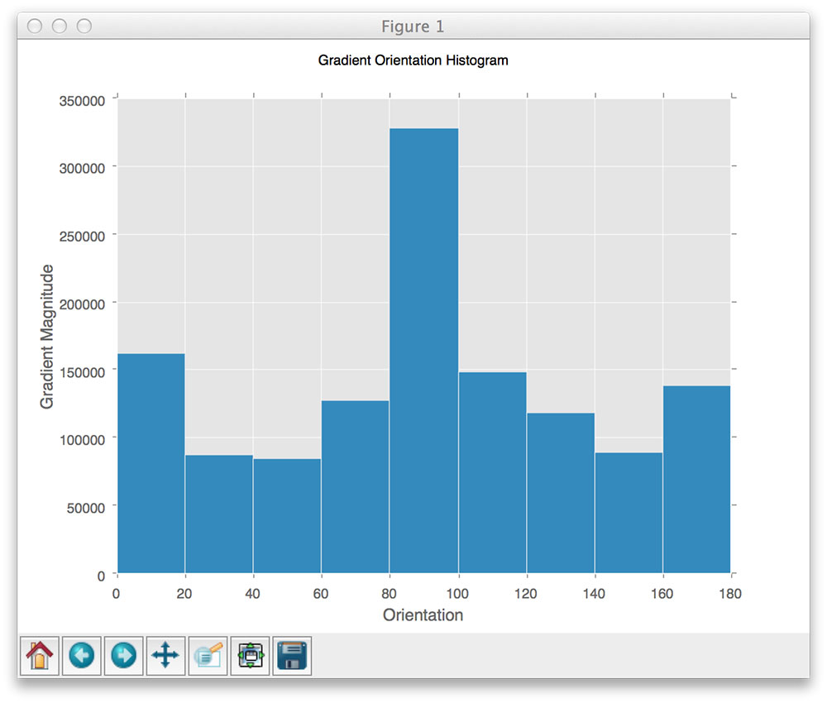
HOG (Histogram of oriented gradients)
Each block position provides
9 feature values (#bins used in this case)

Slide 16
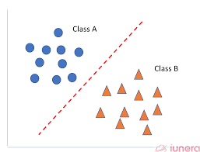
HOG (Histogram of oriented gradients)
SVM Classifier
Given positive/negative samples (same as Haar cascade) , compute the HOG features for each sample → N features
+1 : Positive
0: Negative
Construct feature space matrix (X) <# features x examples> and label vector (Y = $∈$[0,1])
Find hyperplane (w) that minimizes
$$\arg{min w{{ w}^{T}∙X−y=0}}$$

Slide 17
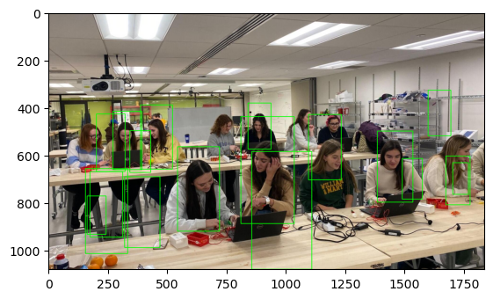
HOG (Histogram of oriented gradients)
hog = cv2.HOGDescriptor()
hog.setSVMDetector(cv2.HOGDescriptor_getDefaultPeopleDetector())
# Detect people in the image
(rects, weights) = hog.detectMultiScale(imgray, winStride=(4, 4),
padding=(8, 8), scale=1.05)

Slide 19
def preprocess_hog(digits):
samples = []
for img in digits:
gx = cv.Sobel(img, cv.CV_32F, 1, 0)
gy = cv.Sobel(img, cv.CV_32F, 0, 1)
mag, ang = cv.cartToPolar(gx, gy)
bin_n = 16
bin = np.int32(bin_n*ang/(2*np.pi))
bin_cells = bin[:10,:10], bin[10:,:10], bin[:10,10:], bin[10:,10:]
mag_cells = mag[:10,:10], mag[10:,:10], mag[:10,10:], mag[10:,10:]
hists = [np.bincount(b.ravel(), m.ravel(), bin_n) for b, m in zip(bin_cells, mag_cells)]
hist = np.hstack(hists)
eps = 1e-7
hist /= hist.sum() + eps
hist = np.sqrt(hist)
hist /= norm(hist) + eps
samples.append(hist)
return np.float32(samples)
Compute the directions of edges in the image
Make histogram of the distribution of magnitudes found at each angle
Normalize histograms

Slide 20
class SVM(object):
def __init__(self, C = 1, gamma = 0.5):
self.model = cv.ml.SVM_create()
self.model.setGamma(gamma)
self.model.setC(C)
self.model.setKernel(cv.ml.SVM_RBF)
self.model.setType(cv.ml.SVM_C_SVC)
def train(self, samples, responses):
self.model.train(samples, cv.ml.ROW_SAMPLE, responses)
def predict(self, samples):
return self.model.predict(samples)[1].ravel()
def load(self, fn):
self.model = cv.ml.SVM_load(fn)
def save(self, fn):
self.model.save(fn)
OpenCV is using a One-verses-All SVM model
model = SVM(C=2.67, gamma=5.383)
model.train(samples_train, labels_train)

Slide 21
From OpenCV’s Help description:
Gamma:
Role: Defines the influence of a single training example. It controls the "width" of the RBF kernel (the most commonly used kernel with SVMs).
Interpretation:
Low gamma: The influence of a single training example reaches far, leading to a smoother decision boundary and a more generalized model.
High gamma: The influence of a single training example is localized, leading to a more complex decision boundary that closely fits the training data (potentially overfitting).
C:
Role: Controls the trade-off between maximizing the margin and minimizing the classification error.
Interpretation:
Low C: A larger margin is encouraged, potentially leading to misclassifications on the training data but creating a simpler model that generalizes better.
High C: The model tries to correctly classify all training examples, potentially leading to a more complex decision boundary and overfitting.

