Slide 1
Lecture 11 Image Restoration
ECE 1360/2360 Image Processing
Learning Objectives:

Slide 2
Image restoration in digital image processing is the process of recovering a corrupted or degraded image, such as a blurred or noisy image, into its original state. It's different from image enhancement, which is used to create new characteristics in an image to make it more visually appealing. Image restoration is an image-to-image operation that reverses the process that blurred the image

Slide 3
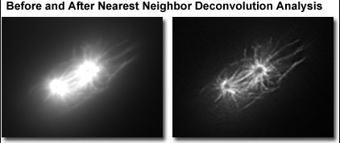

Slide 4
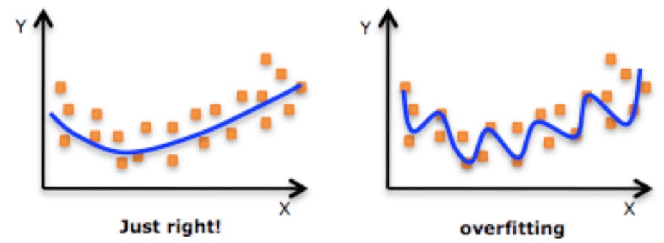
Challenges in Image Restoration
Although digital image restoration techniques have come a long way, there are still several challenges that need to be addressed. Here are a few of the most significant challenges:
Lack of Information
Sometimes, the degradation in the image is so severe that it is impossible to restore the image to its original quality. This can happen when there is a lack of information in the original image. For example, if an image is heavily compressed, some information may be lost, making it impossible to restore the image to its original quality.
Computational Complexity
Image restoration is a complex process that involves numerous computational steps, which can make it a resource-intensive task. This means that restoring high-resolution images in real-time can be challenging, as it requires a lot of processing power. However, recent advances in hardware and software technology have made it possible to improve the speed and efficiency of image restoration algorithms. Researchers are constantly exploring new techniques and methods to enhance the accuracy and quality of restored images, while also reducing the computational demands of the process. Despite these advancements, there is still much to learn and improve upon in the field of image restoration, as it remains a critical area of research in numerous industries, including healthcare, entertainment, and security.
Overfitting
When it comes to image restoration, overfitting can be a particularly significant problem. In this scenario, the algorithm is trained on a set of images, and it learns to restore them to their original state. However, if the algorithm becomes too specialized during training, it may not be able to generalize well to new images that it has not seen before. This can lead to poor results, which is something that needs to be carefully considered when using machine learning for image restoration.
Fig 4.
Multi-Dimensional Data Restoration
Another challenge in image restoration is multi-dimensional data restoration. This is when images have multiple dimensions, such as color channels, depth, or time. Traditional image restoration techniques are often limited to two dimensions, which can make it difficult to restore images with additional dimensions. However, recent advances in machine learning and deep learning have made it possible to restore multi-dimensional data with greater accuracy and efficiency, making it possible to restore images with more complex structures.

