Slide 1
Lecture 12 Image Inpainting
ECE 1360/2360 Image Processing
Learning Objectives:
Diffusion based
Patch based
Video based
Deep-learning methods (LaMa)

Slide 2
https://github.com/geekyutao/Image-Inpainting

Slide 3
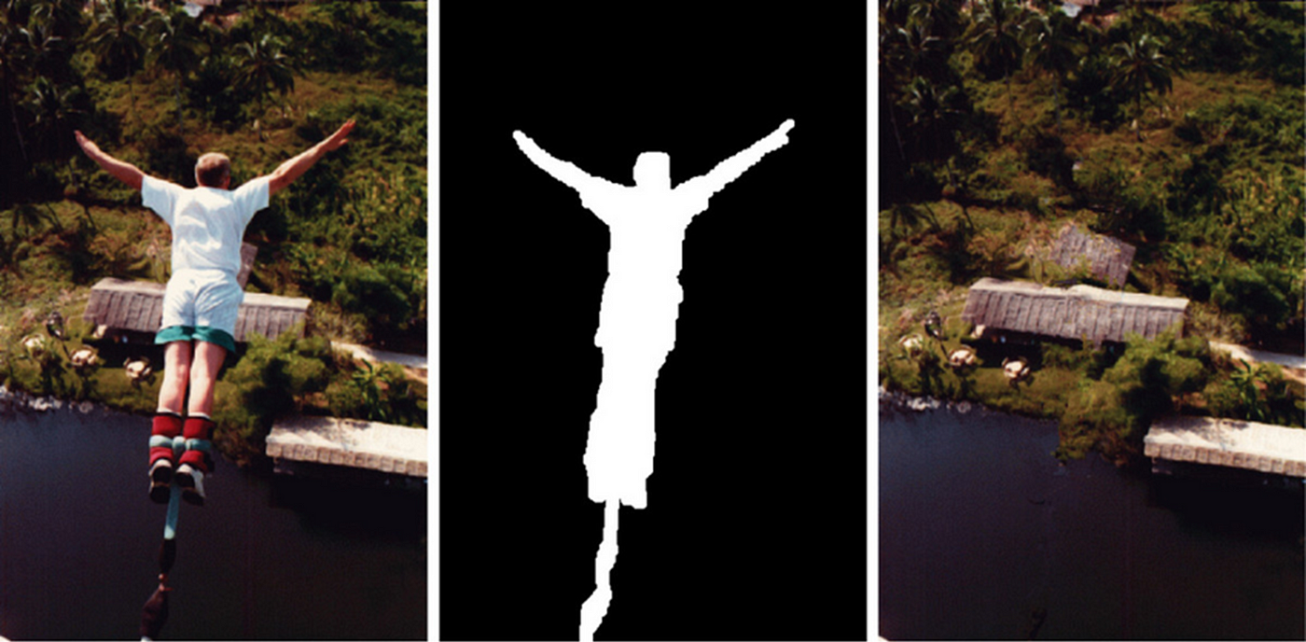

Slide 4
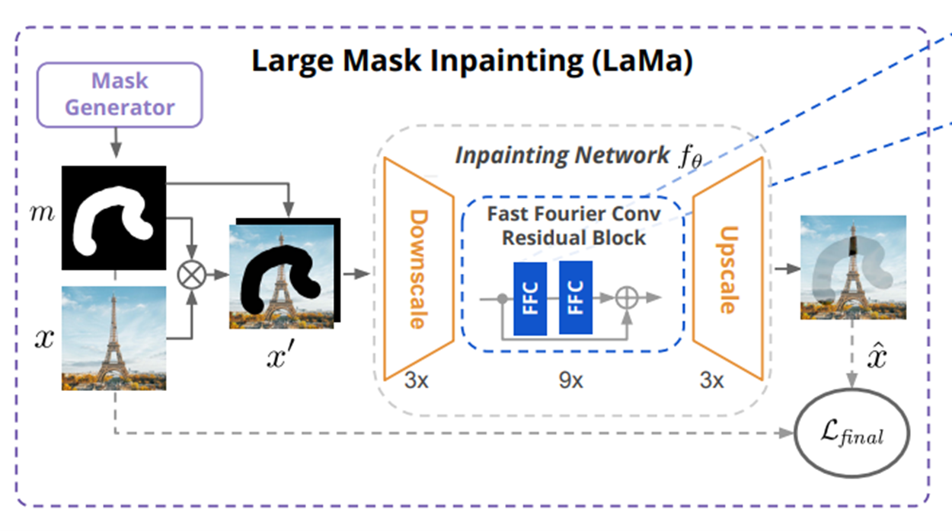
LaMa research paper published in 2021 by Roman Suvorov et al.

Slide 5
