Slide 1
Lecture 3 Image Statistics
ECE 1360/2360 Image Processing
Learning Objectives:
Histograms
Color schemes
Gamma-correction
Hue, saturation
Contrast/brighten

Slide 3

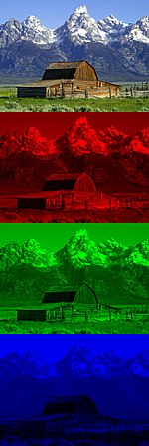
RGB
Red
Green
Blue

Slide 4
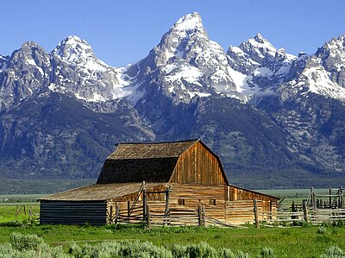
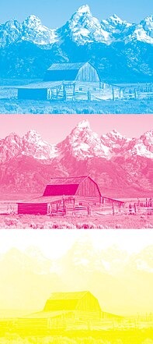
CMY

Slide 5
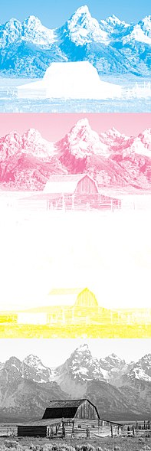
CMYK

Slide 6
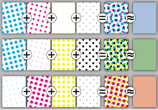
CMYK
Half toning

Slide 7
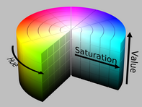
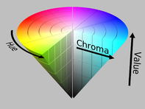
HSV Radial space
Hue.. Angle
Red = 0
Green = 120
Blue = 240
Saturation. Radius
Value
0 = Black
1 = Full color

Slide 8
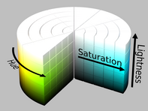
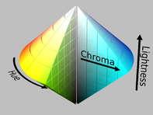
HSL Sphereical space
Hue.. Angle
Red = 0
Green = 120
Blue = 240
Saturation. Radius
Lightness
0 = Black
1 = white

Slide 9
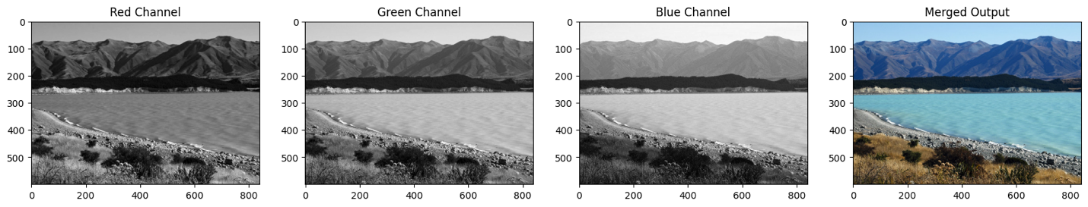
Color channels

Slide 10
Splitting and Merging Color Channels
cv2.split() Divides a multi-channel array into several single-channel arrays.
cv2.merge() Merges several arrays to make a single multi-channel array. All the input matrices must have the same size.
OpenCV Documentation
Documentation link
In [15]:
# Split the image into the B,G,R componentsimg_NZ_bgr = cv2.imread("New_Zealand_Lake.jpg", cv2.IMREAD_COLOR)b, g, r = cv2.split(img_NZ_bgr)

Slide 11
Converting to different Color Spaces
cv2.cvtColor() Converts an image from one color space to another. The function converts an input image from one color space to another. In case of a transformation to-from RGB color space, the order of the channels should be specified explicitly (RGB or BGR). Note that the default color format in OpenCV is often referred to as RGB but it is actually BGR (the bytes are reversed). So the first byte in a standard (24-bit) color image will be an 8-bit Blue component, the second byte will be Green, and the third byte will be Red. The fourth, fifth, and sixth bytes would then be the second pixel (Blue, then Green, then Red), and so on.
Function Syntax
dst = cv2.cvtColor( src, code )
dst: Is the output image of the same size and depth as src.
The function has 2 required arguments:
src input image: 8-bit unsigned, 16-bit unsigned ( CV_16UC... ), or single-precision floating-point.
code color space conversion code (see ColorConversionCodes).
OpenCV Documentation
cv2.cvtColor: Documentation link
ColorConversionCodes: Documentation link
Changing from BGR to RGB
In [16]:
# OpenCV stores color channels in a differnet order than most other applications (BGR vs RGB).img_NZ_rgb = cv2.cvtColor(img_NZ_bgr, cv2.COLOR_BGR2RGB)

Slide 12
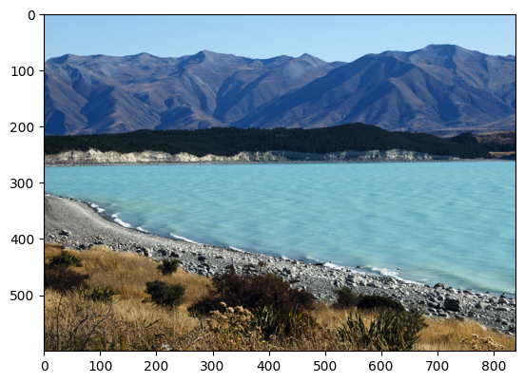
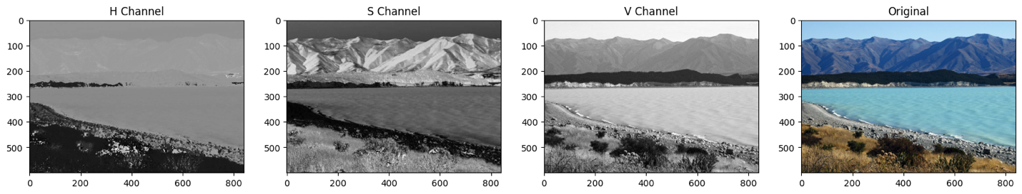
HSV
Changing to HSV color space
In [17]:
img_hsv = cv2.cvtColor(img_NZ_bgr, cv2.COLOR_BGR2HSV)# Split the image into the B,G,R componentsh,s,v = cv2.split(img_hsv)# Show the channelsplt.figure(figsize=[20,5])plt.subplot(141);plt.imshow(h, cmap="gray");plt.title("H Channel");plt.subplot(142);plt.imshow(s, cmap="gray");plt.title("S Channel");plt.subplot(143);plt.imshow(v, cmap="gray");plt.title("V Channel");plt.subplot(144);plt.imshow(img_NZ_rgb); plt.title("Original");

Slide 13
HSV
Hue- color of image
Sat- intensity of color (pure red vs dark red)
V- value (independent of color)

Slide 14
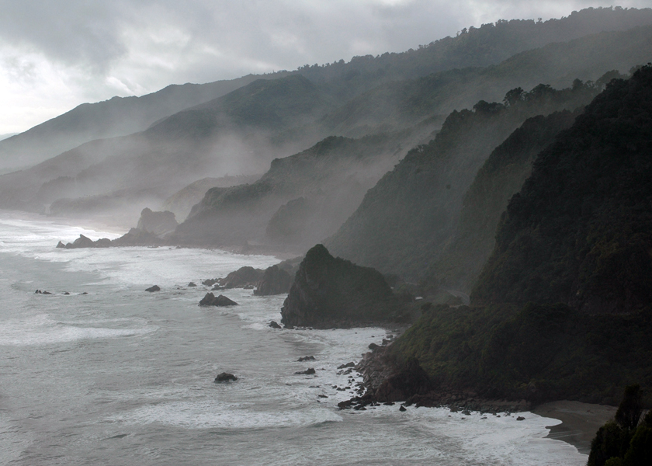
Brightness
Addition or Brightness
The first operation we discuss is simple addition of images. This results in increasing or decreasing the brightness of the image since we are eventually increasing or decreasing the intensity values of each pixel by the same amount. So, this will result in a global increase/decrease in brightness.

Slide 15
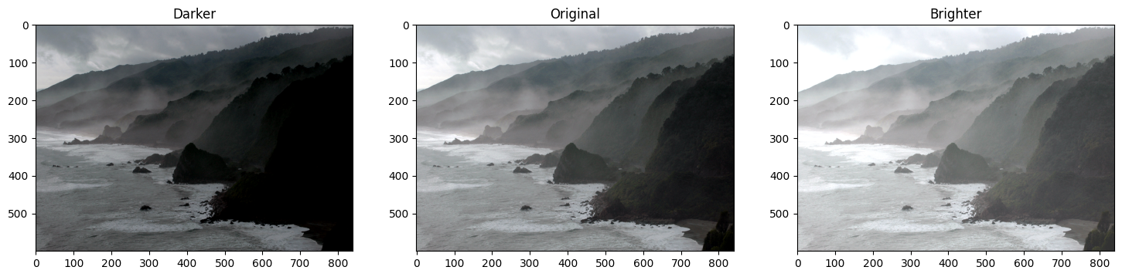
matrix = np.ones(img_rgb.shape, dtype="uint8") * 50img_rgb_brighter = cv2.add(img_rgb, matrix)img_rgb_darker = cv2.subtract(img_rgb, matrix)# Show the imagesplt.figure(figsize=[18, 5])plt.subplot(131); plt.imshow(img_rgb_darker); plt.title("Darker");plt.subplot(132); plt.imshow(img_rgb); plt.title("Original");plt.subplot(133); plt.imshow(img_rgb_brighter);plt.title("Brighter");

Slide 16
COntrast
Multiplication or Contrast
Just like addition can result in brightness change, multiplication can be used to improve the contrast of the image.
Contrast is the difference in the intensity values of the pixels of an image. Multiplying the intensity values with a constant can make the difference larger or smaller ( if multiplying factor is < 1 ).

Slide 17
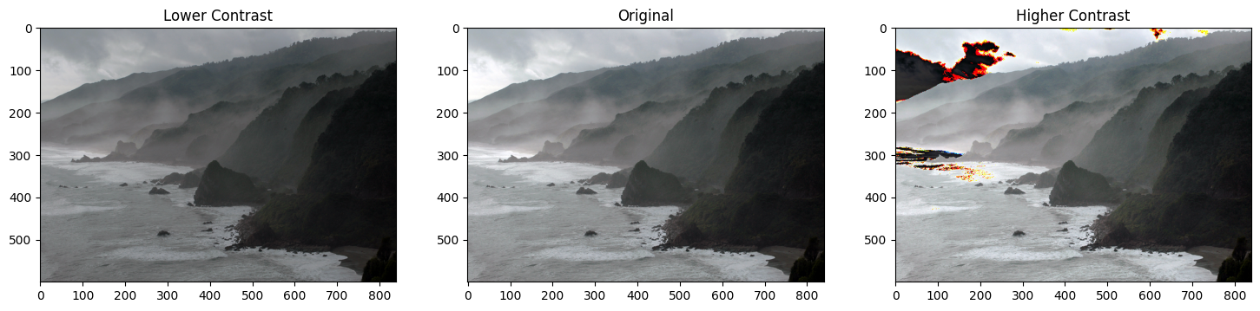
matrix1 = np.ones(img_rgb.shape) * 0.8matrix2 = np.ones(img_rgb.shape) * 1.2img_rgb_darker = np.uint8(cv2.multiply(np.float64(img_rgb), matrix1))img_rgb_brighter = np.uint8(cv2.multiply(np.float64(img_rgb), matrix2))# Show the imagesplt.figure(figsize=[18,5])plt.subplot(131); plt.imshow(img_rgb_darker); plt.title("Lower Contrast");plt.subplot(132); plt.imshow(img_rgb); plt.title("Original");plt.subplot(133); plt.imshow(img_rgb_brighter);plt.title("Higher Contrast");

Slide 18
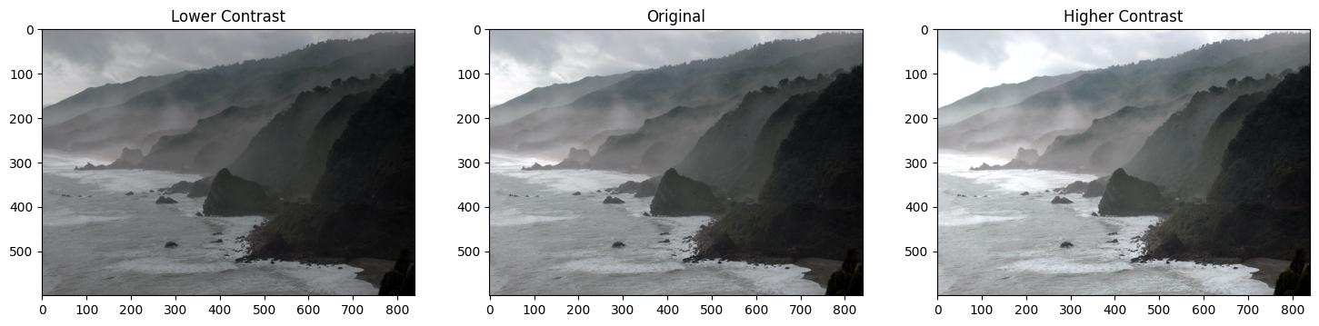
What happened?
Can you see the weird colors in some areas of the image after multiplication?
The issue is that after multiplying, the values which are already high, are becoming greater than 255. Thus, the overflow issue. How do we overcome this?
Handling Overflow using np.clip
In [7]:
matrix1 = np.ones(img_rgb.shape) * 0.8matrix2 = np.ones(img_rgb.shape) * 1.2img_rgb_lower = np.uint8(cv2.multiply(np.float64(img_rgb), matrix1))img_rgb_higher = np.uint8(np.clip(cv2.multiply(np.float64(img_rgb), matrix2), 0, 255))

Slide 19
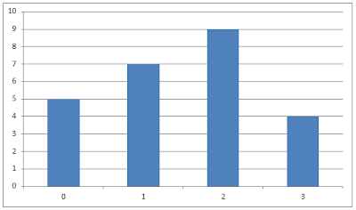
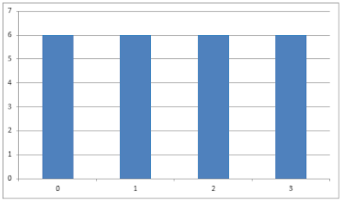
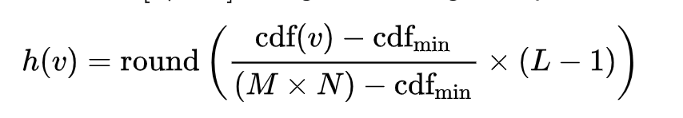
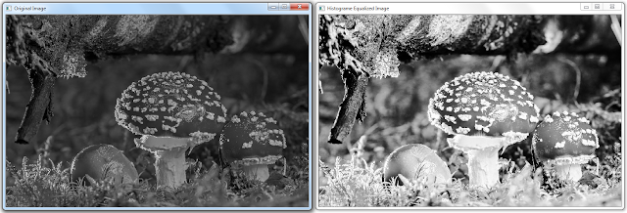
Equalization

Slide 20
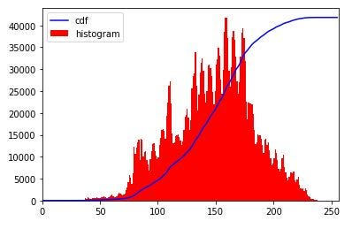
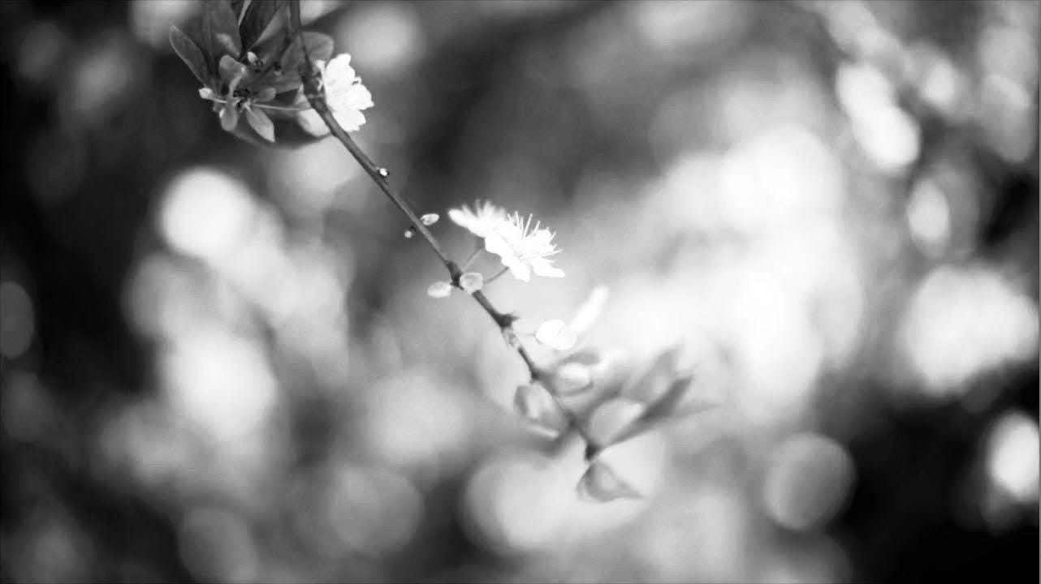
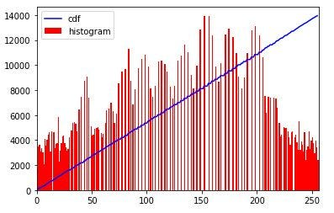
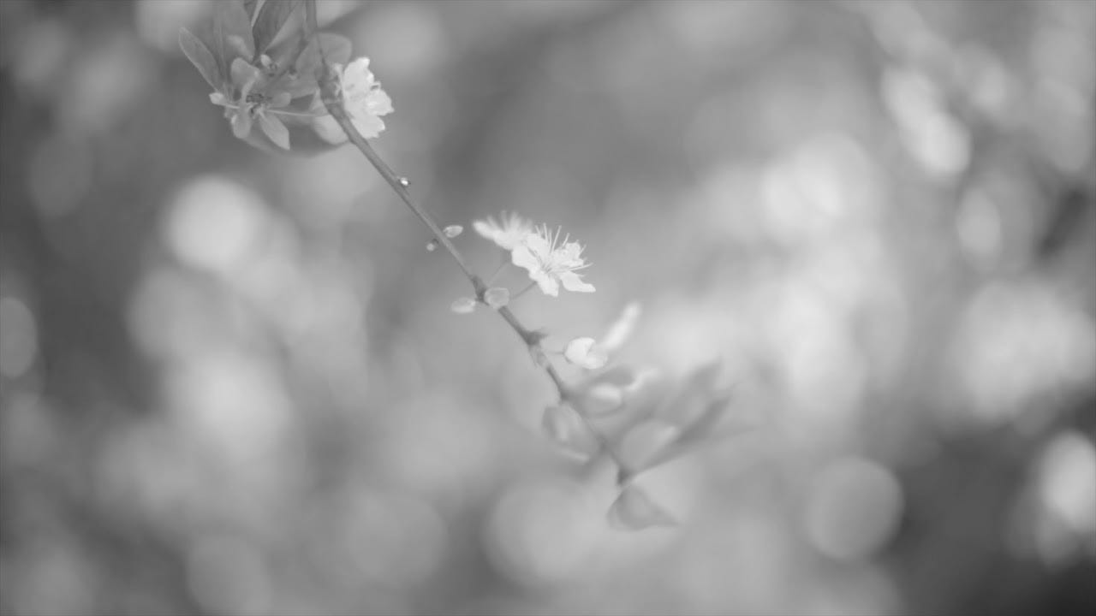
equ = cv.equalizeHist(img)

Slide 21
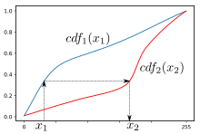
Histogram matching

Slide 22
Adaptive histogram matching

Slide 23
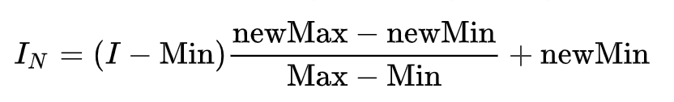
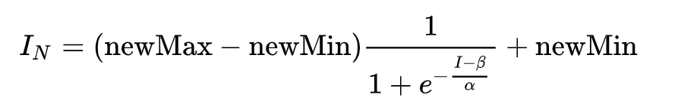
Normalization
Match the contrast level (range of intensities)

Slide 24

# Normalize image
normalized_image = cv2.normalize( image, None, alpha=0, beta=255, norm_type=cv2.NORM_MINMAX)

Slide 25

# Convert image to grayscale
gray_image = cv2.cvtColor(image, cv2.COLOR_BGR2GRAY)
# Normalize grayscale image
normalized_gray_image = cv2.normalize( gray_image, None, alpha=0, beta=255, norm_type=cv2.NORM_MINMAX)
# Convert normalized grayscale image back to color normalized_color_image = cv2.cvtColor( normalized_gray_image, cv2.COLOR_GRAY2BGR)

Slide 26
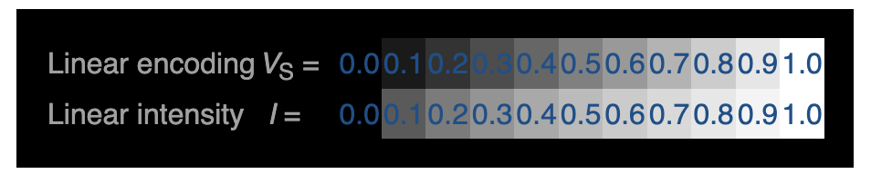
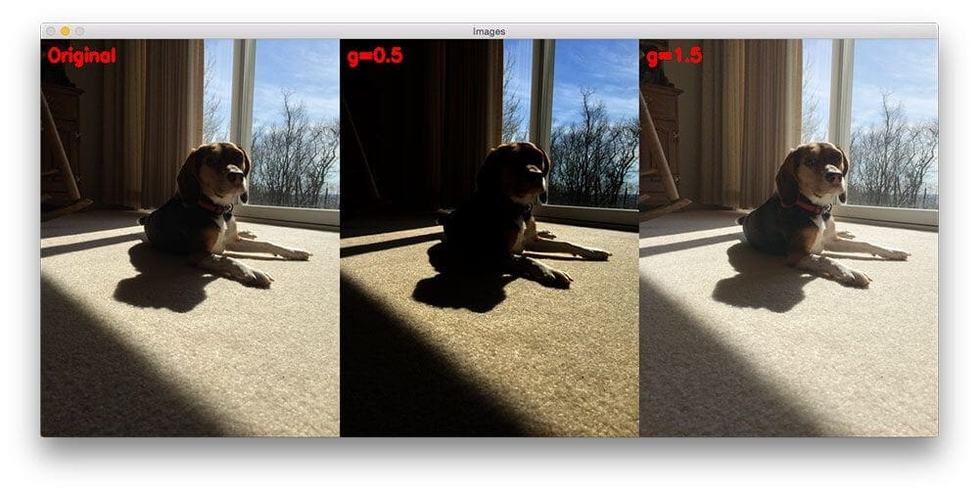
Gamma correction
gamma correction, a translation between the sensitivity of our eyes and sensors of a camera
O = I ^ (1 / G)

Slide 27
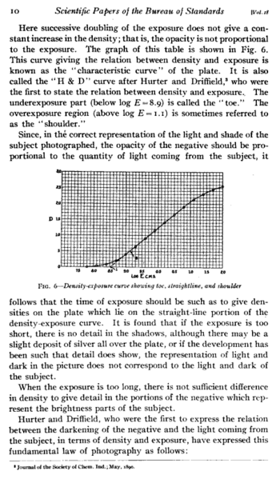
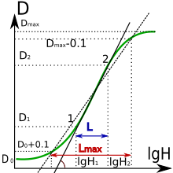
Hurter–Driffield curve

Slide 28
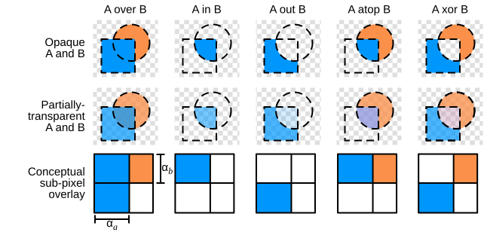
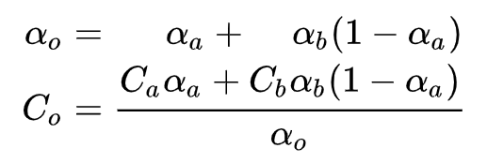
Alpha channel

Slide 29
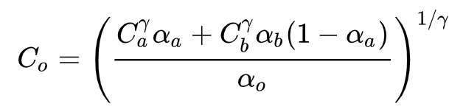
Alpha blending

