Slide 1
Lecture 4 Filters- Denoising
ECE 1360/2360 Image Processing
Learning Objectives:
Filtering in 2D
Smoothing filters
Statistical filters

Slide 2
Gaussian
Bilinear filter
Median filter

Slide 3
Multidimensional filters
Strategies
Spatial (fixed relationship) filters
Common-Mode filters
Remove (or keep) signals that are common between multiple measurement vectors
E.g. PCA, ICA, CCA methods
External reference
Template of what noise looks like from external measure (e.g. temperature probe)
Filter transfer
Regression approaches
ARIMAX
State-space filters (next lecture)

Slide 4
Spatial Filters
Signals have a “fixed” relationship to each other
E.g. channel 1 and 2 are neighbors in space
Can be homogenous sampling (like CCD camera) or sparse sampling (e.g. microphones placed around the room)

Slide 5
FIR design
$$H_{D}\left(e^{jw}\right)⇒H\left(e^{jw}\right)=\sum_{k=0}^{M}{h[k]{∙e}^{−jkw}}$$
Ideal filter
Realized filter
$$\min_{\{h[k]\}}{\frac{1}{2π}\int_{−π}^{π}{dw{\left|H_{D}\left(e^{jw}\right)−H\left(e^{jw}\right)\right|}^{2}}}$$

Slide 6
FIR design
$$H_{D}\left(e^{jw}\right)⇒H\left(e^{jw}\right)=\sum_{k=0}^{M}{h[k]{∙e}^{−jkw}}$$
Ideal filter
Realized filter
$$H\left(e^{jw}\right)=A\left(w\right)∙e^{−jα∙w+jβ}$$
$$\min_{\{a[k]\}}{\frac{1}{2π}\int_{−π}^{π}{dw{\left|A_{D}\left(w\right)−A\left(w\right)\right|}^{2}}}$$
$$\min_{\{h[k]\}}{\frac{1}{2π}\int_{−π}^{π}{dw{\left|H_{D}\left(e^{jw}\right)−H\left(e^{jw}\right)\right|}^{2}}}$$
$$a\left[k\right]=DFT\{A\left(w\right)\}$$

Slide 7
FIR design
$$H_{D}\left(e^{jw}\right)⇒H\left(e^{jw}\right)=\sum_{k=0}^{M}{h[k]{∙e}^{−jkw}}$$
Ideal filter
Realized filter
$$H\left(e^{jw}\right)=A\left(w\right)∙e^{−jα∙w+jβ}$$
$$\min_{\{h[k]\}}{\frac{1}{2π}\int_{−π}^{π}{dw{\left|H_{D}\left(e^{jw}\right)−H\left(e^{jw}\right)\right|}^{2}}}$$
$$\min_{\{a[k]\}}{\sum_{k=−∞}^{∞}{{\left|a_{D}[k]−a[k]\right|}^{2}}}$$
Parseval’s Theorem

Slide 8
Window method for FIR design
$$\min_{\{a[k]\}}{\sum_{k=−M/2}^{M/2}{{\left|a_{D}[k]−a[k]\right|}^{2}+\sum_{k=−∞}^{−M/2}{{\left|a_{D}[k]\right|}^{2}}+\sum_{k=M/2}^{∞}{{\left|a_{D}[k]\right|}^{2}}}}$$
$a[k]$= $a_{D}[k]∙w$[k]
Time domain window
Ideal filter
A$(w)$= $A_{D}\left(w\right)∗$W(w)

Slide 9
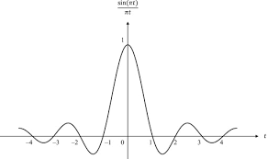
Window method for FIR design
$$\min_{\{a[k]\}}{\sum_{k=−M/2}^{M/2}{{\left|a_{D}[k]−a[k]\right|}^{2}+\sum_{k=−∞}^{−M/2}{{\left|a_{D}[k]\right|}^{2}}+\sum_{k=M/2}^{∞}{{\left|a_{D}[k]\right|}^{2}}}}$$

Slide 10
Low-pass
$$\lim_{n→0}{=\frac{w_{c}}{π}}$$
$$\frac{sin⁡(kw_{c})}{πk}$$
High-pass
$$\frac{−sin⁡(kw_{c})}{πk}$$
$$\lim_{n→0}{=1−\frac{w_{c}}{π}}$$
Band-pass
$$\frac{sin⁡(kw_{up})}{πk}−\frac{sin⁡(kw_{low})}{πk}$$
$$\lim_{n→0}{=\frac{w_{up}−w_{low}}{π}}$$
Notch
$$\frac{sin⁡(kw_{low})}{πk}−\frac{sin⁡(kw_{up})}{πk}$$
$$\lim_{n→0}{=1−\frac{w_{up}−w_{low}}{π}}$$

Slide 11

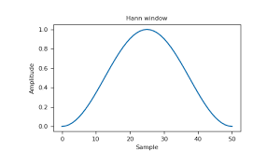
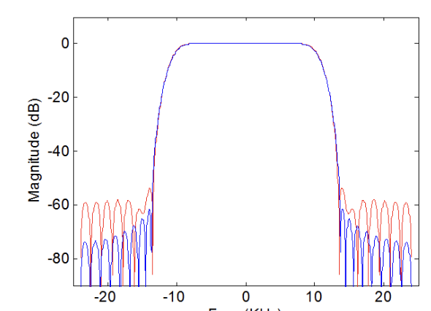
Window method for FIR design
$$a_{D}\left(k\right)$$
$$w(k)$$
a$(k)$= a_{d}$\left(k\right)∙w$(k)
$$H\left(e^{jw}\right)$$
W(w)
$$A_{D}\left(w\right)$$
A$(w)$= $A_{D}\left(w\right)∗$W(w)

Slide 12
Window method for FIR design
$$a_{D}\left(k\right)$$
$$w(k)$$
a$(k)$= a_{d}$\left(k\right)∙w$(k)
$$ℱ\left\{w(t)\right\}=W(w)$$
$$H\left(e^{jw}\right)$$
$$ℱ^{−1}\left\{A_{D}\left(w\right)∗W(w)\right\}$$
W(w)
$$A_{D}\left(w\right)$$
A$(w)$= $A_{D}\left(w\right)∗$W(w)

Slide 13
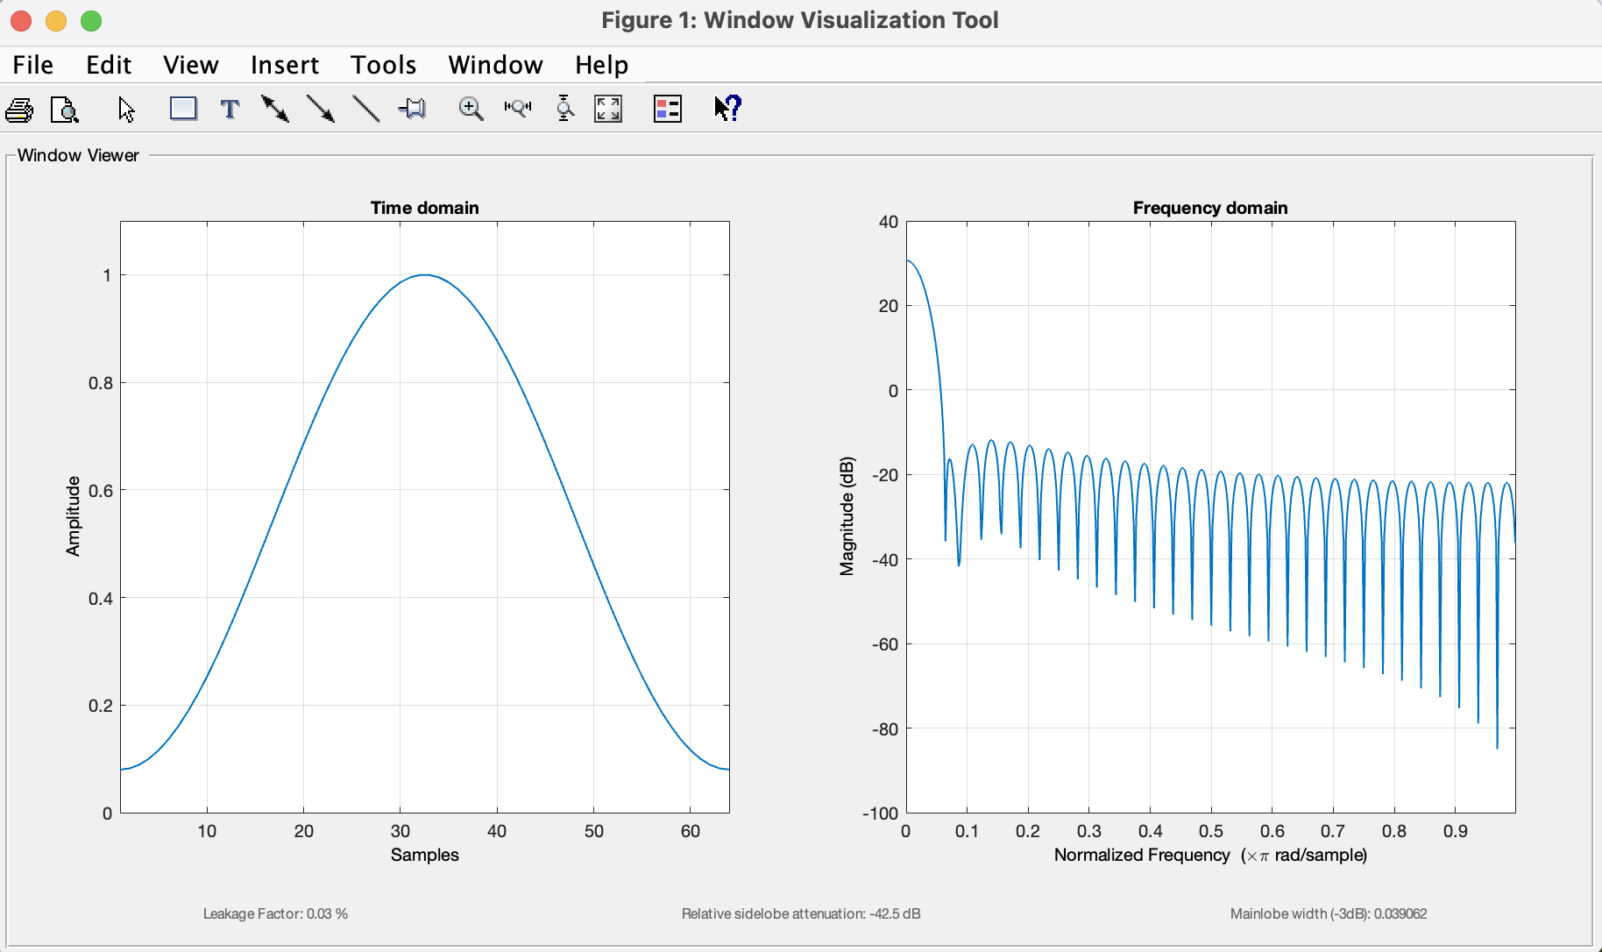
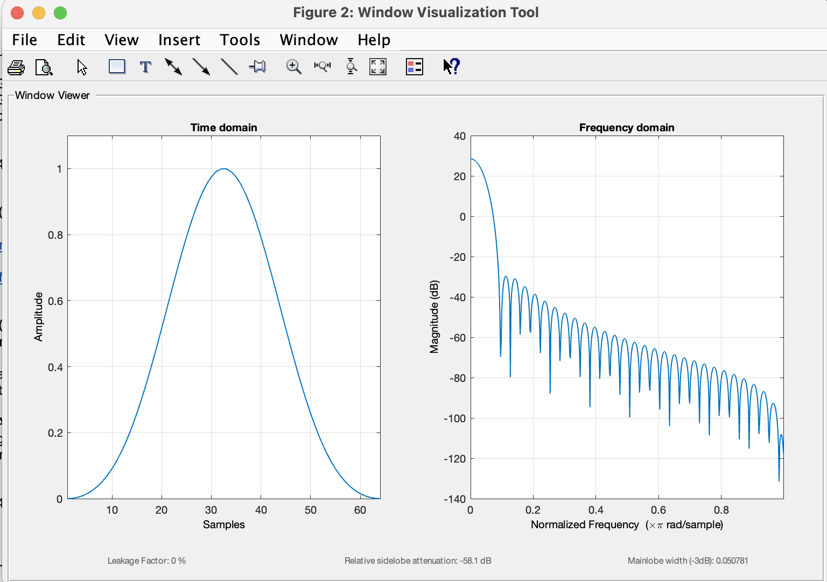
Hamming
Main-lobe width → transition bandwidth
Blackman
Side-lobes → ripple in pass/stop band

Slide 14
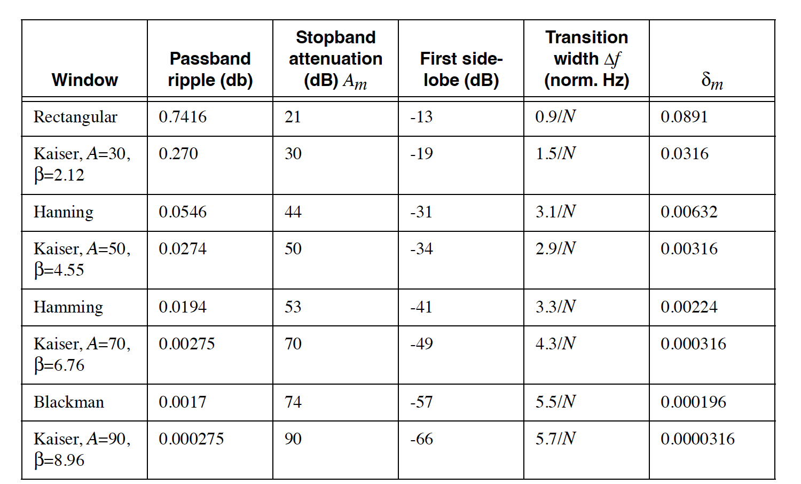
Main-lobe width → transition bandwidth
Side-lobes → ripple in pass/stop band

Slide 15
2D FIR filtering
homogenous sampling
$$yf\left[n\right]=x\left[n\right]∗h[n]$$
$$yf\left[i,j\right]=x\left[i,j\right]∗h[i,j]$$
$$yf\left[i,j\right]=\sum_{n=−∞}^{∞}{\sum_{m=−∞}^{∞}{h\left[n,m\right]∙x[i−n,j−m]}}$$

Slide 16
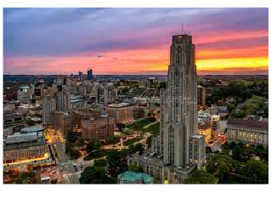

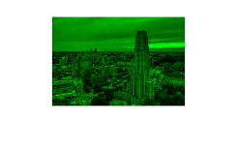
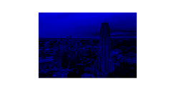
Image filters
2D version of windowed FIR design

Slide 17
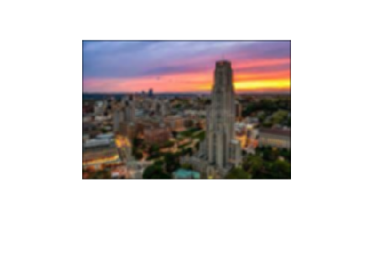
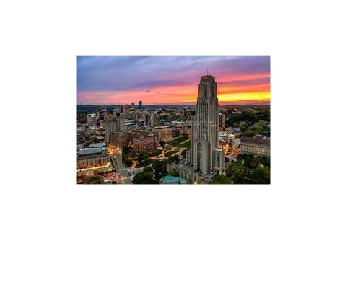
$$yf\left[i,j\right]=\sum_{n=−∞}^{∞}{\sum_{m=−∞}^{∞}{h\left[n,m\right]∙x[i−n,j−m]}}$$
Gaussian filter
FIR ideal LPF
FIR ideal HPF

Slide 18
Window method for FIR design
$$a_{D}\left(k\right)$$
$$w(k)$$
a$(k)$= a_{d}$\left(k\right)∙w$(k)
$$H\left(e^{jw}\right)$$
W(w)
$$A_{D}\left(w\right)$$
A$(w)$= $A_{D}\left(w\right)∗$W(w)

Slide 19
Window method for FIR design
$$a_{D}\left(k\right)$$
$$w(k)$$
a$(k)$= a_{d}$\left(k\right)∙w$(k)
“T” – temporal sampling interval → “voxel size”
”F” – temporal frequency (s⁻¹) → spatial frequency (cm⁻¹)
“w” – frequency in radians/s → same definition
Images are typically a lot fewer samples than time (e.g. 1024x1024 vs #time-points)
Larger filter kernels will have more edge effects (edges on all 4 sides of an image)
Zero-padding needed

Slide 20
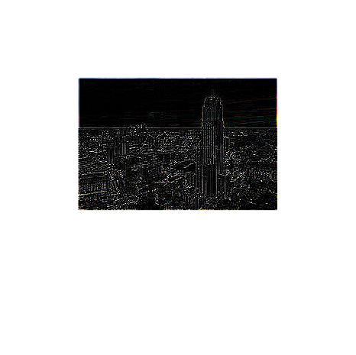
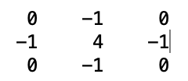
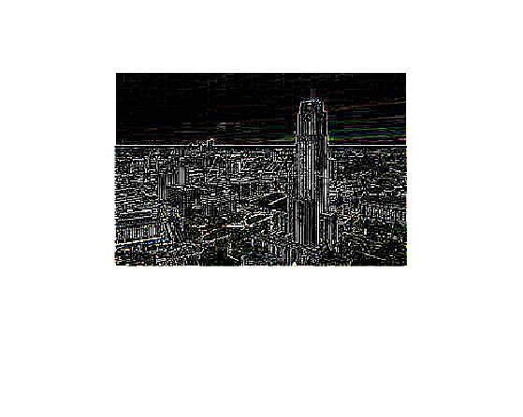
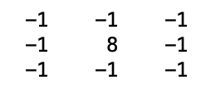
$$yf\left[i,j\right]=\sum_{n=−∞}^{∞}{\sum_{m=−∞}^{∞}{h\left[n,m\right]∙x[i−n,j−m]}}$$
Edge detection (High pass filter)
$$h\left[n,m\right]=$$
$$h\left[n,m\right]=$$

Slide 21
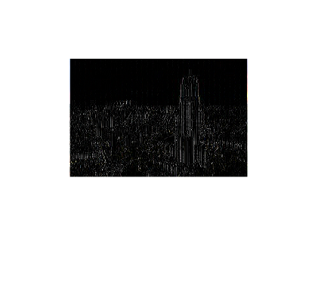
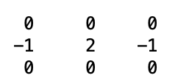
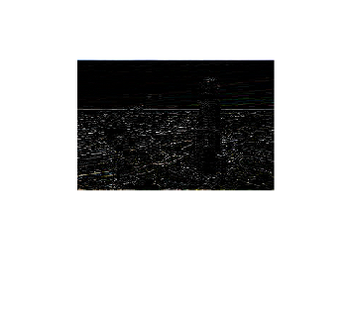
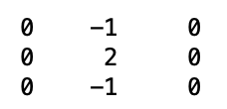
$$yf\left[i,j\right]=\sum_{n=−∞}^{∞}{\sum_{m=−∞}^{∞}{h\left[n,m\right]∙x[i−n,j−m]}}$$
Edge detection (High pass filter)
$$h\left[n,m\right]=$$
$$h\left[n,m\right]=$$

Slide 22
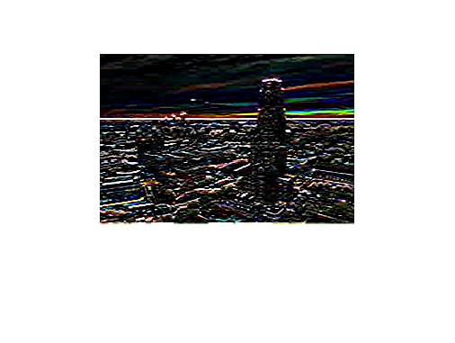
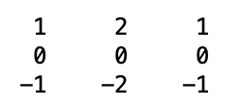
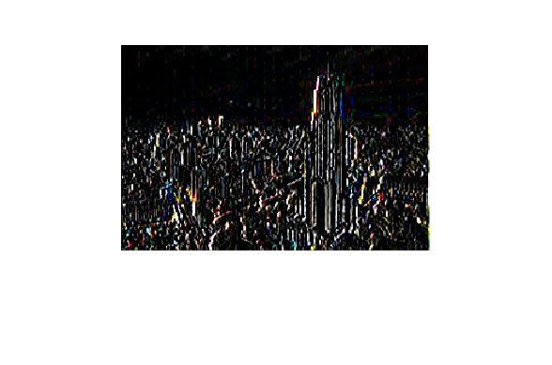
$$yf\left[i,j\right]=\sum_{n=−∞}^{∞}{\sum_{m=−∞}^{∞}{h\left[n,m\right]∙x[i−n,j−m]}}$$
Edge detection (High pass filter)
Sobel Filter
$$h\left[n,m\right]=$$

Slide 23
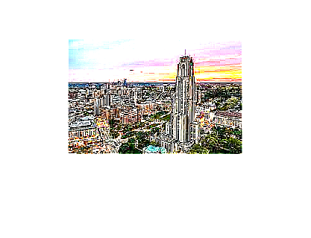
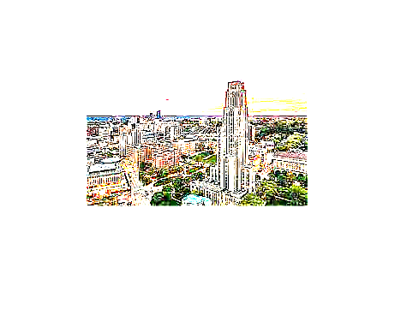
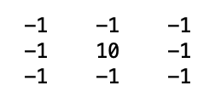
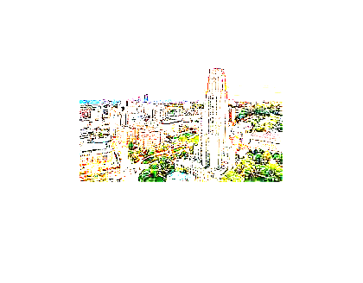
$$yf\left[i,j\right]=\sum_{n=−∞}^{∞}{\sum_{m=−∞}^{∞}{h\left[n,m\right]∙x[i−n,j−m]}}$$
Sharpening filter (High pass filter)
$$h\left[n,m\right]=$$

Slide 24
2D IIR Filters
$$H\left(z_{1},z_{2}\right)=\frac{\sum_{k=−N}^{N}{\sum_{k=−N}^{N}{b(k,l)z_{1}^{−k}z_{2}^{−l}}}}{\sum_{k=−N}^{N}{\sum_{k=−N}^{N}{a(k,l)z_{1}^{−k}z_{2}^{−l}}}}$$
Unlike the temporal IIR, we have both ”causal” and “anticausal” terms
$$y\left[i,j\right]=\frac{1}{a[0,0]}\sum_{k=−N}^{N}{\sum_{l=−N}^{N}{b\left[k,l\right]∙x\left[i−k,j−l\right]−}}\sum_{k=1}^{N}{\sum_{l=1}^{N}{a\left[k,l\right]∙y\left[i+k,j+l\right]−}}\sum_{k=1}^{N}{\sum_{l=1}^{N}{a\left[k,l\right]∙y\left[i−k,j−l\right]}}$$

Slide 25
