Slide 1
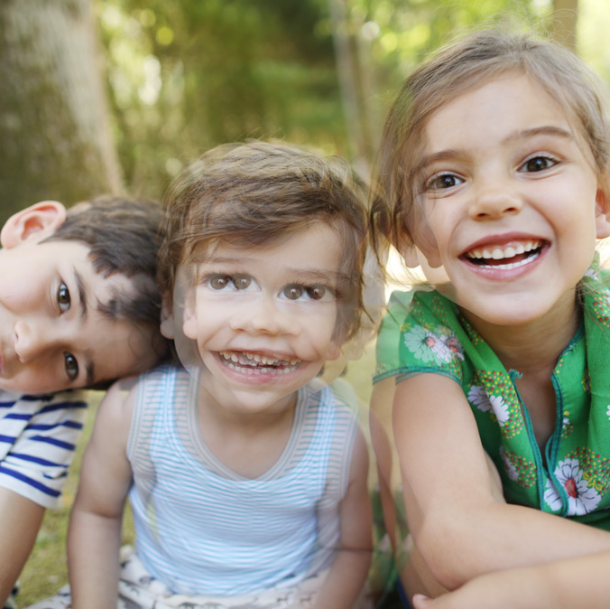
Lecture 14 Depth and 3D Estimation
ECE 1390/2390
Image from
https://my.clevelandclinic.org/

Slide 2
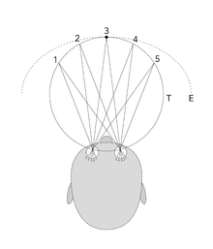
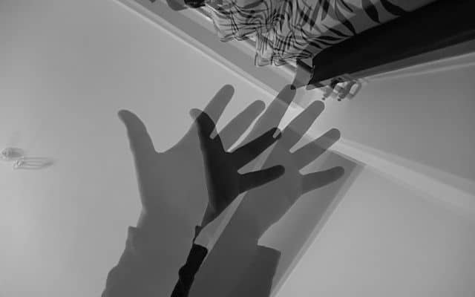

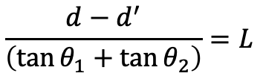
Stereo Vision
Image Displacement
← d’ →
+
+
L
𝜽₁
𝜽₂
$$d−d^{′}=L∙\left(\tan{θ_{1}}+\tan{θ_{2}}\right)$$
Camera Displacement
← d →
$$\frac{d−d^{′}}{\left(\tan{θ_{1}}+\tan{θ_{2}}\right)}=L$$

Slide 3
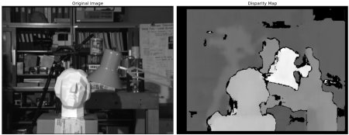
Stereo Vision
Image Displacement
← d’ →
+
+
imgL = cv.imread('tsukuba_l.png', cv.IMREAD_GRAYSCALE)
imgR = cv.imread('tsukuba_r.png', cv.IMREAD_GRAYSCALE)
stereo = cv.StereoBM.create(numDisparities=16, blockSize=15)
disparity = stereo.compute(imgL,imgR)
plt.imshow(disparity,'gray')
L
𝜽₁
𝜽₂
$$d−d^{′}=L∙\left(\tan{θ_{1}}+\tan{θ_{2}}\right)$$
Camera Displacement
← d →
$$\frac{d−d^{′}}{\left(\tan{θ_{1}}+\tan{θ_{2}}\right)}=L$$

Slide 4
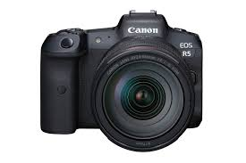
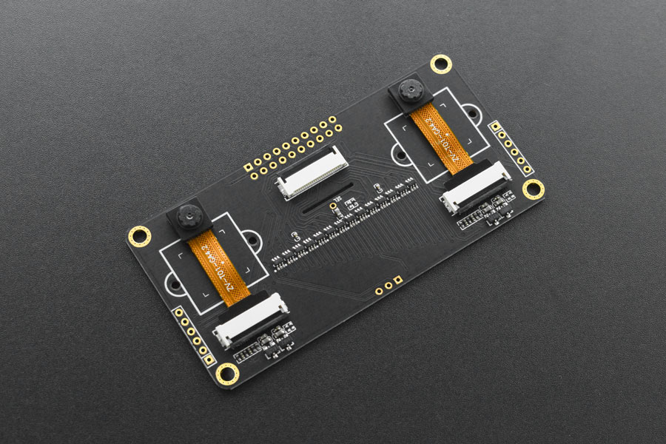

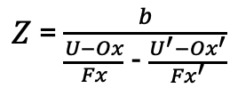

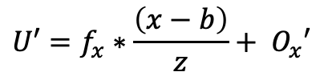

Stereo Vision
Camera 1 (left)
Camera 2 (right)
fx : focal length in x
fy : focal length in y
Ox: Origin of image in x
Oy: Origin of image in y
[U,V]: Point in image
fx' : focal length in x
fy ‘: focal length in y
Ox’: Origin of image in x
Oy’: Origin of image in y
[U’,V’]: Point in image
(0,0)
b
(b,0)
b - displacement of cameras (in x plane)
$$U=f_{x}∗\frac{x}{z}+ O_{x}$$
$$U′=f_{x}∗\frac{\left(x−b\right)}{z}+ O_{x}′$$
$Z$= $\frac{b}{\frac{U−Ox}{Fx}\text{ −} \frac{U^{′}−Ox^{′}}{Fx^{′}}}$
$$V=f_{y}∗\frac{y}{z}+ O_{y}$$
$V′=f_{y}′∗\frac{y}{z}+ O_{y}$’

Slide 5
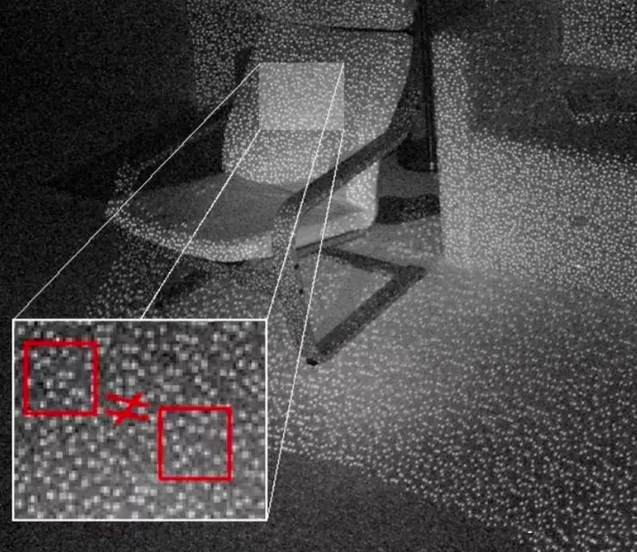
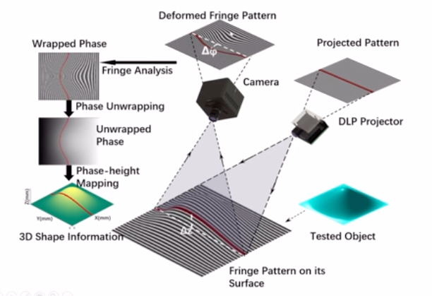

Slide 6
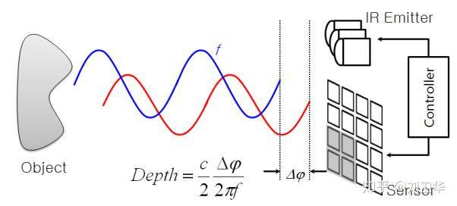
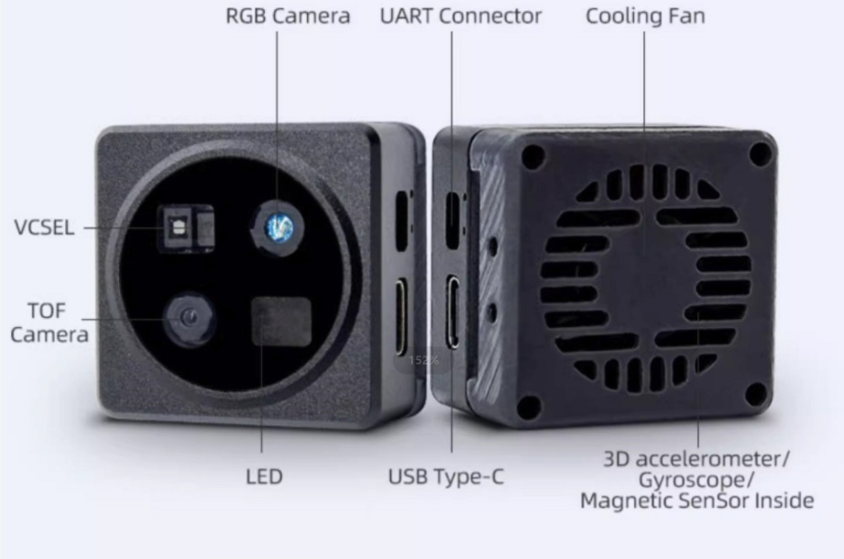
LIDAR (ToF)

Slide 7
Monocular depth estimation
MiDAS (https://github.com/isl-org/MiDaS)
Ranftl, R., Lasinger, K., Hafner, D., Schindler, K., & Koltun, V. (2020). Towards robust monocular depth estimation: Mixing datasets for zero-shot cross-dataset transfer. IEEE transactions on pattern analysis and machine intelligence, 44(3), 1623-1637.
MIT License
Fastest
Qualitative. Depth order (but not quantitative distances)
ZoeDepth (https://github.com/isl-org/ZoeDepth)
Bhat, S. F., Birkl, R., Wofk, D., Wonka, P., & Müller, M. (2023). Zoedepth: Zero-shot transfer by combining relative and metric depth. arXiv preprint arXiv:2302.12288.
MIT License
~ 4x slower than MiDAS
Depth estimation in quantitative
Marigold (https://github.com/prs-eth/Marigold)
Ke, B., Obukhov, A., Huang, S., Metzger, N., Daudt, R. C., & Schindler, K. (2024). Repurposing diffusion-based image generators for monocular depth estimation. In Proceedings of the IEEE/CVF Conference on Computer Vision and Pattern Recognition (pp. 9492-9502).
Apache License
~ 200x slower than MiDAS
PatchFusion (https://github.com/zhyever/PatchFusion)
Li, Z., Bhat, S. F., & Wonka, P. (2024). Patchfusion: An end-to-end tile-based framework for high-resolution monocular metric depth estimation. In Proceedings of the IEEE/CVF Conference on Computer Vision and Pattern Recognition (pp. 10016-10025).
MIT License
~ 400x slower than MiDAS

Slide 8
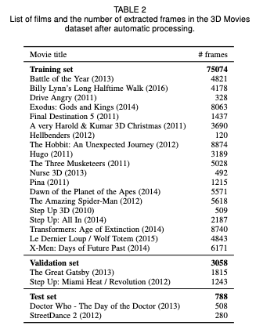
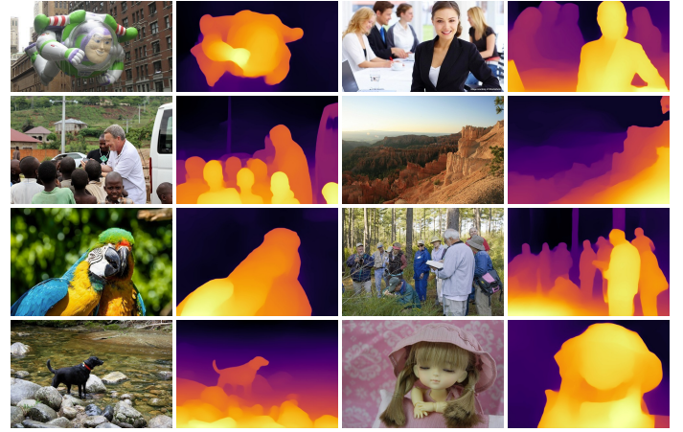
MiDAS
Deep Learning based Model
ResNET based architecture
Trained on movies available in both 3D and standard format

