Slide 1
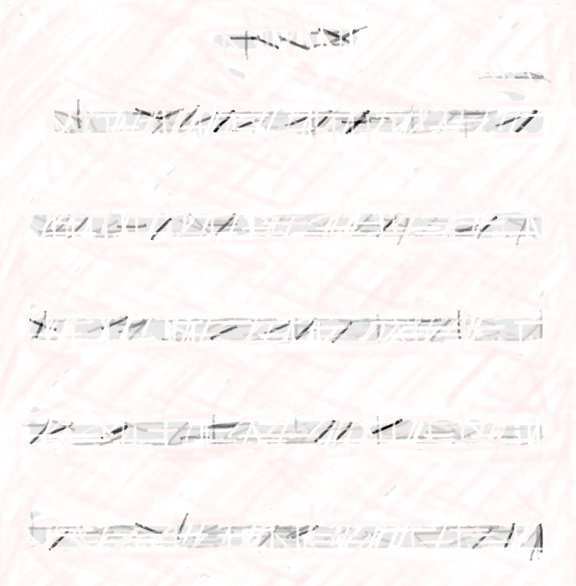
EBBB Final Project
Bell Hsia, Oliver Kettleson-Belinkie, Phillip Lavrenyuk, Jaiden Steele

Slide 2
Concept: Sheet Music Reader
we need like inspo. and stuff.

Slide 3
PROCESS
  develop neural network that is able to “recognize” music notes
    create a repository of training data: quarter notes, rests
  develop segmentation pipeline that can return an array of individual music notes from a score passed to the function

Slide 4
RESOURCES
oliver put in whatever you used in your code here. like what packages or whatever or where you got the code in

Slide 5
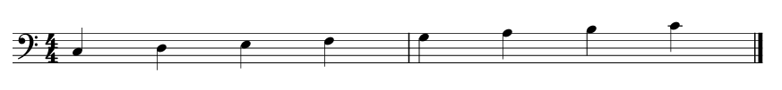
CHALLENGE 1
simple C-scale

Slide 6



“minimum viable product”
what must our code be able to do in order to play a C-scale?
  recognize the notes, both duration and pitch
  no segmentation…yet.
what ground rules are we setting?
  fixed BPM and clef
  quarter notes only, no rests
  C3 - C4 range
C3
C4
rest

Slide 7
NEURAL NETWORK
oliverrrrrrrrrrrrrrrr

Slide 8
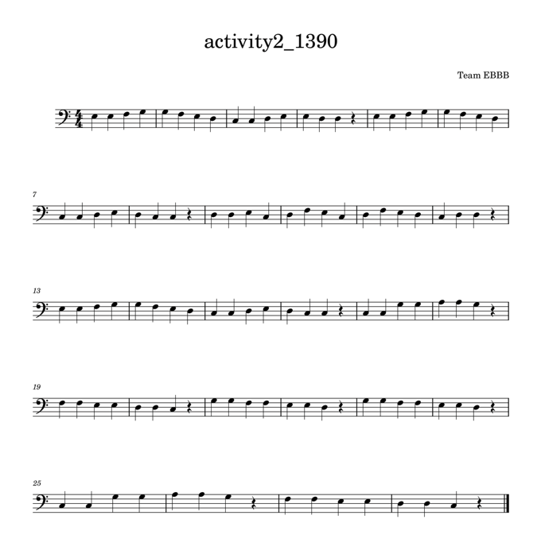
CHALLENGE 2
extended score, “ode to joy” and “twinkle twinkle little star”

Slide 9
SECOND ITERATION
what more must our code be able to do in order to play something more complex?
  recognize rests!
  fully automate both segmentation and recognition
so we started work on a segmentation pipeline…

Slide 10
[LIVE DEMO]

Slide 11
FUTURE DIRECTIONS
what next. talk about like more capabilities and whatnot

