Slide 1
CanvasHub
By Safciu Alexandru, Safta Andreea si Popa Bianca

Slide 2



Introduction
Welcome to our presentation on the development of a web application tailored for our local art club. This software system is meticulously crafted to streamline administrative tasks while empowering club members to effortlessly organize conferences and art exhibitions.
With a user-friendly interface, administrators can seamlessly add new venues for meetings and exhibitions, oversee payments, and manage user accounts. Embedded within the system is a comprehensive relational database housing information on conference rooms, art galleries, and user profiles, ensuring efficient operations and enhanced member experiences.

Slide 3
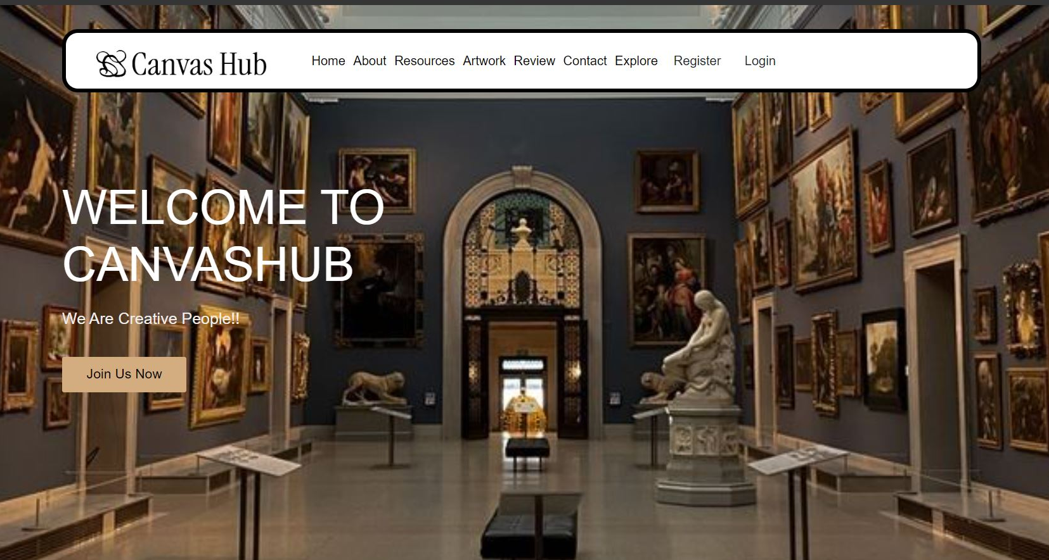
Implementing the Frontend

Slide 4
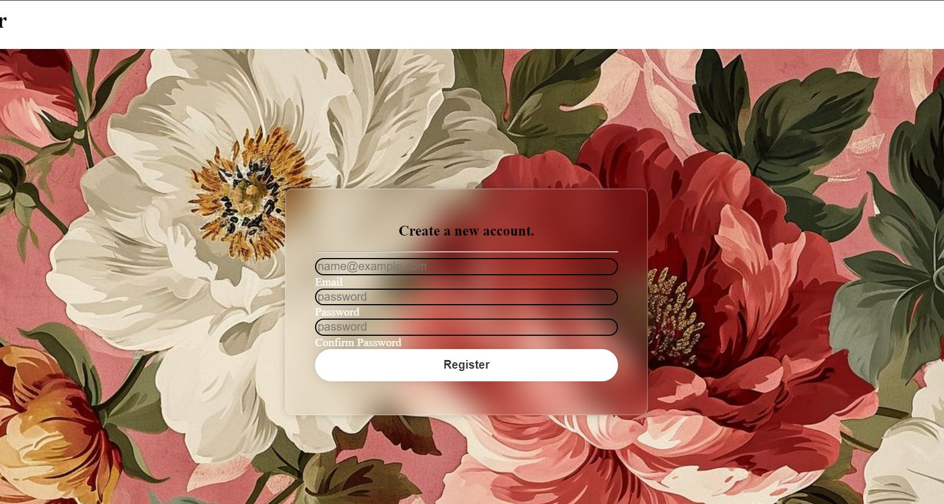

Implementing the Frontend
In crafting these web pages, a combination of HTML (Hypertext Markup Language) and CSS (Cascading Style Sheets) was employed to create a seamless and visually appealing user experience. HTML forms the backbone of the pages, providing the structural framework that organizes content elements into a coherent layout. Through HTML, elements like headers, navigation bars, content sections, and form fields were defined, establishing the fundamental structure of the web application.

Slide 5
Implementing the Frontend
By leveraging CSS, various styling attributes such as fonts, colors, margins, and borders were meticulously applied to HTML elements. This allowed for the customization of the appearance, ensuring a cohesive and branded look across the entire application. Furthermore, CSS facilitated the implementation of responsive design principles, enabling the pages to adapt seamlessly to different screen sizes and devices. In summary, the strategic utilization of HTML and CSS in these web pages facilitated the creation of a user-centric and aesthetically pleasing interface. HTML provided the structural foundation, while CSS added the stylistic flourishes and responsiveness necessary to elevate the user experience. Together, these technologies synergized to deliver a compelling and engaging web application tailored to the needs of its users.

Slide 6
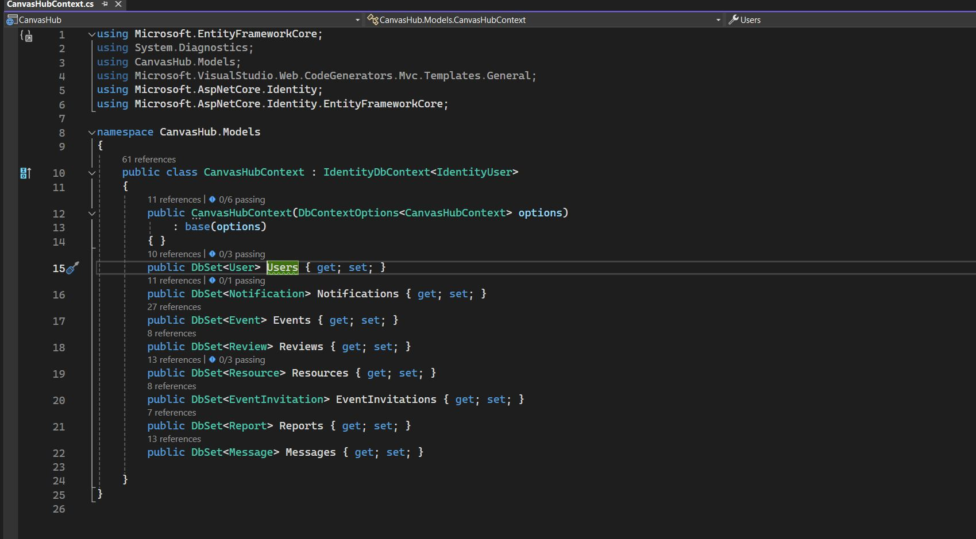
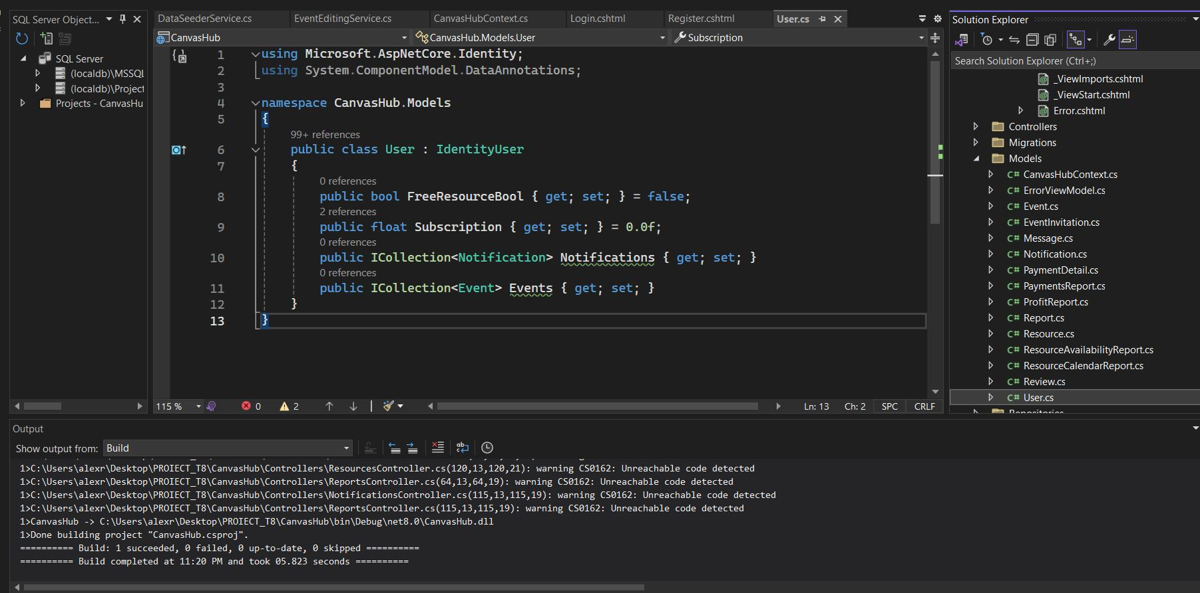
Implementing the Models/Controlers
In this application, both the models and controllers play pivotal roles in creating a cohesive and functional system built using ASP.NET Core MVC and Entity Framework Core. These components work together to manage and manipulate data, ensuring a seamless user experience and robust backend operations.

Slide 7
Implementing the Models/Controlers
The CanvasHubContext class acts as the primary context for interacting with the database. It inherits from IdentityDbContext<IdentityUser>, integrating ASP.NET Identity to handle user accounts, authentication, and authorization seamlessly. This context class defines DbSet properties for various entities such as User, Notification, Event, Review, Resource, EventInvitation, Report, and Message. These DbSet properties enable Entity Framework Core to track and manage these entities within the database, facilitating efficient data operations.
The User model extends the built-in IdentityUser class, adding custom properties such as FreeResourceBool and Subscription. This model represents the application's users, incorporating identity and authentication features provided by ASP.NET Identity. Each user can have multiple notifications and events, as indicated by the collections of Notification and Event entities.
The EventsController oversees operations related to events. It offers methods to display all events, show details of a specific event, create new events, edit existing ones, and delete events. This controller ensures that each operation is secured against overposting attacks by using data binding and validation attributes. The EventsController's methods interact with the Entity Framework Core context to perform CRUD operations on the Event model, maintaining the application's data integrity.
The HomeController handles basic navigation and error handling within the application, including actions for displaying the home page, privacy policy, and error pages. This controller ensures smooth navigation and user experience within the application.
Overall, these models and controllers work in harmony to create a robust and efficient application. By leveraging ASP.NET Core Identity and Entity Framework Core, the application ensures secure and efficient data management, supporting various functionalities provided by the controllers, and delivering a seamless user experience.

Slide 8
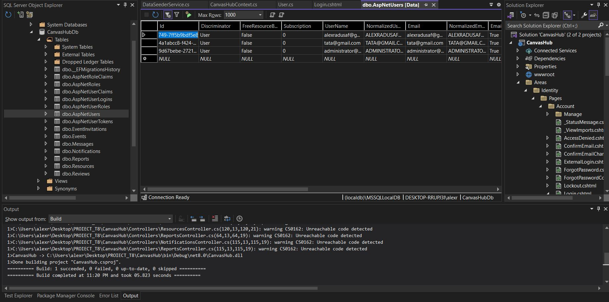
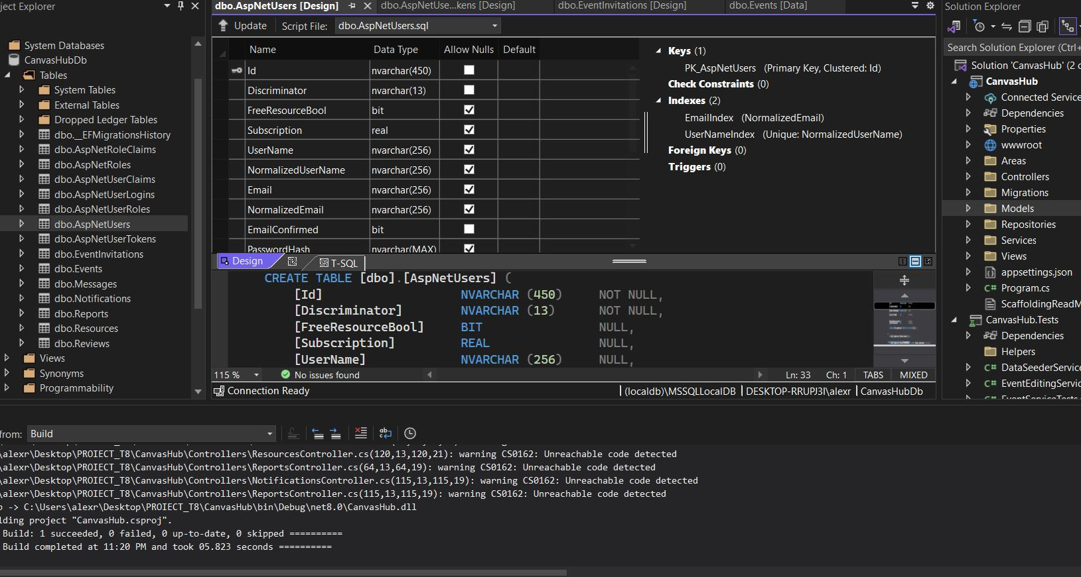
SQL Database
The SQL database for the CanvasHub application is designed to store and manage various types of data related to user accounts, events, notifications, messages, invitations, reviews, resources, and reports. The database schema is structured to maintain relationships between these entities, ensuring data integrity and facilitating efficient data retrieval and manipulation.

Slide 9
SQL Database
The database schema includes several key relationships and constraints:
One-to-Many Relationships: Users can have multiple events, notifications, reviews, resources, and invitations. Events can have multiple reviews and resources.
Foreign Keys: Foreign key constraints ensure that relationships between tables are maintained. For instance, the EventId in the Resources and Reviews tables ensures that each resource and review is associated with a valid event.
Primary Keys: Each table has a primary key (e.g., UserId, EventId, NotificationId) that uniquely identifies each record.
The SQL database for the CanvasHub application is carefully designed to store and manage a wide range of data efficiently. By leveraging Entity Framework Core, the application ensures that database operations such as querying, updating, and deleting records are performed seamlessly. The use of ASP.NET Identity further enhances the security and management of user accounts, providing a robust foundation for the application's functionality.

Slide 10
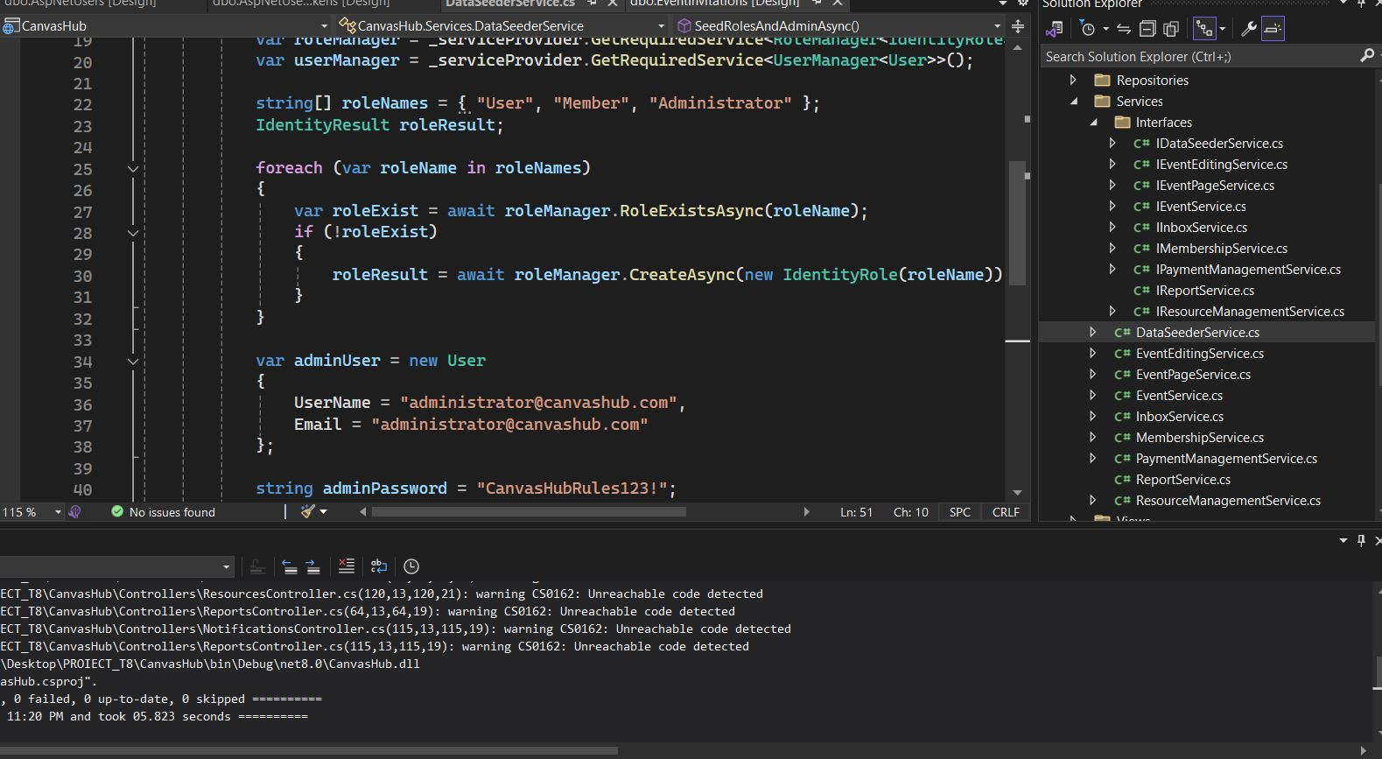
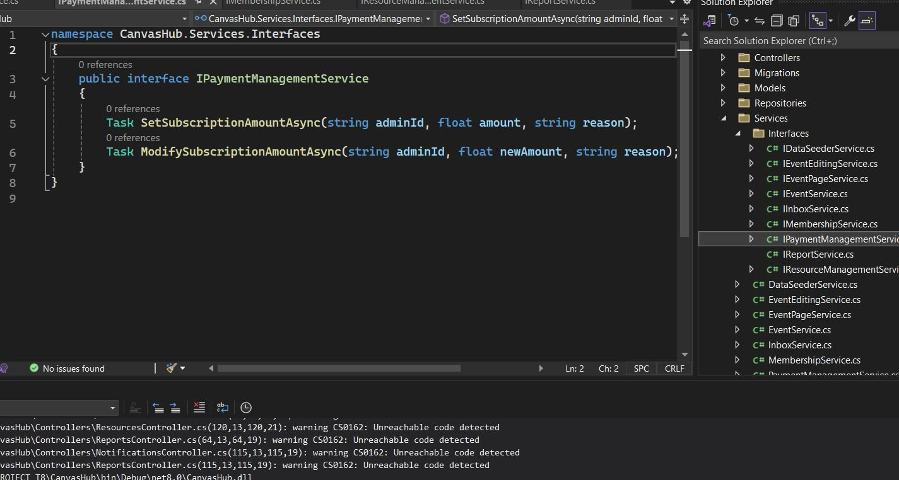
Implementing the Servicies
The CanvasHub application includes several services that support its core functionalities, focusing on data seeding and event editing.

Slide 11
Implementing the Servicies
The DataSeederService is responsible for initializing essential roles and the administrator account in the application. This service implements the IDataSeederService interface and uses the ASP.NET Core dependency injection framework to retrieve instances of RoleManager and UserManager. It ensures that the predefined roles ("User", "Member", and "Administrator") exist in the system. If these roles do not exist, it creates them. Additionally, the service checks for the existence of an administrator user account. If the administrator account does not exist, it creates this account with a specified email and password, confirms the email, and assigns the "Administrator" role to the user. This service is crucial for setting up the application's initial security and access control structure.
The EventEditingService provides functionality for editing events within the application. This service implements the IEventEditingService interface and interacts directly with the CanvasHubContext to perform database operations. When editing an event, the service first retrieves the event along with its associated resources and invitations, ensuring that the user requesting the edit has the appropriate permissions. It updates the event’s name, description, and associated resources based on the provided new details. Moreover, it validates that a reason for the modification is provided to ensure accountability for changes. After updating the event, the service sends notifications to all users invited to the event, informing them about the changes. This ensures transparency and keeps participants informed about updates.
These services play a pivotal role in maintaining the functionality and integrity of the CanvasHub application.

Slide 12
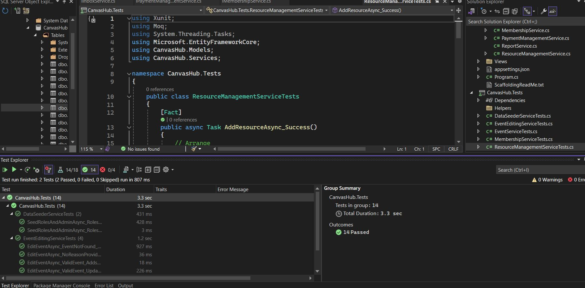
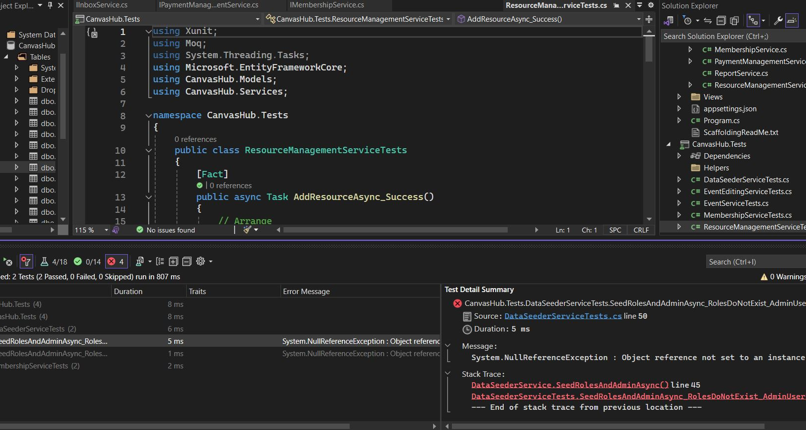
Unit Tests
The CanvasHub application includes comprehensive unit tests for its services to ensure functionality and reliability. Here's a summary of the unit tests for the DataSeederService and EventEditingService:

Slide 13
Unit Tests
The DataSeederServiceTests class contains unit tests for the DataSeederService, which is responsible for seeding roles and an administrator user in the CanvasHub application. These tests use mocks of RoleManager<IdentityRole> and UserManager<User> to simulate interactions with the identity system. The tests cover various scenarios to ensure that the service correctly seeds roles and the admin user based on the existing state of the database.
The EventEditingServiceTests class includes unit tests for the EventEditingService, which allows users to edit events. These tests use an in-memory database to simulate the application's data context, ensuring that the service interacts with a realistic database environment. The tests cover key functionalities and edge cases to verify the service's behavior when editing events.
These unit tests provide comprehensive coverage of the core functionalities and edge cases for both the DataSeederService and EventEditingService, ensuring that these services behave as expected in various scenarios. The use of mock objects and an in-memory database facilitates isolated testing of the service logic without relying on external dependencies.

Slide 14
Conclusion
CanvasHub is a robust and comprehensive web application designed to facilitate event management and resource sharing within a user-friendly platform. It leverages the ASP.NET Core framework to ensure scalability, security, and performance. The architecture of CanvasHub is well-structured, adhering to the MVC (Model-View-Controller) pattern to separate concerns and enhance maintainability.

Slide 15

The way to get started is to quit talking and begin doing.
Walt Disney

Slide 16

Thank you

