Slide 1
Link-State Routing
Arun.sachithanandam- a 20325521
Karthik narisetti-a 20338139
SHREYAS SALIGRAMA CHANDRAKANTHA-A20330984

Slide 2
Introduction
Routing is the process of selecting best paths in a network. Routing is performed for many kinds of networks, including the telephone network (circuit switching), electronic data networks and transportation networks.
In packet switching networks, routing directs packet forwarding. through intermediate nodes. Intermediate nodes are typically network hardware devices such as routers, bridges, gateways, firewalls, or switches.
The routing process usually directs forwarding on the basis of routing tables which maintain a record of the routes to various network destinations.

Slide 3
Link State Routing Protocol
A link-state routing protocol is one of the two main classes of routing protocols used in packet switching networks for computer communications, the other is the distance-vector routing protocol.
The link-state protocol is performed by every switching node in the network.
The basic concept of link-state routing is that every node constructs a map of the connectivity to the network, in the form of a graph, showing which nodes are connected to which other.

Slide 4
Link State Routing Protocol (cntd.)
Each node then independently calculates the next best logical path from it to every possible destination in the network.
The collection of best paths will then form the node's routing table.
The basic concept of link-state routing is that every node constructs a map of the connectivity to the network, in the form of a graph, showing which nodes are connected to which other nodes.
Each node then independently calculates the next best logical path from it to every possible destination in the network.
The collection of best paths will then form the node's routing table.

Slide 5
Dijkstra’s Shortest Path Algorithm
Dijkstra's algorithm, is a graph search algorithm that solves the single-source shortest path problem for a graph with non-negative edge path costs, producing a shortest path tree.
It is often used in routing and as a subroutine in other graph algorithms.
It can be used for finding costs of shortest paths from a single vertex to a single destination vertex by stopping the algorithm once the shortest path to the destination vertex has been determined.

Slide 6
Dijkstra’s Shortest Path Algorithm (cntd.)
Dijkstra's algorithm can be used to find the shortest route between one city and all other cities.
Hence, the shortest path algorithm is widely used in network routing protocols, most notably IS-IS and OSPF.
The run time of Dijkstra’s algorithm is given by O(|V|^2) where ‘V’ is the number of vertices.
It is the fastest known single-source shortest-path algorithm for arbitrary directed graphs with unbounded non-negative weights.

Slide 7
Pseudo-Code For Dijkstra’s Algorithm
Let v1 be the origin vertex, and initialize W and ShortDist[u] as
W := {v1}
ShortDist[v1] :=0
FOR each u in V - {v1}
ShortDist[u] = T[v1,u]
Now repeatedly enlarge W ,until W includes all vertices in ’V’
WHILE W <> V
Find the vertex ‘w’ in ‘V – W’ at the minimum distance from ‘v1’
MinDist = INFINITE
FOR each ’v’ in ‘V – W’
IF ShortDist[v] < MinDist
MinDist = ShortDist[v]
‘w’ = ‘v’
END {if}
END {for}

Slide 8
Pseudo-Code For Dijkstra’s Algorithm (cntd.)
Add ‘w’ to ‘W’
W = W U {w}
Update the shortest distance to vertices in V - W
FOR each u in V – W
ShortDist[u] := Min(ShortDist[u],ShortDist[w] + T[w,u])
END {while}

Slide 9
Program Design
The objective of the application is to performs the following tasks –
•To simulate the process of generating connection table for each router in a given network.
•To compute the optimal path with least cost between any two specific routers.

Slide 10
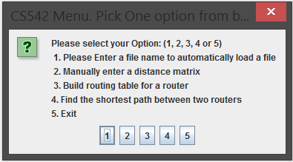
Interface Design

Slide 11
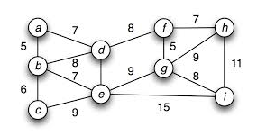
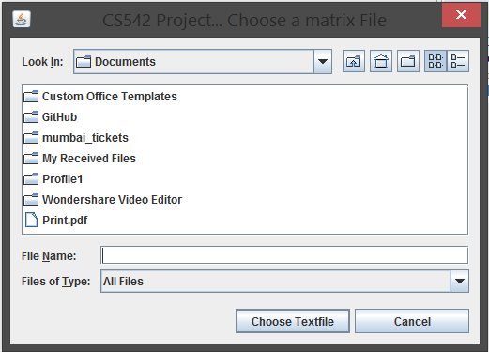
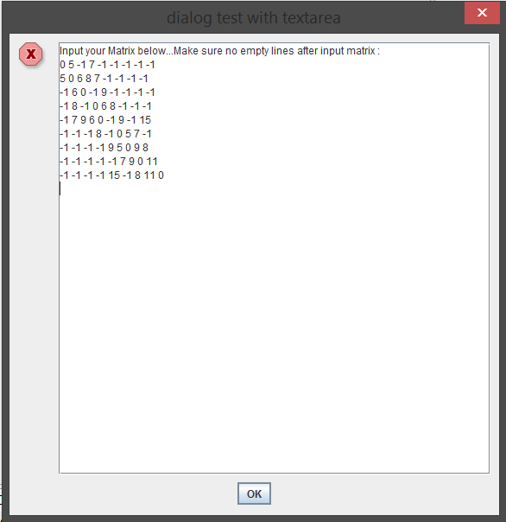
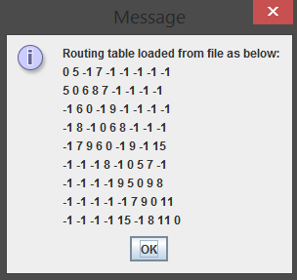
Input to the application

Slide 12
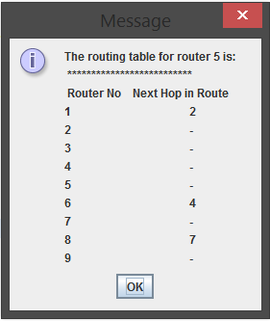
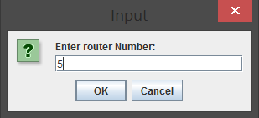
To build the routing table

Slide 13
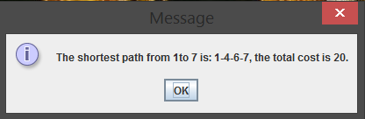
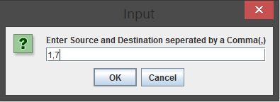
To find the Shortest path between two routers
Enter the input in the form(source,destination)

Slide 14
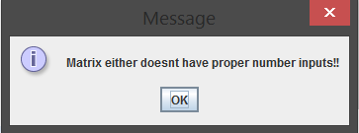
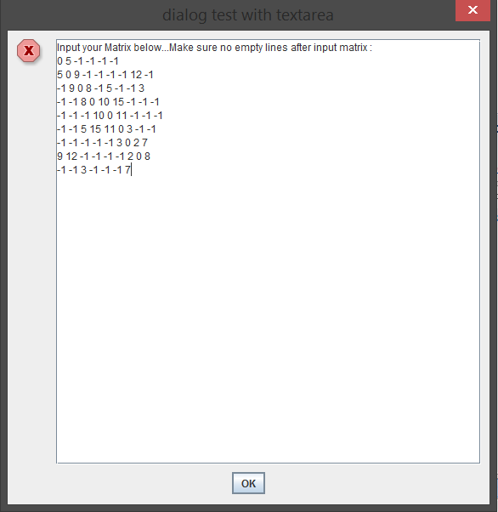
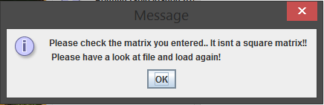
Error Handling
When loading a file of format other than a text file.
When there is an invalid input to the application from the text file or if the entered matrix is not a square matrix

Slide 15
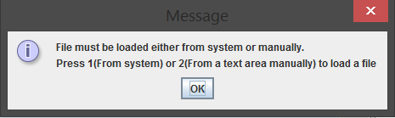
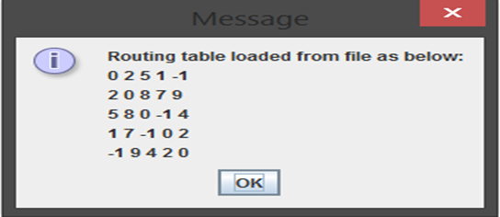
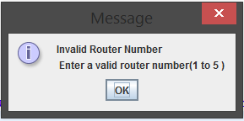
Error Handling (cntd.)
When the user selects the options to build a routing table for a router or to find the shortest path between two routers without providing input to the application.
While building the routing table, if the user enters a router number that is greater than the number of routers.

Slide 16
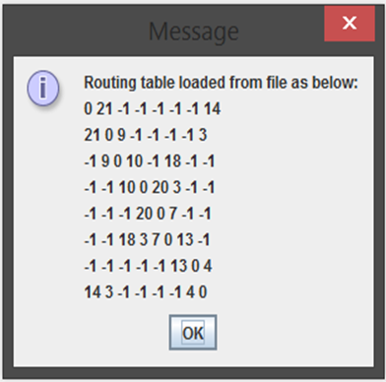
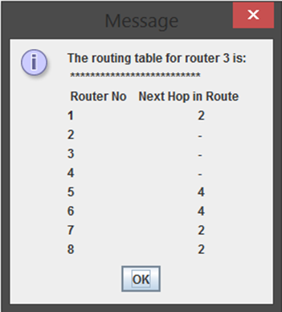
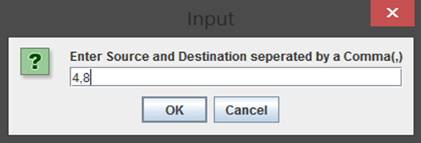
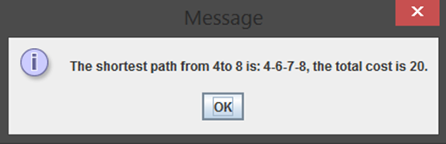
Test Cases

Slide 17
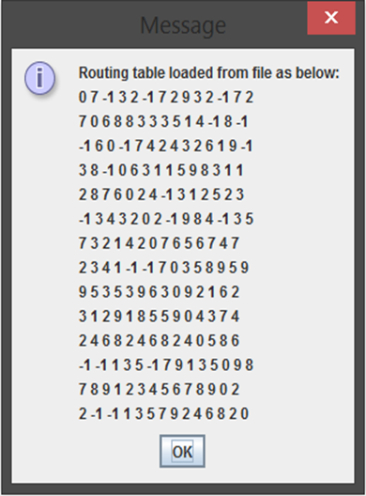
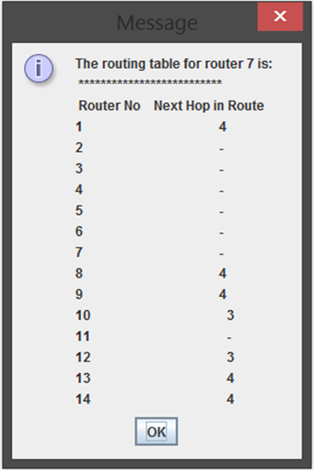
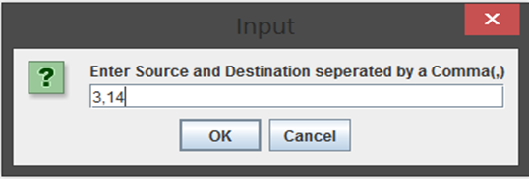
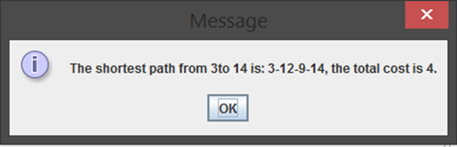
Test Cases (cntd.)

Slide 18
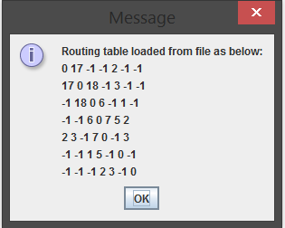
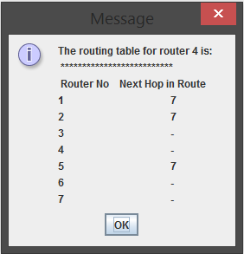
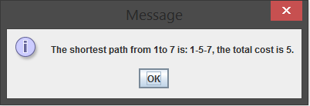
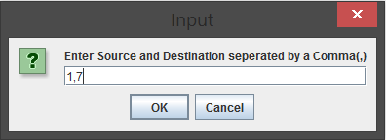
Test Cases (cntd.)

Slide 19
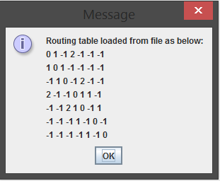
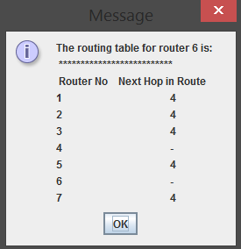
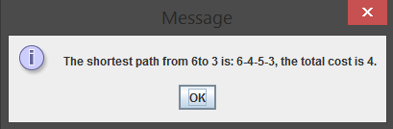

Test Cases (cntd.)

Slide 20
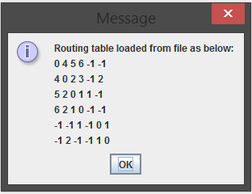
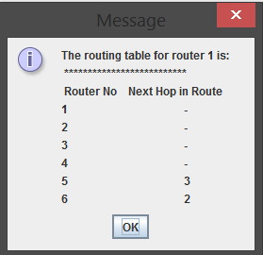
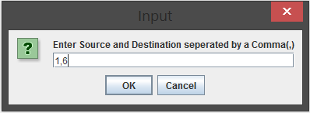
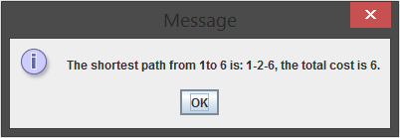
Test Cases (cntd.)

Slide 21
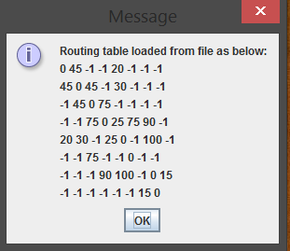
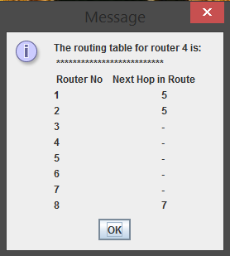
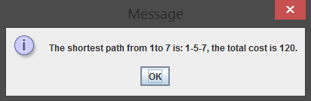
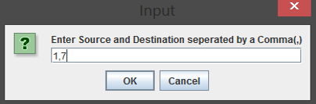
Test Cases (cntd.)

Slide 22
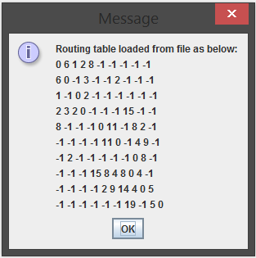
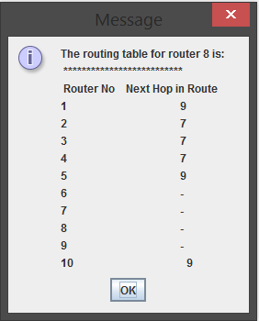
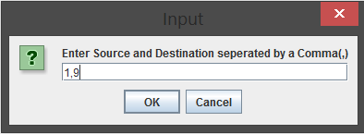

Test Cases (cntd.)

Slide 23
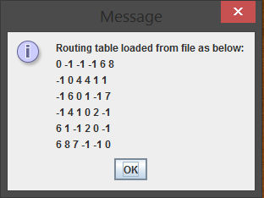
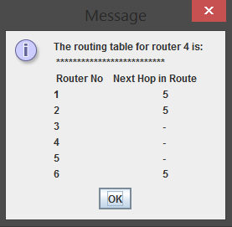
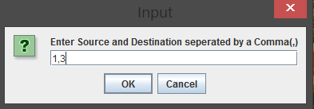
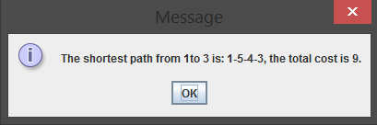
Test Cases (cntd.)

Slide 24
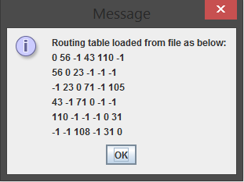
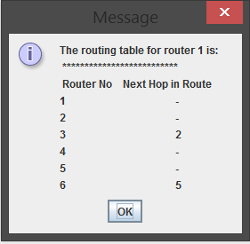
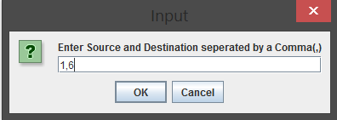
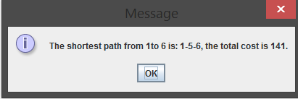
Test Cases (cntd.)

Slide 25
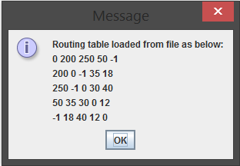



Test Cases (cntd.)

Slide 26
Test Cases (cntd.)

Slide 27
Test Cases (cntd.)

Slide 28
Test Cases (cntd.)

Slide 29
Instructions to run the code
Keep the input.txt file ready so that it can be loaded to the application format.
Ensure that a .txt file format is chosen and a square matrix is entered with the values separated by a single space.
The user can also manually enter the topology matrix in the text area.
Ensure that a square matrix is entered and there is no empty lines after the input matrix.
An executable file CS 542LSR is provided and a minimum JRE version of 1.7.0 is required in order to run the application.
A menu option is displayed to the user to perform the required operations.
On selecting option 5 the application exits.

Slide 30
References
http://web.eecs.umich.edu/~sugih/courses/eecs489/lectures/13-RoutingLS.pdf
http://en.wikipedia.org/wiki/RoutingMasterOpt/MyL09.pdf
http://en.wikipedia.org/wiki/Link-state_routing_protocol
http://en.wikipedia.org/wiki/Dijkstra%27s_algorithm
http://www.cc.gatech.edu/aimosaic/students/Psych-students/Shikano/Projects/AlgoNet/spa/code.html

