Slide 1
Plot generation study in Chia Blockchain
By
Shlok Mohan Chaudhari
Vishal Gawade
Prajakta Kumbhar

Slide 2
Introduction
Chia: a more environmentally friendly cryptocurrency
Uses proof-of-space-and-time consensus algorithm
Relies on storage space instead of computational power
Goal: understand the Plot generation in Chia blockchain

Slide 3
Motivation
Studying the plot generation process, we can gain insights into the underlying algorithms and data structures used by Chia, which can inform the development of new blockchain systems and protocols.
Understanding the 4 phases in the Chia plot generation process can help identify potential bottlenecks and areas for optimization, leading to faster plot generation and better system performance.
Plot generation is a computationally intensive task that requires the optimal use of system resources, including CPU, memory, and storage. Studying the different phases can help identify best practices for resource allocation and management.

Slide 4
Background
Chia launched in 2017 as a new cryptocurrency and blockchain platform
Addresses environmental concerns associated with Bitcoin
Uses a more energy-efficient consensus algorithm
Plot generation speed remains a challenge
Requires significant disk operations for plot generation

Slide 5
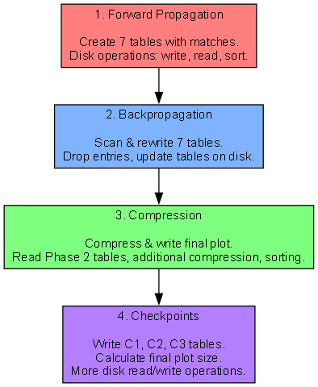
Proposed solution
Forward Propagation:
Compute all tables and final outputs f_7.
Temporary file allows proof creation but is not space-efficient
Backpropagation:
Remove unuseful data for finding proofs.
Adjust positions in next table for dropped entries.
Compression:
Convert from (pos, offset) to double-pointer format.
Reduce entry overhead for more compressed storage.
Checkpoints:
Iterate through Table_7 and write Table_7.
Compress tables into checkpoint tables.

Slide 6
Algorithm
Forward propagation phase:
For x in 0...2^k - 1:
Compute f1(x)
Write (f1(x), x) to table1
For table in 1..6:
Sort tablei by (fi(x), pos, offset). for table1, by f1(x)
For entry in tablei:
if entries L and R match:
Compute fi+1(CL, CR) for table1, M=x
C = Collation_i(CL, CR)
Store (fi+1, pos, offset, C) in tablei+1
# 2 Backpropagation phase
For table in 6..1:
Iterate through tablei and tablei+1:
Drop unused entries in tablei
sort_key = table == 7 ? fi : tablei+1pos
Rewrite used entries in tablei as (sort_key, pos, offset)
Rewrite entries in tablei+1 as (sort_key, pos, offset)
If i > 1:
Sort tablei by (pos, offset)

Slide 7
Algorithm
Checkpoints phase:
For entries in table7:
Compress f7 entries into C1,C2,C3 tables
Write pos6 entries to table P7k
Compression phase:
For table in 1..6:
Iterate through tablei and tablei+1:
Read sort_key, pos, offset from tablei+1
Read tablei entries in that pos and offset: eL, eR
y, x = sort(eL.newPos, eR.newPos)
line_point = x*(x-1)//2 + y
Rewrite tablei+1 entry as (line_point, sort_key)
Sort tablei+1 by line_point
For entry e, i in enumerate(tablei+1):
newPos = i
Rewrite e as (sort_key, newPos)
Write compressed e.line_point deltas to table Pi
Sort tablei+1 by sort_key

Slide 8
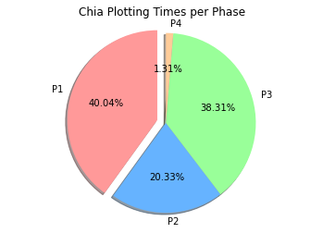
Evaluation
Phase 1: Create seven tables with different matches
Disk operations: writing, reading, and sorting data
Phase 2: Scan and rewrite each table from Phase 1
Disk operations: read original tables, drop entries, write updated tables
Phase 3: Compress and write final plot to disk
Disk operations: read Phase 2 tables, compress and sort, write final plot data
Phase 4: Write additional tables (C1, C2, C3) and calculate final plot size
Disk operations: read and write operations for additional tables
Copying the final plot: Copy plot to destination directory
Disk operations: read plot from temp directory, write to destination directory

Slide 9
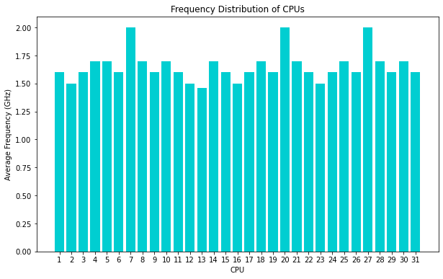
Evaluation
Frequency Distribution:
CPU frequencies range from 1200 MHz to 3.00 GHz.
Idle percentages vary across CPUs, with some having higher idle percentages.
The idle percentage of CPUs varies from 0.3% to 2.7%
Most CPUs have the majority of their frequency distribution in the 3.00 GHz range.
Exploration of more efficient frequency scaling policies can lead to better power management.

Slide 10
Related work
Bram Cohen's paper "Chia: A better bitcoin"
Proposes a new cryptocurrency
Utilizes proof-of-space-and-time consensus mechanism
The chia-plotting-optimizer GitHub repository (https://github.com/codez0mb1e/chia-plotting-optimizer)
Provides an open-source tool to optimize Chia plot generation performance
Dinh et al.'s paper "Untangling Blockchain: A Data Processing View of Blockchain Systems"
Provides a comprehensive overview of blockchain systems from a data processing perspective
The Chia website's "Plotting Basics" page
Offers an introduction to the Chia plot generation process.

Slide 11
Conclusion
Since the plot generation requires iterative searching and sorting algorithms, the plot generation performs such repetitive tasks, which results in overhead.
the system is experiencing a high number of disk write operations, specifically in the writeback process, which are power-intensive and may be slowing down the plot generation process.
Future work:
Further optimize CPU utilization by enabling better load balancing
Investigate the feasibility of implementing parallel processing techniques.
Explore the possibility of using hardware accelerators or specialized storage devices to decrease disk operations.

Slide 12

Thank You!

